Slide 1
Office 365 and Teams Quick Start Guide for DEVELOP participants
June 25, 2020

Slide 2
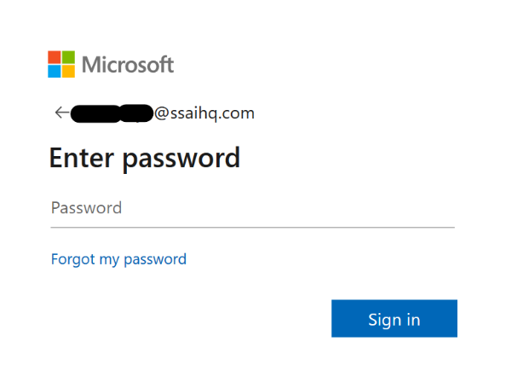
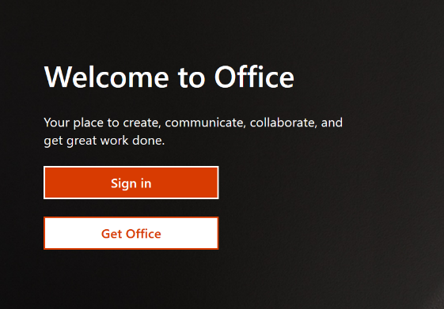
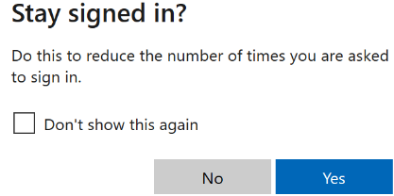
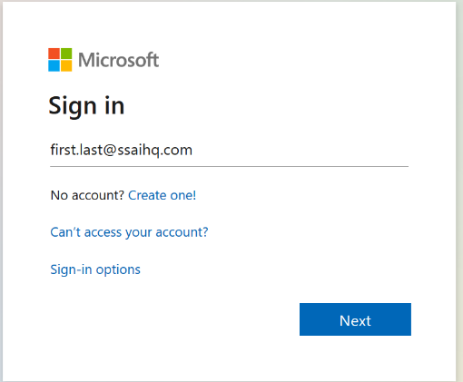
SSAI Office 365 Sign In
In a browser type in https://www.office.com
Click Sign-in on the Welcome screen
Your password is unique** to SSAI Office 365 and will be assigned
If you are on a private device you can choose to stay signed in to reduce the number of times you are asked to sign-in. Do not do this on a shared or public device
Your account name is
firstname.lastname@ssaihq.com
Click Next on the Sign-in screen
**Note on passwords – SSAI is currently implementing an identity management solution that will synchronize all of your accounts across SSAI including O365. In the interim your O365 will be unique. Deployment of the single sign on identity management is schedule for June of 2020.

Slide 3
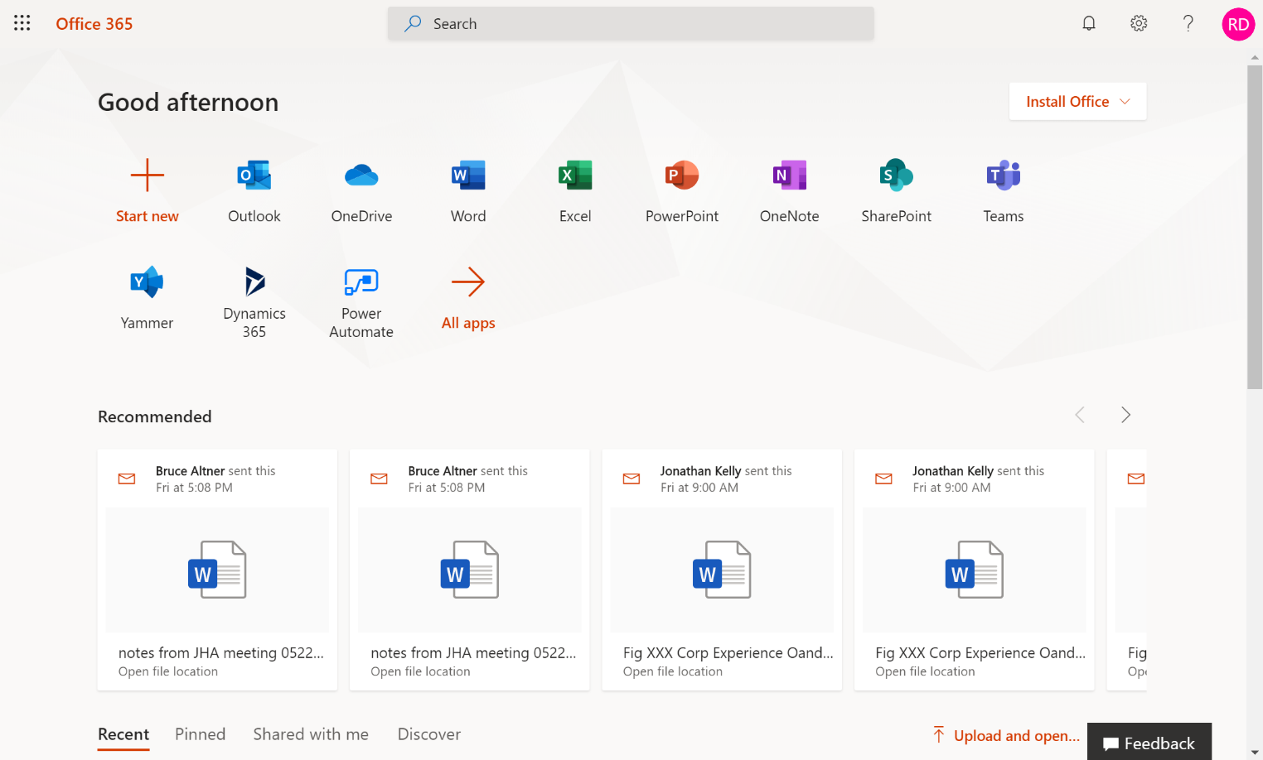
SSAI Office 365 Overview
Check your e-mail with Outlook
Store your files on OneDrive
Start collaborating with Teams
Edit documents online with the required Microsoft office application
Take notes online using OneNote
View recommended files – typically recent files shared with you in O365
With the E1 license provided to you, you will not be able to install and activate the desktop office applications, you can only use them in the O365 portal. You can install and use the Teams desktop and mobile applications. You can also install the other mobile apps on mobile devices (iPad Pro and other tablets larger than 10.1” excluded).

Slide 4
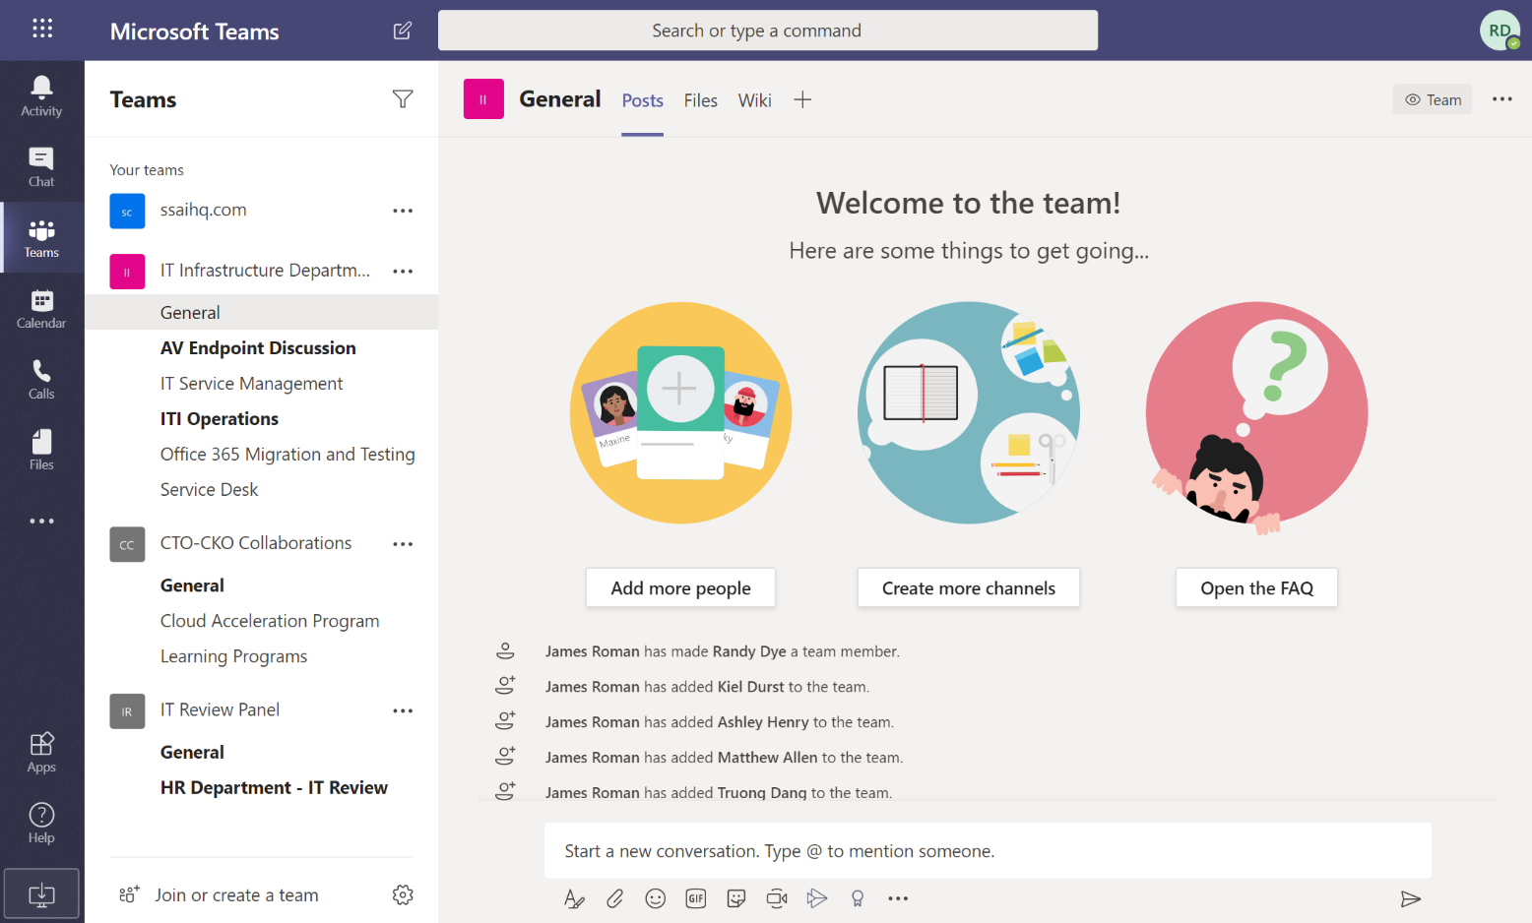
SSAI Office 365 Teams Overview
Click on Teams to view the teams that you are a member of or to join an exiting or create a new team
List of teams you are a member of
Click on your initials for options
View your Calendar, schedule Teams meetings and initiate an instant meeting with Meet now
Click on Help first thing to look at help topics and take watch the introductory traning videos
You can install and use the Teams desktop and mobile applications. You can download desktop application by clicking on your initials in the top right hand corner.

Slide 5
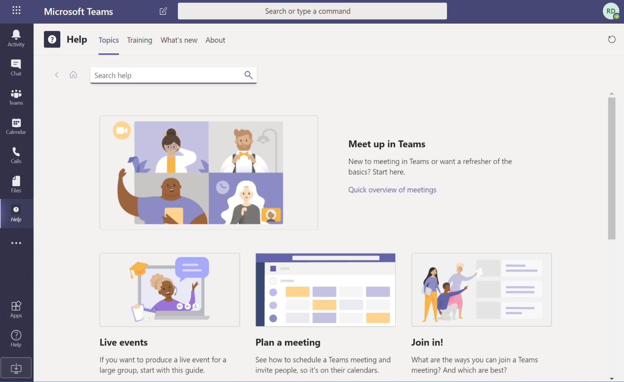
SSAI Office 365 Teams Help
Selecting the Help icon will provide you with these tabs to view Topics and Training materials
Select Training to view materials
Once you have clicked on help on the bottom left and selected Topics or Training this Help icon is available in the left toolbar.
We highly encourage you to click on the Training tab and watch the Welcome to Teams, What is Microsoft Teams, and other training videos and materials available here. Please review the “Teams QS.pdf” quick start guide, which we have provided and is also available under the Training tab.

Slide 6
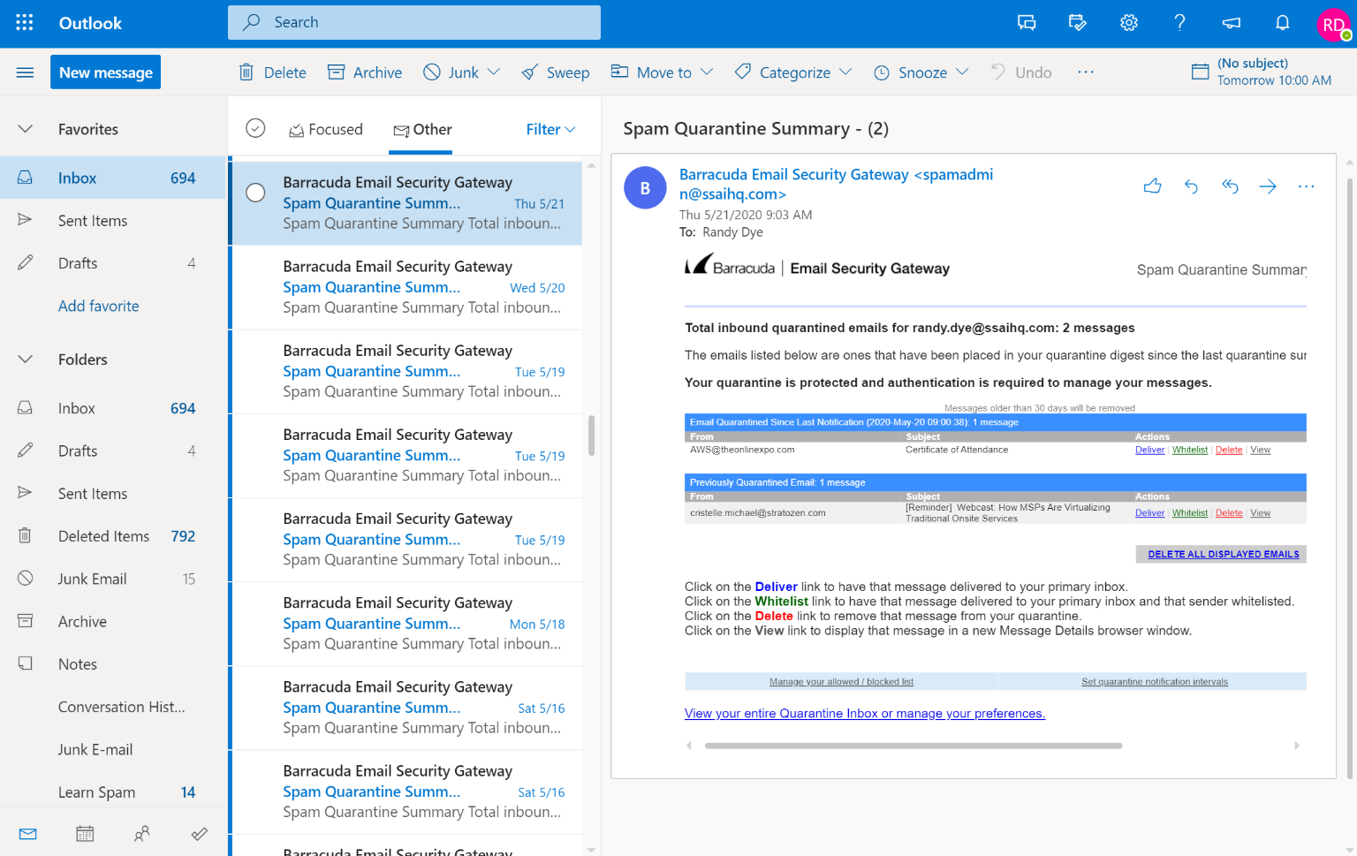
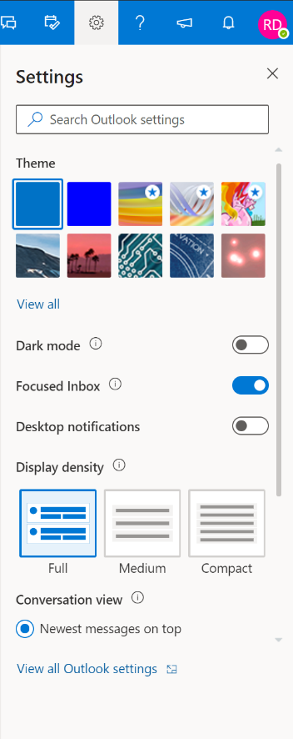
SSAI Office 365 Outlook Web Overview
Click on here compose and send a new message
Click here to filter or sort your inbox
Click here to configure your settings
Click here to view your inbox and read new messages that will be displayed to the right
Outlook web defaults to Focused view. If you are new to this you can change it in the settings or learn more about it by clicking the ? (help) icon and entering “focused”
Click on Help first thing to look at help topics and take watch the introductory traning videos
Navigate to calendar, people, and Todo list view
The outlook mobile application can also be used.

Slide 7
Office 365 Account Migration and O365 Identities
For existing SSAI account holders only
SSAI is currently transitioning E-mail and calendaring from Communigate Pro to Office 365 and is currently implementing a new identity management service (Okta) that will provide a universal directory and single sign on capability
In the interim this has the following impact to your use of Office 365:
Your O365 account is firstname.lastname@ssaihq.com
Your O365 password is unique to O365
Initially you will have two inboxes and calendars
O365 accessible in office.com portal and Teams
Legacy/Communigate accessible in Pronto webmail and existing Outlook
E-mails sent to your address firstname.lastname@ssaihq.com from outside of SSAI O365 are received in Legacy/Communigate and forwarded to O365.
E-mails sent to your address firstname.lastname@ssaihq.com from within SSAI O365 will are not forwarded to Communigate and are only available in O365
Calendars are not synchronized – if you accept a meeting in Communigate it does not show up in Teams/O365 outlook and visa versa
Plan is to have DEVELOP program existing users migrated by first week in June
Plan is to have Okta in place for initial participants, if not their O64 password will be different than their Global ID, but they will only have to use O365 calendar and email
For existing NASA credentialed employees – you will have two O365 identities
A NASA O365 identity and an SSAI O365 identity
You can switch between identities in O365 applications such as Teams
When logged on with a given identity you will only see the items associated with that identity
In Teams when logged in with NASA identity you will see NASA teams, channels, Sharepoint sites, and people
In OneDrive you will only have access to files you uploaded when logged in with that identity
O365 Federation – we are working with NASA on O365 Federation between NASA and SSAI
That will provide more integration between the two – presence indication, calendar views, and messaging
You will still have two identities

