Slide 1
InVEST Urban Development
Incorporating Earth Observation Data into the Integrated Valuation of Ecosystem Services and Tradeoffs (InVEST) Urban Flood Risk Mitigation Model Python API
Son Do• Jessica Besnier
Pop-Up Project| Spring 2023
Notes:
Hello!
We are the InVEST urban development team and we focused on incorporating Earth Observation Data into the InVEST Urban Flood Risk Mitigation Model with Python API.

Slide 2


Meet the Team
Son Do
Jessica Besnier
Notes:
Here are the members of the Team, Son Do and Jessica Besnier. Son graduated with his masters from University of Houston in December 2022 and Jessica is a second year PhD student at the University of Virginia.

Slide 3
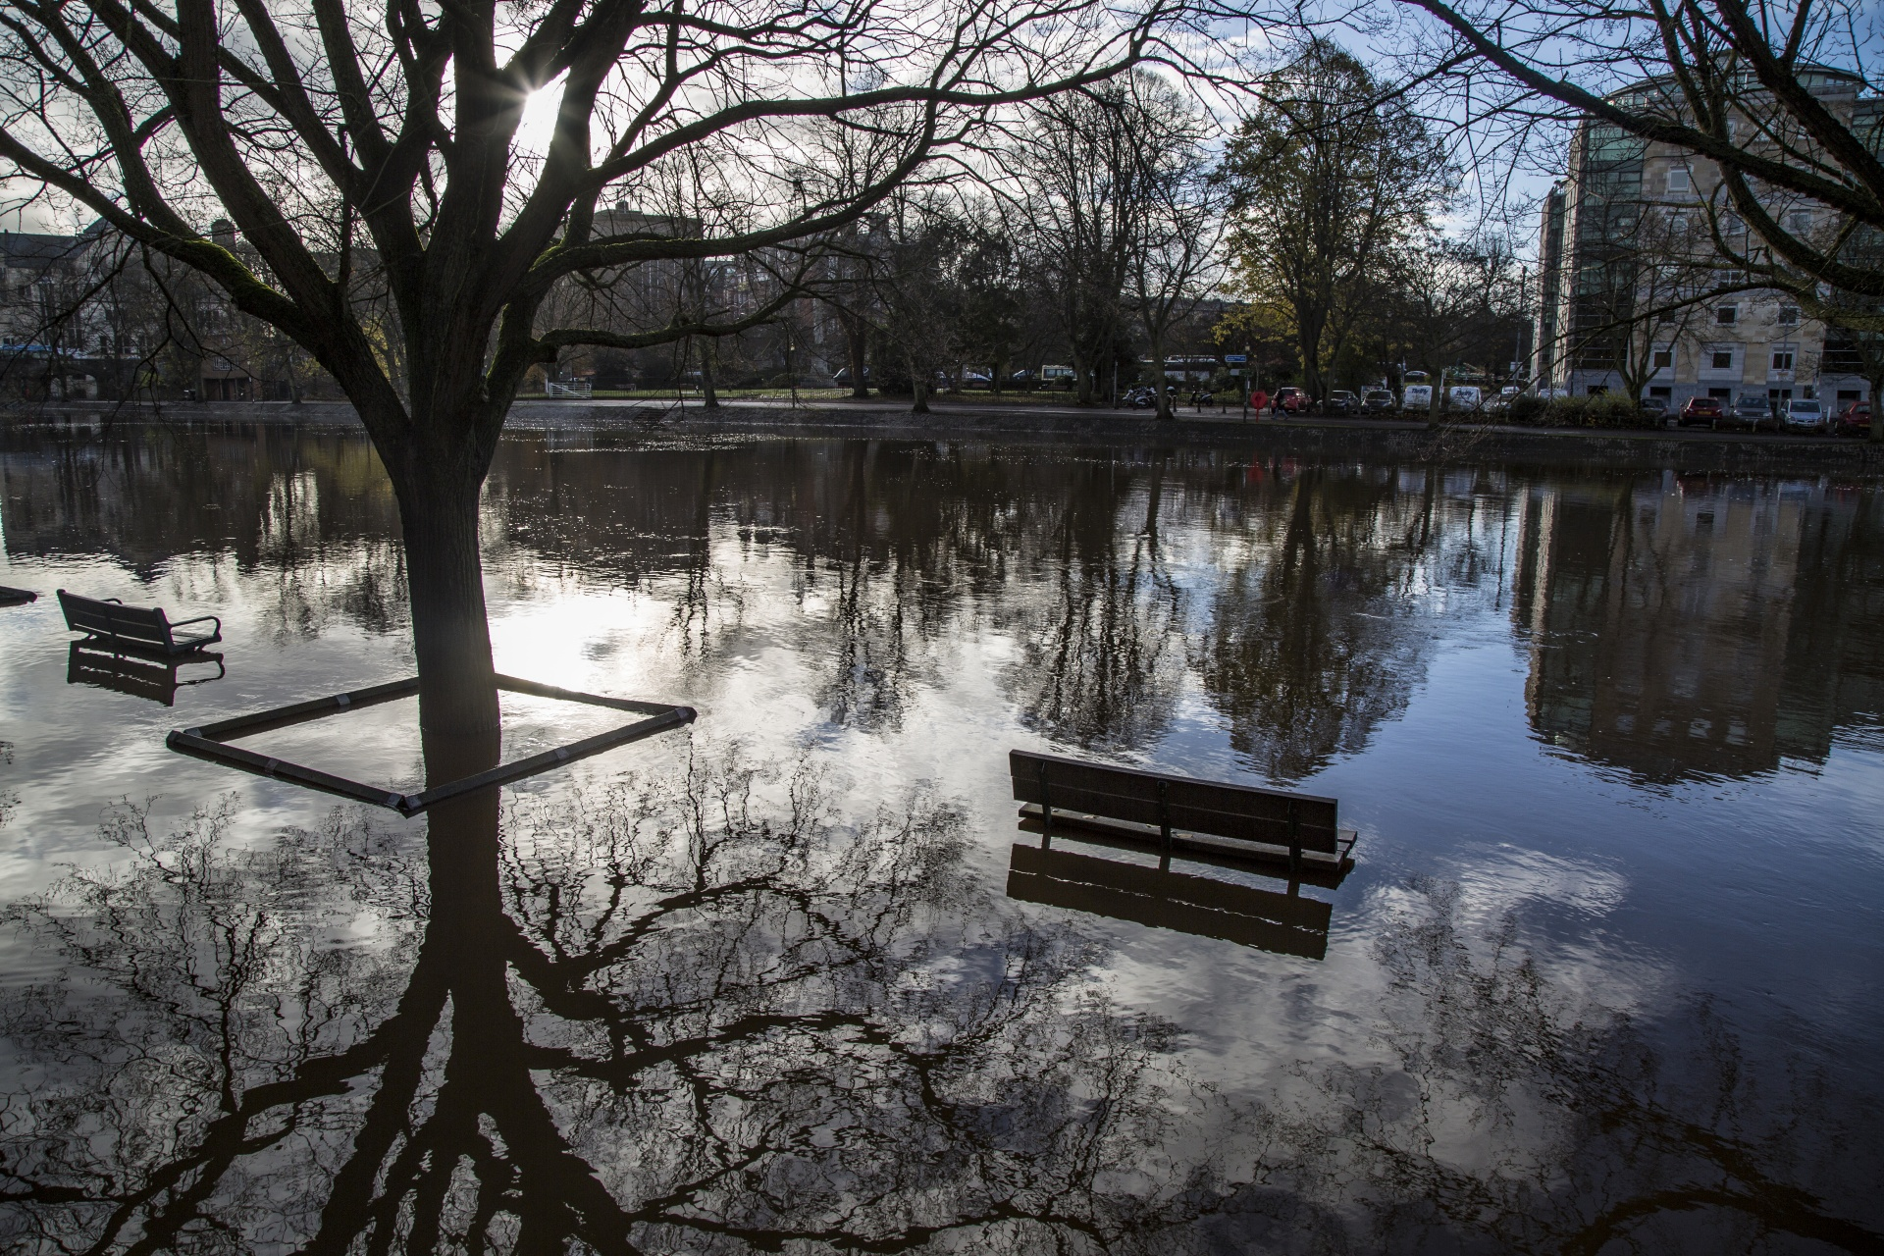
Outline
Model Overview
Objectives
Project Locations
Data
Methodology
Results
Conclusions
Errors and Uncertainties
Future Work
Image Credit: George Hodan
Acknowledgements
Notes:
These presentation of our work will begin with a model overview detailing the previous capabilities of the InVEST Model, then head into objectives of the project, then the project locations, data, methods, results, conclusions, errors, future work, and end with acknowledgements.
------------------------------Image Information Below ------------------------------
•Image Credit: George Hodan – Public Domain Photos
•Image Source: https://www.publicdomainpictures.net/en/view-image.php?image=199484&picture=potop&jazyk=RO - public domain free download; used under Creative Commons license CC0 1.0

Slide 4
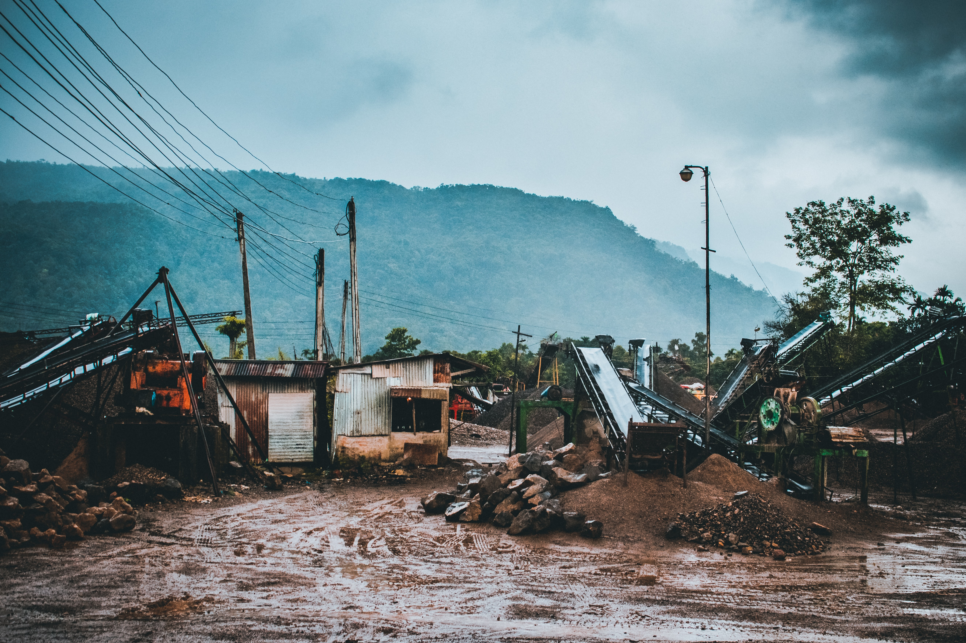
Urban Flooding
floodwater accumulation resulting from an influx of stormwater which exceeds the drainage system capacity to move water
Image Credit: Unspalsh Stock Photos
Impacts of Urban Flooding
Infrastructure
Ecosystems
Contamination
Economic Issues
Notes:
What is urban flooding? Urban Flooding is when there is an influx of water from a storm which exceeds the capacity of the drainage system to move the water which results in the water having no where to go and become flood runoff. Not only is urban flooding bad for the economy and infrastructure, but it also can spread diseases, contaminate water supply, and destroy ecosystems.
Image: From Unsplash stock photos, Sadiq Nafee
Url: https://unsplash.com/photos/nrnd1-fTsdQ Photo used under Unsplash License: https://unsplash.com/license

Slide 5
Model Overview:
InVEST: Integrated Valuation of Ecosystem Service and Tradeoffs
A family of tools what help quantify the value of natural capitol
Notes:
The Integrated Valuation of Ecosystem Services and Tradeoffs (InVEST) Urban Flood Risk Mitigation Model is a flood model that calculates runoff retention and determined the amount of runoff per pixel—the model also calculated the potential economic damage and potential flood extent. The model takes various inputs such as precipitation, land cover, soil type, building footprint and other data input.
*Icons came from PowerPoint

Slide 6

Model Overview:
InVEST Urban Flood Risk Mitigation (UFRM) Model
An urban flood model that calculates the runoff retention and looks at the amount of runoff retained per pixel compared to storm volume
Also calculates the potential economic damage by calculating potential economic damage and flood extent potential
Notes:
The InVEST Urban Flood Risk Model (*put in full fancy name*) is a flood model that calculates runoff retention and determined the amount of runoff per pixel—the model also calculated the potential economic damage and potential flood extent. The model takes various inputs such as precipitation, land cover, soil type, building footprint and other data input. The model relies on the curve number which determinates how much rainfall becomes direct runoff and how much is retained based on the land cover and soil type of each pixel. From there, the model can look into the runoff retention and flood volume of pixels and sub-watershed within a watershed.
*Icons came from PowerPoint

Slide 7
Model Overview: Previous uses of InVEST
Environmental Justice
Other DEVELOP Teams
Disasters
Italy (Ligurian coastal cities)
Applications around the world
India (Hyderabad city)
Notes:
The InVEST Urban Flood Risk Model has been used in previous develop projects alongside environmental justice measures to determine if different areas and people groups are disproportionately affected by floods. It has also been used to determine areas where floods are prone. Additionally there have been a few applications of this model outside the US such as determining the vulnerability of coastal cities in Italy as well as for a city in India that experiences frequent flash floods. This model predicts where the greatest areas of runoff and discharge are within the study area.

Slide 8
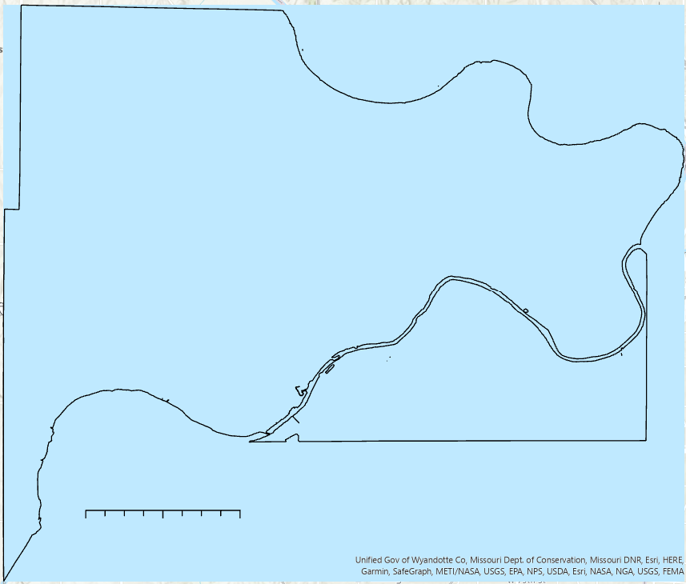
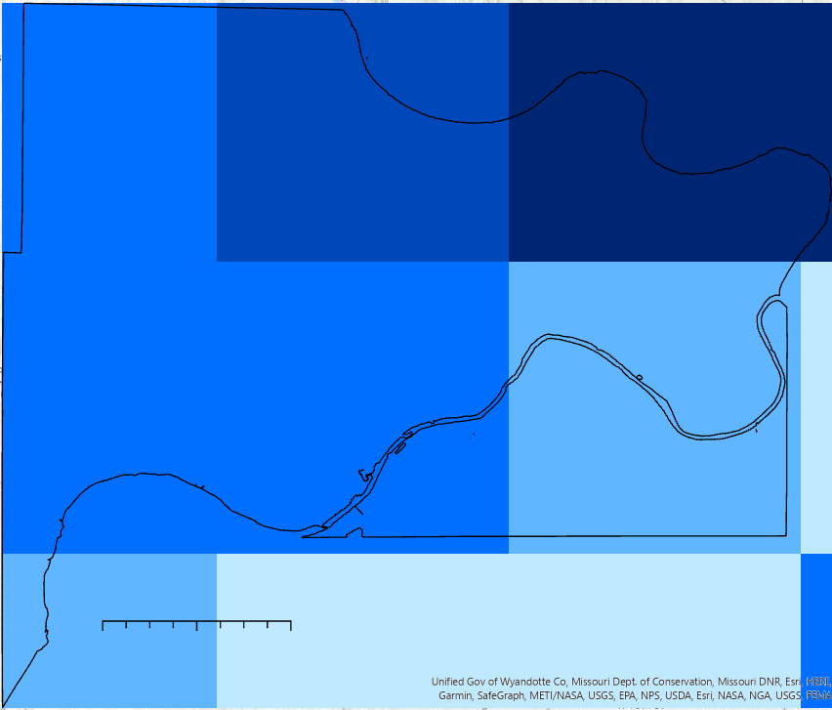

Model Overview: Current Limitations
These Show the rainfall on August 22, 2017, in Wyandotte County, KS
Rainfall from GPM IMERG with the being one value and the right being raster values
N
N
Rainfall (mm)
0 2.5 5 miles
110.5-112
112.1-114
114.1-117.5
117.6-121
121.1-125.5
0 2.5 5 miles
Notes:
One of the main limitations with InVEST is the inability to input spatially variable precipitation data. Instead of being able to input a raster with various precipitation values, you can only input one value for the entire shapefile. Doesn’t allow use of spatially variable precipitation input which means there is only one value over the entire watershed. The left photo shows what the previous model uses as input- one value with the right picture showing the improved raster input values.
*photos made by DEVELOPers in ArcGIS
As you can see in the photos, there is a large difference in rainfall values over a county and without the spatial variability, a lot of information is missing.

Slide 9



Objectives
Implement spatially variable precipitation data into InVEST Model
Analyze significance of the changes before and after model is changed by testing model in Kansas City
Validate modified model with flood map from Sentinel-1
Notes:
The main objectives of this project was to improve the InVEST model by implementing spatially variable raster precipitation data into the model, analyzing the significance of the improvement by applying the improved model to the same location that it has been previously used, Kansas City assessing the improvements of the model.
*The icons are from PowerPoint

Slide 10
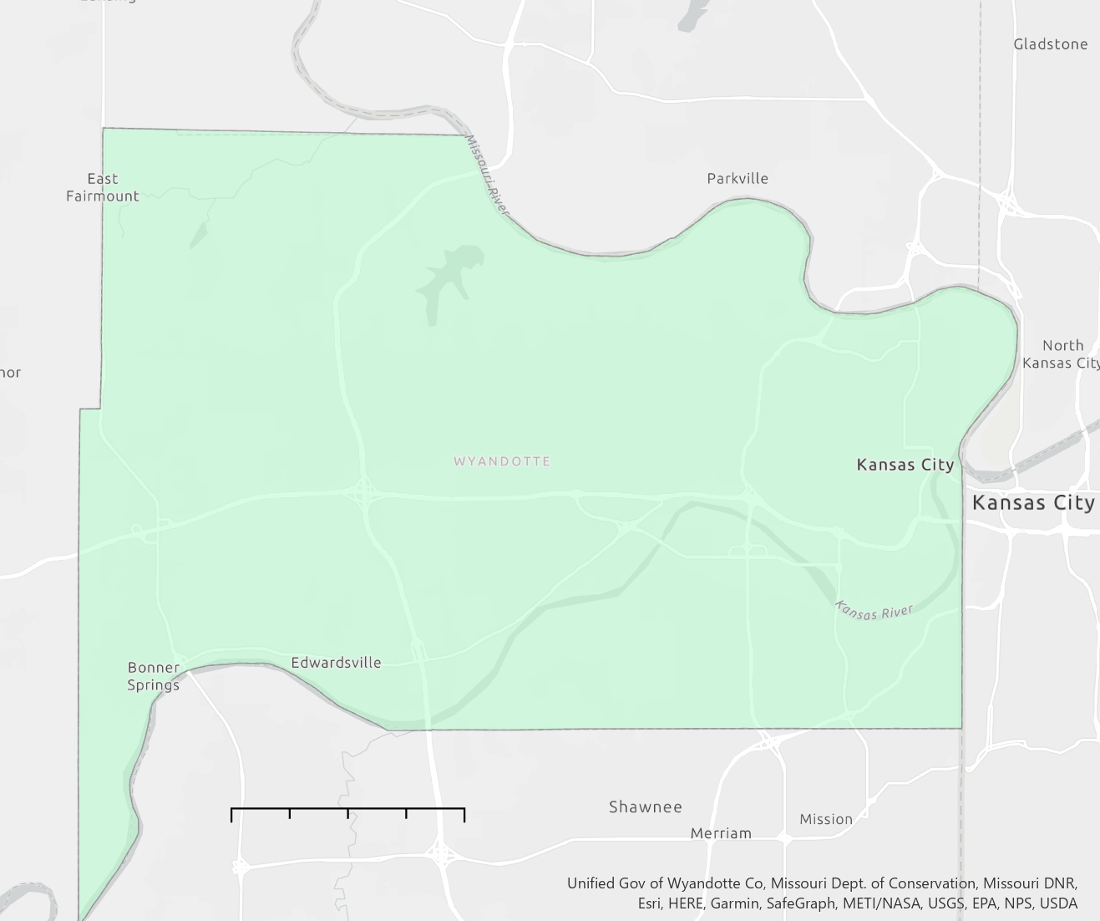
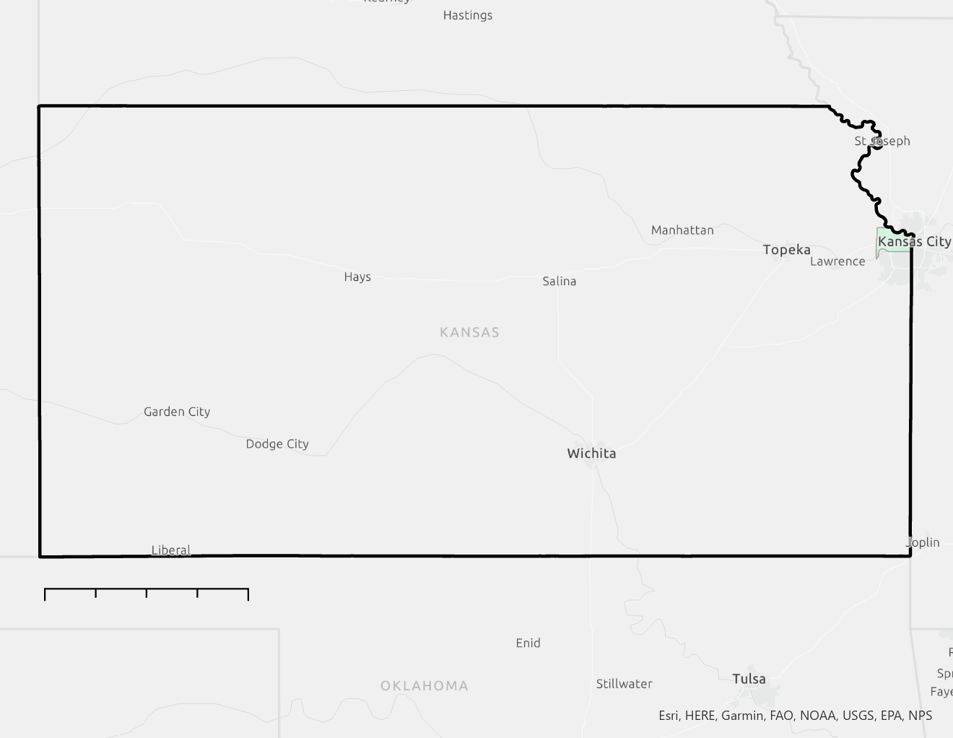
Project Locations- Testing and Validation
Kansas City, Kansas (Wyandotte County)
N
Study Period:
Storm events in August 2017
Storm events in June 2019
0 60 120 miles
**Will compare previous results to the improved model for sensitivity and statistical analysis
0 2.5 5 miles
Notes:
Our test location was Kansas city, KA with the shapefile being Wyandotte county. This study site served as a validation for the new model and the storm events of august 2017 and may and June 2019 were studied.
Basemap: Light Grey – Unified Government of Wyandotte County. Department of Conversion, Missouri DNR
ESRI HERE germin Safegraph, METI/NASA, USGS, EPA, NPS, USDA

Slide 11
Data Overview- InVEST Input and Outputs
Precipitation (GPM IMERG)
Runoff Retention
Land Cover (NLCD)
Nominal Flood Depth
Hydrological Soil Types
Area Polygons
Potential Damage
Building footprints
Avoided Damage
Damage Loss
Notes:
In order to run the InVEST model, various datasets were needed. To predict the runoff retention and the nominal flood depths, a single value from the accumulation of rainfall for the storm event from GPM was needed as well as land cover and hydrological soil types. Additionally area polygons, such as subbasin watershed delineations were needed as well as building footprints and damage loss table for the potential damage and avoided damage. More information on these datasets is seen on the next slide. For this project we focused just on the runoff retention and nominal flood depth as opposed to the potential and avoided damage.

Slide 12
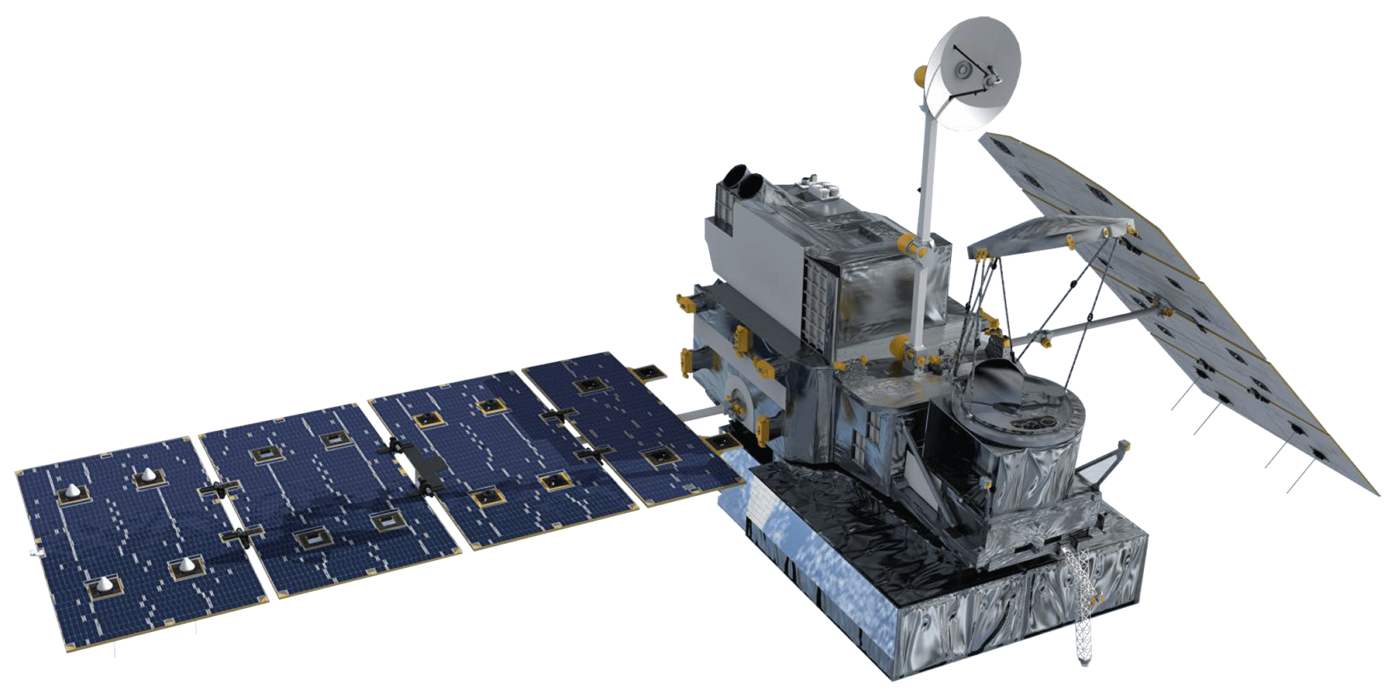

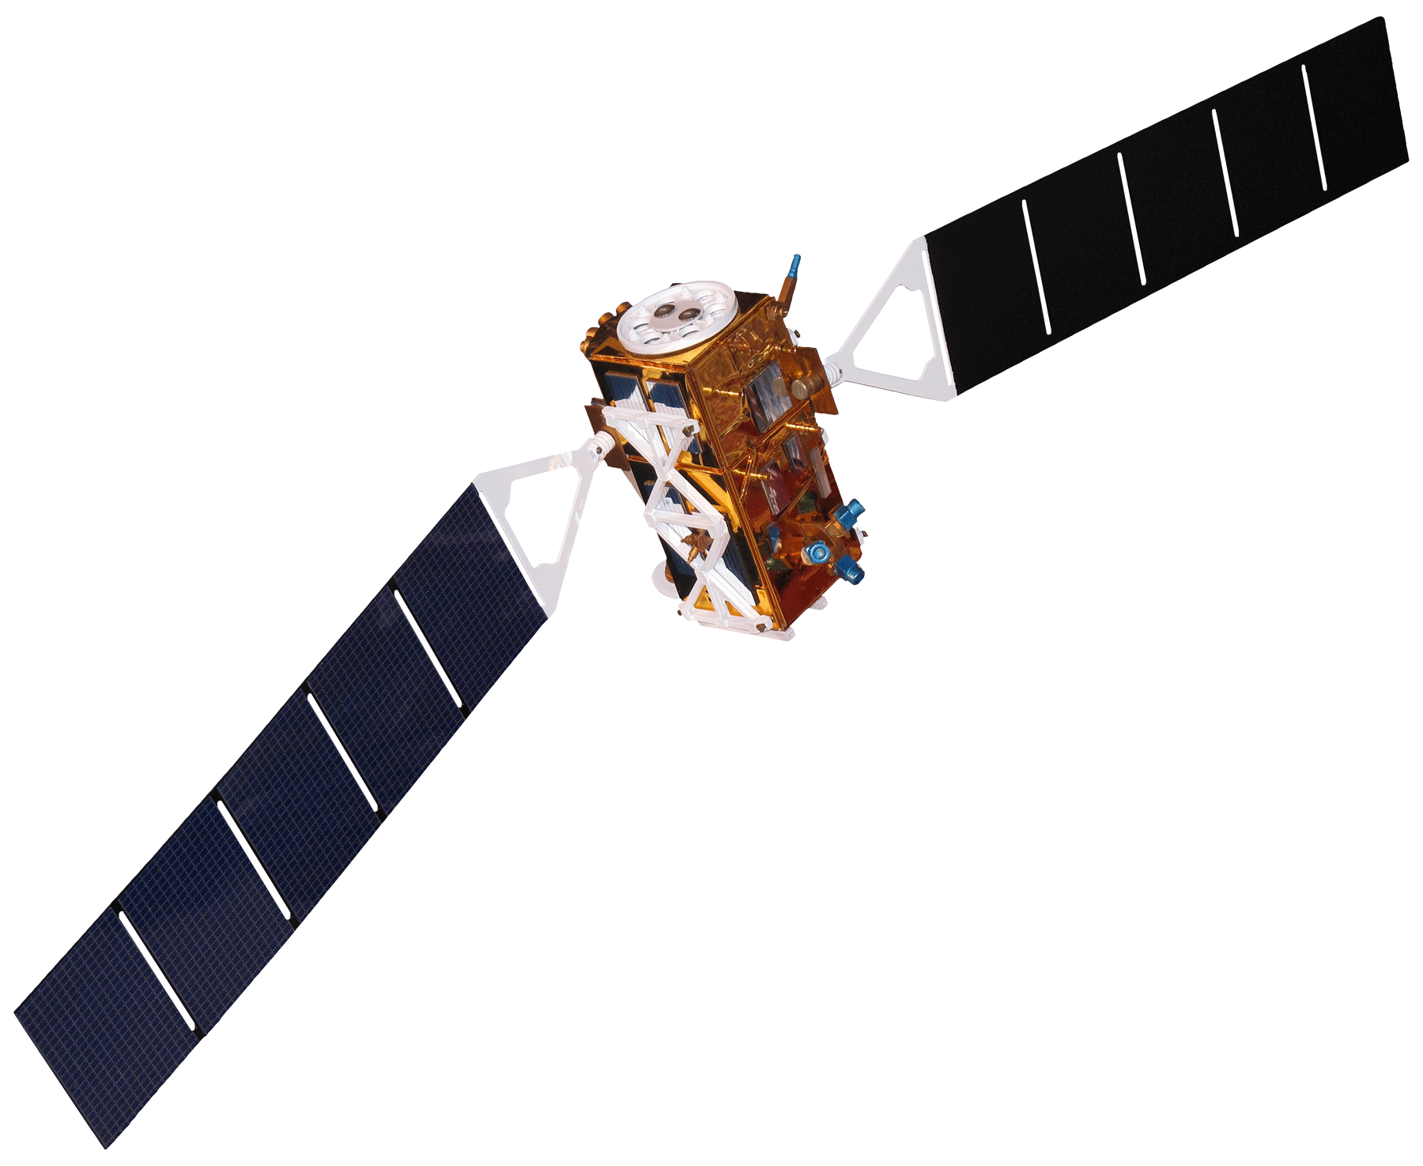
Earth Observations
Sentinel-1 SAR
Images for Validation
GPM IMERG
Precipitation
Image Credit: NASA, ESA
Notes:
Two main satellites used for this model are the GPM IMERG and Sentinel-1 satellites. The GPM IMERG mission gathers precipitation data whereas the sentinal-1 mission takes images of the earth that can be used for a variety of applications, including determining flood depth as we did in our validation.
Image GPM: From DEVELOPEDIA, Mike Bender
Url: https://www.devpedia.developexchange.com/dp/images/1/14/08_GPM.png
Image Sentine-1: From DEVELOPEDIA, Mike Bender
Url: https://www.devpedia.developexchange.com/dp/images/8/81/23_Sentinel1.png

Slide 13
Other Datasets and their uses
USGS 2019 USA National Land Cover Dataset
Land Cover
USDA Gridded Soil Survey Geographic Soil Type and drainage class dataset
Soil Groups
Estimation of Direct Runoff from Storm Rainfall
Curve Number - Biophysical Table
USGS National Elevation Dataset 3D Elevation Program, 1/3rd arc-second digital elevation model
DEM for watershed delineation
Notes:
This chart shows the rest of the datasets and their purpose in this project. The raster's, GPM, Soil type, and land cover were used as inputs into the model whereas the curve number was inputted into the biophysical table to relate the soil group and land cover to the runoff retention rate. The DEMs were used for watershed delineation.

Slide 14
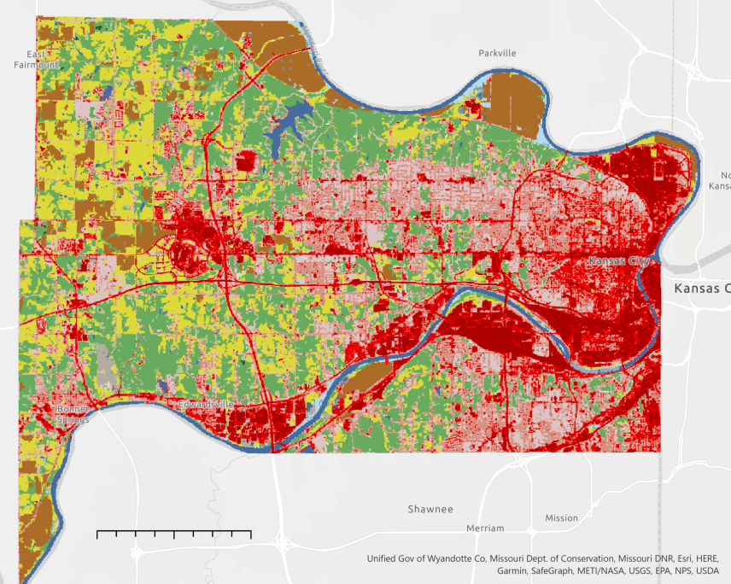
Data- Land Use/ Land Cover (LULC)
Open Water
N
Developed, Open Space
Developed, Low Intensity
Developed, Medium Intensity
Developed, High Intensity
Barren Land
Deciduous Forest
Evergreen Forest
Mixed Forest ​
Shrub/Scrub ​
Herbaceous
Hay/ Pasture
Cultivated Crops​
Woody Wetlands
Emergent Herbaceous Wetlands
0 2.5 5 miles
Notes:
This slide shows the land cover of the area of interest, showing that there is a range of land covers, but primarily developed on the eastern side of the county and more pastures and forests on the western side.
Basemap: Light Grey
Unified Government of Wyandotte County. Department of Conversion, Missouri DNR
ESRI HERE germin Safegraph, METI/NASA, USGS, EPA, NPS, USDA

Slide 15
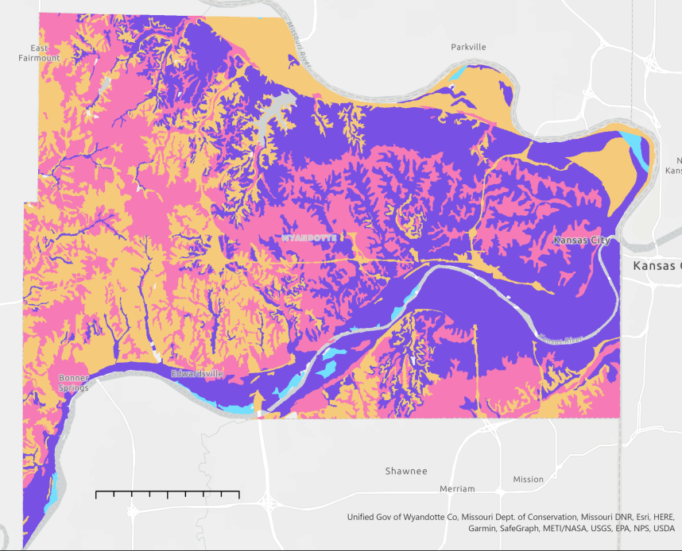
Data- Soil Cover
N
Group A
High Infiltration when wet
Group B
Moderate infiltration when wet
Group C
Slow Infiltration when wet
Group D
Very slow infiltration when wet
0 2.5 5 miles
Notes:
The soil groups for the county are shown above with the four groups spread across the basin. Group A is the least prevalent in this county, with most of the soil cover ranging from groups B-D, meaning that the soil is very slow to moderate infiltration.
Basemap: Light Grey
Unified Government of Wyandotte County. Department of Conversion, Missouri DNR
ESRI HERE germin Safegraph, METI/NASA, USGS, EPA, NPS, USDA

Slide 16
Methodology- Original InVEST model
Digital Elevation Model (DEM)
Delineated Watershed Polygons
Singular value for the entire AOI ➔ Overestimation of rainfall and flood depth
Rainfall Depth (mm)
Runoff Retention
Urban Flood Risk Mitigation Model
Land Cover Raster
Flood Volume
Soil Groups Raster
Runoff Values
Land Use and Land Cover
Biophysical Table
Curve Number Values
Notes:
In order to run the invest model, these rasters, values, and tables are needed. They produce runoff retention, runoff values, and flood volume. The main focus of the project was the rainfall depth- with it being a singular value in the original model and then changing it later.

Slide 17
Methodology- Improved InVEST model
Digital Elevation Model (DEM)
Delineated Watershed Polygons
GPM Rainfall Raster
Runoff Retention
Urban Flood Risk Mitigation Model
Land Cover Raster
Flood Volume
Soil Groups Raster
Runoff Values
Land Use and Land Cover
Biophysical Table
Curve Number Values
Notes:
In order to run the invest model, these rasters, values, and tables are needed. They produce runoff retention, runoff values, and flood volume. The main focus of the project was the rainfall depth- with it being a singular value in the original model and then changing it later.

Slide 18


Methodology- Model Alteration
Change rainfall input from single value to raster
Create new .py model based on the original InVEST model
Align and resample land cover, soil type, and rainfall raster
Alter model input and raster calculation
Modify flood runoff and retention calculation code for rainfall array input
Notes:
The main methodology of this project was the model alteration where we created a new .py model based on the original InVEST model and altered the model input and raster calculation by changing rainfall input from single value to raster, aligning and resampling LULC, soil type, and rainfall raster images, and modifying flood runoff/retention calculation code for rainfall array input.
--- icons from powerpoint

Slide 19



Methodology- Validation
Acquire coincident Sentinel-1 SAR images during the event
Perform water classification and combine it with DEM
Compare satellite-based flood depth from results from two UFRM models
Notes:
In order to validate the modified model, we acquired coincident Sentinel-1 SAR images during the event, Performed water classification to derive flood extent mapping and combine it with DEM to derive flood depth map, and then Compared satellite-based flood depth from results from two UFRM models
**icons from PowerPoint

Slide 20
Results- Model Outputs
Runoff per pixel
(Q in mm)
Raster
Runoff Retention per pixel
Raster
Runoff Retention per pixel (m³)
Raster
Flood Risk Service
Shapefile
Notes:
These showcase the outputs that the model produces. There are four separate pieces of information that we can look at. First, the model estimates runoff in mm calculated by the curve number method which is used with the biophysical table. Additionally, the runoff retention per pixel and in m3 across the watershed. All three of these outputs come in raster file and can be visualized in ArcGIS. The final output is the flood risk service shapefile. This includes the average runoff retention, sum of retention volumes and flood volume per sub watershed.
Parameter log: Each time the model is run, a text (.txt) file will be created in the Workspace. The file will list the parameter values and output messages for that run and will be named according to the service, the date and time. When contacting NatCap about errors in a model run, please include the parameter log.
Runoff_retention.tif: raster with runoff retention values (no unit, relative to precipitation volume). Calculated from equation (117).
Runoff_retention_m3.tif: raster with runoff retention values (in �3). Calculated from equation (118).
Q_mm.tif: raster with runoff values (mm). Calculated from equation (115).
flood_risk_service.shp: Shapefile with results in the attribute table:
rnf_rt_idx: average of runoff retention values (��) per watershed
rnf_rt_m3: sum of runoff retention volumes (�_�3�), in �3, per watershed.
flood_vol: The flood volume (Q_m3, equation (119)) per watershed.
The equations are from the model website: https://invest-userguide.readthedocs.io/en/latest/urban_flood_mitigation.html

Slide 21
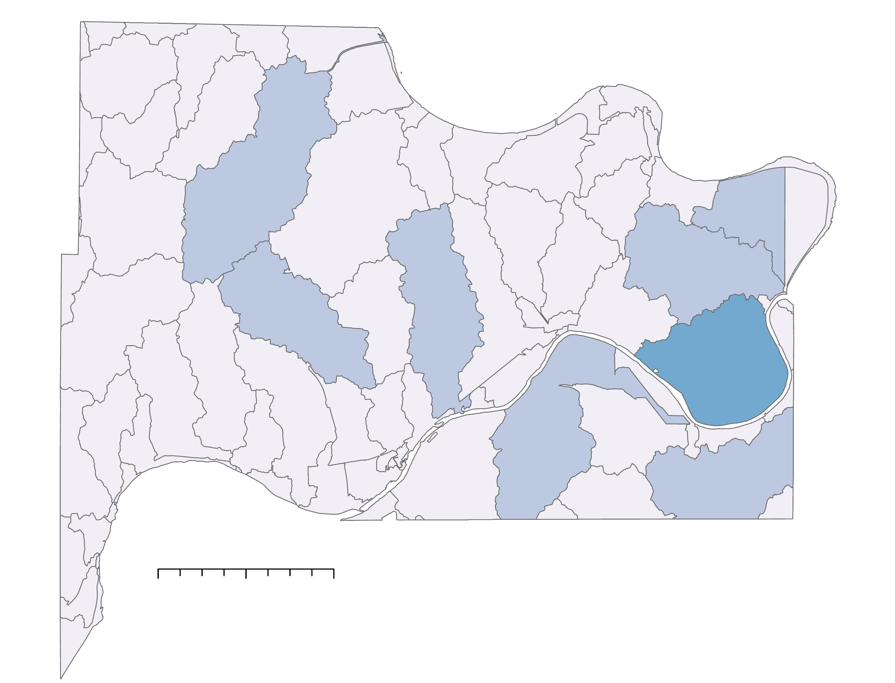
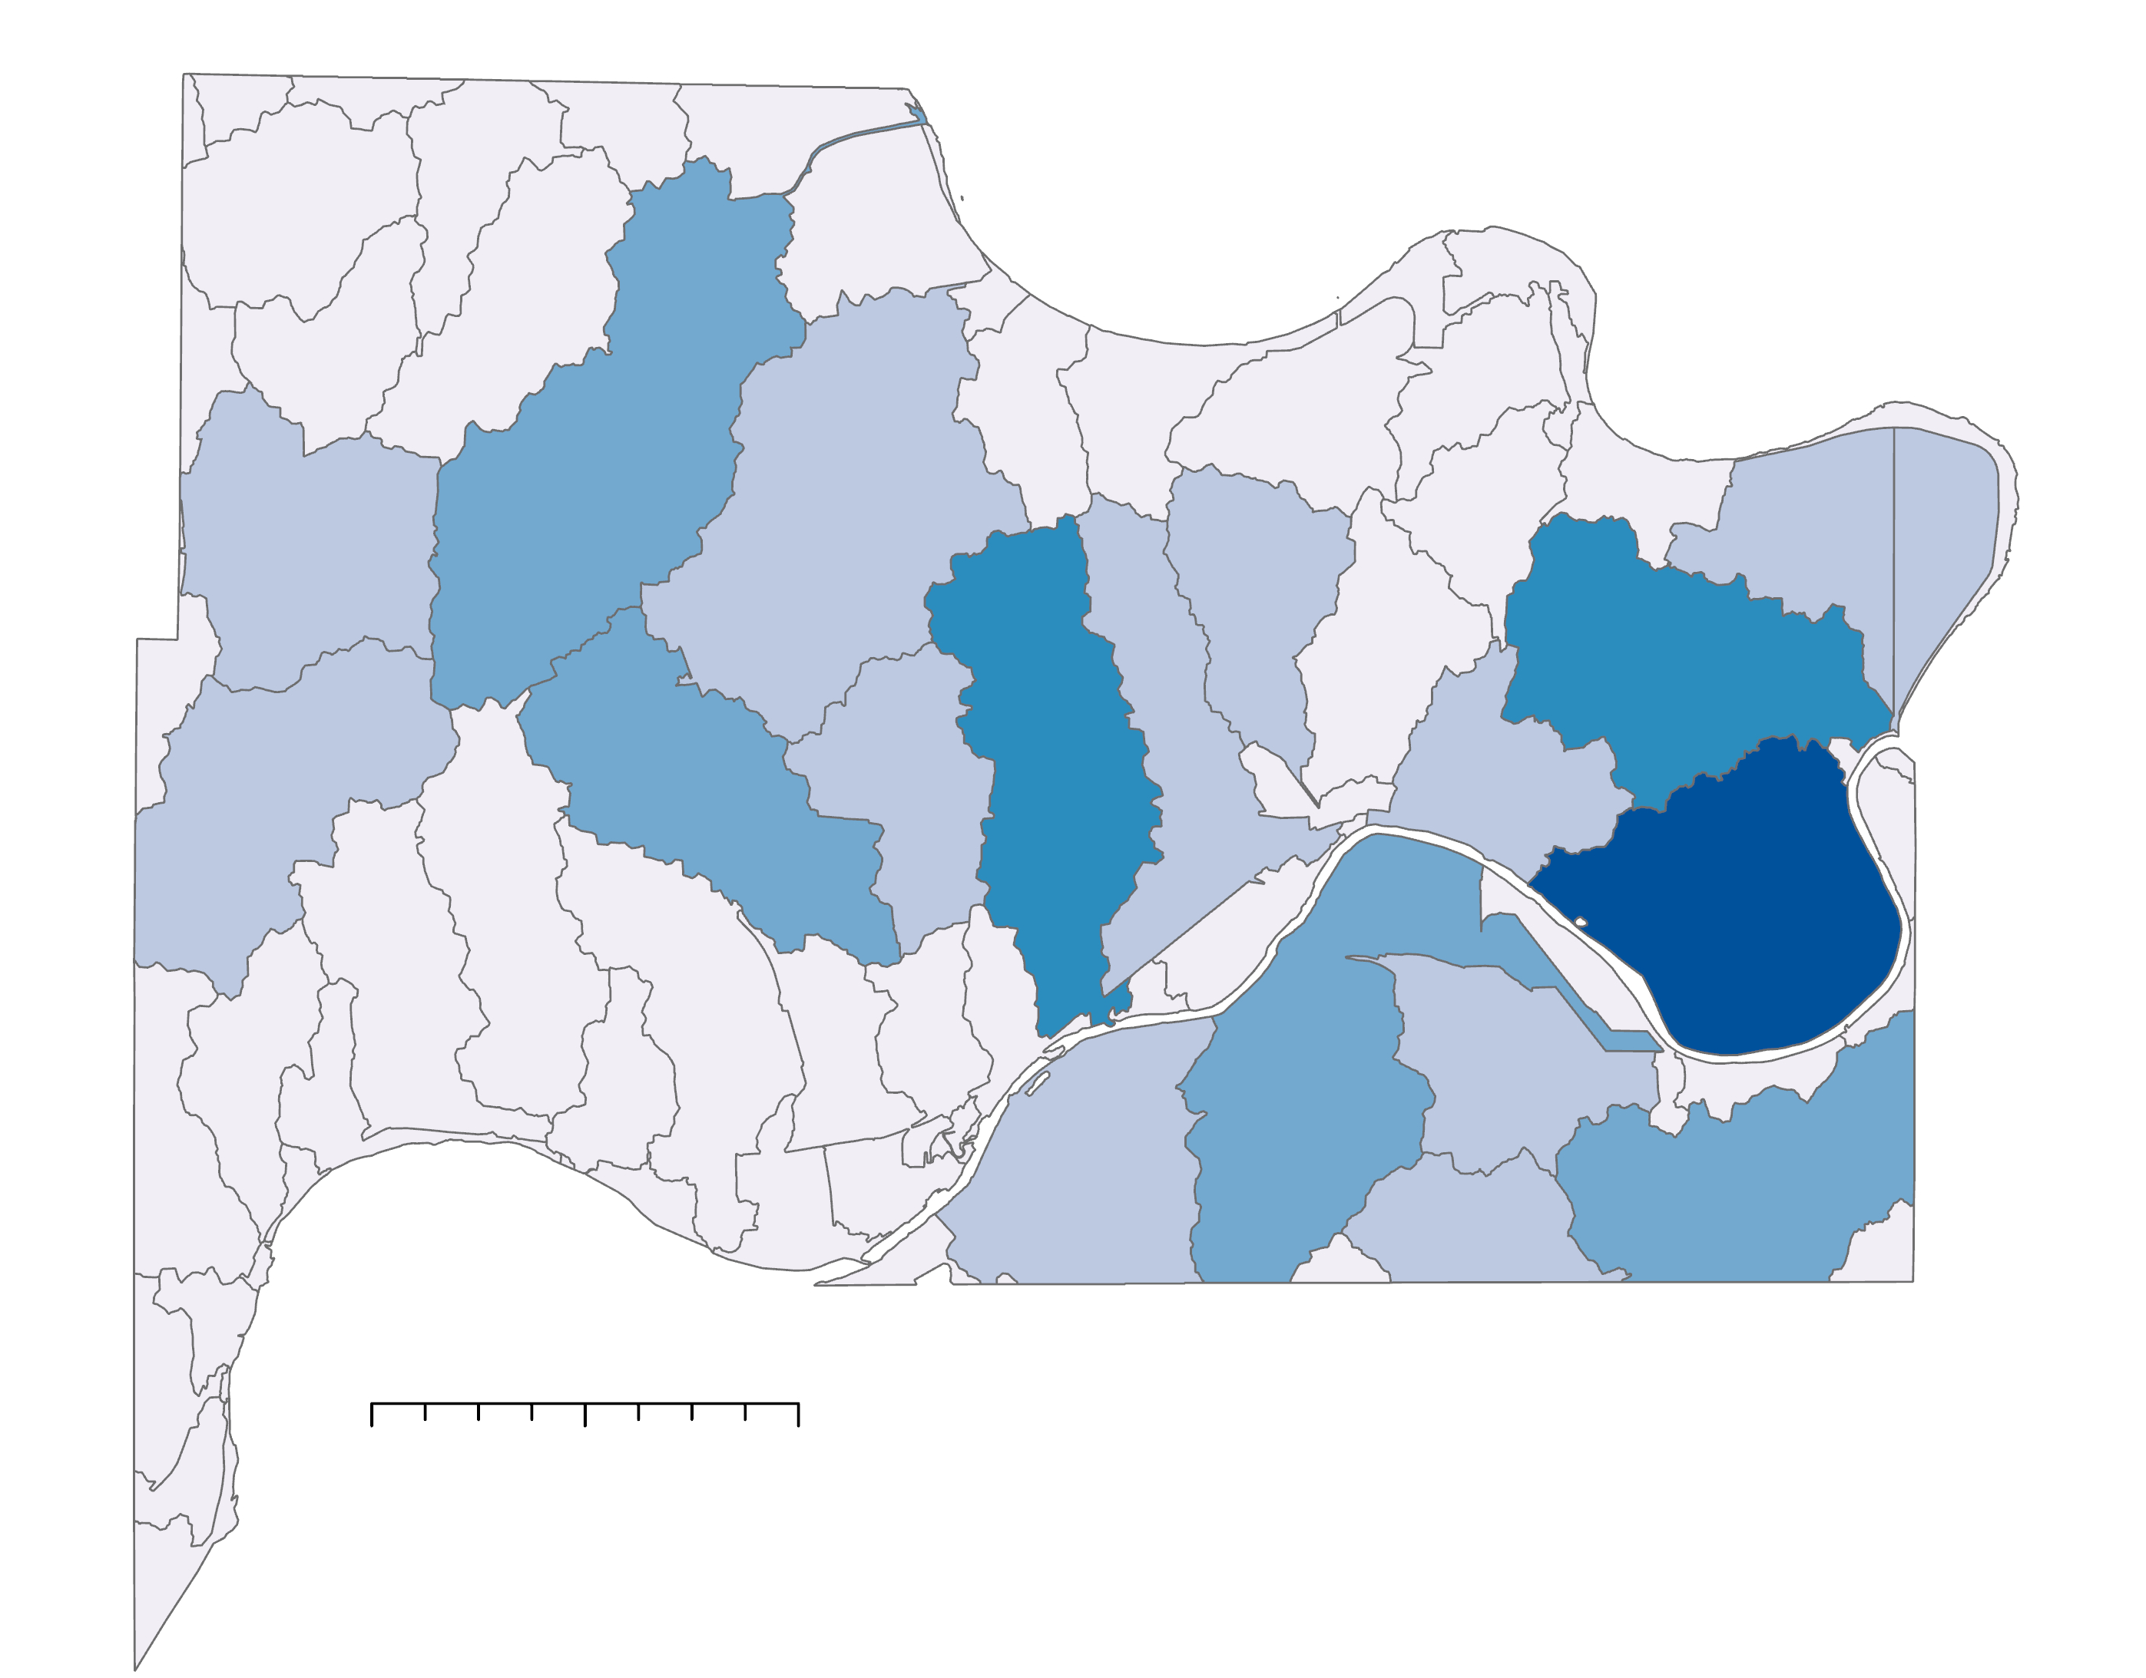
Sensitivity Analysis- 20mm vs. 30mm input
20mm
30mm
N
N
Flood Volume (m³)
0 2.5 5 miles
0 to 85,000
85,001 to 170,000
170,001 to 250,000
250,001 to 340,000
340,001 to 425,000
0 2.5 5 miles
Notes:
By running a sensitivity analysis, we were able to understand the effects of the change of rainfall input on the model. We ran the original model with 20mm of rainfall and 30mm of rainfall will the rest of the inputs being kept the same to test how sensitive the model is. The flood volume increased 231% between the two inputs showing that the model is sensitive to the rainfall input.

Slide 22
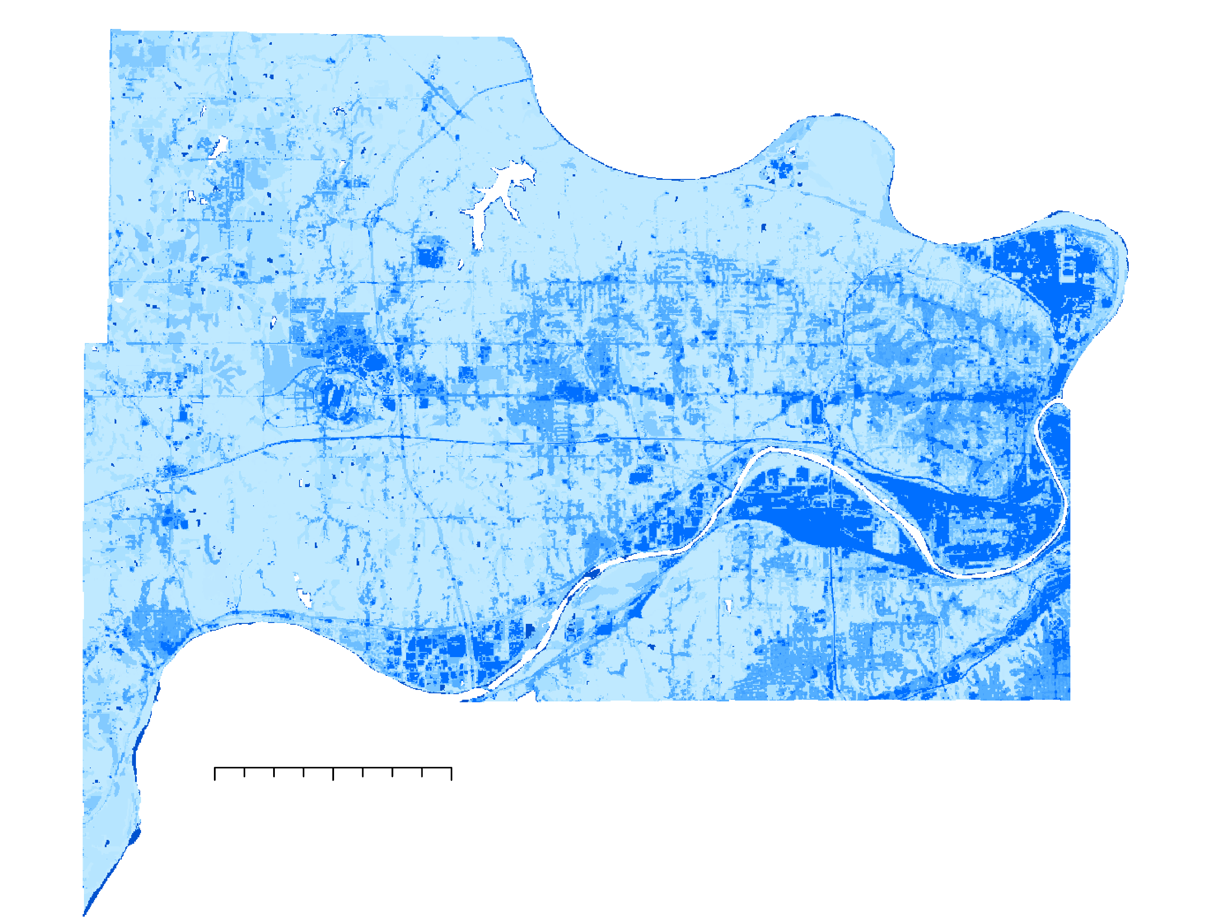
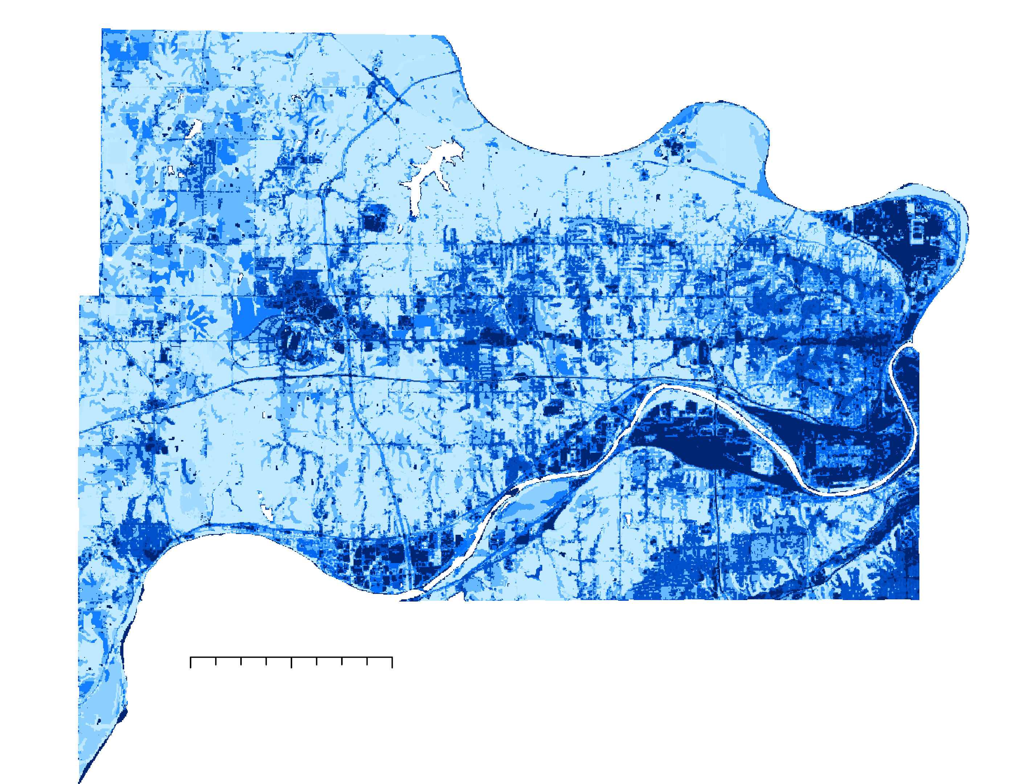

Sensitivity Analysis- 20mm vs. 30mm input
20mm
30mm
N
N
0 2.5 5 miles
Q(mm)
0 2.5 5 miles
30
0
Notes:
By running a sensitivity analysis, we were able to understand the effects of the change of rainfall input on the model. We ran the original model with 20mm of rainfall and 30mm of rainfall will the rest of the inputs being kept the same to test how sensitive the model is. Since the model gives us various outputs, we looked into the Flood Volume per sub watershed (m3), discharge per pixel (mm), and the runoff retention percentage per pixel.

Slide 23
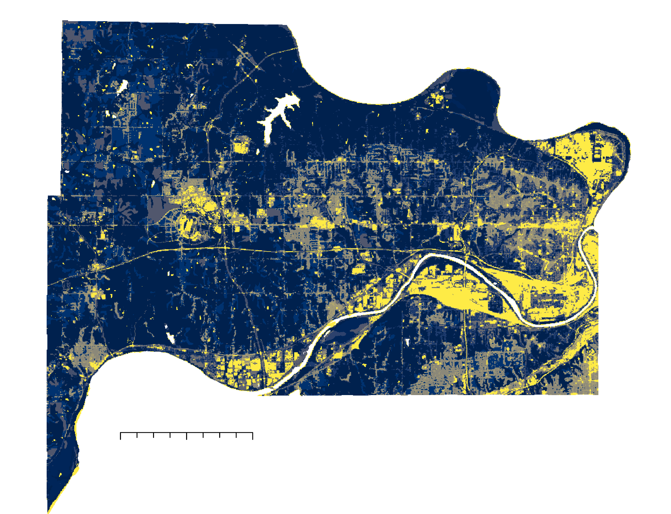
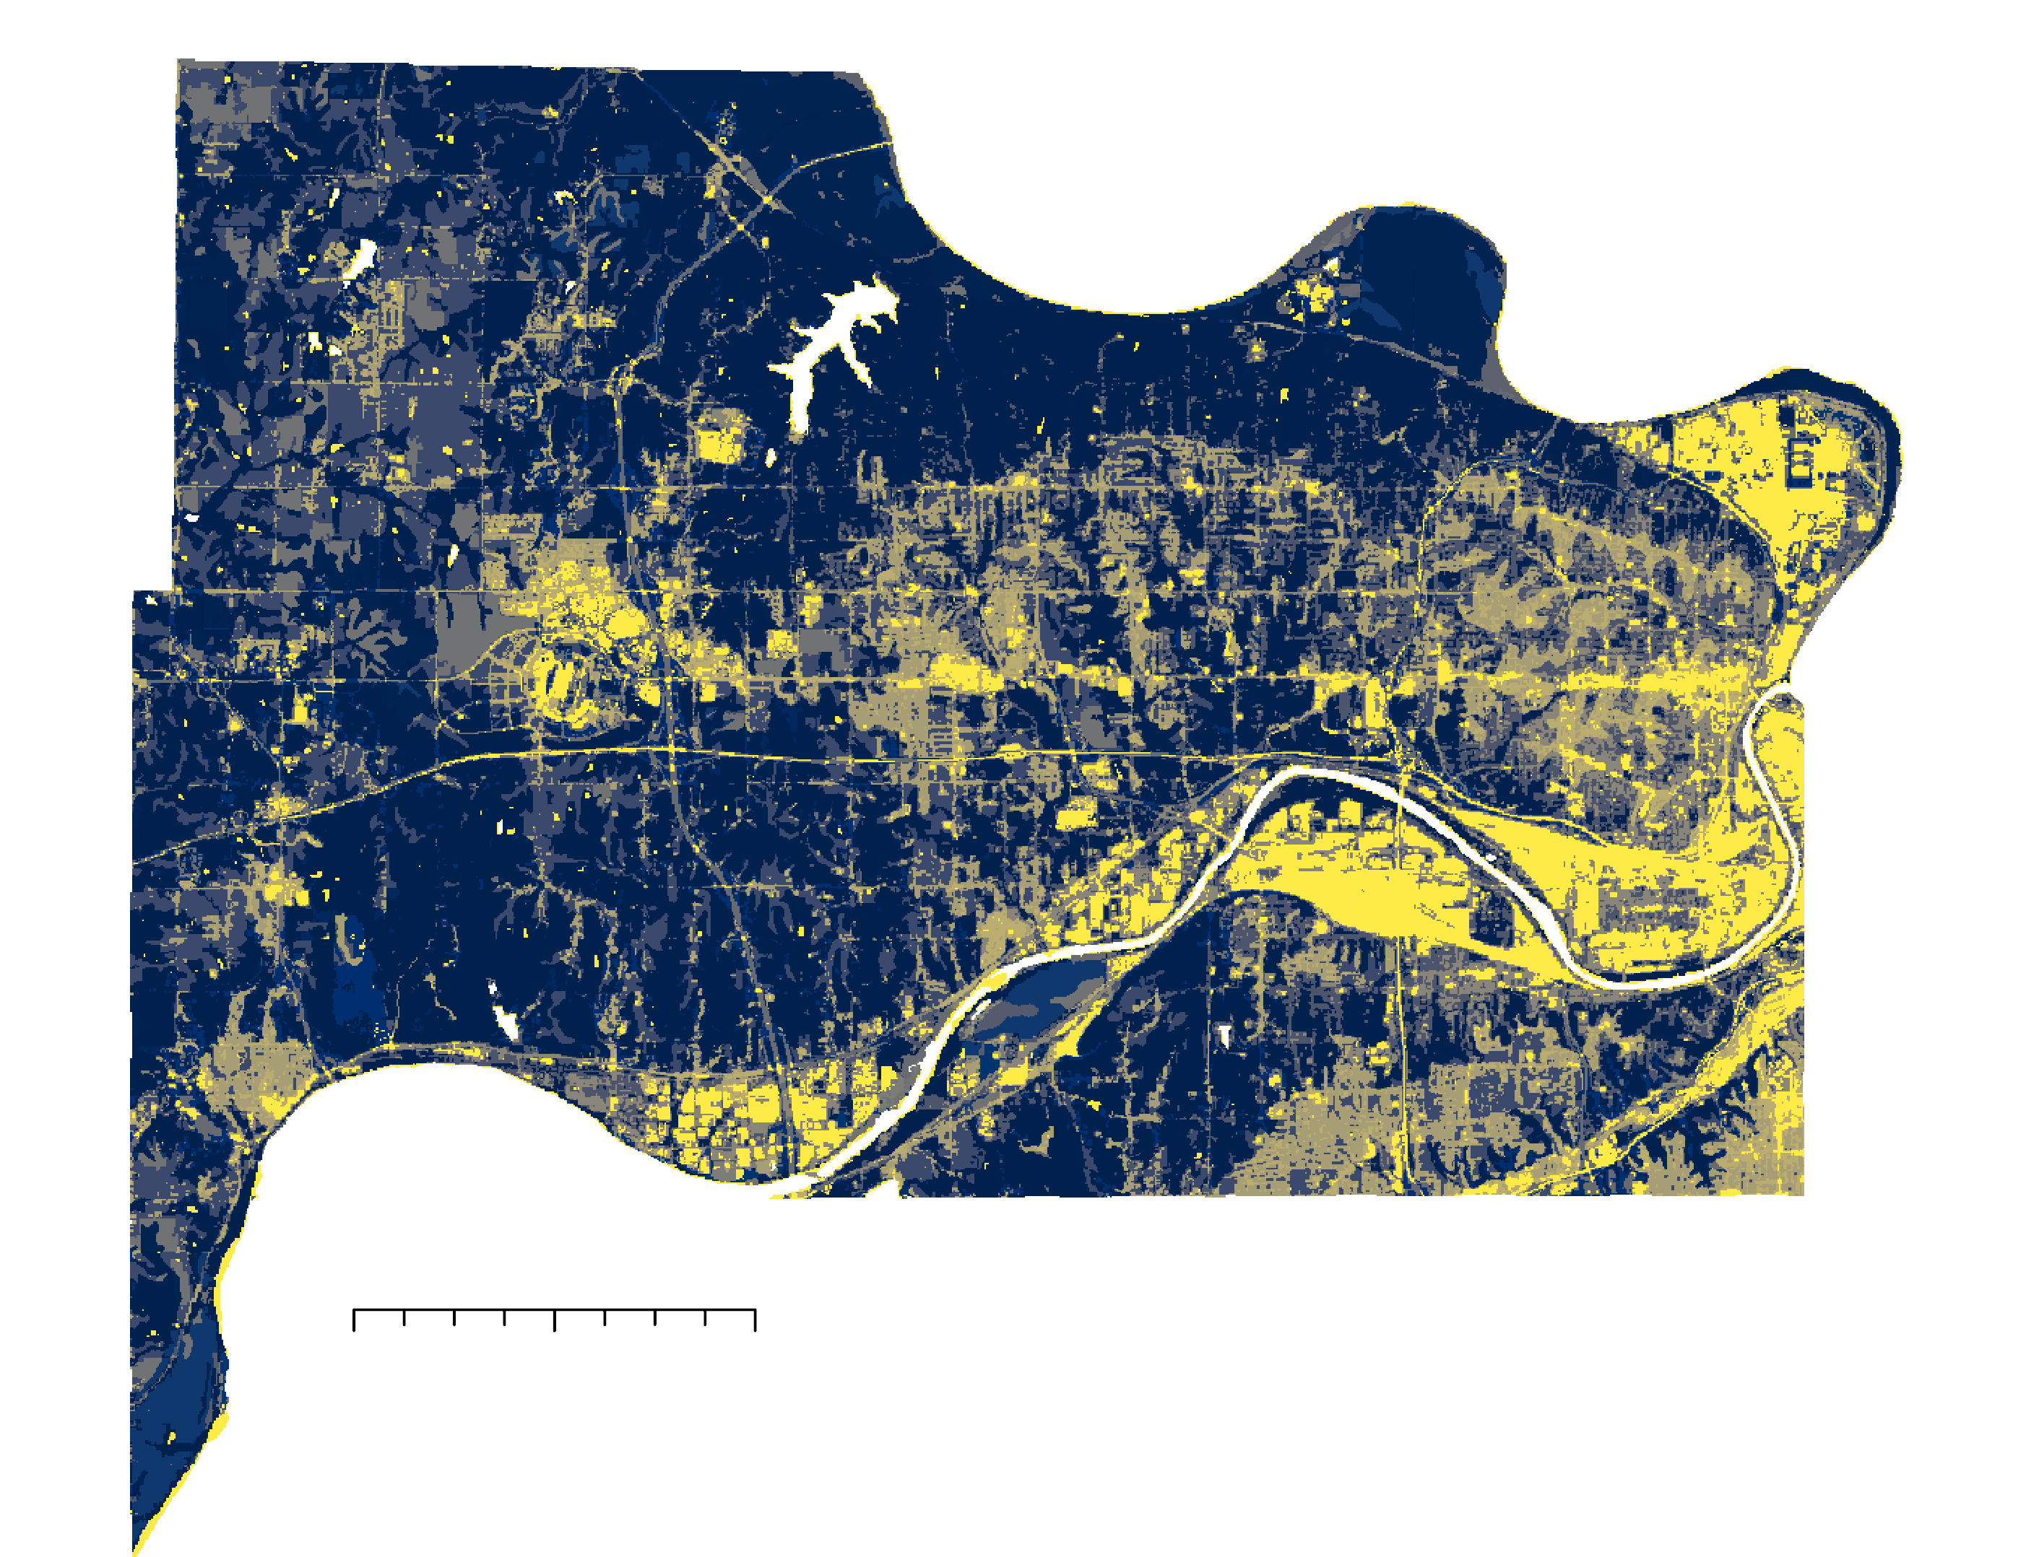

Sensitivity Analysis- 20mm vs. 30mm input
20mm
30mm
N
N
0 2.5 5 miles
Runoff Retention
0 2.5 5 miles
1
0
Notes:
By running a sensitivity analysis, we were able to understand the effects of the change of rainfall input on the model. We ran the original model with 20mm of rainfall and 30mm of rainfall will the rest of the inputs being kept the same to test how sensitive the model is. Since the model gives us various outputs, we looked into the Flood Volume per sub watershed (m3), discharge per pixel (mm), and the runoff retention percentage per pixel.
On average, the runoff retention volume increasing by 135% showing that the model is sensitive to the rainfall input.

Slide 24
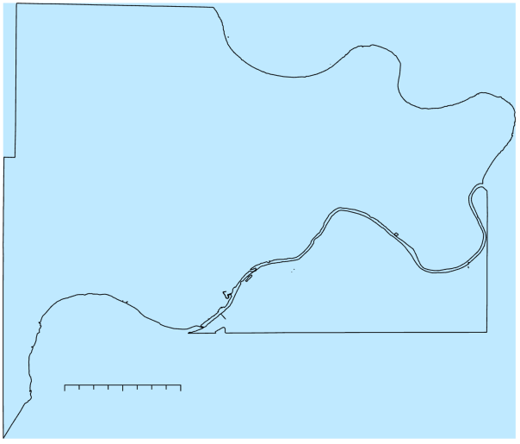
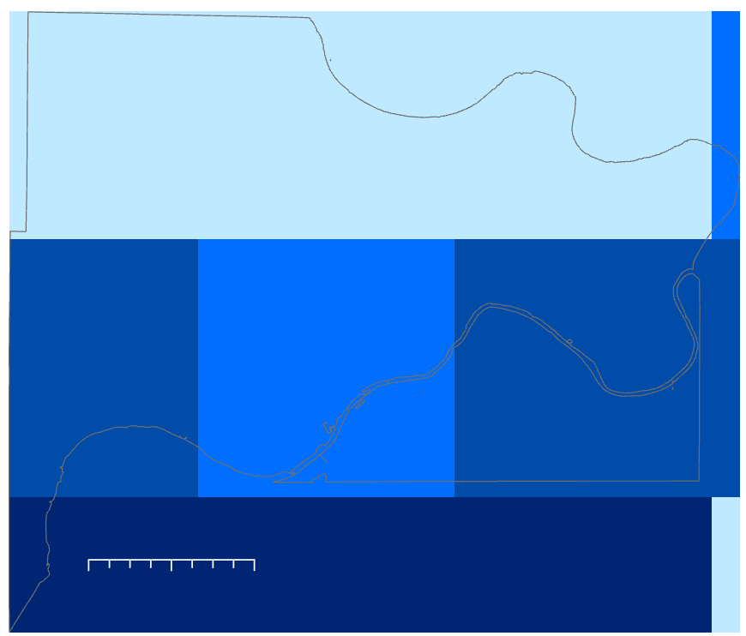
Model Input- Rainfall- August 21st, 2017
N
N
Rainfall (mm)
0 2.5 5 miles
1.6-1.6
1.61- 5
5.1-8
8.1-10
10.1-14.5
0 2.5 5 miles
Notes:
One of the main limitations with InVEST is the inability to input spatially variable precipitation data. Instead of being able to input a raster with various precipitation values, you can only input one value for the entire shapefile. Doesn’t allow use of spatially variable precipitation input which means there is only one value over the entire watershed. The left photo shows what the previous model uses as input- one value with the right picture showing the improved raster input values.
*photos made by DEVELOPers in ArcGIS
As you can see in the photos, there is a large difference in rainfall values over a county and without the spatial variability, a lot of information is missing.

Slide 25
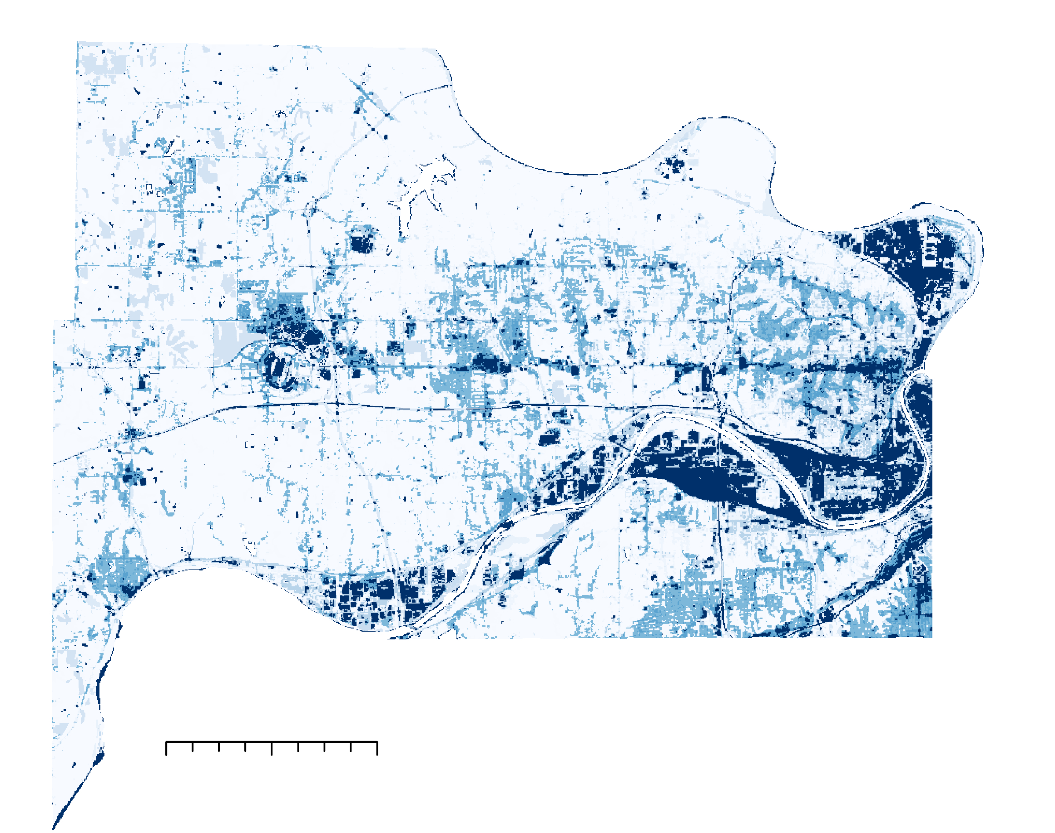
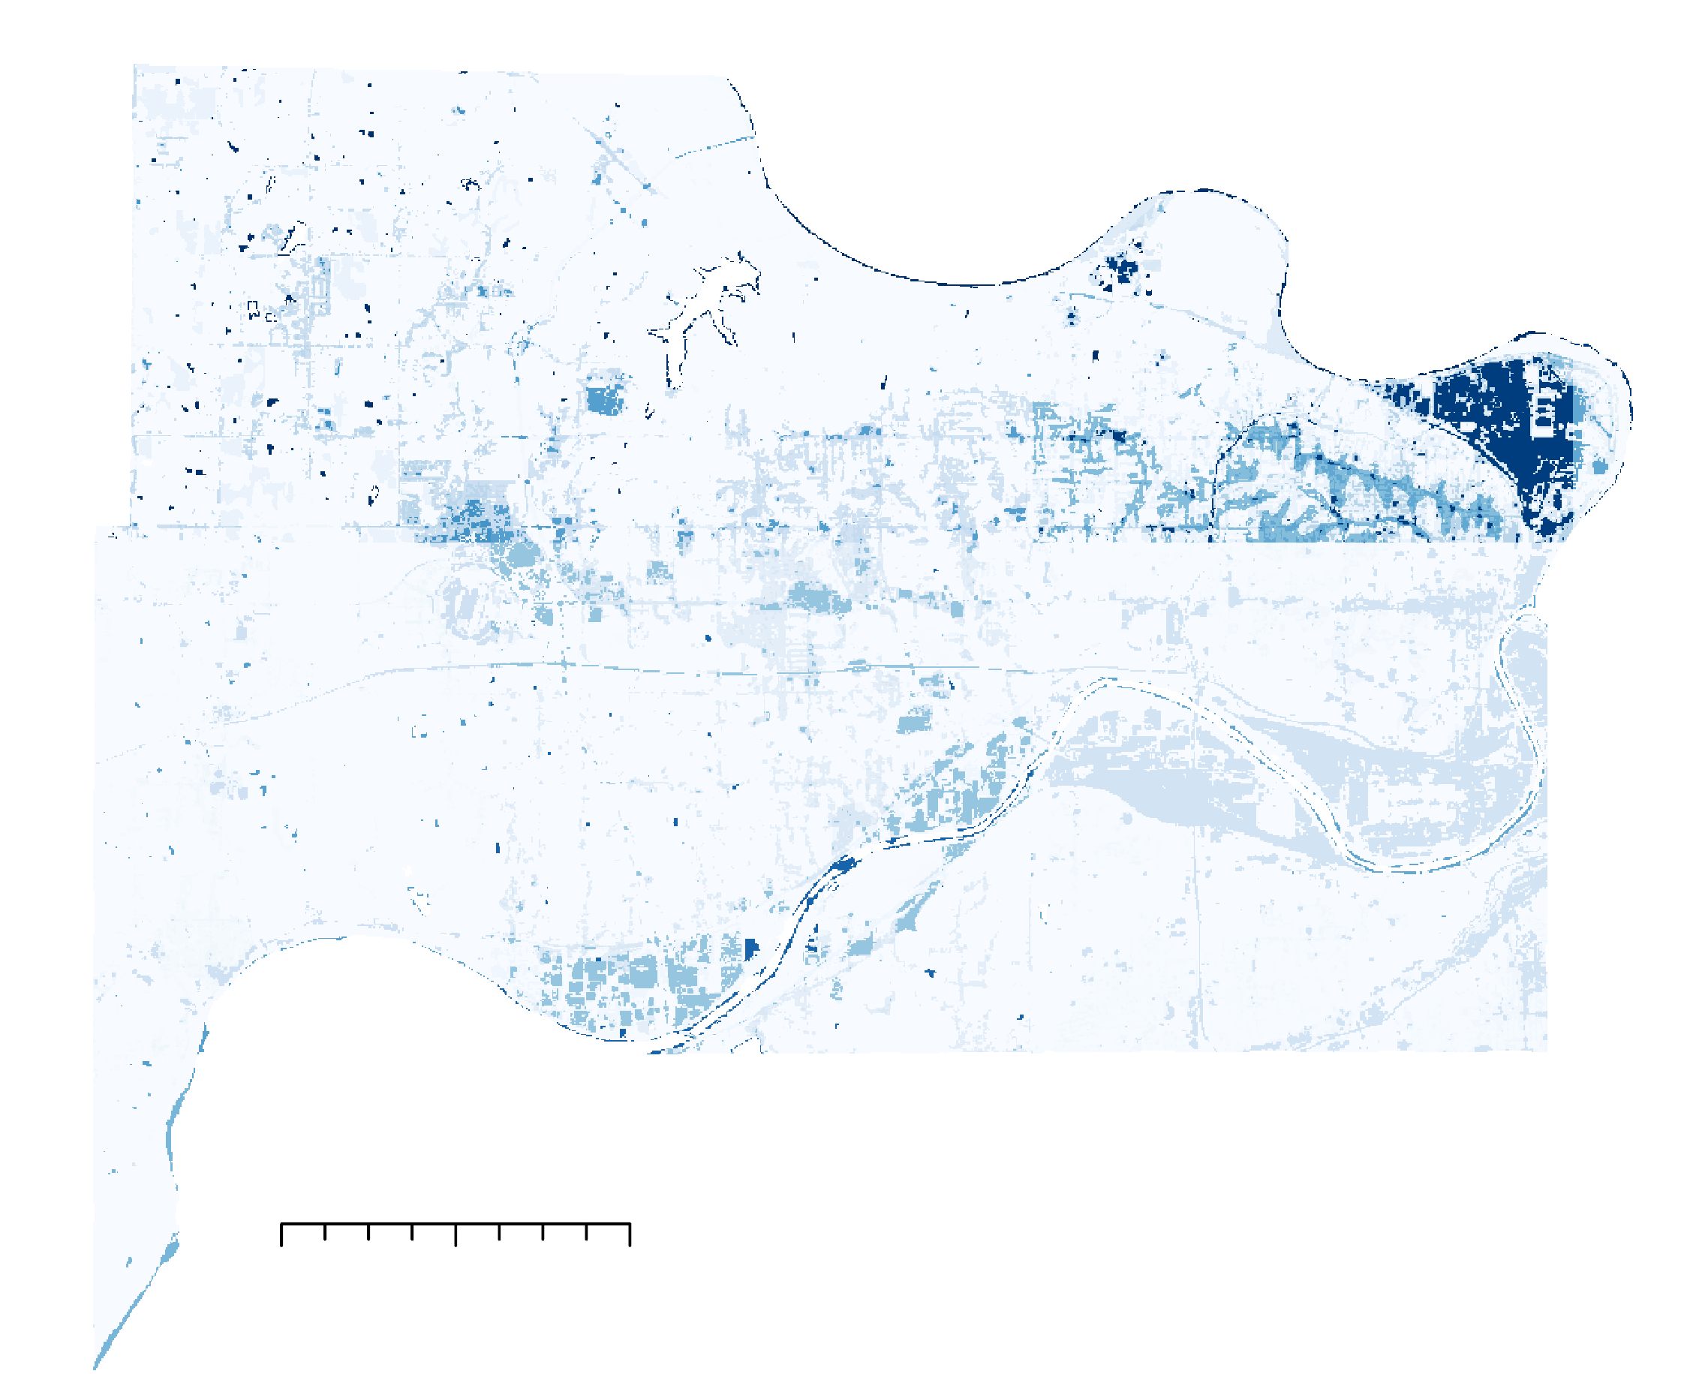
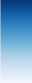
Results- Discharge- August 21, 2017
Original (Maximum Rainfall)
Modified
N
N
Q(m³)
0 2.5 5 miles
13.03
0
0 2.5 5 miles
Notes:
These pictures are the discharge or the flood volume of water in m across the county showing more volume of water towards the right side (eastern) of the county. The left image is the modified or improved model with the right image being the original model using the maximum rainfall across the county as an input. The original model significantly overestimates the flood volume across the entire basin.

Slide 26
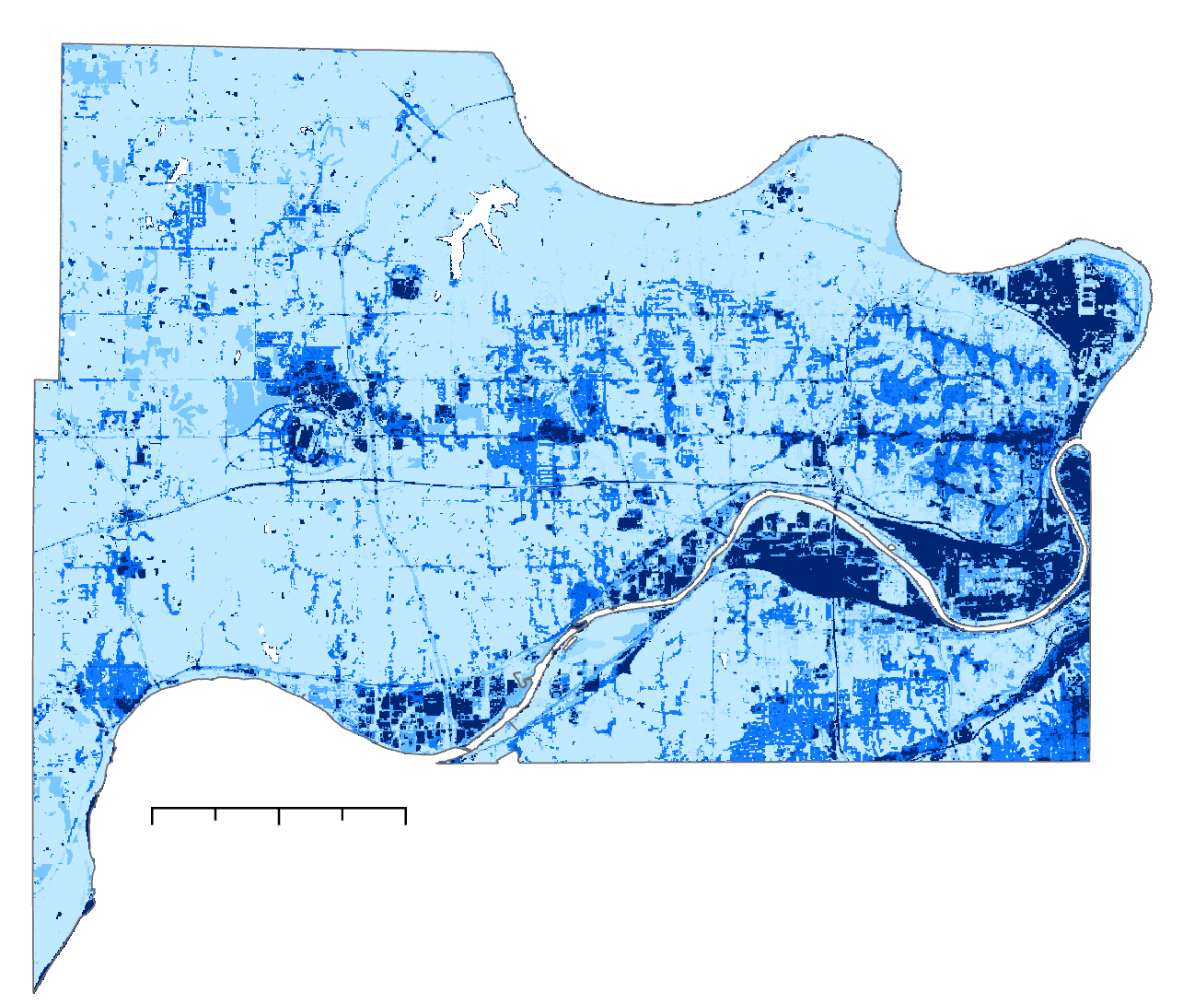
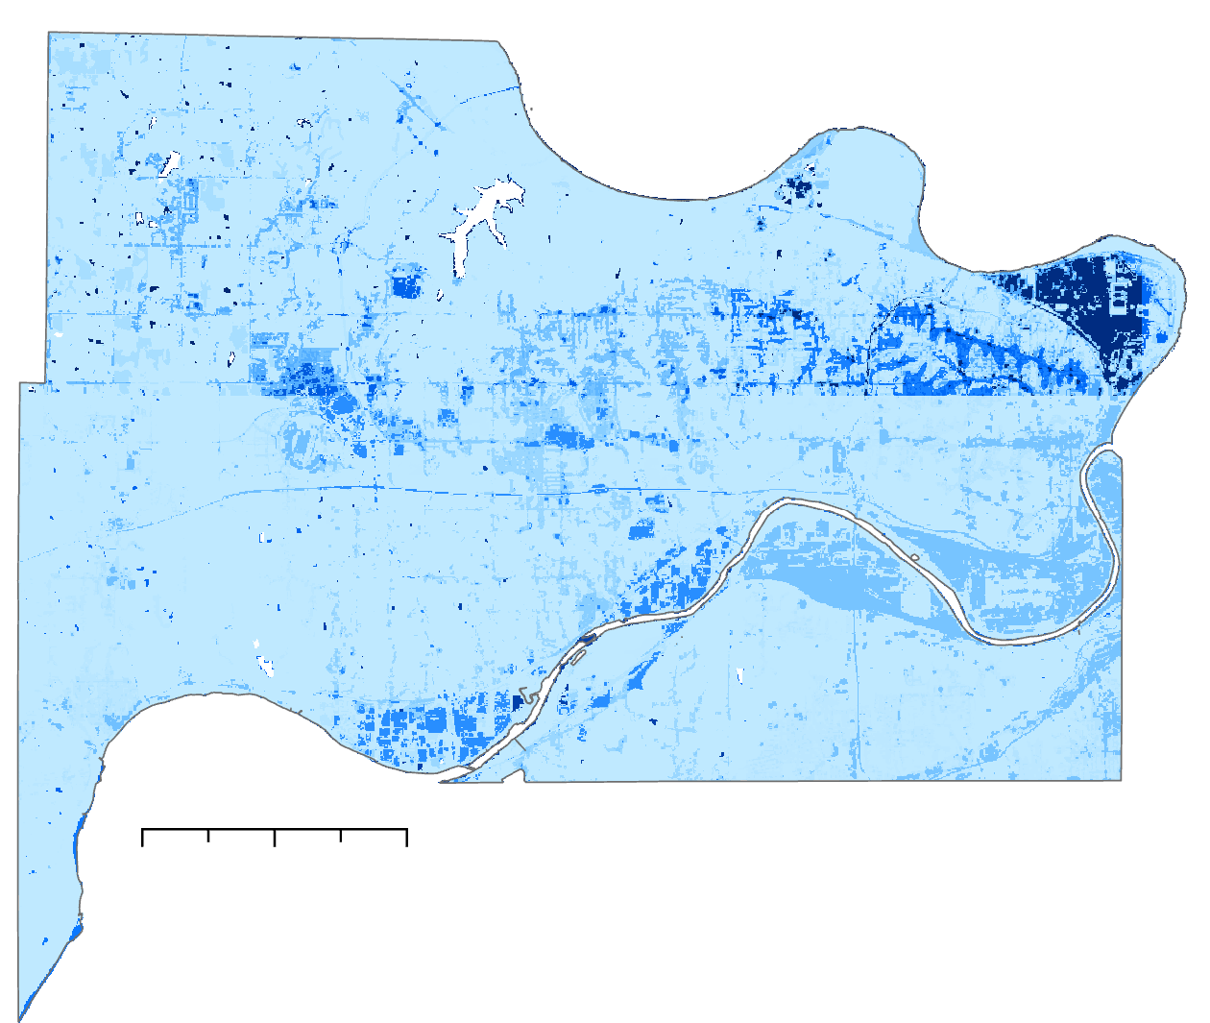
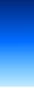
Results- Discharge- August 21, 2017
Original (Maximum Rainfall)
Modified
N
N
0 2.5 5 miles
Q(mm)
0 2.5 5 miles
14.5
0
Notes:
These pictures are the discharge or the flood volume of water in mm across the county showing more volume of water towards the right side (eastern) of the county. The left image is the modified or improved model with the right image being the original model using the maximum rainfall across the county as an input. The original model significantly overestimates the flood volume across the entire basin.

Slide 27
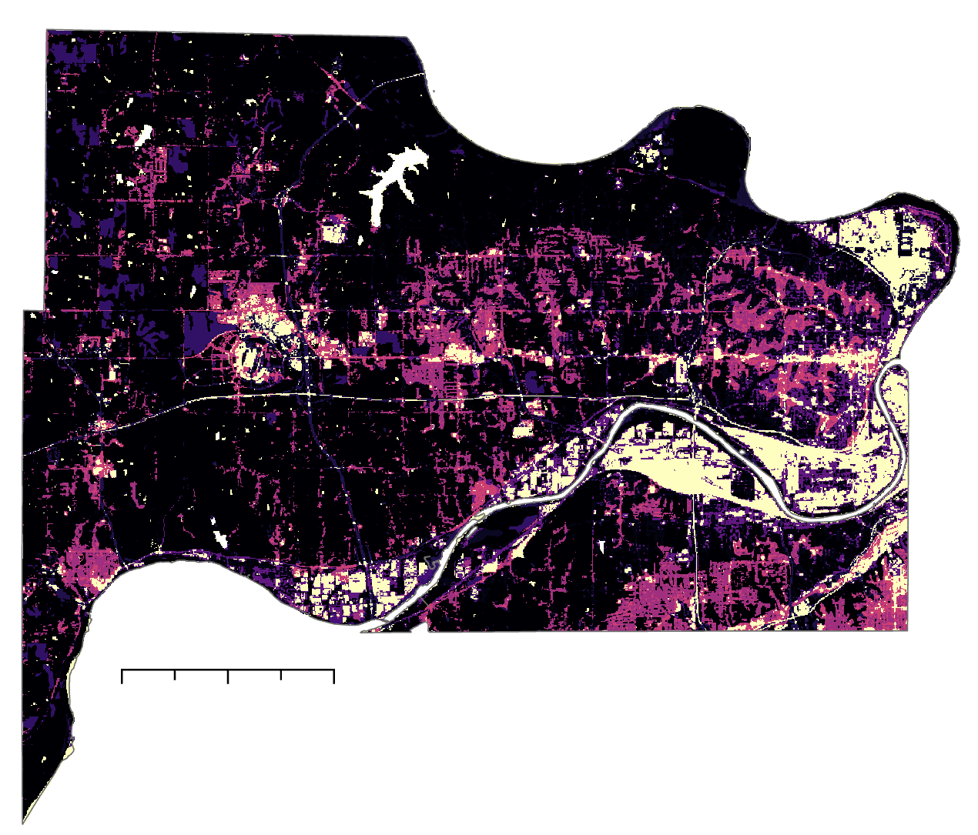
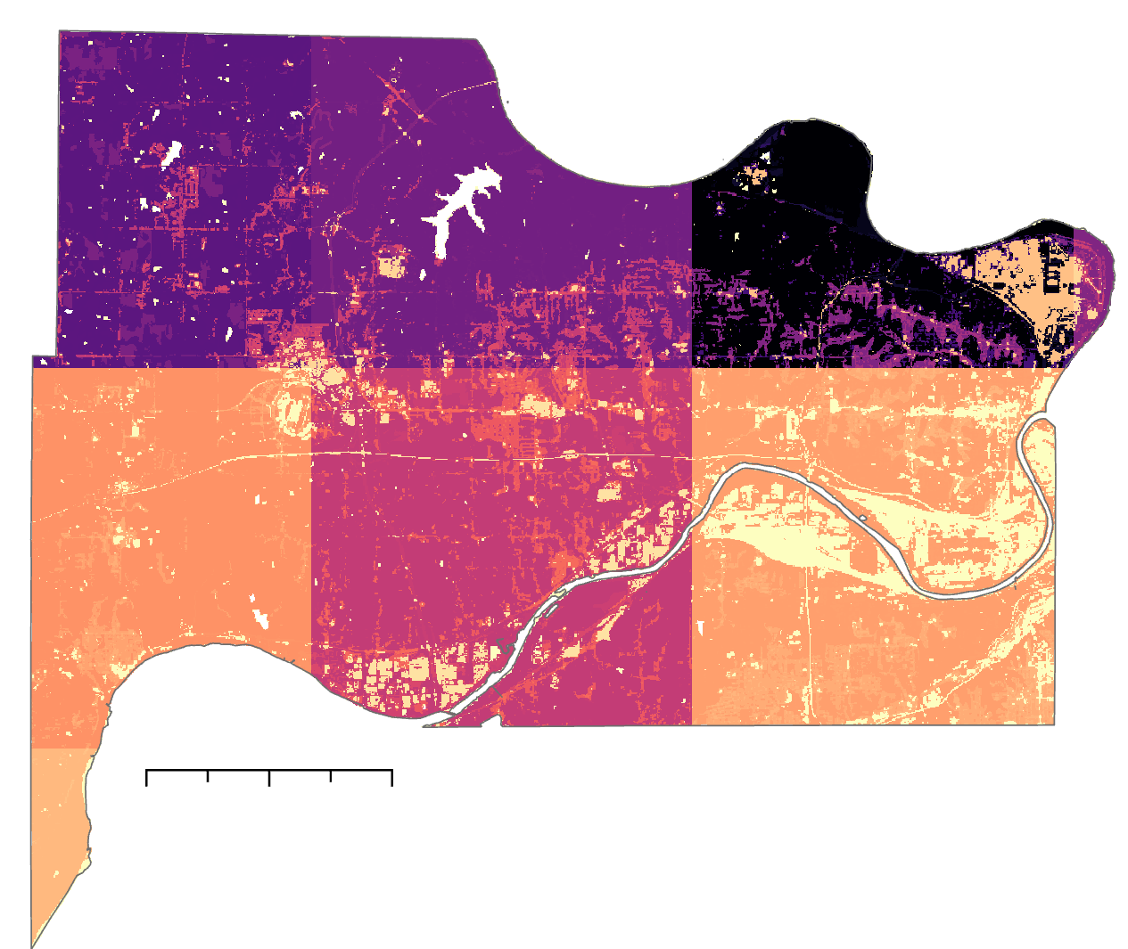

Results- Runoff Retention- August 21, 2017
Original (Maximum Rainfall)
Modified
N
N
Runoff Retention (m³)
0 2.5 5 miles
0 2.5 5 miles
13.03
0
Notes:
These images shows the runoff retention index (or percentage) across the county showing that there is greater runoff retention on the left side of the county than the right country. The left image is the improved model which better estimates the runoff.

Slide 28
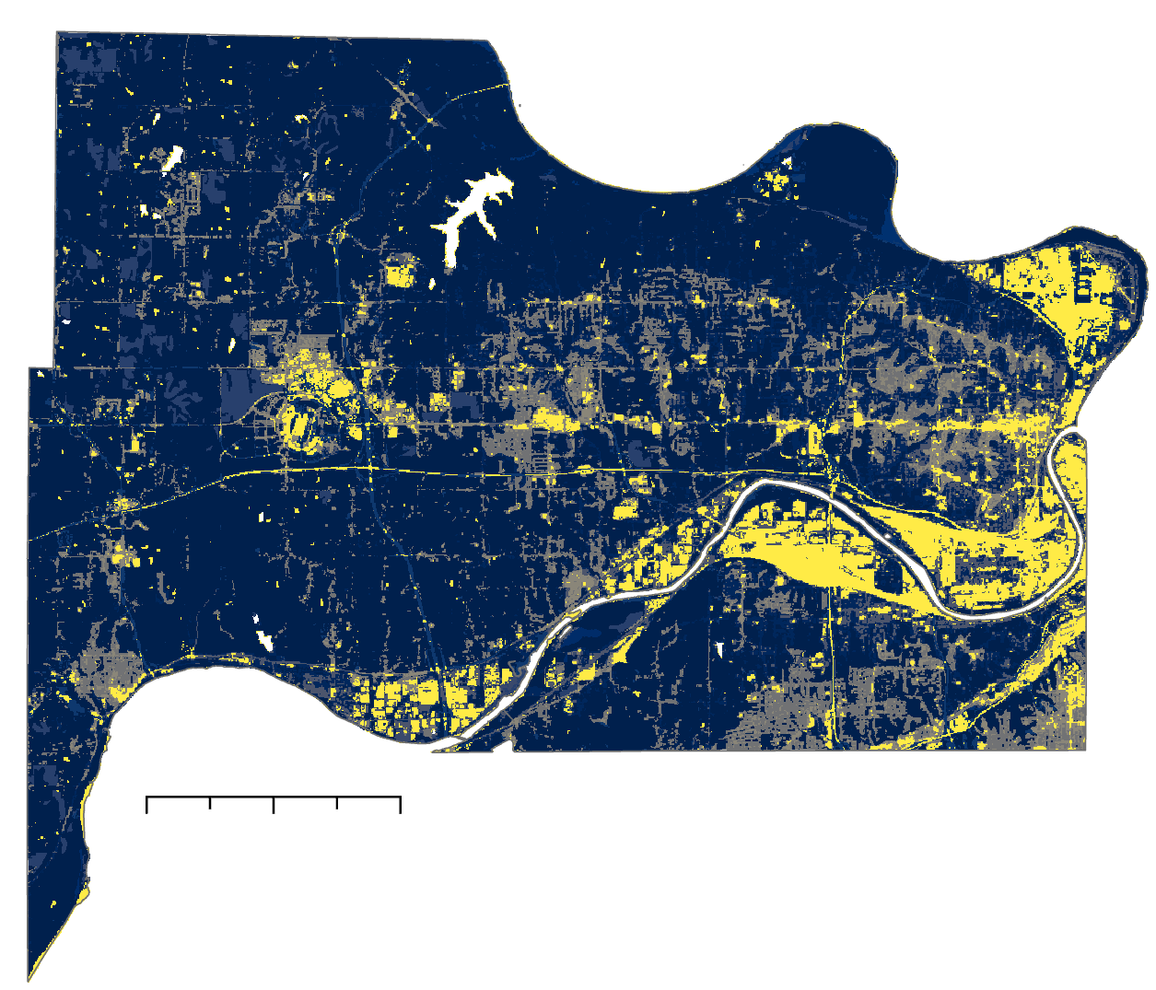
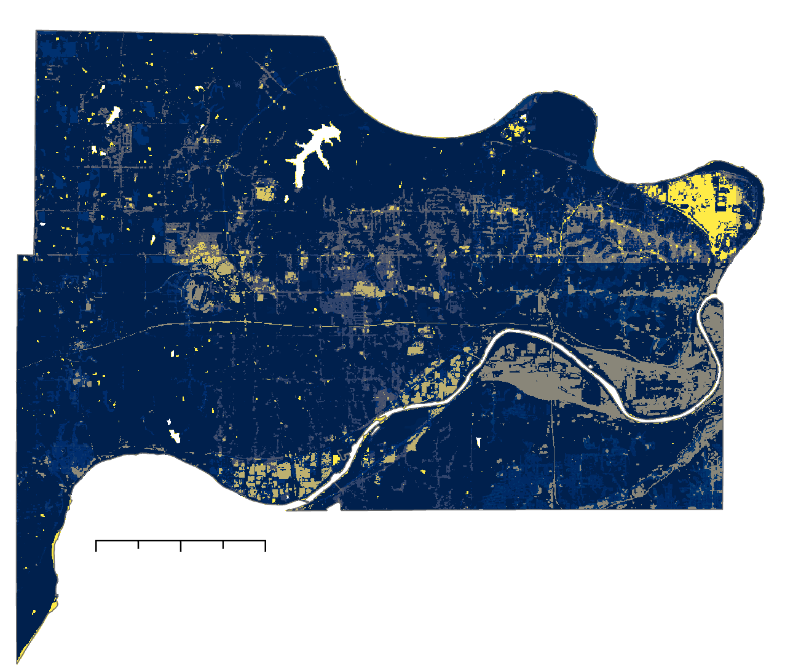
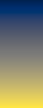
Results- Runoff Retention- August 21, 2017
Original (Maximum Rainfall)
Modified
N
N
0 2.5 5 miles
Runoff Retention
0 2.5 5 miles
1
0
Notes:
These images shows the runoff retention index (or percentage) across the county showing that there is greater runoff retention on the left side of the county than the right country. The left image is the improved model which better estimates the runoff.

Slide 29
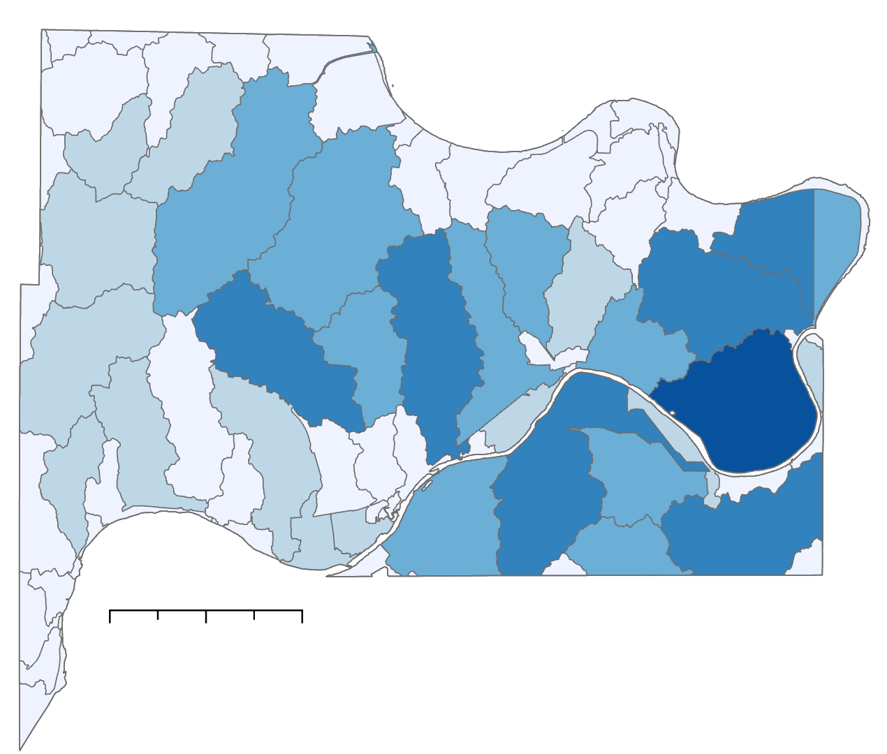
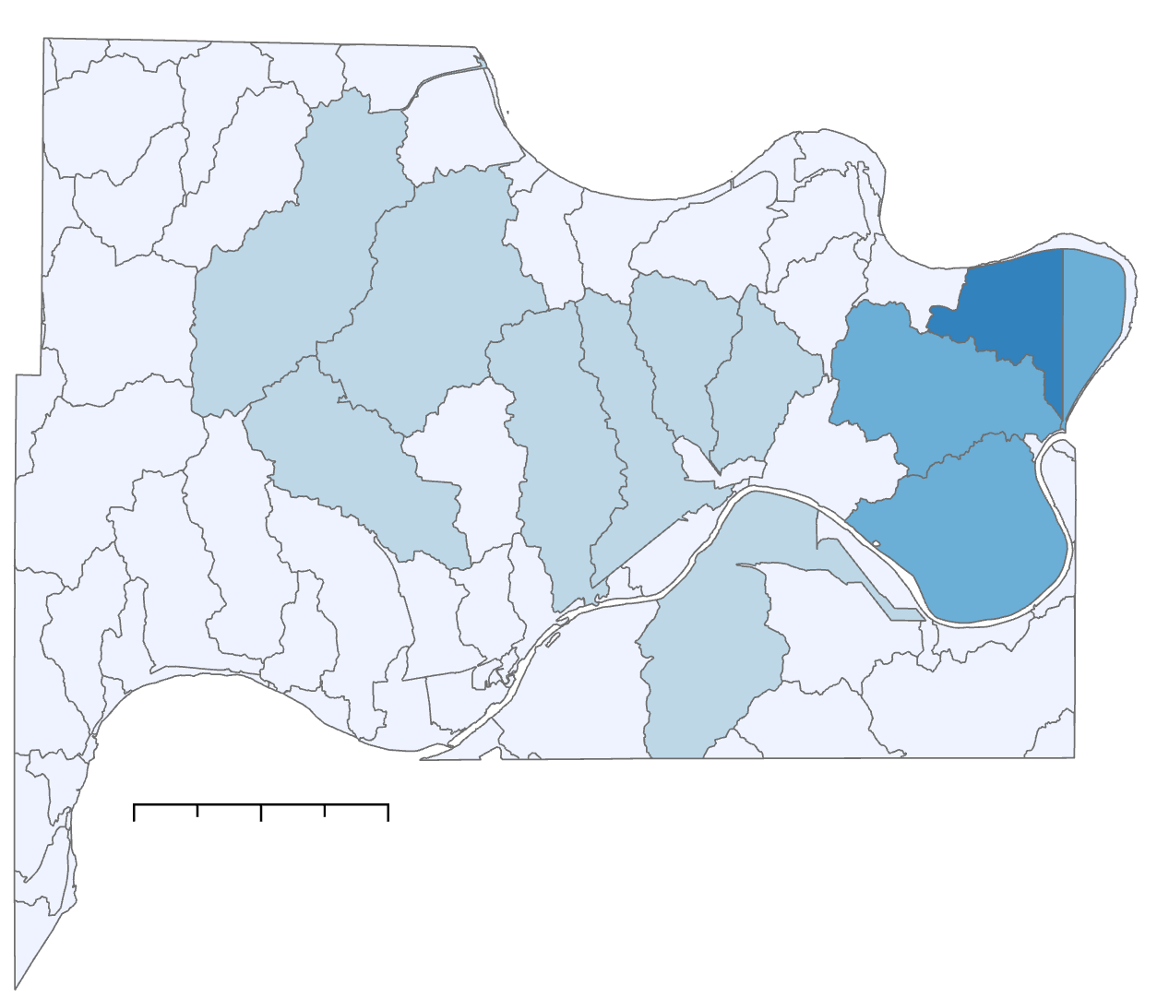
Results- Flood Volume- August 21, 2017
Original (Maximum Rainfall)
Modified
N
N
Flood Volume (m³)
0 2.5 5 miles
0 to 9,000
9,001 to 23,000
23,001 to 45,000
45,001 to 84,000
84,001 to 140,000
0 2.5 5 miles
Notes:
These results show the flood volume per sub watershed across the entire basin with both the improved (modified) model and the maximum rainfall (original) model. As you can see the modified model estimates the volumes significantly lower than the original model.

Slide 30
Model Input- Rainfall- August 22,2017
N
N
Rainfall (mm)
0 2.5 5 miles
110.5-112
112.1-114
114.1-117.5
117.6-121
121.1-125.5
0 2.5 5 miles
Notes:
This is the rainfall for the storm event on August 22nd 2017.
One of the main limitations with InVEST is the inability to input spatially variable precipitation data. Instead of being able to input a raster with various precipitation values, you can only input one value for the entire shapefile. Doesn’t allow use of spatially variable precipitation input which means there is only one value over the entire watershed. The left photo shows what the previous model uses as input- one value with the right picture showing the improved raster input values.
*photos made by DEVELOPers in ArcGIS
As you can see in the photos, there is a large difference in rainfall values over a county and without the spatial variability, a lot of information is missing.

Slide 31
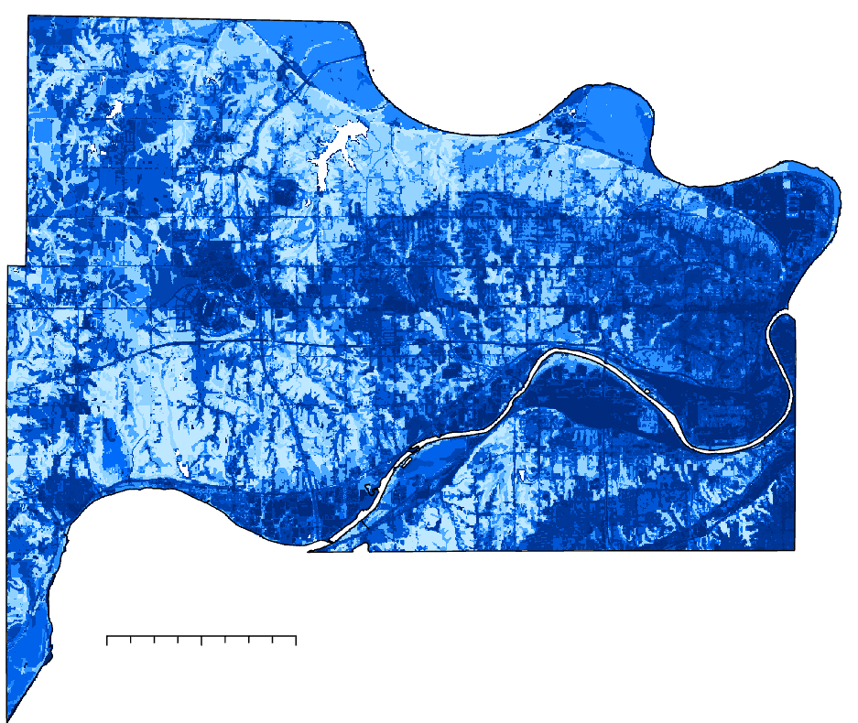
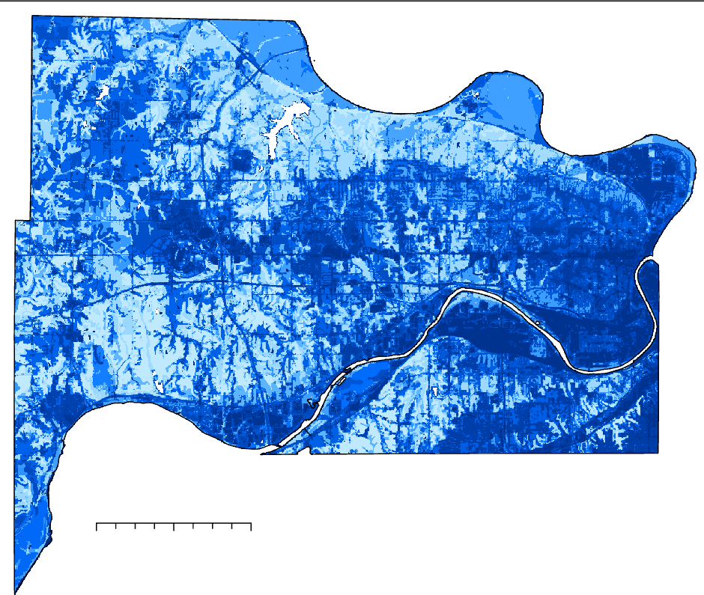
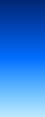
Results- Discharge- August 22, 2017
Original (Maximum Rainfall)
Modified
N
N
Q (mm)
125
0
0 2.5 5 miles
0 2.5 5 miles
Notes:
These images show the discharge in both models. Since the rainfall was so high and the lowest rainfall across the entire basin was 110 mm, the difference between these images in minimal, however present.

Slide 32
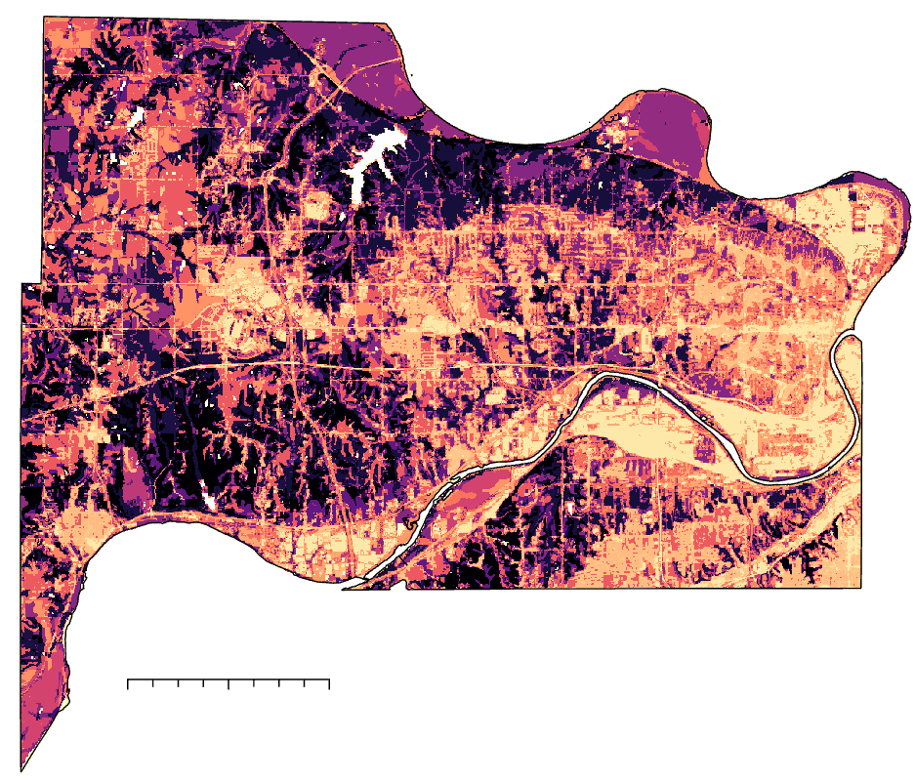
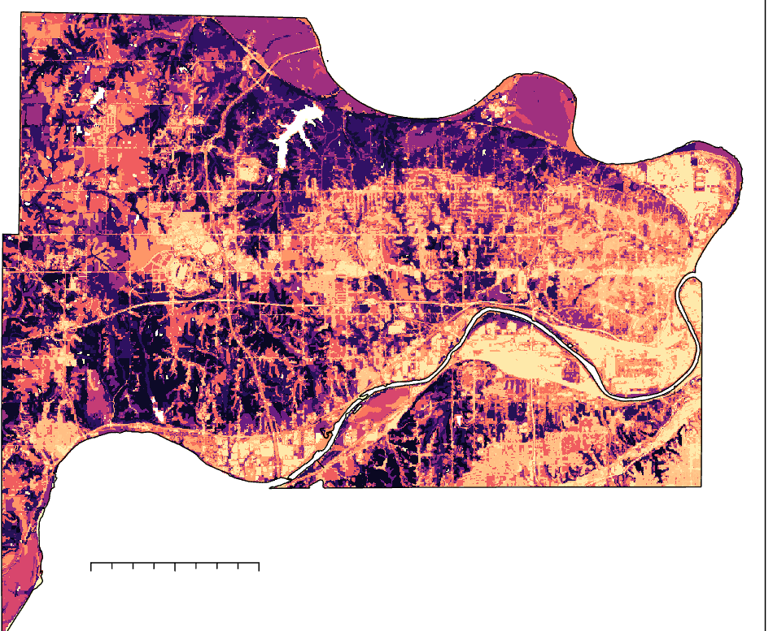
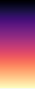
Results- Runoff Retention- August 22, 2017
Original (Maximum Rainfall)
Modified
N
N
Runoff Retention (m³)
0 2.5 5 miles
112
0
0 2.5 5 miles
Notes:
These images show the runoff retention in m3 across the entire county with both the original and modified model. There is more retention on throughout the original model also showing that it overpredicts the runoff.

Slide 33
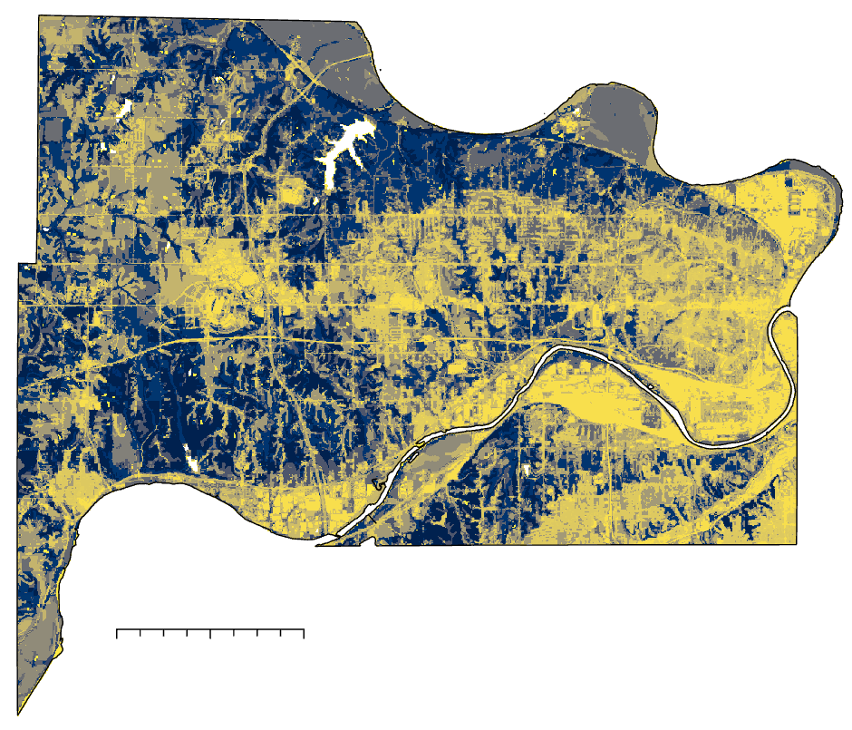
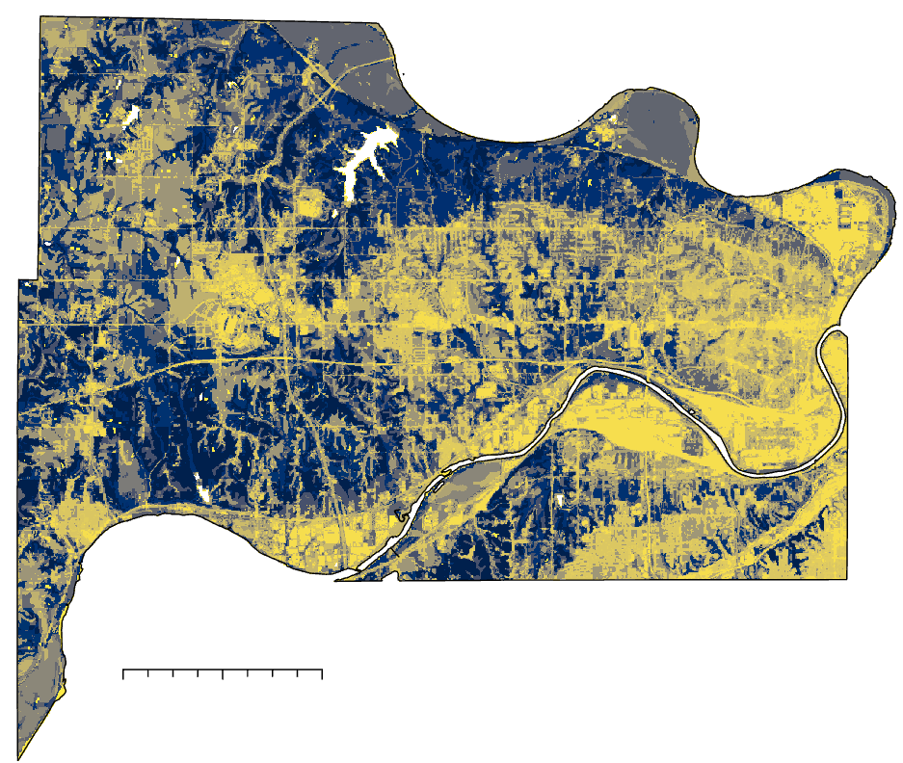
Results- Runoff Retention- August 22, 2017
Original (Maximum Rainfall)
Modified
N
N
Runoff Retention
1
0
0 2.5 5 miles
0 2.5 5 miles
Notes:
These results show the runoff retention index on August 22 2017. The yellow is less retention whereas the blue is the higher retention percentage.

Slide 34
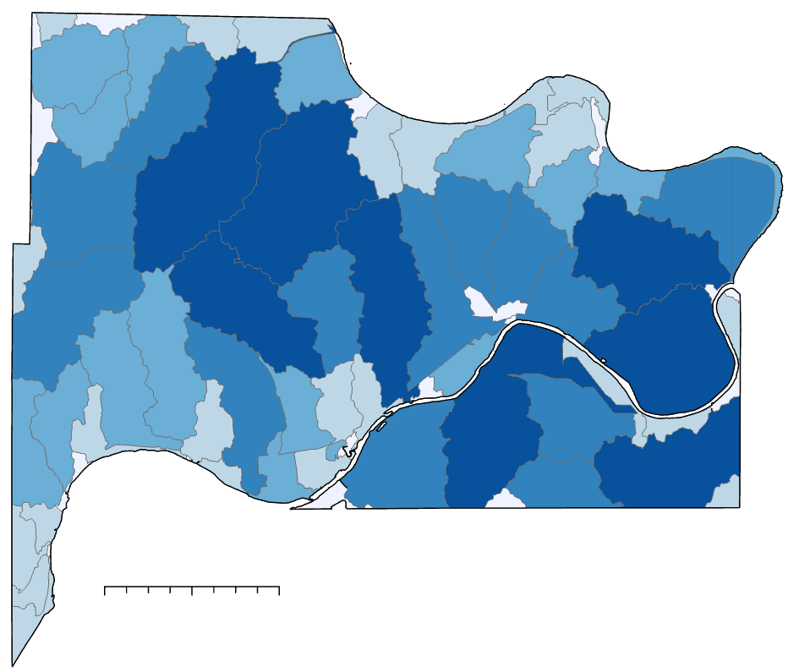
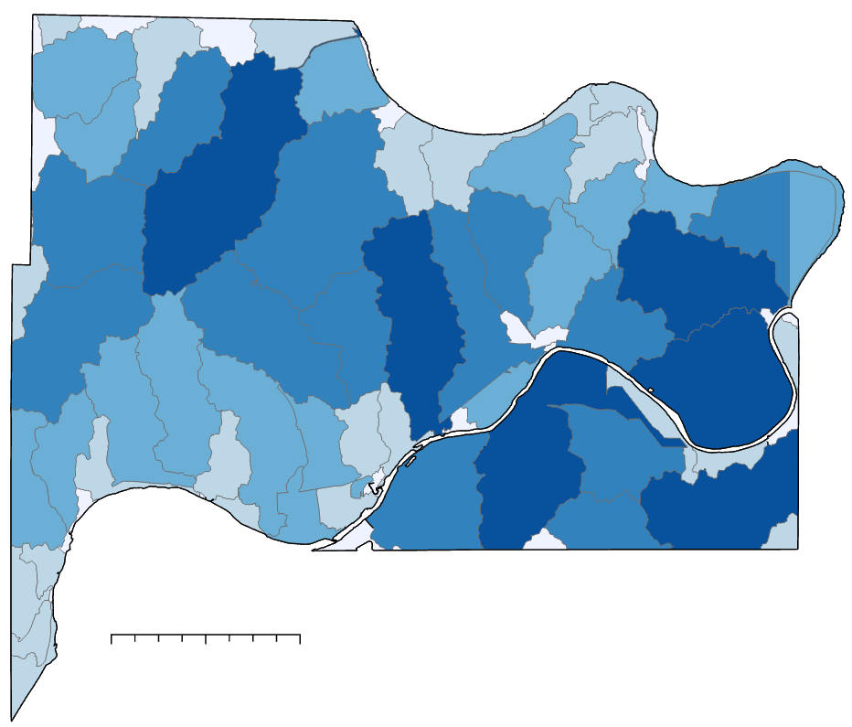
Results- Flood Volume- August 22, 2017
Original (Maximum Rainfall)
Modified
N
N
Flood Volume (m³)
0 to 122,000
122,001 to 340,000
340,001 to 740,000
740,001 to 1,500,000
1,500,001 to 2,700,000
0 2.5 5 miles
0 2.5 5 miles
Notes:
These are the flood volume results showing some difference between the two models.

Slide 35
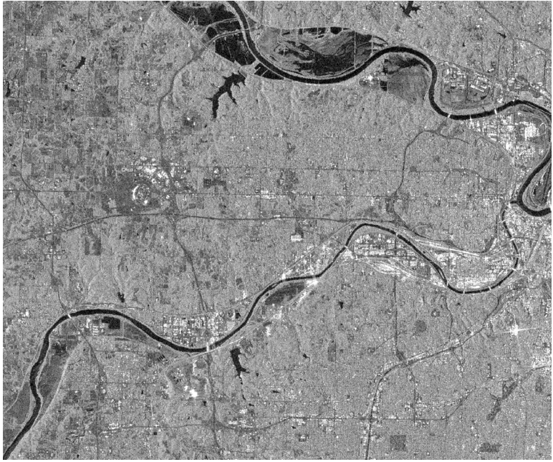
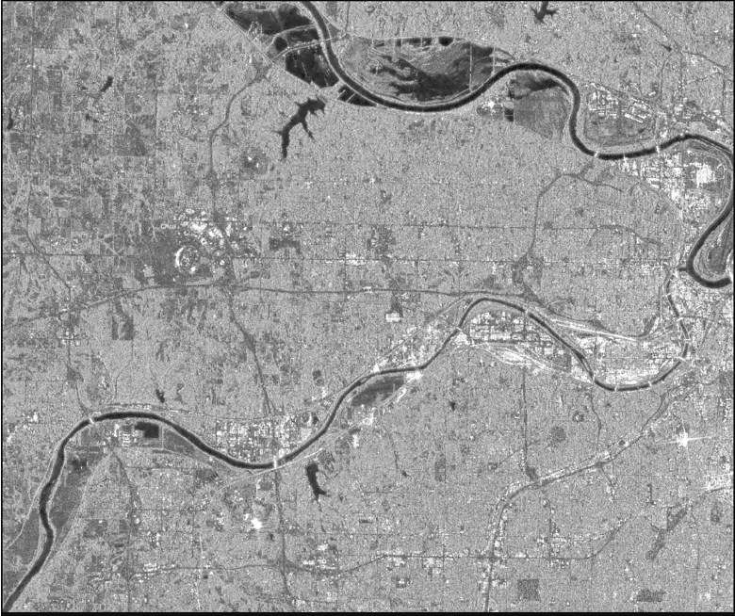
Model Validation– Sentinel-1 pre-processing
Raw Sentinel-1 SAR image over Wyandotte County on June 15th, 2019
Pre-processed SAR image
Speckle Filtering
Slope Correction
Notes:
Since no in-situ inundation extent or flood depth data could be found for the AOI, we have to rely on satellite-based flood map to cross-compare with the results from the InVEST UFRM model. Unfortunately, there is no Sentinel-1 SAR image over the AOI that is coincident with the more significant fluvial flood event such as one on August 22nd 2017. Therefore, we chose one during a low-to-moderate flood event which happens on June 15th 2019. It is worth noting that the flood map derived from Sentinel-1 images contain lots of uncertainty from shadows from buildings and trees, surface roughness effect from rain and wind
we performed two SAR image pre-processing steps before the intensity images could be used for water mapping: Speckle noise filtering and radiometric slope correction. Speckle appears in SAR images as granular noise because of the interference of waves reflected from many out-of-phase elementary scatterers within the same resolution cell. In addition, due to the side-looking angle of the SAR instrument, geometric distortions such as layover, shadow, and foreshortening often occur in SAR imagery. Therefore, a radiometric slope correction using a DEM is also often employed for SAR image pre-processing.
photos made by DEVELOPers in Google Earth Engine

Slide 36
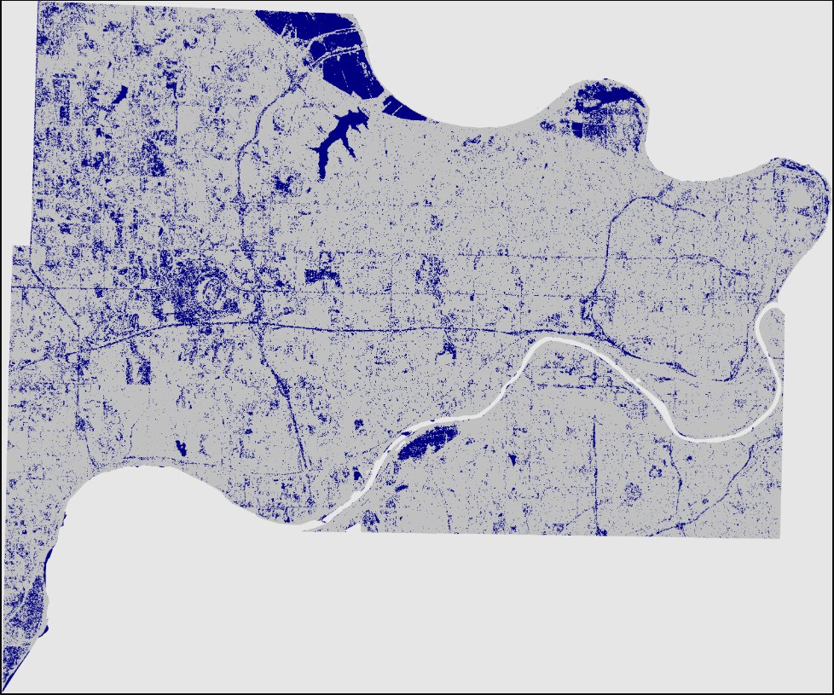
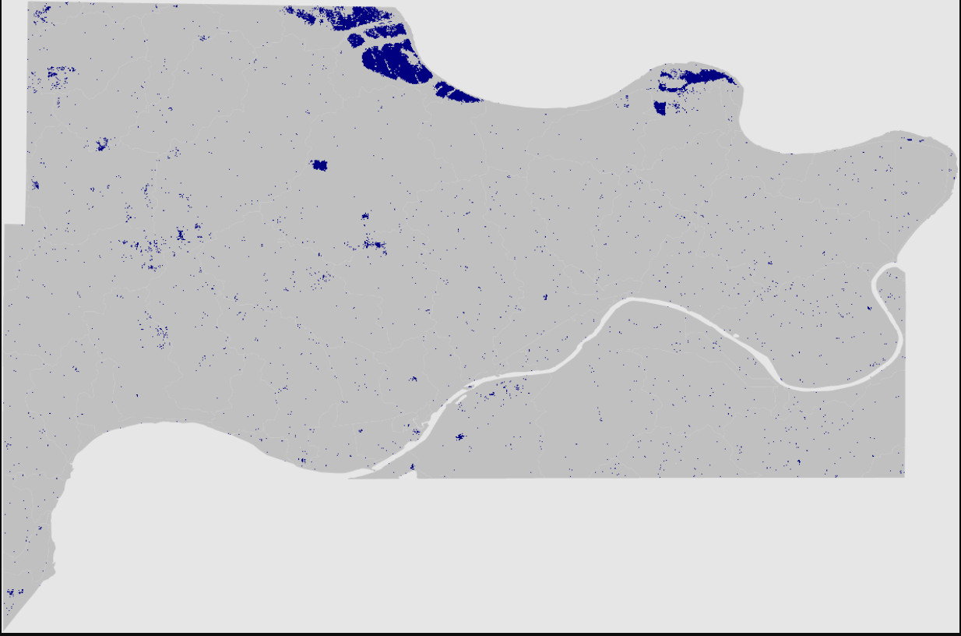
Model Validation– Sentinel-1 flood map
Water extent map from Edge Otsu thresholding
Roads and flat terrain pixels misclassified as flood
Water extent map from Z-score change detection method (DeVries et al., 2020)
Notes:
Initially, we chose Edge Otsu thresholding define and buffer the edges (assuming to be water) before sampling the histogram for traditional Otsu thresholding to classify water and non-water. However, A lot of highway and flat land pixels are misclassified as water since they also have similar backscatter intensity as water. Therefore, we used a different change detection method for water mapping. We chose a method called z-score mapping, which calculate how much SAR intensity in the flood image deviate from average SAR intensity during the dry season. The water extent map from Z-score change detection is more realistic and therefore will be used for cross-comparison with InVEST UFRM
Z-score image calculation:
$${\text{Z}}_{{\text{σ}}_{\text{0}}}\text{=}\frac{{\text{σ}}_{\text{0}}\text{− }\overline{{\text{σ}}_{\text{0}}^{\text{Dry}}} }{\text{std}\text{(}{\text{σ}}_{\text{0}}^{\text{Dry}}\text{)}}$$
${\text{σ}}_{\text{0}}\text{:}$ target SAR intensity image,
$\overline{{\text{σ}}_{\text{0}}^{\text{Dry}}}$ & $\text{std}\left({\text{σ}}_{\text{0}}^{\text{Dry}}\right)$: mean and standard deviation of dry-time SAR intensity images
photos made by DEVELOPers in Google Earth Engine

Slide 37
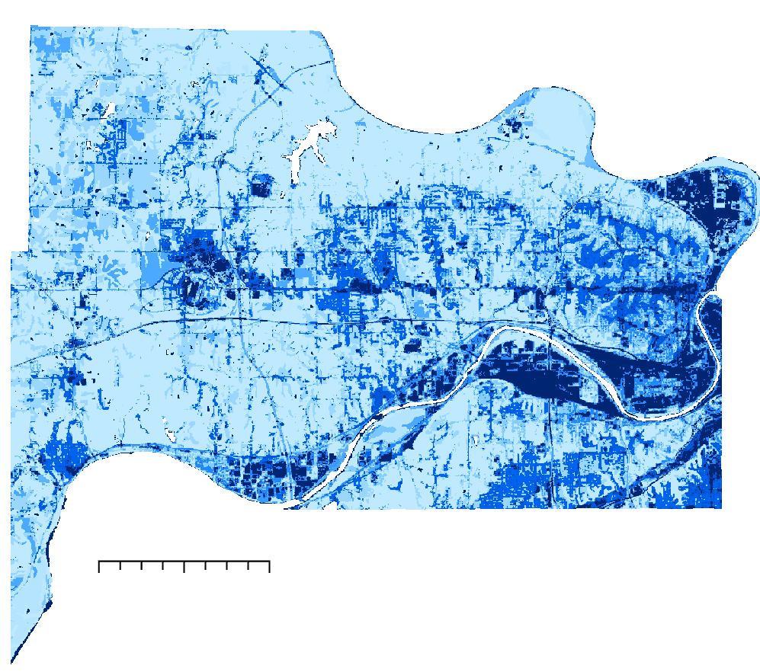
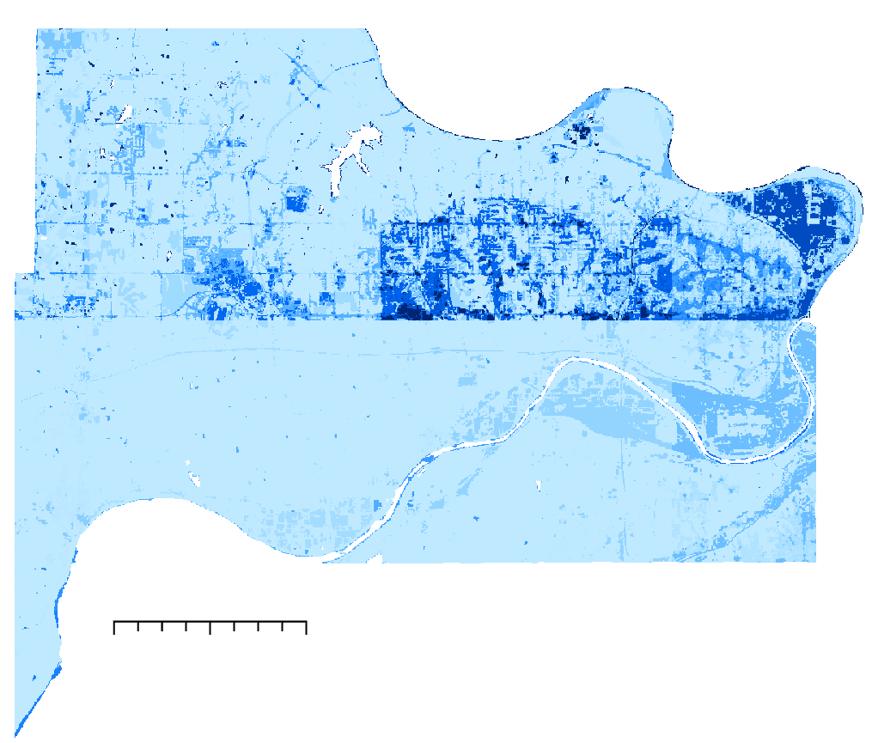
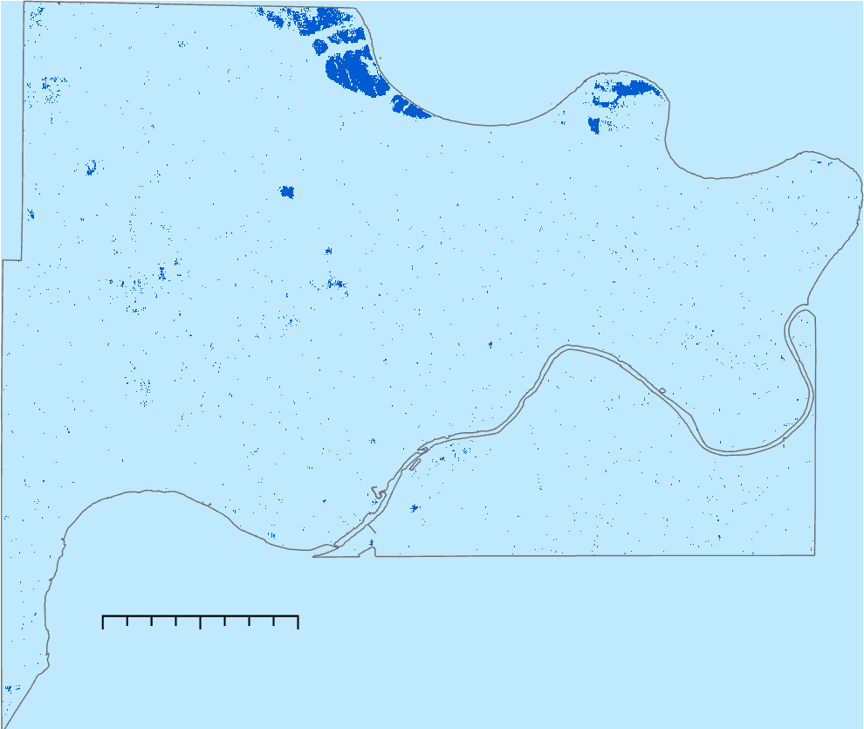

Model Validation– Discharge – June 15th, 2019
Original (Maximum Rainfall)
Modified
Sentinel-1
N
N
N
0 2.5 5 miles
0 2.5 5 miles
0 2.5 5 miles
Q(mm)
Flood Detection
19.7
0
Non-flooded
Flooded
Notes:
These pictures are the discharge or the flood volume of water in mm across the county showing more volume of water towards the right side (eastern) of the county. The left image is the modified or improved model with the right image being the original model using the maximum rainfall across the county as an input. The original model significantly overestimates the flood volume across the entire basin.
Most of the flood pixel in from Sentinel-1 are the area next to Missouri River, which could be the result of pluvial flooding from river discharge overflowing. Since the model focuses more on fluvial flooding for high rainfall, neither model could predict the flooding presented in satellite-derived flood map. However, the satellite-derived flood map confirms the overestimation of flooding in the original model and proves that the modified model is more realistic
photos made by DEVELOPers in ArcGIS pro

Slide 38

Conclusions
GPM raster rainfall input improves the prediction of flood volume and runoff values
More accurate prediction allows for improved resiliency
Widespread use of a simple urban flood model
Image Credit: Nastya Dulhiier
Notes:
In conclusion, we improved the InVEST UFRM by adding the ability to input GPM or other raster precipitation data, thus improving the accuracy of the model. This model can have widespread use and various applications, even to those who don't have extensive background in remote sensing.
Image: From Unsplash stock photos, Nastya Dulhiier
Url: https://unsplash.com/photos/FBZgAUe2278 Free to use under the Unsplash License https://unsplash.com/license

Slide 39
Errors and Limitations
Challenging to implement as only minimum variables are looked at
InVEST doesn’t account for hydraulic flow, elevation, sewer infrastructure, fluvial flooding, or social vulnerability
GPM's large spatial resolution introduces uncertainty
Changes in curve number and impervious surfaces (values used could be incorrect)
Notes:
Some of the errors and limitations of this project were that the model is challenging to implement as only minimum number of variables are looked at. Additionally, the model doesn't account for hydraulic flow, elevation, sewer infrastructure, fluvial flooding, or social vulnerability. The spatial resolution introduces uncertainty with GPM. Lastly, the changes in curve number and impervious surface could be incorrect.

Slide 40
Future Work
Downscaling GPM and using higher resolution precipitation input
Incorporating infiltration calculations
More in-depth validation
Application in other locations
Notes:
Moving forward, some improvements that can be made on this model are to downscale GPM in order to increase the spatial variability of the input precipitation raster. Currently, GPM raster spatial resolution (10 km) is still quite large compared to other raster resolution (30 m). Many academic studies were conducted in downscaling GPM precipitation using DEM and NDVI with random forest regression. Downscaling precipitation will further improve the model since it is very sensitive to change in precipitation input. Also, curve number derivation method used in the model is good for impervious surface but might not be accurate for area with high infiltration/low imperviousness. Incorporating infiltration calculation to the model for region with low imperviousness will further improve the model.
With any project, further validation improves the accuracy and dependability of models. Since we couldn’t find a good in-situ dataset for the AOI, we have to rely on satellite-based flood mapping which contains many uncertainties. More in-depth validation with overserved data is necessary to confirm the accuracy of the model. Lastly, application in other locations, such as Richmond Virginia and Sacramento California will allow more individuals to work with this model, improve it, and utilize the results.

Slide 41
Advisors:
Dr. Venkataraman Lakshmi, University of Virginia
Dr. Kenton Ross, NASA Langley Research Center
DEVELOP Fellows:
Caroline Williams – Node Fellow
Laramie Plott – PC Fellow
Cecil Byles – PC Fellow
We would like to thank the MA Disasters team from who we gathered data and information regarding the original InVEST model.
This material contains modified Copernicus Sentinel data (2019), processed by ESA.
Notes:
We would like to acknowledge Dr. Venkat Lakshmi and Dr. Kent Ross for their assistance and guidance throughout this project. We would also like to thank our PC fellows for their assistance throughout the project, especially with our deliverables. We would also like to thanks the MA disasters team for their project which guided us through our project and for letting us use their data and preliminary results for continued improvement. Finally, we'd like to acknowledge and thank our Node Fellow, Caroline Williams for all her help throughout this program.

Slide 42
Datasets Used
Dataset | Purpose | Date | Source | Resolution
GPM IMERG Final Precipitation L3 1 day 0.1 degree x 0.1 degree V06 | Precipitation | 2017, 2019 | NASA GES DISC | 0.1x0.1 degrees
USGS 2019 USA National Land Cover Dataset | Land Cover | 2019 | USGS | 30m x30m
USDA Gridded Soil Survey Geographic Soil Type and drainage class dataset | Soil Groups | 2019 | USDA | 10m x 10m
Estimation of Direct Runoff from Storm Rainfall | Curve Number | 2004 | USDA | n/a
USGS National Elevation Dataset 3D Elevation Program, 1/3rd arc-second digital elevation model | DEM for watershed delineation | 2020 | USGS | 10m x 10m
Sentinel-1 SAR GRD: C-band Synthetic Aperture Radar Ground Range Detected | SAR images for validation | 2017, 2019 | ESA/Google Earth Engine | 10m x 10m
Notes:
This table shows the datasets, purpose, data, source, and resolution for all data used in this project. The raster's, GPM, Soil type, and land cover were used as inputs into the model whereas the curve number was inputted into the biophysical table to relate the soil group and land cover to the runoff retention rate. The DEMs were used for watershed delineation.

Slide 43
Results- Model Outputs
Runoff per pixel
(Q in mm)
S_{max,i} = (25400/CN_{i}) - 254
Q_{p,i}= {(P-YS_{max,i})2/
(P+[1-Y]S_{max,i})}
Raster with values per pixel across entire AOI
Runoff Retention per pixel
R_{i} = 1 – (Q_{p,i}/P)
Raster with runoff values per pixel across entire AOI
Runoff Retention per pixel (m³)
R_m3_{i} = Ri * P * pixel area * 10 ⁻³
Raster with runoff values in m³ per pixel across entire AOI
Flood Risk Service
Includes the average runoff retention, sum of retention volumes, and flood volume per sub watershed
Shapefile
Notes:
These showcase the outputs that the model produces. There are four separate pieces of information that we can look at. First, the model estimates runoff in mm calculated by the curve number method which is used with the biophysical table. Additionally, the runoff retention per pixel and in m3 across the watershed. All three of these outputs come in raster file and can be visualized in ArcGIS. The final output is the flood risk service shapefile. This includes the average runoff retention, sum of retention volumes and flood volume per sub watershed.
Parameter log: Each time the model is run, a text (.txt) file will be created in the Workspace. The file will list the parameter values and output messages for that run and will be named according to the service, the date and time. When contacting NatCap about errors in a model run, please include the parameter log.
Runoff_retention.tif: raster with runoff retention values (no unit, relative to precipitation volume). Calculated from equation (117).
Runoff_retention_m3.tif: raster with runoff retention values (in �3). Calculated from equation (118).
Q_mm.tif: raster with runoff values (mm). Calculated from equation (115).
flood_risk_service.shp: Shapefile with results in the attribute table:
rnf_rt_idx: average of runoff retention values (��) per watershed
rnf_rt_m3: sum of runoff retention volumes (�_�3�), in �3, per watershed.
flood_vol: The flood volume (Q_m3, equation (119)) per watershed.
The equations are from the model website: https://invest-userguide.readthedocs.io/en/latest/urban_flood_mitigation.html

