Slide 1
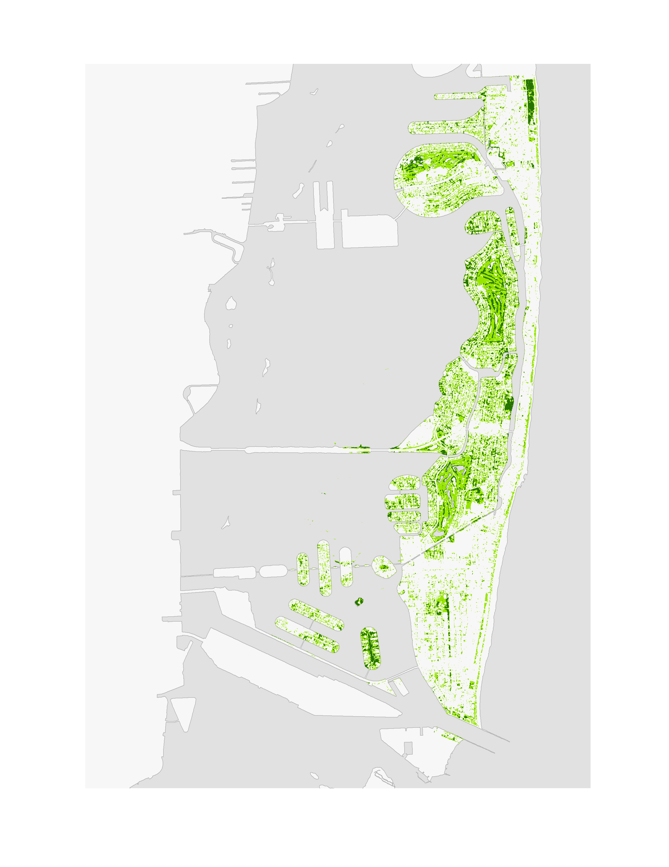
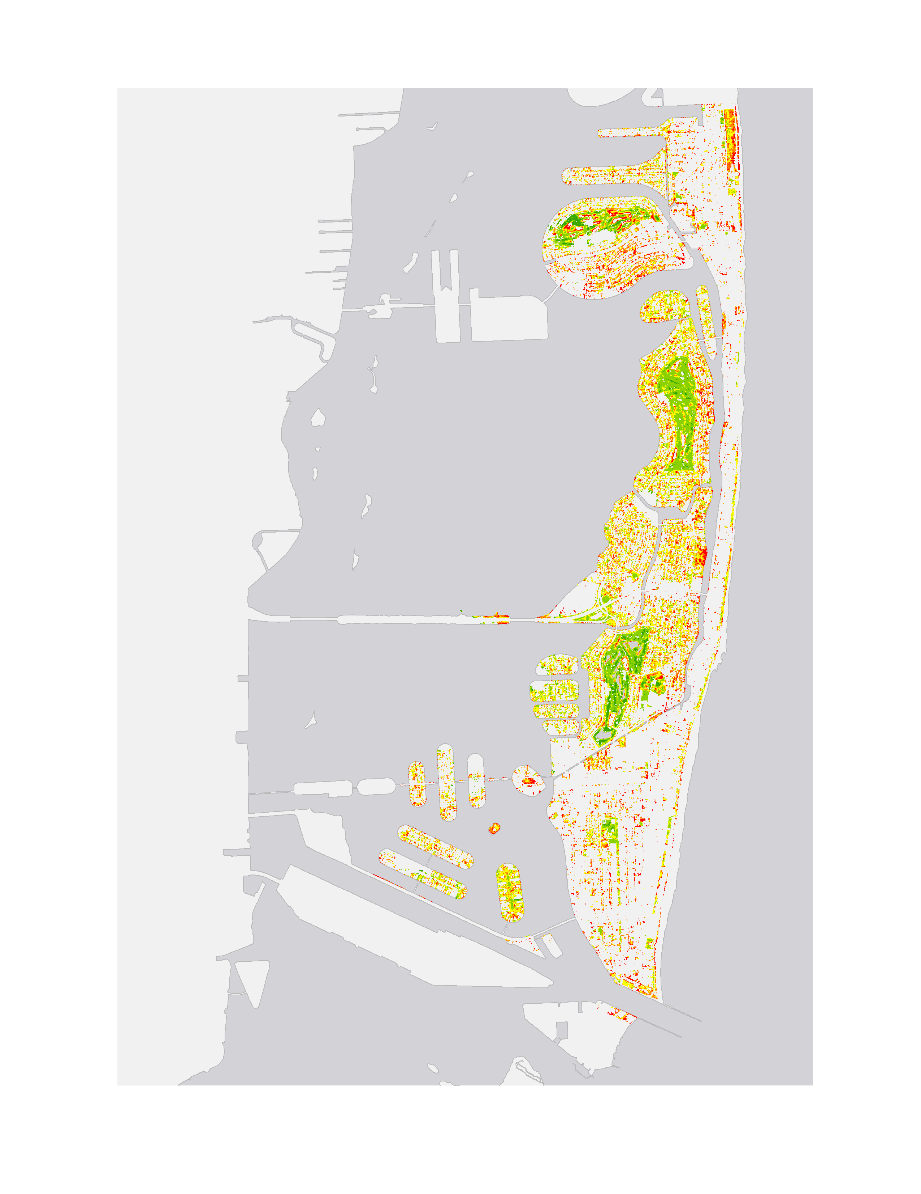


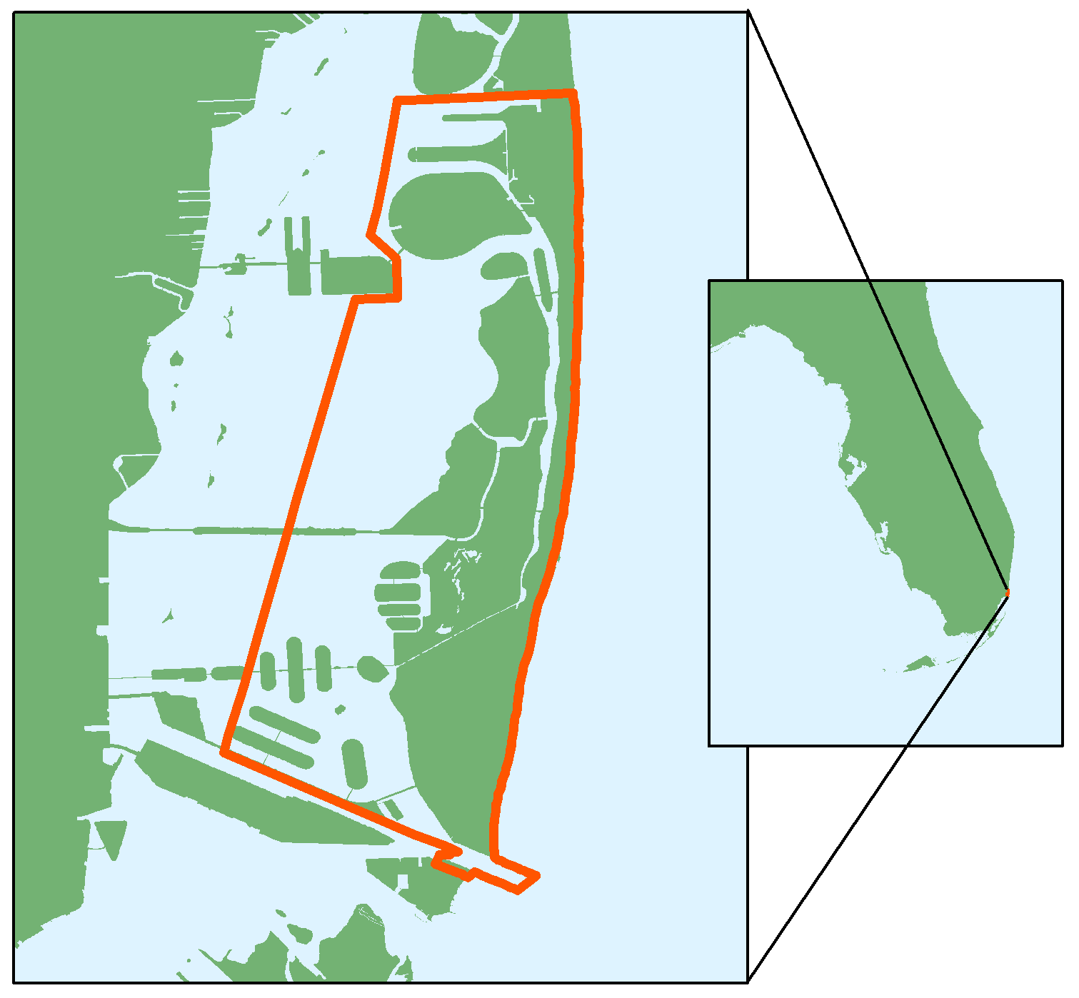


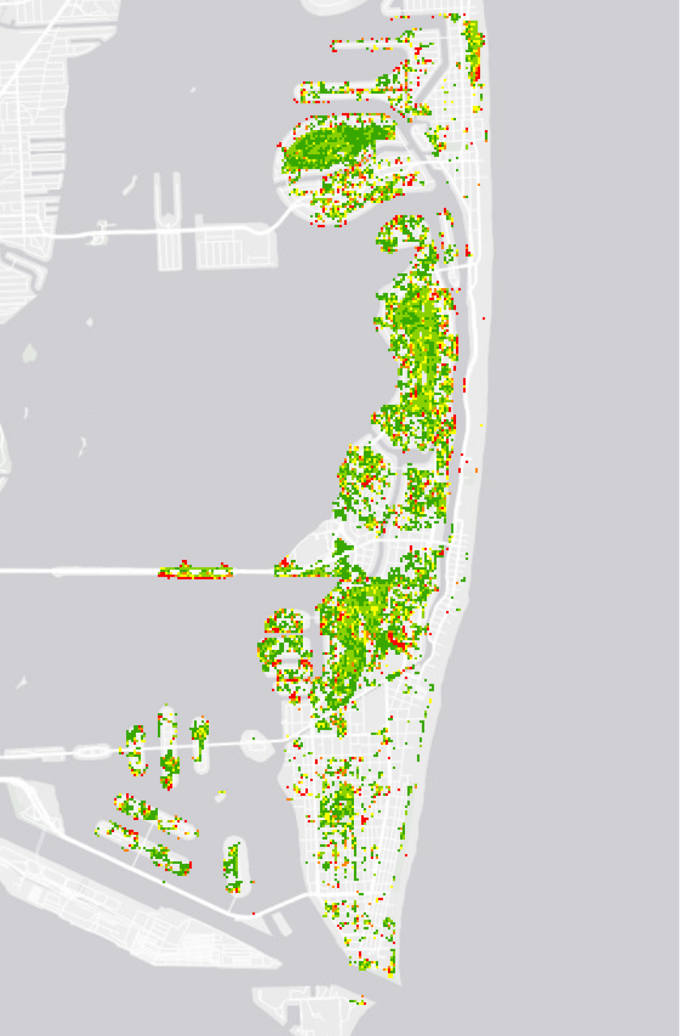
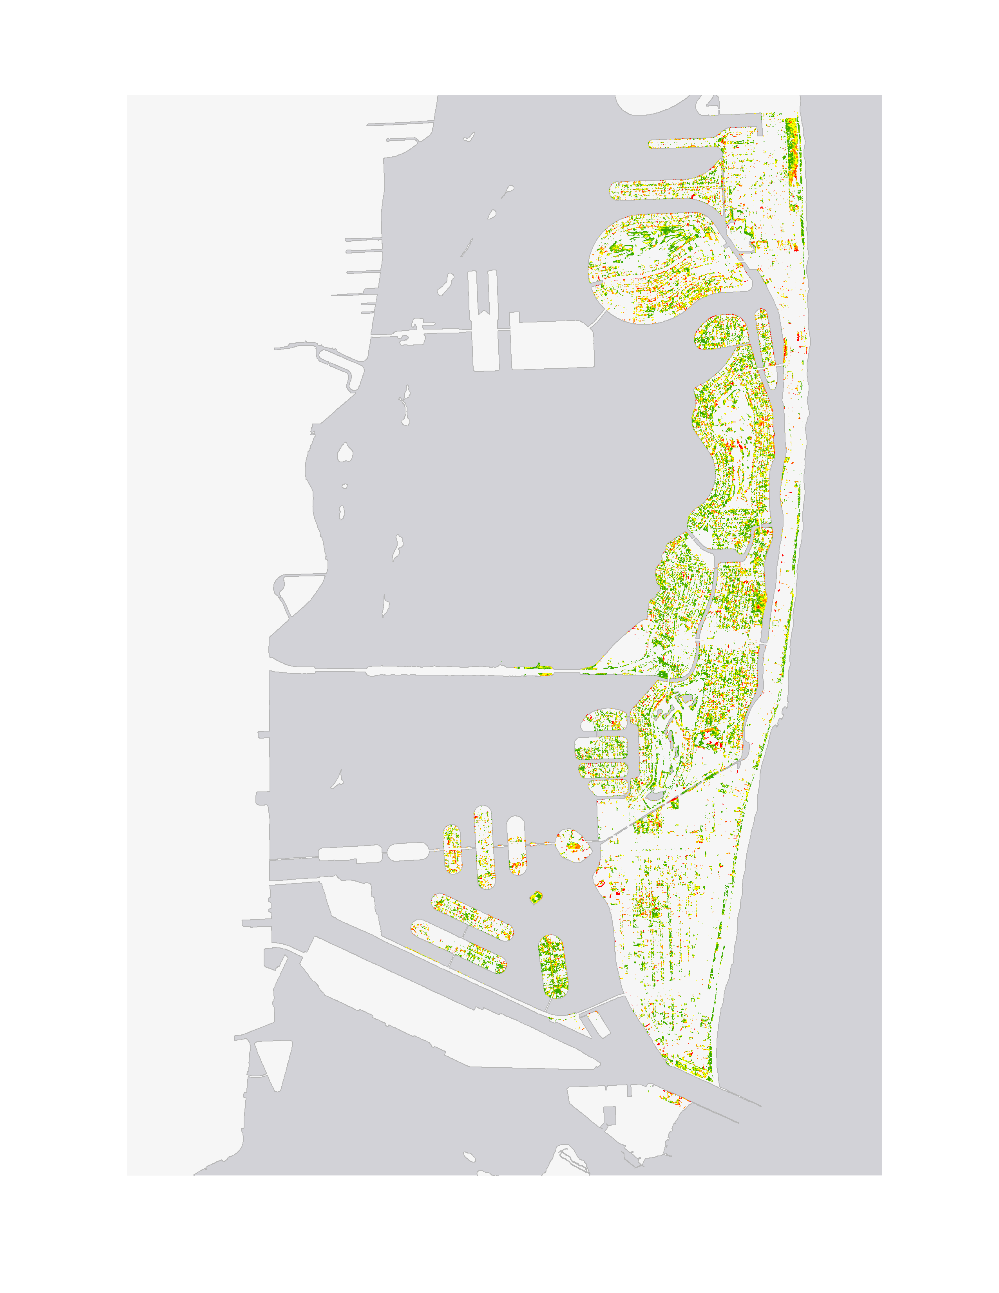




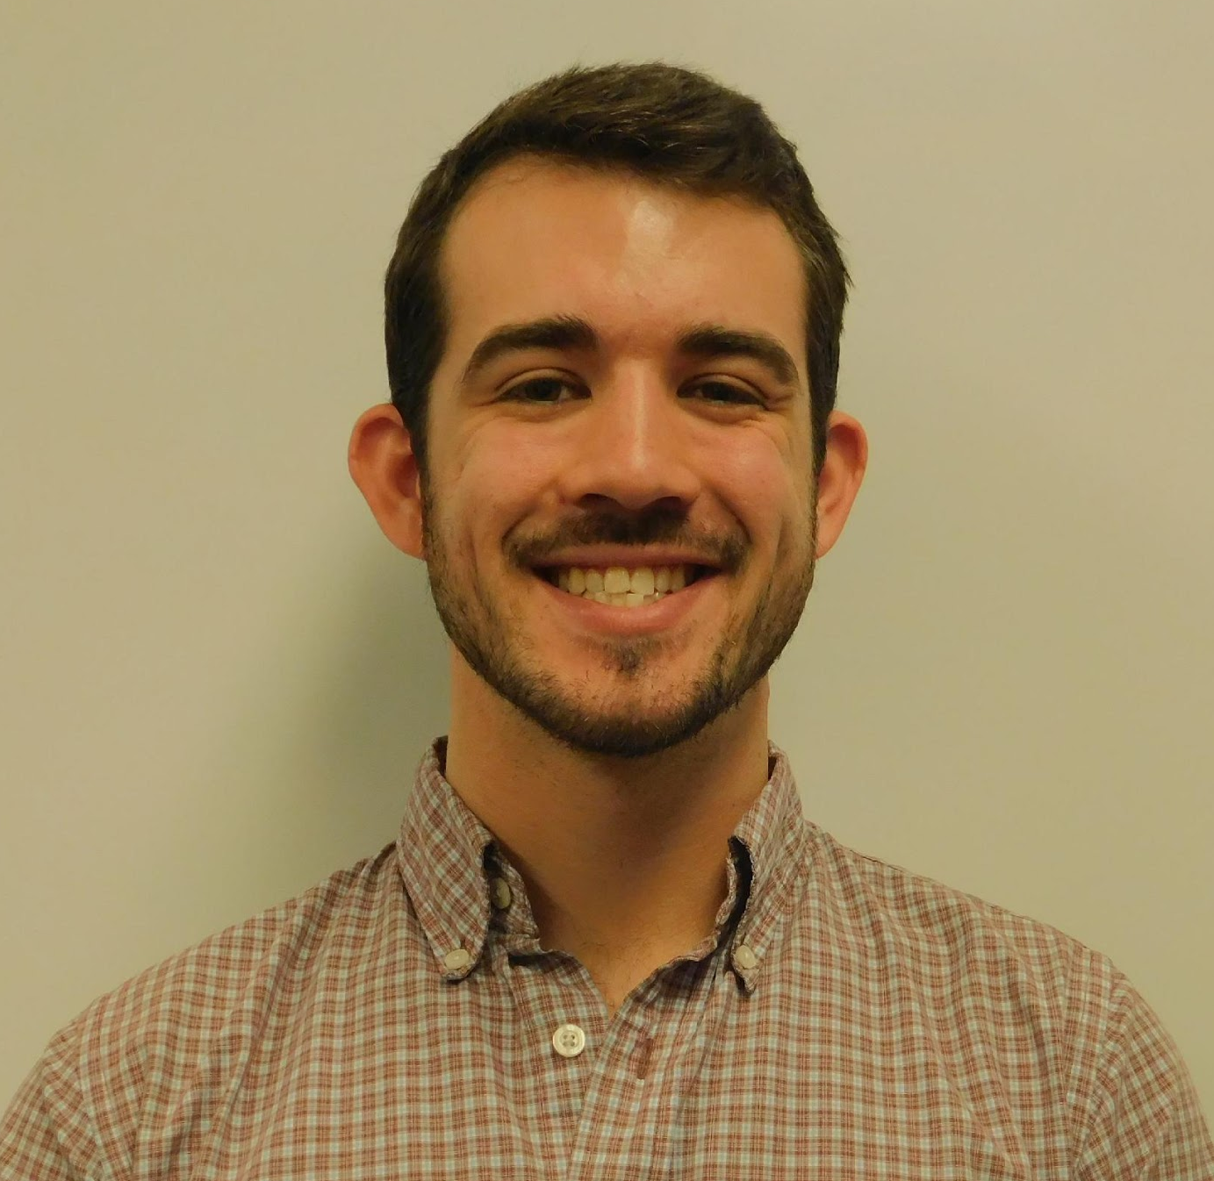
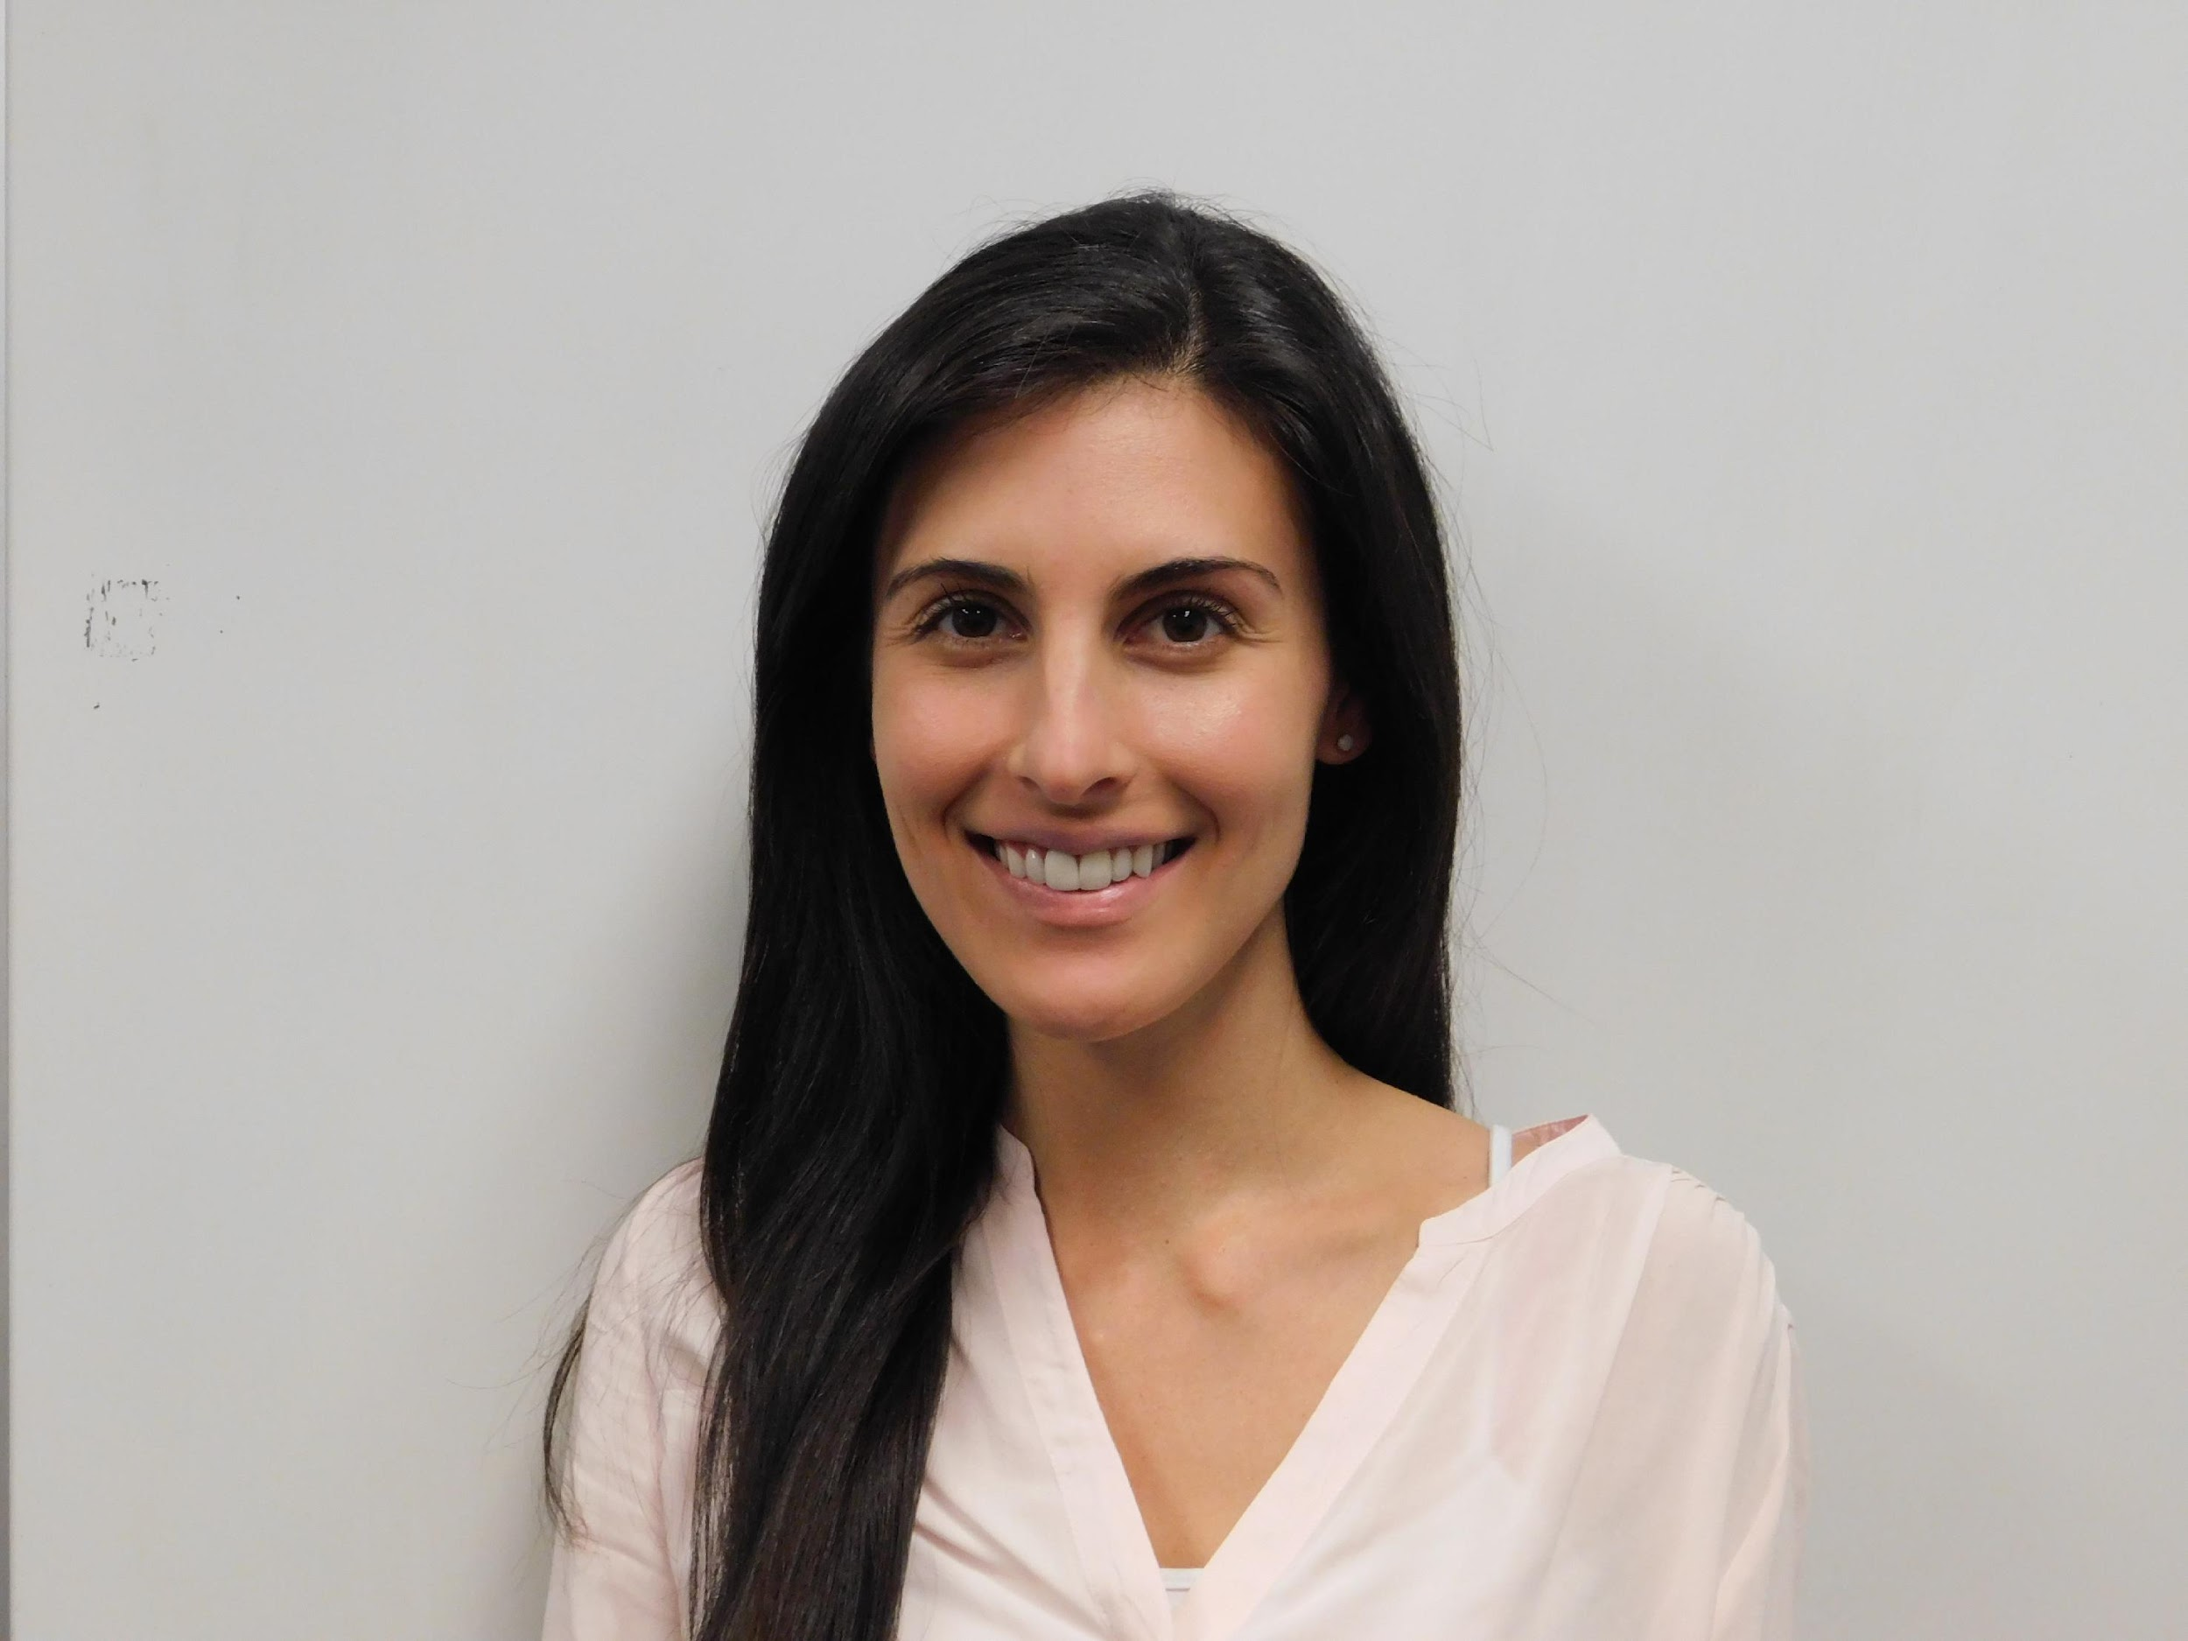
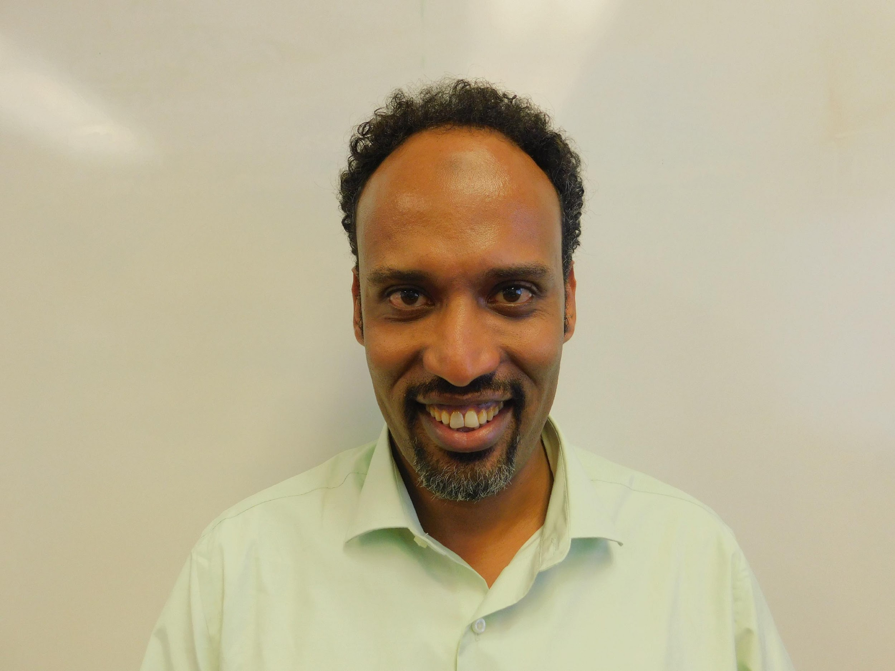
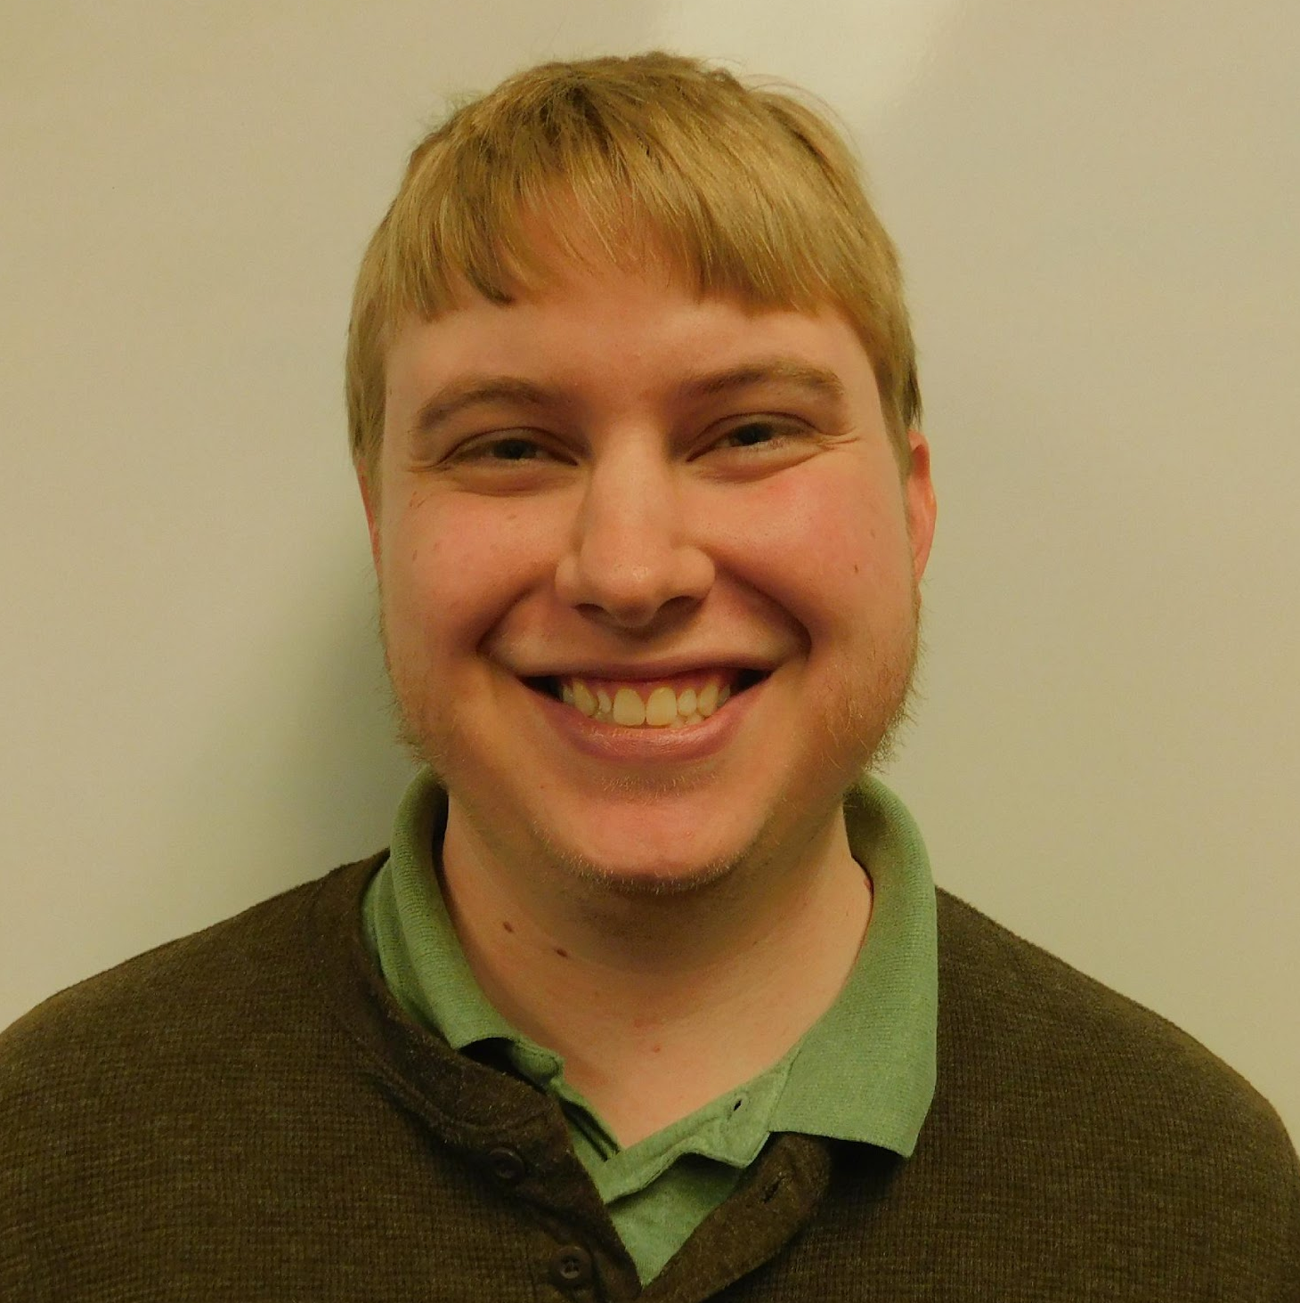
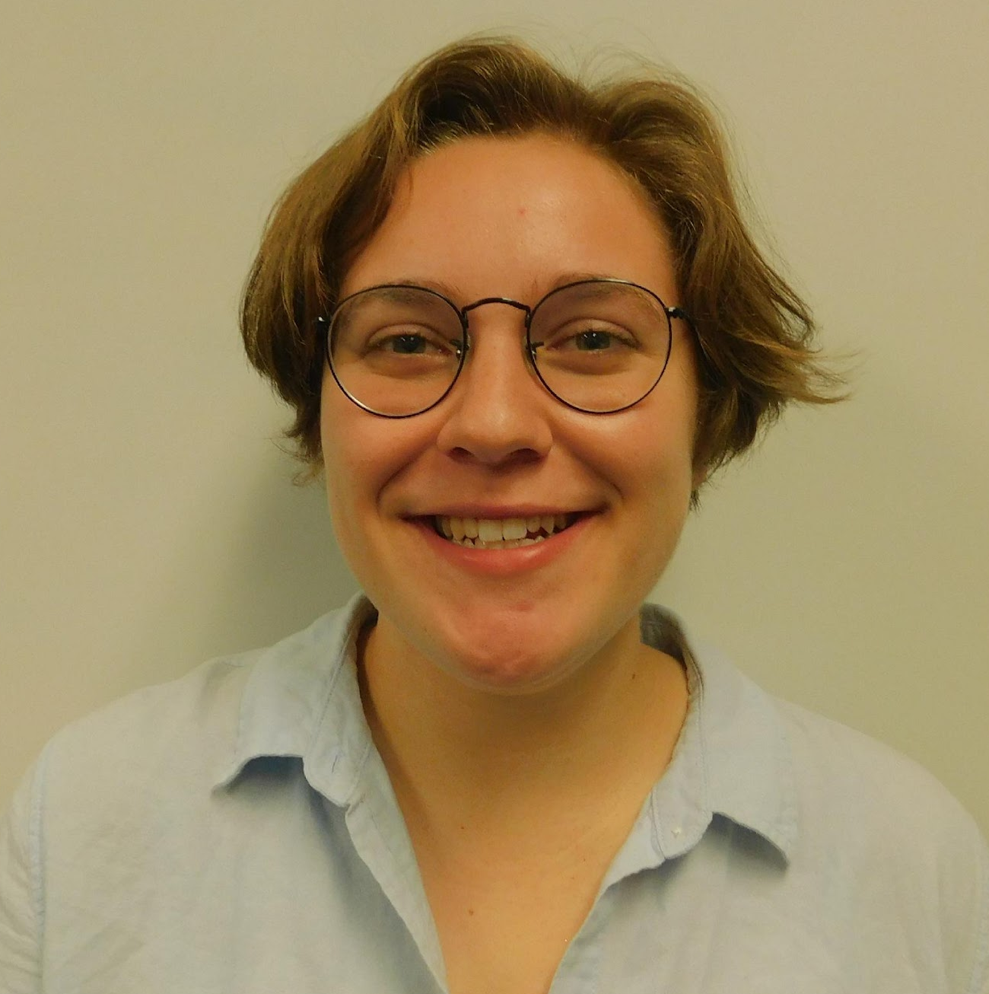
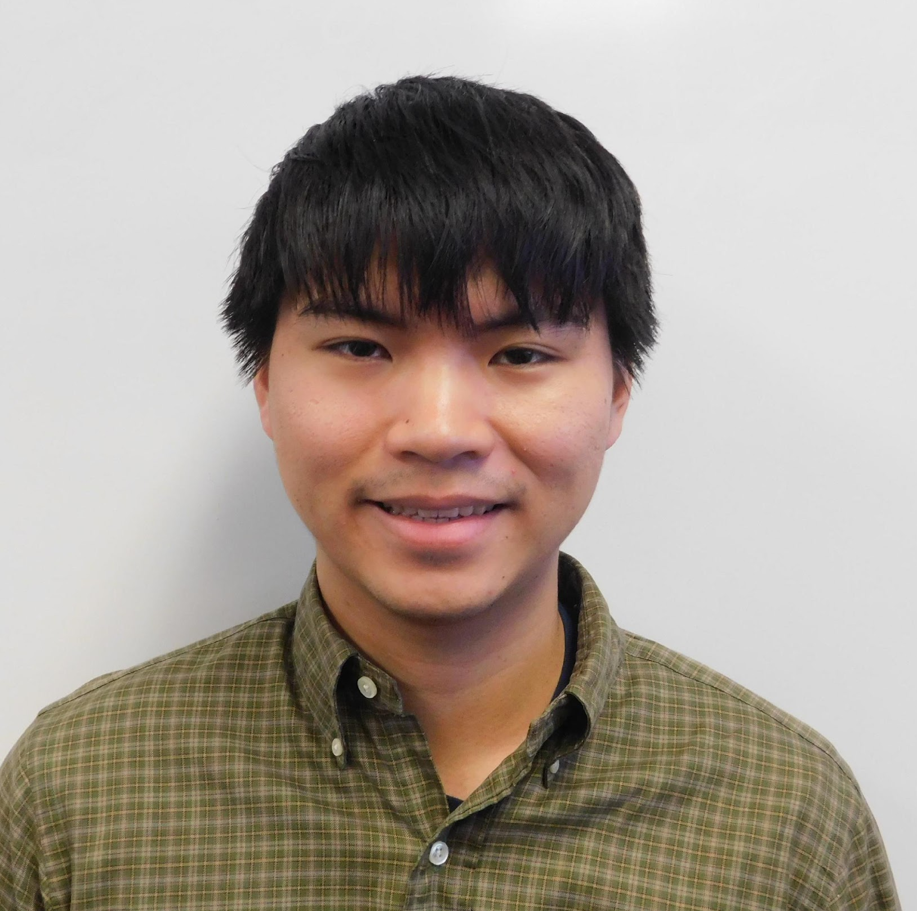
Using NASA Earth Observations to Assess Vegetation Resiliency and Water Quality Concerns to Enhance Green Infrastructure Plans in Light of Extreme Weather Events
Abstract
Methodology
In response to projected sea level rise and extreme weather events, Miami Beach and other urban areas surrounding Biscayne Bay are developing adaptive strategies to mitigate the effects of changing environmental conditions. City officials are involved with ongoing efforts to reduce storm damage and monitor water quality with the goal of protecting coastal resources. Some important considerations for these adaptive strategies include identifying resilient plant species and gaining a better understanding of water quality patterns. This NASA DEVELOP project employed Earth observations to assess post-Hurricane Irma canopy loss and recovery, in addition to water quality changes of the surrounding bay. These analyses will assist the Miami Beach Public Works Department in evaluating changing conditions across the Biscayne Bay area and provide decision makers with additional predictive insights from deep learning models to enhance restoration plans and undertake proactive countermeasures. The results of the vegetation damage and water quality analyses will aid the ecological management, hurricane preparedness, and land use planning efforts led by the city of Miami Beach to improve coastal resiliency.
Vegetation Data
Landsat 8
PlanetScope
Comparative Vegetation Analysis with NDVI
Vegetation Damage
Vegetation Resiliency Map
Vegetation Recovery
Turbidity
Water Quality Time Series
Water Quality Data
Sentinel 3
Aqua MODIS
In situ data
Chlorophyll-A
Water Quality Forecast Tool
In situ parameters
Deep Water Code
Objectives
Project Partners
City of Miami Beach, Public Works Department
Assess resiliency of coastal and urban vegetation in response to Hurricane Irma
Analyze water quality patterns in the Biscayne Bay area from 1990 to present
Communicate the relevance of NASA Earth observing satellites to the city of Miami Beach and how the project’s methods can be applied to geographically similar locations
Results
Initial Vegetation
Cover
Immediate Vegetation
Damage
Study Area
Grasses and Shrubs
No Damage
Canopy
Minimal Damage
Use images.
For ALL images – make sure all text is legible and add legends separately (so they can be moved or resized). If text is not editable, a team member must be available to make changes with a very short turn-around time (hours, not days) after submission.
Make sure that it has some sort of flow, that it makes sense. Show your results in a logical order.
No bullets.
Moderate Damage
High Damage
Miami-Dade County
Biscayne Bay Area
City of Miami Beach
1990-2017
Severe Damage
Biscayne Bay
Florida
0
1
2
4
Km
Landsat 8
Vegetation
Recovery
PlanetScope
Vegetation
Recovery
Earth Observations
No Recovery
No Recovery
Minimal Recovery
Minimal Recovery
Moderate Recovery
Moderate Recovery
High Recovery
High Recovery
Full Recovery
Full Recovery
Landsat 8 OLI
Aqua MODIS
Conclusions
The PlanetScope analysis indicated that small vegetation such as grasses and shrubs recovered earlier than larger vegetation with canopy cover..
The Landsat 8 analysis identified areas where vegetation recovered the most and least throughout the city of Miami Beach.
In situ water quality measurements in the Biscayne Bay area can help validate Aqua MODIS chlorophyll-a products.
EXAMPLE
Acknowledgements
Team Members
Dr. Rosanna Rivero and Dr. Marguerite Madden, University of Georgia
Francisco D’Elia, City of Miami Beach Public Works Department
Miami Beach Urban Development I Team, NASA DEVELOP National Program
Austin Stone
Project Co-Lead
Caren Remillard
Project Co-Lead
Emad Ahmed
Matthew Becton
Shannon Duffy
Charles Lu
Miami Beach Urban Development II
Georgia – Athens | Spring 2018

