Slide 1
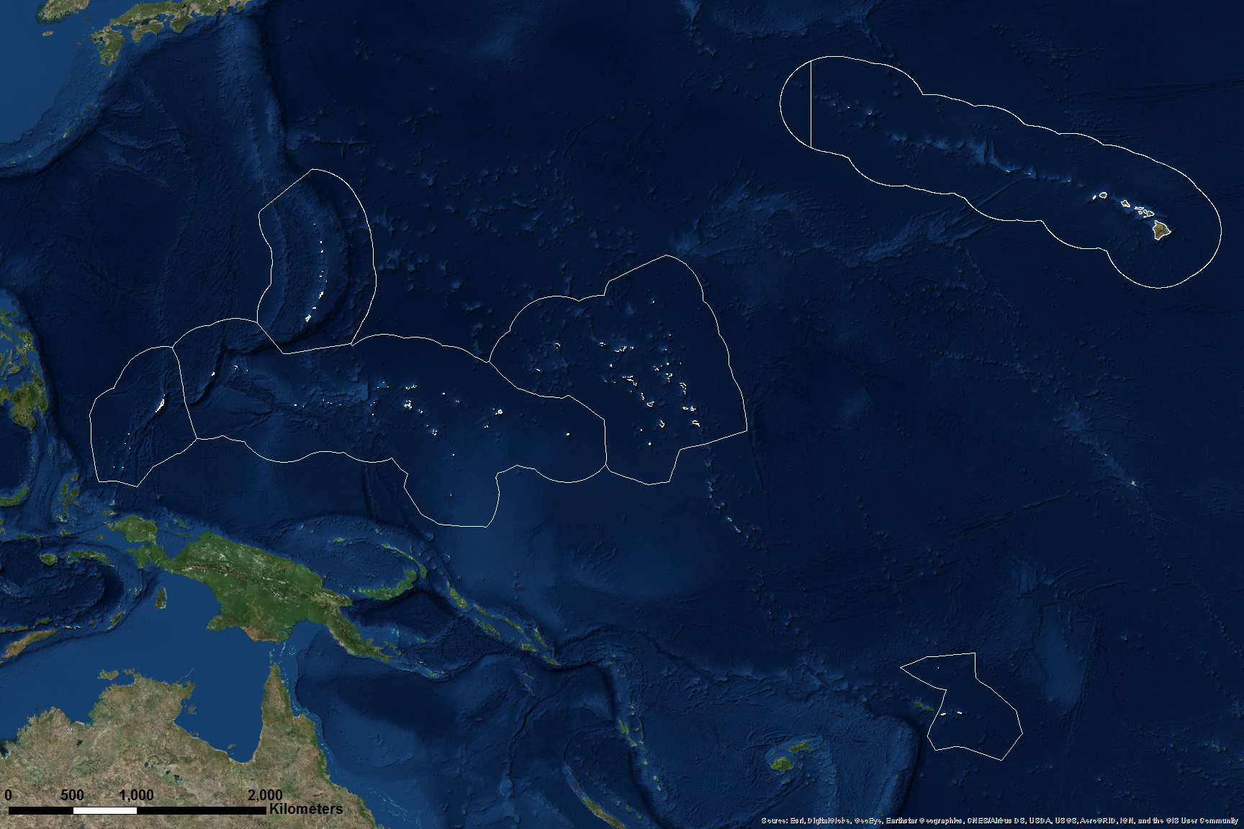
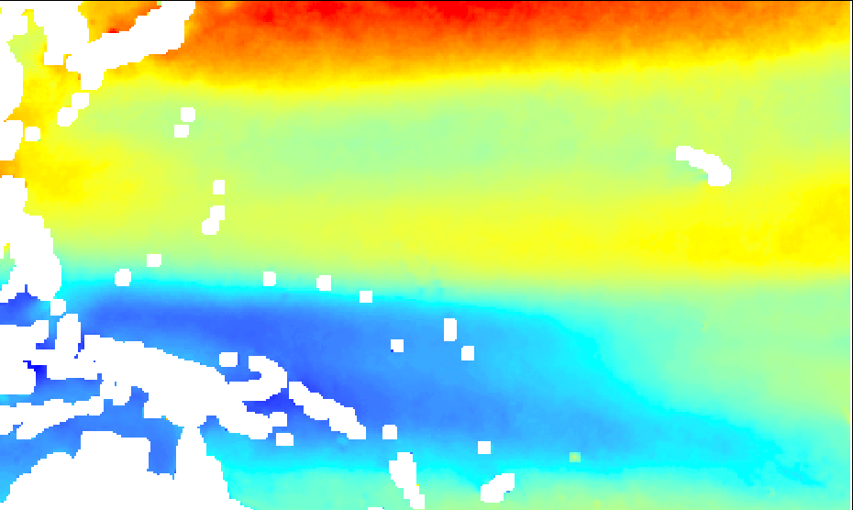
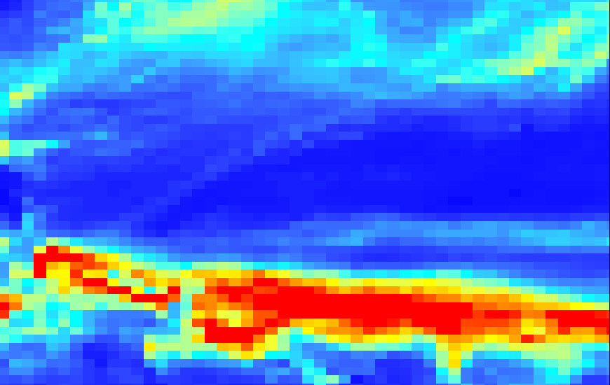
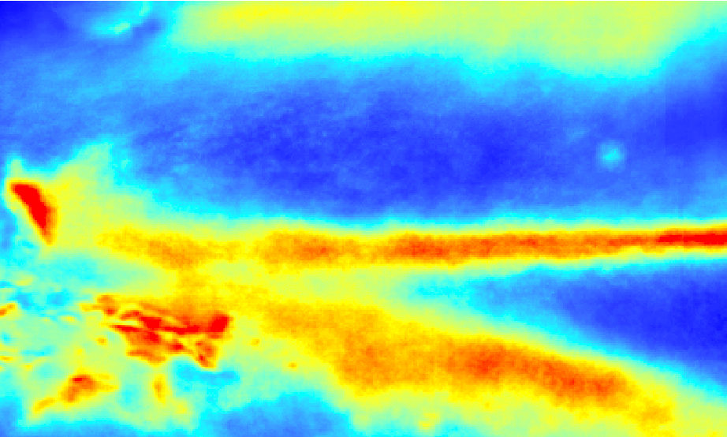
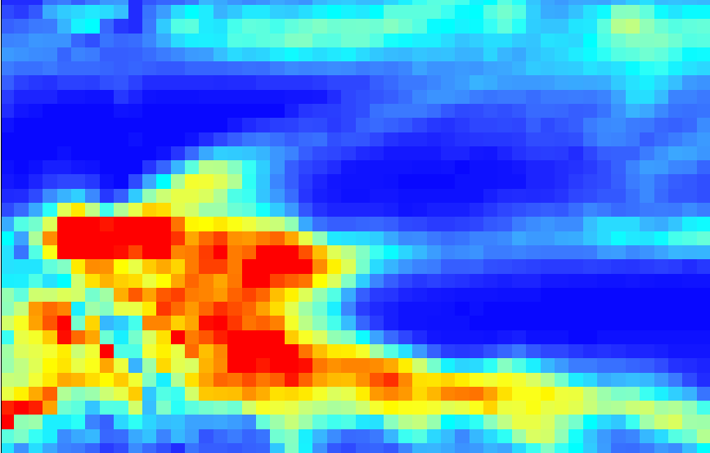
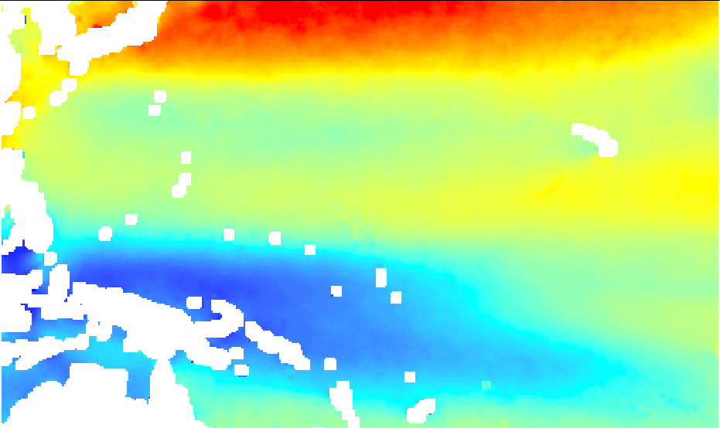
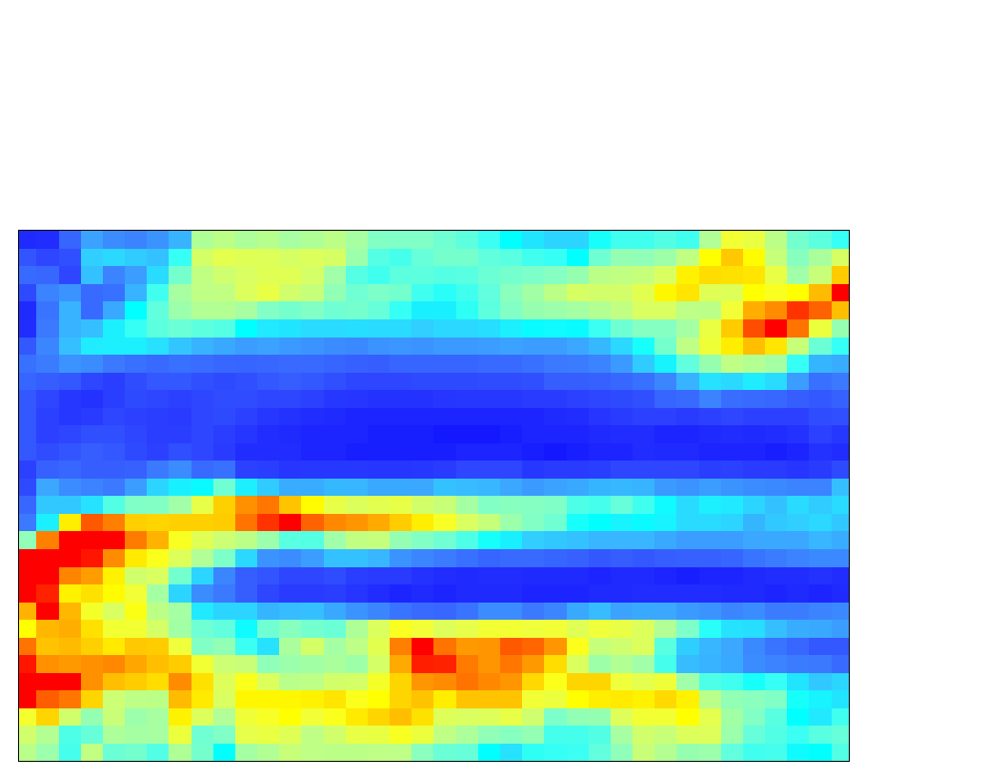
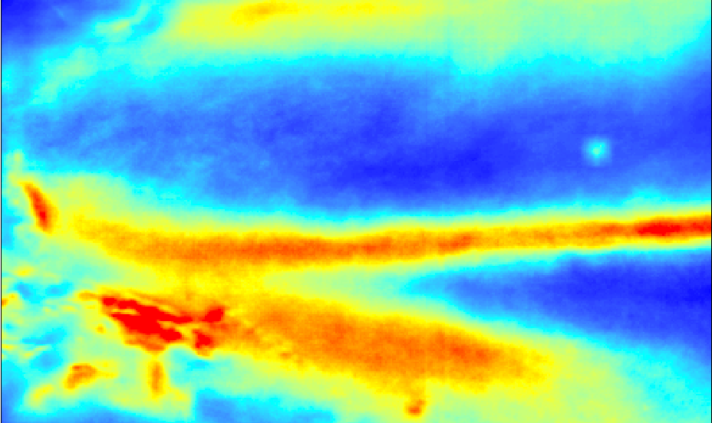
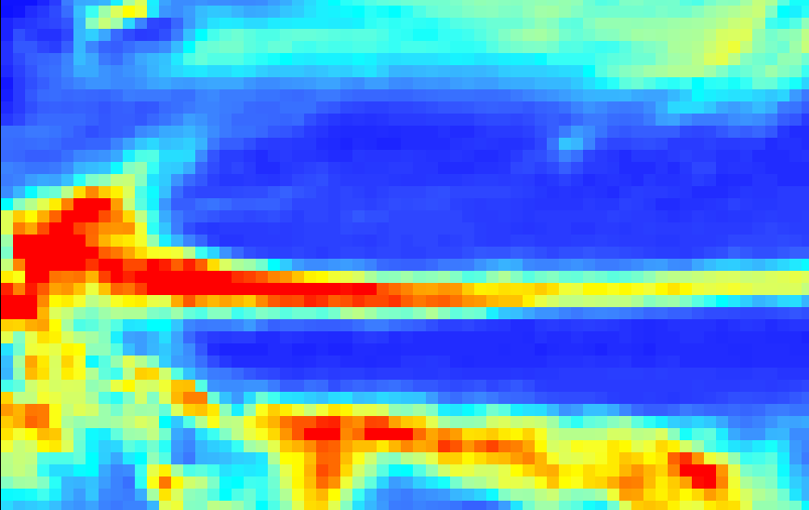
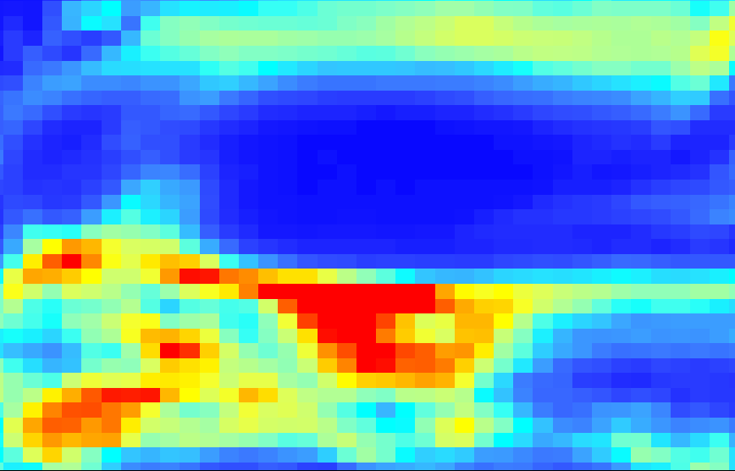
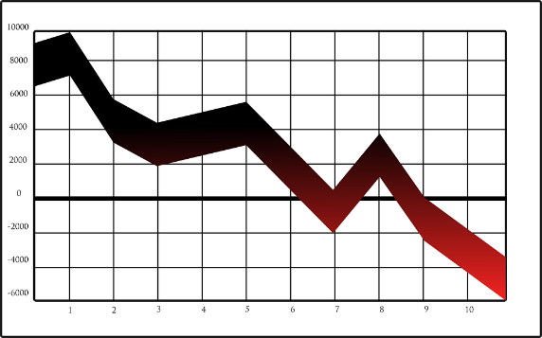
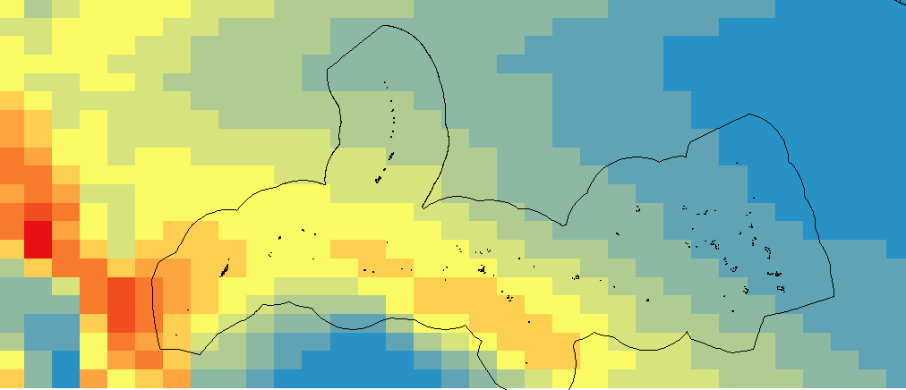
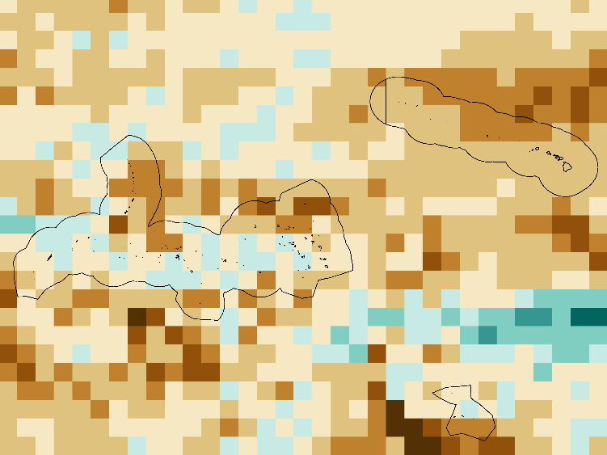
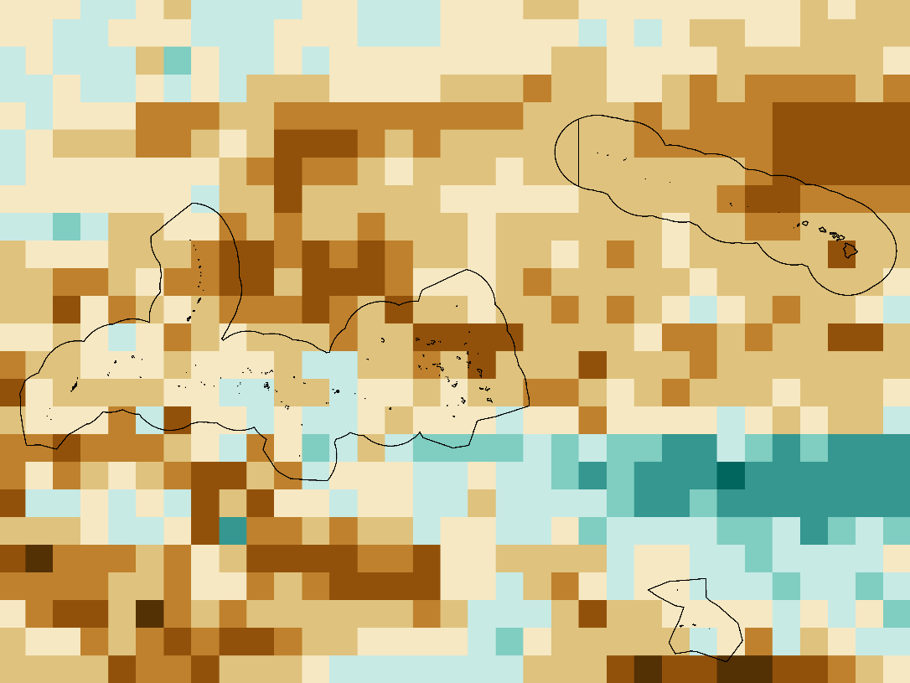
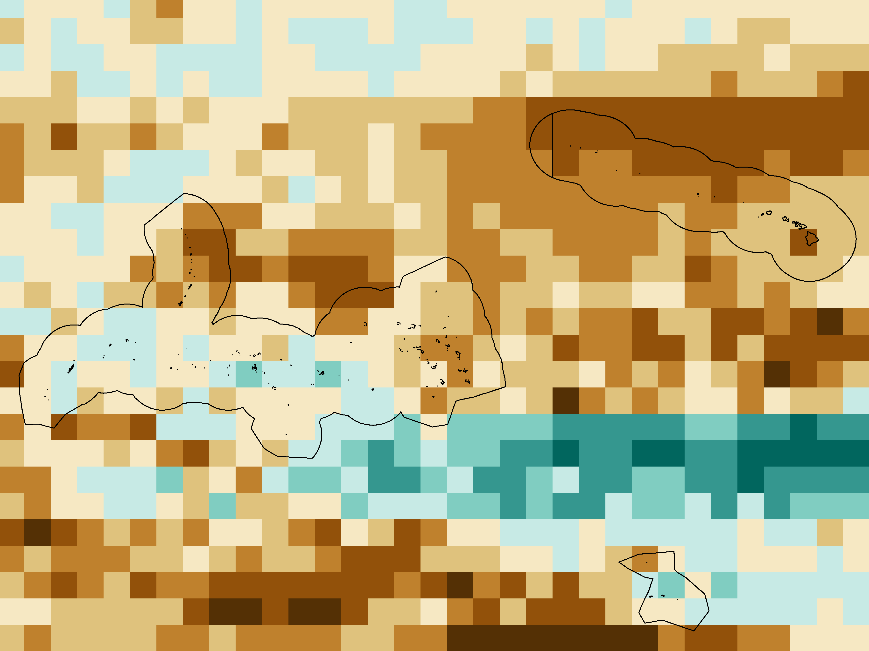
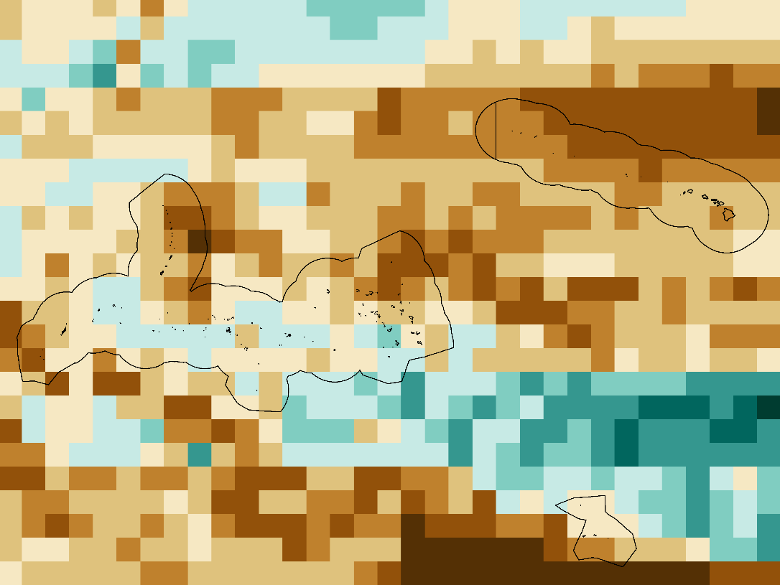
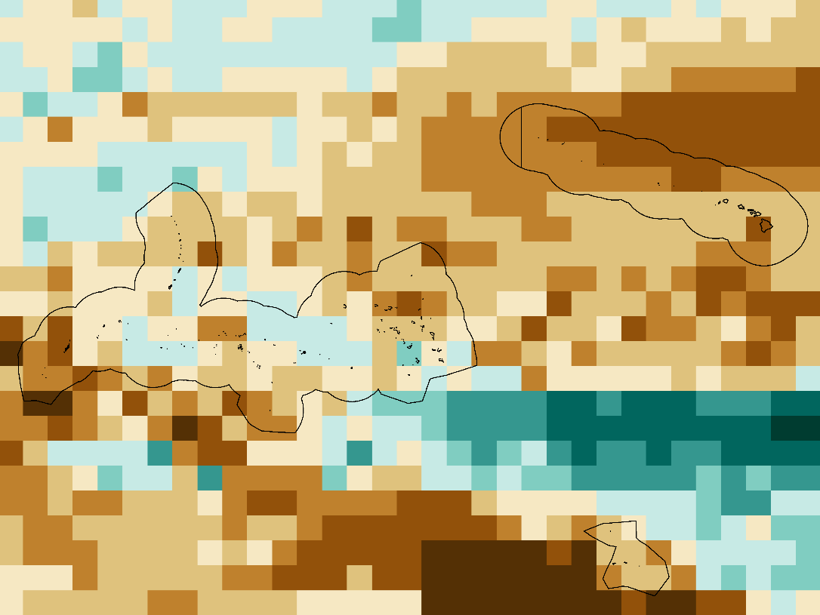
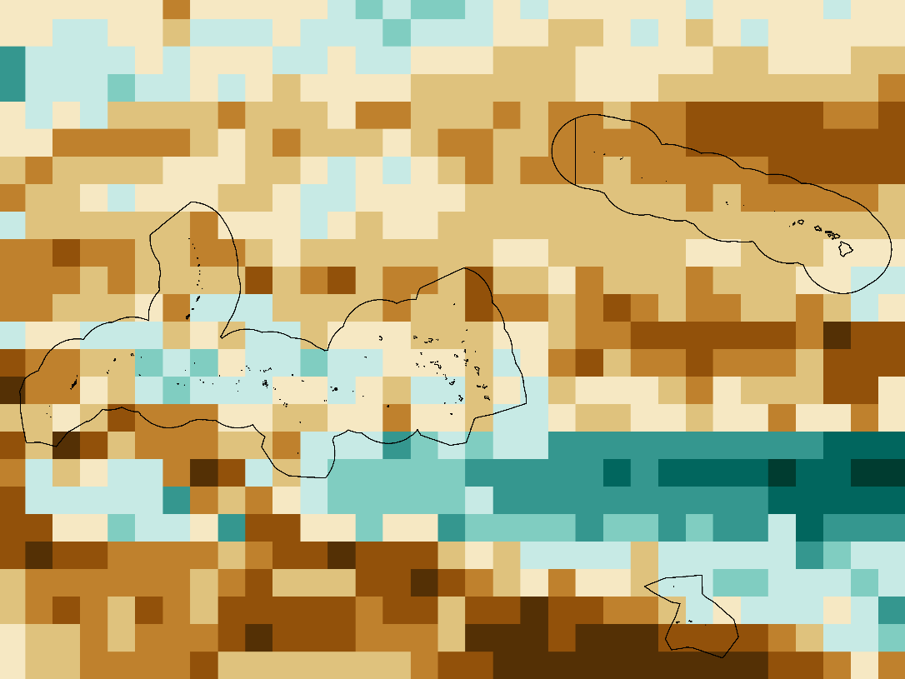
Using Global Climate Models to Project Monsoon and Future Extreme Weather Trends in the Pacific
Abstract
Study Area
Hawai’i and the U.S. Affiliated Pacific Islands (USAPI) comprise more than 2,000 islands that span thousands of miles of ocean and are home to nearly 1.9 million people. This region is particularly vulnerable to economic, social, and environmental impacts resulting from changes in sea level rise and storm patterns over the next century. Climatologists and regional decision makers are interested in understanding projected long-term changes in extreme weather events for adaptation and mitigation planning. This study provided an initial outlook at regional trends in the location of the monsoon and distribution of the extremes in wind speed and rainfall over the course of the 21st century. Select Global Climate Models (GCMs) from the Coupled Model Intercomparison Project Phase 5 (CMIP5) were verified against historic NOAA satellite data. This project used the future simulations to calculate the projected changes in magnitude for extreme values of wind speed and rainfall rate, return interval frequency for rainfall and wind speed, and distribution of monsoon events. The results include gridded maps of monsoon distribution and extreme wind and rain values, as well as return interval plots for virtual stations within the USAPI and Hawai’i Exclusive Economic Zones on a decadal basis for the years 2030-2100.
Commonwealth of the Northern Mariana Islands
Guam
Republic of the Marshall Islands
Hawai’i
Republic of Palau
Federated States of Micronesia
Methodology
American Sāmoa
Model Selection – Correlation Test
End Product -
Monsoon Maps
Future projection
Objectives
Jan
Jan
Monsoon Criteria
Rain rate > 0 mm/hr Southwest wind direction
-
Verify historic Global Climate Model datasets with NOAA Climate Data Record platforms
Extract surface wind and rainfall data from Global Climate Model future simulations for the period 2030-2100
Determine projected trends in magnitude and occurrence of extreme wind speed and rain rate (95th and 5th percentile values) for study area
Compute return interval time series of wind speed and rainfall totals at virtual stations for study area
Create projected distribution maps of Western North Pacific Monsoon
Dec
Dec
+
Historic (1988-2005)
Downloaded PERSIANN and SSM/I climatologies
Historic Period (1988-2005)
6 CMIP5 models
Projected Anomalies
End Product – Return Interval Plots
Group data by decade
GEV
End Product - Extreme Wind & Rain Maps
Calculate Future & Historic (1988-2005):
Earth Observations
95th
Generalized Extreme Value Functions
Percentile values
Hawai’i & US Affiliated Pacific Islands Disasters
5th
NOAA Ocean Near-Surface Atmospheric Properties – Climate Data Record (ONSAP – CDR) Special Sensor Microwave Imager (SSM/I)
NOAA Precipitation Estimates from Remotely Sensed Information Using Artificial Neutral Networks – Climate Data Record (PERSIANN – CDR)
Results
End Product: Distribution of Western North Pacific Monsoon Days
Percentile values
Group data by decade
Avg Yearly Monsoon Count
2090
End Product: Return Interval Plots for Rain Totals and Wind Speed at Virtual Stations
days/year
0 - 10
10 - 20
20 - 30
30 - 40
40 - 50
50 - 60
60 - 70
70 - 80
80 - 90
90 - 100
100 - 110
End Product: Change in Magnitude & Exceedance Days of Extreme Rain Rate & Wind Speed
2030
Monthly Rainfall (mm)
95th Percentile Rain Rate Change
2090
Return Period (years)
mm/day
-10 - -4
-4 - -2
-2 - -.9
-.9 - .5
.5 - 2
2 - 4
4 - 6
6 - 10
10 - 14
14 - 20
2030
Example: Map display of count of project monsoon days per year for future decades in the Western North Pacific
Example: Return Period Frequencies plotted against Monthly Rainfall Levels for a Virtual Station
Conclusions
Global Climate Model simulations varied in performance against satellite observations
FSM & and RMI expect to have more days of intense rain and less days of intense wind
Return level values of 50-yr events is generally trending upwards across the region
Monsoon events expect to increase in frequency in most of the Western North Pacific
Example: Change in Magnitude of 95th Percentile Threshold Value of Rain Rate (Future Decade – Historic)
Project Partners
Mark Lander, Professor, University of Guam
John Marra, NOAA Regional Climate Services Director, Pacific Region
Team Members
Acknowledgements
Michael Kruk, Science Advisor
Matthew Widlansky, University of Hawaii
Jared Rennie, North Carolina Institute for Climate Sciences
Ryan Smith, US Air Force, 14th Weather Squadron
James Adams, NOAA NCEI
Xungang Yin, NOAA NCEI
Dongsoo Kim, NOAA NCEI
Jonathan Brannock, North Carolina Institute for Climate Sciences
Andrew Shannon
Project Lead
Aaron Mackey
Rachel Wegener
North Carolina – NCEI
Fall 2017

