Slide 1
CALIPSO Cross-Cutting III
Interacting with CALIPSO Data Through a Graphical User Interface (GUI)
Kathleen Moore (Project Lead)
Jordan Vaa

Slide 2
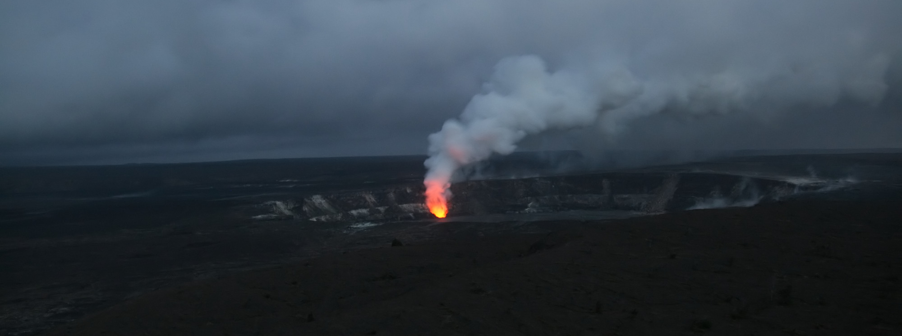
Community Concerns - Aerosols
Occur both naturally and as a result of human activity
Can warm or cool the environment significantly
If inhaled in large concentrations, bad for health
Image Credit: Brocken Inaglory
Notes:
Though aerosols occur naturally from sources like dust storms and volcanic eruptions, human industrialization has contributed significantly to the production of these particles that can so adversely harm our health.
Image Source: https://commons.wikimedia.org/wiki/File:Sulfur_dioxide_emissions_from_the_Halema%60uma%60u_vent,_glows_at_night.jpg

Slide 3
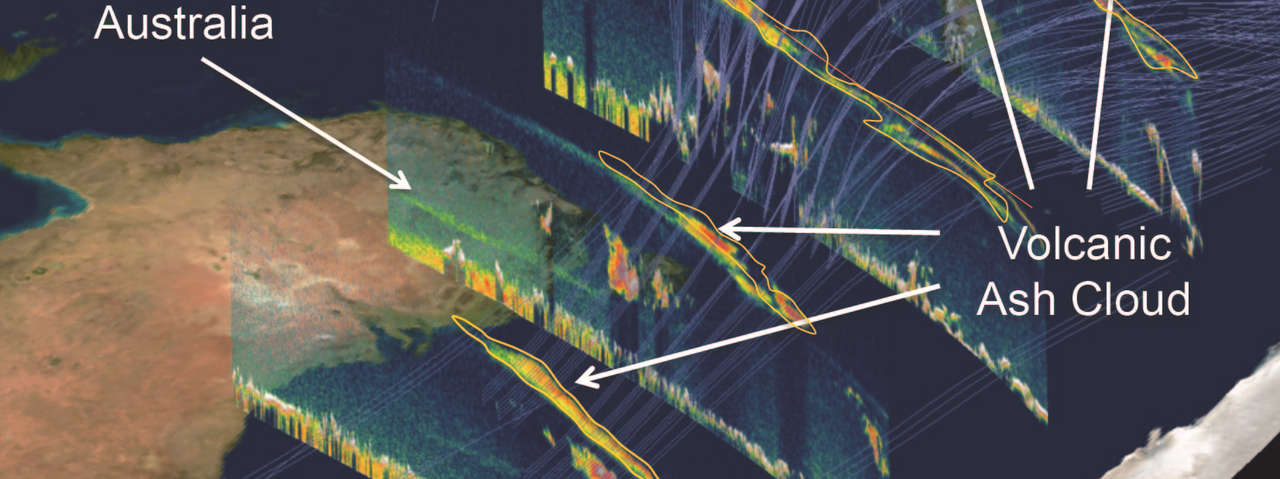
Image Credit: NASA
Motivation – track aerosols
CALIPSO satellite: backscattering profile, curtain data
CALIPSO science team: integrated analysis tool
PDF Harvester: Outdated IDL visualizer
Notes:
The CALIPSO science team at LaRC studies the vertical profiles of backscattering data output by the CALIPSO satellite. These images reveal aerosols in the atmosphere and are used for analysis of atmospheric health. Depending on the wavelength of light used, different aerosols become visible. These can be smoke, dust, sulfates, and other potential pollutants, as well as clouds and harmless dust particles. Until now, the team has been using an outdated visualizer with virtually no ability to interact with the data. Our task was to ameliorate this problem by producing a new one.
Image Source: https://commons.wikimedia.org/wiki/File:Profiles_from_Australia_and_New_Zealand_with_model_trajectories.jpeg

Slide 4
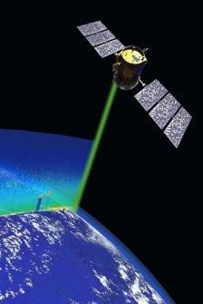
Goals
Clean Installation: Easy-to-Use Installer
MAC OS capability: Broaden User Options
OPeNDAP Integration: Ease Data Download
Image Credit: NASA
Notes:
The major goals of this terms project were to simplify the installation process of VOCAL as well as create a working MAC OS implementation. A secondary goal was to integrate OPeNDAP capabilities into VOCAL such that researchers could utilize OPeNDAPs data storage capabilities inside the VOCAL program.
Image Source: http://science-edu.larc.nasa.gov/images/spotlight/1-CALIPSO_cropped448W-336H.jpg

Slide 5
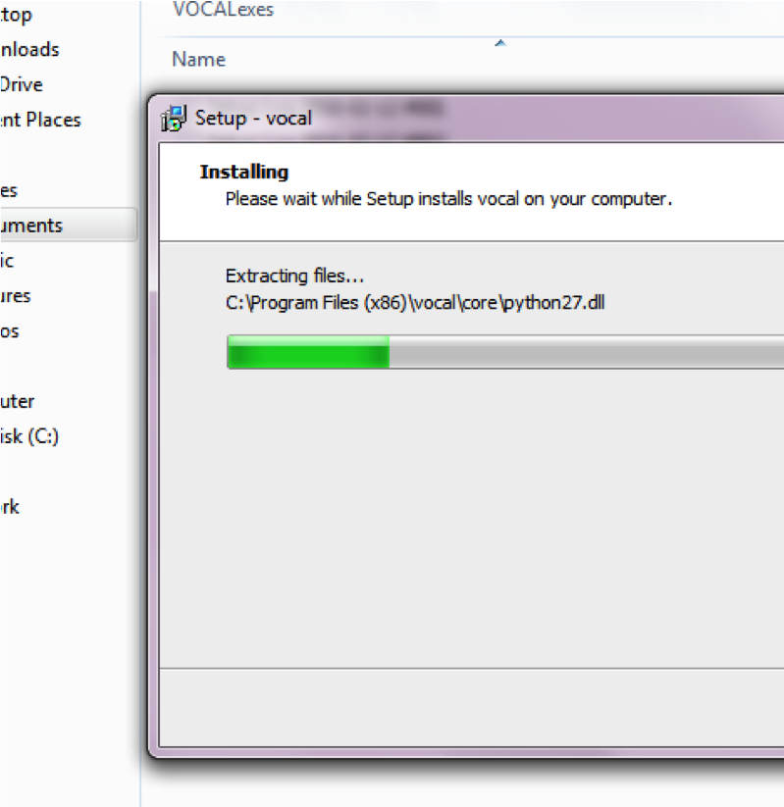
Methodology
Finalize installations
Deploy to partner
Collect feedback from partners
Add additional functionality
Image Credit: Katie Moore
Notes:
After finalizing the builds for the Windows and Mac OS installations, we were poised to hand over the software for a “beta” release. Since then, we have been in a feedback cycle wherein we add additional functionality/improve the GUI and simultaneously incorporate feedback from our partners.

Slide 6
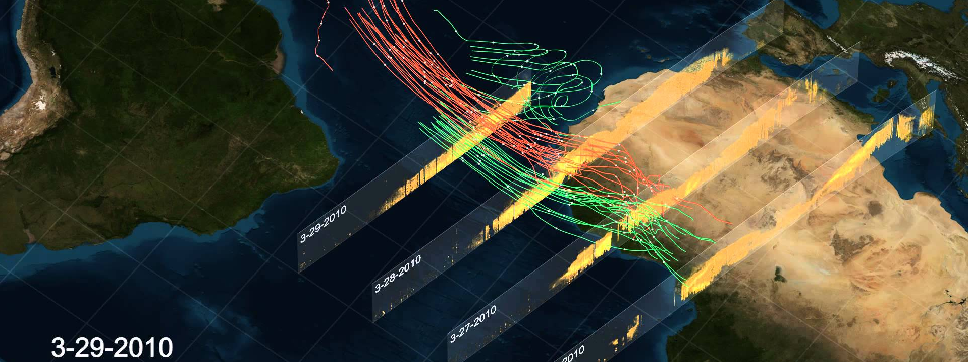
Results
VOCAL Platform: Python based data visualizer
OPeNDAP Integration: data access and sharing
Open-Source Release: developer collaboration
Image Credit: NASA's Scientific Visualization Studio
Notes:
The Visualization Of CALIPSO (VOCAL) platform was developed in the Summer of 2015 using the Python computer language. This language offered many benefits over IDL, the language the previous visualizer was written, namely its open source nature. VOCAL was designed to perform all tasks the old IDL platform was capable of, as well as adding new functionality. The new functionality focuses on collaboration and sharing between developers and researchers. Because it is written in python, it is much easier for developers to work on improving and updating VOCAL for future needs and uses. Additionally, VOCAL has been designed to integrate OPeNDAP functionality to allow easier access to the data as well as allow users to share data and results much easier.
Image Source: https://i.ytimg.com/vi/jcf6Nf4LlbE/maxresdefault.jpg

Slide 7
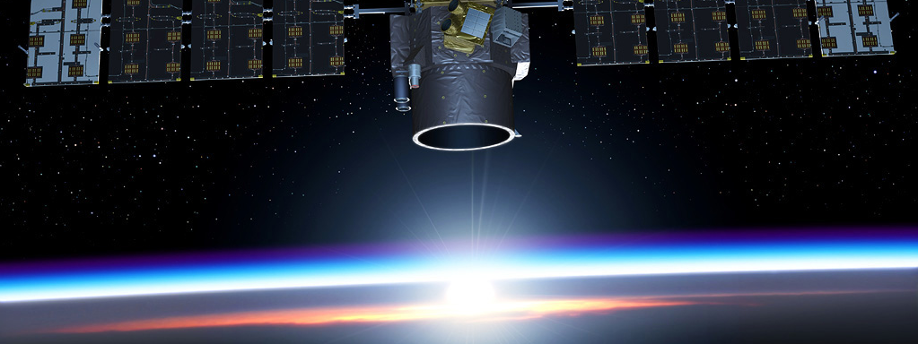
Image Credit: CNES
Acknowledgements
Advisors
Dr. Kenton Ross, NASA DEVELOP
Grant Mercer, UNLV
Partners
Dr. Chip Trepte, NASA CALIPSO Science Team
Notes:
Image Source: http://calipsooutreach.hamptonu.edu/images/img_gallery/Satellite/images/Calipso-03-1024.jpg

