Slide 1
North Carolina Ecological Forecasting
Examining shoreline extent and overall wetland health
Zand Bakhtiari (Team Lead)
Brad Gregory
Stephen Zimmerman
Kayla Patel

Slide 2
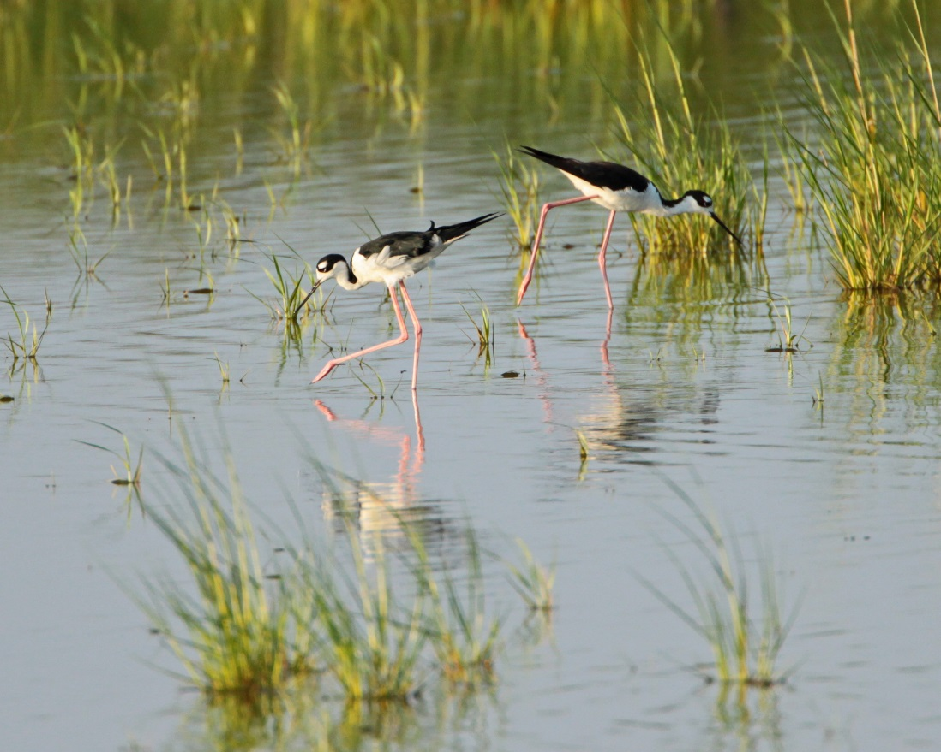
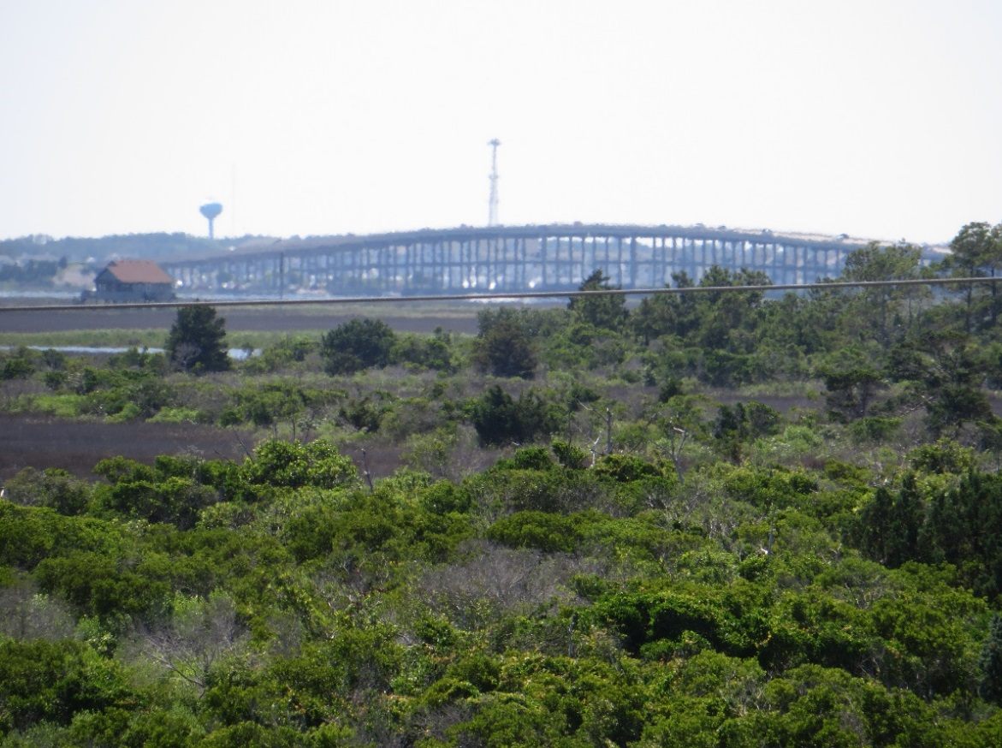
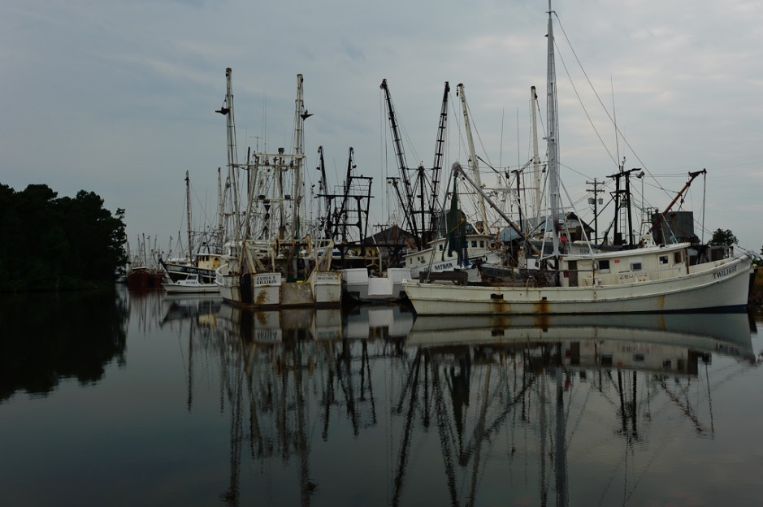
Background
Image credit: Matt Tillett, creative commons
Image credit: Ken Lund, creative commons
Vital terrestrial/aquatic buffers
Support diverse wildlife
Recreational activities
Image credit: John Bule, creative commons
Notes:
Wetlands are an important buffer between terrestrial and aquatic ecosystems, they are simply regions of land that are frequently inundated with water (much like Norfolk, VA). Wetlands can filter toxic heavy metals introduced by certain industries and also high concentrations of excess nutrients introduced by agriculture from runoff. High primary productivity in wetlands removes excess nutrients by absorption for growth; toxic heavy metals are filtered from the water by a process called phytoremediation, where the plant uptakes the metal and stores it throughout the biomass of the plant (depending on the plant will decide where the metal will be stored within the plant). Dense vegetation root structures allows for trapping of sediment and consequently mitigates shoreline erosion. Vegetation also dampens tidal/wave energy from the tides, storms, hurricanes.
Wetlands provide nursery for many juvenile fish species by providing shelter among the aquatic/subaquatic vegetation from larger predatory fish. Having these areas of refuge increases the chance of survival to adulthood and is major part in sustaining healthy populations of adult fish species. Healthy fish populations is crucial for commercial fisherman which is a large part of the economy and culture in the Albemarle-Pamlico sounds.
These ecosystems also offer recreation for humans, things like kayaking/canoeing, recreational fishing, nature photography, and conservation enthusiasts.

Slide 3
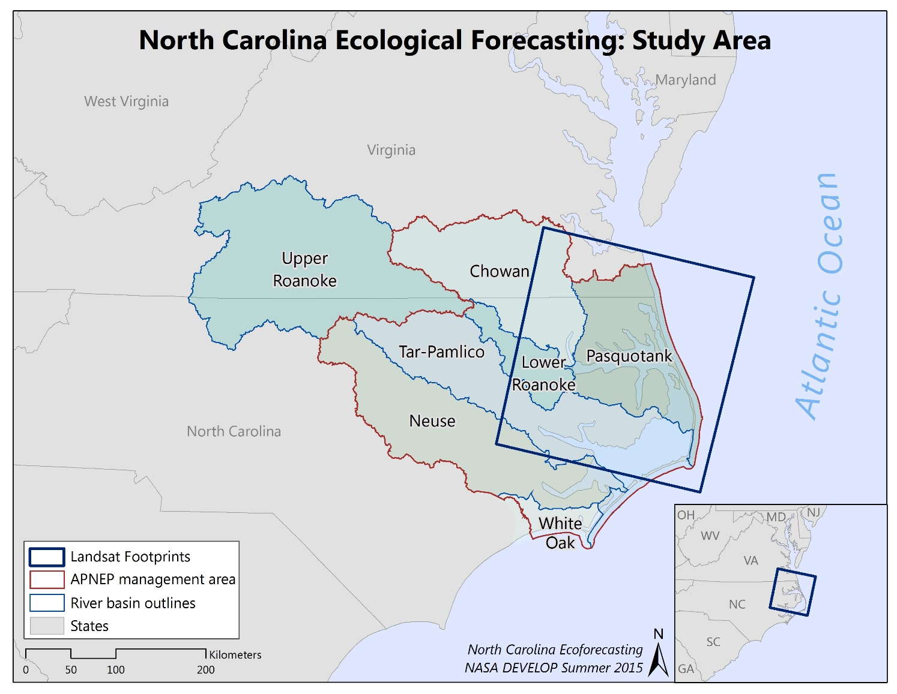
Study Area – Study Period
Albemarle-Pamlico watershed
National Estuary Program (NEP)
2000-2015
Notes:
Albemarle-Pamlico Watershed:
Second largest estuary system in the United States
Water from 43 North Carolina and 38 Virginia counties drains into the A-P watershed
There are 6 major river basins that drain water from these counties into the A-P watershed → Chowan, Roanoke, Tar-Pamlico, Neuse, Pasquotank, and White Oak
Drainage from the NC/VA counties and the major river basins all end up in one of the 8 major sounds in this region → Albemarle, Pamlico, Back, Bogue, Core, Croatan, Currituck, and Roanoke
National Estuary Program (NEP):
Deemed an “estuary of national significance” in 1987 among the first 28 National Estuary Programs (NEP) established by the U.S. Environmental Protection Agency (EPA) through amendments of the federal Clean Water Act (CWA).
Study Period:
2000-2015 → We decided on this period simply because of time constraint.

Slide 4
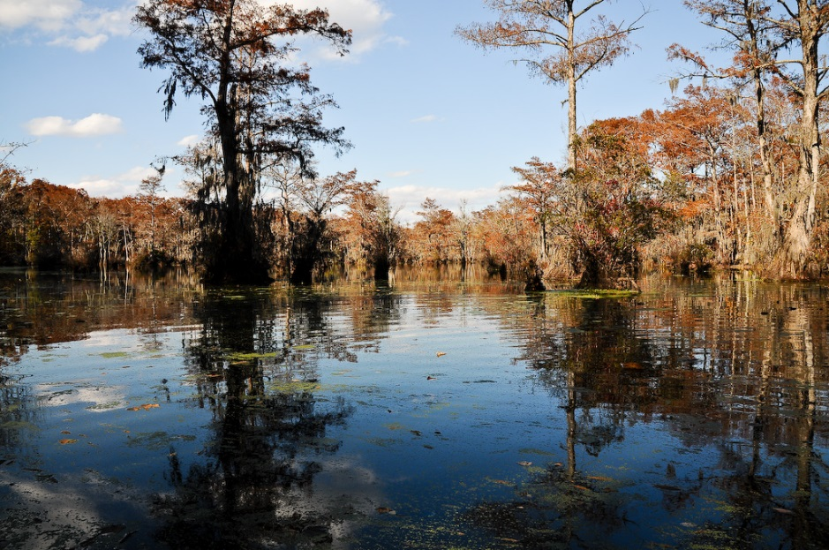
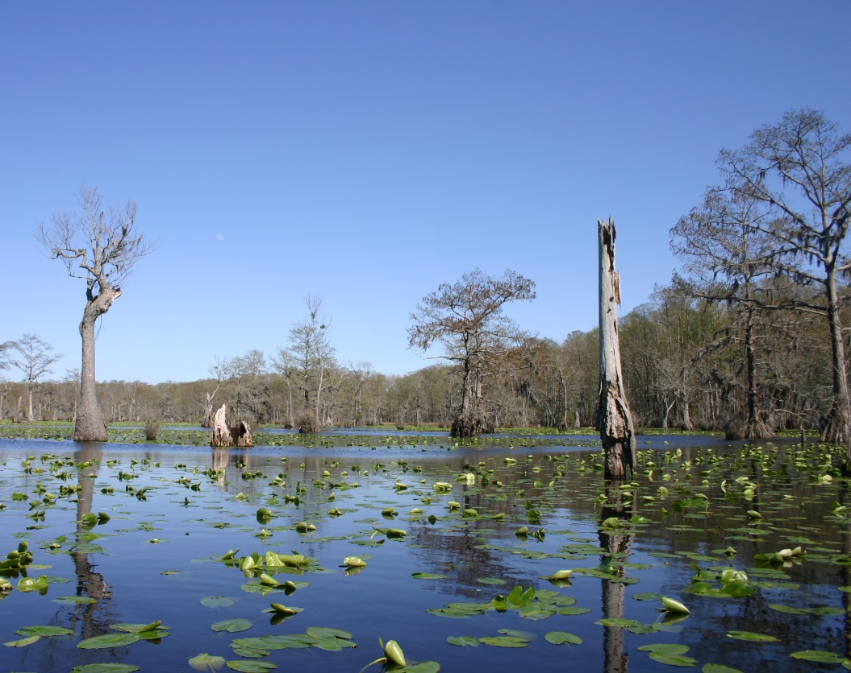
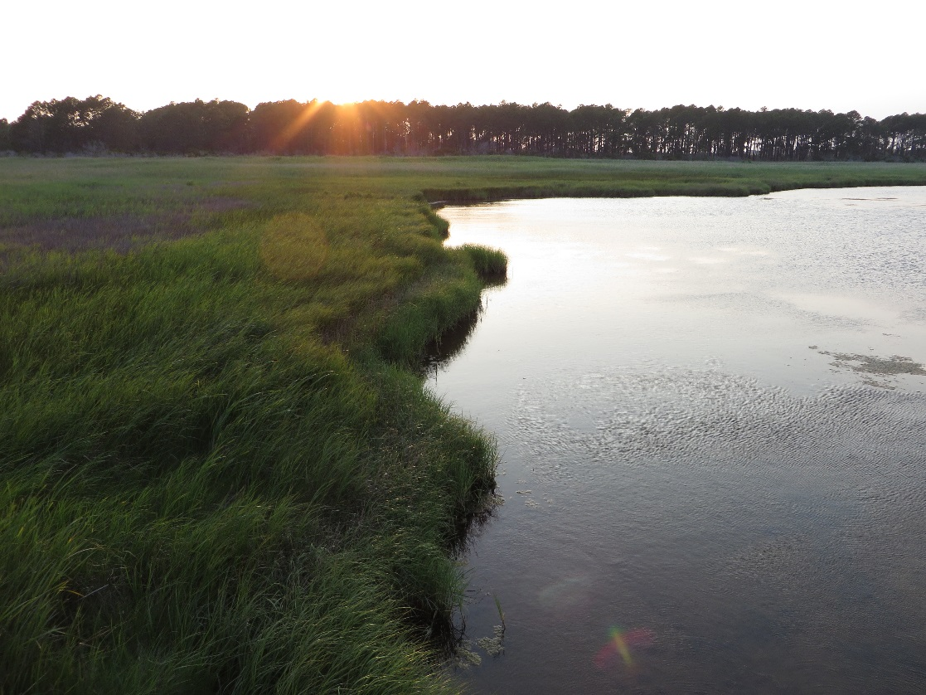
Nature Inspiration
Image credit: John Bule, Creative Commons
Image credit: Ryan Somma, Creative Commons
Image credit: Ken Lund, Creative Commons
Notes:
Top right and bottom left photos were taken at Merchant’s Millpond State Park in North Carolina, just southwest of the Great Dismal Swamp.
Bottom right photo is a marsh, vegetation seen is Spartina alterniflora (cordgrass).

Slide 5
Community Concerns
Impacts of wetland degradation:
Local ecosystems
Local and regional economies
Image Credit: Stephen Zimmerman
Notes:
Wetland degradation is a major concern because of all the services these ecosystems provide not only for the general health of the wetland ecosystem itself but other surrounding ecosystems, and also for the economic services provided for humans.
Local ecosystems:
Wetlands are good at filtering excess nutrient and toxic heavy metals
Wetlands provide nursery for many juvenile fish species
Wetlands have high primary productivity and effectively sequester CO₂ in the form of plant biomass
Local and regional economies:
Because many juvenile fish species rely on wetlands for nursery the local fishing industry success is dependent on healthy wetlands to nurse juvenile fish species and sustain adult fish populations
Eco-tourism and recreation is a major economic opportunity in this region and would likely diminish with loss of healthy wetlands

Slide 6
Image Credit: Stephen Zimmerman
Objectives
Determine shoreline extent
Assess relative wetland health
Case studies
Notes:
We determined the extent of the shoreline by applying a Normalized Difference Water Index (NDWI) that tracks the changes in water extent over the years of our study period.
We also assessed the relative health of wetlands by applying a [specific wetland health index TBD] that determines the carotenoid/chlorophyll-a ratio, a good indicator of healthy vegetation.
As a means to validate our indices we conducted case studies at specific sites of interest that represent where either wetland health has degraded due to natural disturbances (ie. Sea level rise), or from anthropogenic causes such as intentional wetland draining for urban development or conversion to agriculture.
****Something about C-CAP****

Slide 7
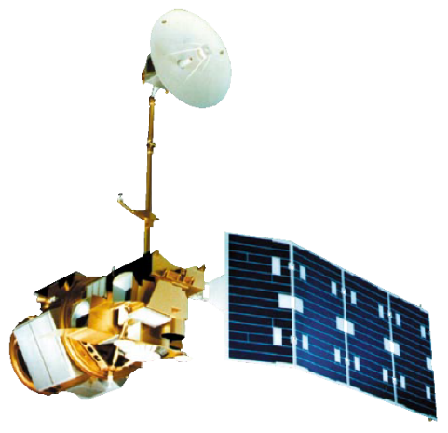
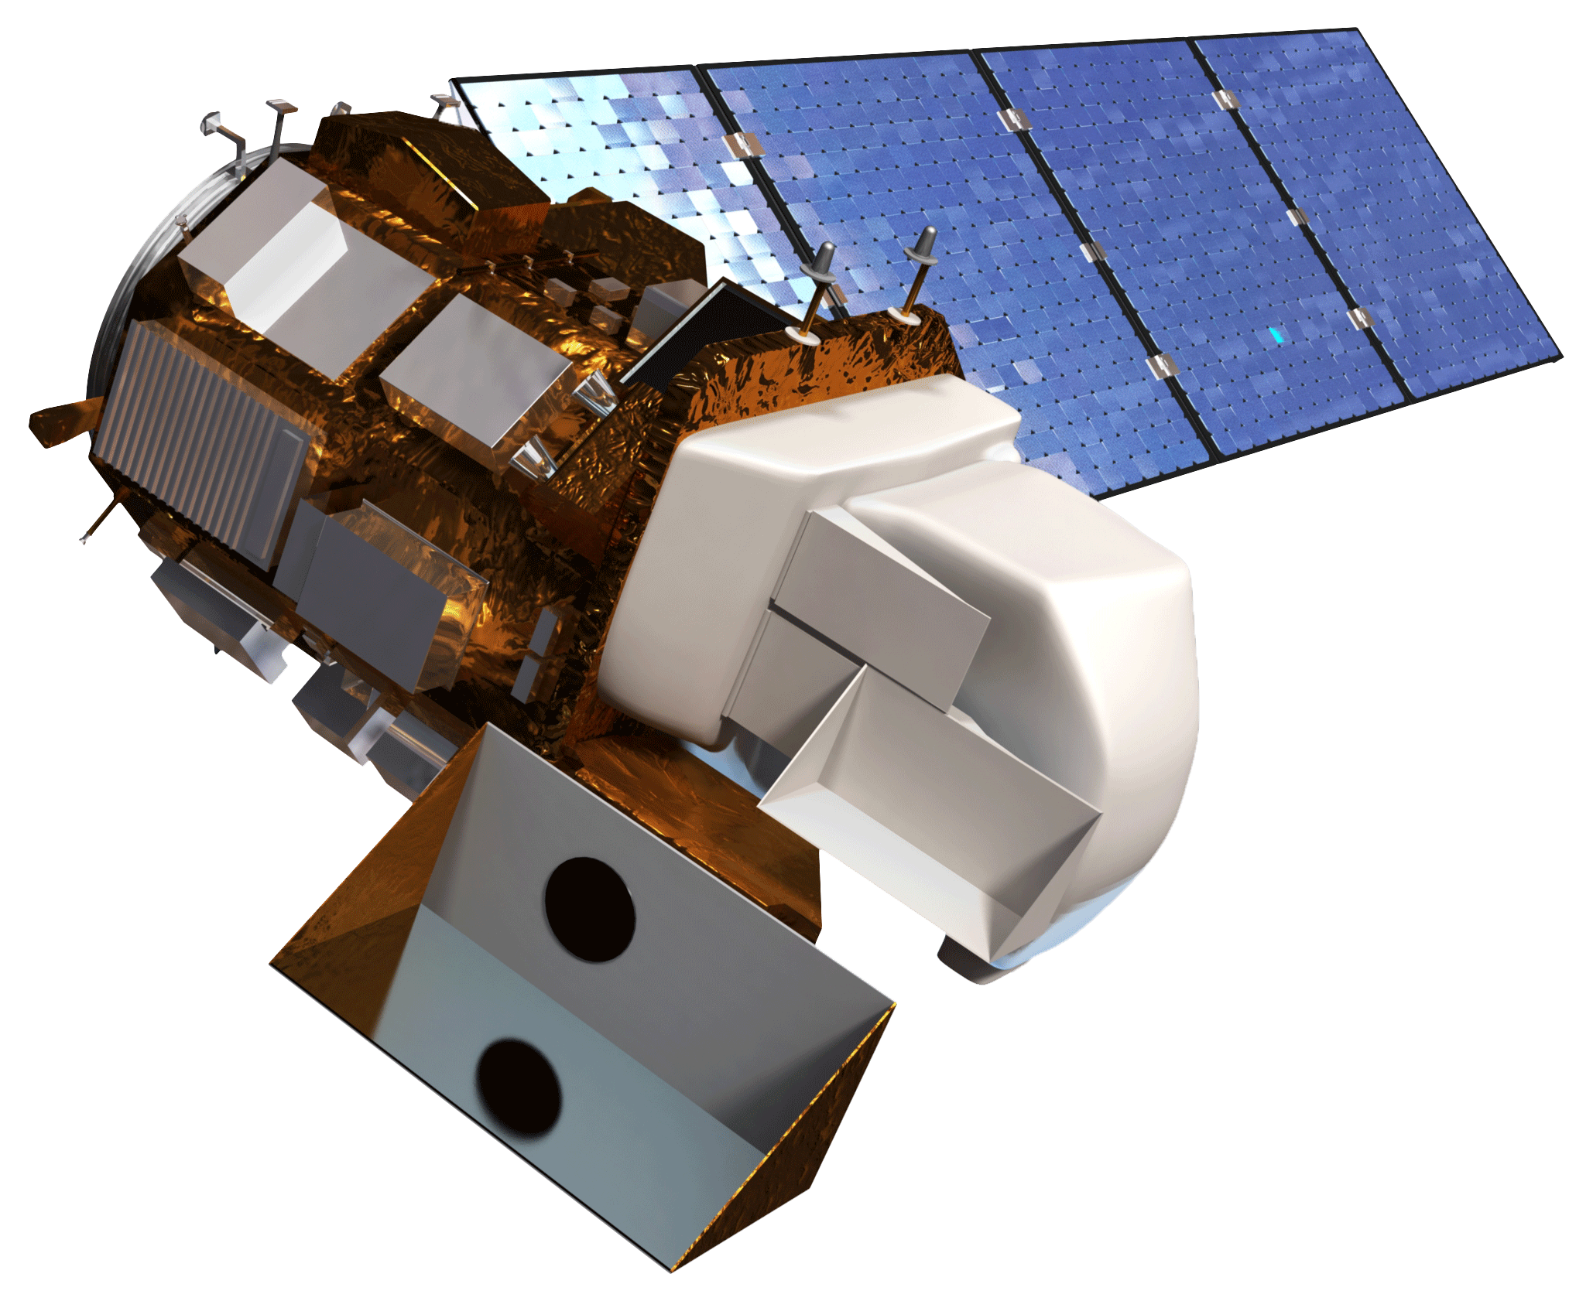
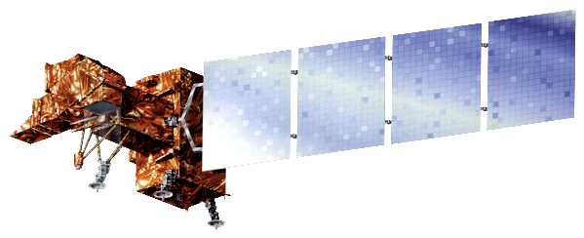
NASA Satellites/Sensors
Landsat 5 Thematic Mapper (TM)
Landsat 7 Enhanced Thematic Mapper (ETM+)
Landsat 8 Operational Land Imager (OLI)

Slide 8
Methodology
Data Acquisition
Data Pre-processing
Data Analysis
Automated file unzipping, images separated by year
NDWI, wetland health index, NDPI calculated
Landsat 5 TM, 7 ETM+, and 8 OLI
Summer, winter, spring, fall image for each year
Top-of-atmosphere reflectance calculated for each scene
Threshold applied to NDWI images, years summed
Notes:
A python script was built that unzips the images and separates them by year
important that in the original image file the year is specified correctly – for example we used an image from December 28th, 2002 as the winter 2003 image and we needed to change the initial tar.gz file path to have a 2003 in it so the image would not be thrown in with the 2002 images.
Top-of-atmosphere reflectance was calculated for each image using the dnppy module

Slide 9
Methodology
Data Acquisition
Data Pre-processing
Data Analysis
Automated file unzipping, images separated by year
NDWI, wetland health index, NDPI calculated
Landsat 5 TM, 7 ETM+, and 8 OLI
Summer, winter, spring, fall image for each year
Top-of-atmosphere reflectance calculated for each scene
Threshold applied to NDWI images, years summed
Notes:
A python script was built that unzips the images and separates them by year
important that in the original image file the year is specified correctly – for example we used an image from December 28th, 2002 as the winter 2003 image and we needed to change the initial tar.gz file path to have a 2003 in it so the image would not be thrown in with the 2002 images.
Top-of-atmosphere reflectance was calculated for each image using the dnppy module

Slide 10
Methodology
Data Acquisition
Data Pre-processing
Data Analysis
Automated file unzipping, images separated by year
NDWI, wetland health index, NDPI calculated
Landsat 5 TM, 7 ETM+, and 8 OLI
Summer, winter, spring, fall image for each year
Top-of-atmosphere reflectance calculated for each scene
Threshold applied to NDWI images, years summed
Notes:
A python script was built that unzips the images and separates them by year
important that in the original image file the year is specified correctly – for example we used an image from December 28th, 2002 as the winter 2003 image and we needed to change the initial tar.gz file path to have a 2003 in it so the image would not be thrown in with the 2002 images.
Top-of-atmosphere reflectance was calculated for each image using the dnppy module

Slide 11
Advisors
Dr. Kenton Ross – DEVELOP National Science Advisor
Jeff Ely – DEVELOP Geoinformatics Fellow
Partners
Albemarle-Pamlico National Estuary Program (APNEP)
Others
N/A (may change?)

