Slide 1
Los Angeles Health & Air Quality Identifying Urban Emission Patterns in the Los Angeles Megacity
NASA DEVELOP Showcase
Washington, D.C.
July, 30th 2015
Talha Rafiq (Project Lead)
Isis Frausto-Vicencio
Valerie Carranza
Photo by DAVID ILIFF. License: CC-BY-SA 3.0

Slide 2
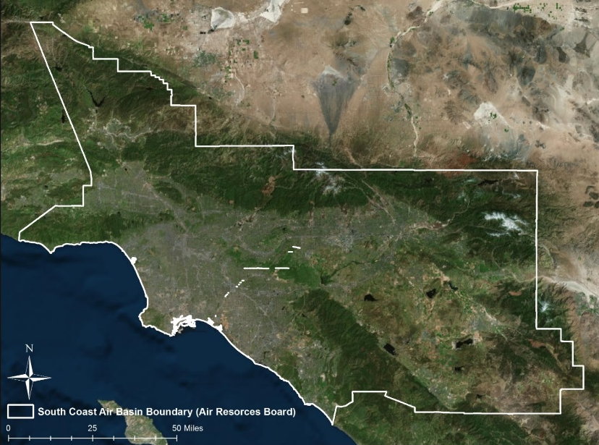
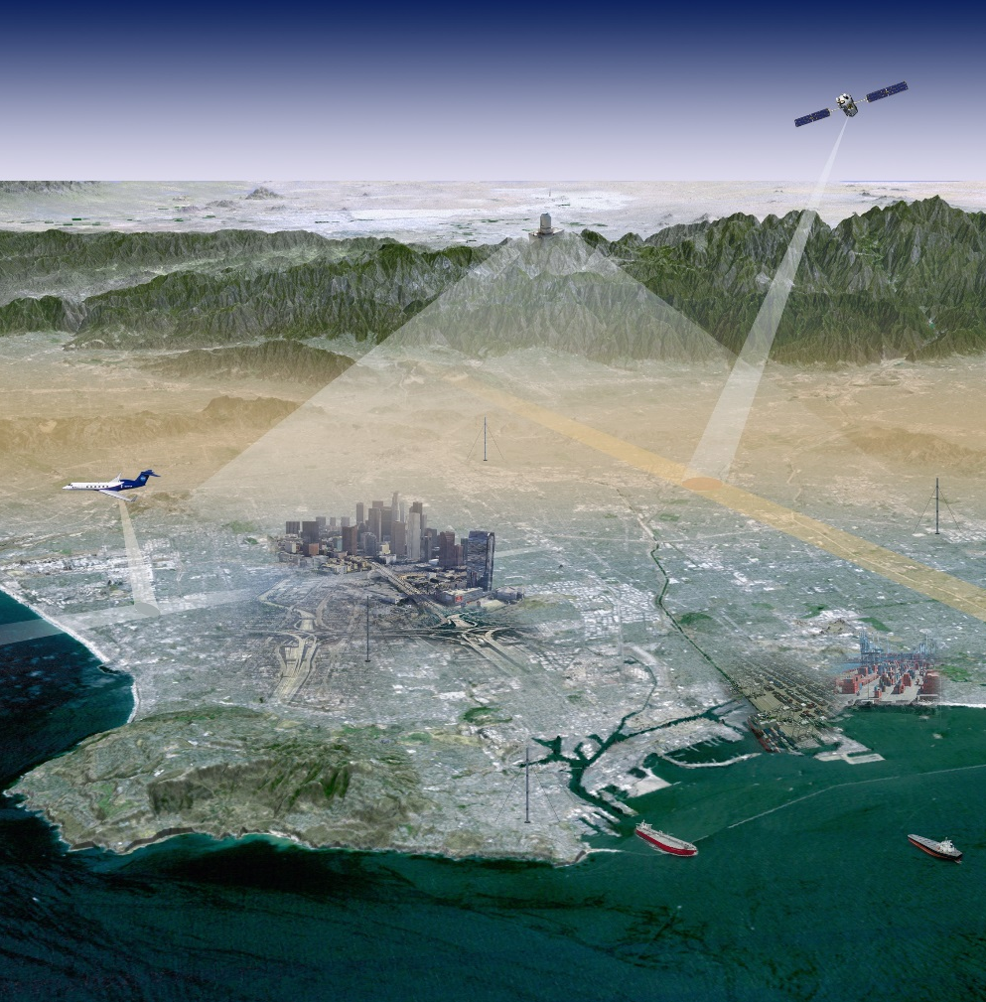
Background
Photo by JPL Megacities Carbon Project

Slide 3
Objectives
Research
Obtain and formulate emission factors for the top CH₄ producing sectors
Develop
Develop a raster-based spatial representation of CH₄ emissions in the SoCAB region
Compare
Compare our bottom-up method with top-down NASA Earth observations: HyTES and CLARS

Slide 4
Methodology
Data Collection of Methane Sectors
Process & Validate
Research & Rank of CH₄ Emission Sectors using studies from California AIR Resources Board (CARB)
Convert all data into 3km by 3km grid cell raster visualization
CARB 2012 | SoCAB
(projected)
Rank | Source | SoCAB Total (Gg CH₄/year)
1 | Landfills | 171.3
2 | Oil & Natural Gas | 87.4
3 | Livestock-Dairy | 77.3
4 | Wastewater Treatment Plants | 56.3

Slide 5
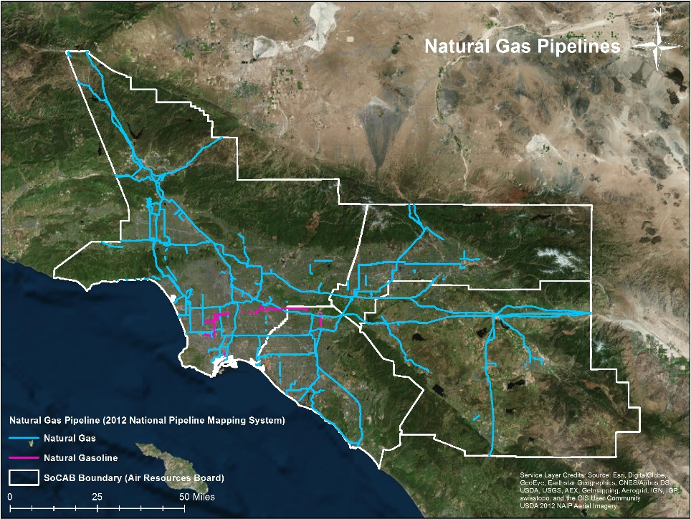
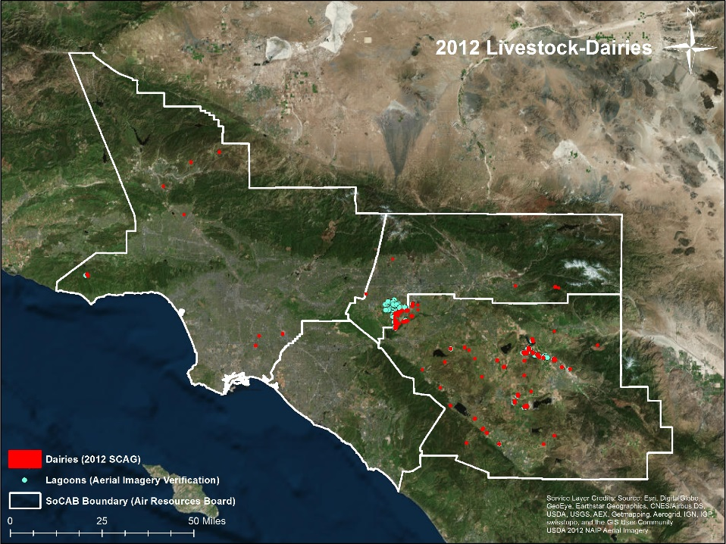
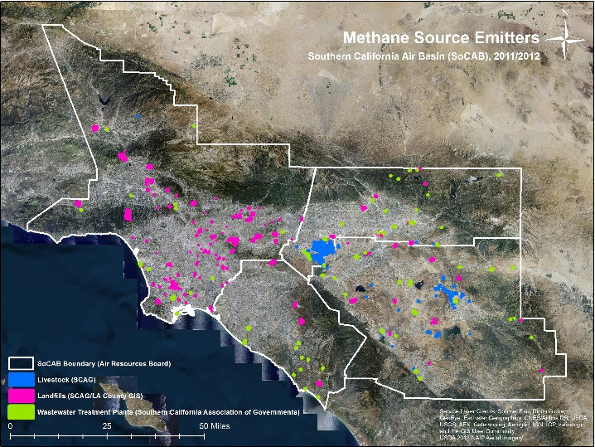
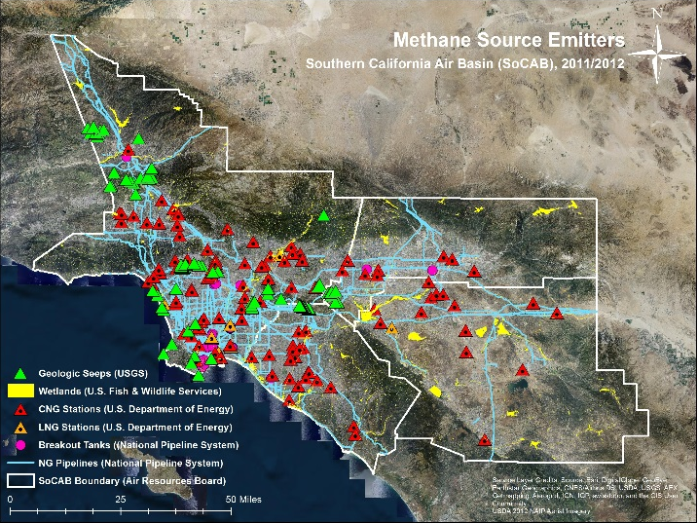
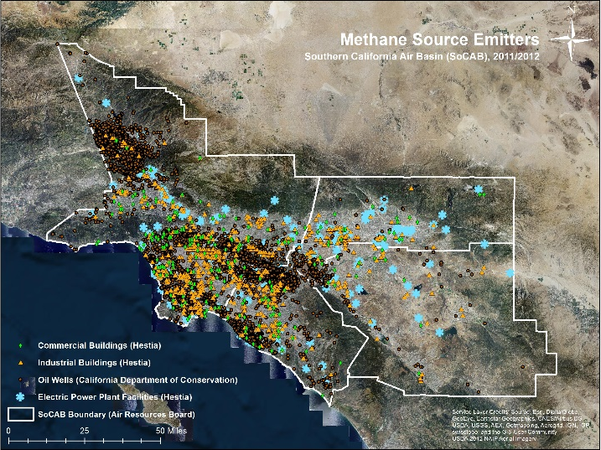
Spatial Datasets

Slide 6
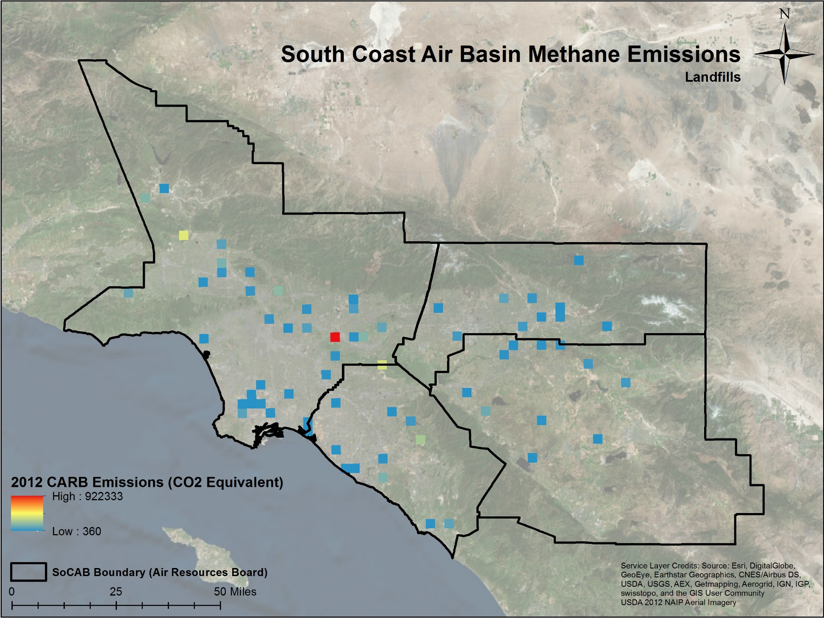

Slide 7
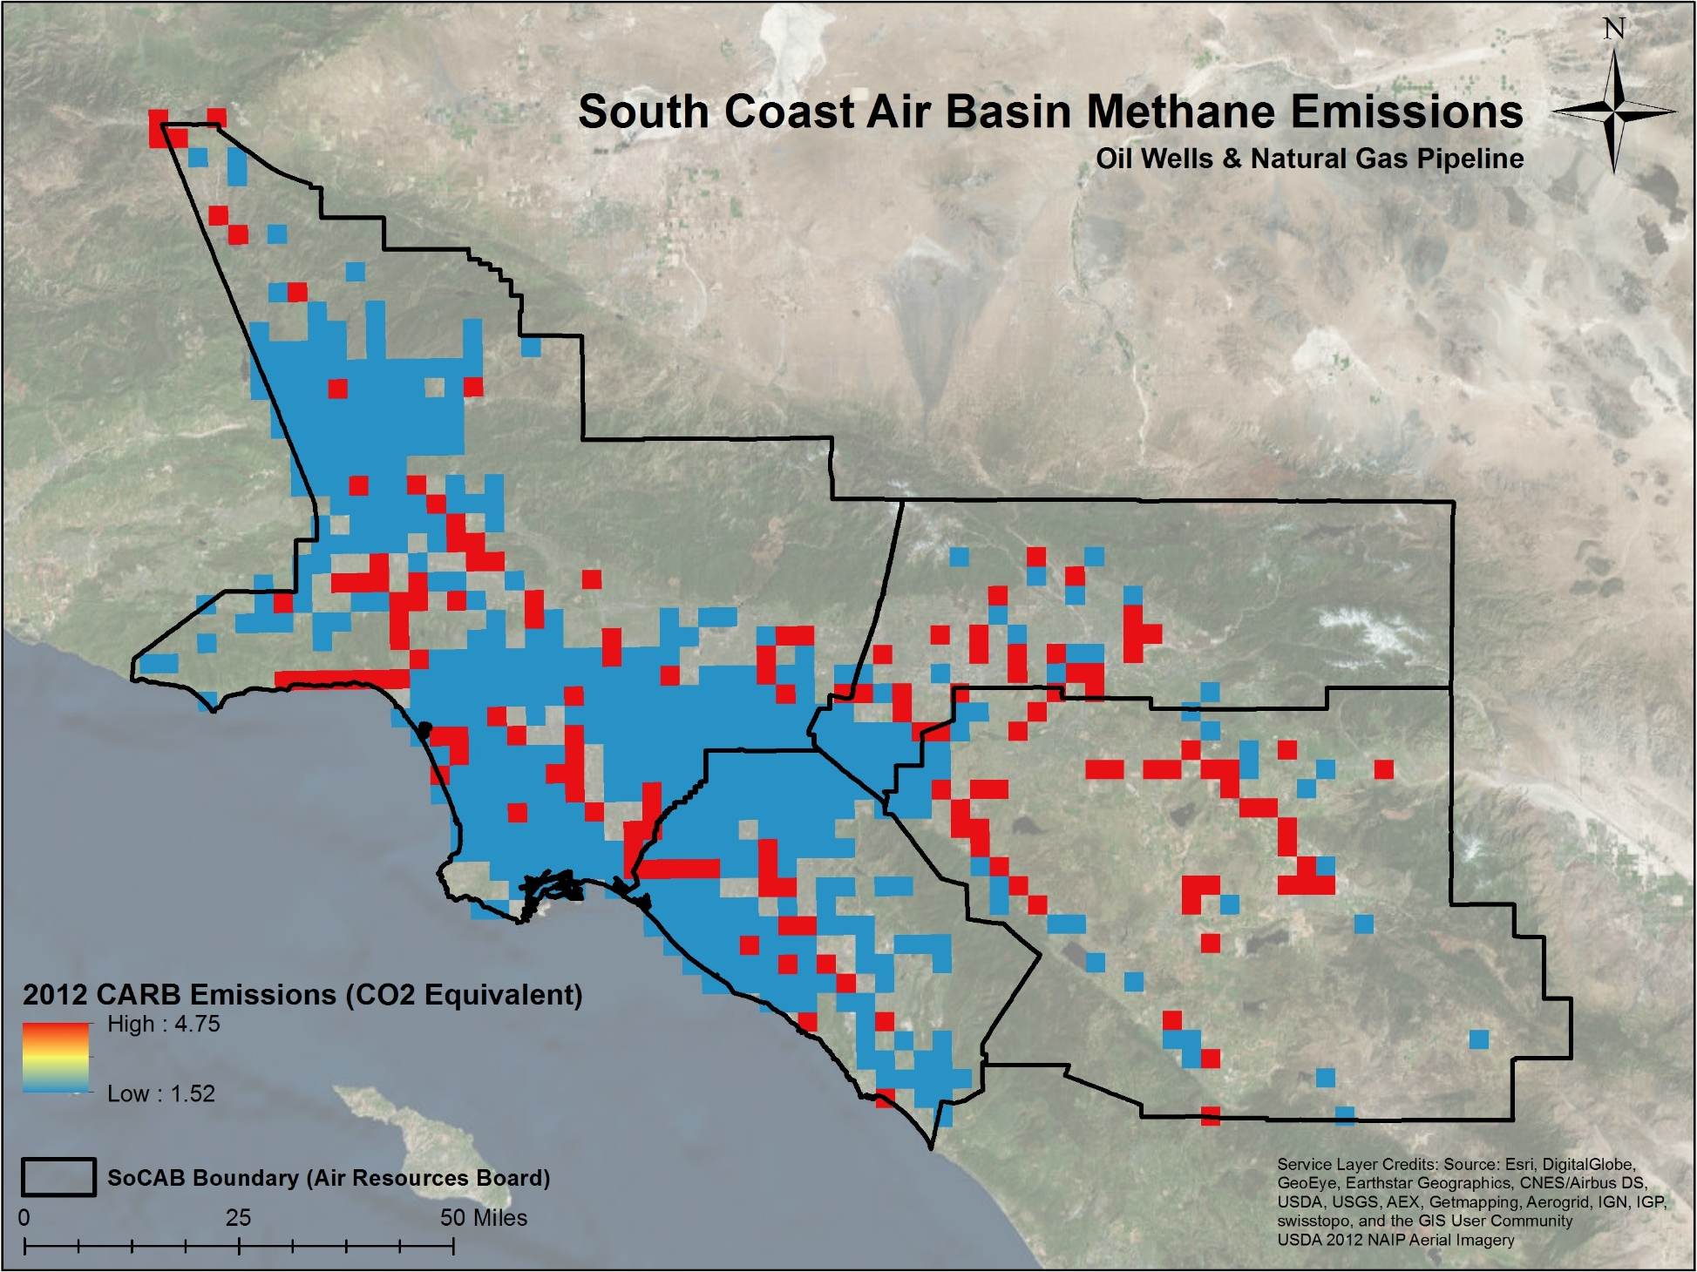

Slide 8
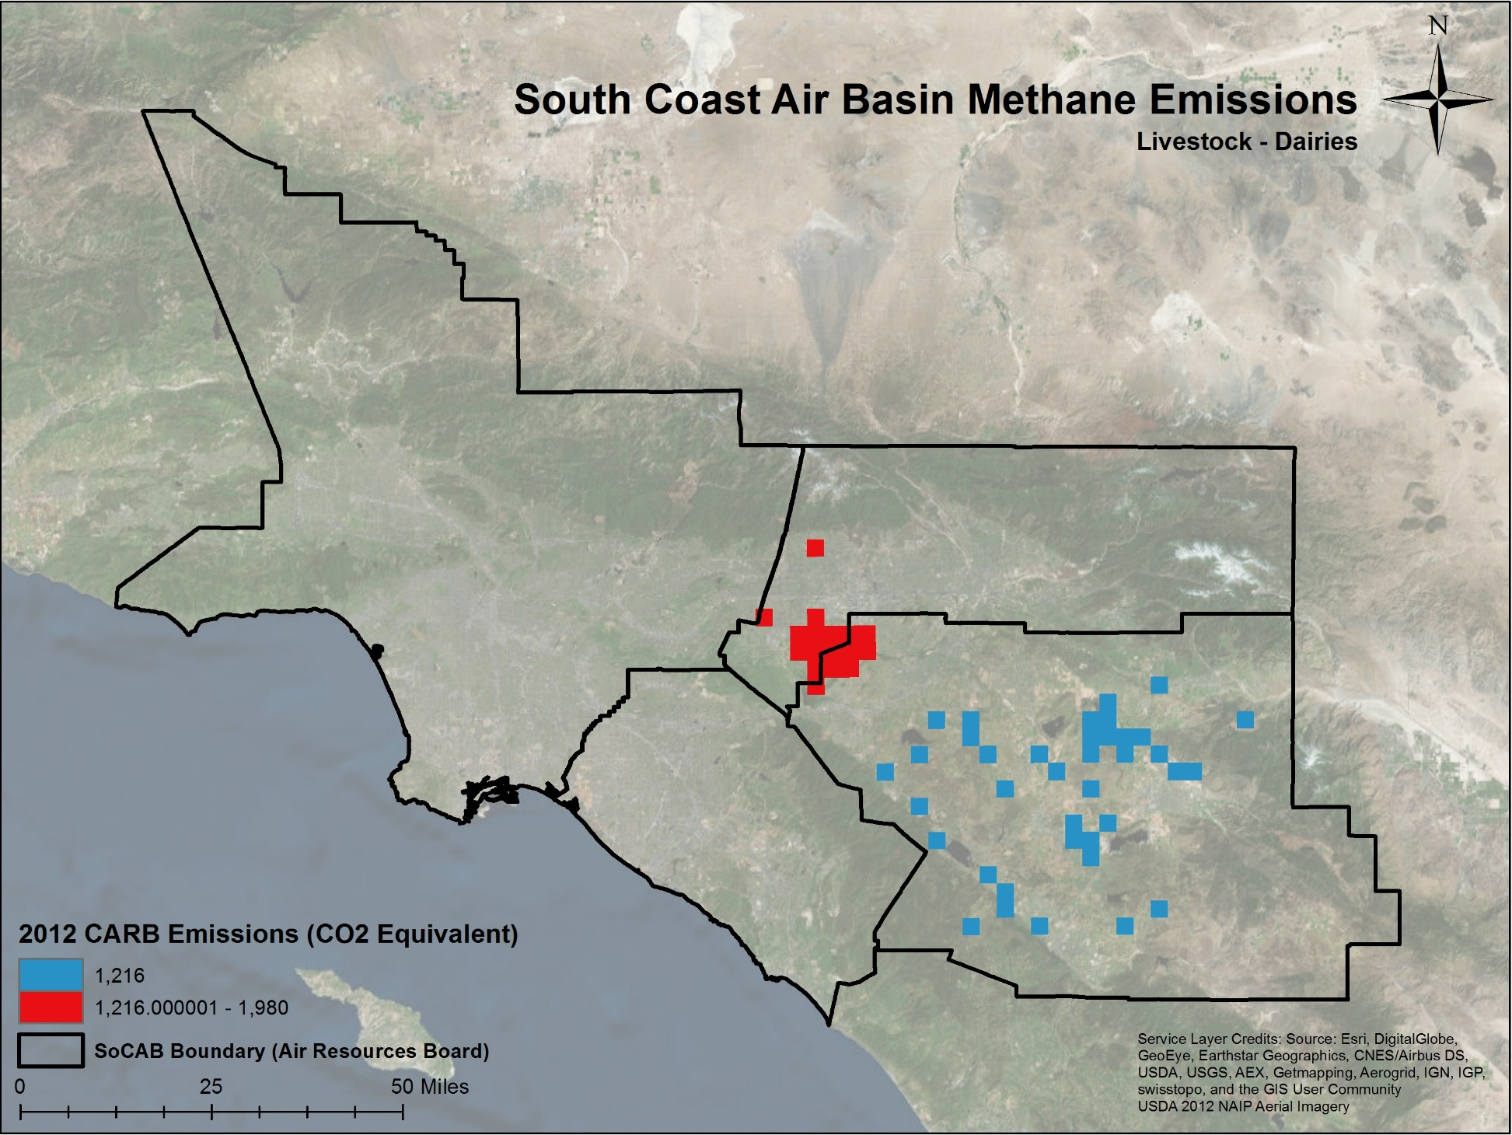

Slide 9
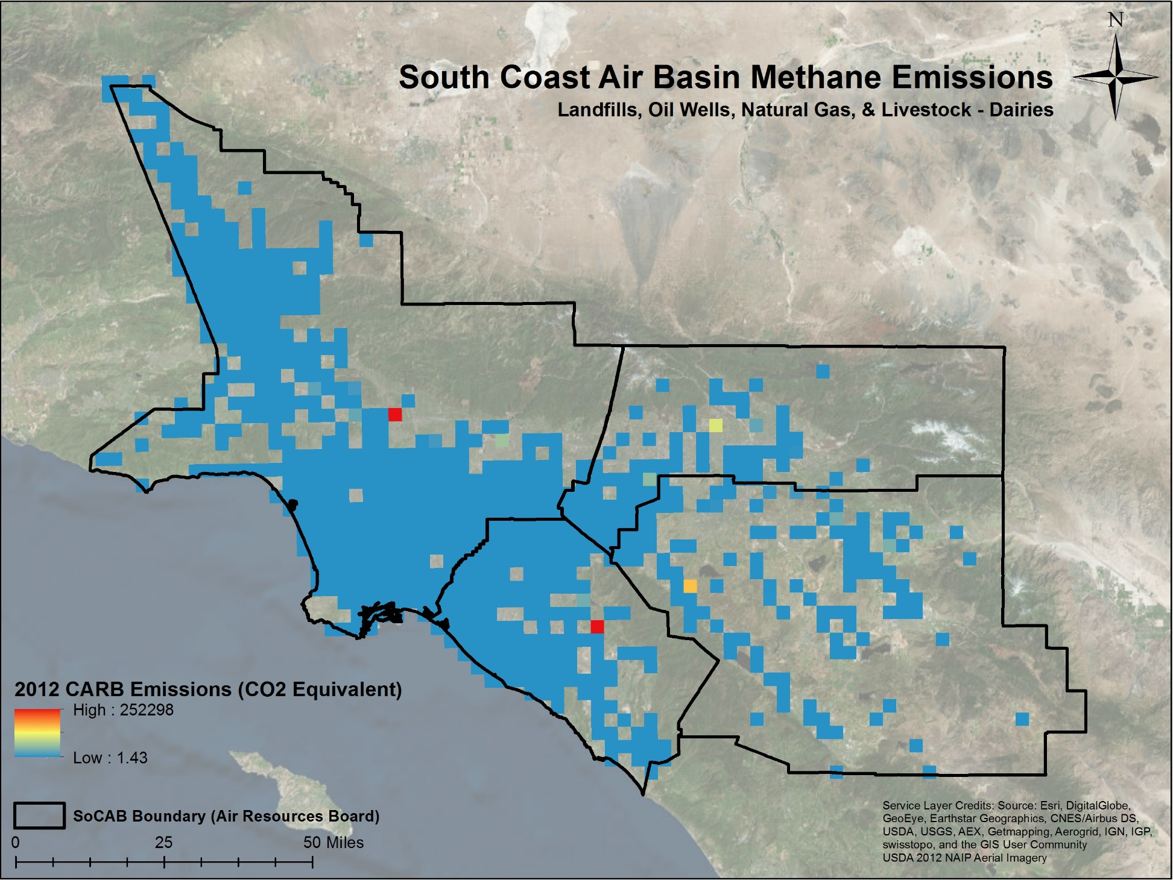

Slide 10
Future Research
Comparison of this bottom-up method to top-down NASA Earth Observations
In-situ network
OCO-2
TCCON
JAXA GOSAT

