Slide 1
North Carolina Water Resources
Utilizing NASA Earth Observations to Monitor Harmful Algal Blooms in the Albemarle and Pamlico Sounds of North Carolina
Chad Smith (Project Lead)
Jelly Riedel
Keith Benjamin
Daniel Wozniak
Matthew Carter

Slide 2
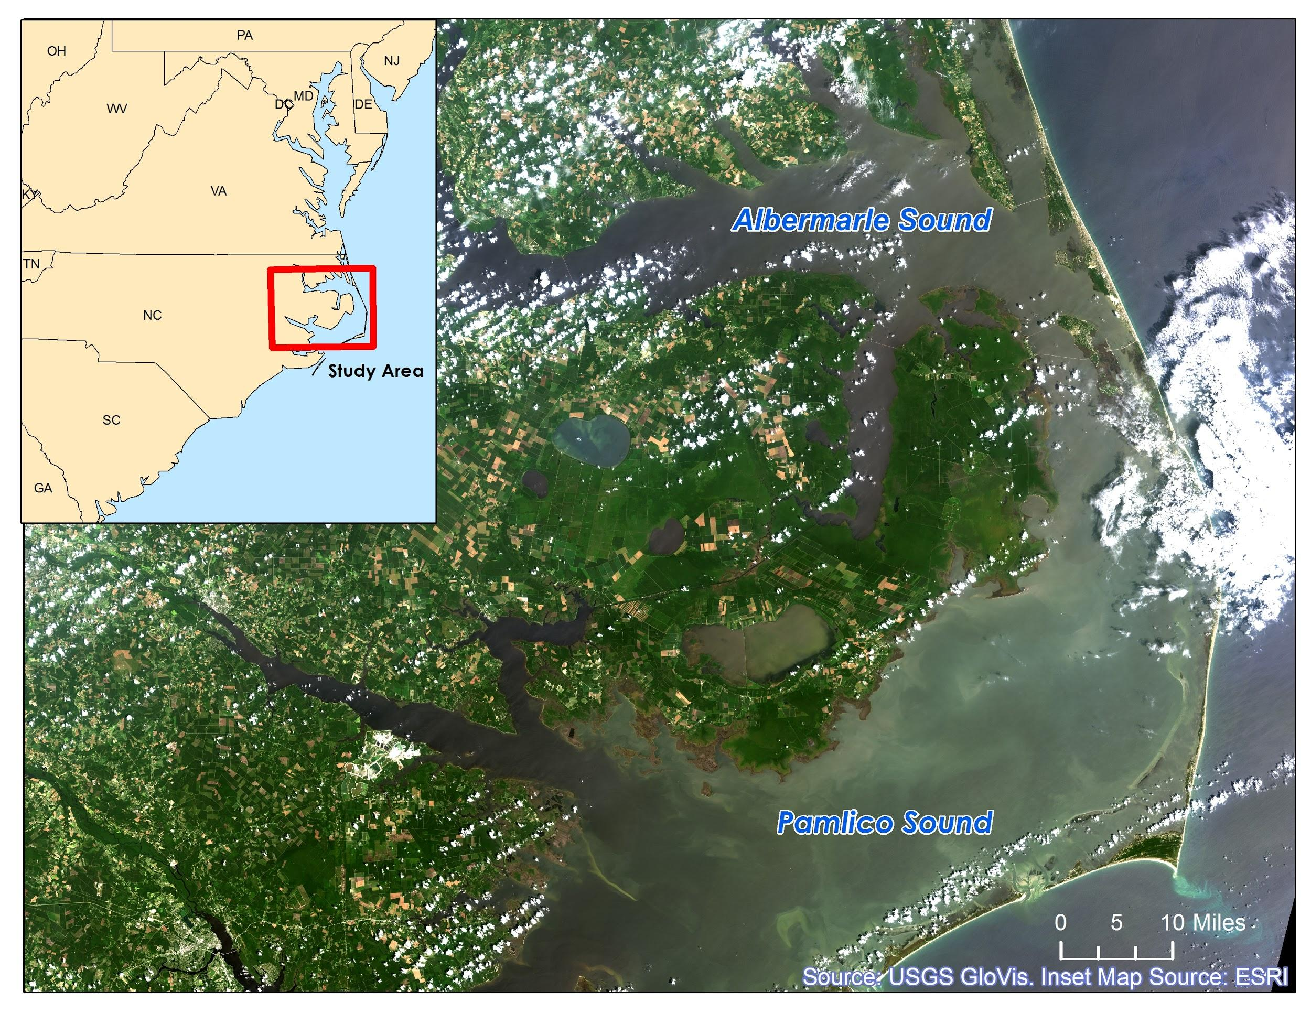
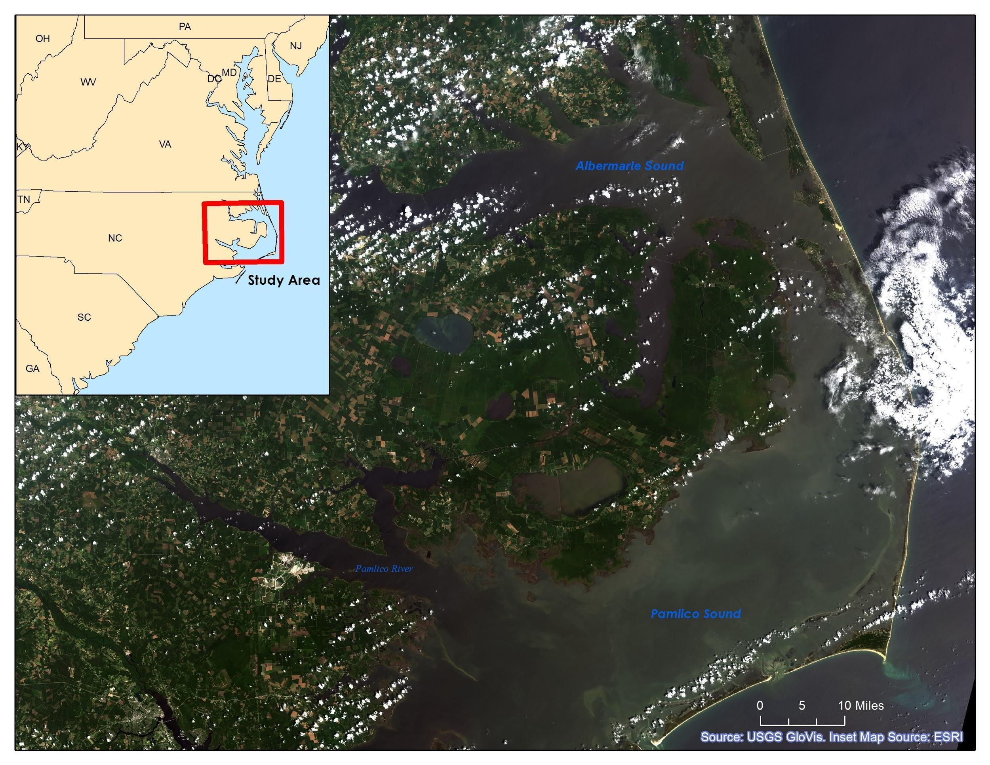
Community Concerns
Why are the Albemarle and Pamlico Sounds so important?
2nd largest estuary in the United States
Contains 99% of the Atlantic coast’s submerged aquatic vegetation (SAV)
Supports one of the nation’s richest fisheries
Valuable to sportsmen and tourists
Notes:
I think this map looks too dark. We can replace it with a lighter image. I can mess with the symbology in the raster to make it appear lighter.
The Albemarle-Pamlico National Estuarine Complex is the 2nd largest estuary in the United States
Contains 99% of the Atlantic coast’s submerged aquatic vegetation outside of Florida
Supports one of the nation’s richest fisheries
Valuable for its appeal to recreational sportsmen and tourists

Slide 3
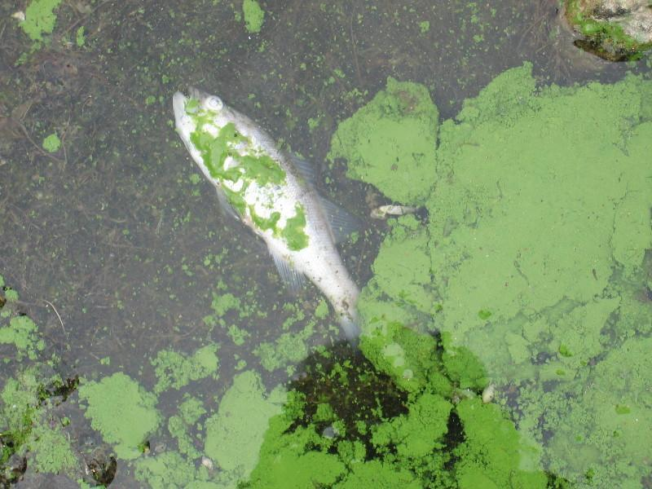
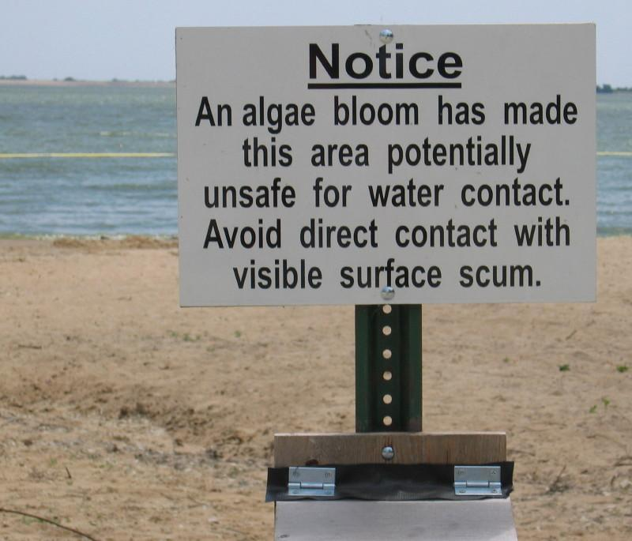
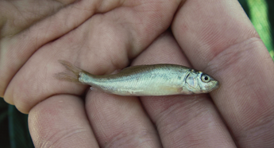
Community Concerns
Dangers of Harmful Algal Blooms (HABs):
Toxins in concentrations lethal to wildlife and domestic animals
Adverse human health effects
Hypoxic zones
Reduced light availability in water column for SAV
Source: USGS
Source: USGS
Source: USGS

Slide 4
Project Partners
Dr. Michelle Mooreman
Sharon Fitzgerald
USGS North Carolina Water Science Center
Jim Hawhee
Dean Carpenter
Dr. Bill Crowell, Director
Albemarle-Pamlico National Estuary Partnership (APNEP)

Slide 5
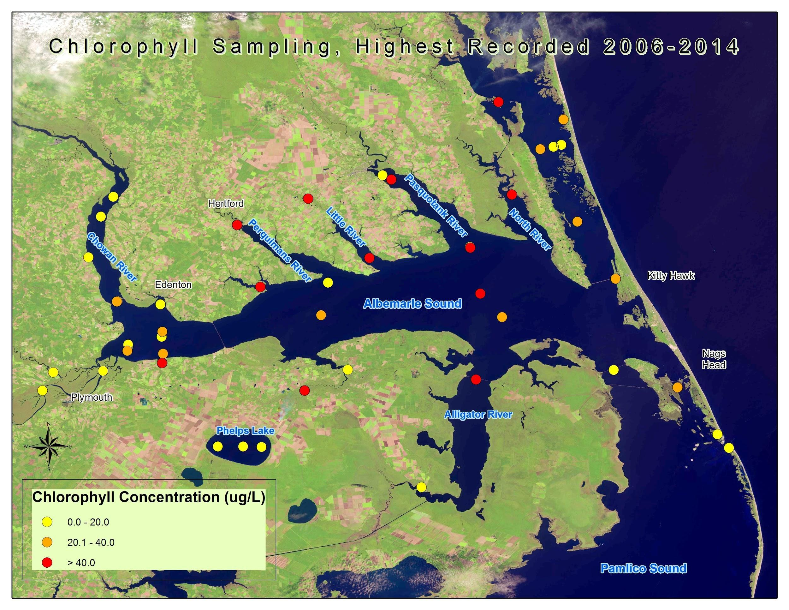
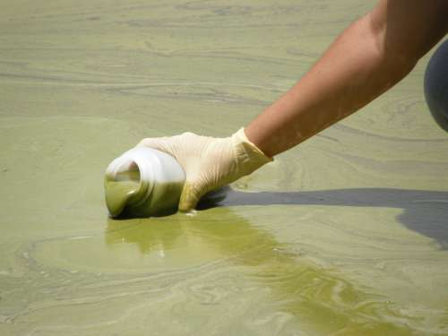
Project Objectives
Create a 10 year time-series representation of HAB extent from 2004 to 2014 using Chl-a as a proxy for algae
Compare MODIS-derived HAB maps with in situ water sample data
Provide end-users with informational maps of large-scale HAB extent
Source: USGS

Slide 6
Project Methodology
NASA Earth Observations: | Data Acquisition:
Aqua MODIS Level 2 Data | Sea Wifs Data Analysis System-SeaDAS Goddard Space Flight Center Website
In situ Data: Water Quality Samples Station Locations
SeaDAS Chl-a algorithm

Slide 7
Project Methodology
MODIS Level 2 Daily Ocean Color Data
NWQMC Monitoring Station Locations
Processing- Reject partial images, etc.
NC Water Science Center Data & NWQMC Point Sample Data
Gridding
Clip to Study Area
Convert Collection Dates to Cardinal Dates
OC3M MODIS derived Chlorophyll (443, 489, 547)
Join Available Data to create XY Event Layers in ArcMap
Extract Raster Values for comparison to in situ data
Point Shapefiles
Calculate Monthly Means of Chl-a Concentration
Cartographic Representations of Point Samples with Landsat Imagery Basemaps
Overlay on Landsat Imagery Basemaps for Time Series Representation
Notes:
add animations for each thing

Slide 8
Time Series Animation-Results

Slide 9
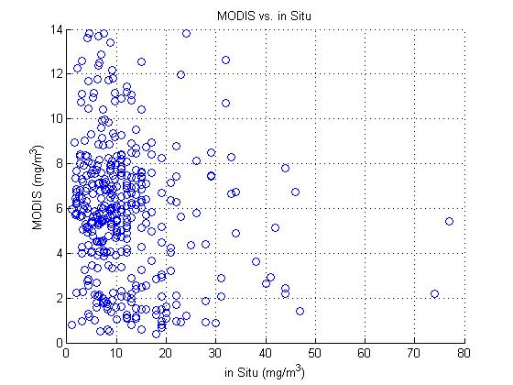
Conclusions
MODIS OC3M-derived chlorophyll demonstrated poor correlation with in situ measurements
R² Values .0196%
Further research needed to establish estuary-specific remote sensing algorithms to detect chlorophyll
Need in situ data for cyanobacteria

Slide 10
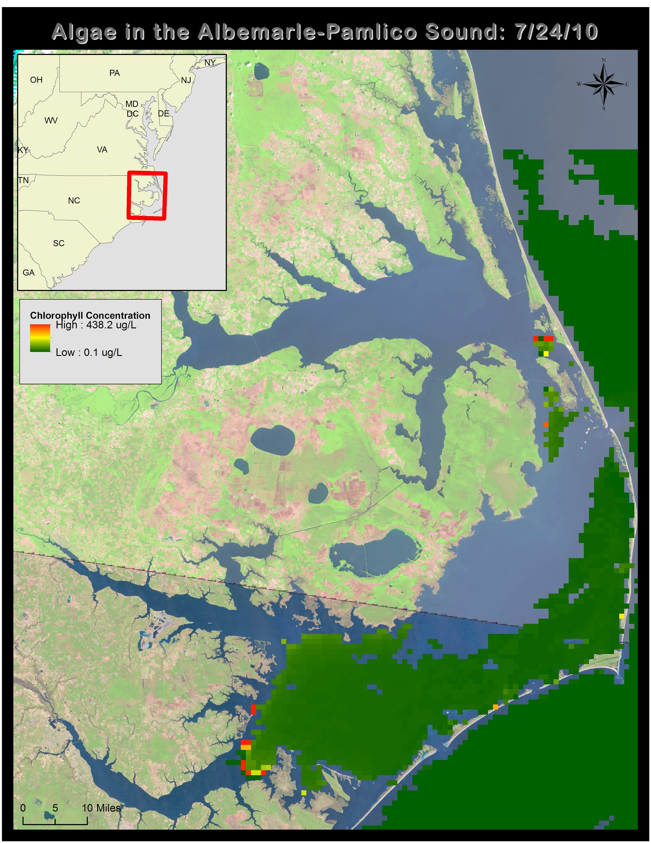
Uncertainty / Error Analysis
OC3M Algorithm use in coastal waters not as accurate as open oceans
MODIS bands not necessarily the best for detecting singular types of phytoplankton
Water sample depth v. surface/near surface algae

Slide 11
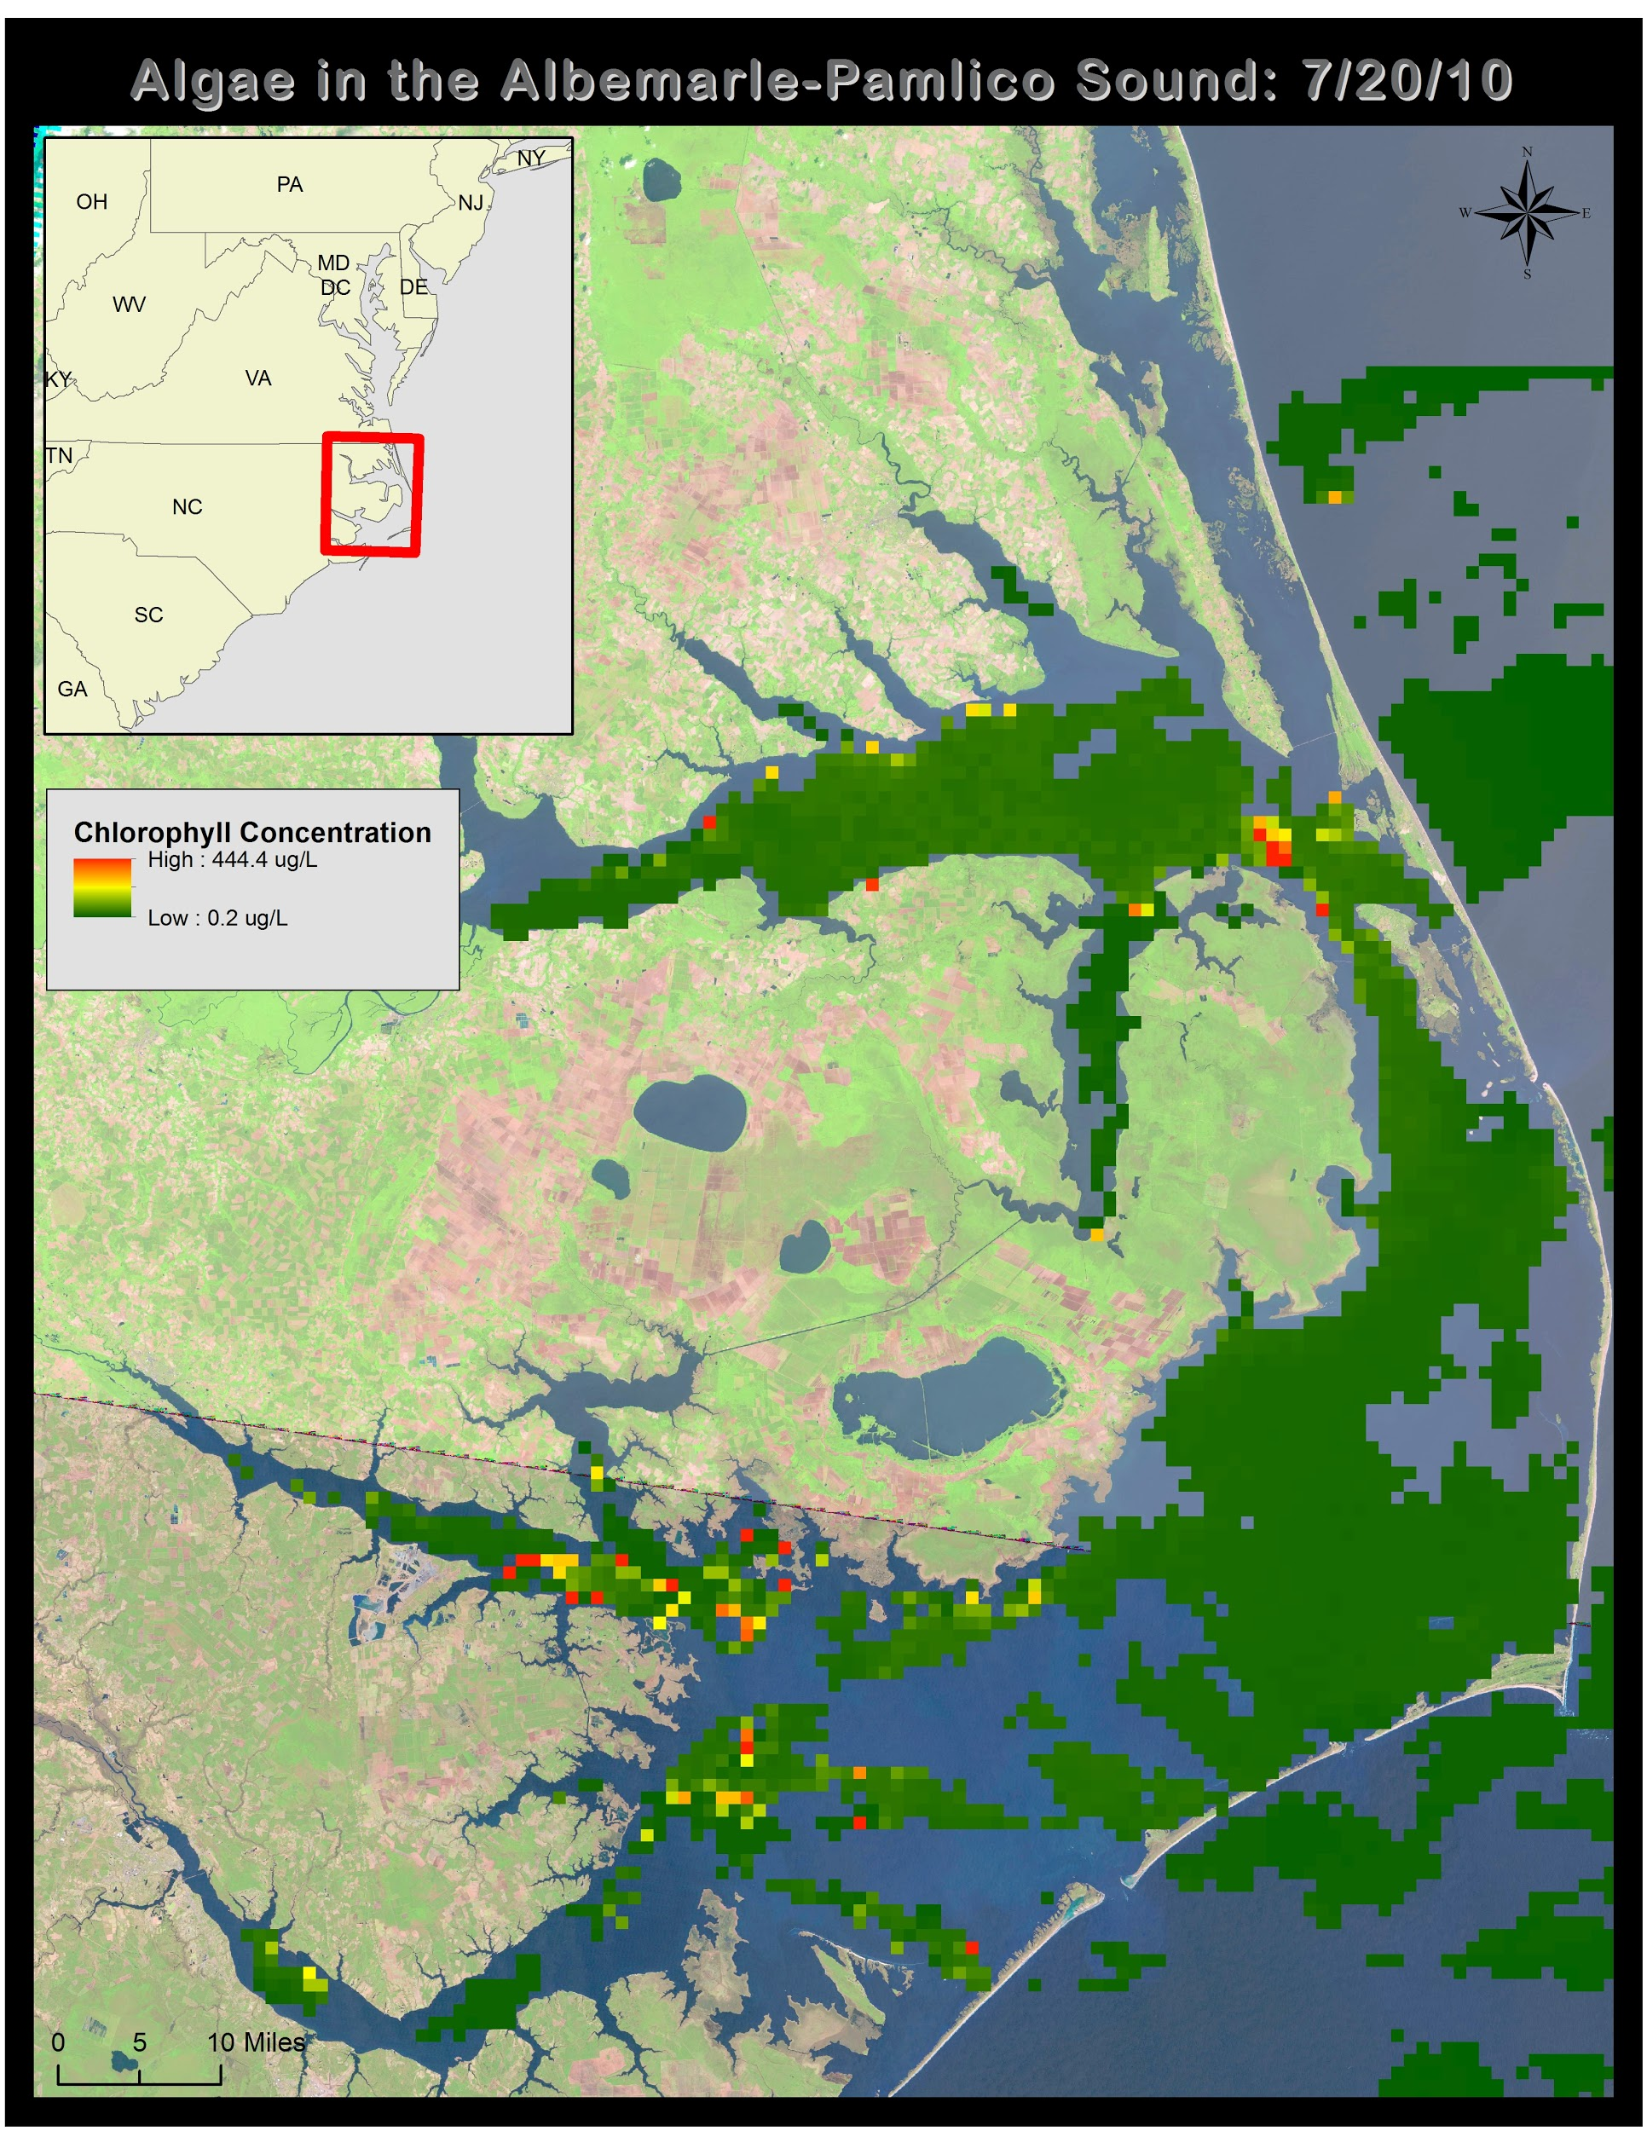
Benefits of Research
Large extent of HAB monitoring
Historical record of HAB behavior
Seasonal Monitoring of HABs

Slide 12
Future Work
Correlations between other types of phytoplankton and MODIS.
Incorporation of estuary-specific algorithms for local area of interest
Investigation of relationships between chl-a concentration and land cover/ land use in the area or other water quality factors (dissolved O2, N, P, etc).

Slide 13
Acknowledgements
Advisor
Dr. Kenton Ross, DEVELOP National Science Advisor
Partners
Dr. Michelle Mooreman & Sharon Fitzgerald,
USGS North Carolina Water Science Center
Jim Hawhee, Dean Carpenter, & Dr. Bill Crowell, Director,
Albemarle-Pamlico National Estuary Partnership (APNEP)
Others
Jeff Ely, Geoinformation Scientist
This material is based upon work supported by NASA through contract NNL11AA00B and cooperative agreement NNX14AB60A.

