Slide 1
North Carolina Ecological Forecasting II
Update of the NOAA C-CAP Wetland Delineation and Land Use Classes Using Remote Sensing
Ben Roberts-Pierel (Project Lead)
Jake Patrick
Brett Buzzanga
Benjamin Charlem
Michelle Pasco
Taylor Sage
Notes:
Name introductions.

Slide 2
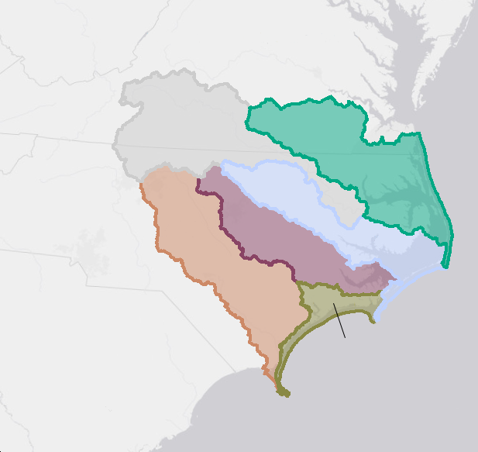
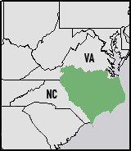
Study Area
Albemarle-Pamlico Estuarine System
Study Period: Summer 2015
Notes:
Study Area:
Albemarle-Pamlico Estuarine System
It is the largest lagoonal estuarine system in the United States
It consists of six river basins (Pamlico, Albemarle, Roanoke, Neuse, Cape Fear, Onslow Bay)
This project focuses on the Albemarle/Pamlico sounds watershed
The Study Period was from Spring 2015 to Fall 2015

Slide 3
Image Credit: sugargliding
Status of the Basin
Climate Change
Population Growth
Water Quality Influences
Notes:
Status Of The Basin:
There are two major threats to wetland extents/health:
Population growth- Population grew by 36% between 1990-2010. This lead to land use change and leads to more Industrial and Agricultural runoff ending up in the system.
This Industrial and Agricultural runoff also effects water quality, causing a decrease in human health.
In addition, Climate change has triggered steady sea-level rise, causing Wetland deterioration at a rate of -3.3 feet/year (ibid).)
In order to ensure the preservation of these areas, an improved data set of the current extents and rates of deterioration of wetlands in the Albemarle/Pamlico Sounds watershed is needed to properly assess the possible future impact on the area and surrounding communities.
Image Credit: sugargliding. IMG_2446. Outer Banks, North Carolina. July 2009. Image Modified. https://www.flickr.com/photos/xmrocks/3759181472/in/photolist-6JbMFE-6JbLHm-6J7Gtt-6J7MYv-6JbNSW-6JbNFs-6J7KG6-6J7LJT-6J7Jx4-6J7MDF-6JbPRS-6J7KSK-4ZZnYf-4ZZph1-4ZZoN9-5xNnLK-5xNmwT-6J7Ltx-6JbLVU-6J7L64-6JbNmq-6J7Gh2-6J7Jet-6J7Mj4-6J7M4Z-6JbN5C-6JbT1m-2JLKXH-6J7wmc-6JbA4S-6J7vRX-6JbAZo-6J7uWM-6J7zFX-6J7tMt-6JbDbq-6J7zYc-6JbEeL-6J7tUK-6J7vmk-6JbCA7-6Jbzfd-6J7wyV-6JbBFd-6Jbzq3-6J7vEx-6JbzDq-6JbDEq-6JbAqU-6JbyYJ

Slide 4
Partner Organization
Albemarle-Pamlico National Estuary Partnership (APNEP)
Image Credit: Ben Roberts-Pierel
Notes:
This is our partner organization

Slide 5
Objectives
Provide an updated land classification system for APNEP for use in policy making
Create a replicable methodology
Identify invasive species Phragmites Australis
Image Credit: NASA Johnson
Notes:
1. The primary objective of this project was to create an updated classification to the NOAA CCAP (Coastal Change Analysis program)
CCAP is updated every 5 years
Our Goal was to give our partners, The Albemarle-Pamlico National Estuary Partnership (APNEP) more current data to work with, In addition to a methodology for replicating the process we followed so that APNEP can update the classification more regularly than CCAP allows.
2. The summer term for this project, North Carolina Ecological Forecasting I looked at wetland health in the Albemarle-Pamlico watershed. As a secondary goal, we hoped to link our findings with theirs to improve the usefulness of our work and to create continuity between the two projects.
Image Credit: NASA Johnson. sts059-208-068. Pamlico Sound Area, North Carolina. March 1994. Image Modified. https://www.flickr.com/photos/nasa2explore/9366996364/in/photolist-3Mdf8a-3MicD5-3MhyFL-3MdShD-3MhVAG-3Miaqd-3MhVjQ-3MdCnn-3MhTUd-3MhUdj-3MdcDH-3MhUxL-3MdBAM-3MdBN6-3iEMY1-dwHknA-fgJiFj-fjDc9R-5xNhpv-5xTP2m-5xTNU9-5xSE9J-5xNkHP-5xSHA3-5xSDYQ-5xSGpw-5xPqgX-5xNjxM-3Rh9Y8-3iEN4o-3iApvP-3iApsD-3iENdy-3iApb2-3iENs1-3iEN2L-3iENg1-3iApAn-3iApyF-3iAtEK-3iENnb-3iApjv-41YnvS-3MhSPy-5xSDGf-5xSDmL-fgyXjx-fiPZkT-ffoZCE-ffp1oL/

Slide 6
NASA Earth Observations
Landsat 8
Operational Land Imager (OLI)
Image Credit: USGS
Notes:
1. Images from NASA's Landsat 8 were used for this project
Images from June 23, 2015, July 25, 2015, August 10, 2015 were used
The two scenes used are as follows: Path 14, Row 35 and Path 14, Row 36
Although we considered using other data from the Terra mission such as NDVI from MODIS and DEMs derived from the ASTER instrument, we concluded that higher resolution or more purposeful imagery for our project was available from other sources, principally the USGS and USDA.

Slide 7
Methodology
Data Acquisition
USGS
USDA
Data Processing
Aggregation of Data
Training Sites
(Polygons)
Final Result
Supervised Class
Accuracy Assessment
Revised
Re-run
Notes:
The flowchart shown here gives a general breakdown of our project methodology. We first acquired data from NASA EOS, USGS, and USDA and performed any pre-processing necessary. We used these data sets, listed here in light green rectangles, to develop a better understanding of the contextual factors and ultimately to create training sites for our supervised classification model. We used the understanding gained from these ancillary datasets to create polygons or training sites which represented specific land cover types.

Slide 8
Data Sets
Notes:
The specific datasets utilized included: Landsat 8 OLI, USDA Cropscape, NOAA’s C-CAP land cover classifications, the National Hydrological Dataset, SSURGO soil data, and Digital Elevation Models. Most of these were collected from USGS and USDA. The main method of analysis was through the Landsat 8 composite images dated from the summer of 2015. The other datasets were used as supplementary data to cross-reference with what we were seeing in the Landsat images. Jake will discuss the details of this in the next slides.

Slide 9
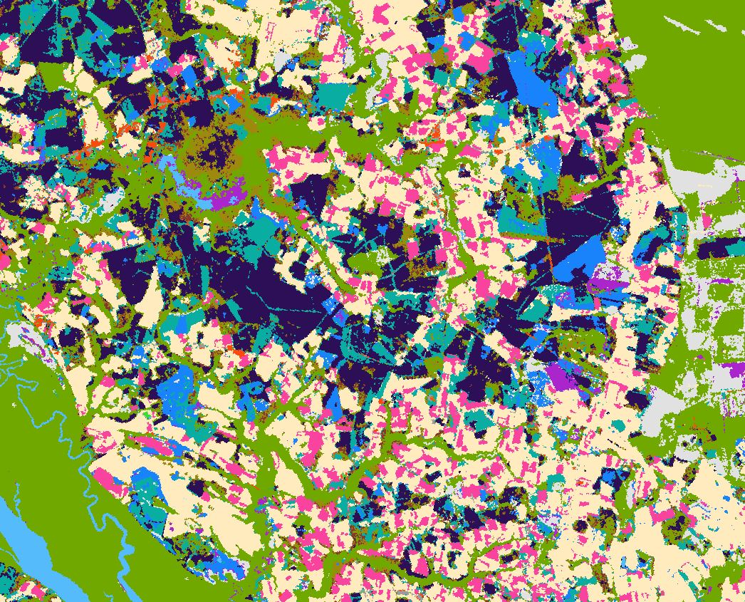
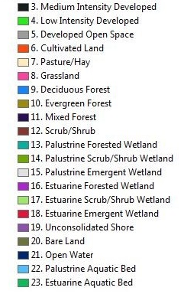
NOAA Coastal Change Analysis Program (C-CAP)
Notes:
Data from C-Cap shows coastal regions and is published every 5 years at a 30m resolution
The C-CAP dataset consists of 25 classes but some were removed because they were not relevant (ex. Tundra, ice/snow)
Product was created using an unsupervised classification and a number of ancillary datasets to cross reference.

Slide 10
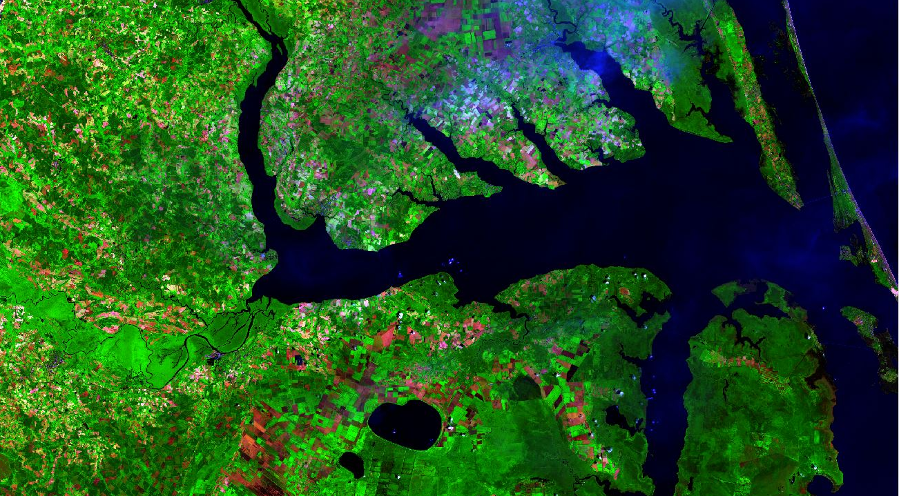
Landsat 8 Scenes
Land classification was carried out with these images and other ancillary data
Notes:
Images from June 23rd 2015, July 23rd and August 10th were downloaded from Earth Explorer. The surface reflectance product was downloaded which has been corrected for both surface reflectance and some atmospheric interference. Two scenes were produced (14, 35 and 14, 36).
Bands were composited in ArcGIS to produce images that were useful for classifying land use types.

Slide 11
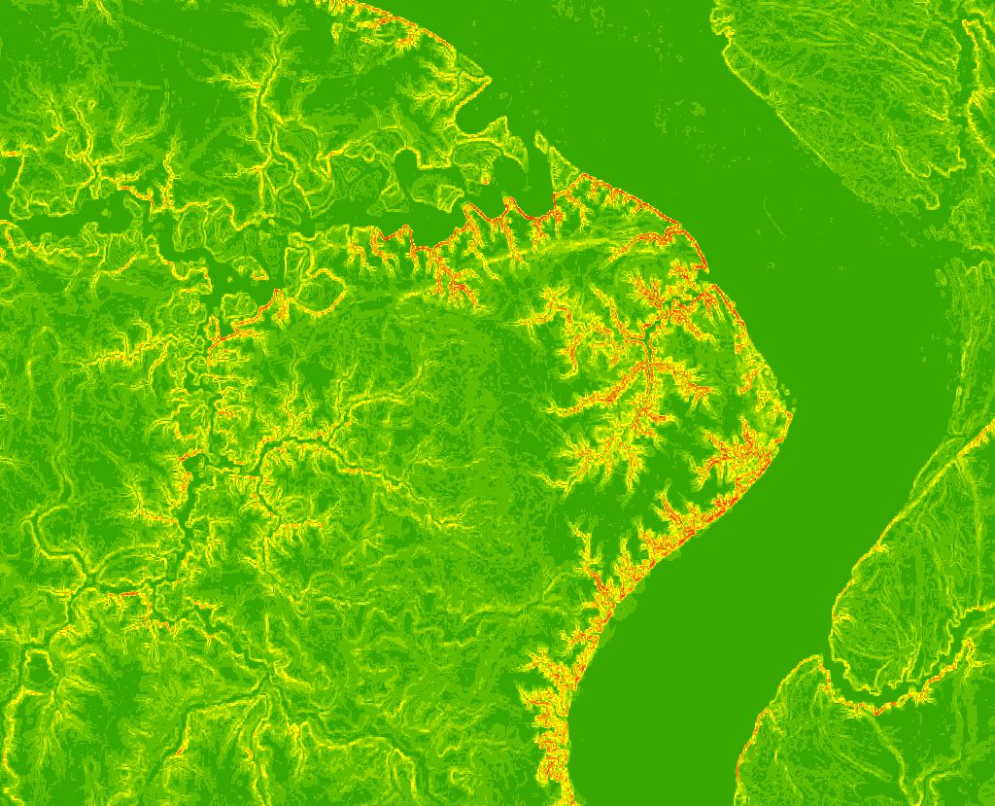
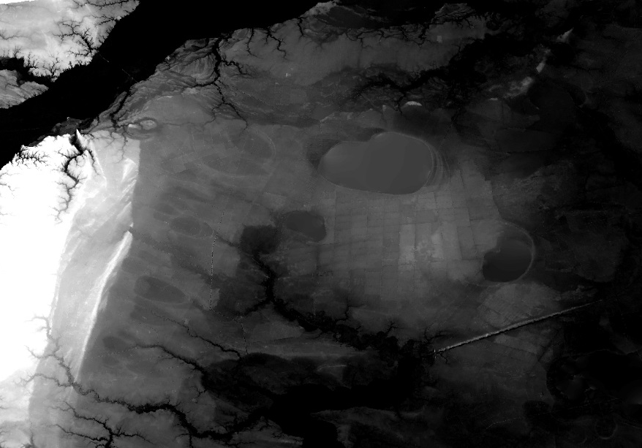
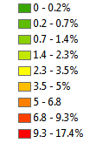
Digital Elevation Model (DEM)
Derived slope (left) and DEM (right) assists classification and differentiates low-lying wetland areas
Notes:
A digital elevation model is a commonly used data layer to assess elevations across a landscape. We used 3DEP (Digital Elevation Product) DEMs from the USGS.
The image shows percent slope which is sometimes more helpful than the DEM for easily identifying and highlighting areas of elevation change.
The DEM and Slope layers are useful for understanding the difference between forested wetlands and forests as they many times look similar on a Landsat or satellite image.

Slide 12
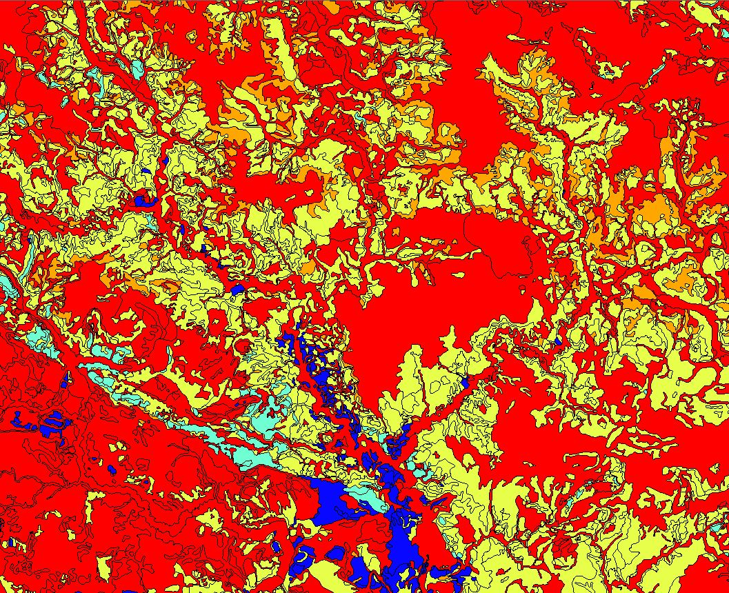
Soil Survey Geographic Database (SSURGO)
Depth to water table and percent hydric soils
Notes:
SSURGO is a large database of many different types of soil-related data obtained from USDA.
We found that the Depth to Water Table and the Percent hydric soil was helpful in delineating differences between forests and forested wetland.
Hydric soil is the anoxic soil which is inundated for part of the year and is the soil generally found in wetlands.

Slide 13
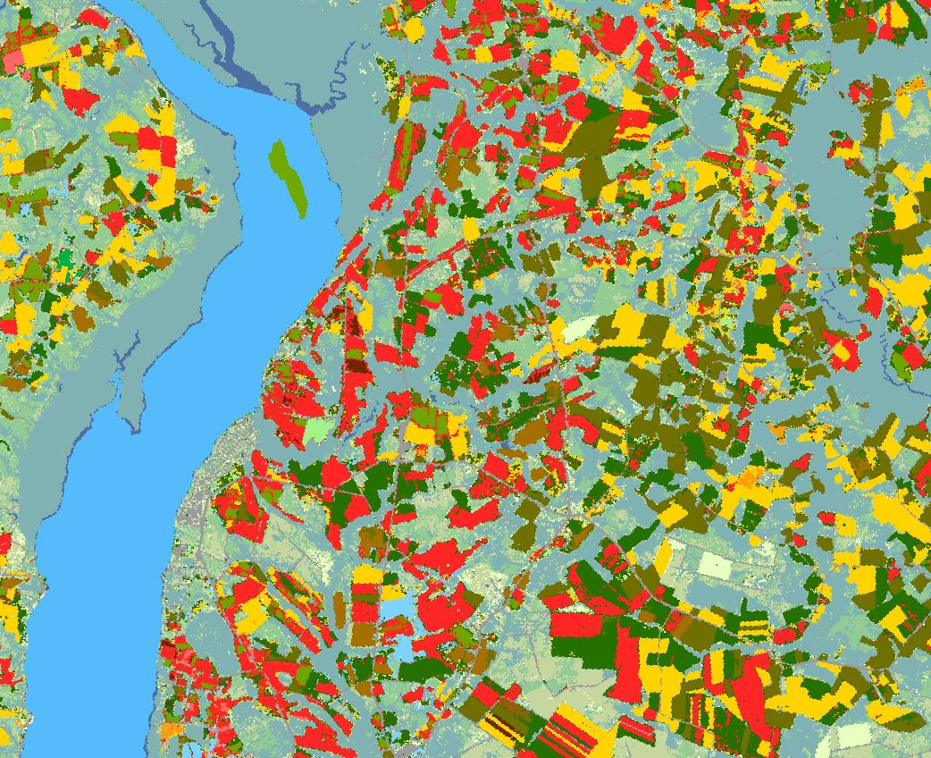
CropScape
Determination of crop types. The legend shows a sample of the types of agriculture classified.
Notes:
Cropscape is another land use classification dataset available from the USDA which focuses on crop type.
Although this is the main focus it also characterizes forest types, two categories of wetlands, woody wetlands and urban wetlands, and urban areas.
This dataset was also a useful alternative to the C-CAP which could be used to cross reference areas or classes that were difficult to characterize.

Slide 14
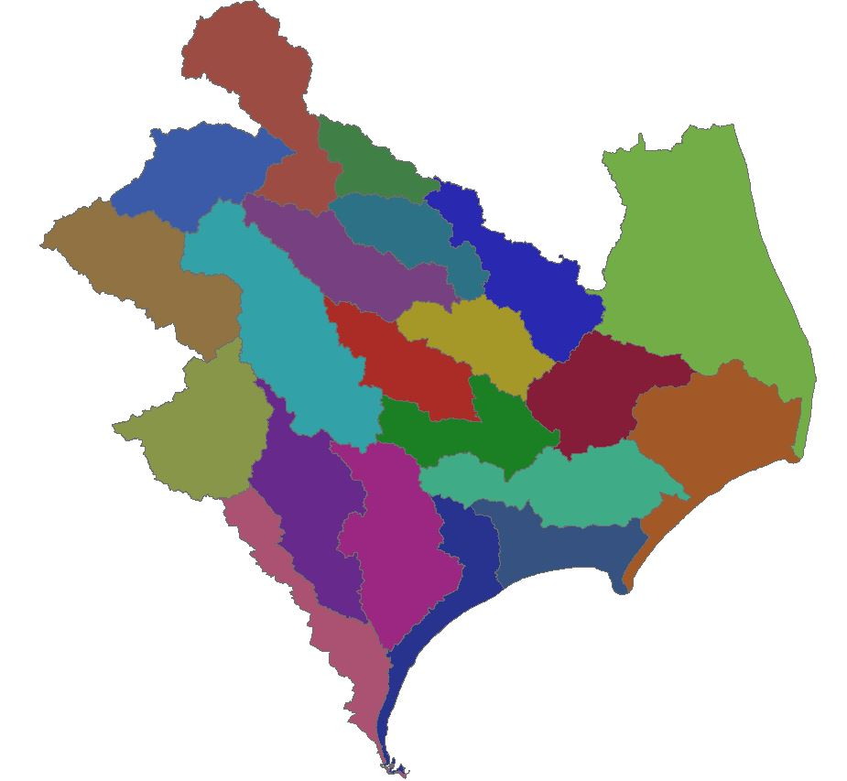
National Hydrography Dataset
(NHD)
Watershed boundaries and waterbody layers
Notes:
These are watershed boundaries and waterbody layers. They are useful for making images and understanding study area extent.

Slide 15
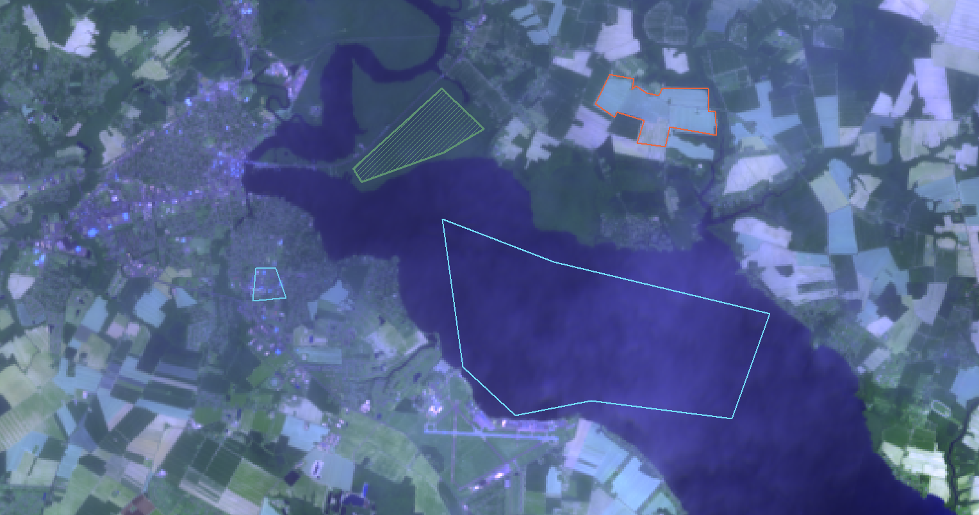
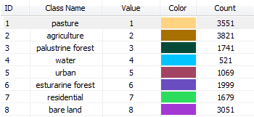
Training Sites (Polygons)
Notes:
We opted to use a supervised land use classification because of the greater degree of control we could exert over the outcome and in order to utilize more ancillary data more easily.
To conduct the supervised classification, training sites were selected by outlining polygons using the Image Classification toolbar in ArcGIS and attributing polygons with a given land class. The screen grab is just for demonstration purposes.

Slide 16
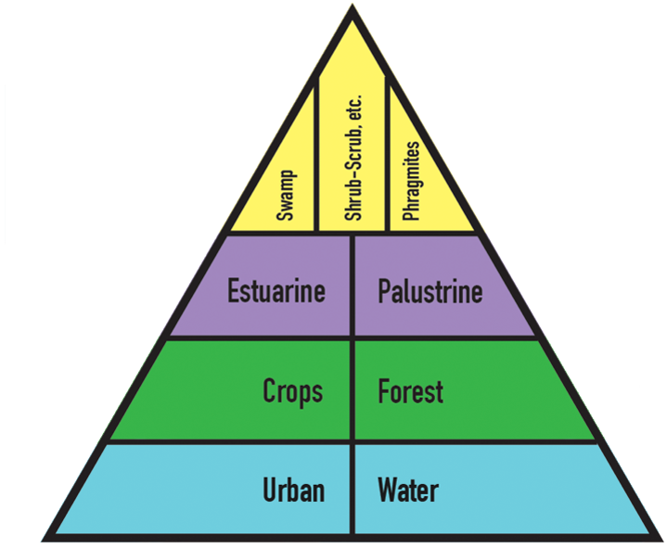
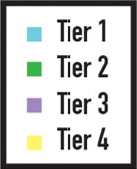
Classification Pyramid
Notes:
The pyramid graphic represents an approximation of the process we followed in selecting polygons. We started with those land types which were easiest to identify and worked our way up into delineating the types of wetlands. This was the most difficult group of classes to identify and the focus of our project.

Slide 17
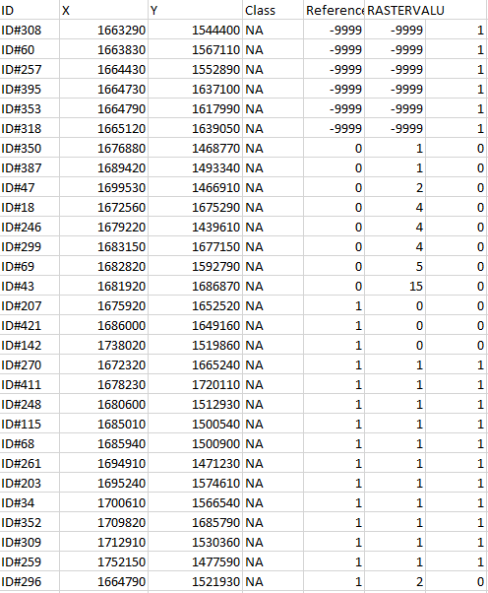
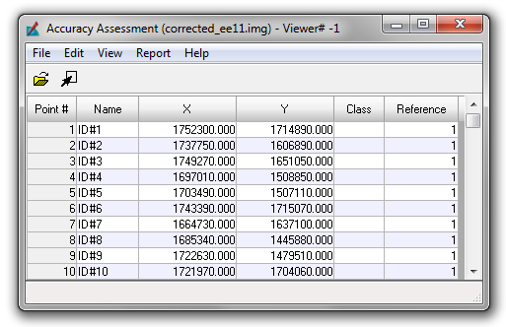
Accuracy Assessment
Conducted in ERDAS Imagine and Microsoft Excel
Randomly generated points attributed in ArcGIS and Google Earth
Overall accuracy of 48%
Notes:
ERDAS Imagine was used to generate random points and then points were referenced using ArcGIS and Google Earth as well as photos within this program.
Statistics were then calculated in excel and an overall accuracy of approximately 50% was generated for the full classification.

Slide 18
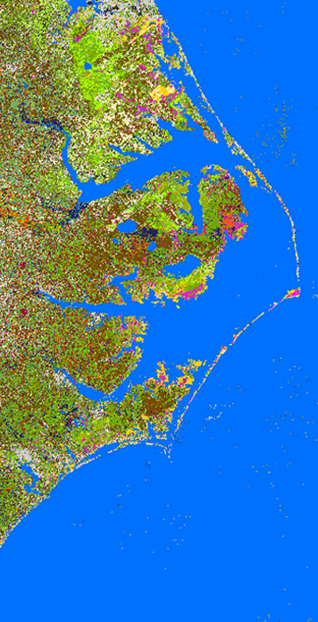
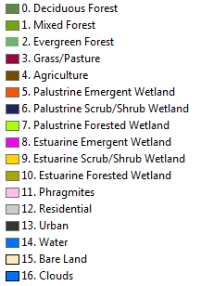
Final Classification
Final classification was created in Google Earth Engine and imported to ArcGIS and Erdas IMAGINE for analysis.
Notes:
The principal result of the project was the LULC map produced from the training sites assembled in ArcGIS. This particular classification was produced in Google Earth Engine (GEE) using a composite of seven bands from Landsat 8 and a slope layer derived from 1/3 arc second DEMs. Samples of the results depicting the Great Dismal Swamp in Northern North Carolina.

Slide 19
Image Credit: Shannon S.
Results
Show areas of difference between C-CAP and our Classification
Highlight potential uses of remote sensing data for identification of Phragmites
Notes:
One of the goals of this project was to highlight certain areas that the team from last term identified as experiencing declines in wetland health. In order to show these areas a sample of our classification as well as the C-CAP was simply compared with their study focus areas to determine which types of wetland are identified as having declining wetland health.
Image Credit: Shannon S. Perfect Ending. Currituck Sound, North Carolina. June 2014. Image Modified. https://www.flickr.com/photos/shannon-s/14422500500/in/photolist-nYt5VJ-qSYna-xsVar9-6J2G5c-6J6JuJ-a1CGXH-bCRDzD-eVZxQf-4ZZyHW-4ZZyeW-4ZVqtF-4ZZBFL-aifgHC-eTti9H-6J2Dpp-4ZZCyd-4ZVpyH-nNgjMP-4ZVoEX-4ZVmsH-ahXShh-6JbDSQ-6J7yBM-4ZYa1f-6JbNwj-4ZZGYC-6J6HVJ-6J6HaC-6J2BV8-6J2C32-6J6JAS-6J6H1J-6J6Hju-6J6HFb-6J2DSv-6J2D1e-6J6J4w-ntZiAB-4ZVi9F-6J2DZF-6J6Hsd-6J2CKr-6J2BLK-6J6Jm3-nLrfXN-cez8zY-4Uo24Z-6J6LJY-6J6MYm-6J6L49

Slide 20
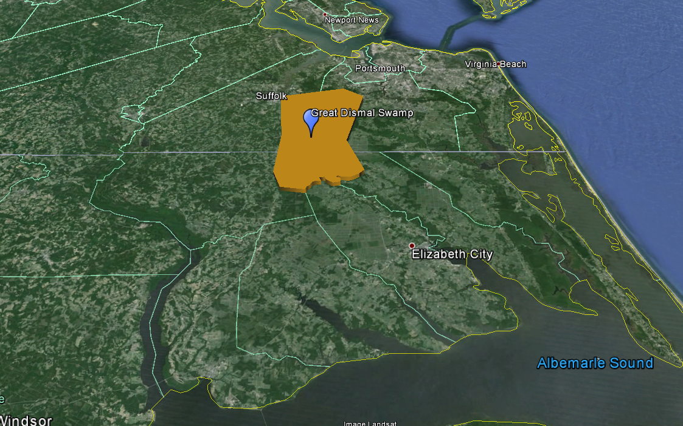
C-CAP vs Result
Area outlined in orange shows the Great Dismal Swamp, the area of focus in the next slide.
Notes:
Shows the location of the Great Dismal Swamp within the study area
Relevant for the next slide

Slide 21
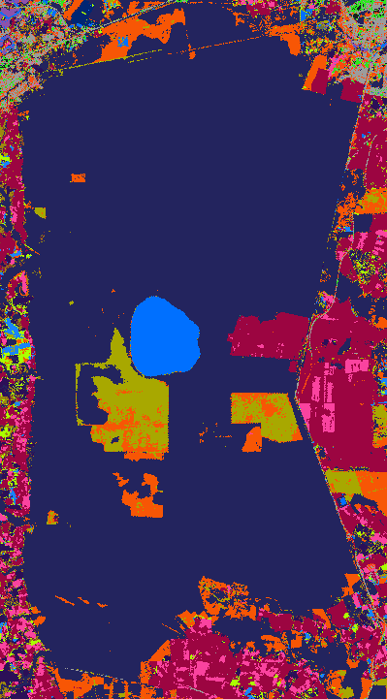
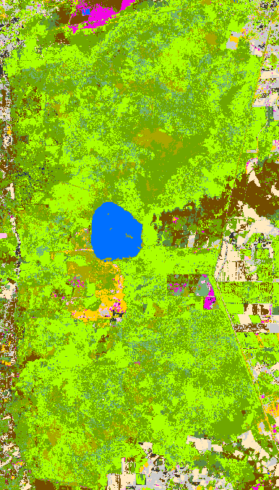
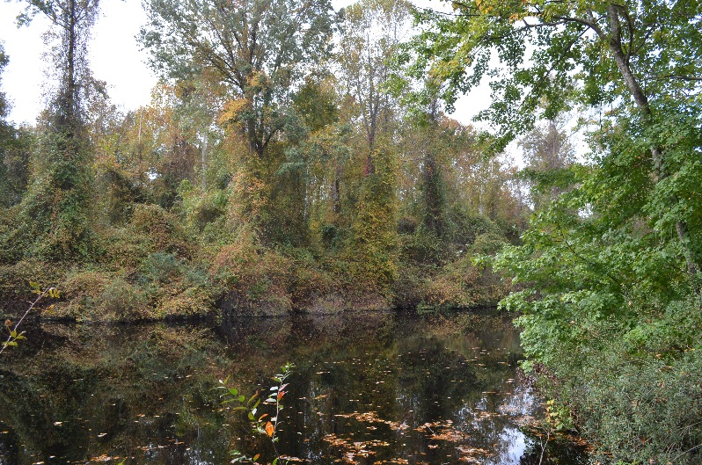
C-CAP vs Result
N
N
Palustrine Scrub/Shrub Wetland in C-CAP (left) is classified as Palustrine Forested Wetland in our result (right).
Forested Wetland in the Great Dismal Swamp.
Notes:
One of the principle uses of these results was to compare with the C-CAP product to highlight areas where our classifications differ from C-CAP, particularly in the wetland classes. The most prevalent differences found were in the classification of palustrine scrub/shrub wetlands by C-CAP when in reality much of this area should likely be defined as palustrine forested wetlands. Furthermore, there are large areas defined by C-CAP as grass or pasture which have been developed into urban or agricultural land.
There are a few potential sources of error in this project. The first and likely most influential is human error. The team developed a methodology for identifying wetland class types to attempt to standardize the process, however, selection of training sites remains largely subjective to the analyst. The process leveraged a wide range of data to cross reference and any error in these layers could also present a compounding factor. There is also a high level of potential error in the classification mechanism when trying to identify classes which have such a similar spectral signature (e.g. forest and forested wetland). In a similar realm, influences of factors such as clouds have an impact on the classification and how the algorithm is able to identify classes on the ground.

Slide 22
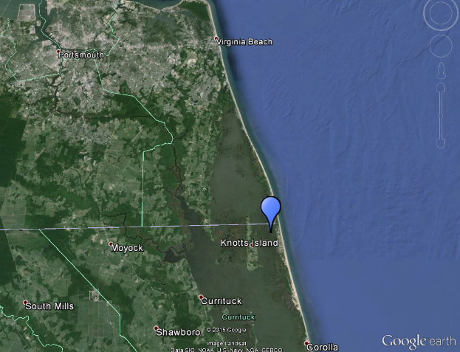
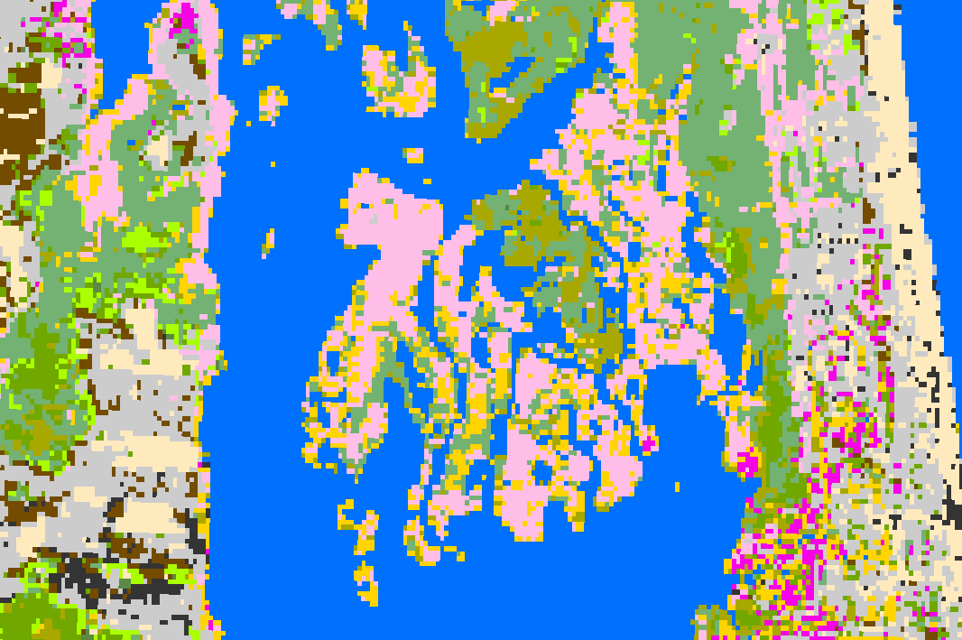
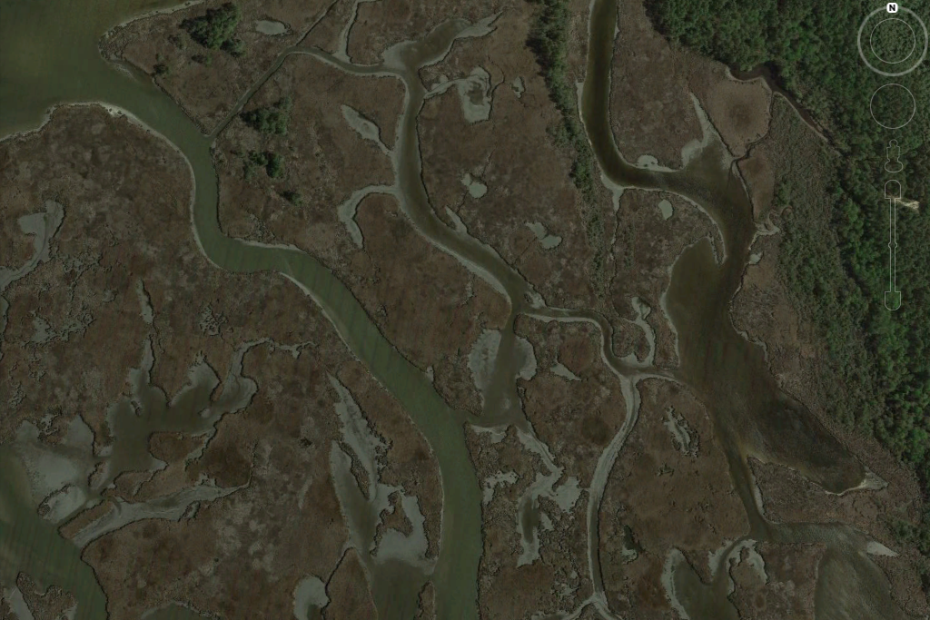
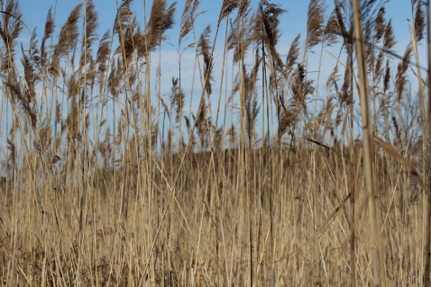
Phragmites Australis
Area classified as Phragmites australis.
Image Credit: Google Earth
Notes:
One of our other goals was to attempt to identify the invasive species Phragmites Australis, a common reed found in riparian and near shore zones around the US.
We utilized Google Earth and georeferenced photos to identify areas where Phragmites grows and then we looked at those locations in ArcGIS at our Landsat composites to determine if there is a characteristic visual signature. We were able to potentially identify such a signature and the classification was successful in some areas in verifying the presence of Phragmites. It is shown in pink in the image to the left.

Slide 23
Image Credit: Ben Roberts-Pierel
Conclusions and Future Work
The final classification showed some differences between C-CAP and our classification.
Some areas affected by Phragmites Australis were identified but require further verification.
Study could benefit from further specificity and additional ground truth data.
Notes:
We were able to identify some differences in classification between our results and C-CAP
Phragmites identification was successful in some areas but would require additional field verification for validation of our results on a wider scale and for supporting our methodology.
Like many projects, this one could have benefitted from additional ground truth data.

Slide 24
Advisors
Dr. Kenton Ross, NASA DEVELOP Science Director
Partners
Albemarle-Pamlico National Estuary Partnership (APNEP)
Others
Emily Adams, NASA DEVELOP Center Lead
Rebekke Muench, NASA DEVELOP Assistant Center Lead
North Carolina Ecological Forecasting I Team, NASA DEVELOP at Langley Research Center (Zand Bakhtiari, Stephen Zimmerman, Kayla Patel, Brad Gregory)
Notes:
Acknowledge advisors

