Slide 1
Alabama Agriculture:
Mapping Irrigation in Alabama to Improve Data Input and Model Evaluation for NASA Driven Crop-Hydrology Models
Casey Calamaio, University of Alabama in Huntsville
Samuel Ayers, University of Alabama in Huntsville
Kyle Pennington, University of Alabama in Huntsville

Slide 2
Community Concerns
Water Resource Management
Unreported or inaccurate estimates of water withdrawals, especially from irrigation
Water usage above 1,000 gallons should be reported to the state
Agricultural Expansion and Irrigation
Effects of increased agriculture in Alabama on local watersheds
Crop and Hydrology Models
Improving knowledge of where and how much irrigation exists in Alabama

Slide 3
Project Objectives
Develop a method to statistically infer irrigated cropland from greenness indices
Edge detection and segmentation analysis to extract irrigation networks
Provide methodology and models to state institutions and NASA driven crop models

Slide 4
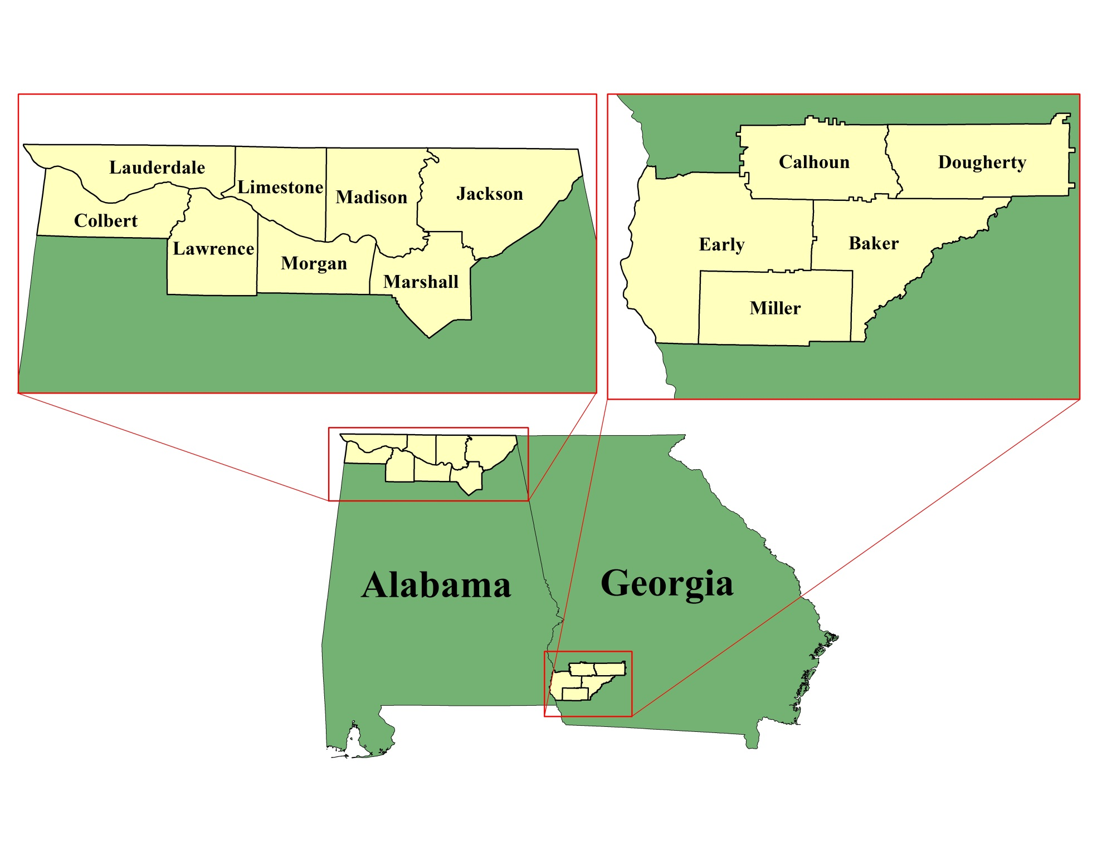
Study Area
Northern Alabama and Southwestern Georgia

Slide 5
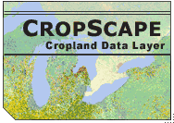
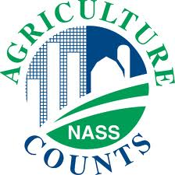
Data Collection
Earth Observations:
Landsat 7 ETM+ (2012)
Advanced Spacebourne Thermal Emission and Reflectance (ASTER) (2013)
Supplemental Datasets:
USDA Cropland Data Layer (CropScape)
GADM Global Administrative Areas
USDA National Agricultural Statistics
2007 Agriculture Census
Landsat 7 ETM +
TERRA (ASTER Sensor)

Slide 6
Methodology
Overview:
NASS CropScape and Statistical Method:
CropScape shows the locations and species of crops
Used to mask Landsat 7 ETM+ NDVI
Resulting image has a normal distribution of values
During the 2012 drought event, NDVI values above one standard deviation are inferred as potentially irrigated crops
Feature Extraction:
FX classifies an image via spectral, textural, and spatial characteristics
Spatial compactness is used to delineate circular fields
FX toolset used on an ASTER image at 15m resolution

Slide 7
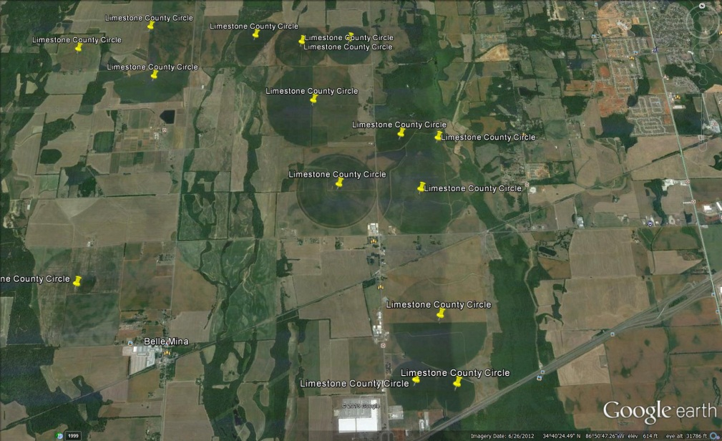
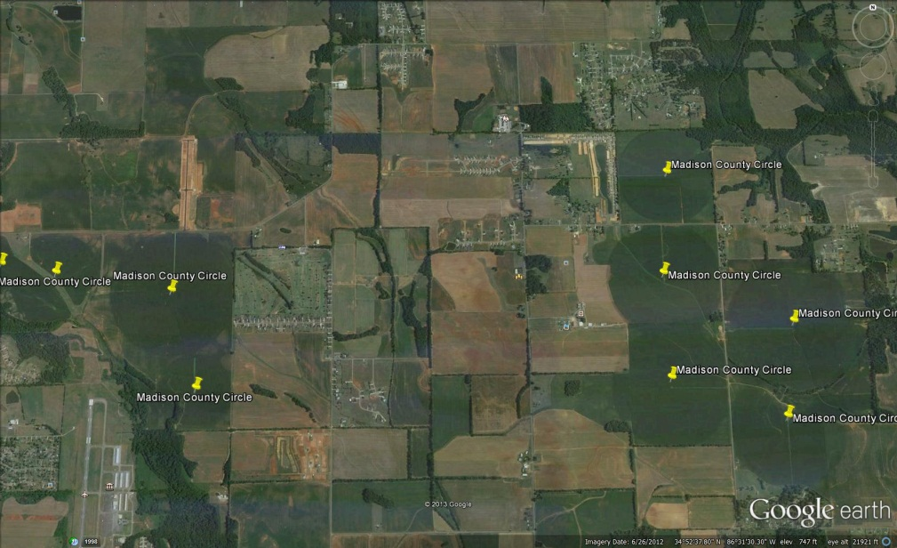
Methodology
Initial Observation and Acquisition
Use Google Earth to identify center-pivot irrigation systems
A center-pivot irrigation system waters crops via a central point which has multiple spans of sections along a radius pointing outward from the center of the circle
Generally are the most economically feasible when used for 40-60 acres or more
The system can be automated to move on its own
Most center-pivot systems are designed to apply a maximum of 2 inches (gross) water per week
Additionally located and tagged the center-pivot irrigation systems on Google Earth (pictured below: left Limestone County, right Madison County

Slide 8
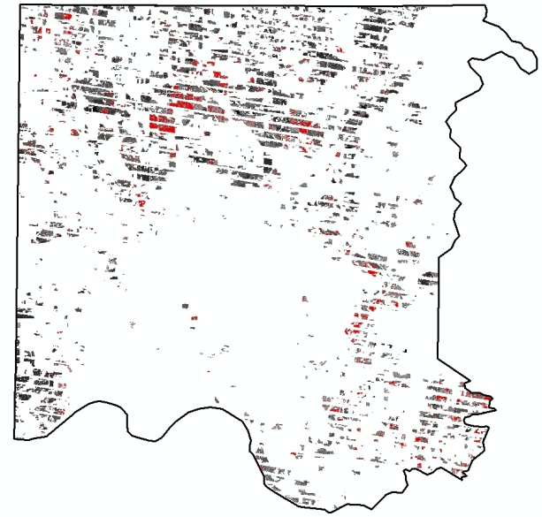
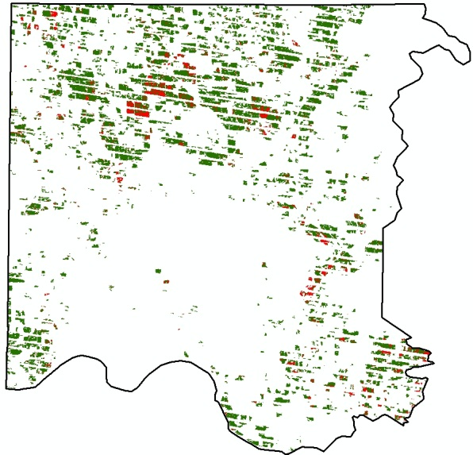
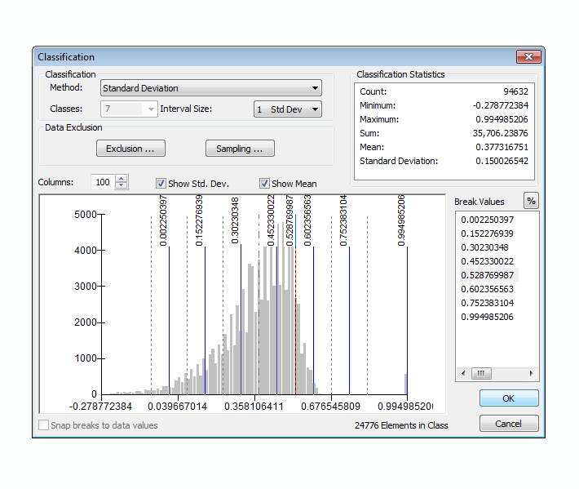
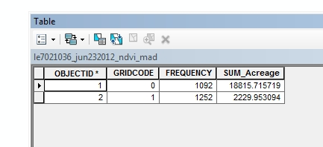
Methodology
Statistical Methodology:
NDVI and Statistical Extraction Feature Conversion and Computation
Normalized Difference Vegetation Index
Acreage Computation
0 = Values < 1 std.
1 = Values ≥ 1 std.
Extreme NDVI values considered as potential irrigated are one standard deviation above the mean

Slide 9
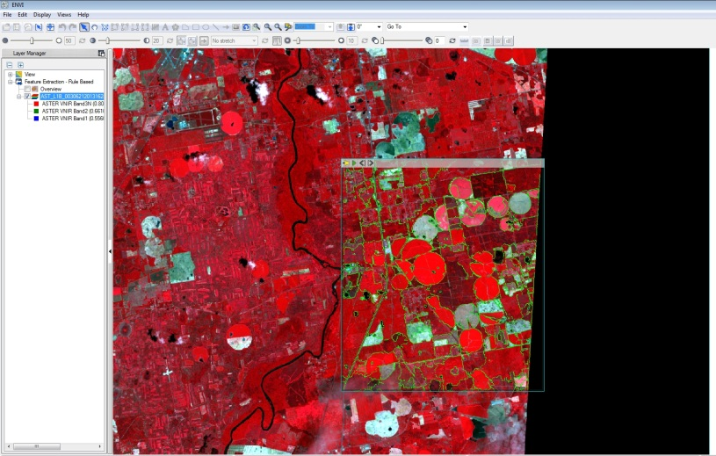
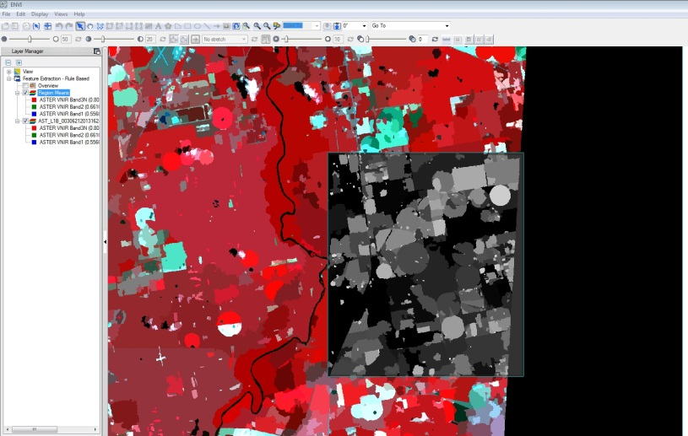
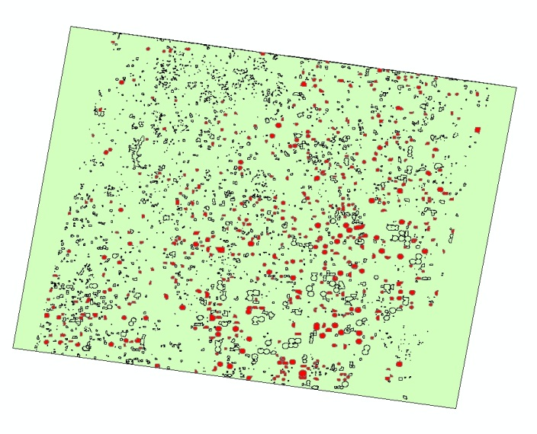
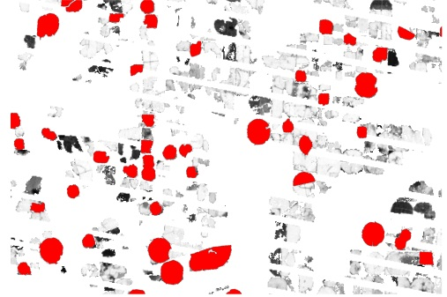
Methodology
Feature Extraction: ENVI 5.0 FX
ASTER Imagery over SW Georgia
Segmentation Analysis and edge detection
Classify image via spatial characteristics – spatial compactness for circular fields
Establish a compactness value threshold and export resulting features
Center pivot irrigation systems

Slide 10
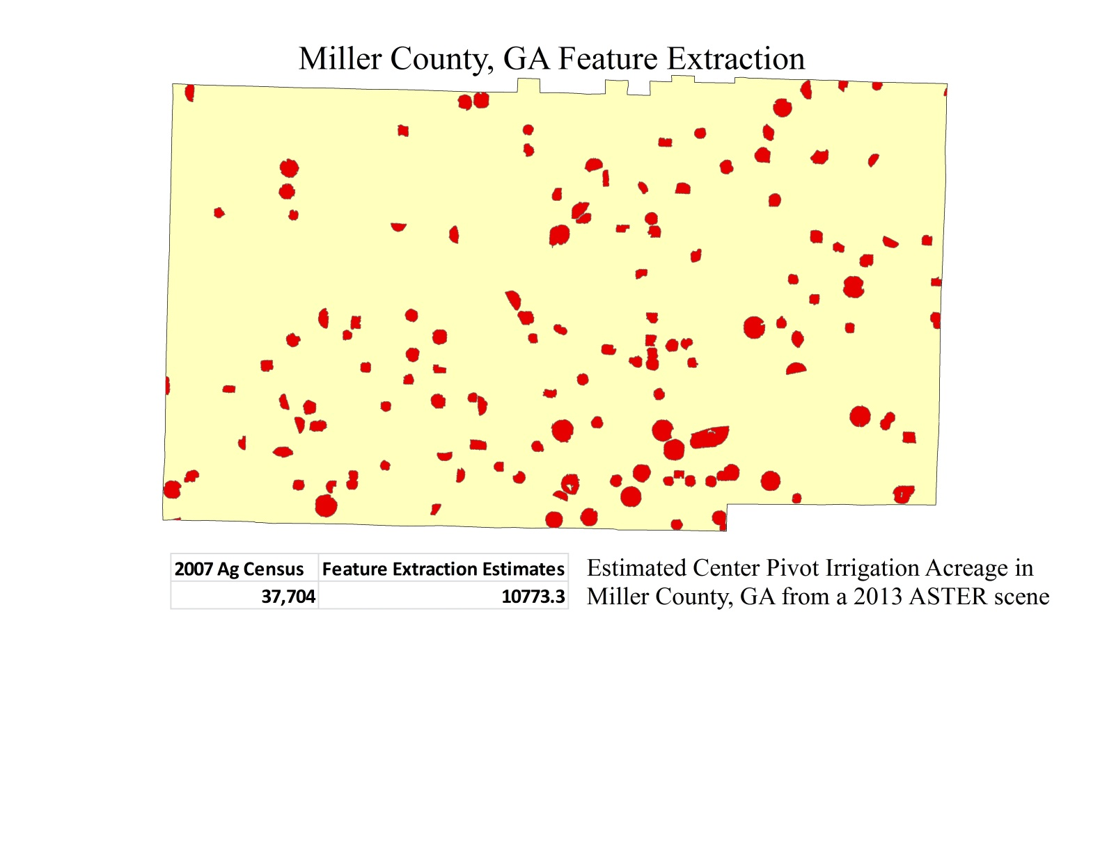
Results and Discussion
Feature Extraction Results:
2007 Agriculture Census (USDA) listed Miller County with 37, 704 acres of total irrigated cropland
Irrigation estimates from FX are low
Narrow search parameter and increase number of classes
This search focused solely on center pivot irrigation

Slide 11
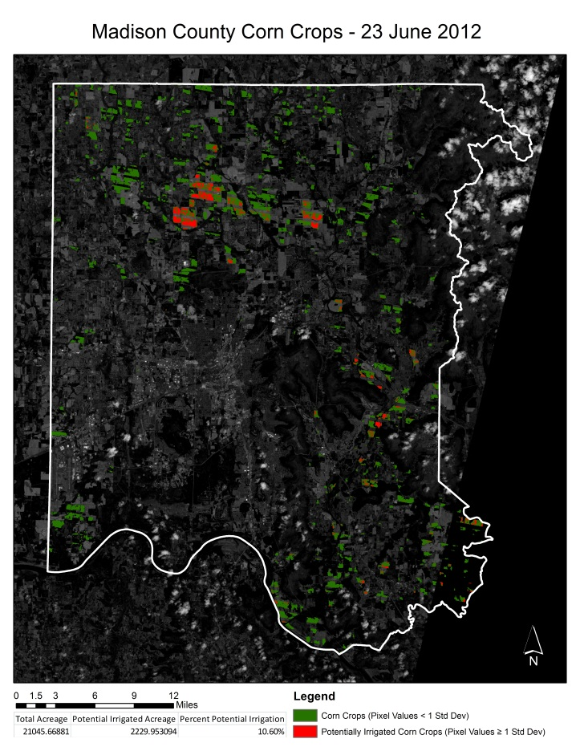
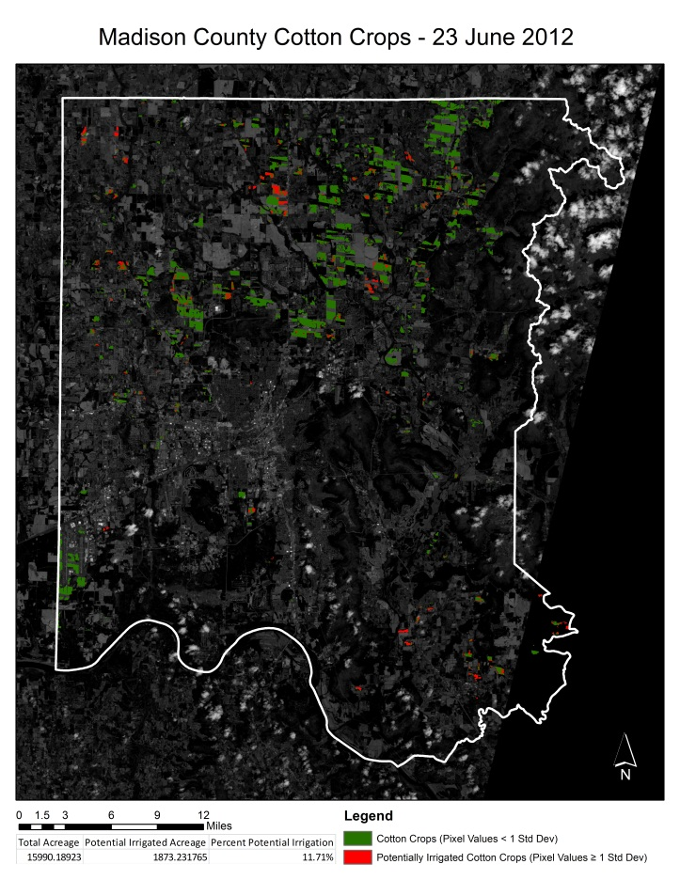
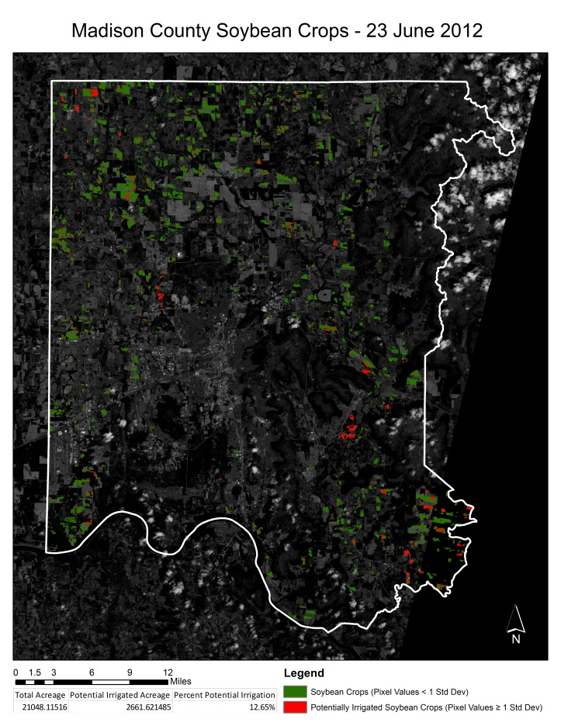
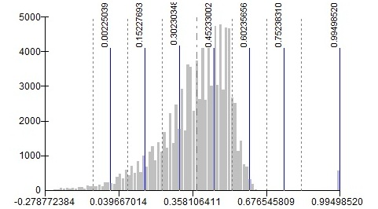
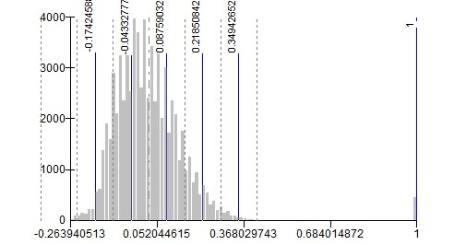
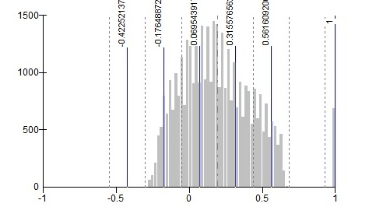
Results and Discussion

Slide 12
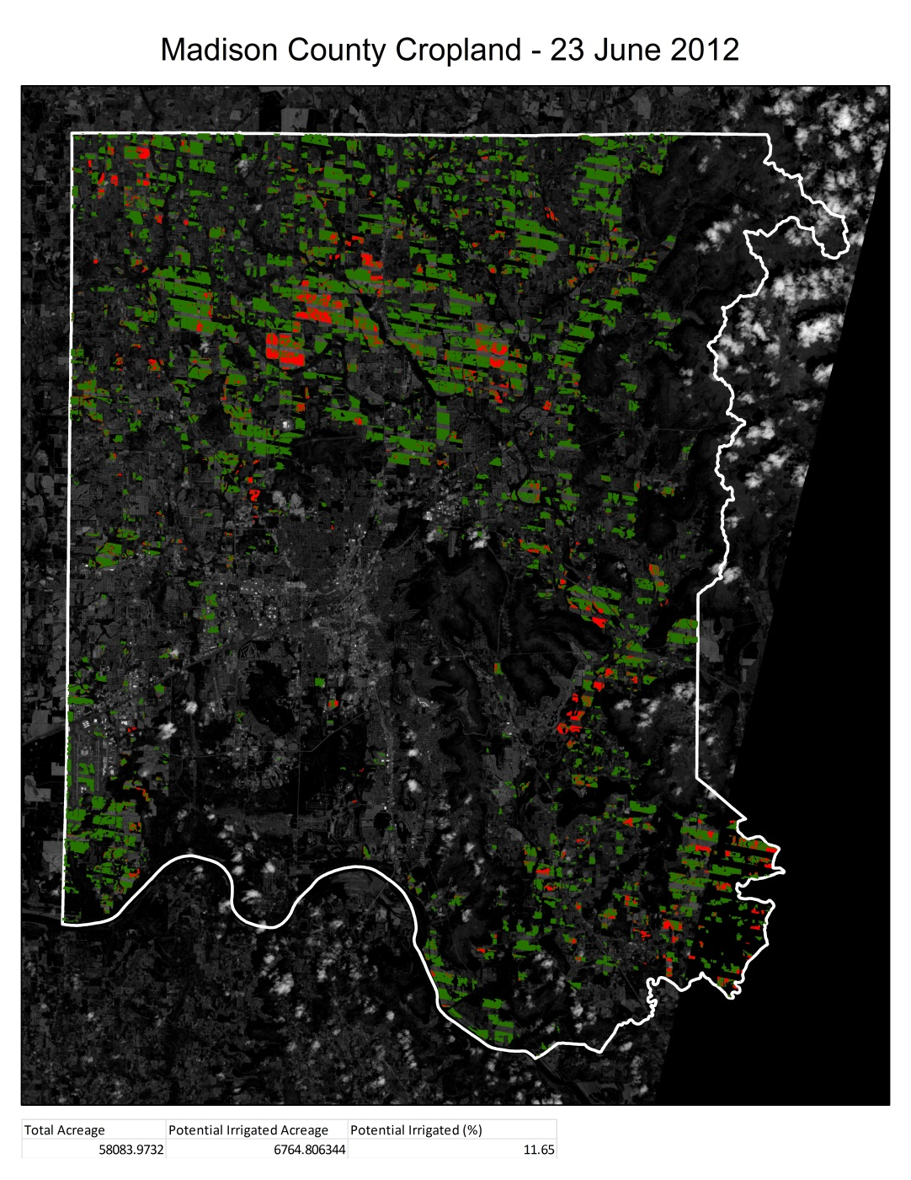
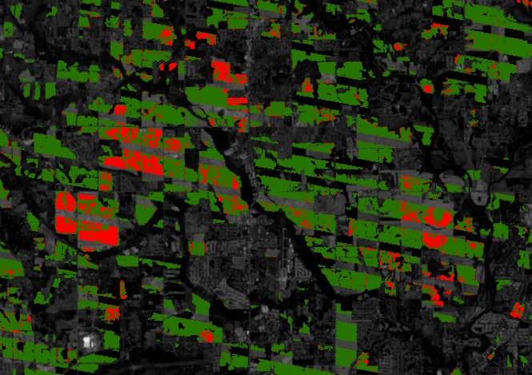
Results and Discussion
Example result map:
Madison County in N. Alabama
Total Cropland (corn, cotton, and soybean)
Red values indicate potentially irrigated crops
Total Acreage: 58,083
Potential Irrigation: 6,764 (~ 11.65%)
Known center pivot irrigation systems were detected

Slide 13
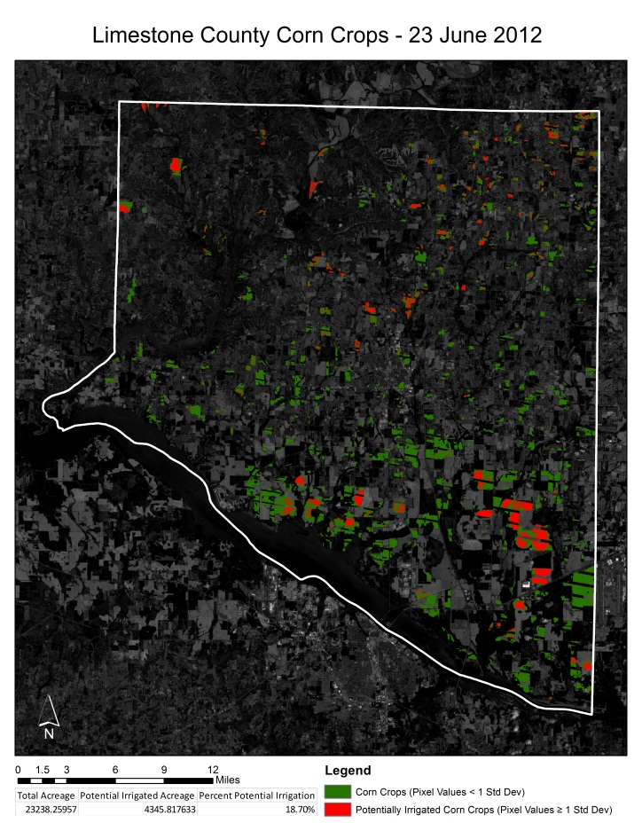
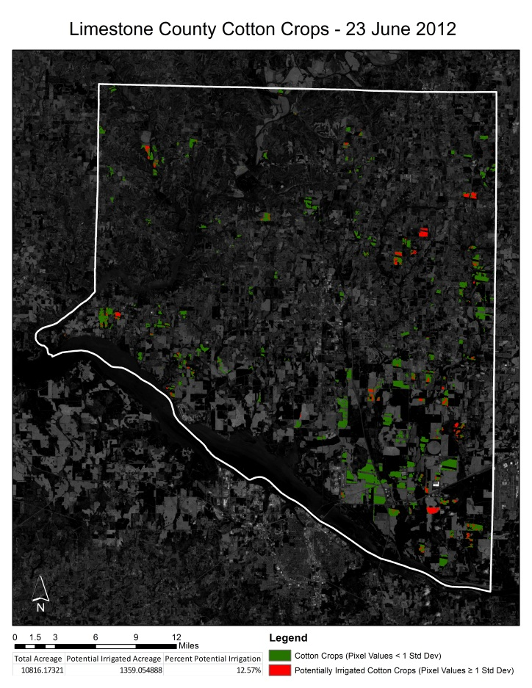
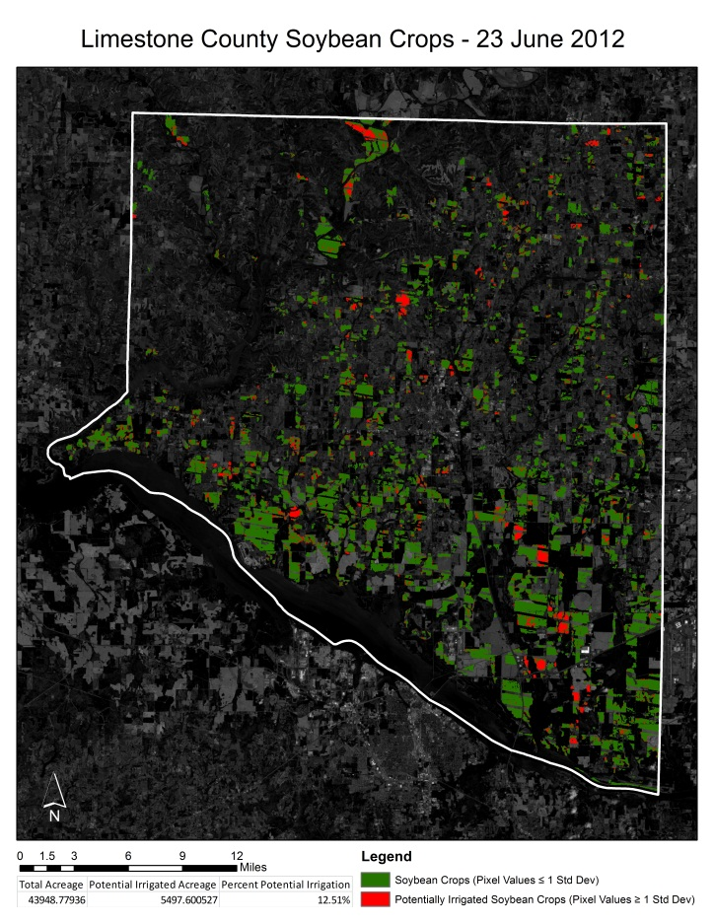
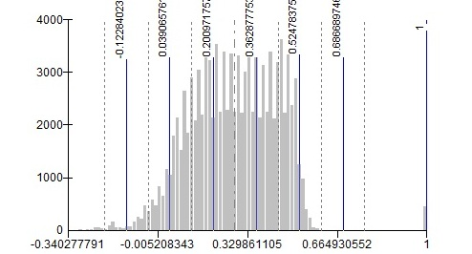
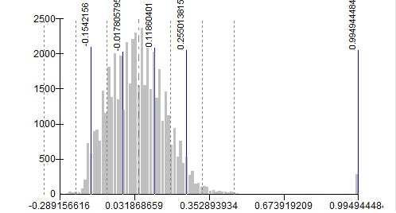
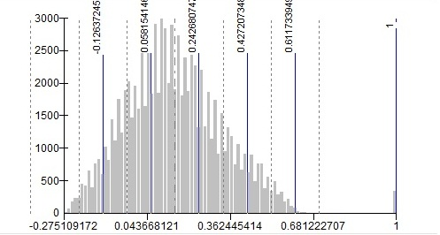
Results and Discussion

Slide 14
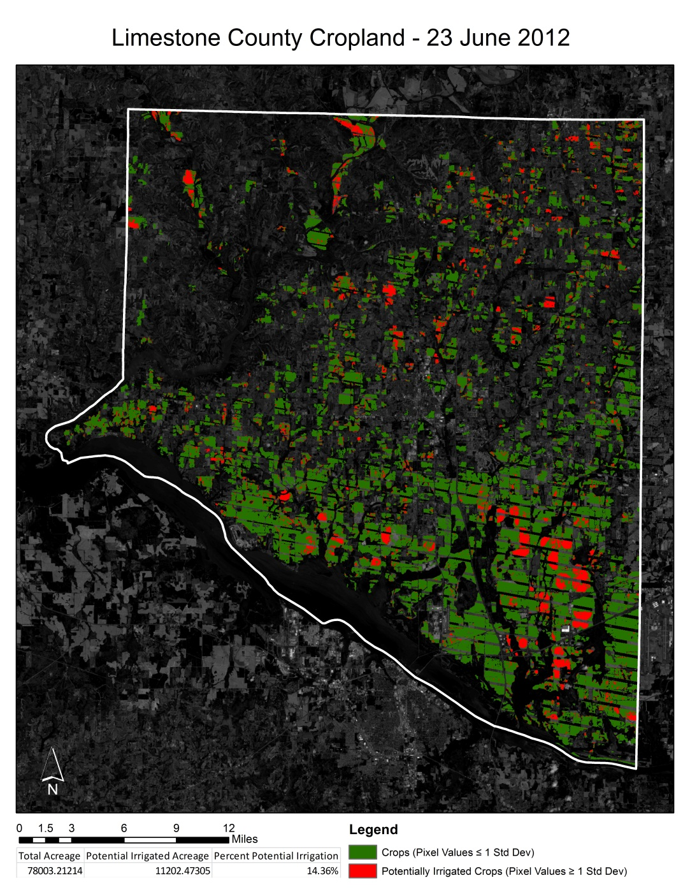
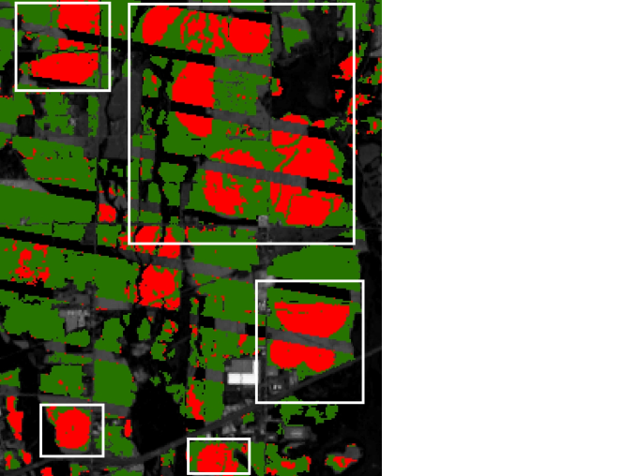
Results and Discussion
Example result map:
Limestone County
Total Cropland (corn, cotton,
and soybean)
Red values indicate potentially
irrigated crops
Total Acreage: 78,003
Potential Irrigation: 11,202 (~14.36%)
Known center pivot irrigation systems
detected

Slide 15
Results and Discussion
Error and Uncertainty
FX features are trial and error in many cases
Additional classes for Rule-Based feature extraction
Capable of partitioning partial center pivot (3/4 or half)
Textural and spectral properties to narrow search parameters
Higher resolution datasets provide more accurate segmentation and will yield better results
Inherent inaccuracy of CropScape data
Coarse resolution of cropland data and inconsistent data values
Automatically derived and no ground truthing
Does not differentiate irrigated and non-irrigated cropland
This project focused on circular fields (center pivot irrigation) because they are easily identified and were most likely in use during the 2012 drought event

Slide 16
Conclusion
Alternative methods to identifying irrigation in Alabama is imperative to determining the actual usage of fresh water in local watersheds
This project aimed to develop a methodology to locate irrigation on a large scale
Feature extraction and statistical analysis of crops during drought events effectively emphasized potentially irrigated fields
These tools can help expedite more time consuming mapping techniques
Future work will emphasize narrowing the search threshold for irrigation and automate these processes
Faster, more effective results for variable input into crop – hydrology models

