Slide 1
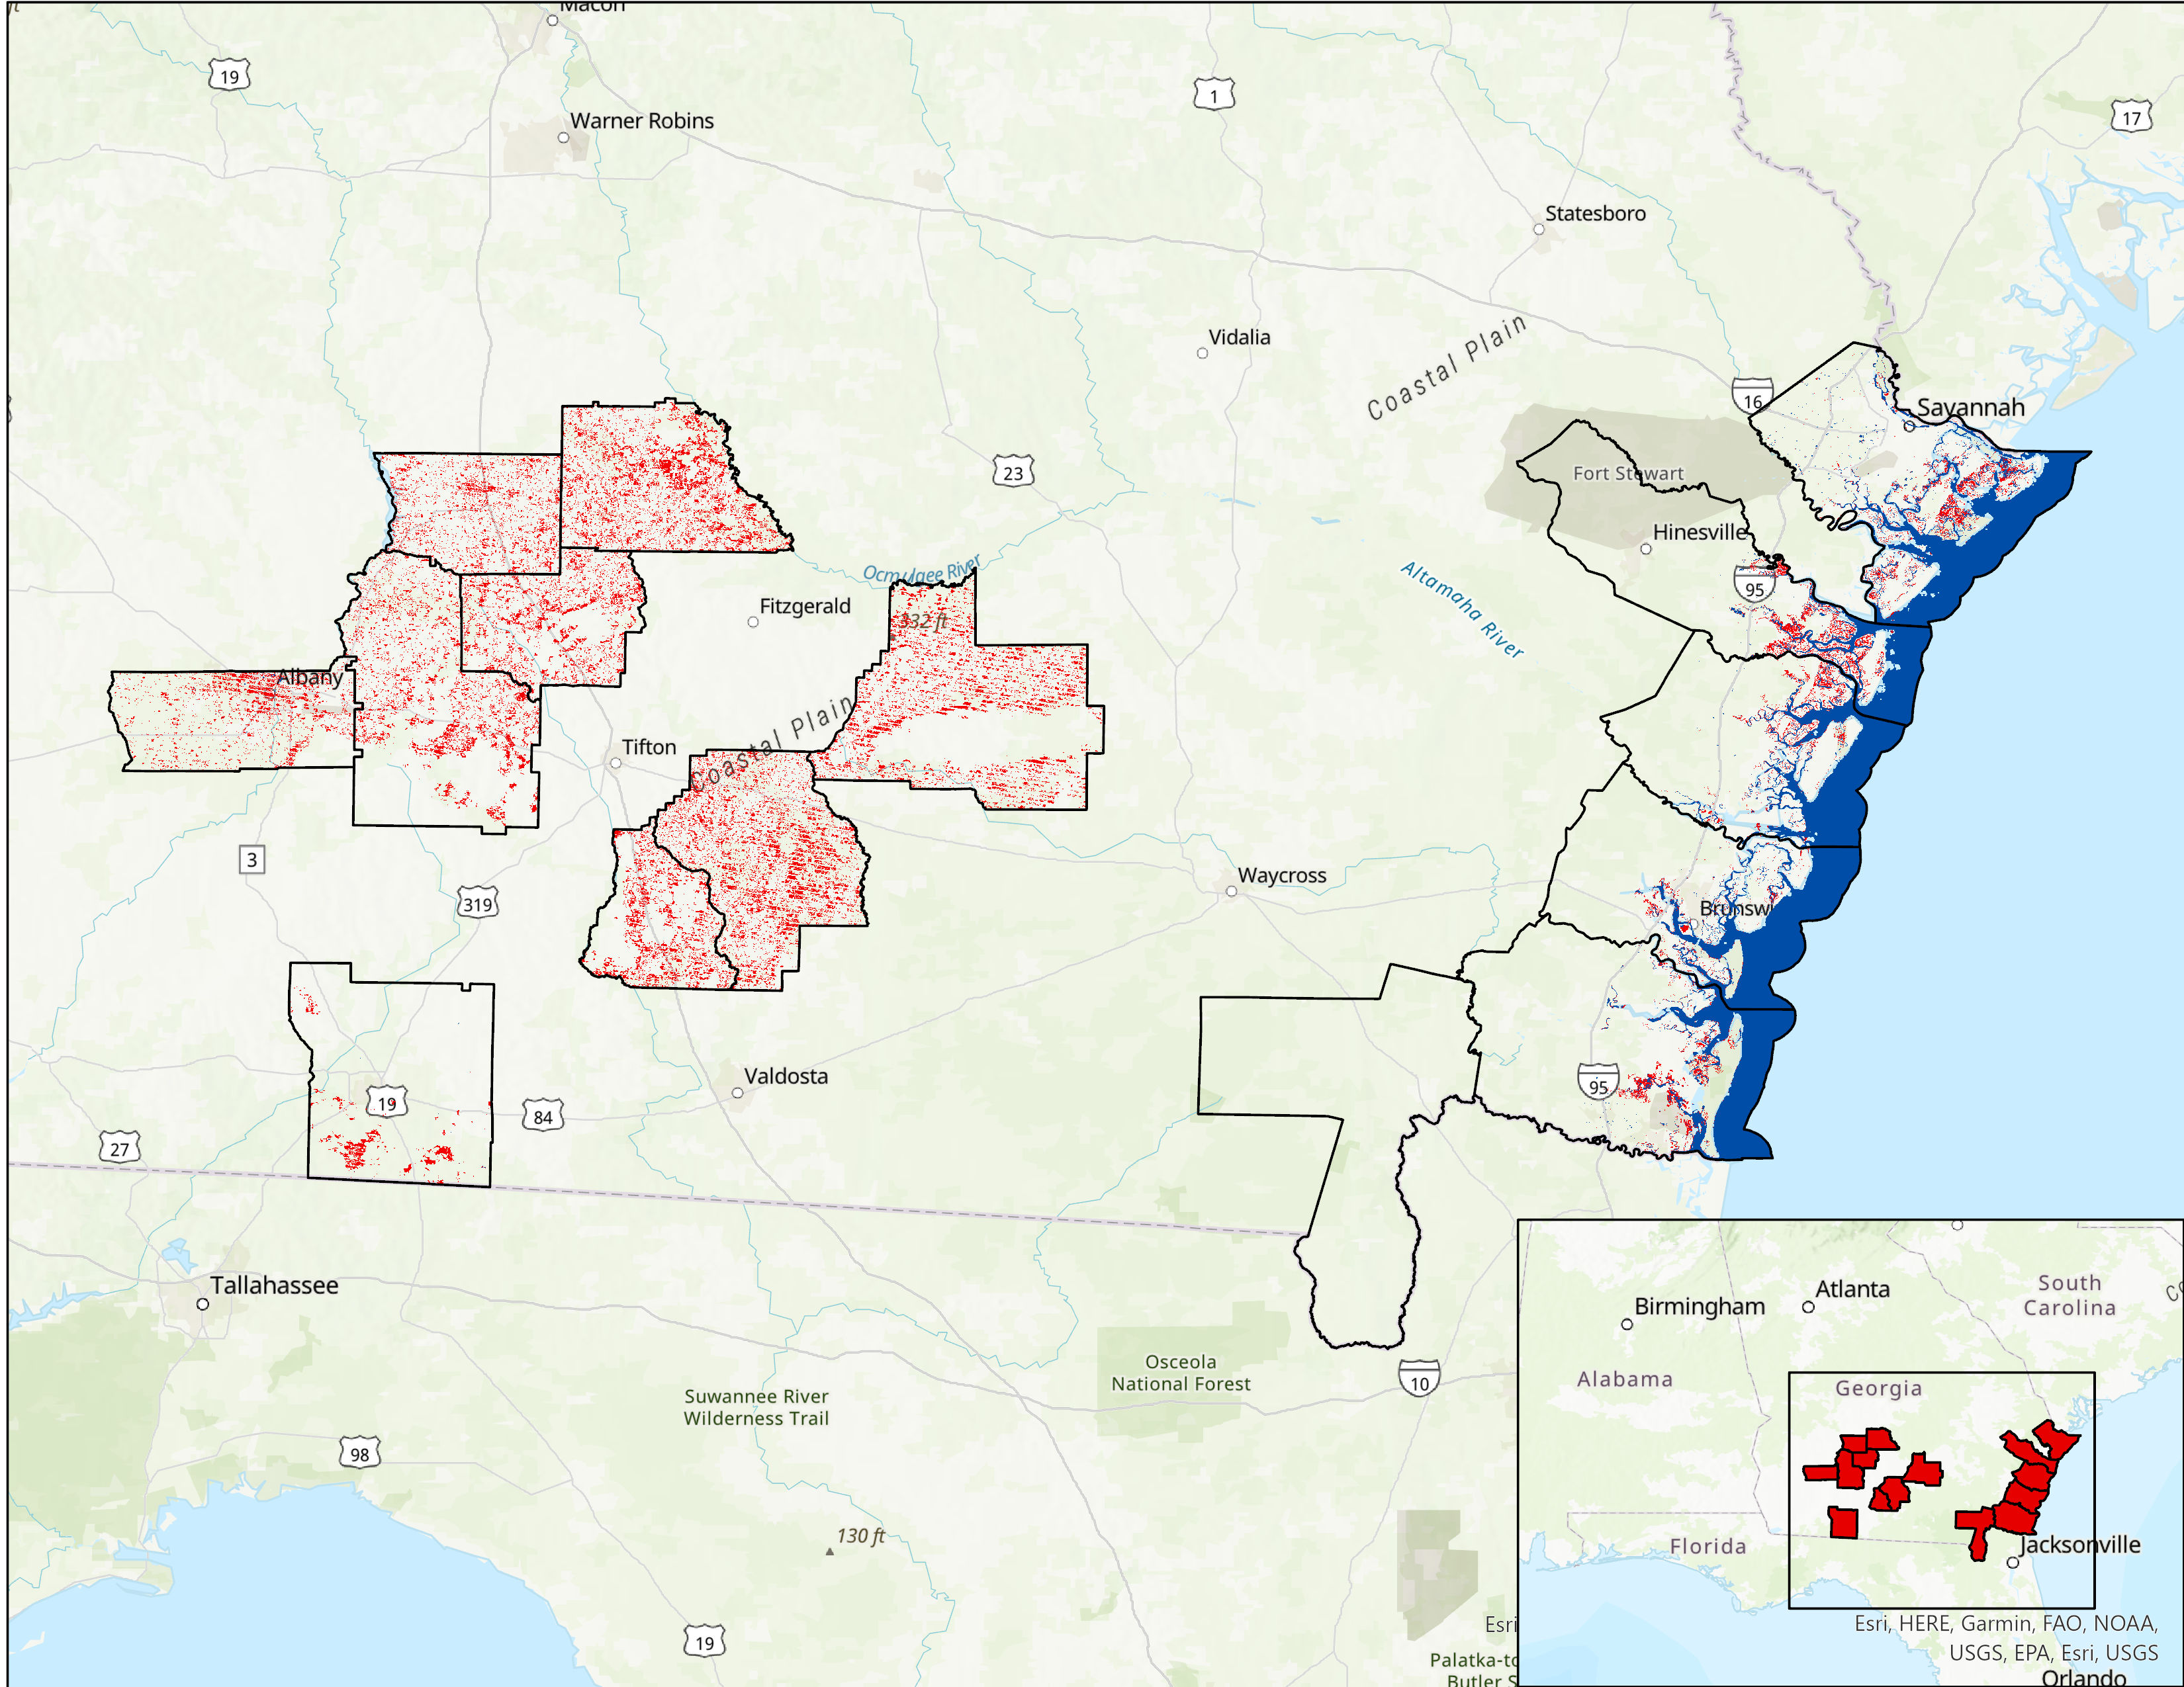
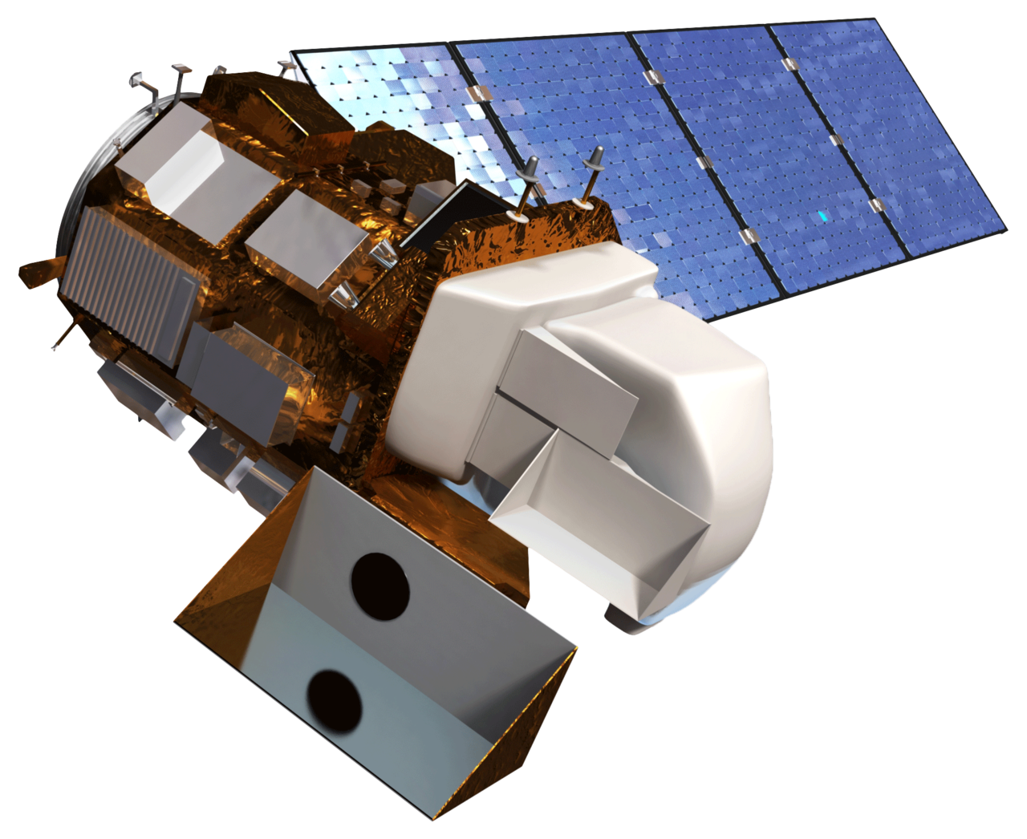
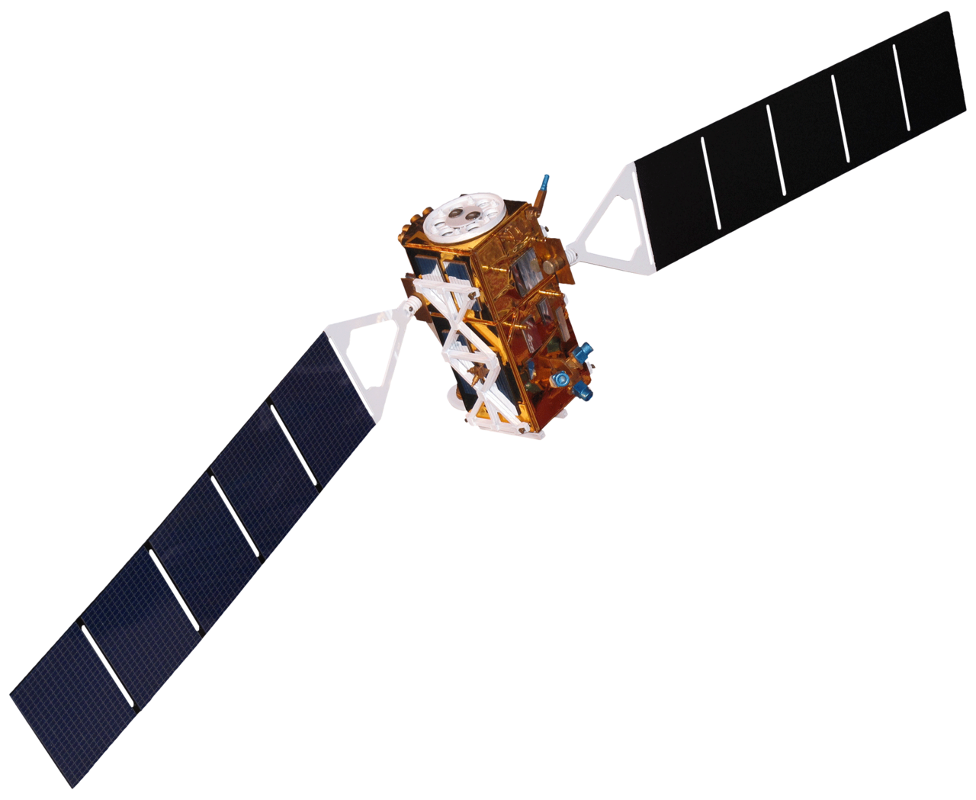
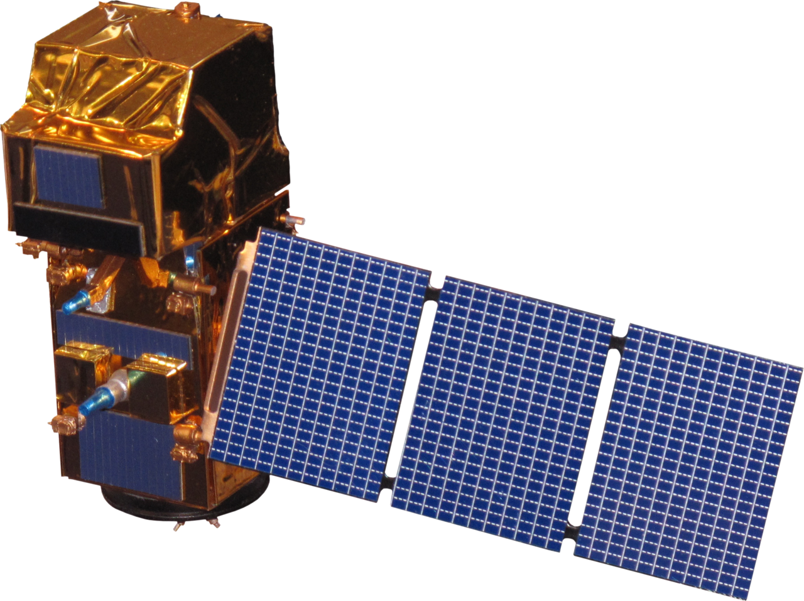
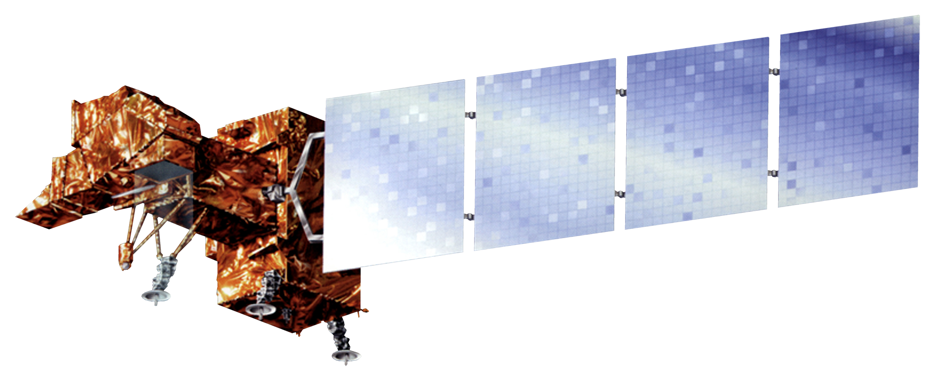
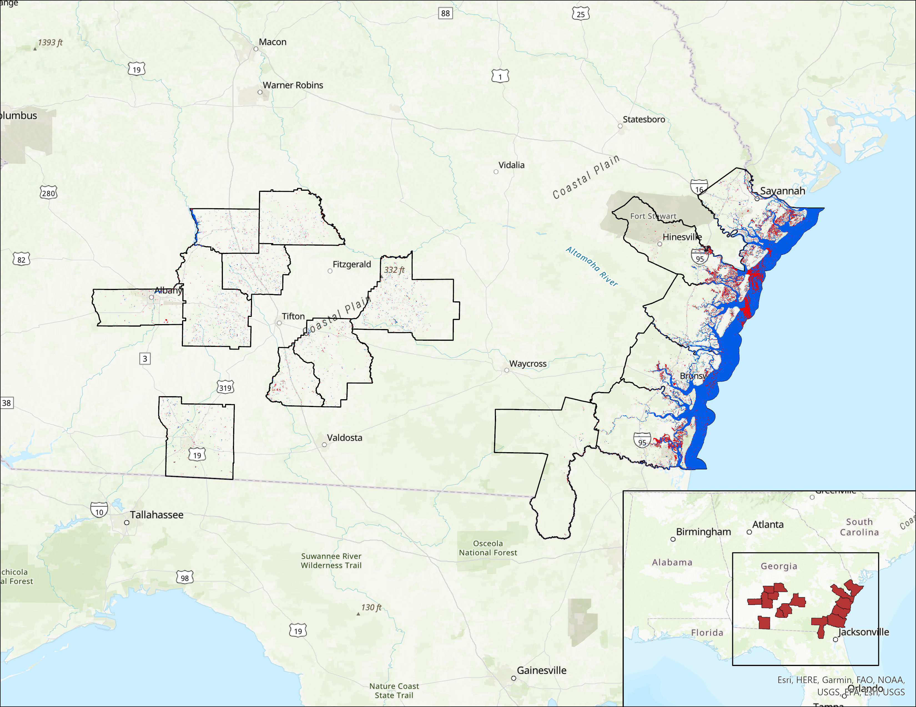
Evaluating the Impacts of Hurricane Irma on Georgia Heirs' Property Owners Using NASA Earth Observations
Abstract
Methodology
Georgia Disasters
In September 2017, Hurricane Irma made landfall in southern Georgia, causing severe flooding and widespread destruction. Disaster recovery programs were inaccessible for heirs’ property owners due to title difficulties. The NASA DEVELOP team worked in partnership with the Georgia Heirs Property Law Center (The Center) to identify potential heirs’ properties impacted by Hurricane Irma. We created flood extent maps, a socioeconomic overlay, and identified potential areas of structural damage. We utilized surface reflectance data from Landsat 7 Enhanced Thematic Mapper Plus (ETM+), Landsat 8 Operational Land Imager (OLI) and Sentinel-2 MultiSpectral Instrument (MSI) and backscatter data from Sentinel-1 C-band Synthetic Aperture Radar (C-SAR). We produced flood extent maps by consolidating these Earth observations in NASA SERVIR’s Hydrologic Remote Sensing Analysis for Floods (HYDRAFloods) tool in Google Earth Engine (GEE). To produce one socioeconomic overlay, we used Computer Assisted Mass Appraisal (CAMA) data to identify areas of heirs’ properties likelihood. To identify potential structural damage, we used optical imagery data from PlanetScope and RapidEye. Our flood extent map results found that backscatter data was more reliable than surface reflectance, resulting in mainly coastal flooding. With these maps, we created one socioeconomic overlay for Camden County. Lastly, we found only nine potential instances of structural damage in Albany, Dougherty County. These end products will allow The Center to make informed decisions about the allocation of funds for heirs’ property disaster assistance.
GEE Python API
Landsat 7 ETM+
Permanent Water and Edge Otsu Method
Landsat 8 OLI
mNDWI
NDWI
ACS
Potential Heirs’ Parcels
ArcGIS Pro
Sentinel-2 MSI
Backscatter
Flood Extent Maps
Overlay
Sentinel-1 C-SAR
Heirs’ Property Impact Maps and Tables
Project Partners
Objectives
Georgia Heirs Property Law Center:
Skipper StipeMaas, Executive Director
Delene Porter, Chief Operating Officer
Tiffany Reed, Program and Grants Coordinator
Identify how Hurricane Irma has impacted Georgia heir's properties owners
Generate HYDRAFloods flood extent maps of counties in study area
Produce one county's socioeconomic overlay on a flood extent maps
Results
Earth Observations
Landsat 7 ETM+
Landsat 8 OLI
Sentinel-1 C-SAR
Sentinel-2 MSI
Conclusions
For flooding in all counties, Landsat 7 detected 510 square miles, Landsat 8 detected 96 square miles, and Sentinel-1 detected 6.3 square miles.
Landsat 7 observed flooding in only inland counties, while Landsat 8 and Sentinel-1 observed mainly coastal flooding.
Due to optical satellites difficulty to penetrate cloud cover, we decided only to use the Sentinel-1 flood extent map in our overlays.
The CAMA analysis of Camden County revealed 660 potential heirs properties(2.14% of all properties), and 52 properties within 50 meters of floods.
Flood
0
60 mi
Permanent Water
Figure 1: Optical imagery flood extent map using Landsat 7 and Landsat 8
Future Work
Refine flood extent maps by quantifying flood depth and conducting a time series analysis of the flood.
Overlay flood extent maps with ACS and CAMA data for all 15 counties.
Analyze potential inequalities of disaster relief funding.
Flood
0
60 mi
Permanent Water
Acknowledgements
Figure 2: Synthetic Aperture Radar (SAR) imagery flood extent map using Sentinel-1
Team Members
Science Advisor: Dr. Marguerite Madden, University of Georgia
Fellow: Sarah Payne
Special Thanks:
Dr. Kenton Ross, NASA Langley Research Center
Jimmy Nolan and Scott Pippin, Carl Vinson Institute of Government
Nemin Wu, Graduate Student, University of Georgia
Isabella Chittumuri
(Project Lead)
Shakirah Rogers
Nathan Tesfayi
Nancee Uniyal
Athens – Georgia

