Slide 1
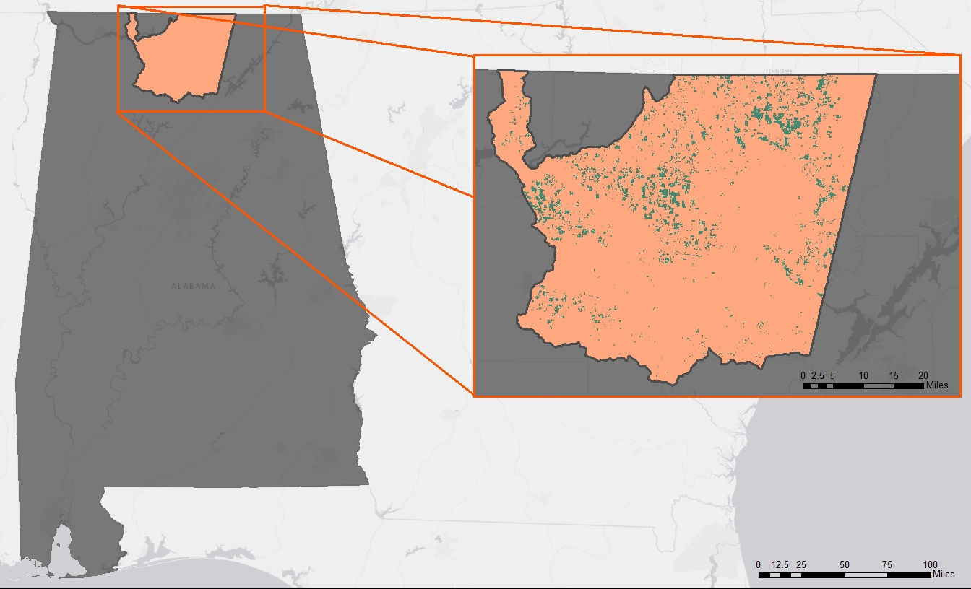


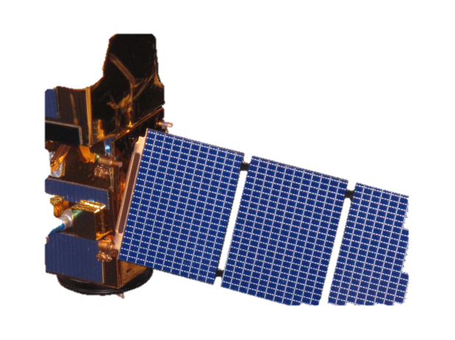
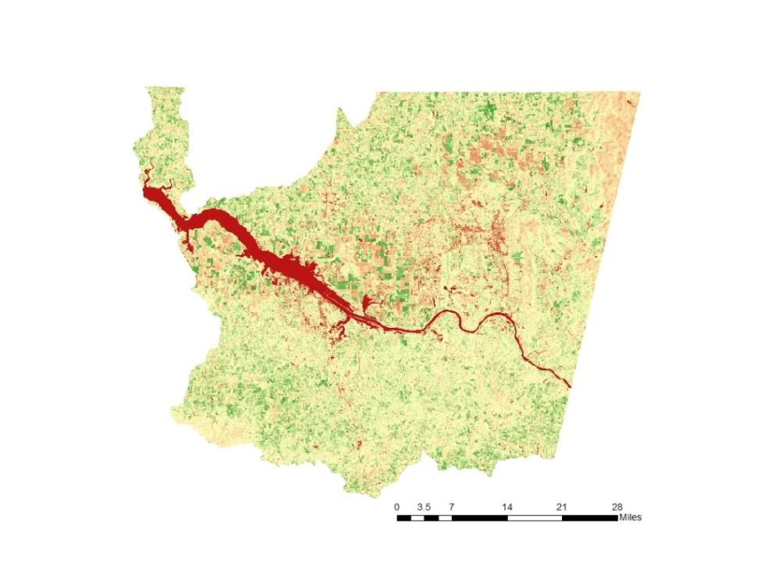
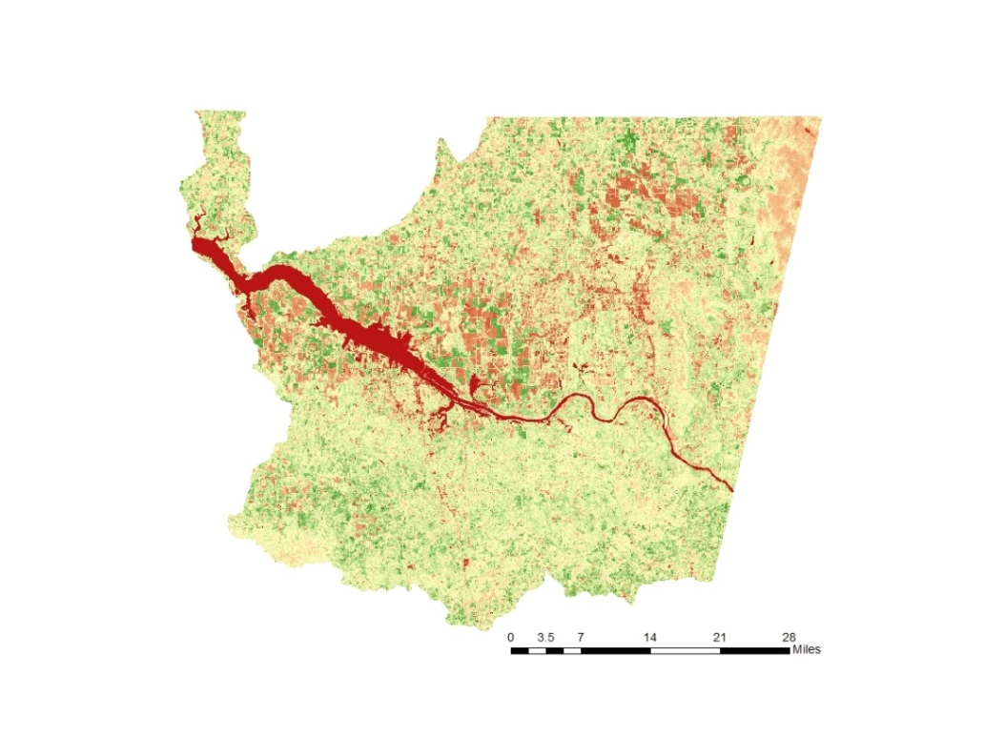
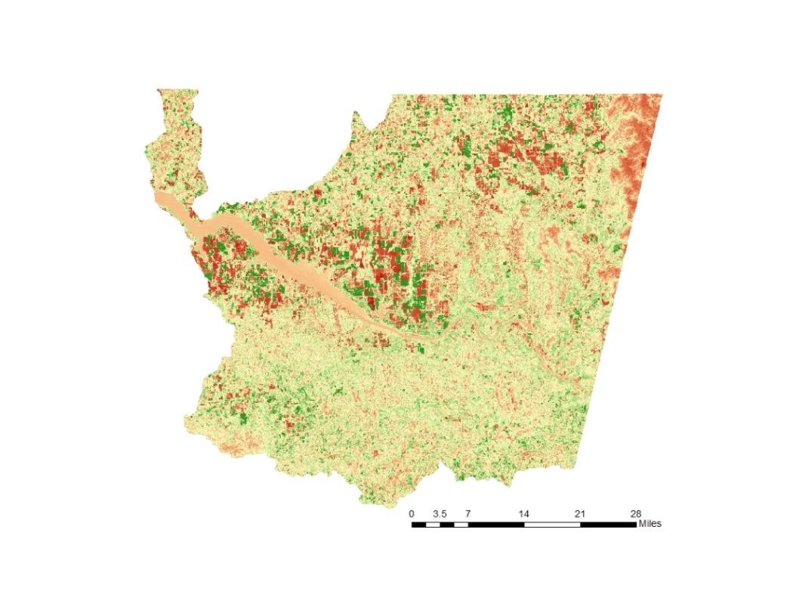





Analyzing and Assessing Drought Conditions for Crops across Alabama Using NASA Earth Observations
Abstract
Objectives
Over the past decade, drought in Alabama has had a major impact on agriculture, causing crop yields to fall well below normal levels. The Alabama Office of the State Climatologist (AOSC) monitors drought using a myriad of data types and sources, and compiles the information into a weekly drought-monitoring map, the United States Drought Monitor (USDM). This project explored using two vegetation indices, Green Normalized Difference Vegetation Index (GNDVI) and Normalized Difference Vegetation Index (NDVI), and one water index, the Normalized Difference Water Index (NDWI), from high-resolution satellites, Landsat 5 TM, Landsat 8 OLI, and Sentinel 2 MSI to increase the level of detail in drought depiction for the USDM. Additionally, the project considered whether farms with center pivot irrigation fared better than farms relying solely on precipitation during the 2011 and 2016 drought using data provided by the Earth System Science Center (ESSC) at University of Alabama, Huntsville. The results were compared to the USDM output and the crop’s water stress index, which was provided by the ESSC’s Gridded Decision Support System for Agrotechnology Transfer (GriDSSAT) crop model. The project resolved that although higher-resolution satellites do provide information on when a crop is under vegetative stress before the USDM depicts drought conditions, the resolution of Landsat 5 and Landsat 8 was not high enough to analyze crops at a field level scale.
Determine relevant indices for monitoring drought in Alabama
Create a time series for multiple vegetation and water indices including NDVI, GNDVI, and NDWI
Assess suitability of Landsat sweeps for characterizing water stressed crops in Alabama
Compare findings to AOSC’s GriDSSAT crop model
Study Area
Wheeler Lake Hydrologic Unit Code – 8 in orange defines the study area for this project. Row crops are represented on the map in green.
Methodology
Landsat 5 - 2009, 2011
Landsat 8 - 2016
Sentinel-2 - 2016
NDVI, NDMI, GNDVI
Time Series
Cropland Data Layer
Earth Observations
Center-Pivot Irrigation
Results
GriDSSAT
Alabama Agriculture
Statistical analysis
Landsat 8 (OLI)
Landsat 5 (TM)
Sentinel 2 (MSI)
Results
Conclusions
GNDVI
NDVI
NDWI
Relevant indices:
  NDVI has merit if paired with a higher spatial and temporal resolution sensor
  GNDVI has similar values to NDVI
  NDWI provided valuable data for GriDSSAT comparison
Landsat is not suitable for characterizing water-stressed crops due to high density of coniferous vegetation
  30 m spatial resolution is too coarse
  16 day temporal resolution only not suitable for flash droughts
Observed similar trends in indices and GriDSSAT crop model, however, unable to quantify
April 2016
Remote Sensing Indices Compared to GriDSSAT, 2016
Date | Proxy Month | GNDVI | NDVI | NDWI | WSGI | USDM
7-Apr | APR 2016 | 0.359 | 0.364 | 0.153 | 0 | 0
23-Apr | MAY 2016 | 0.359 | 0.364 | 0.108 | 0 | 1
10-Jun | JUN 2016 | 0.385 | 0.417 | 0.132 | 0.510 | 3
26-Jun | JUL 2016 | 0.394 | 0.429 | 0.178 | 0.520 | 4
Project Partners
Alabama Office of the State Climatologist (AOSC)
Dr. John Christy
University of Alabama in Huntsville, Earth System Science Center
Cameron Handyside
Acknowledgements
Team Members
Dr. Jeffrey Luvall
NASA Marshall Space Flight Center
Dr. Robert Griffin
University of Alabama
in Huntsville
Leigh Sinclair
University of Alabama in Huntsville, Information Technology and Systems Center
Dashiell Cruz
NASA DEVELOP
Chris Ploetz
Team Lead
Maggi Klug
Olivia Callaway
Emilene Sivagnanam
NASA Marshall Space Flight Center – 2017 Spring

