Slide 1
Peru Water Resources and Disasters
Utilizing NASA Earth Observations to Develop a Comprehensive Water Budget for the Asunción district in Peru
Sarah Medley(Project Lead)
Kieran Blakemore
Jordan Bates
Scott Arnette
Grant Bloomer
Azeb Shewago
Michael Mullins

Slide 2
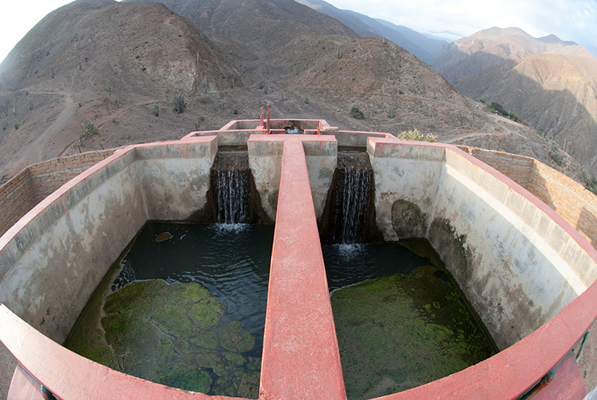
Community Concerns
In rural areas of Peru, only about 65% of residents have access to satisfactory water resources
Only 37% of residents have access to satisfactory sanitation facilities
45,012 people affected by flooding in Peru
Source: Water for People
Notes:
Many developing countries, like Peru, struggle with providing water security and sanitation services to rural communities. In rural areas of Peru, only about 65% of residents have access to satisfactory water resources. Only 37% of residents have access to satisfactory sanitation facilities.
Inadequate flood risk management plans further convolute efforts to provide water resource management systems. Aso far, over 45,012 people have been affected by floods in Peru.
Source: http://www.waterforpeople.org/making-a-difference/peru

Slide 3
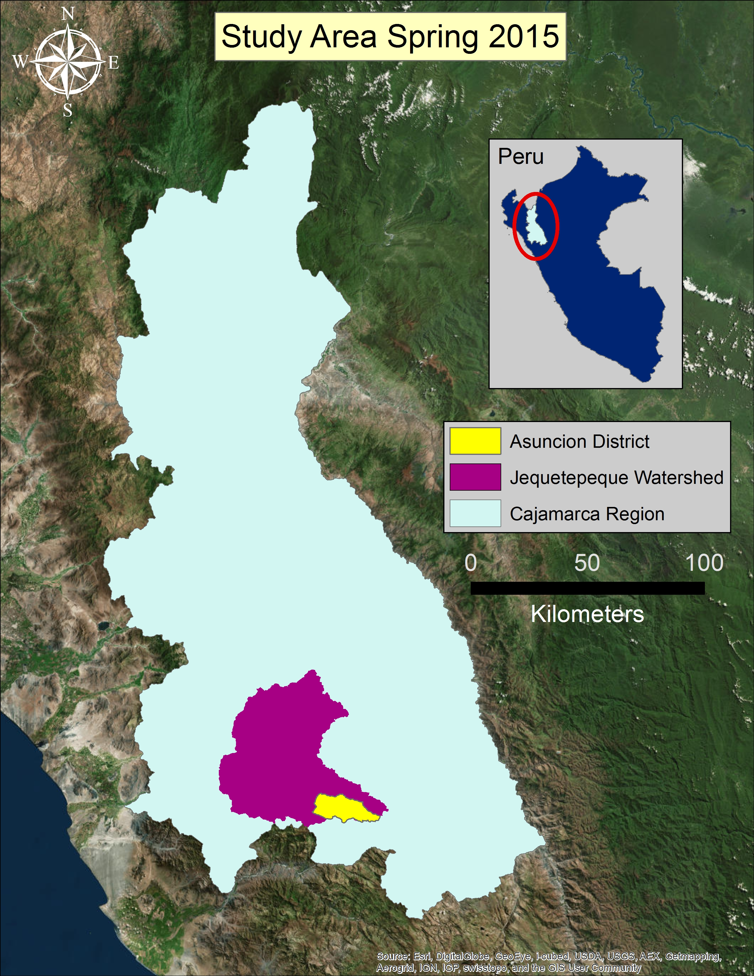
Study Area
Asunción District, Cajamarca Province, Cajamarca Region of Peru
Asunción is home to around 12,000 inhabitants.
96% of these inhabitants use farming as a means for life.
The total ground surface area for the Asunción district is 211 km².
Asunción is located inside the Cajamarca region on the North Eastern corner of Peru.
Notes:
The study area for our project was the Asuncion District inside of the Cajamarca Province and Region of Peru. Asuncion, a 211 km^2 piece of land, is home to 12,000 Peruvians and 96% of them are farmers who rely on water resource plans.

Slide 4
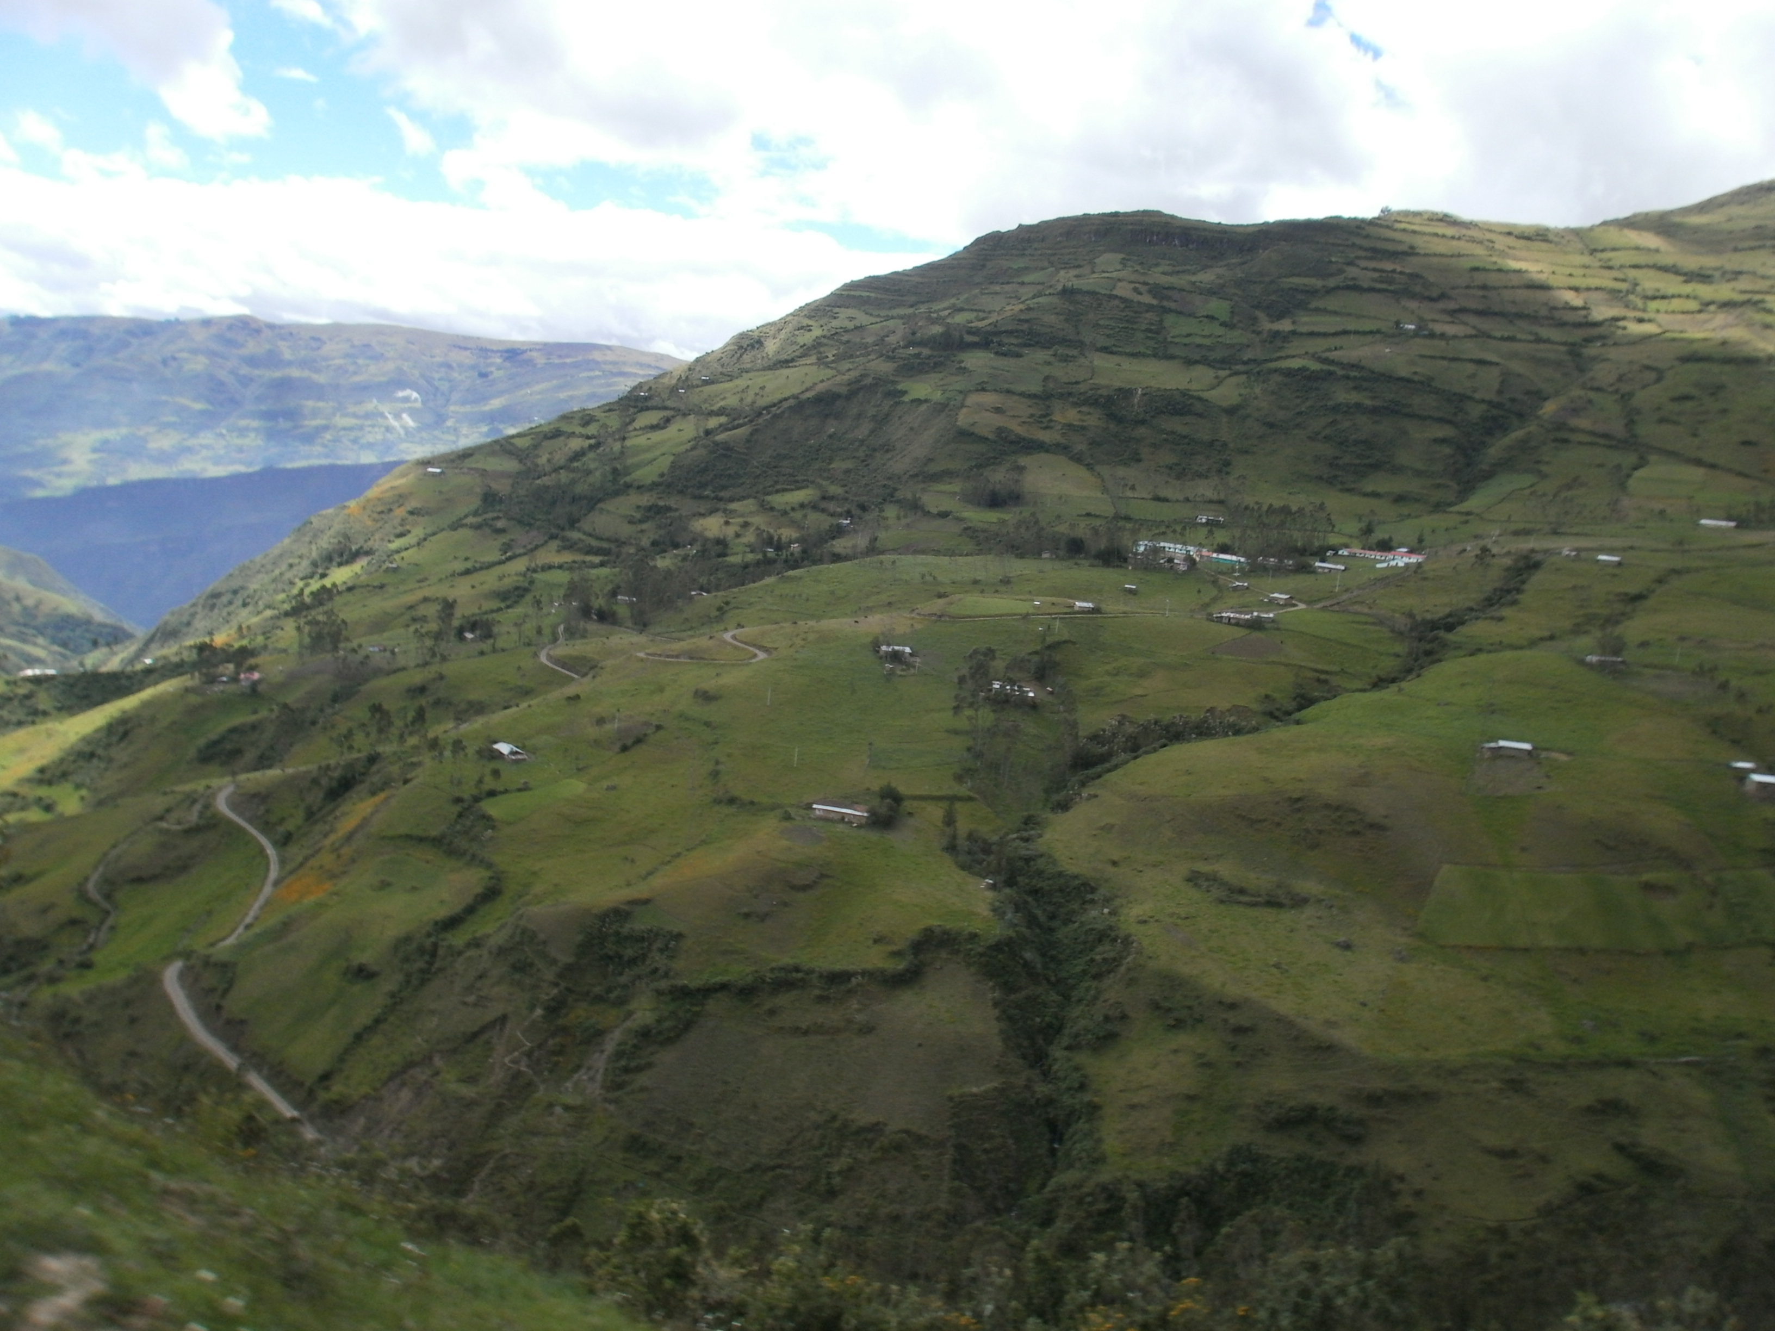
Project Overview
Partners:
Water For People
Instituto Nacional de Defensa Civil del Peru (INDECI)
Why NASA DEVELOP?
Lack of in-situ-data
Incorporating remotely sensed imagery to augment lack of data
Use a scientific method for making real life decisions for the people of Peru
Source: Water for People
Notes:
Water for People, a non-profit organization dedicated to providing clean water in developing countries, is currently working with the Peruvian government to develop a water budget and assist in flood risk mitigation. Currently Water For People lack some of the in-situ sata they need and wish to incorporate remotely sensed data from NASA Earth observations to help augment currently available in-situ data. In addition, current flood disaster management plans are incomplete and there are not enough proactive plans to prevent widespread disaster.
Source: http://www.waterforpeople.org/making-a-difference/peru and http://wfp.akvoflow.org/

Slide 5
Objectives
Build a SWAT model for the Jequetepeque river watershed to study the hydrological processes in the study area
Transfer the knowledge to build, calibrate, and validate SWAT models through provided tutorials and tools to partners
Identify preliminary models and data to estimate the flood risk assessment and research best prediction models
Source: Juan Francisco (Water for People)
Notes:
Identify parameters for the SWAT model. Download the appropriate datasets and acquire ancillary data. Configure the data in a manner that is compatable and uniform with SWAT. Run the model in ArcGIS with the necessary data. Review the table outputs and calibrate to test the performance of the model.
Once completed with the SWAT model, the team started on a knowledge transfer for Water For People. This included video tutorials of data collection, project setup, and data processing. These videos along with collaboration with Arsett will help in the process of creating a user frirendly webinar for Water For People.
For flood modeling we have identified the Integrated Flood Analysis System as an effective tool for flood-forecasting and warning using satellite-based rainfall and global GIS databases for poorly gauged basins.

Slide 6
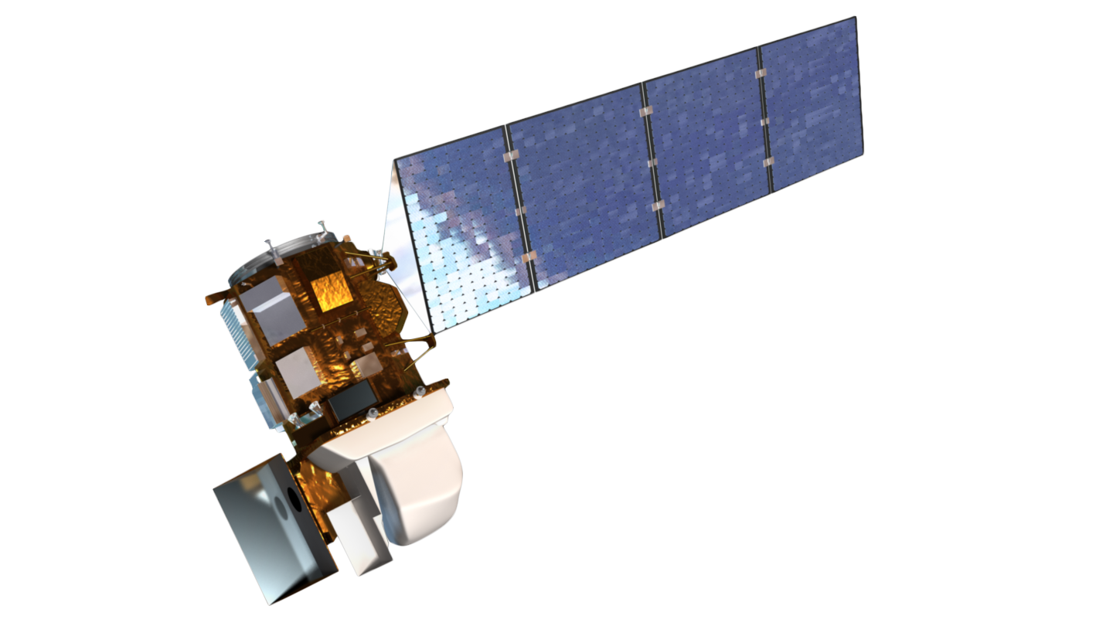
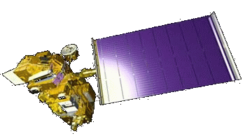
NASA Earth Observations
Satellite: Terra
Sensor: Advanced Spaceborne
Thermal Emission and
Reflection Radiometer
(ASTER)
Product: Digital Elevation Model
(DEM)
Satellite: Landsat 8
Sensor: Operational Land Imager
(OLI)
Product: Land Use
Notes:
For this project two earth observation satellites were used. The Landsat 8 OLI sensor was used for high resolution imagery to conduct a supervised classfication. The Terra ASTER sensor was used for its Digital Elevation Model for the HRU Analysis component of the SWAT Model. This helped delineate watersheds and conduct a slope classification.

Slide 7
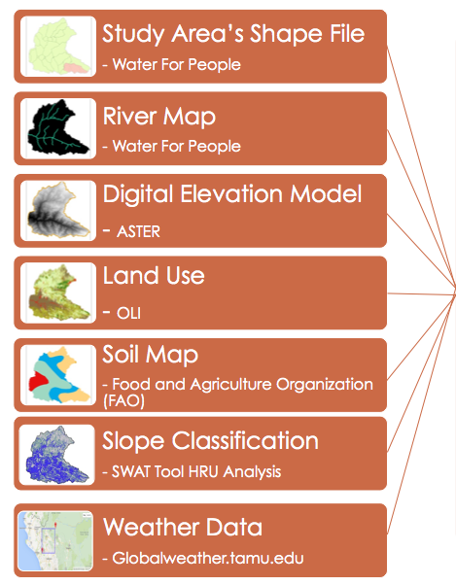
Acquisition & Processing
Notes:
Acquisition
Elevation data collected from ASTER, a satellite used to produce digital elevation models using infrared cameras.
Soil inputs for SWAT were collected from the Food and Agriculture Organization of the UN’s Digital Soil Map of the World.
Land use was derived from Landsat 8 OLI through supervised classification.
Weather data was gathered from Globaleweather.tamu.edu from Texas A & M University.
The slope classification is created in the SWAT model. It is based on the DEM data and classified into percent slope.
The river data was ancillary data retrieved from Water For People.
Processing
SWAT functions as a continuous simulation of watersheds.
Simulation of the watershed is separated in the land phase, controlling the amount of sediment loadings, and the routing phase, the actual water movement of water and sediments.
SWAT reads observed data based on monthly statistics and creates simulations of water flow.

Slide 8
Results
Notes:
This is the final result of the supervised classification for the SWAT model. These classifications include forrest decidous, urban, water, agriculture generic, barren, and pasture divisions.

Slide 9
Results
Notes:
Here we can see one of the final maps that the SWAT model computes. Included in the map are the subbasins located inside the Jequetepeque watershed, the reach of the river network, and the monitoring points alongside the river network. The Asuncion district intersects with subbasins 31, 29, 28, 26, and 24.

Slide 10
Results: Simulated Discharge
Notes:
Here is a graph of discharge from 2004 through 2014. The data used for this was derived from the SWAT simulation tables output section of the model. These numbers were simulated from global weather data taken from Texas A & M’s data for SWAT website. We are currnelty working to calibrate and validate the model through SWAT- CUP. However there is not enough historical data to fully calibrate it and we will be transfereing the knowledge to Water For People so that they will have the ‘Know how” and can fully calibrate it as they collect data through out time. Calibration and validation would help them understand how the model performed and would allow them to make alterations to increase the performance of the model.

Slide 11
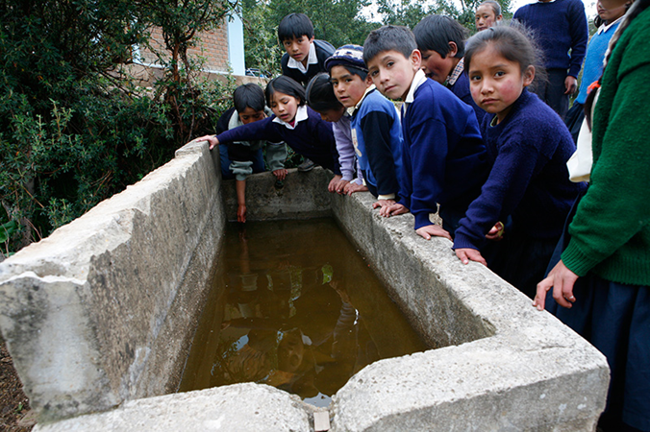
Conclusions
The final results can be used to serve as decision support tools in Water for People’s projects in Peru
Tutorials developed can be used to assist other regions facing similar challenges
In the future, flood models will be developed for the located flood risk areas
Source: Water for People
Notes:
This model and its results will provide Water For People with data that will support their decision making when developing a water resources plan for The Asuncion District
The tutorials we are developing and Webinars that are in progress with assistance form ARSET, will allow Water For People to funderstand and use the SWAT model to its potential. Also, the knowledge transfer will allow them to transfer the knowledge themselves to other organizations within Peru where there is a need for a water resource plan.
We have already located the flood study area for next term with help from Water For Preple and INDECI and have been studying models to impliment in this area. Calaboration with INDECI will become more prominent has we begin to focus more on floods.
This term has brought us closer to helping provide Peru with a complete water security plan in the need, sanatation, and hazards of water.
Some things to improve on:
Calibration
Validation
A more in depth soil layer and compatable database – too generalized by dominant soil type.
Source: http://www.waterforpeople.org/making-a-difference/peru

Slide 12
Acknowledgements
Advisors
Dr. Kenton Ross,NASA DEVELOP National Science Advisor
Dr. DeWayne Cecil, Global Science and Technology Inc.
Partners
Mark Duey & Juan Francisco Soto Hoyos, Water for People
Instituto Nacional de Defensa Civil del Peru (INDECI)
Others
Hon. J. Jack Kennedy, Mentor
Ms. Melanie Salyer, Mentor
Steve Padgett-Vasquez, University of Georgia
Dr. Ryan Stewart , Virginia Tech
This material is based upon work supported by NASA through contract NNL11AA00B and cooperative agreement NNX14AB60A.
Notes:
Thank you all!

Slide 13
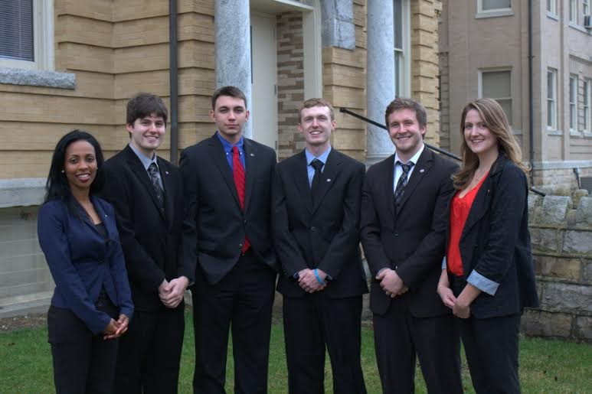
Peru Project Team
Left to right: Azeb Shewago, Scott Arnette, Grant Bloomer, Kieran Blakemore, Jordan Bates,
Sarah Medley

