Slide 1
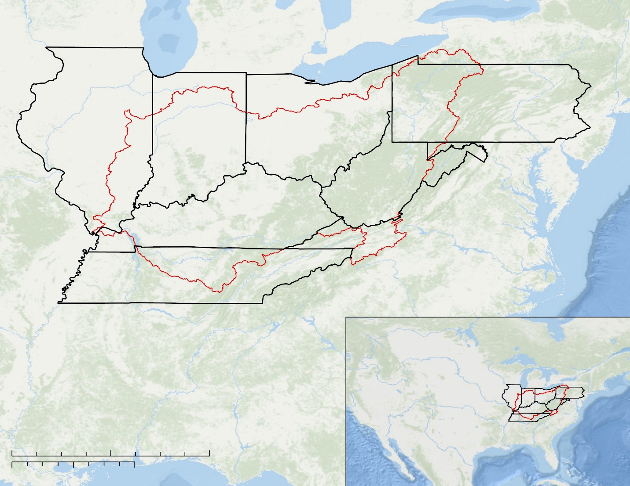
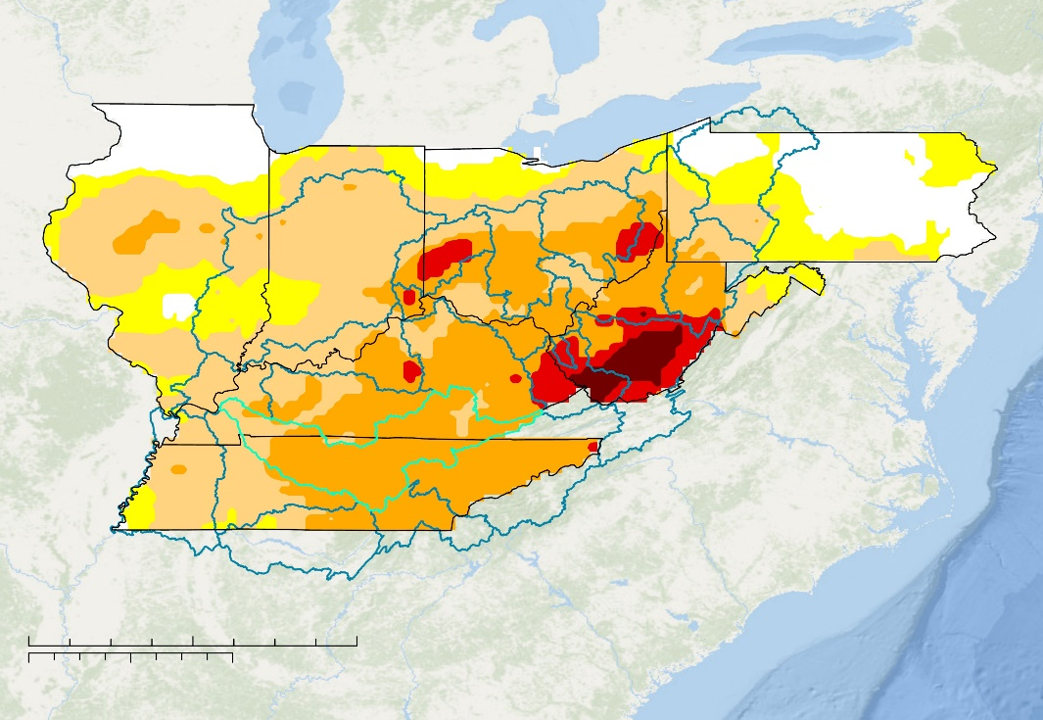
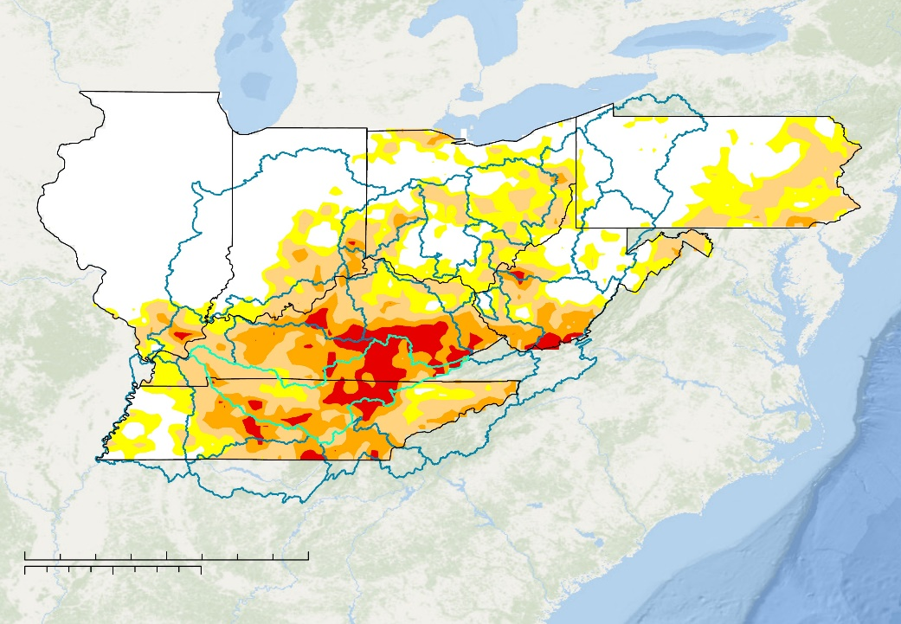
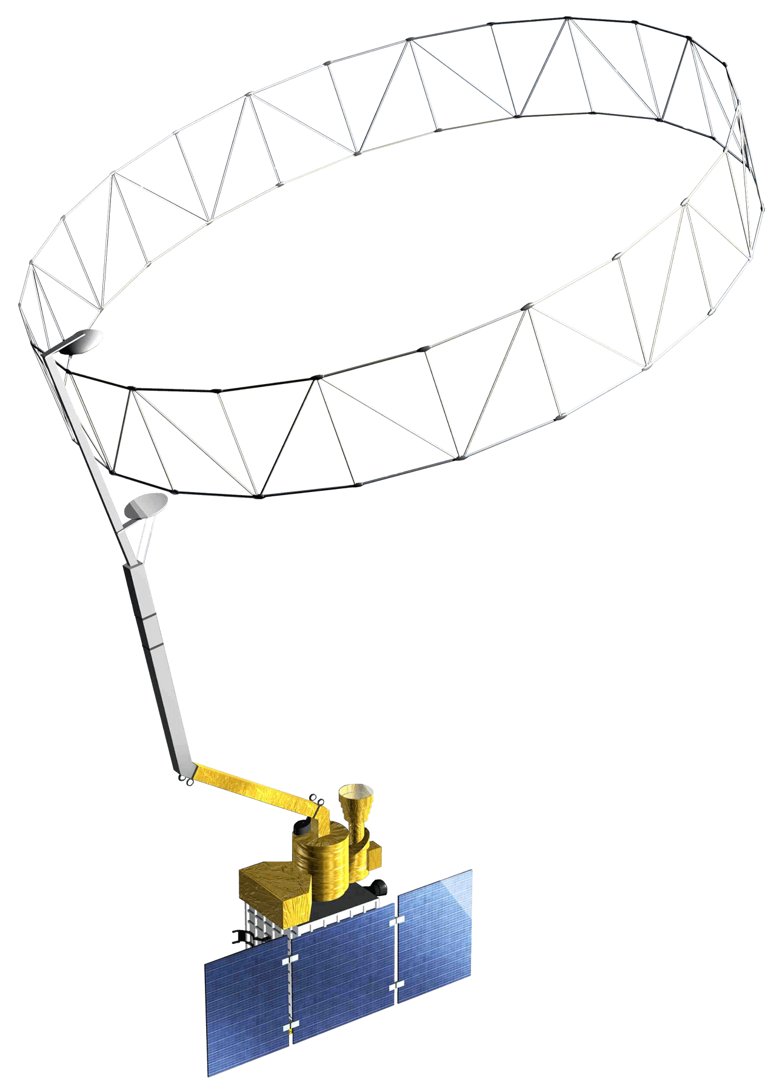
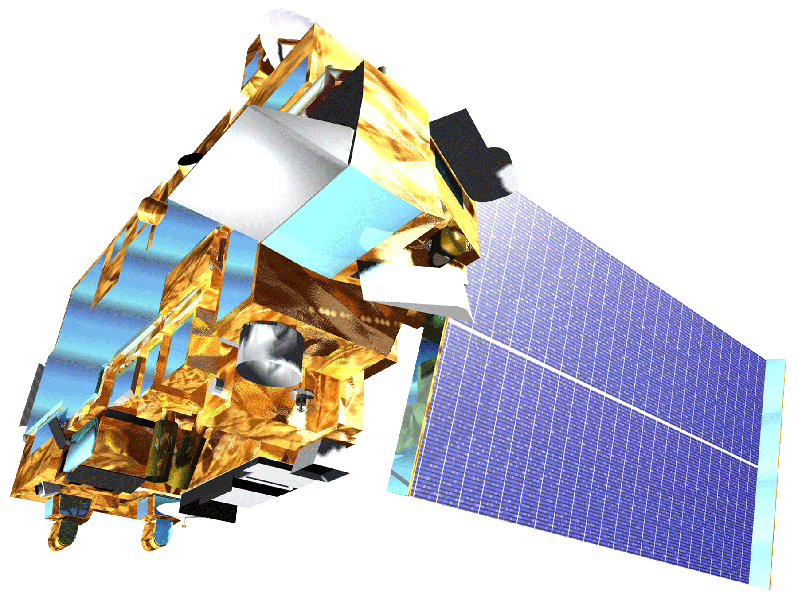
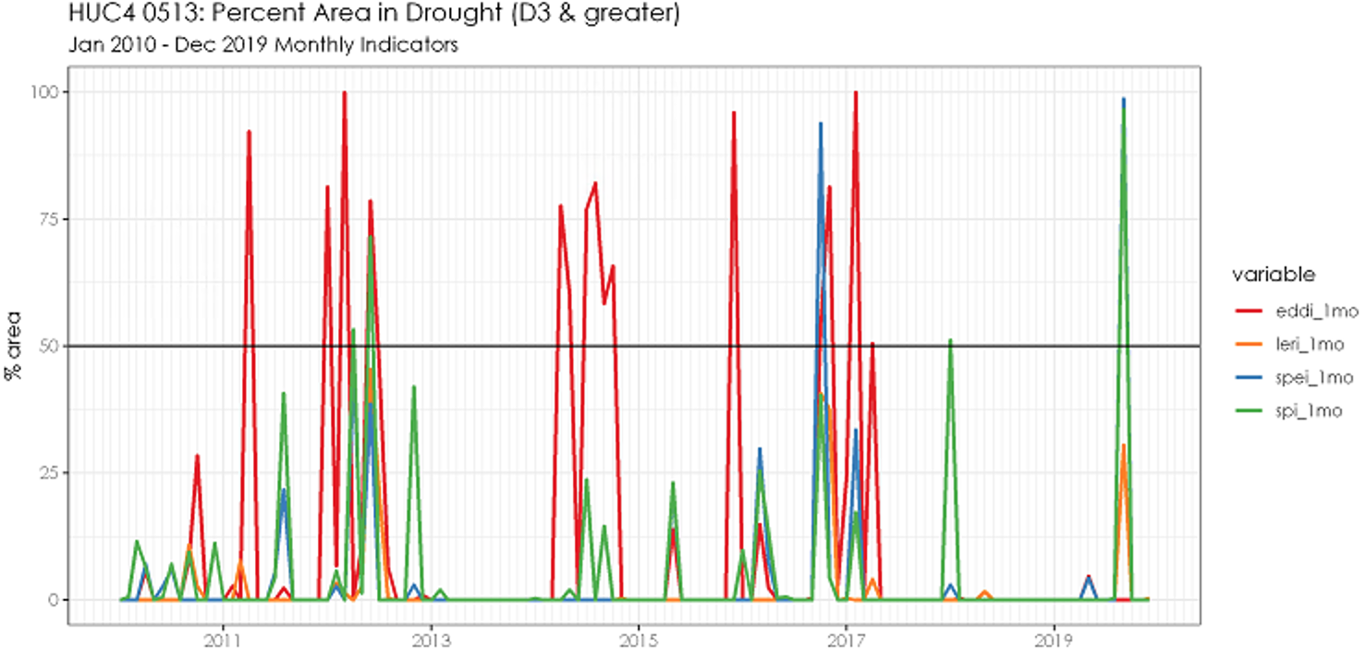
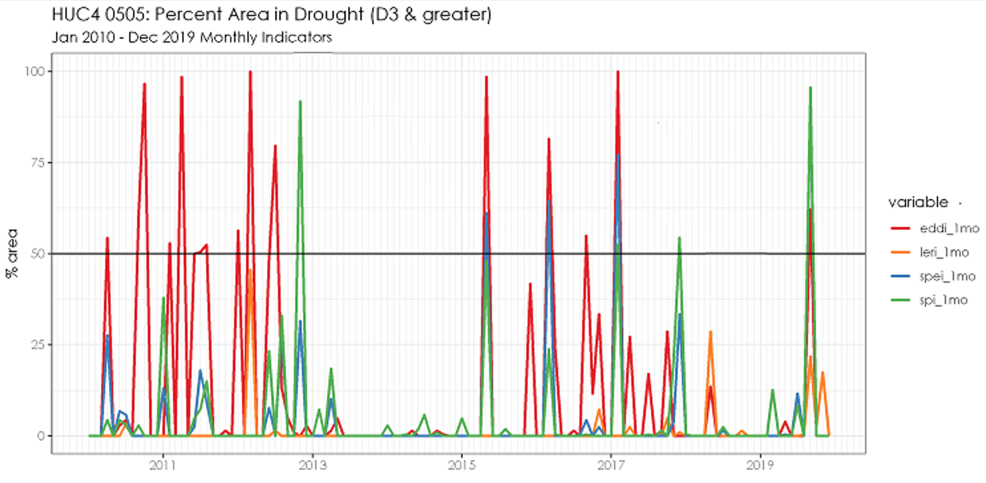
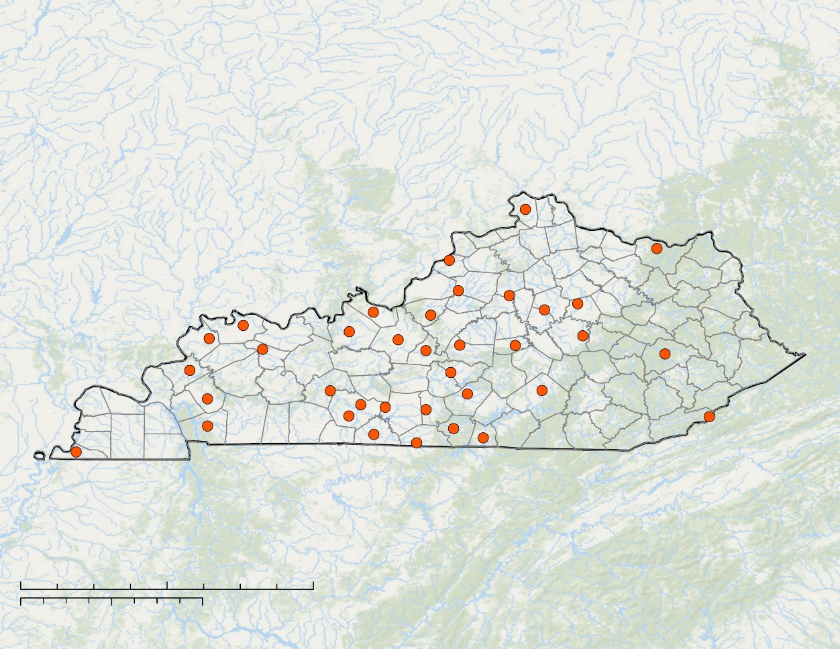
Monitoring Flash Drought Potential and Quantifying the Hydrologic Impacts in the Ohio River Basin Utilizing NASA Earth Observations
Abstract
Methodology
Ohio River Basin Water Resources
Flash drought conditions emerge in a matter of weeks following persistent weather anomalies, such as high temperatures or large vapor pressure deficits, that drive increased evaporative demand. Vegetation response rapidly depletes soil moisture, threatening surface water supplies, triggering significant crop loss, and increasing wildfire risk. Drought indices sensitive to flash drought are currently not included in drought forecast models in the Ohio River Basin (ORB). The team assessed and compared drought indices, gauge-based data, and satellite measurements over the course of the September 2019 flash drought event in the Ohio River Basin to investigate environmental fingerprints throughout flash drought evolution. Potential leading flash drought indicators were compared to the Standardized Precipitation Index (SPI) to aid the National Weather Service (NWS) Ohio River Forecast Center and Kentucky Climate Center in producing early warning flash drought forecasts. These drought indices included Evaporative Demand Drought Index (EDDI), Standardized Precipitation Evapotranspiration Index (SPEI), and Landscape Evaporative Response Index (LERI) (derived from Terra Moderate Resolution Imaging Spectroradiometer (MODIS)). Soil moisture response was evaluated using Soil Moisture Active Passive (SMAP) L-band radiometer data and Kentucky Mesonet gauge-based measurements. This analysis enables climatologists and weather forecasters to keep decision-makers and stakeholders better informed about drought risks to implement the appropriate actions for preparation of drought onset.
1. Drought Indicator Comparison Analysis
Index | Physical Measurement | Output | Grid
LERI | Terra MODIS land surface temperature | actual evapotranspiration (ET_{a}) anomaly 2000 – 2019 | 1 km
EDDI | NASA National Land Data Assimilation Systems (NLDAS-2) temperature, humidity, wind speed, & solar radiation | evaporative demand (E₀) anomaly 1980 – 2019 | 12 km
SPEI | NOAA NCEI nClimGrid precipitation & temperature | water balance standardized 1895 – 2019 | 5 km
SPI | NOAA NCEI nClimGrid precipitation | precipitation standardized 1895 – 2019 | 5 km
Table 1. Description of drought indicators used in analysis.
ACQUISITION
PROCESSING
ANALYSIS
Study Area
Objectives
II. Resample to 12 km grid
I. Download drought index data products:
July – Oct 2019
Jan 2010 – Dec 2019
III. Crop to region of interest
V. Assess spatial and temporal patterns in drought index behavior
OHIO RIVER BASIN (ORB)
IV. Reclassify to USDM categories
Compare drought index products to identify potential leading and reacting flash drought indicators
Investigate environmental hydrologic response through soil moisture observations to better understand nature of flash drought in ORB
Demonstrate the use of SMAP-derived soil moisture to enhance in situ data observations in Kentucky
USDM | Z-SCORE | PERCENTILE
No Drought | -0.4 or greater | 31 to 100
D0 | - 0.5 to -0.7 | 21 to 30
D1 | - 0.8 to -1.2 | 11 to 20
D2 | -1.3 to -1.5 | 6 to 10
D3 | -1.6 to -1.9 | 3 to 5
D4 | -2.0 or less | 0 to 2
VI. Complete time series analysis for HUC4 sub-watersheds within the study area.
Table 2. U.S. Drought Monitor (USDM) classification thresholds.
State Boundary
2. Soil Moisture Analysis
Study period: July – October, 2019
0
100
Ohio River Basin
ACQUISITION
PROCESSING
ANALYSIS
200
400
Miles
III. Compute median SMAP (5 cm) & Mesonet (2-, 4-, & 8-inch)
0
100
200
400
Kilometers
I. Convert KCC Mesonet station data to spatial data frame
IV. Visualize and assess time series by station & physiographic region
Results
II. Extract SMAP raster data for
Mesonet station points
Compute 3-day & 7-day rolling mean
V. Soil texture comparison to RMSE
September 2019 Drought Classification
Compute RMSE daily
EDDI 1-MONTH
LERI 1-MONTH
Earth Observations
Project Partners
No Drought
Soil Moisture Active Passive
(SMAP)
Kentucky Climate Center
NOAA National Weather Service, Ohio River Forecast Center
D0 (Abnormally Dry)
D1 (Moderate Drought)
D2 (Severe Drought)
Level 4 gridded surface (5 cm) soil moisture
D3 (Extreme Drought)
0
100
200
400
D4 (Exceptional Drought)
0
100
200
400
Miles
Miles
HUC4 Boundary
0
100
200
400
Kilometers
0
100
200
400
Kilometers
Terra MODerate Resolution Imaging Spectroradiometer (Terra MODIS)
Figure 1. Ohio River Basin USDM drought classification of September 2019 1 month EDDI and LERI products. HUC4 boundaries used for for time series analysis.
2010 – 2019 Drought Index Time Series for Cumberland Sub-watershed
Thermal imagery used in LERI evapotranspiration fraction computation
100
EDDI 1-Month
75
LERI 1-Month
Conclusions
50
SPEI 1-Month
Percent area >= D3
SPI 1-Month
25
EDDI displays sensitivity, likely because it represents potential evapotranspiration, which frequently changes with meteorological variations.
Project partners observe EDDI as a leading indicator of drought risk, which can be used in combination with other indicators to assess drought onset.
SPI and SPEI 1-month products capture the observed severity of the 2019 flash drought.
SMAP and Mesonet measurements exhibit similar patterns of wetting & drying. These patterns reflect trends in categorical drought changes.
Soil textural class has no observable relationship with SMAP and Mesonet comparison.
0
2011
2013
2015
2017
2019
Figure 2. Percent area classified as D3 or D4 for monthly drought indicators within the Cumberland HUC4 (code 0513 – highlighted in Figure 1 plots)). Flash drought events in 2012, 2016, and 2019 highlighted.
Soil Moisture Measurements during 2019 Flash Drought
KENTUCKY MESONET
STATIONS
0.4
0.3
2-inch Mesonet
0.2
a.
4-inch Mesonet
0.1
8-inch Mesonet
Volumetric Soil Moisture (m³m⁻³⁾
5-cm SMAP
0.4
Mesonet Surface
Average
Team Members
Stations
0.3
0
50
100
200
Miles
County Boundary
0.2
b.
0
50
100
200
Kilometers
State Boundary
0.1
Jul
Aug
Sep
Oct
Nov
Figure 3. 2019 Kentucky Mesonet and SMAP soil moisture at a.) Breckinridge County (HARD) and b.) McLean County (PVRT).
Acknowledgements
Ronald Leeper
NOAA NCEI, North Carolina Institute for Climate Studies
Andrew Shannon
NASA DEVELOP NC – NCEI Fellow
Stuart Foster
Kentucky Climate Network
James Noel
NOAA NWS Ohio River Forecasting Center
Jordan Basham
Western Kentucky University PBS
Rocky Bilotta
NOAA NCEI, Center for Weather and Climate
Adelaide
Schmidt
Project Lead
Kayleigh
DeBruyne
Jessica
Ganim
Isabelle
Runde
North Carolina – NCEI

