Slide 1
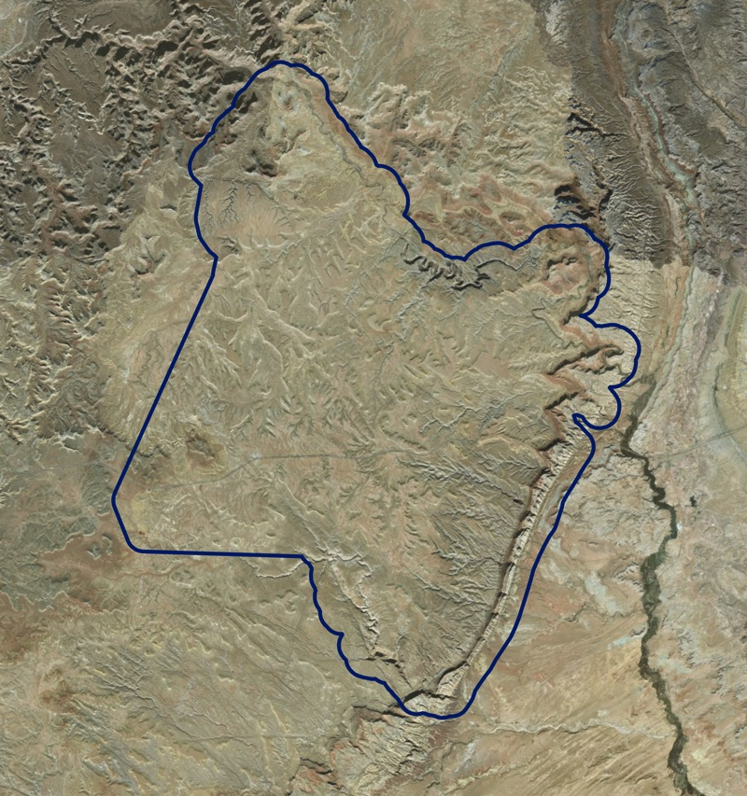
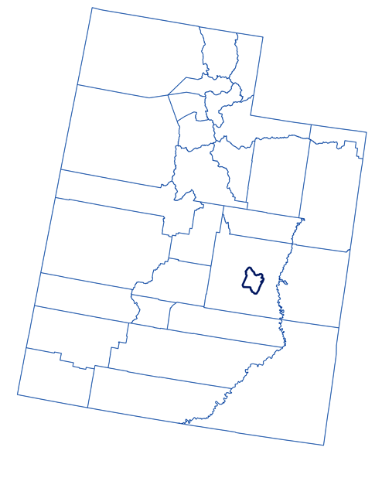
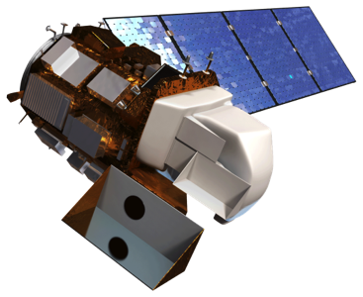
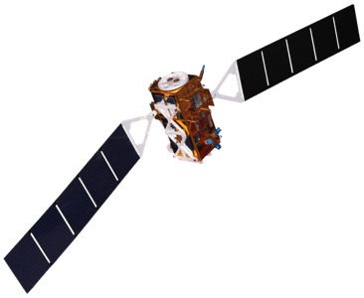
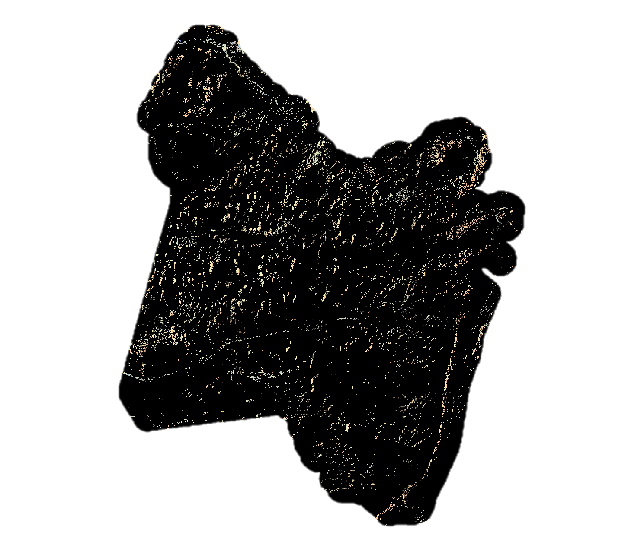
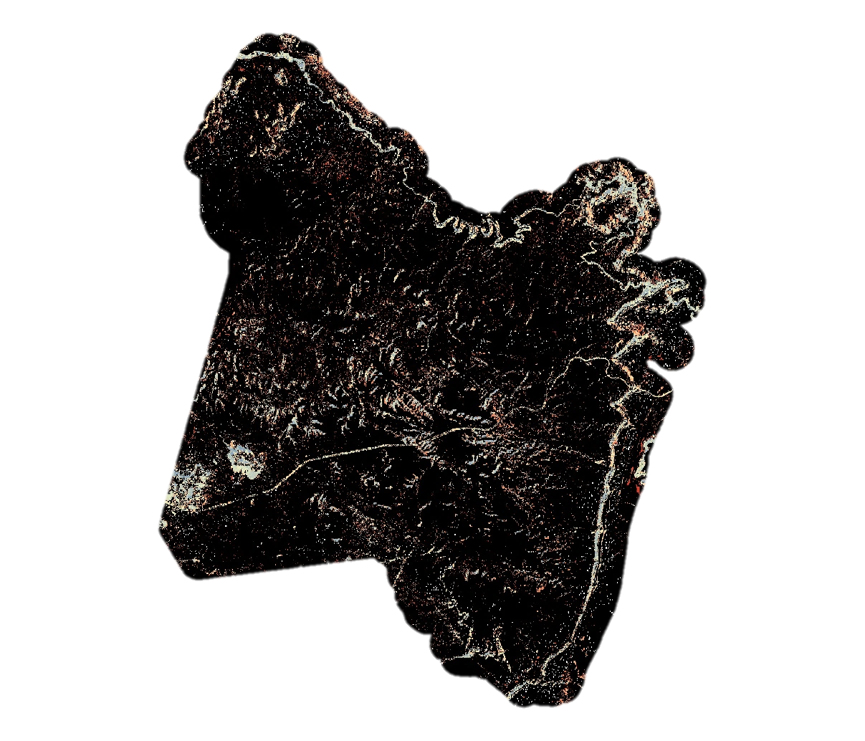
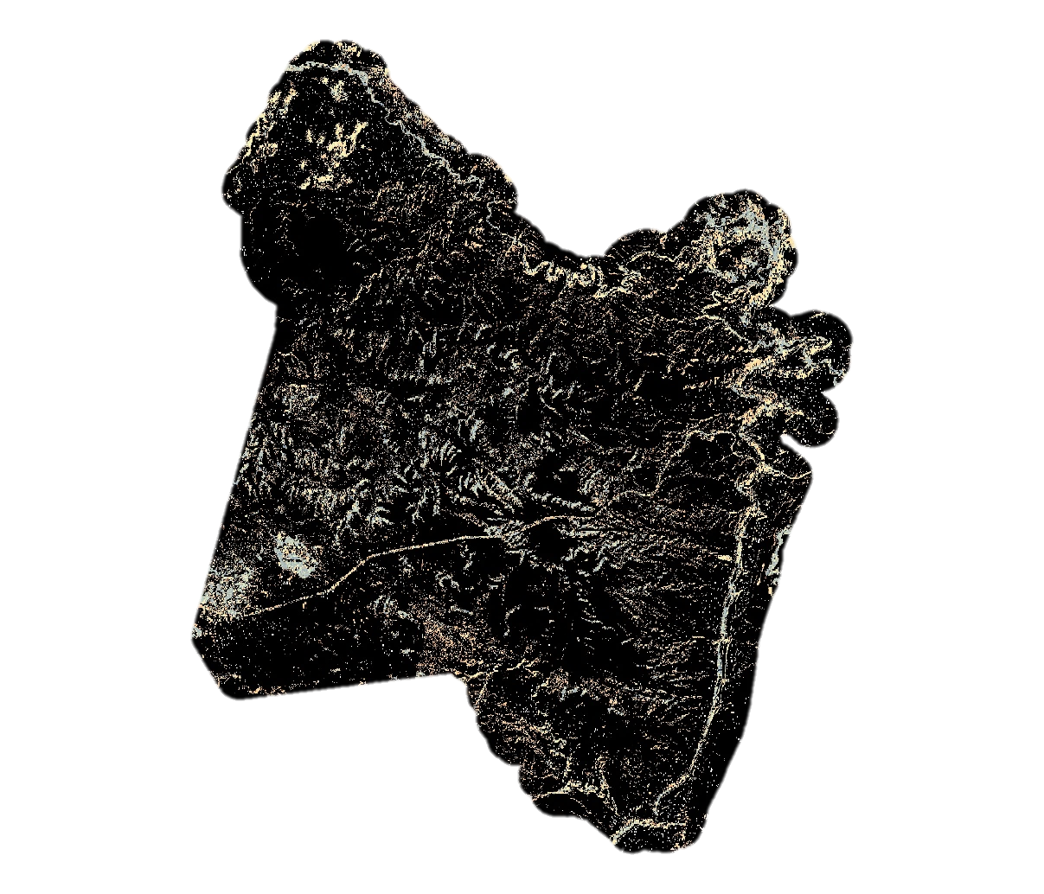
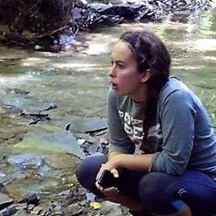
Utilizing Landsat to Detect Ephemeral Water Sources in Support of a USGS Feasibility Assessment and Management Strategy of Equids
Abstract
Objectives
Since 1971, federal agencies have been tasked with managing burros in federally-designated herd management areas (HMAs). Because these areas are often large and remote, obtaining sufficient data on horse and burro populations and habitat preference can be difficult and expensive. In recent years, the United States Geological Survey (USGS) has partnered with the Bureau of Land Management (BLM) to study the population dynamics and habitat preferences of wild horse and burro populations on the Sinbad HMA in central Utah. Researchers at the USGS and BLM hypothesize that surface water is potentially an important factor in wild horse and burro habitat selection, thus these agencies are interested in determining how water availability affects species’ movement in both time and space. NASA DEVELOP leveraged NASA Earth observations and pre-existing water availability data to determine the spatial and temporal distribution of water on the landscape. Maps were developed to help researchers create habitat selection models for wild horses and burros on the Sinbad HMA and elsewhere.
Develop temporally-explicit water detection maps that identify the presence of ephemeral water sources in Sinbad HMA
Evaluate model utility and map accuracy by comparing our results with pre-existing surface water maps and field observations
Generate a modeling tutorial that will enable end users to replicate this study in future years for this and additional study locations
Methodology
NASA Earth Observations
Landsat 8 OLI
STRM
Senintel-1 C-SAR
R
Random Forest
Study Area
PRISM Climate Data
Google Earth Engine
Water Presence Map
Field Data
Ocular Digital Survey Data
Sensor Input
Data
Software
Algorithm
Output
1
2
3
4
5
Earth Observations
Utah
Landsat 8
Sentinel-1
Shuttle Radar Topography Mission
Sinbad HMA and surrounding area utilized by local burro populations
Results
Landsat Model
Dry Season
Panchromatic Landsat Model
Wet Season
Dry Season
More wet
Wet Season
More wet
More dry
More dry
Out of Bag estimate of error rate: 9.26%
Model’s Accuracy: 90.7407%
Cohen’s kappa coefficient: 0.3284
Area under the ROC curve: 0.6347
Users Accuracy: 30.0%
Producer’s Accuracy: 50.0%
Specificity: 0.3
Sensitivity: 0.9694
Out of Bag estimate of error rate: 5.91%
Model’s Accuracy: 94.0850%
Cohen’s kappa coefficient: 0.8803
Area under the ROC curve: 0.7655
User’s Ac`curacy: 94.5%
Producer’s Accuracy: 92.2%
Specificity: 0.9454
Sensitivity: 0.9373
Team Members
Conclusions
The model that employed the panchromatic sharpened technique had a higher resolution than the standard Landsat model and incorporated a less-skewed training data set. Comparatively, the panchromatic 15m Landsat model provided marked improvement to the standard 30m Landsat reflectance models, and more accurately displayed ephemeral surface water in distinct seasons.
These maps and modelling approaches will support the USGS and BLM in developing habitat selection models for research of wild burro behavior.
These modelling approaches and frameworks can be adapted to other studies and research projects, including that of the critically endangered African wild ass.
Kristen Dennis
Project Lead
Anson Call
Gary Olds
Tim Mayer
Acknowledgements
Dr. Paul Evangelista (Natural Resource Ecology Laboratory, Colorado State University)
Dr. Catherine Jarnevich (USGS, Fort Collins Science Center)
Nick Young (Natural Resource Ecology Laboratory, Colorado State University)
Dr. Kate Schoenecker (USGS, Fort Collins Science Center)
Dr. Sarah King (Ecosystem Science and Sustainability Dept., Colorado State University)
This material contains modified Copernicus Sentinel data (2017), processed by ESA
Project Partners
Fort Collins Science Center, Ecosystem Dynamics Branch
Utah State Office
Utah Water Resources
Colorado – Fort Collins | Spring 2018

