Slide 1
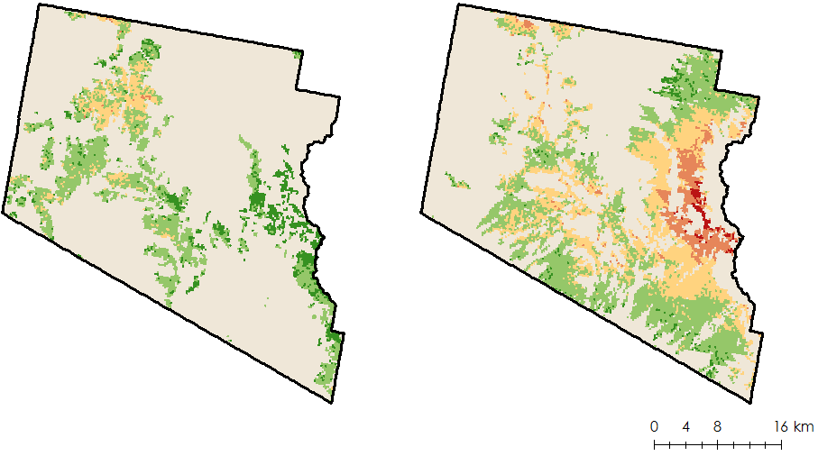
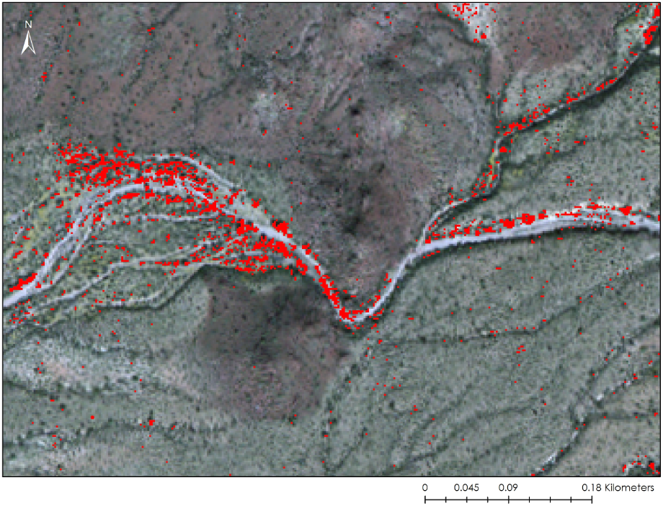
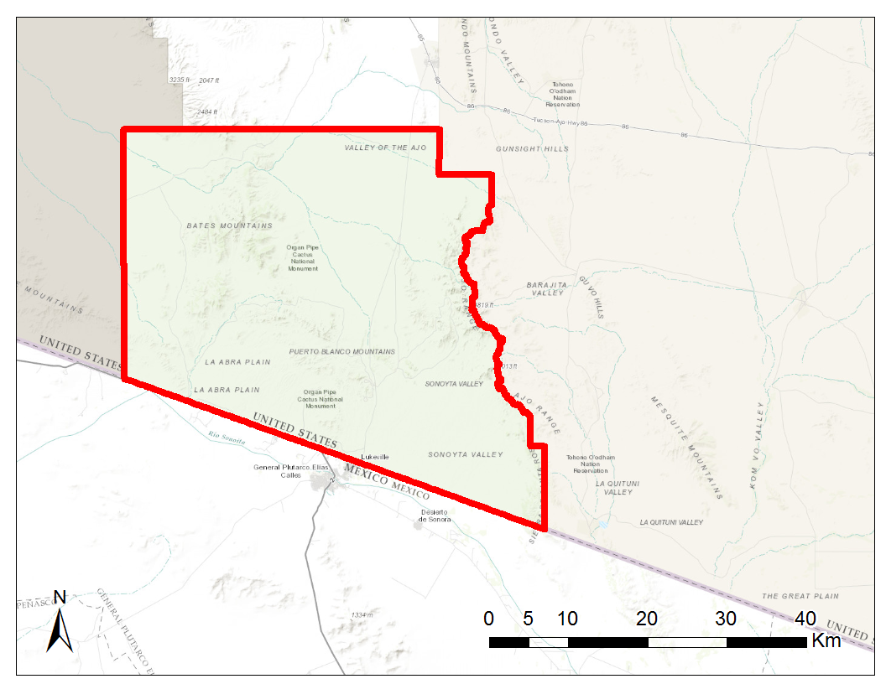
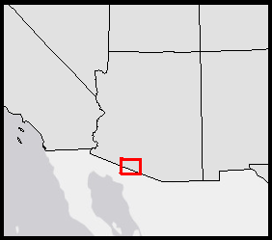
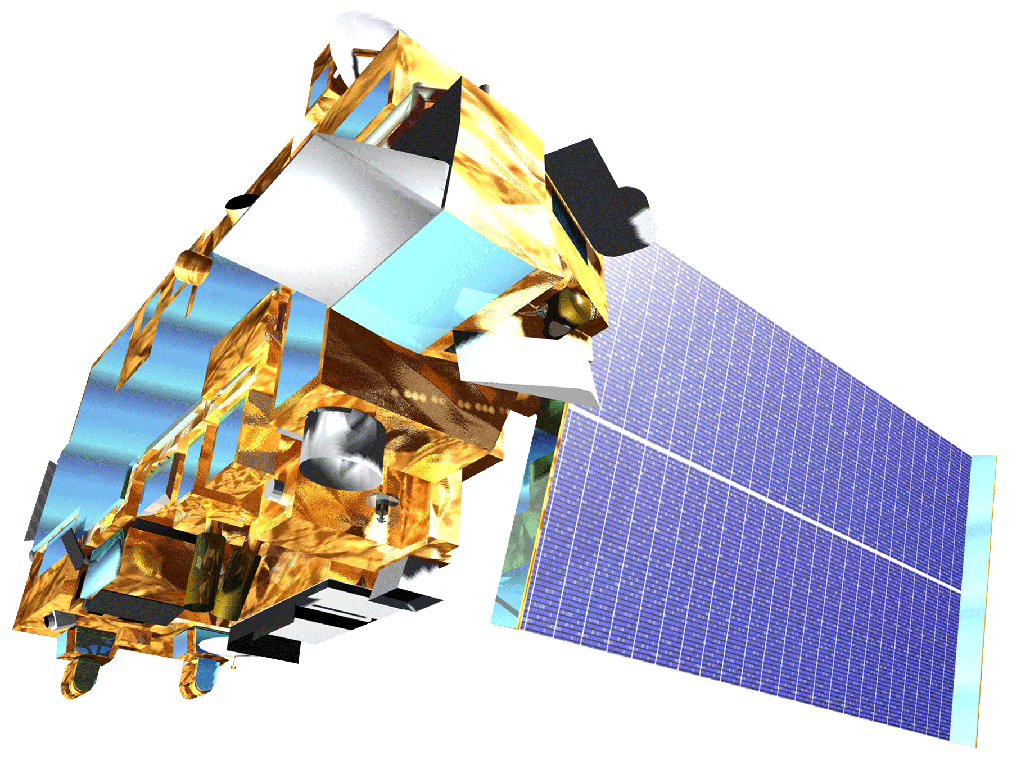
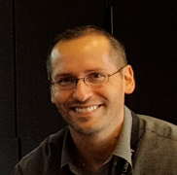
Detecting and Monitoring Invasive Buffelgrass in the National Parks of Southwestern Arizona
Abstract
Objectives
Organ Pipe Cactus National Monument, located in southern Arizona, is home to both diverse native species and a rich cultural history. It is the only place in the United States where large stands of organ pipe cactus (Stenocereus thurberi) can be found. Unfortunately, the Park’s landscape is under threat from invasive buffelgrass (Pennisetum ciliare), a non-native species originally brought to the United States from Eurasia and Africa to stabilize soils and improve the productivity of rangelands. Buffelgrass forms dense mats in vacant gaps between native plants that normally serve as fire breaks. Consequentially, these mats become vast fuel loads with high peak fire temperatures that drastically increase the chance of devastating wildfires. The plant also threatens the transformation of native desertscapes to grasslands through an expansive root system that allows the species to outcompete native flora. Currently, park managers rely on costly aerial and ground surveys to monitor this species. To improve the capability of the National Park Service (NPS) to combat the spread of buffelgrass, this project investigated and furthered two methodologies for buffelgrass detection, and mapped predicted locations of buffelgrass presence. Because buffelgrass has a quick phenological response to precipitation events, the Climate-Landscape Response (CLaRe) model was used to study the relationship between remotely sensed Normalized Difference Vegetation Index (NDVI) data derived from the Moderate Resolution Imaging Spectroradiometer (MODIS) and rainfall data from the Parameter-elevation Relationships of Independent Slopes Model (PRISM). The team also tested a spectral-based approach, using the Mixture Tuned Matched Filtering (MTMF) technique on high-spatial-resolution WorldView-2 data.
Expand the capabilities of the National Park Service to detect, monitor, and target non-native buffelgrass
Investigate the effectiveness of Climate Landscape Response (CLaRe) metrics and Mixture Tuned Matched Filtering (MTMF) techniques for buffelgrass detection
Create classification map of buffelgrass presence/absence in Organ Pipe Cactus National Monument
Results
CLaRe:
2011:
Vegetation Class 1 (left) = Parkinsonia microphylla, Ambrosia deltoidea, Stenocereus sp.,
Jatropha sp.
Vegetation Class 2 (right) = Acacia sp. , Ambrosia ambrosioides, Ambrosia deltoidea, Parkinsonia
microphylla
NDVI ~ Precipitation:
NDVI ~ Precipitation + Evapotranspiration:
Methodology
Data Acquisition & Preprocessing
Data Analysis and End Products
MODIS
NDVI composites
Climate Landscape Response (CLaRe) on stratified and unstratified landscape
Correlation Value Maps
Evapotranspiration (ET)
PRISM
Precipitation
0
0.15
0.30
0.45
0.60
0.75
MTMF:
Radiometric Calibration & Atmospheric Correction
Mixture Tuned Match Filtering (MTMF)
Binary Classification Maps
February 10, 2012
WorldView-2
Predicted Buffelgrass locations
Southern Arizona Ecological Forecasting
Study Area
Nevada
Utah
Colorado
California
Arizona
New
Mexico
Conclusions
Organ Pipe Cactus National Monument
CLaRe metrics had mixed success in identifying the dynamic between NDVI and water balance variables across the landscape. More detailed field data is necessary to examine if buffelgrass is in fact impacting correlation values.
MTMF modeled presence and absence maps, when implementing Match Filter Score thresholds, proved moderately to highly accurate when compared with available field data.
Earth Observations
Terra MODIS
Project Partners
Dana Backer, Park Ecologist
Cynthia Wallace, Research Scientist
Dr. Seth Munson, Research Ecologist
Dr. Temuulen Sankey, Remote Sensing Scientist – Northern Arizona University
Team Members
Acknowledgements
Dr. Natasha Stavros (NASA Jet Propulsion Laboratory)
Jeanne Taylor (Organ Pipe Cactus National Monument, Botanist)
Ben Holt (DEVELOP Mentor)
This material is based upon work supported by NASA through contract NNL11AA00B and cooperative agreement NNX14AB60A. Any mention of a commercial product, service, or activity in this material does not constitute NASA endorsement. Any opinions, findings, and conclusions or recommendations expressed in this material are those of the author(s) and do not necessarily reflect the views of the National Aeronautics and Space Administration and partner organizations.
.
Molly Spater
Team Lead
Natalie Queally
Nick Rousseau
Erika Higa
NASA Jet Propulsion Laboratory – Fall 2016

