Slide 1

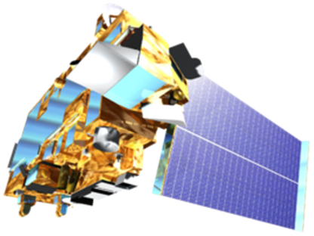
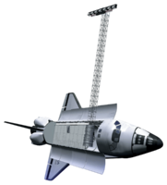

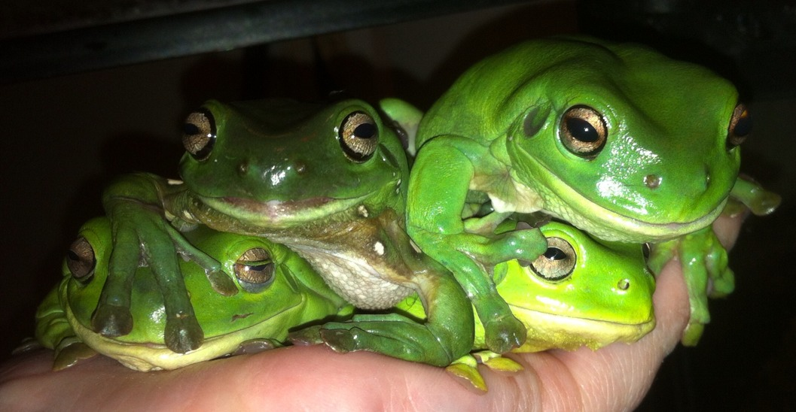



Mississippi Ecological Forecasting
Utilizing NASA Earth Observations to Locate Potential Habitat for the Dusky Gopher Frog
Ross Reahard (Project Lead), Rudy Bartels, James Brooke, Meredith Williams
Affiliation(s)
Abstract
Objectives
Utilize NASA Earth Observations to Locate Potential Habitat for the Dusky Gopher Frog, the most endangered species of frog in North America.
Study Area
Methodology
Landcover
St. Tammany Parish, LA
Hancock County, MS
Harrison County, MS
Jackson County, MS
Precipitation
Clip
to
Study
Area
Weighted
Based
on
Habitat Parameters
Overlaid
All
Layers
Final
Image
Elevation
Earth Observations
Soil
Landsat 8 (OLI)
Terra
Imagery
Space Shuttle
Landsat 5
Results
Conclusions
Use images.
Make sure that it has some sort of flow, that it makes sense. Show your results in a logical order.
No bullets.
Use bullets.
Use complete sentences with periods.
Team Members
Project Partners
Acknowledgements
The Nature Conservancy
U.S. Fish & Wildlife Service
U.S. Army Corps of Engineers
U.S. Forest Service
Joseph Spruce - Senior Scientist and Lead Science Advisor at NASA SSC
James “Doc” Smoot - Senior Scientist and Assistant Science Advisor at NASA SSC
Ross Reahard - SSC DEVELOP Center Lead
NASA DEVELOP National Program Office
Jim Lee - The Nature Conservancy (TNC) - Biologist
Ed Moody - USDA Forest Service: DeSoto Ranger District - Wildlife Biologist
Linda LaClaire - US Fish and Wildlife Service (USFWS) - Wildlife Biologist
Danny Hartley – US Army Corps of Engineers – Wildlife Biologist
Shelby Barrett – SSC DEVELOP
Ross Reahard (Team Lead), Michael Brooke, Rudy Bartels, Meredith Williams
NASA John C. Stennis Space Center

