Slide 1
Texas Disasters
Utilizing NASA Earth Observations to Assist the Texas Forest Service in Mapping and Analyzing Fuel Loads and Phenology in the Texas Grasslands
Ben Beasley
Alex Holland
Kristen Kelehan
Notes:
Hello,
My name is Ben Beasley
This project is entitled Texas Disasters:
Utilizing NASA Earth Observations to Assist the Texas Forest Service in Mapping and Analyzing Fuel Loads and Phenology in the Texas Grasslands.
Team Members: Alex Holland
Kristen Kelehan

Slide 2
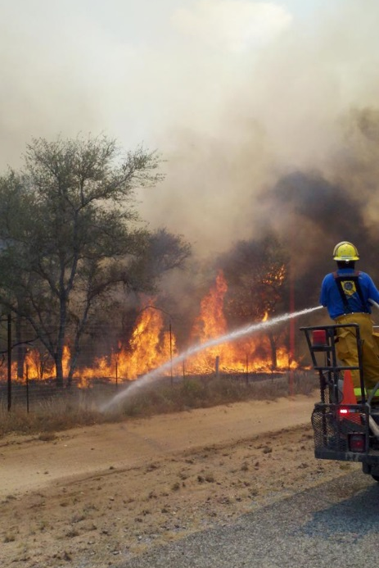
Community Concerns
Wildfires risk has increased due to climate change and recent urbanization
Texas grasslands are highly susceptible to wildfires especially during drought years
In 2011 wildfires in Texas scorched 4,000,000 acres and destroyed nearly 3,000 homes
Source:”
Source: NOAA
Notes:
Wildfires risk has increased due to climate change and recent urbanization
Texas grasslands are highly susceptible to wildfires especially during drought years
In 2011, the state of Texas declared a state of emergency due to the uproar of wildfires that scorched nearly 4,000,000 acres of Texas grasslands, forests, and urban areas and destroyed nearly 3,000 homes.
Image source:
http://www.crh.noaa.gov/bro/?n=2011event_smacfirephotogallery
.

Slide 3
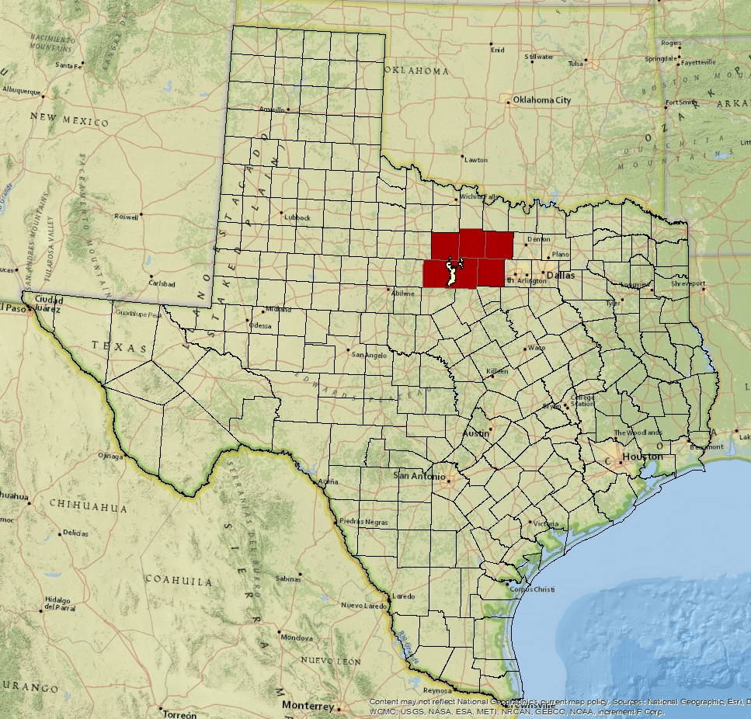
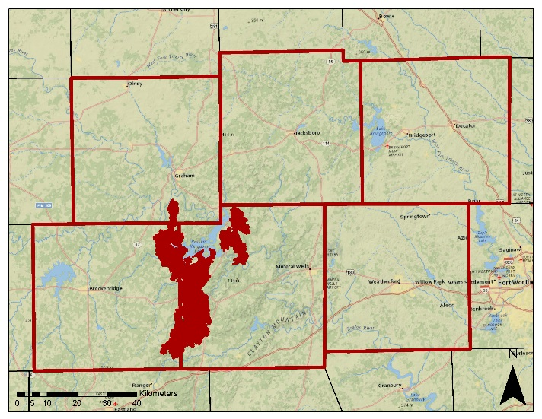
Study Area
The study covers the State of Texas with a case study of the Possum Kingdom Complex wildfires which burned approximately 150,000 acres in 2011.
Notes:
The study covers the entire State of Texas with a case study of the
Possum Kingdom Complex wildfires,
just west of Fort Worth,
which destroyed approximately 150,000 acres in 2011.

Slide 4
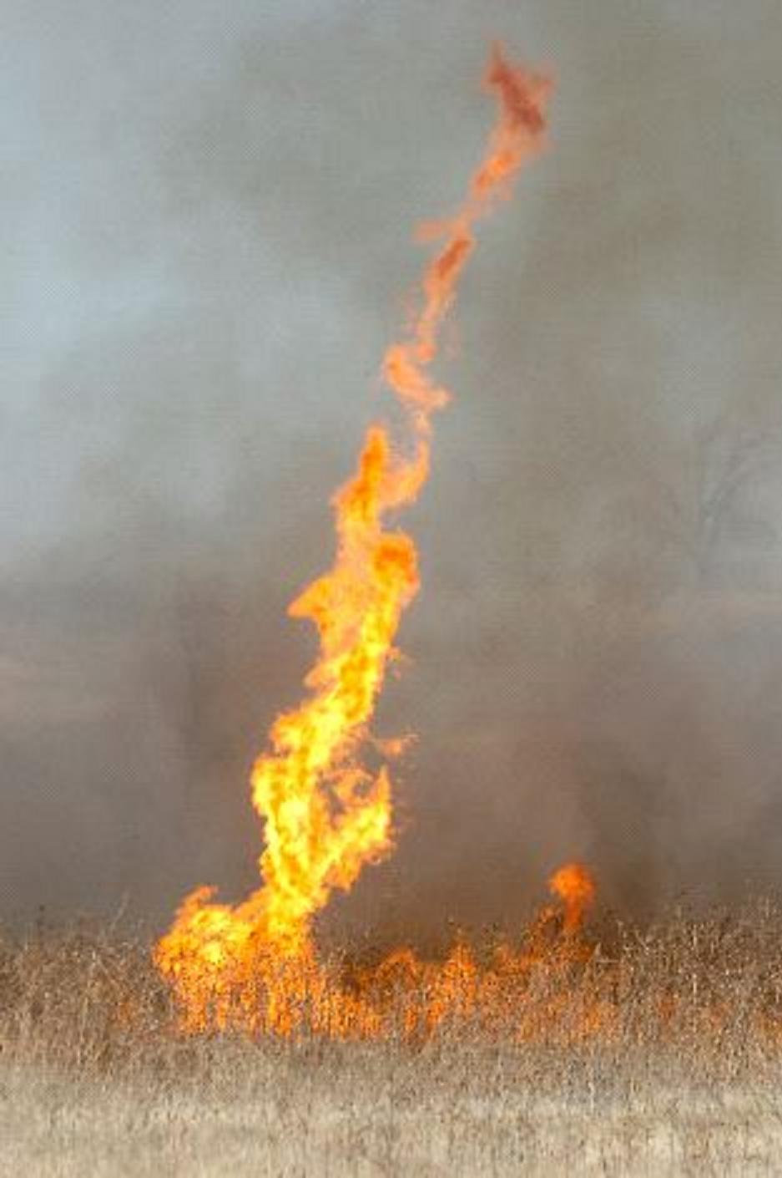
Project Partners
Texas A&M Forest Service
Assessment of wildfire risk
Monitoring of vegetative fuel loads
Calculate fire behavior
Source: NOAA
Notes:
The Texas Forest Service is tasked with estimating and evaluating potential fire risk in order to manage and allocate resources for the prevention and containment of possible wildfires across the varied and dynamic Texas landscape.
Some of the main components for assessing fire risk are understanding vegetative fuel types and fuel loads and making predictions of fire behavior based on the characteristics of each fuel.
They currently use comprehensive fuel mapping techniques using Landsat data but do not have a method to adjust these models to seasonal changes.
Image source:
http://www.srh.noaa.gov/ama/?n=fire_weather

Slide 5
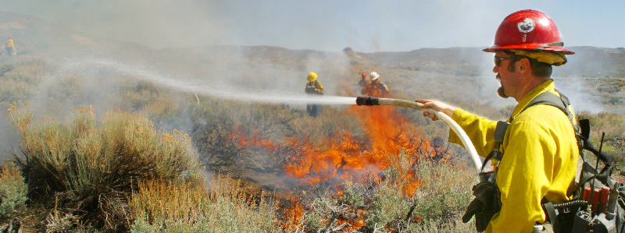
Source: USGS
Objectives
Enhance current fuel mapping capabilities using NASA Earth observation data
Use and demonstrate NASA data to help assess seasonal variations in fuel loads
Compile up-to-date fuel load maps that depict fuel conditions
Notes:
Enhance current fuel mapping capabilities using NASA Earth observation data
Use and demonstrate NASA data to help assess seasonal variations in fuel loads
Compile up-to-date fuel load maps that depict fuel conditions
To provide additional tools wildfire management and fuel modeling.
Image source:
http://www.werc.usgs.gov/OLDsitedata/fire/lv/fireandinvasives/photo_gal.htm

Slide 6
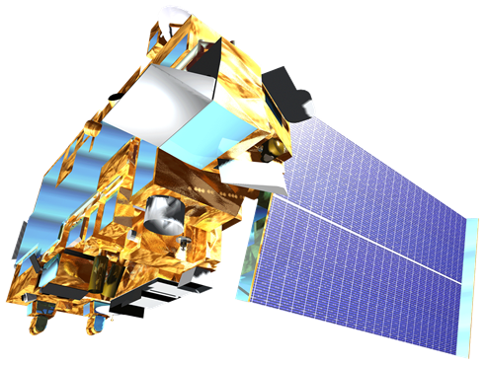
NASA Satellites/Sensors
Sensor | Spatial Resolution | Temporal Resolution
MODIS (Terra and Aqua) Moderate Resolution Imaging Spectroradiometer | 250 m (bands 1-2) 500 m (bands 3-7) 1000 m (bands 8-36) | 1 Day
Landsat 8 OLI Operational Land Imager | 30 m | 16 Days
Notes:
Earth Observations provide a platform for evaluating wildfire fuel across a varied temporal and spatial scales.
For this project the temporal advantages of MODIS data were combined with spatial advantages of Landsat products.

Slide 7
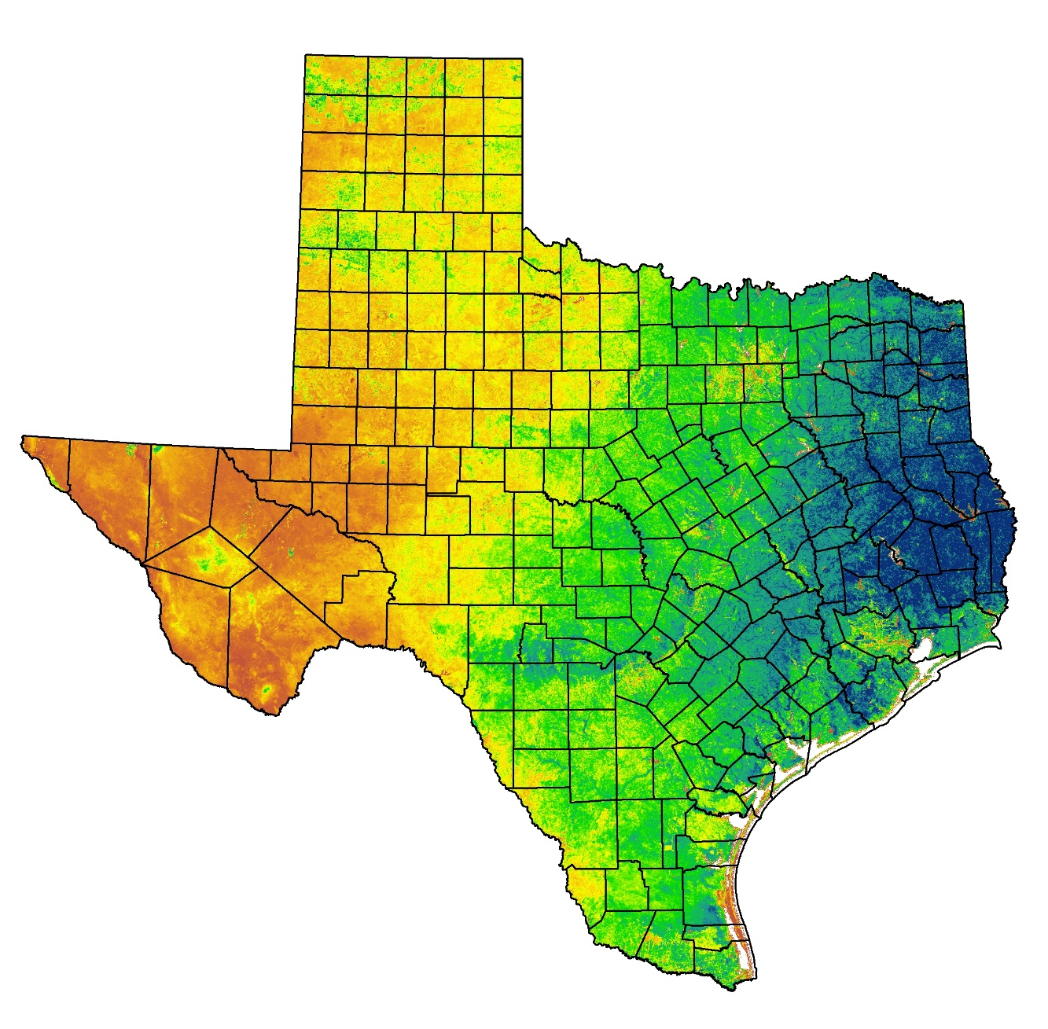
NDVI
2014
Cumulative
NDVI
Normalized
Difference
Vegetation
Index
NDVI = (NIR-VIS/NIR+VIS)
Measure plant productivity based on the density of greenness of vegetation
Source: USFS ForWarn
Notes:
In order to make these fuel maps sensitive to fluctuations NDVI was utilized.
NDVI (Normalized Difference Vegetation Index) is commonly used as a proxy for plant productivity based on the density of the greenness of vegetation.

Slide 8
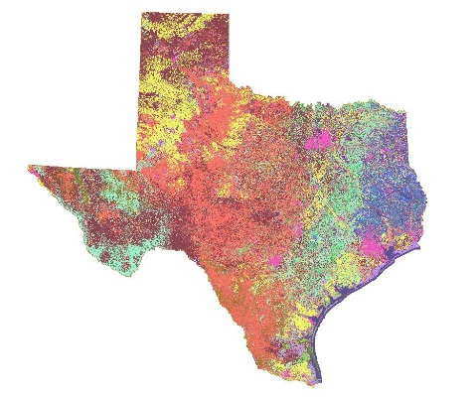
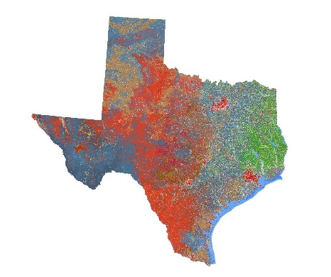
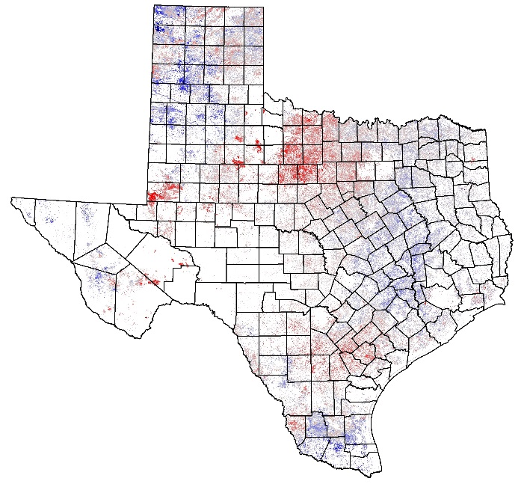
Methodology
Surface Fuel Types
Vegetation
Types
Combined
Fuels and Vegetation
Grassland Annual
Relative Fuel Load
NDVI
2000-2014
NDVI
15 Year Average
NDVI
Annual
Notes:
Fuel Types
First, Surface Fuel Maps were collected from the Texas Forest Service. These maps indicate the type of fuel that will drive a wildfire and the intensity that it will burn.
Next, Vegetation Type Maps were also collected. These maps depict the dominant vegetation in each area.
These two types of maps were hybridized to create a map that combined the surface fuel and vegetation cover.
This allowed for the investigation of areas where the dominant vegetation cover and the main fuel expected to drive a wildfire are no the same.
NDVI
First, NDVI (Normalized Difference Vegetation Index) which is useful for quantifying the greenness of vegetation, was compiled from 2000-2014.
By accumulating and combining 8 day NDVI composites for an each year, the build-up of greenness throughout the year was used as a corollary for annual vegetation productivity.
The 15 year average was calculated to provide an annual biomass accumulation mean.
This was then compared to each annual cumulative NDVI to calculate the percent change in mean annual cumulative NDVI or the relative biomass accumulation.
This highlights areas within each fuel type that are above and below average for a particular year.
So how does this translate into the real world?

Slide 9
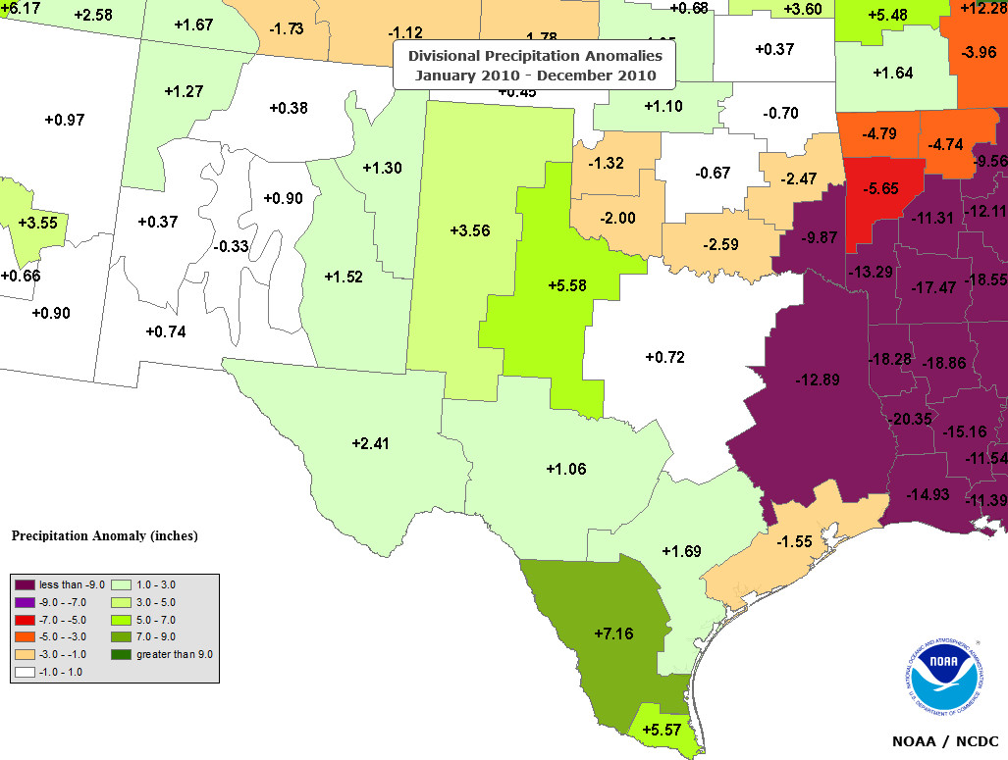
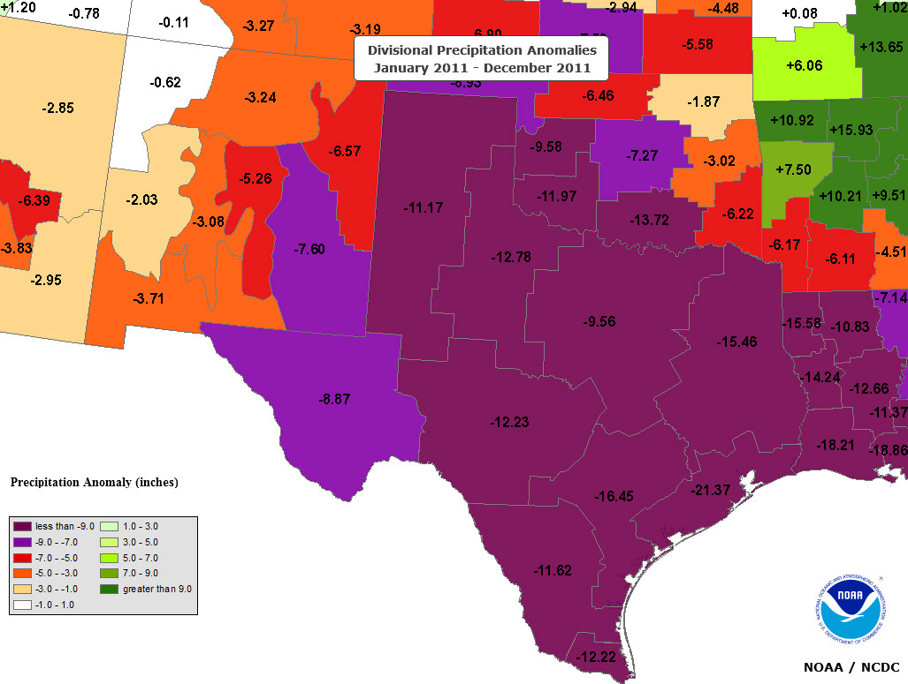
Annual Precipitation
2010 (Wet Year)
2011 (Drought Year)
2010
Relative Precipitation – These maps compare the annual precipitation to the average annual precipitation. The green areas depict above average and the red and purple depict areas below average.
Notes:
One of the main influences on vegetation productivity is precipitation.
These maps produced by the National Climate Data Center
indicate the annual precipitation relative to the average annual precipitation.
The green areas depict above average and the red and purple depict areas below average.
So as you can see
This shows that 2010 was a abnormally dry year and 2011 was abnormally dry year.
So how does this translate into fuel loads?
Source:
Image source: http://gis.ncdc.noaa.gov/map/cag/#app=cdo

Slide 10
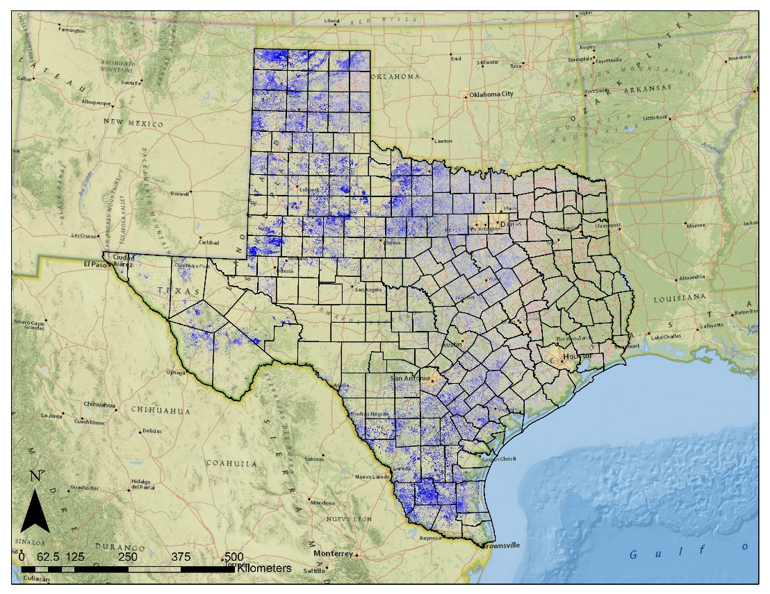
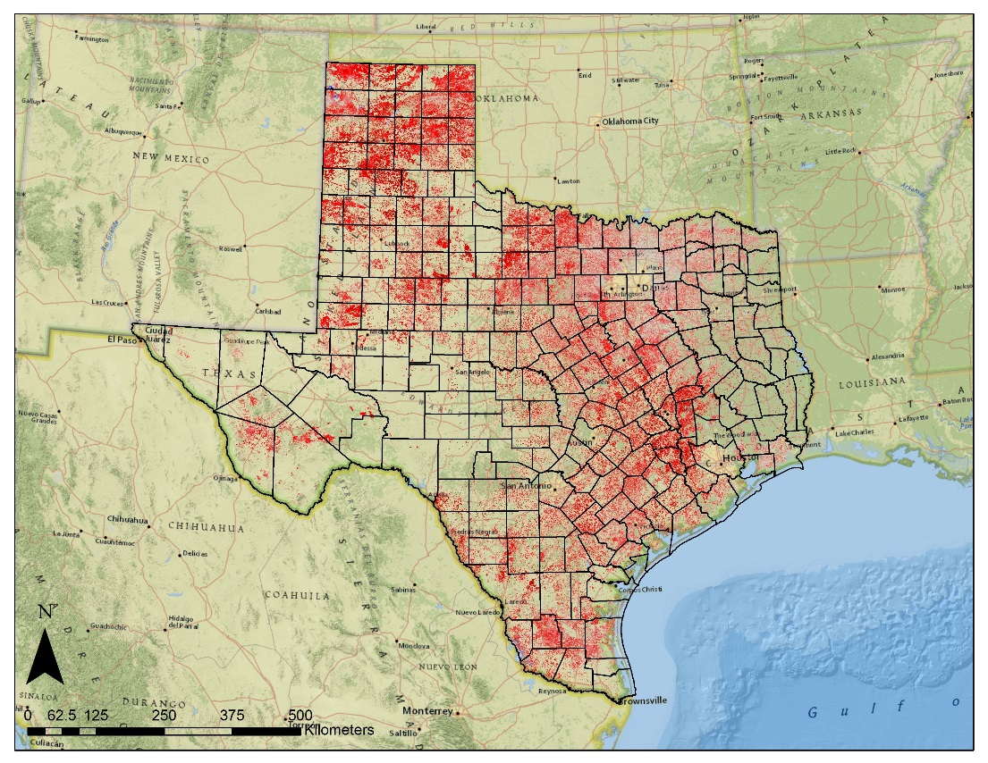
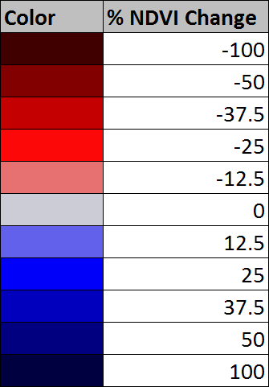
Results - Texas
2010 (Wet Year)
2011 (Drought Year)
2010
Grassland Relative Fuel Loads – Comparison of annual NDVI to 15 year average NDVI. Bluer areas represent greater than average and redder areas represent less than average NDVI response.
Notes:
Here are statewide maps that were created that correspond to the same years (2010 and 2011) as the precipitation maps on the last slide.
They depict the percent change in mean annual cumulative NDVI of grassland fuels by comparing the annual to the 15 year mean.
The Bluer areas represent greater than average and redder areas represent less than average NDVI response.
So as we expected to see there was an increase in vegetation productivity in the wetter 2010 and a decrease in the much dryer 2011.
So how does this translate to fire behavior?
2010 was a wetter than normal year and 2011 was a dryer than normal year.
This is evident in the NDVI response of the grasslands in these years.
An increase in rainfall led to the increase in growth in the grasslands this which caused a above average NDVI signature as seen in the blue areas in the 2010 map.
The following year was much dryer than normal resulting in a lower than average NDVI signature indicated by the red areas in the 2011 map.

Slide 11
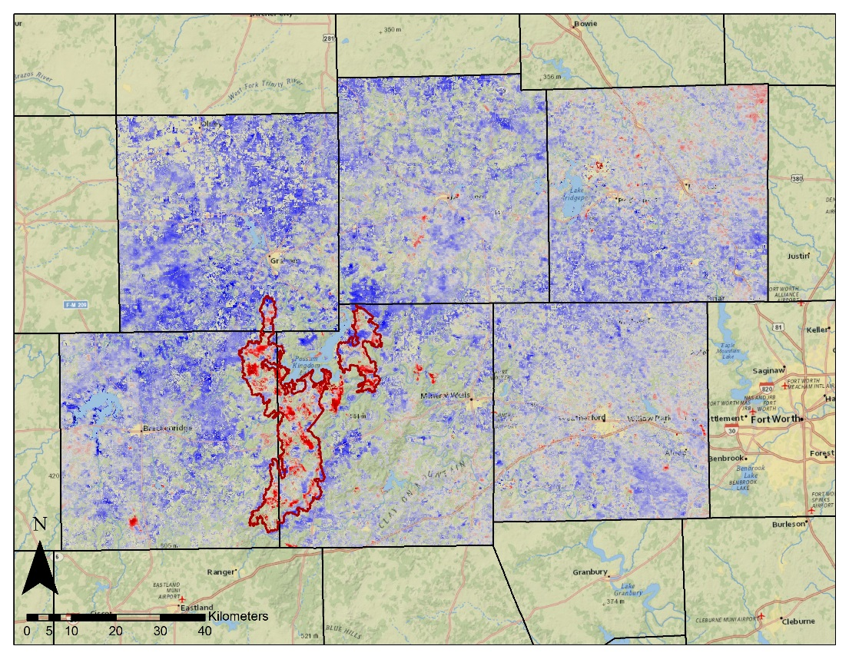
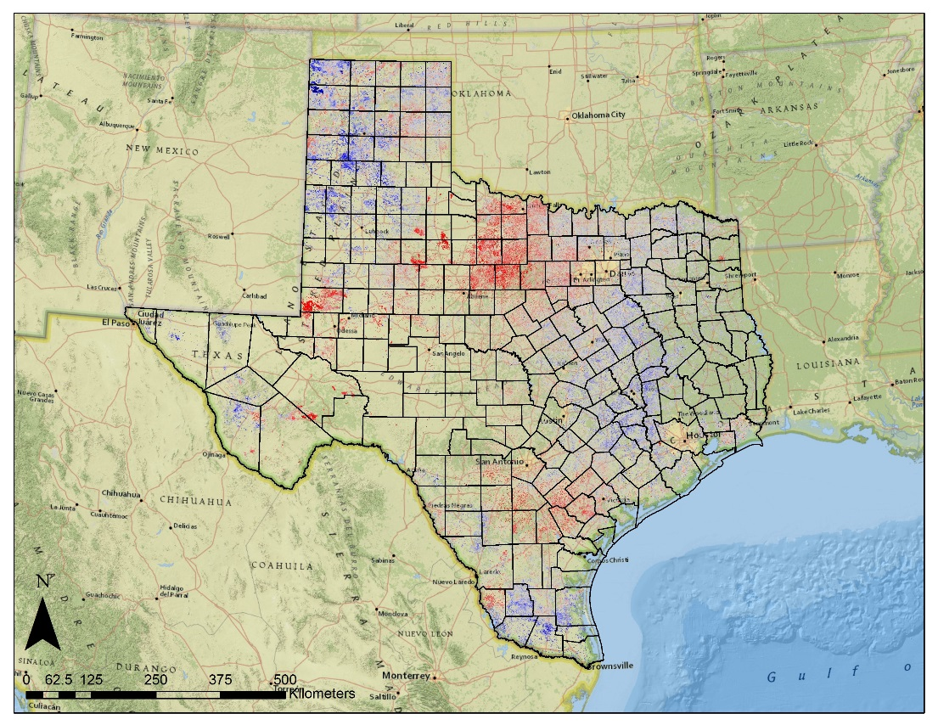
Results
2012 (Post Fire)
2014
Grassland Relative Fuel Loads – Comparison of annual NDVI to 15 year average NDVI. Bluer areas represent greater than average and redder areas represent less than average NDVI response.
Notes:
These maps are of the case study of the Possum Kingdom Complex wildfires of 2011.
The increase in vegetation productivity increased the amount of grass available as fuel and then in
2011 that greater biomass dried out resulting in a fire season that had grassland fuel that contained greater biomass than normal which contributed to the intensity and speed of the fires.
Using NDVI as a proxy for biomass, it is clear that the extra biomass growth in 2010 was a primary factor in the severity of the 2011 fire season.
The following year in 2012 the vegetation productivity was greater than average with the obvious exception within the footprint of the fires.
This was likely due to the burning of large quantities of grass during the fires.
This statewide 2014 map shows how the percent change in cumulative NDVI can vary throughout the state with some areas showing increased productivity and others showing a decrease.
These products are useful in depicting the relative fuel load to quantify the amount difference in vegetation growth.
This type of product works well to understand how much areas have grown relative to the average rates for that area.
This is especially useful for understanding “fuel loading” or the extra amount of biomass that can build up in an area like it did in 2010.
This provides fire risk mangers with additional information of relative growth within a to adjust models based on actual amount of

Slide 12
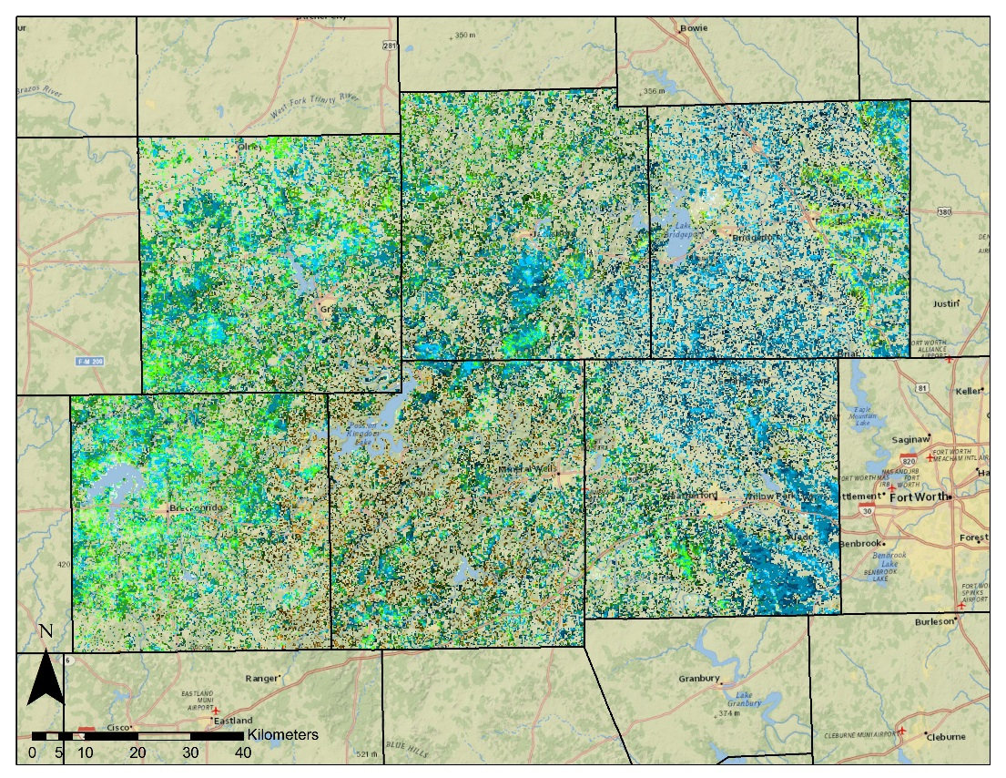
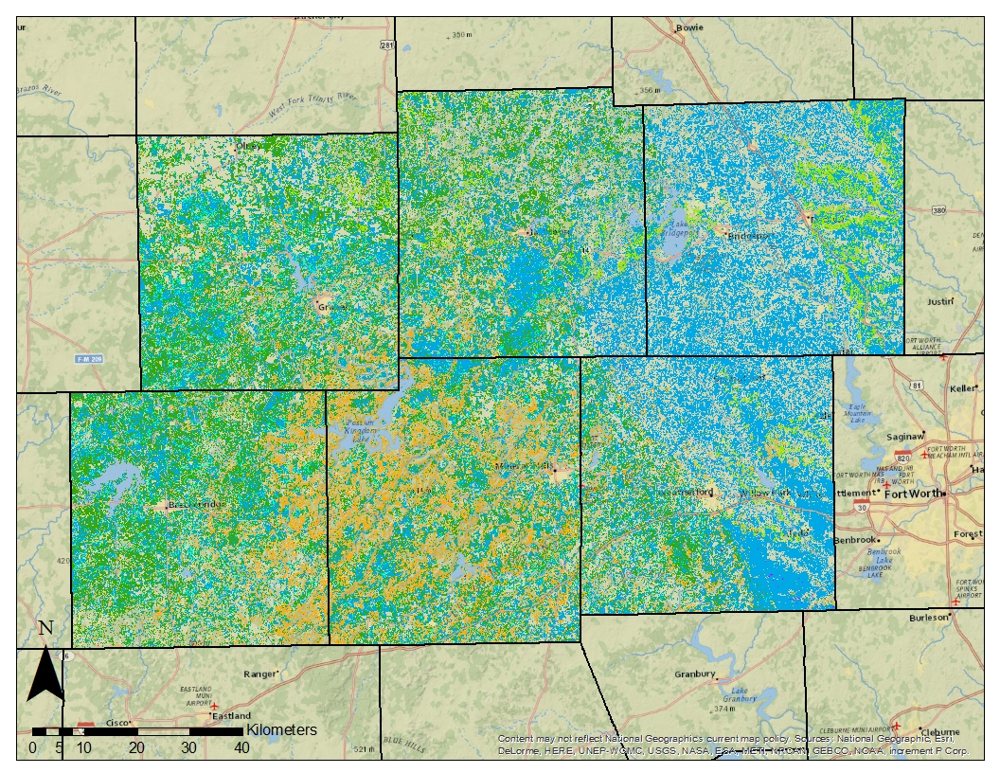
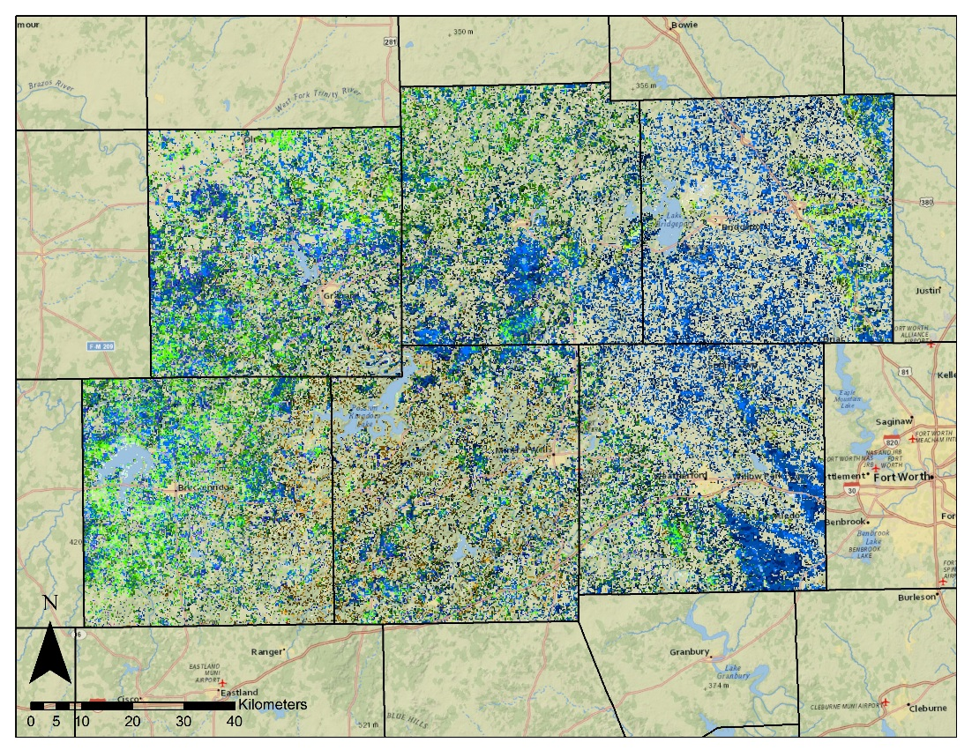
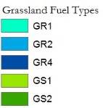
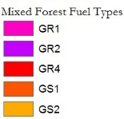
Results
TFS (Surface Fuels)
2014 (Relative Fuels)
Fuel Type Maps – MODIS data was used to calculate zonal mean for each fuel type based on 15 year cumulative annual NDVI. The difference of the 2014 annual NDVI was to show percentage difference from the mean for each fuel type.
Notes:
Maps were also produced which depict the percent change from the mean of each fuel type.
Fuel Type Maps – MODIS data was used to calculate zonal mean for each fuel type based on 15 year cumulative annual NDVI. The difference of the 2014 annual NDVI was to show percentage difference from the mean for each fuel type.
This was done by calculating an average NDVI value of each fuel type.
Then the percent change from the mean was calculated by comparing the annual cumulative NDVI value to the average cumulative NDVI value for each type.
This provides another way to understand variations (spatially as well as temporally) from the average characteristics of each fuel type.
For example, if an area is classified as fuel type GR1 or “grass level 1” but in the 2014 map that area shows 30% greater productivity than the mean of GR1 then the grass may behave more like a GR2 or “grass level 2”
This method provides for another way to compare relative fuel loads to adjust fuel models based on actual vegetation characteristics.

Slide 13
Conclusions
Fuel Loads
Geospatial information on grassland fuel loads are important for assessing wildfire risk
MODIS NDVI
Annual cumulative MODIS NDVI offers a means to monitor relative fuel loads
Fuel Models
Such MODIS NDVI products can serve as inputs to fuel load models
Notes:
Geospatial information on grassland fuel loads are important for assessing wildfire risk
Annual cumulative MODIS NDVI offers a means to monitor relative fuel loads
Such MODIS NDVI products can serve as inputs to fuel load models
Future work:
Relative fuel loads based on MODIS NDVI is a good tool to assess fluctuations in grassland fuels.
Provides wildfire risk managers a new method for adjusting fuel model according to the actual changes grassland growth rates.
Using MODIS data to detect seasonal changes in the Texas Grasslands is a crucial step in moving towards real-time assessment in fuel loads.
The Texas Forest Service can use this data in the future to better assess the wildfire risk based on recent observations rather than using a static fuel model.

Slide 14
Dr. Kenton Ross (NASA DEVELOP National Science Advisor, LaRC)
Joseph Spruce (Senior Scientist and Lead Science Advisor at NASA SSC)
James “Doc” Smoot (Senior Scientist and Assistant Science Advisor at NASA SSC)
Advisors
Partners
Texas Forest Service; Tom Spencer and Curt Stripling- Predictive Services
USDA Forest Service; William “Bill” Hargrove- PI for the ForWarn Early Warning System
Trade names and trademarks are used in this report for identification only.
Their usage does not constitute an official endorsement, either expressed or implied, by the National Aeronautics and Space Administration.

Slide 15
Notes:
Thank you

