Slide 1
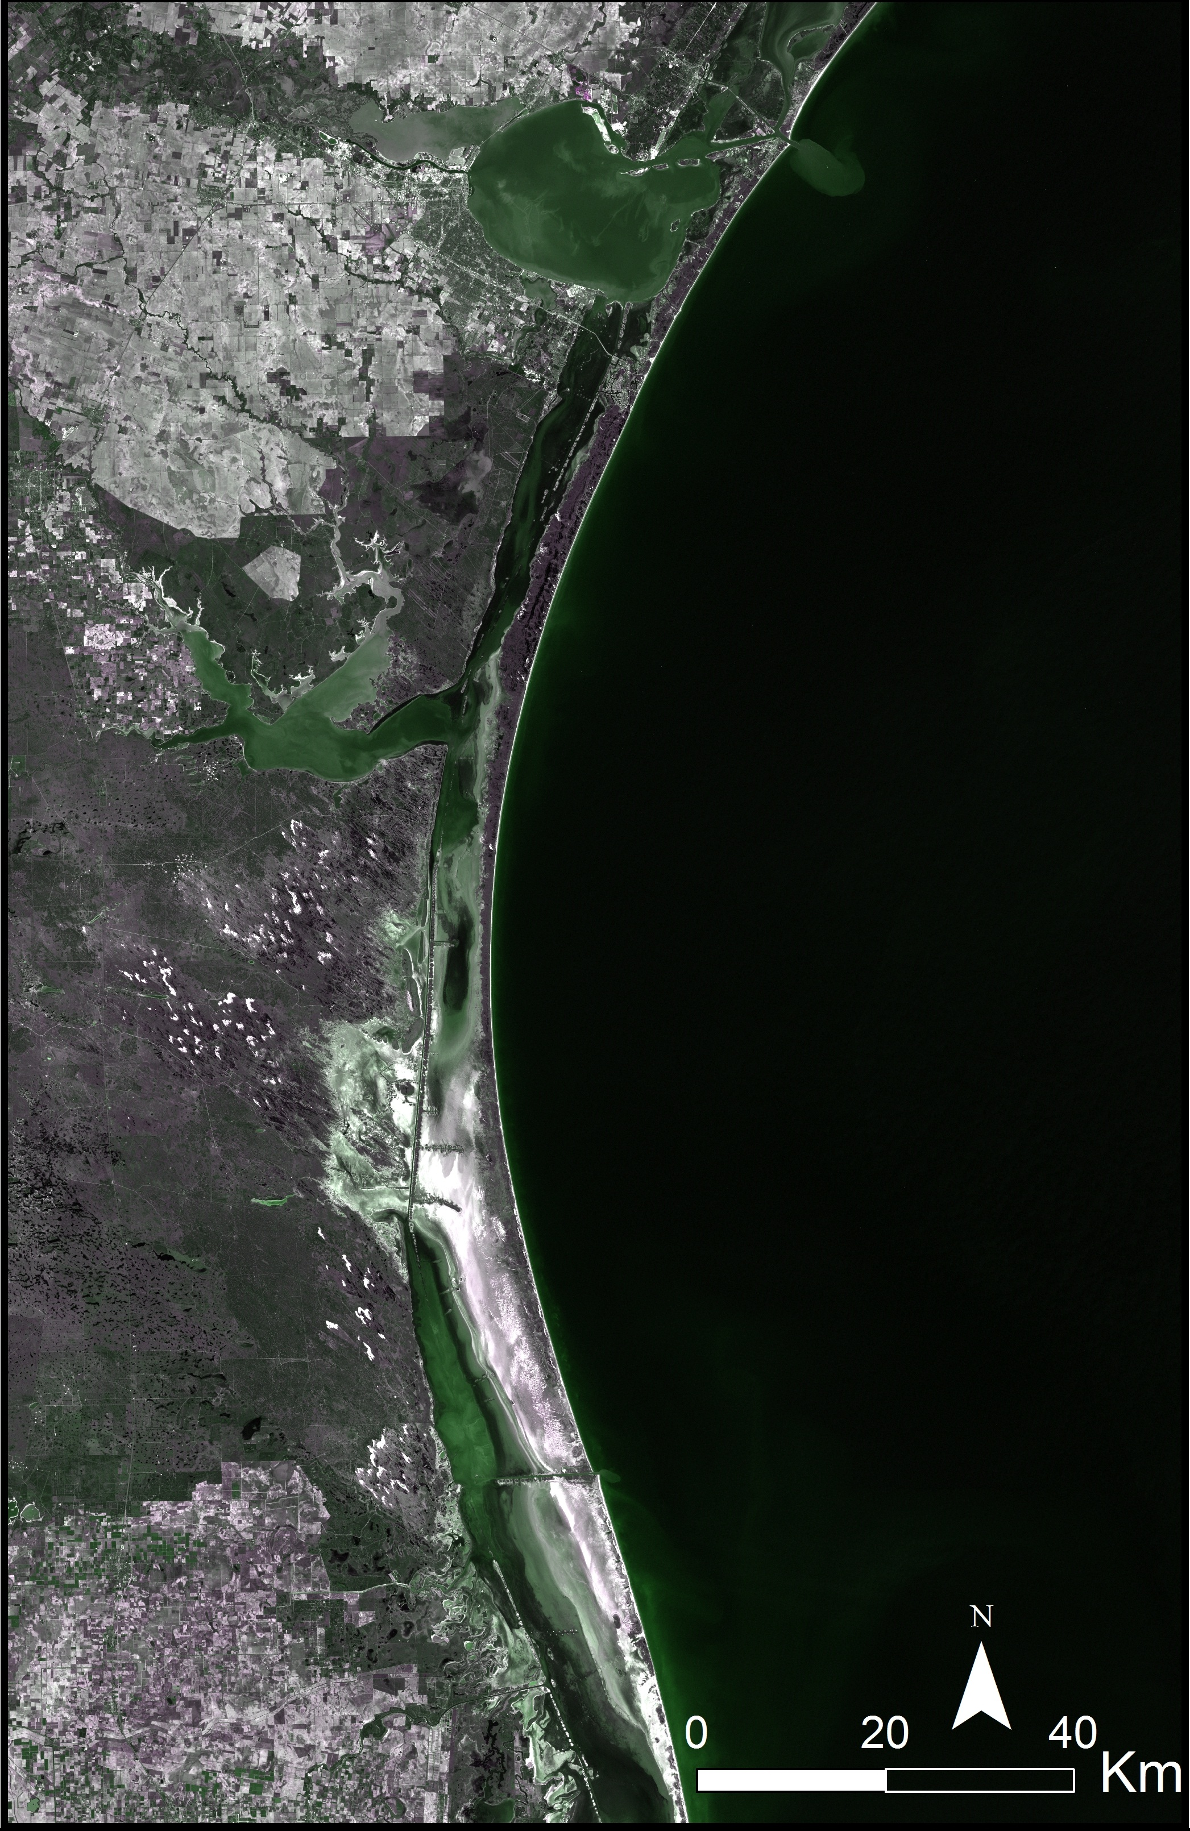
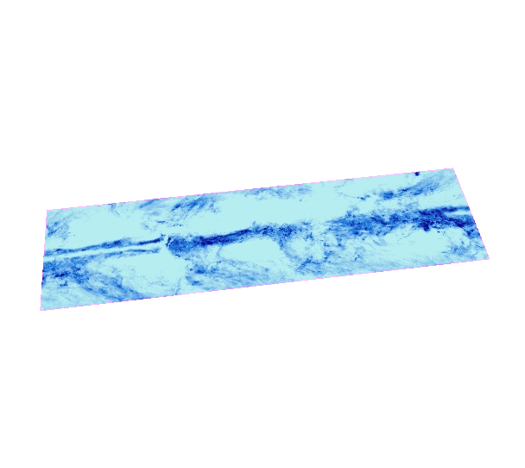
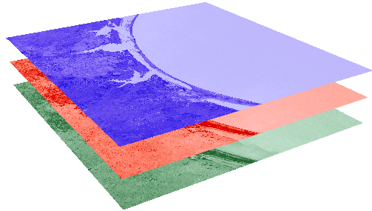
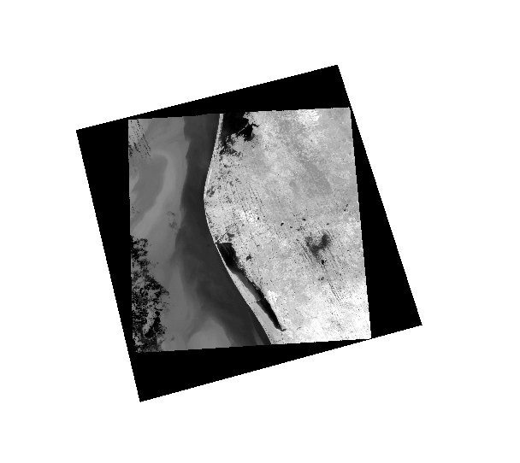
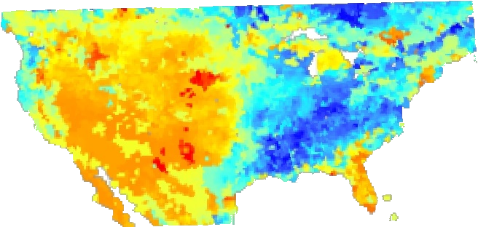
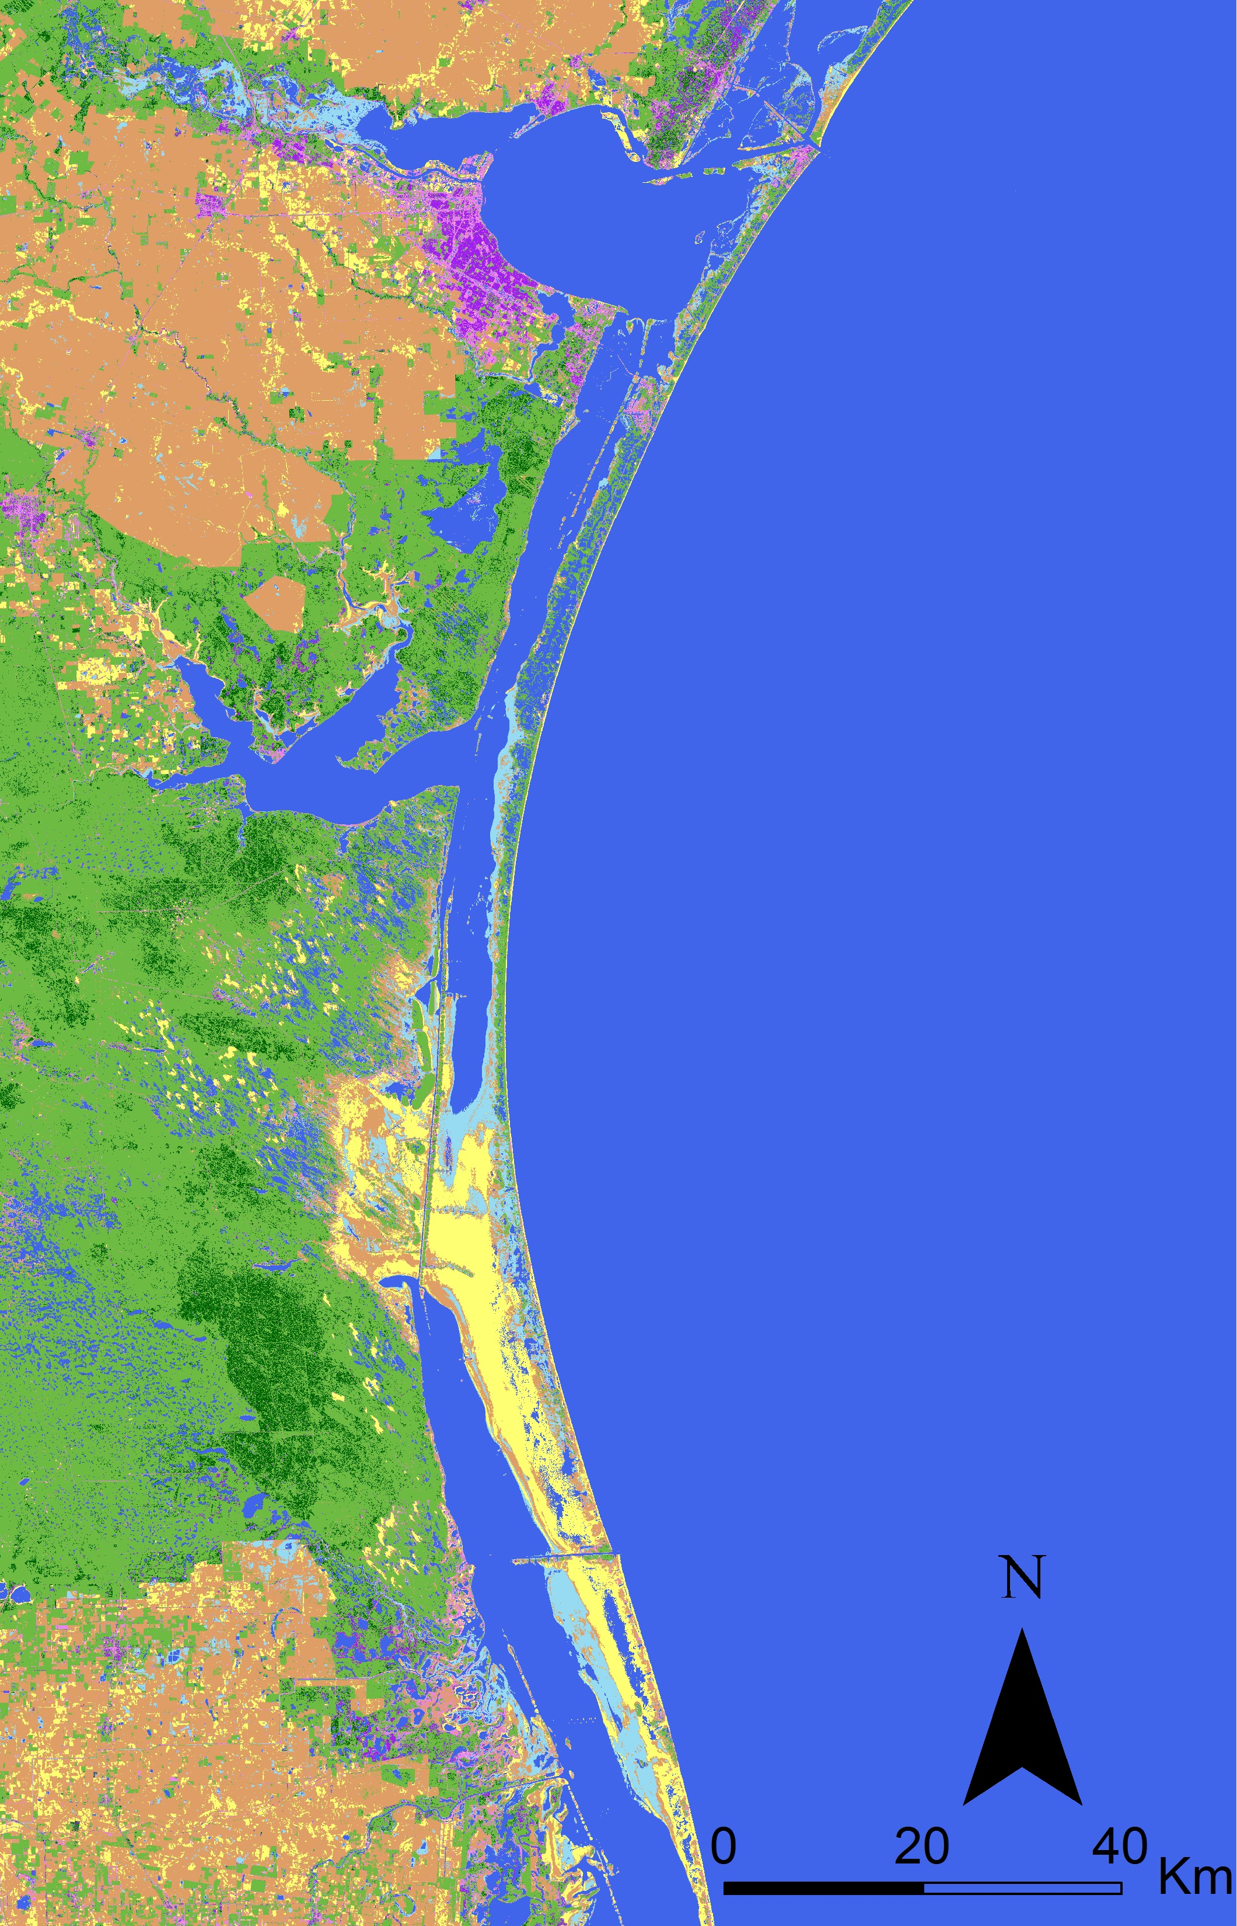
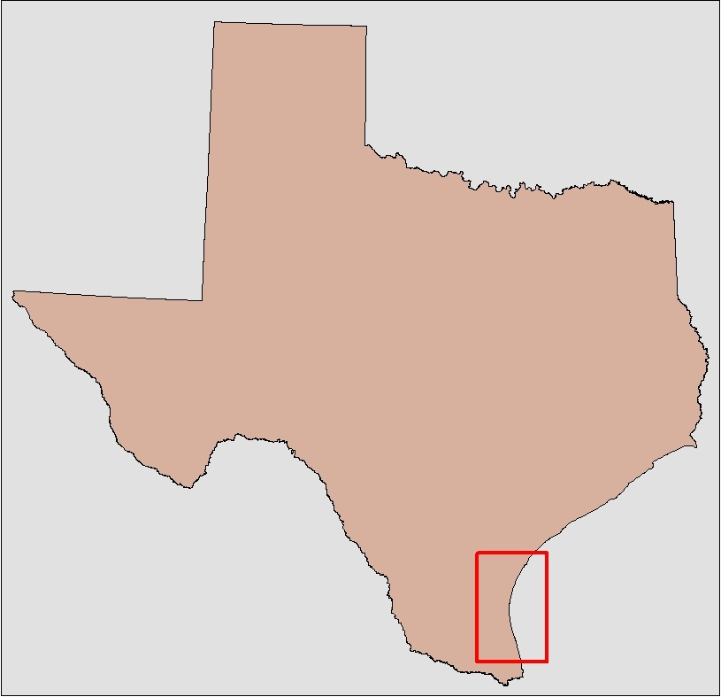
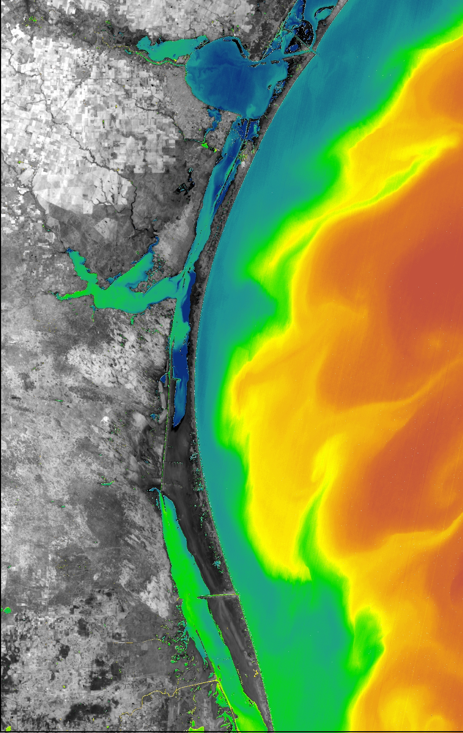
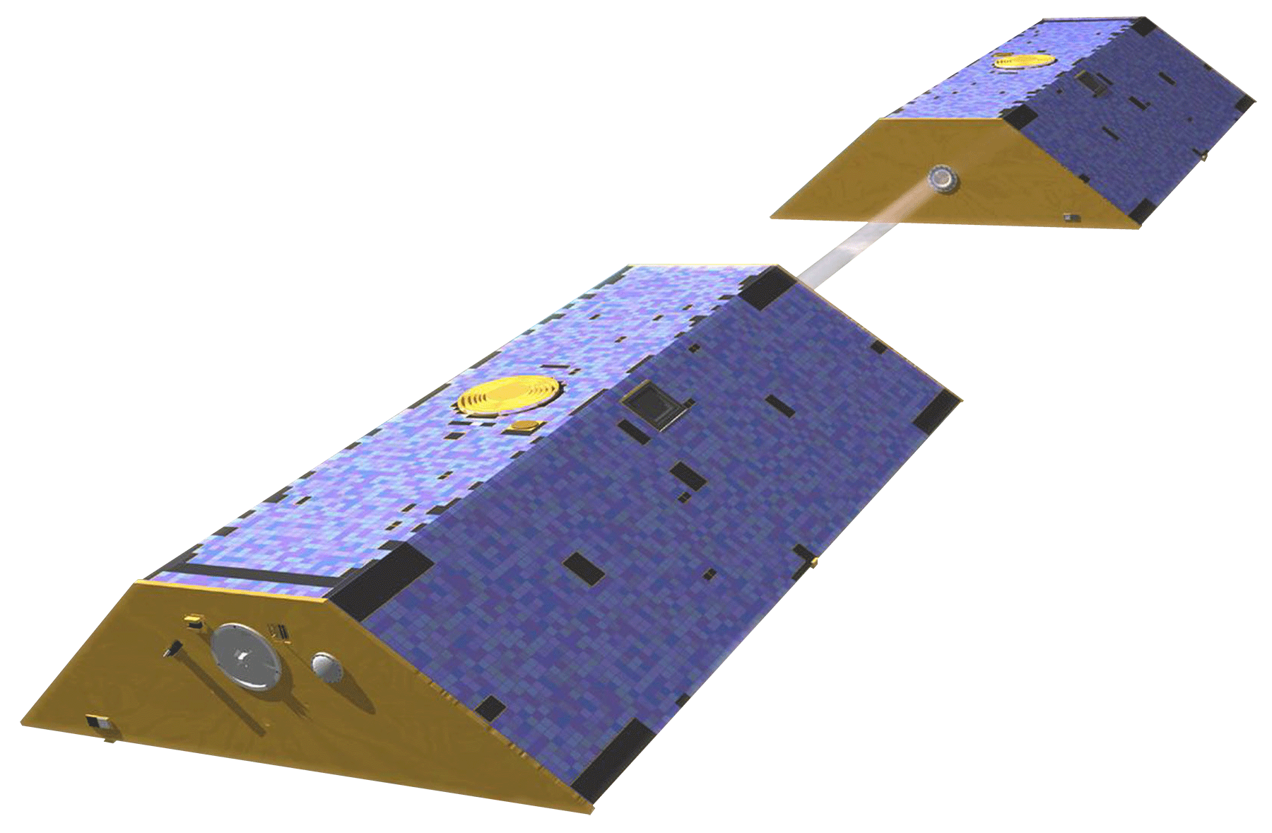
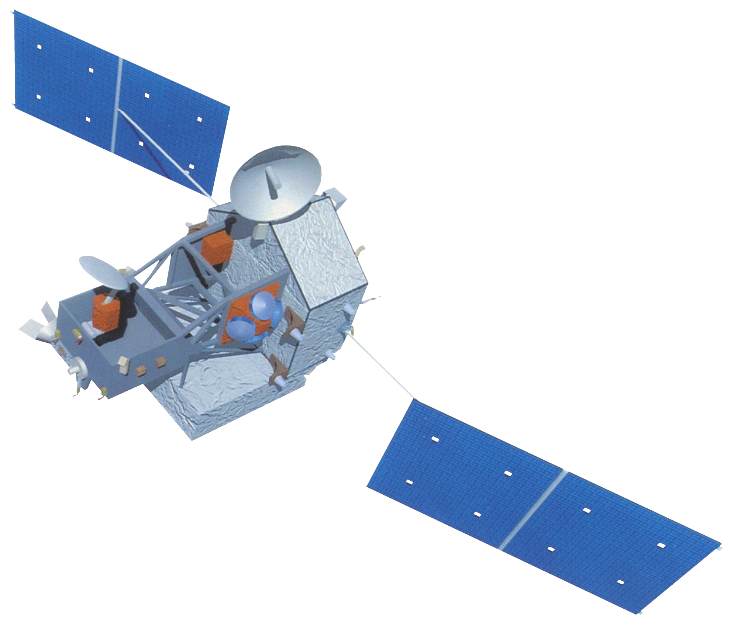
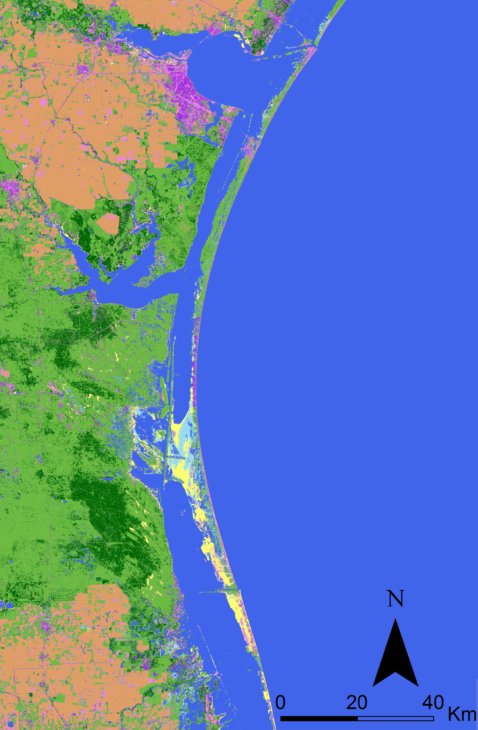
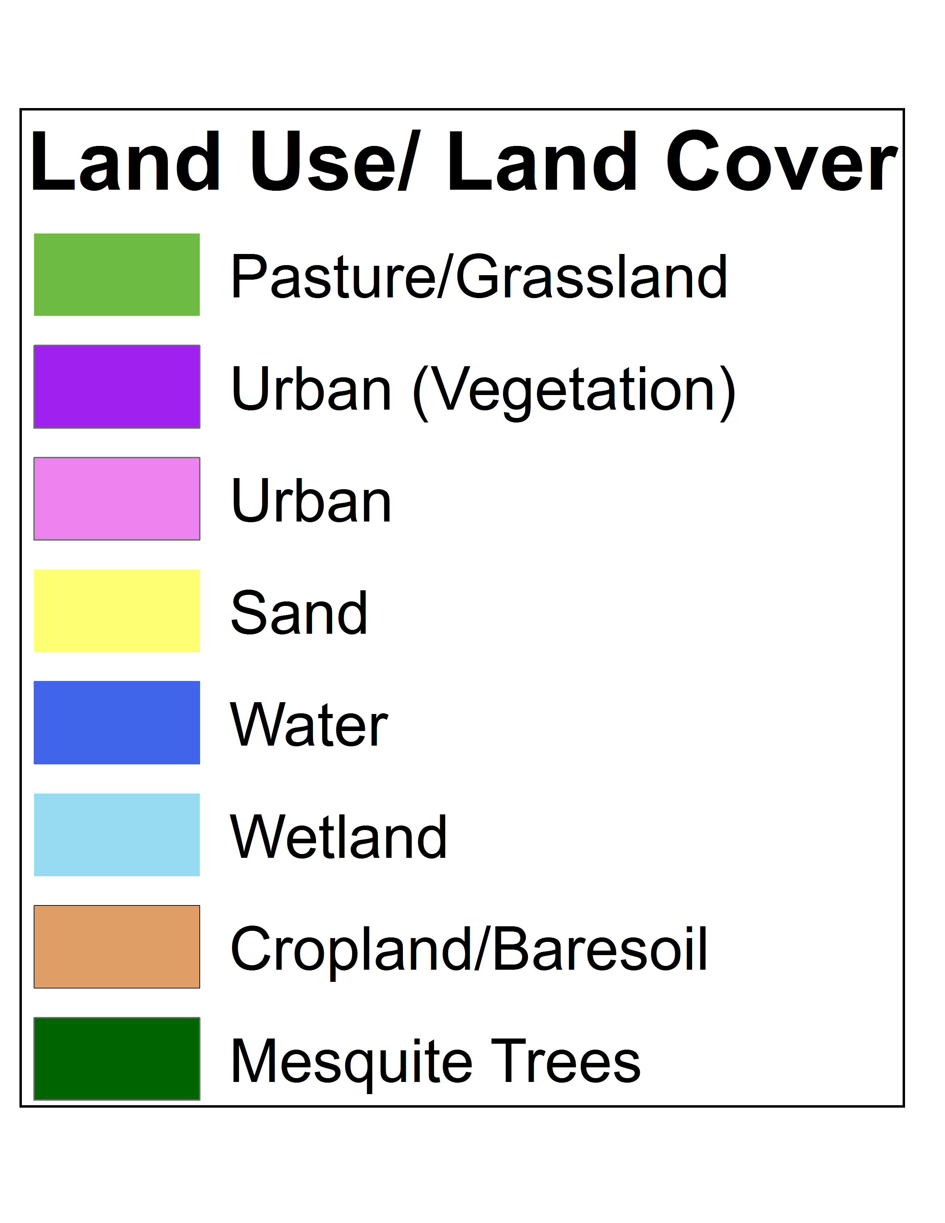
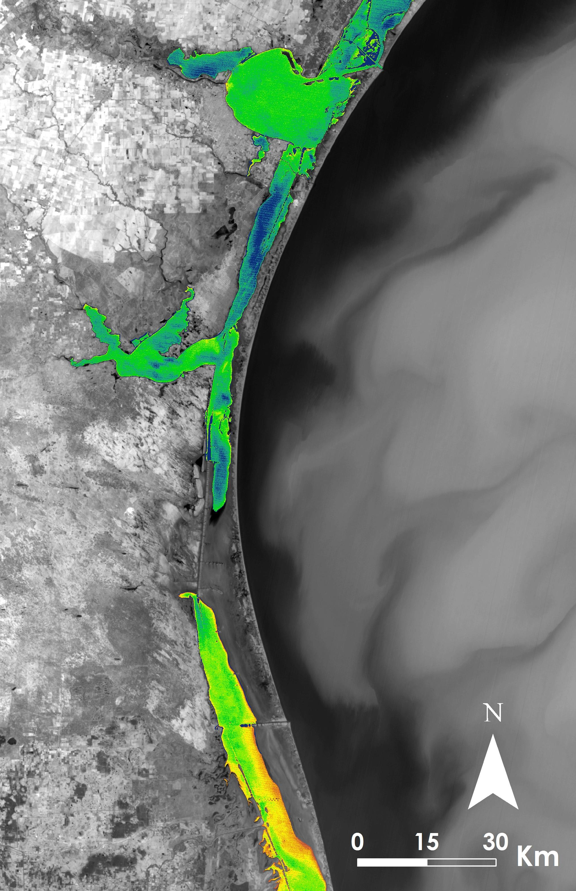
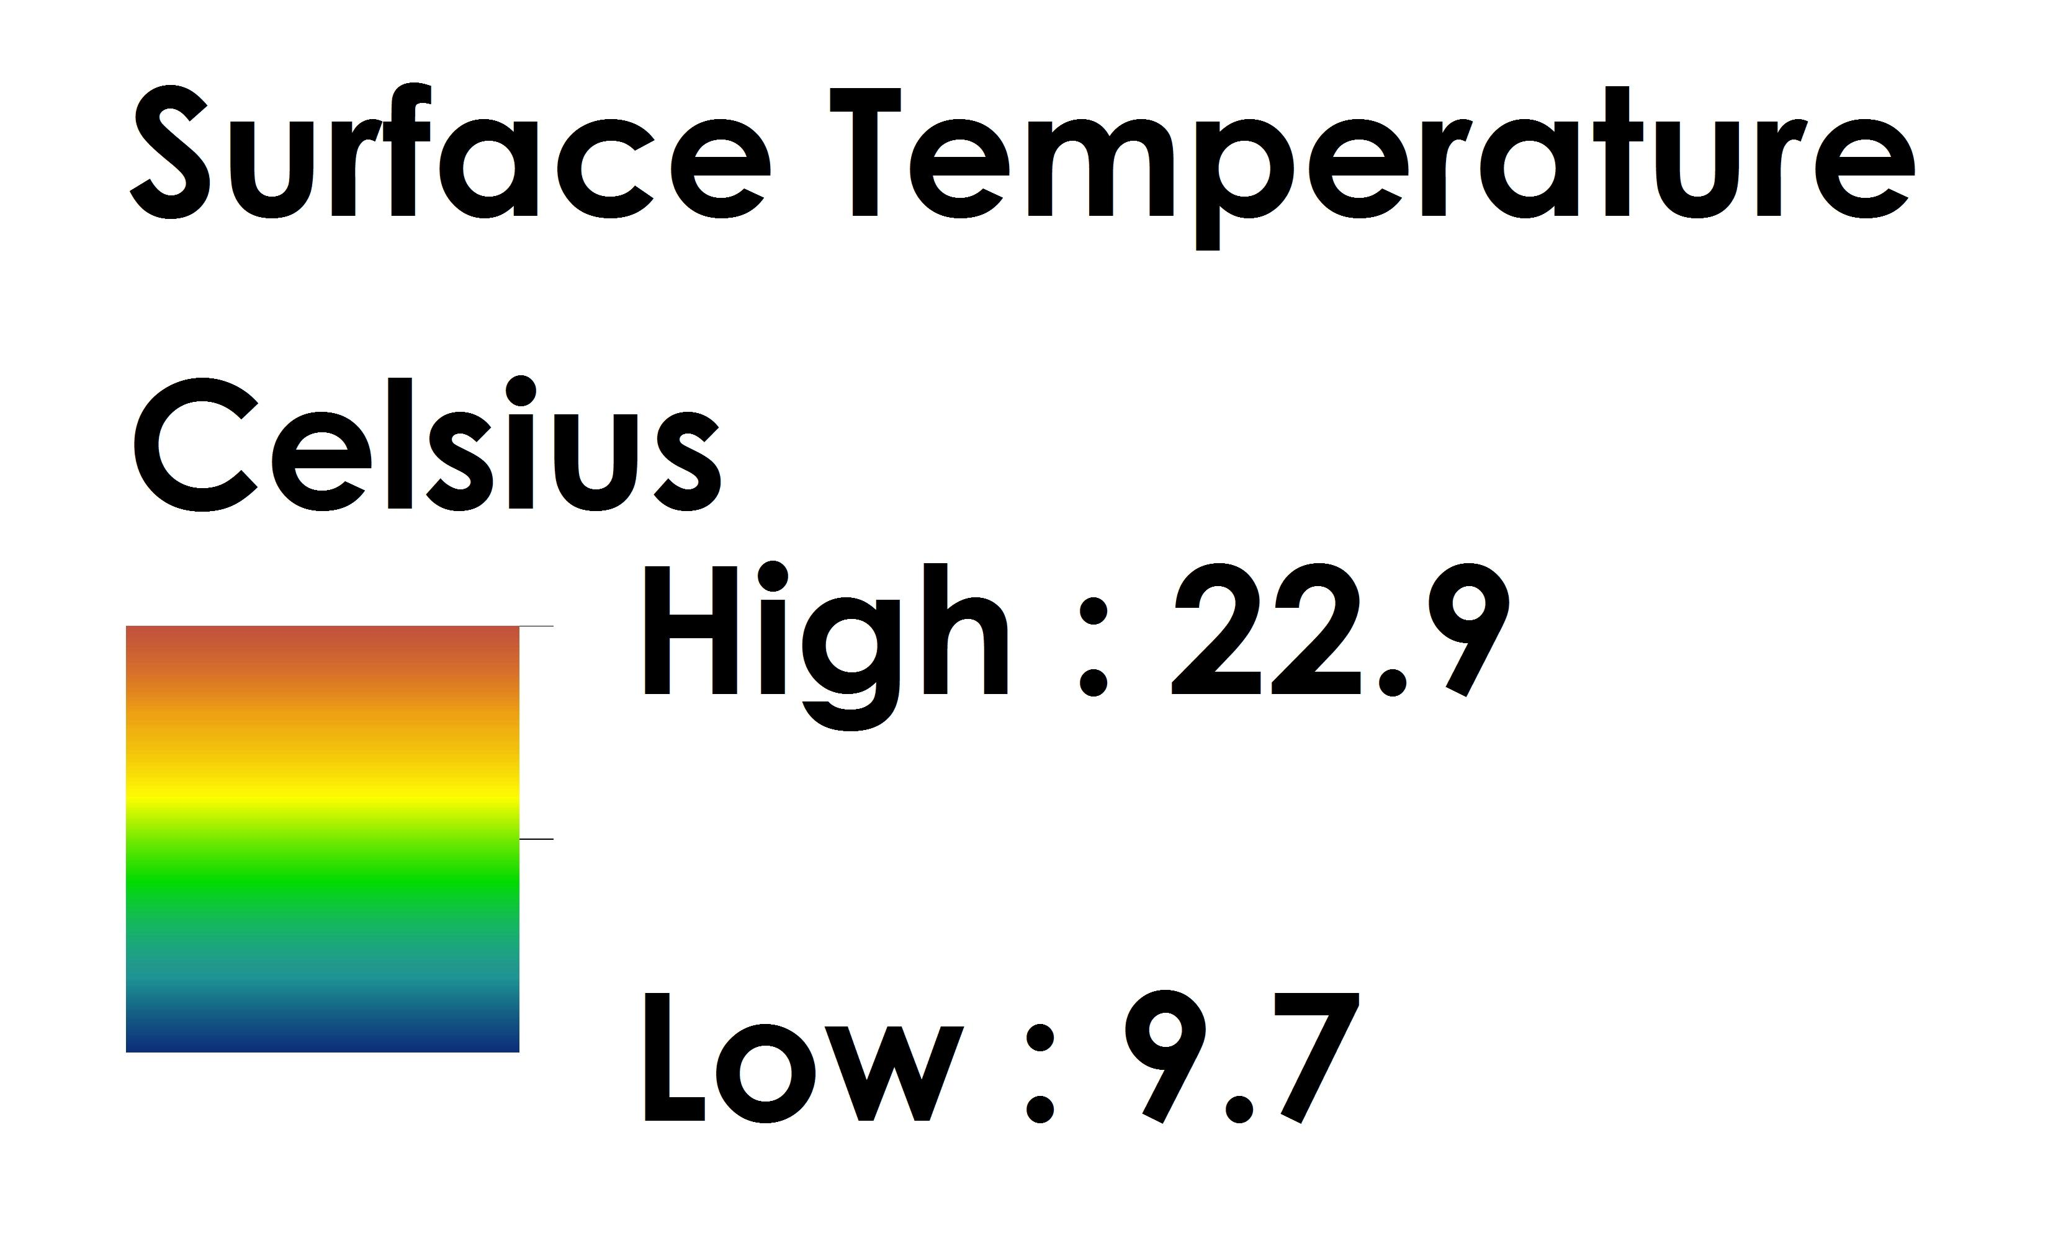
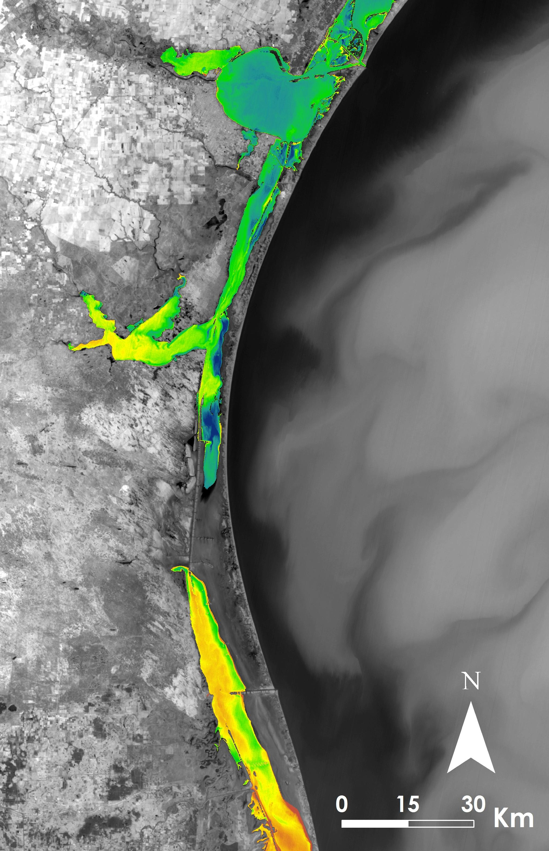
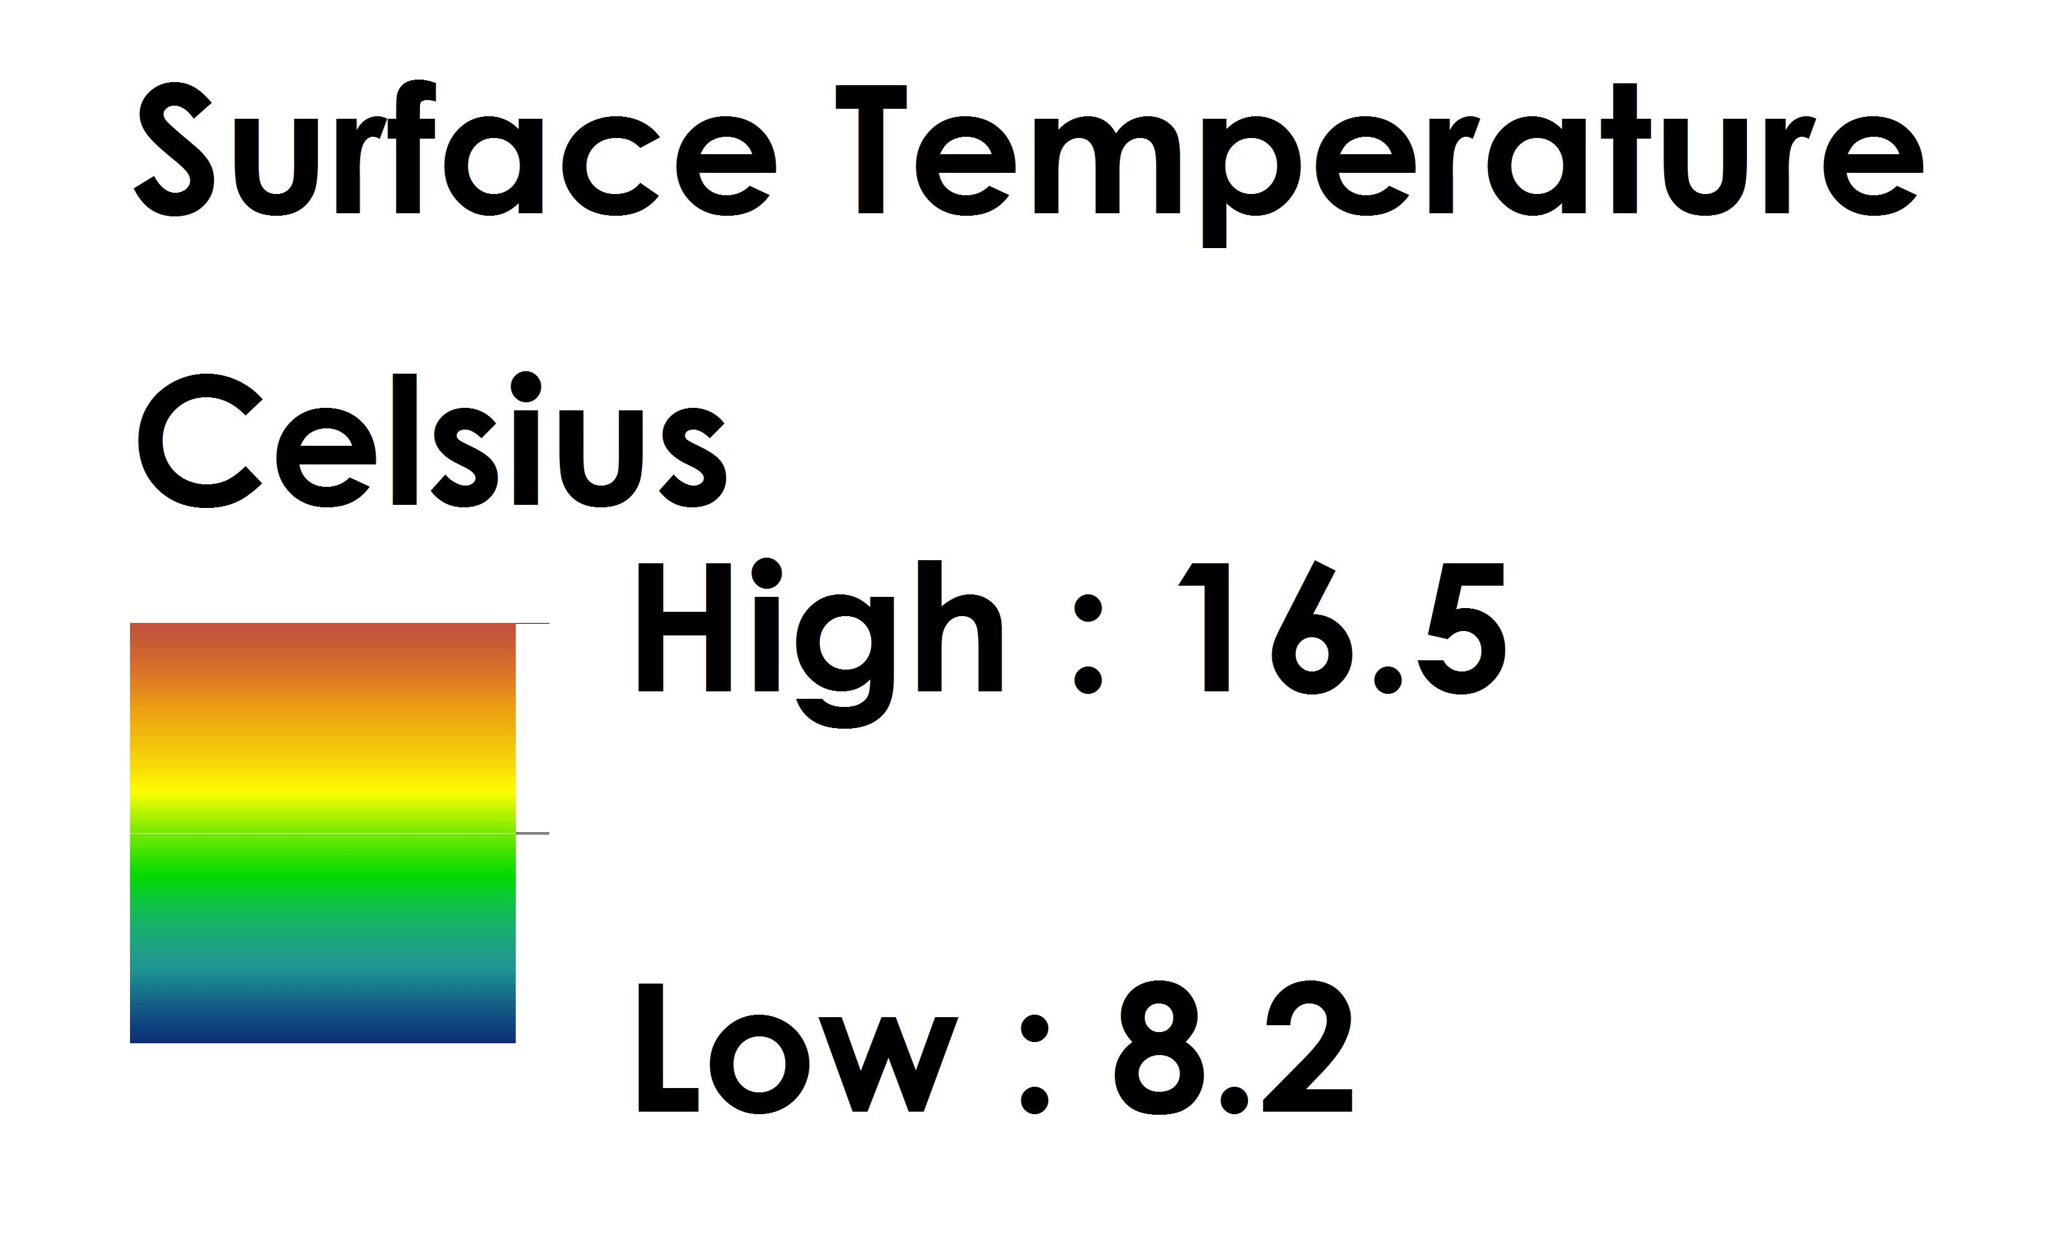
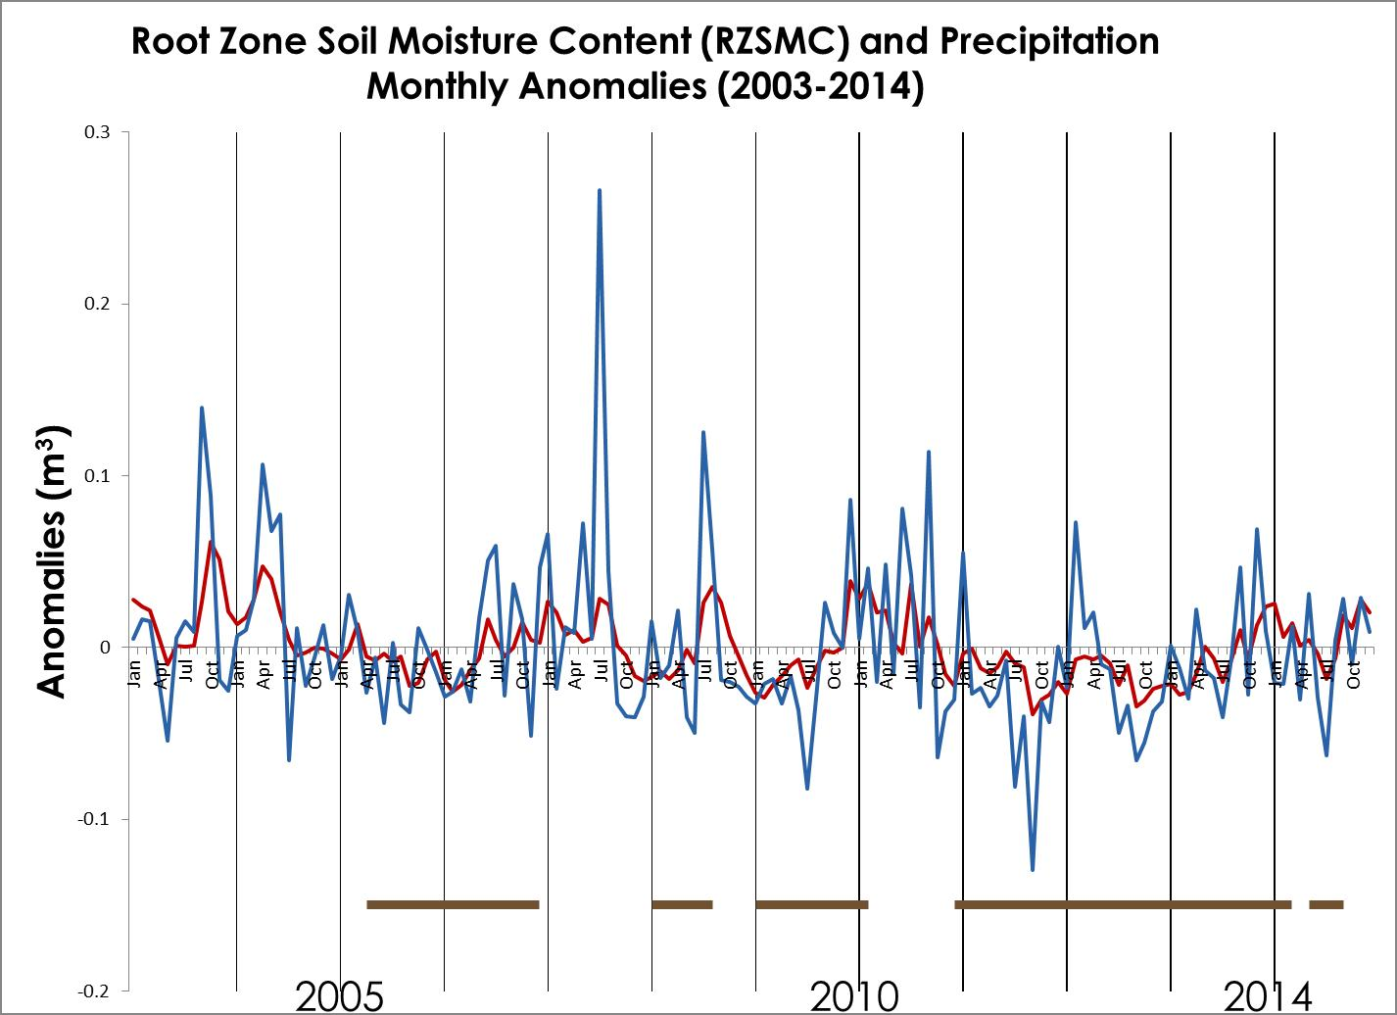
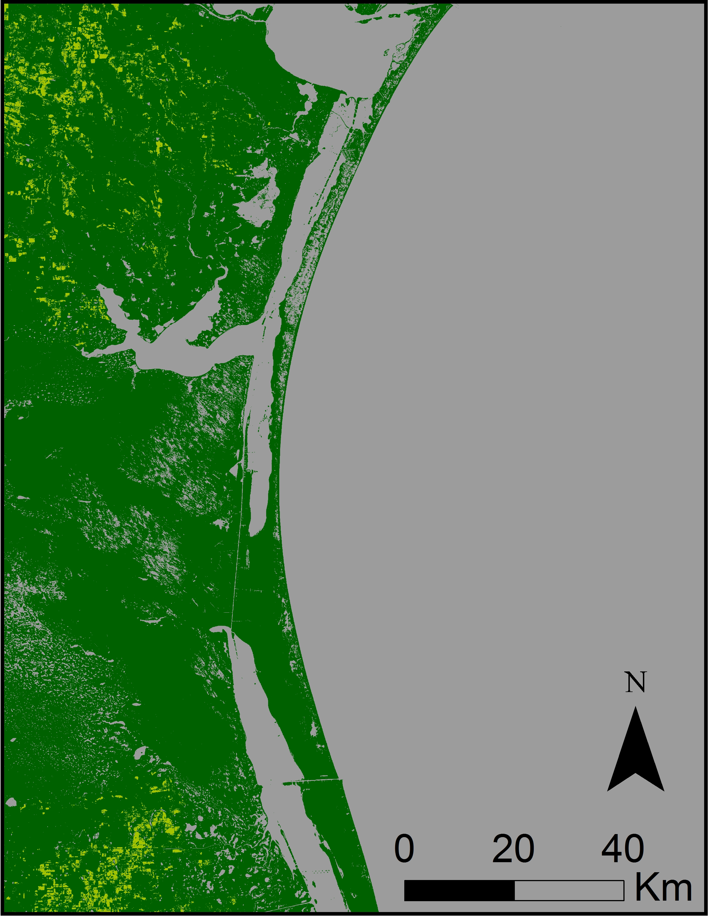
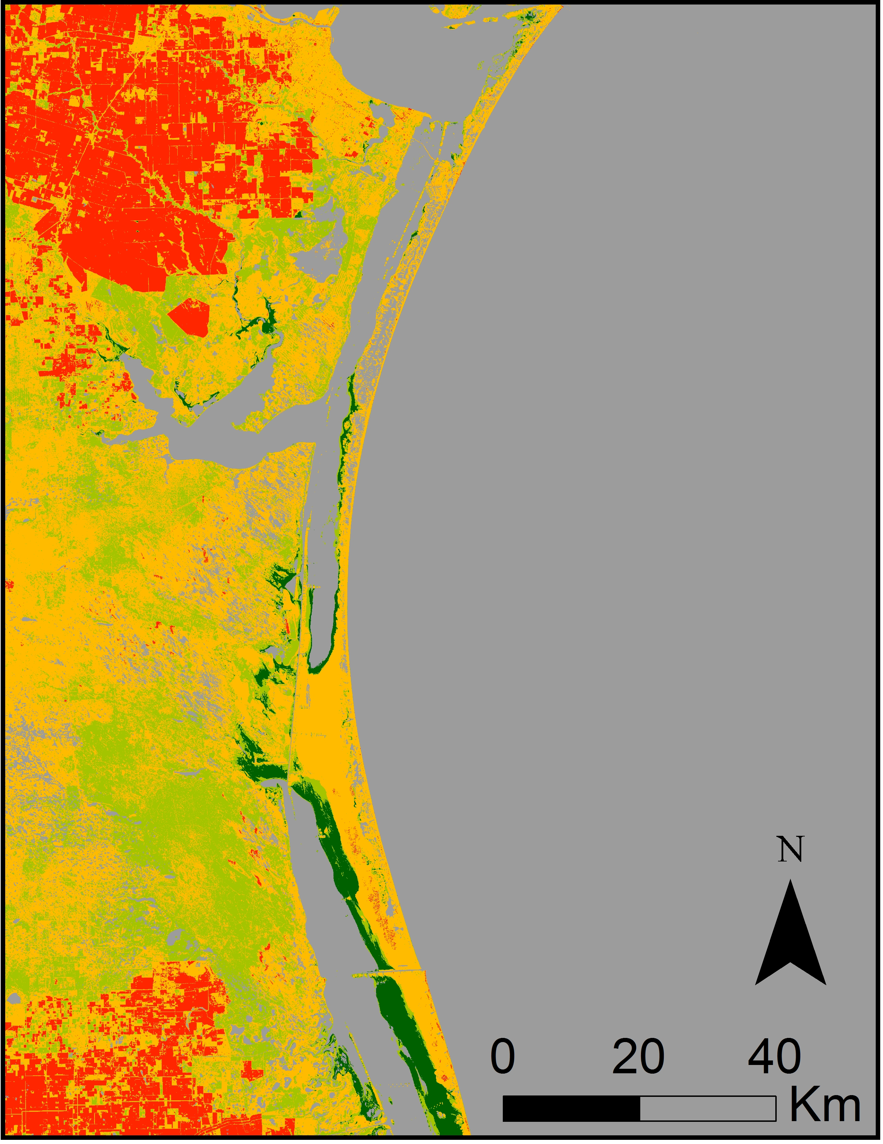
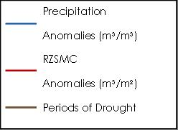
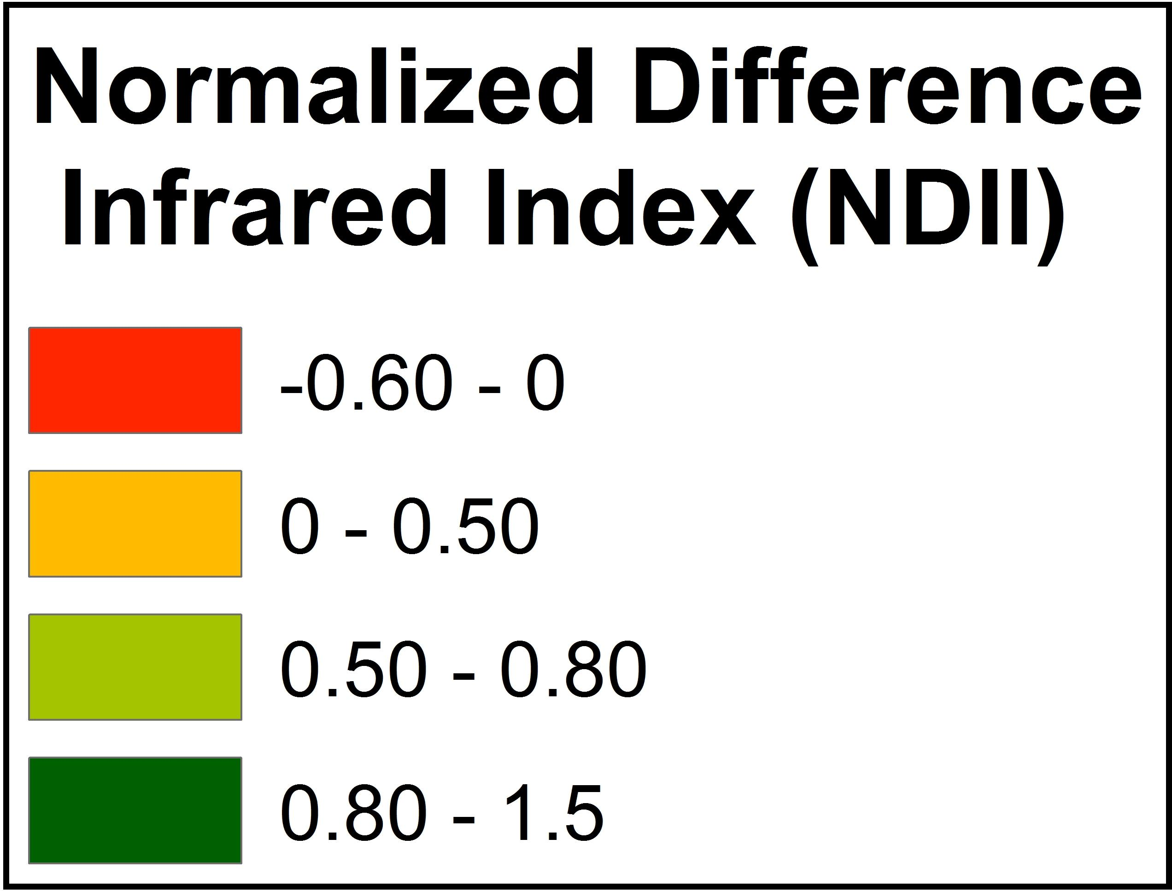
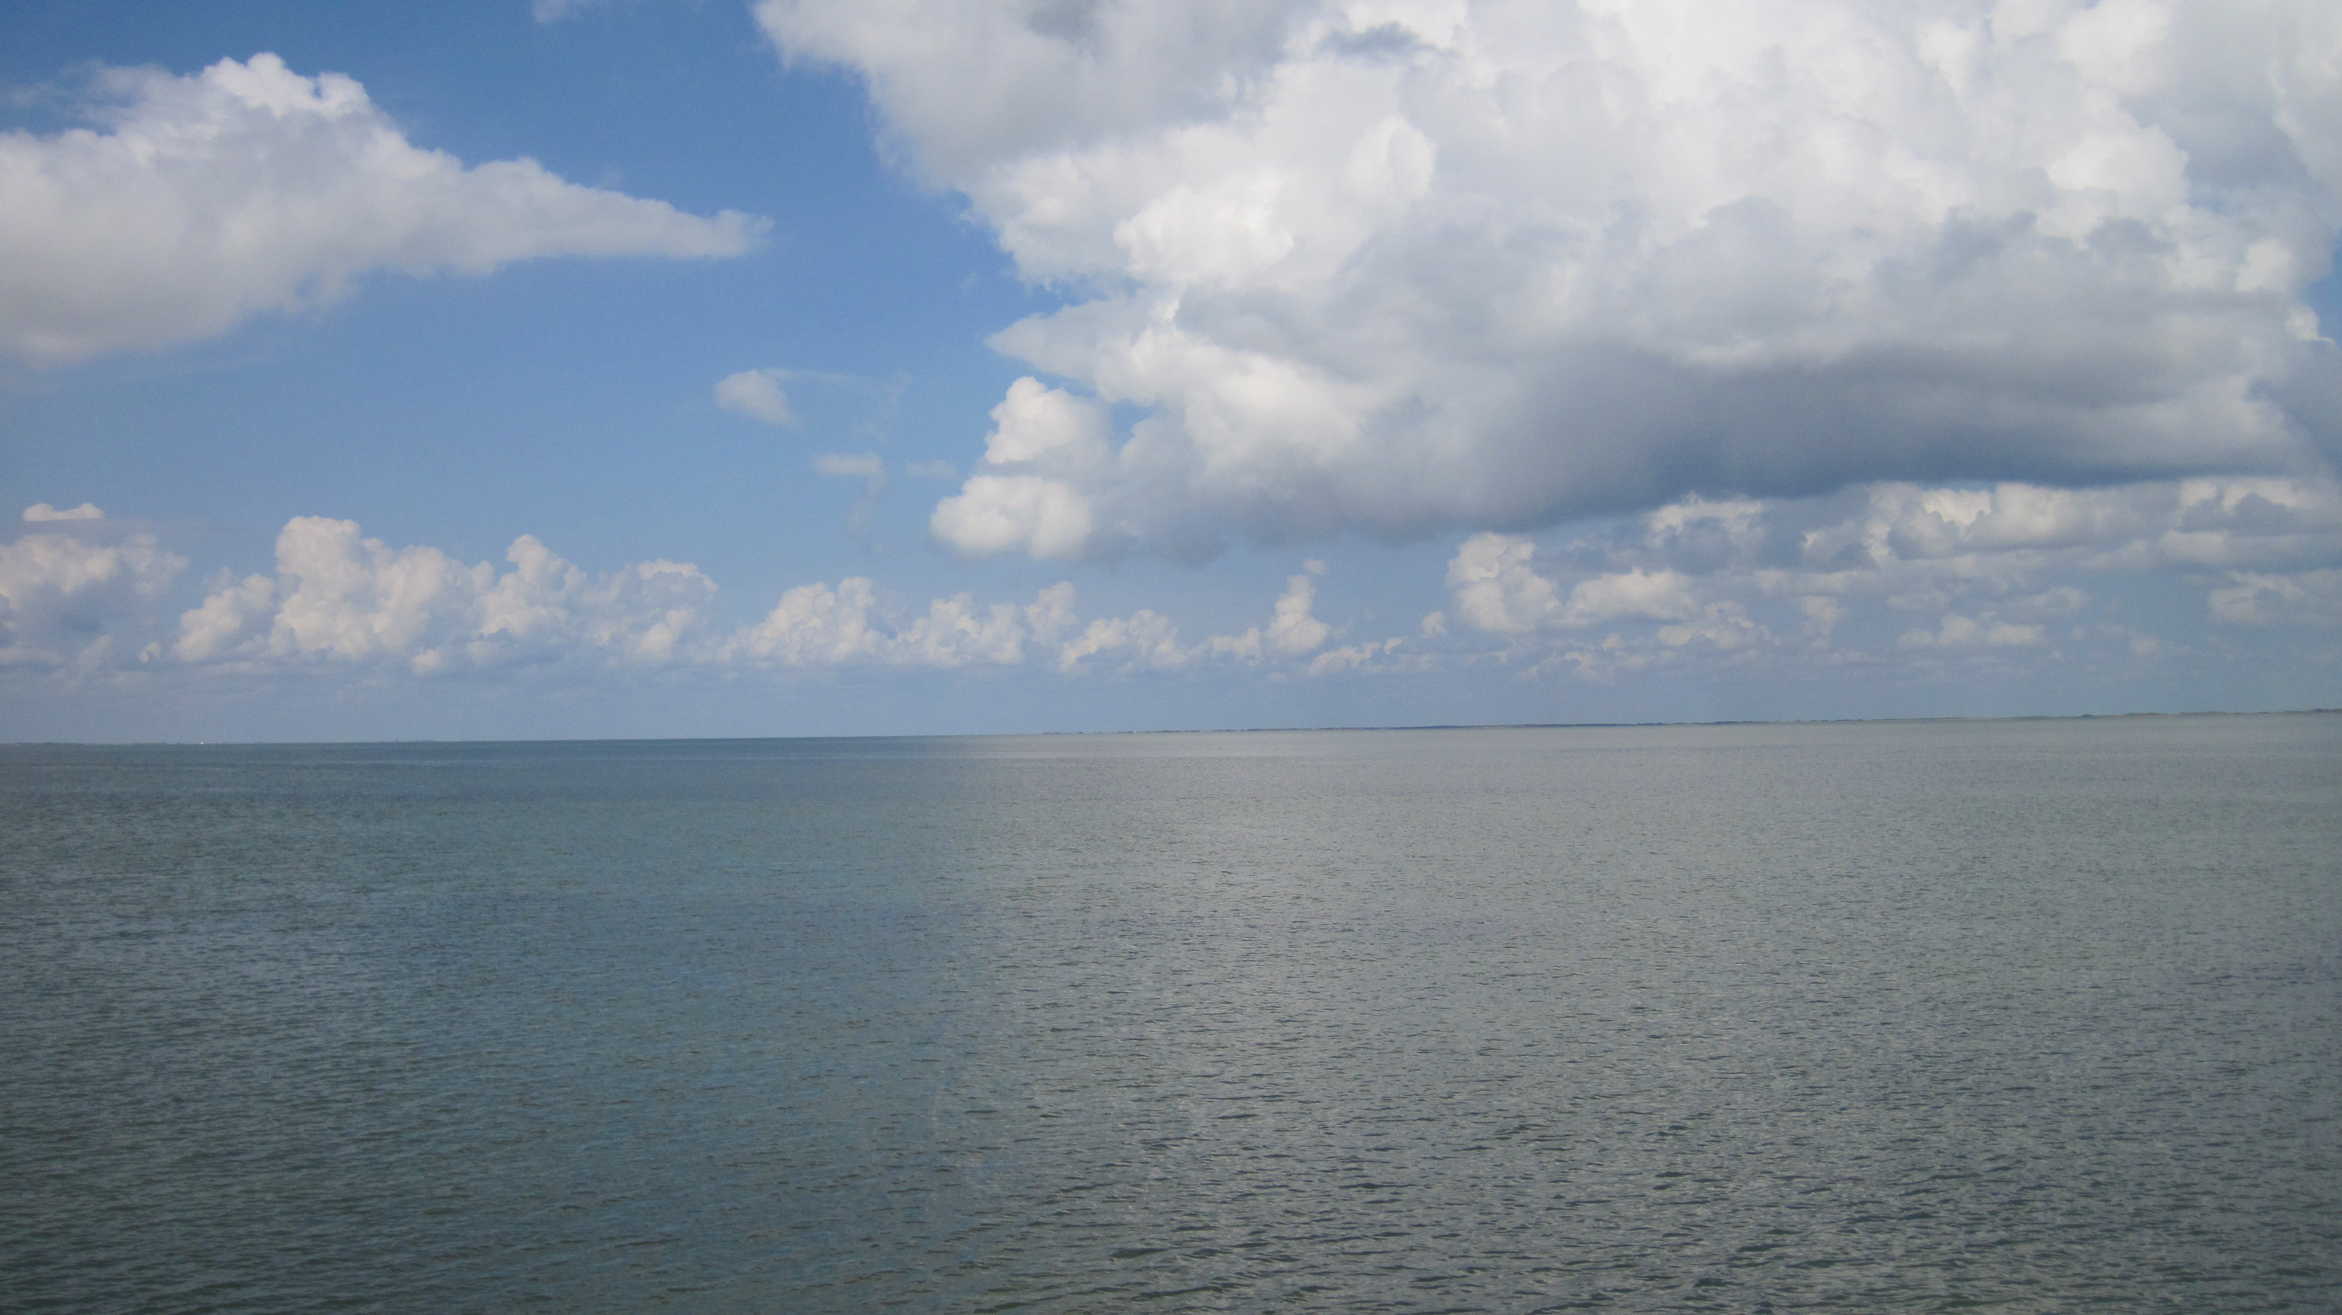
Coastal Texas Water Resources
Utilizing NASA Earth observations to assess estuary health and enhance management of water resources in coastal Texas through land cover and precipitation mapping
Elaina Gonsoroski (Project co-Lead), Tyler Lynn (Project co-Lead), Georgina Crepps, Rodrigo Pereira da Silva, Ryan Schick
NASA DEVELOP Program at the Mobile County Health Department
Abstract
Objectives
This project partnered with the National Park Service (NPS) to help analyze the correlation between mesquite trees and the salinity of the Laguna Madre of Padre Island National Seashore. The lagoon is a hypersaline estuary; however, there is historical evidence that this was not always the case. It is hypothesized that the increase in the number of honey mesquite trees (Prosopis grandulosa var. glandulosa) in the area has contributed to the Laguna Madre’s increased salinity by decreasing the groundwater inflow to the lagoon. These mesquite trees have long taproots capable of extracting significant amounts of groundwater. This project utilized Earth observation data in ERDAS IMAGINE and ArcGIS software to create map time series and analyze the data. Landsat 5, 7, and 8 data were used to create land use/land cover (LULC) maps in order to analyze the change in the occurrence of mesquite trees over time. Thermal maps of the lagoon were generated using Landsat 5,7, and 8 data to understand changes in groundwater inflow. In addition, TRMM and GRACE derived changes in root zone soil moisture content data were compared over the study period. By investigating the suspected positive correlation between the mesquite trees and the salinity of the Laguna Madre, the NPS can improve future land management practices.
Create land use/land cover, precipitation, thermal, and groundwater maps of the study area
Explore the suspected correlation of increasing salinity of the Laguna Madre and the increasing number of mesquite trees in the surrounding area
Create a systematic method for studying the relationship between the mesquite trees, groundwater, and lagoon to aid in land management decisions
Methodology
Study Area
Land Use/ Land Cover
Normalized Difference Infrared Index (NDII)
Thermal Mapping
Water Analysis
Laguna Madre of the Padre Island National Seashore
Study period:
2000 - 2015
Landsat 5, 7, & 8
TRMM
GRACE-derived Root Zone Soil Moisture Content
Laguna Madre
TOA Radiance → Kelvin → Celsius
LULC Map
$$NDII=\frac{NIR−SWIR}{NIR+SWIR}$$
Earth Observations
Accuracy Assessment
NDII Map
Thermal Map
Resample, Clip and Calculate Monthly Anomalies
GRACE
Landsat 7
Results
Landsat 5
(2003)
TRMM
Landsat 8
Conclusions
(2014)
The occurrence of mesquite trees increased over the study period.
Mesquite trees identified by the land cover analysis agreed with the locations of lower stressed vegetation in the NDII maps.
The Pearson’s correlation coefficient between the TRMM precipitation data and the GRACE derived root zone soil moisture content was moderately strong.
No “hot spots” were identified from the thermal mapping to indicate groundwater inflow to the lagoon but analysis will continue.
Accuracy Assessment of Mesquite Trees
2002 | 92%
2006 | 94%
2010 | 88%
2014 | 88%
2003
2014
2002
2014
Team Members
Project Partners
Acknowledgements
National Park Service
Dr. Bernard Eichold, M.D., Dr. PH (Mobile County Health Department)
Joe Spruce (NASA Stennis Space Center)
James “Doc” Smoot (NASA Stennis Space Center)
Dr. Kenton Ross (NASA Langley Research Center)
Joe Meiman (National Park Service)
Left to Right Back Row: Rodrigo Pereira da Silva, Ryan Schick, Elaina Gonsoroski
Front Row: Tyler Lynn, Georgina Crepps
Mobile County Health Department
Notes:
Photo Credit: Joe Meiman, National Park Service

