Slide 1
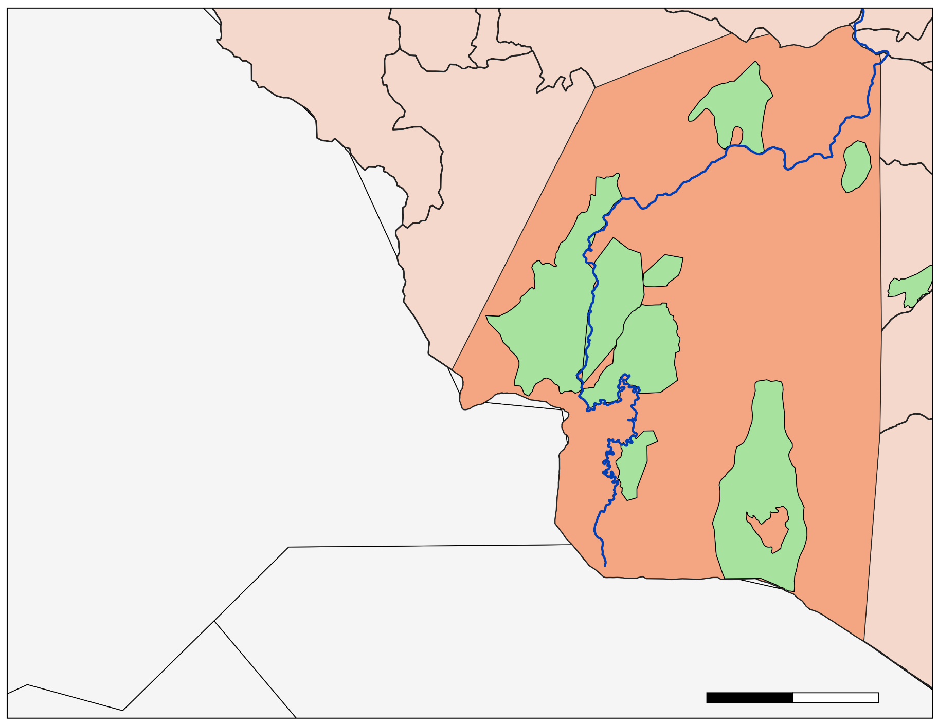
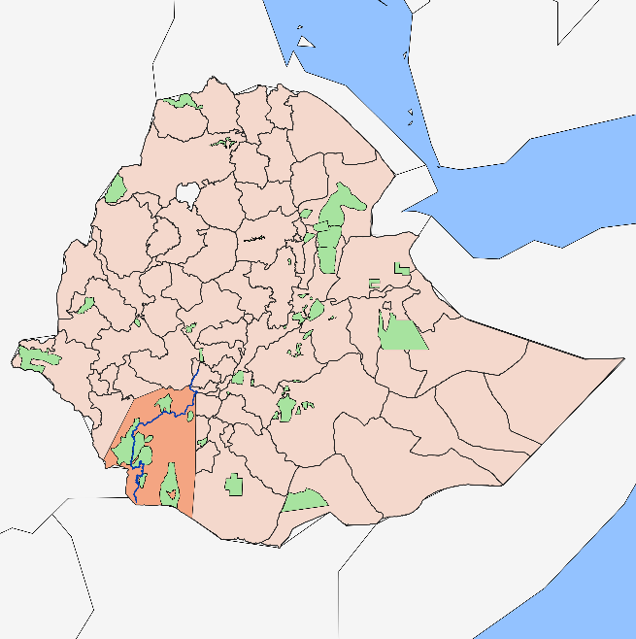
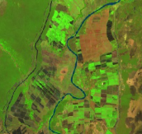
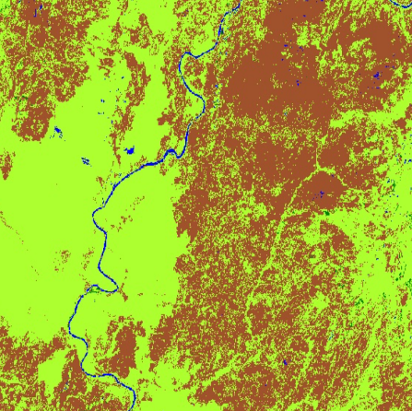
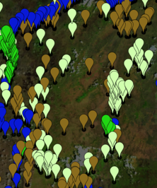
Mapping Land Cover Change in Unprotected and Protected Areas in the Lower Omo River Valley, Ethiopia
Abstract
Earth Observations
Lower Omo Food Security & Agriculture
Ethiopia is home to unique wildlife, biodiversity, and ecosystem services and, like much of the world, is undergoing population growth, development, and land use change. As a result, some biodiverse regions may be at risk of being urbanized, cultivated as agricultural plots, or losing access to water bodies that are essential for maintaining both terrestrial and aquatic life. The DEVELOP team partnered with the Ethiopian Wildlife Conservation Authority to quantify the land cover change between the years 1994, 2010, and 2018. The team utilized Ethiopia’s dry season (January to May) for training point development which was crucial in differentiating the level of greenness between the four land cover classes: water, natural vegetation, cultivated land, and bare ground. The study area covered 62,000 km² of the Lower Omo River Valley and includes eight protected areas. Data from Landsat 5 Thematic Mapper, Landsat 7 Enhanced Thematic Mapper Plus, Landsat 8 Operational Land Imager, and Shuttle Radar Topography Mission were used to employ a Random Forest classifier and identify the four classes within Google Earth Engine. For each of the supervised classifications, overall model accuracy was between 83% (2018) and 89% (1994). Between 1994 and 2018, the Lower Omo Valley experienced an overall increase of 258% (919 km²) in water and 291% (7,188 km²) in cultivated areas, while experiencing a 9% (2,761 km²) decrease in natural vegetation and 19% (5,346 km²) bare ground. There was an increase in water and cultivated land and a decrease in natural vegetation and bare ground in unprotected areas and all protected areas. However, protected areas maintained natural vegetation better than unprotected areas and only experienced a 1% (59 km²) loss compared to a 10% (2,701 km²) loss in unprotected areas.
Landsat 5 TM
Landsat 7 ETM+
Landsat 8 OLI
SRTM
Results
The table below shows the user and producer accuracy metrics for classification outputs.
Land use/cover categories | 1994 User/Producer Accuracy (%) |  | 2010 User/Producer Accuracy (%) |  | 2018 User/Producer Accuracy (%)
Water | 97.4 | 97.4 | 94.8 | 100.0 | 98.6 | 93.4
Natural Vegetation | 80.0 | 85.7 | 77.8 | 83.0 | 77.8 | 76.0
Cultivated Land | 55.6 | 45.5 | 35.7 | 31.2 | 81.5 | 74.7
Bare Ground | 93.4 | 90.5 | 91.8 | 81.8 | 73.9 | 88.9
Study Area
The table below shows the change in total area and percent cover of each class within protected areas, with negative values in red and positive values in green.
Land use/cover categories | 1994 to 2010 |  | 2010 to 2018 |  | 1994 to 2018
 | km² | % | km² | % | km² | %
Water | 417.05 | 452.38 | 292.49 | -57.44 | 124.56 | 135.11
Natural Vegetation | 948.99 | 16 | 1,008.35 | -14.66 | 59.36 | -1
Cultivated Land | 371.35 | 147.2 | 1,564.8 | 250.92 | 1,936.15 | 767.48
Bare Ground | 1,737.38 | -22.75 | 263.9 | -4.47 | 2,001.28 | -26.2
C. Churchura
Maze
Tama
W. Sala
Omo
Mago
The study area (left) is comprised of 62,000 square kilometers of the Lower Omo Valley in Southwestern Ethiopia.
Lower Omo Study Area
Murulle
Chelbi
The table below shows the change in total area and percent cover of each class within unprotected areas, with negative values in red and positive values in green.
Omo River
Land use/cover categories | 1994 to 2010 |  | 2010 to 2018 |  | 1994 to 2018
 | km² | % | km² | % | km² | %
Water | 3,715.01 | 14.12 | 2,920.86 | -73.42 | 794.15 | 301.82
Natural Vegetation | 2,181.29 | 8.71 | 4,882.77 | -17.94 | 2,701.48 | -10.79
Cultivated Land | 662.3 | -29.89 | 5,913.99 | 380.69 | 5,251.69 | 237.01
Bare Ground | 5,234 | -25.10 | 1,889.57 | 12.10 | 3,344.43 | -16.04
Protected Areas
Study Area
50
100
Ethiopian Administrative Zones
0
km
Methodology
Outputs
Inputs
Processing
Google Earth Engine (GEE)
Random Forest classifier within GEE
Classified 1994, 2010, and 2018 composite(Jan-May)
Land Cover by Class
Conclusions
Satellite Imagery
Cultivated land had the largest percent and area increase at an increasing rate, while in unprotected areas, water had the largest percent increase at a decreasing rate.
In terms of area of cultivated land increase, Omo National Park, Chelbi Wildlife Reserve, and Mago National Park had the largest gains of 621, 600, and 259 square kilometers, respectively.
In protected areas, the largest decreases in bare ground coverage were seen in Chelbi, Maze, and Mago, which saw losses of 600 km², 577 km², and 259 km² respectively.
Training Points by Class
8
160
10
Accuracy Metrics
The flowchart above details a simplified version of methods for land cover classification used in this project.
Objectives
Classify land cover in 1994, 2010, and 2018 using Random Forest in Google Earth Engine (GEE).
Create a time series analysis to understand the rate and spatial extent of this change.
Analyze the acreage of land cover change for both protected and unprotected land.
Project Partner
Ethiopian Wildlife Conservation Authority
Acknowledgements
Team Members
Dr. Paul Evangelista, Colorado State University, Natural Resource Ecology Laboratory
Dr. Catherine Jarnevich, USGS, Fort Collins Science Center
Nicholas Young, Colorado State University, Natural Resource Ecology Laboratory
Peder Engelstad, Colorado State University, Natural Resource Ecology Laboratory
Tony Vorster, Colorado State University, Natural Resource Ecology Laboratory
Kristen Dennis, NASA DEVELOP
Dr. Fanuel Kebede, Wildlife Research & Monitoring Director, Ethiopian Wildlife Conservation Authority
Chiara Phillips
Project Lead
Stacy Armbruster
Lauren Lad
Matison Lakstigala
Colorado – Fort Collins

