Slide 1
2019 Spring
NATIONAL
ORIENTATION
MODULE 7. Opportunities
Notes:
Your project Website Image should be placed behind the hexagon grid. An example image has been placed in this position for your reference. Delete the example image, insert your image, right click your image and select the “Send to Back” option. Position and adjust the size of your image so that it lines up with the provided margin rulers.

Slide 2
Travel
Any travel funded by the DEVELOP Program will be coordinated and originated through the DEVELOP NPO.
Travel is a privilege. The program does it’s best to provide opportunities to present DEVELOP work and engage with partners when appropriate – and resources and timing allow.
Travel Process:
DEVELOPer identifies a conference or meeting they are interested in attending.
Talk to the Center Lead about the opportunity; if they approve of the opportunity, then they will work with you to submit a request to NPO (includes description, attendee info, justification for travel, and cost estimate).
NPO will assess merit of the event and funds available.
If NPO approves the travel, NPO will input the traveler and event into the NASA Conference Tracking System to gain agency approval.
Once agency approvals are received, travel requests must be submitted for the travel to be approved by the funding contract.
Once funding organizations approve, travel arrangements (if needed) will be made by NPO and reimbursements will be processed upon the travelers’ return.
By The Way
Certain large conferences (AGU Fall Meeting, AAG Annual Meeting, ASPRS Annual Conference, etc.) are planned 6+ months ahead and are opportunities to attend are competed across the program. Talk to your Center Lead.

Slide 3
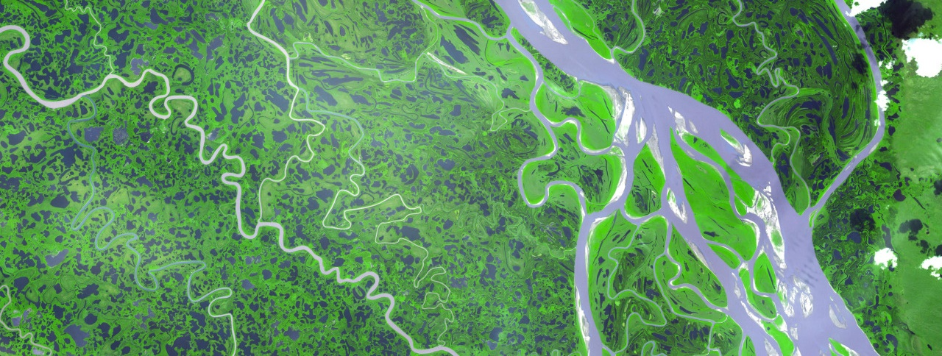
Presenting & Publishing Your Work
For purposes of ensuring appropriate export control review, performance metric tracking, and reporting to NASA HQ, any and all presentations or publications related to DEVELOP (projects or the program in general) must be communicated to, and content shared with, the NPO before submission of the presentation or publication.
Submitting work for presentation or publication is encouraged; however, ALL research is shared property of NASA; therefore, you must have permission prior to submitting your research anywhere. Also, to minimize duplication of effort, the NPO oversees all publications and presentations.
Coordinate with your Center Lead, and, if approved at your node, send a simple email with your ideas before the presentation or publication to Amanda.L.Clayton@nasa.gov and Karen.N.Allsbrook@nasa.gov with the following information:
Description of the activity – conference, presentation to a class, publication, etc.
Timeline for the activity – when the event is or deadline for publication, etc.
A copy of the material (because often presentations can be large, a PDF is good enough for a quick review)
Cost estimate (if applicable)
Thank you for your help with this!

Slide 4
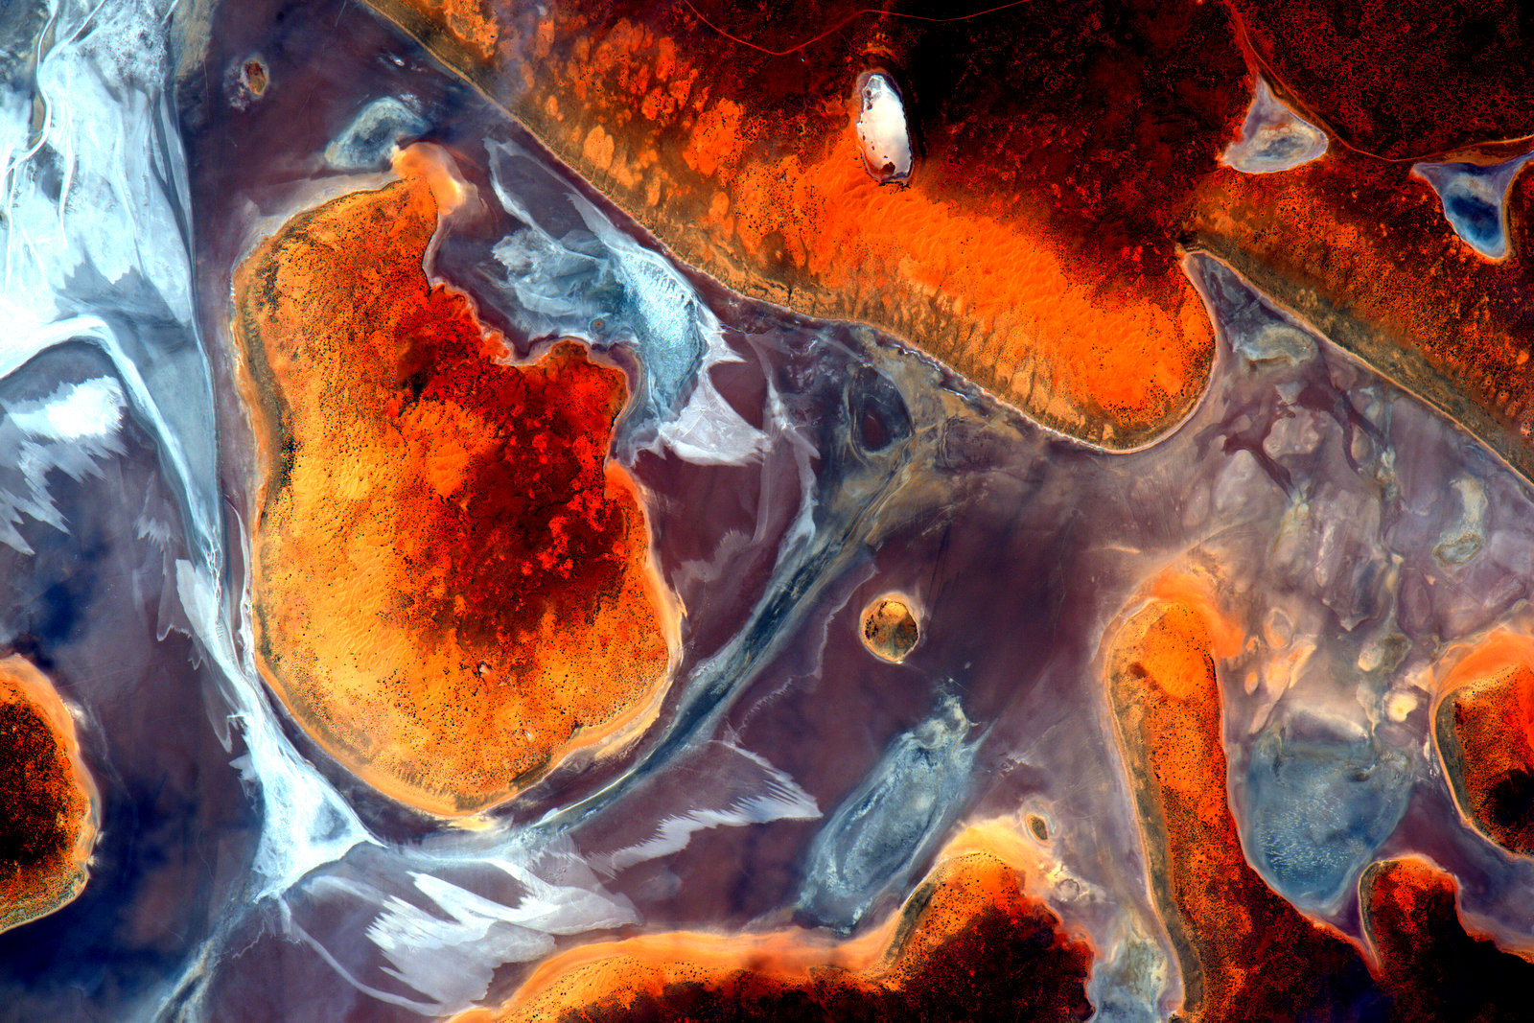
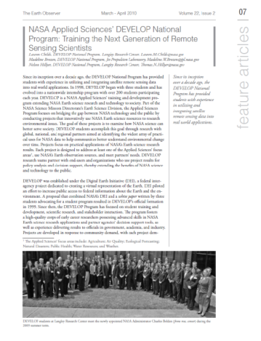
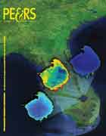
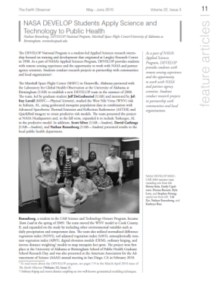
Publications
Publications are a huge avenue for getting the word out about the great research you are a part of with DEVELOP!
DEVELOP is working on increasing the number of its peer-reviewed publications and has seen 5-6 each per year the past couple years.
If you are interested in working your project toward a potential publication, contact your Center Lead and Amanda.
Reminder: All publications must be approved by NPO and NASA’s Export Control process before submission! This means before you ever send a draft to the publisher!
By The Way
DEVELOP publishes in both peer-reviewed venues and in “gray literature” venues! You can see all of the publications on the DEVELOP website’s Media Page.

Slide 5
Publication Process
Discuss with your Center Lead and Science Advisor
Select publication venue
Contact Amanda & the PC Team
Draft the manuscript
Submit draft to NPO for review
NPO/PC Team and project team go back-and-forth with edits to create a final version
NPO submits this pre-print version into export control – NASA Export Control takes about 1-3 weeks
Once approved, the content can be submitted to publication venue
Keep Amanda in the loop with any and all edits from the publisher
The final-final version must be resubmitted to NASA Export control
By The Way
If the decision to publish occurs before the technical paper FD is submitted, you can ask the PC Team about using the journal’s style for your tech paper.
If the decision to publish occurs after the term, the person leading the effort must ensure that all team members are aware, involved to the extent they want to be, and listed as co-authors.

Slide 6
Conferences
DEVELOP presents projects at over 30 conferences each year.
If you have an idea for a conference you’d like to attend, discuss with your Center Lead and together reach out to NPO.
There is a small travel pot provided to each node to support some travel, however those funds may already be accounted for at any specific time.
Ways to attend cost-effectively:
Choose a conference that is local.
Present DEVELOP work at a conference you already are planning to attend either for school or personally.
Pursue school-funding opportunities.
Apply for travel grants offered by professional societies.
Look for opportunities to volunteer in exchange for registration or travel costs.
Look for competitions like the AGU Data Visualization & Storytelling Contest.

Slide 7
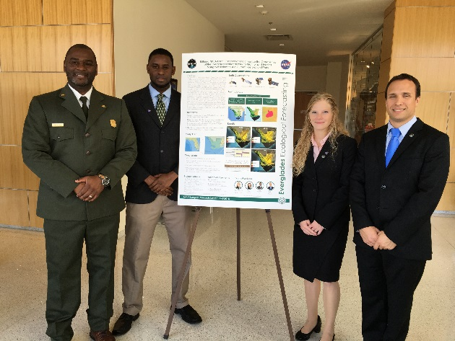
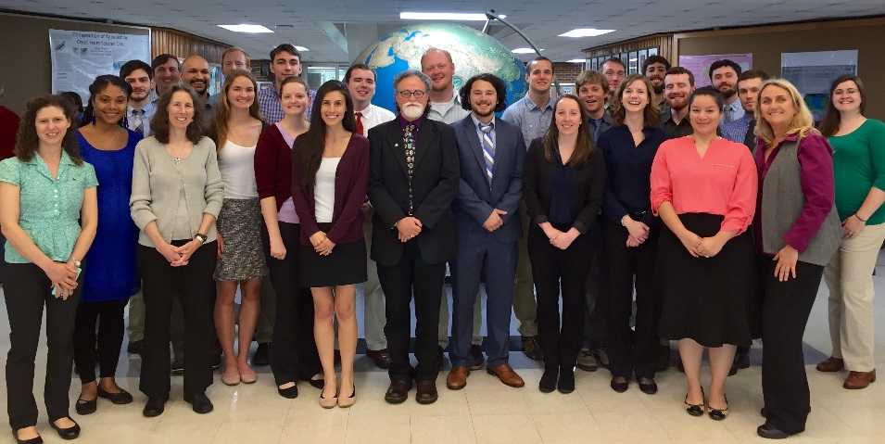
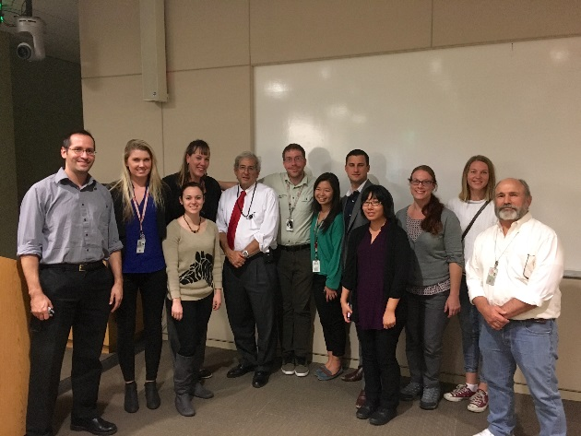
Node Close Outs
At the end of each term, nodes host closeout events where teams present their work.
Typically partners, friends, and family are invited.
Talk to your Center Lead about the specifics for your node.
Closeouts are a great networking opportunity.
Exciting wrap up of the term!

Slide 8
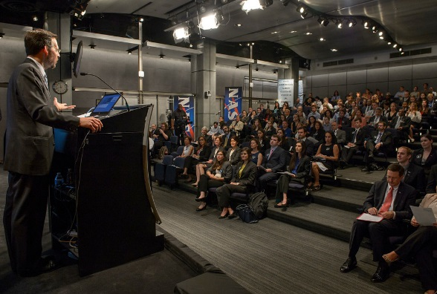
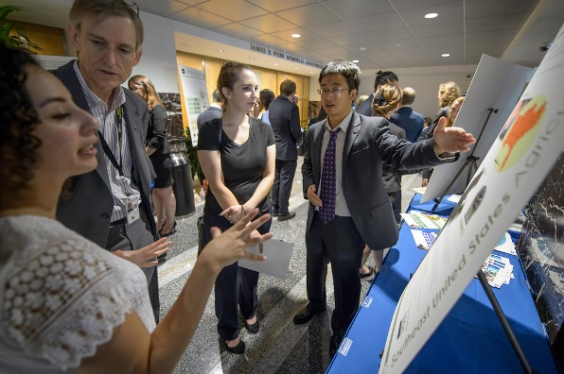
AESAS
What: Annual Earth Science Applications Showcase
Why: To highlight the work being done by DEVELOP and the Applied Sciences, network with NASA HQ officials and partner organizations
Where: NASA Headquarters in Washington, DC
Who: Typically a competitively selected representative from each project; however, depending on the structure of the event details will be communicated closer to the event
When: Summer 2019
By The Way
This opportunity takes place in the summer, however even if you are not a summer participant you are welcome to come. It’s open to the public and many alumni attend!

Slide 9
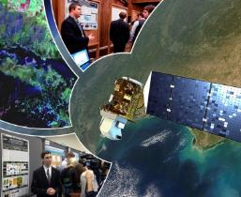
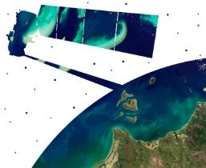
Virtual Poster Session
What is the VPS?
Since 2011, DEVELOP has regularly showcased the work of participants through a series of short, informative videos. These videos are the most publically viewed deliverables and display the impressive work conducted by each team through the use of a digital medium. The VPS is hosted on our YouTube channel and allows the teams to share their work.
The VPS is one of the most unique ways in which teams communicate Earth science to the public! There is a light-hearted, internal competition for the best video, and judges include DEVELOP alumni, science advisors, and NASA HQ personnel.
Thousands of people from around the world view these project videos – For example, the 2017 Spring VPS had visitors from 85 different counties with over 4,000 video views!
Key Dates:
Video Outline – due Week 5
Comm Team Check-In – Week 6
VPS Video & Transcript – due Week 8
VPS Launch – Week 10
By The Way
Questions? Contact the Comm Team with any questions relating to the video.
DEVELOP VPS Archive: www.youtube.com/nasadevelop

Slide 10
Enhanced Capacity Building
Opportunities
Center Lead & Fellow Competitions
Within the organizational structure of DEVELOP, there are elevated positions that support the program as a whole – Center Leads and Fellows.
These positions are full-time supporting both nodes and the national program.
The Fellow Class is competed in June and July each year and begins in September.
Center Lead positions are competed on a rolling basis based on a different timeline for each node.
More information is available on DEVELOPedia:
Fellows: http://www.devpedia.developexchange.com/dp/index.php?title=Fellows_Class_Selections
Center Leads: http://www.devpedia.developexchange.com/dp/index.php?title=Center_Lead_Selections

Slide 11
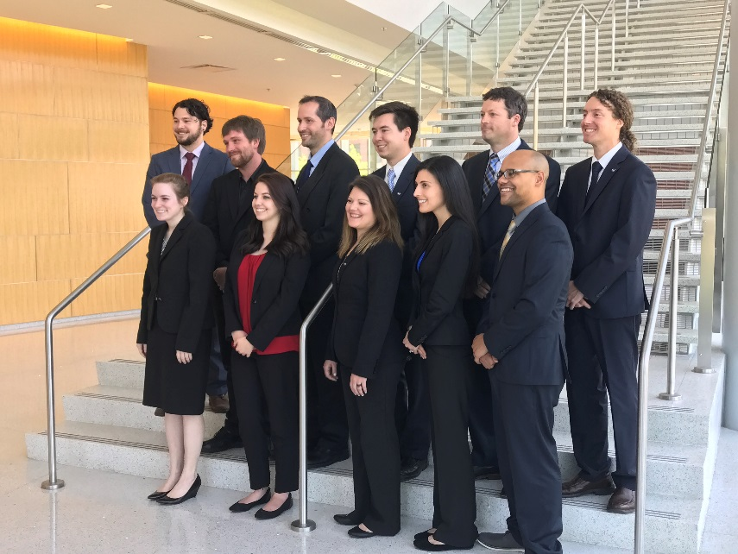
Center Lead
What is a DEVELOP Center Lead? The Center Lead (CL) is an integral piece of the leadership team in the DEVELOP model. The people who assume this role are responsible for managing the majority of the day-to-day operations at their individual nodes, providing guidance and direction to their teams, and supporting strategic planning for their node and the program as a whole.
Center Lead Term: One year (recompeted annually, 2 term limit)
Eligibility Requirements:
At least one term with DEVELOP, multiple preferred
Strong leadership and communication skills
Proficient knowledge and understanding of DEVELOP
Demonstrated ability to generate project ideas and start/maintain partnerships
Ability to spend 40 hours/week in the position
Minimum 3.0 GPA (at current or at most recent academic institution)
U.S. Citizenship

Slide 12
Center Lead
Skills Gained & Opportunities:
Project Management: Project idea generation, proposal writing, technical editing, deliverable creation and review, dissemination of results
Leadership: Opportunities for early career leadership, working with diverse teams
Communication: Writing skills, presentations, telecon communication, meeting organization, working with diverse groups
Increased Personal & Professional Awareness: Personality tests & assessments, and critical feedback and skill strengthening
Shaping the Future of DEVELOP: Participation in leadership and strategic planning retreats, leading innovative projects and activities, and strategic planning
Networking Opportunities: Meet & Greets with NASA and partner organizations leadership, representing DEVELOP at meetings, and workshops and conferences (as funds and opportunities arise)
By The Way
Each term different nodes are accepting applications. This spring, the Colorado – Fort Collins node plans to accept applications. Check DEVELOPedia for the most up-to-date details.

Slide 13
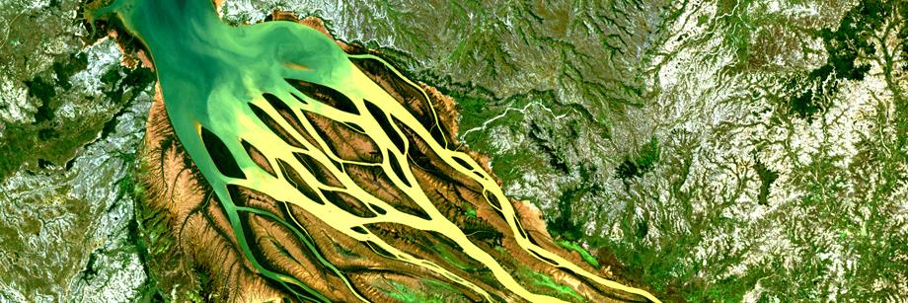
Fellows
What is a DEVELOP Fellow? A Fellow is a recent college graduate who spends one year with DEVELOP growing personally and professionally while contributing to the program as a whole and their node. The position serves in a dual-role by splitting their time between their node and NPO-related tasks.
Fellow Term: One year (September to September)
Eligibility Requirements:
Minimum 3.0 GPA, cumulative or most recent semester
Participation in at least one term with DEVELOP (two or more terms preferable)
Available to work full-time (40 hours per week)
U.S. Citizenship
Competition Timeline:
June/July – Application submission & interviews
July/Aug – Notifications
Sept - Begin
By The Way
All alumni are eligible to apply to a Fellow position – you do not need to be a summer participant to apply. You keep your DEVELOPedia account for perpetuity, which is where details and apps are posted.

Slide 14
Fellow Elements
FY19 Elements
Development Opportunities:
Increase personal & professional awareness: Personality tests & assessments; Critical feedback and skill strengthening
Opportunity to play a key role in the future of DEVELOP: Participation in leadership and strategic planning retreats; Participating and leading key activities and program initiatives
Networking opportunities: Meet & Greets with NASA and partner organizations leadership; Representing DEVELOP at meetings, workshops and conferences (as funds and opportunities arise)
Intellectual Challenges: Participation in the DEVELOP Junto series - 30 minute presentations on personal area of interest for the purpose of sharing a spirit of inquiry and a desire to improve ourselves, our community, and to help others, through discussion and debate of questions in science, politics, philosophy, business and leadership; Flash talk & incubator talk presentations; Leading innovative activities and working with a diverse group of participants each term
Communications
Geoinformatics
Impact Analysis
Information Technology
Project Coordination

Slide 15
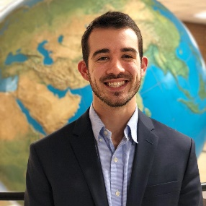
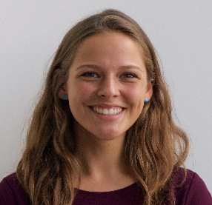
Communications Team
Austin Stone
Comm Senior Fellow
Virginia – Langley
COMMUNICATIONS
TEAM INITIATIVES
WHAT
WE
DO…
Kathrene Garcia
Comm Fellow
Alabama – MSFC
Social Media
Promotional Videos
Create and post campaigns and programmatic news on DEVELOP’s social media accounts
Create new and engaging videos to showcase participants, partners, and the program, overall
Project Videos
Newsletter
Coordinate and promote team project videos, as well as facilitate the Virtual Poster Session competition each term
Design and distribute the DEVELOPer Newsletter each term to report program success and highlight important people and events
Recruitment
Alumni Engagement
Expand DEVELOP’s applicant pool and reach a wider audience; Assist Center Leads with tracking & efforts
Collaborate with Impact Analysis to incorporate alumni into current DEVELOP activities through interactive events and activities
Ambassador Corps
Graphic Design
Utilize talent and enthusiasm of Campus and Alumni Ambassadors who recruit at their respective locations
Design attractive and informational flyers, templates, reports, and other programmatic collateral for the National Program Office

Slide 16
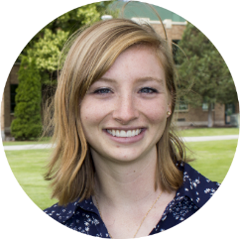
Project Coordination Team
Proposal Review & Development
Deliverable Coordination & Review
Oversee Publication Efforts
Maintain DEVELOPedia Project Resources
Project Tracking
Update Orientation & Guidebook
Shelby Ingram
Georgia – Athens
PC Fellow
Deliverable Templates
Jerrold Acdan
California – Ames
PC Fellow
Madison Broddle
Virginia – Langley
IT/PC Fellow

Slide 17
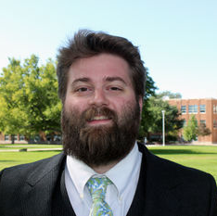
Geoinformatics Team
Common Goals:
Point of contact for GIS and remote sensing needs
Provide programming support and trainings
Support software release and collect internal code
Answer questions on the DESC
Dane Coats
Idaho - Pocatello
Geo Fellow
Megs Seeley
Arizona - Tempe
Geo Fellow

Slide 18
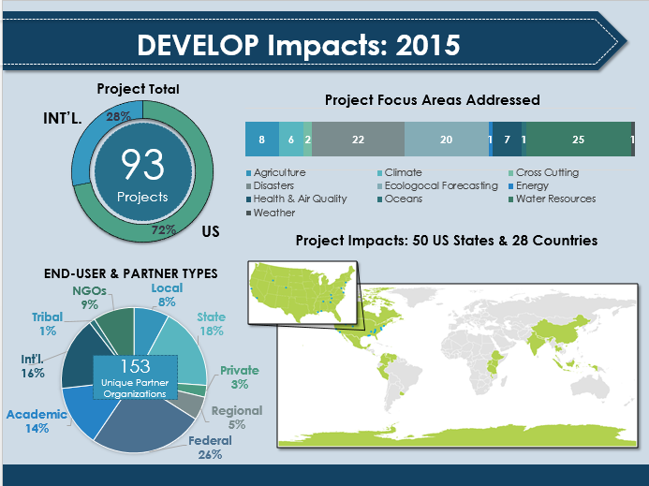
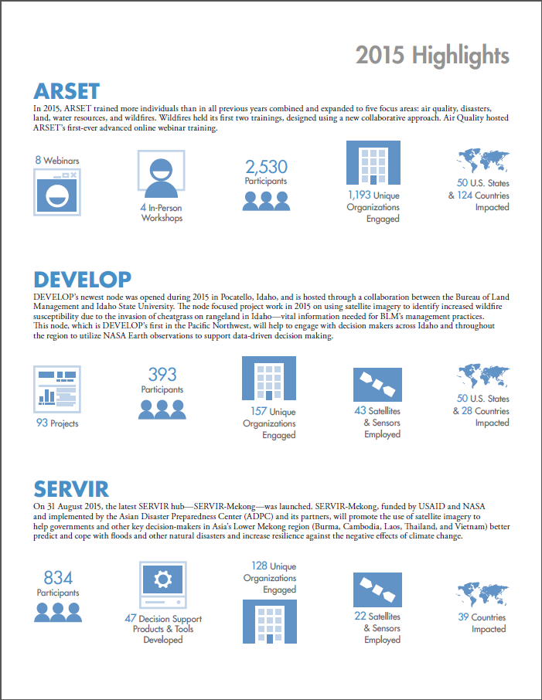
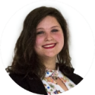
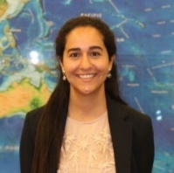
Impact Analysis Team
Our data are everywhere!
Danielle Quick
Virginia – Langley
IA Senior Fellow
Partners
Participants
Projects
CBP Indicators
Impact Analysis Reports
Partner Tracking & Forms
Alumni Highlight Stories
Alumni Survey
CBP Indicators
Center Lead & Fellow PGA
Equal Futures Report
Exit Survey
Fellow Tracking
Indicator Tracking
Participant Info Sheet
CBP Indicators
eBooks
Impact Analysis Reports
Indicator Tracking
Project Strength Index I&II
Project Tracking Sheet
Participant PGA
Partner Highlight Stories
Neda Kasraee
California – JPL
IA Fellow

Slide 19
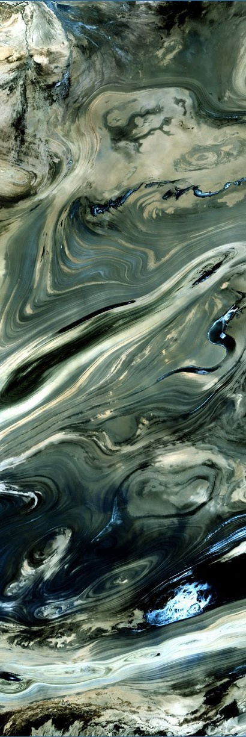
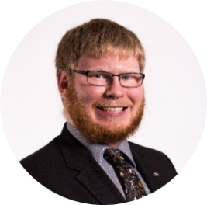
Information Technology
Software Release
Guide Team through the entire Release Process
DEVELOPedia
Knowledge Repository for DEVELOP
Every Participant has an Account
DEVELOP Website
Public Face of DEVELOP
Provide Information about what DEVELOPers are doing
Retain Access after leaving the program
Create and Release Open-Source Software
Meet with Teams and Explain Release Process
Present Projects and Media Appearances
IT Senior Fellow: Jordan Vaa
IT/PC Fellow: Madison Broddle

Slide 20
Quiz Time!
What’s the first step if you want to publish?
Does any content that would be published or presented need to gain export control approval prior to submission/presentation?
Can only summer participants apply to be a Fellow?
Are Center Lead and Fellow positions full-time employees working 40 hrs/wk?
Where can you find more information about which nodes are accepting Center Lead applicants for any given term?

Slide 21
THANK YOU!
Your DEVELOP experience is what you make it.
What opportunities are right for you?
Notes:
Your project Website Image should be placed behind the hexagon grid. An example image has been placed in this position for your reference. Delete the example image, insert your image, right click your image and select the “Send to Back” option. Position and adjust the size of your image so that it lines up with the provided margin rulers.

