Slide 1
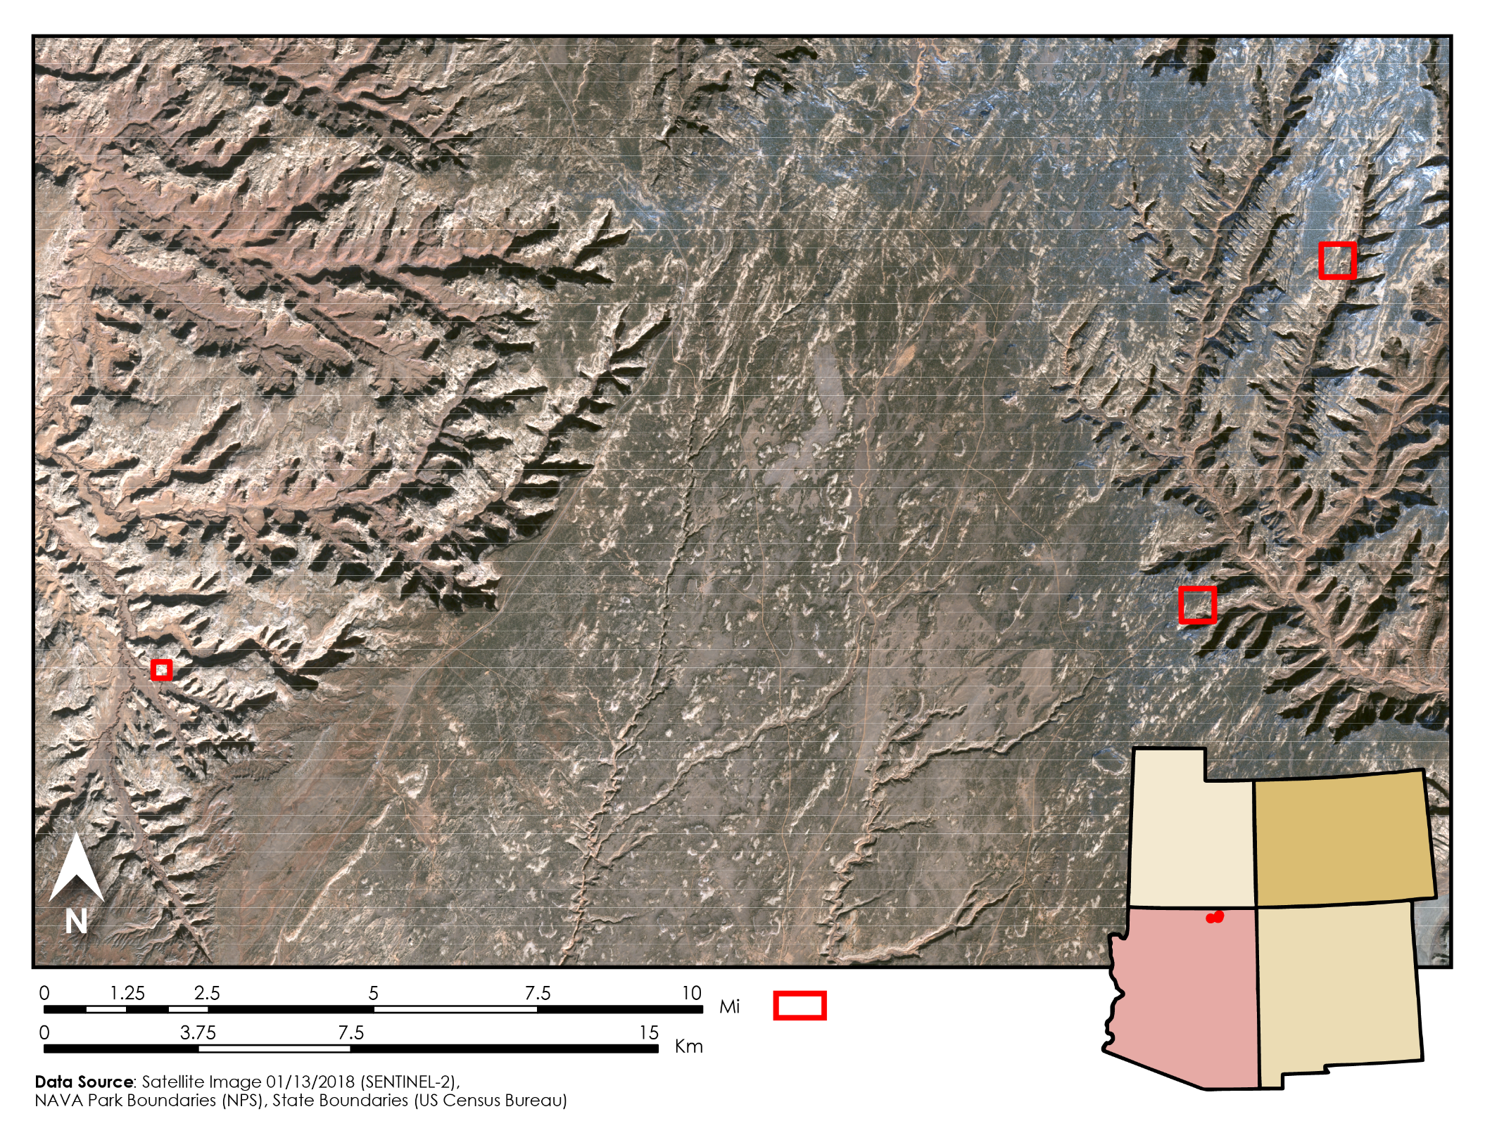
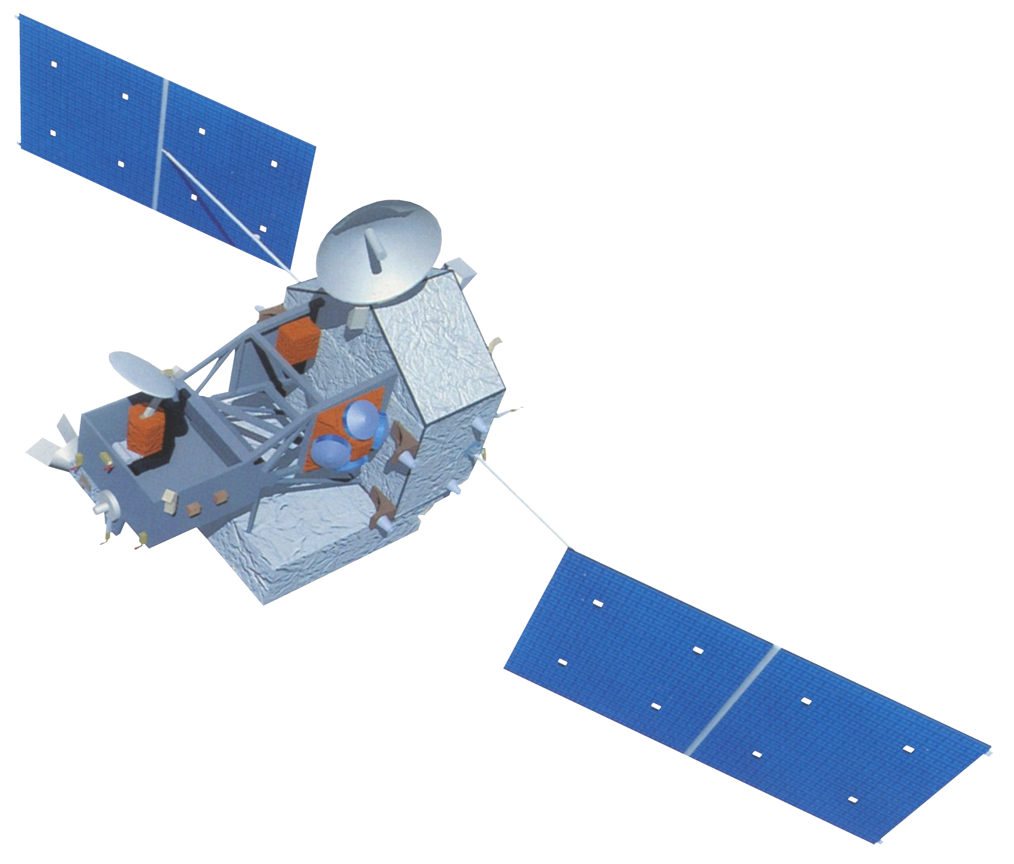
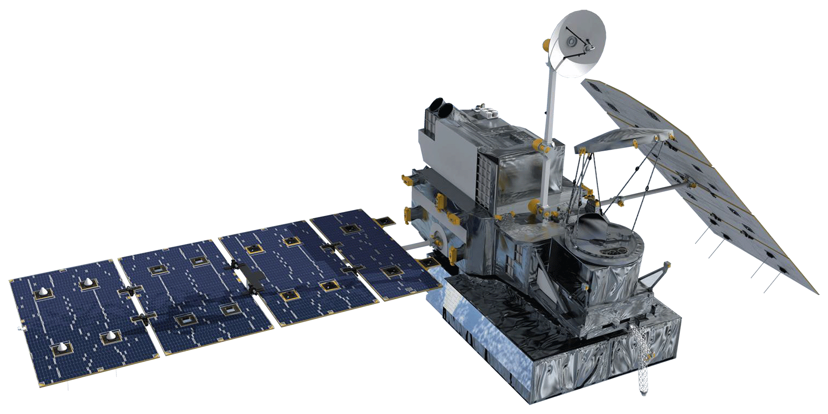
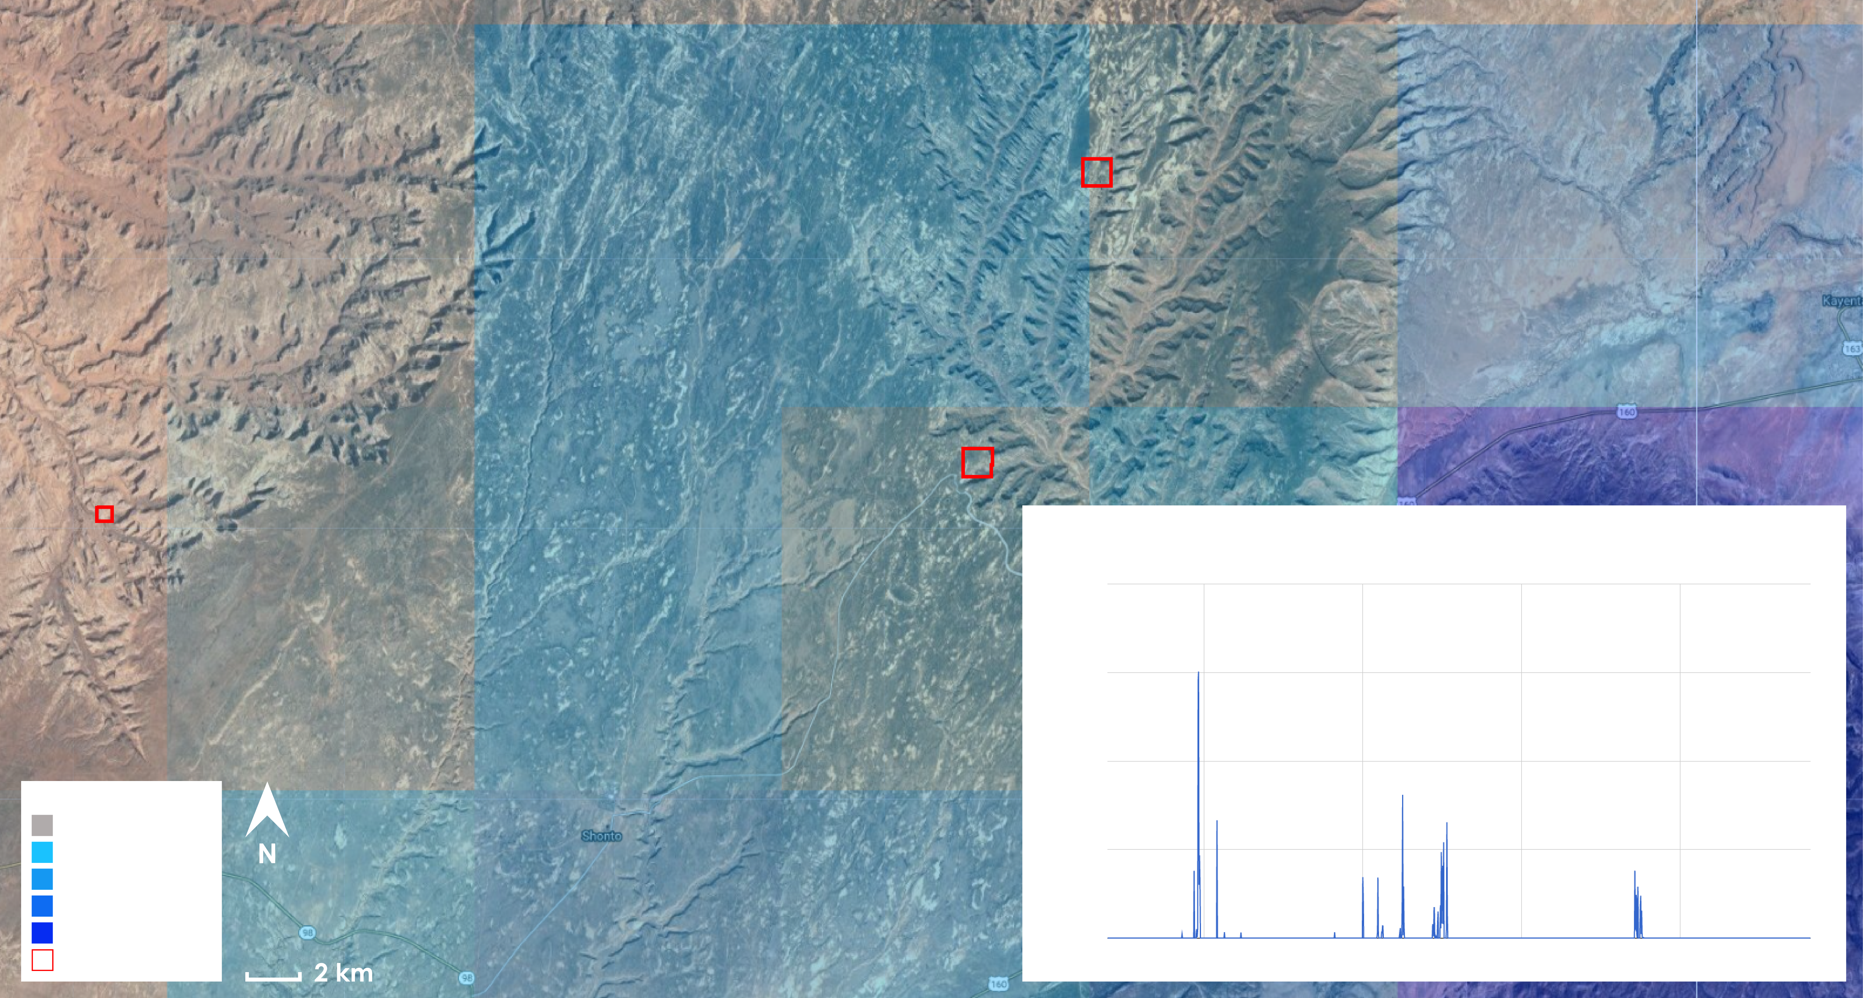
Monitoring and Forecasting Precipitation Patterns and Erosion Potential to Enhance Archaeological Preservation and Decision Making
Abstract
Increasing yearly monsoonal precipitation severity in Navajo National Monument (NAVA) is exacerbating erosion and arroyo cutting, affecting culturally significant archaeological sites in the area. In order to better understand and mitigate erosional processes, land managers at the park would benefit from comprehensive rainfall data and maps of where erosion hazards are more likely to occur. The Idaho NASA DEVELOP team developed virtual rain gauges called Rainfall Intensity Graphs (RIG) and erosion hazard maps that utilize NASA Earth observations to provide a more complete picture of rainfall measurements at the monument. RIG was developed in Google Earth Engine API from Global Precipitation Measurement (GPM) Microwave Imager (GMI) and Tropical Rainfall Measuring Mission (TRMM) Precipitation Radar (PR) satellite data. Rainfall data from RIG were synthetically validated against each other and PRISM data, and were also compared to ground-based weather stations near the monument. The data displayed a weak statistical correlation between satellite derived data and ground based weather stations for the study area. However, peaks within the data showed temporal similarities suggesting that the differences within the data were representative of regional variability. In future work, rainfall data from RIG can be used as temporal and intensity parameters, which combined with Shuttle Radar Topography Mission (SRTM) -derived hazard maps, can help target erosion mitigation.
Study Area
Objectives
Earth Observations
Leverage Google Earth Engine API to create virtual rain gauges for Navajo National Monument (NAVA)
Integrate rain gauge data with geospatial analysis tools to map targets for erosion mitigation
Produce maps of areas most at risk of erosion from fluvial channel incision
Document methodology to allow straightforward reproducibility
SRTM
Park Boundaries
N
TRMM
GPM
Methodology
DATA INPUTS
PROCESSING
END PRODUCTS
Precipitation: TRMM Precipitation Radar, GPM Microwave Imager
Google Earth Engine API: Confine rainfall data to specified spatial and temporal scales
RIG Virtual Rain Gauge (Rainfall Intensity Graphs)
Elevation/Slope:
SRTM Elevation
GIS Erosion Hazard Model
Erosion Hazard Maps
Results
GPM IR Precipitation Intensity Over Time
IR Precipitation
6.0
4.5
3.0
1.5
0.0
CORRELATION | RIG (TRMM) | RIG (GPM) | PRISM | GPMHQ
Weather Station (2000-2017) | 0.30 | 0.29 | 0.63 | 0.19
PRISM | 0.73 | 0.49 | 1.00 | 0.44
Weather Station (2014-2017) | 0.39 | 0.29 | 0.63 | 0.19
RIG (GPM) | 0.54 | 1.00 | 0.49 | 0.70
Precipitation Intensity
Precipitation rate (mm/hr)
very light
light
moderate
heavy
very heavy
08/05/17
08/12/17
08/19/17
08/26/17
NAVA boundaries
Time (months)
Conclusions
The rainfall data from RIG was positively correlated with ground-based weather stations for the study area.
RIG provides near-real time and historical representations of the timing and intensity of rainfall events at the watershed scale.
Peaks within the data show temporal similarities suggesting differences within the data are representative of regional variability.
Data can differentiate high intensity rainfall in months with few rainy days, or months that show many rainy days with low intensity rains.
Team Members
Partner & Acknowledgements
The Navajo National Monument team would like to thank our partners, advisors, collaborators, and contributors for their help: Keith Weber (GIS Training and Research Center at ISU); Dr. Gregory Luna Golya (National Park Service); Dr Jeremy Shaw (Colorado State University); and Amy Schott (National Park Service).
Dane Coats
Project Lead
Brandon Crawford
Leah Kucera
Theresa Condo
Zach Sforzo
Navajo National Monument Water Resources
Idaho – Pocatello | Spring 2018

