Slide 1
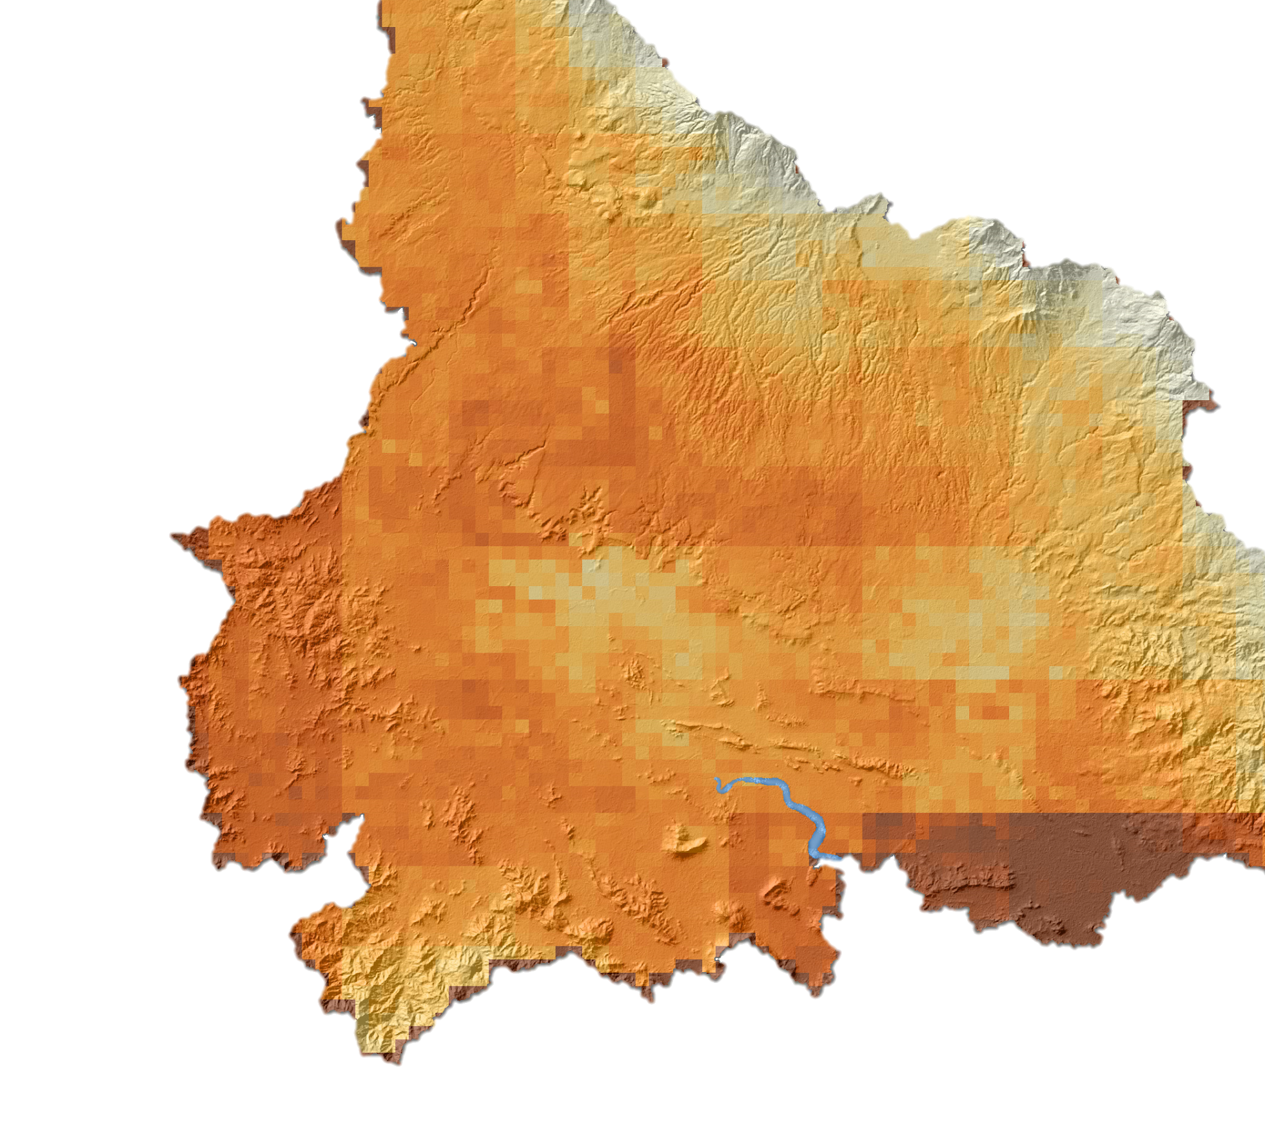
Monitoring Drought and Water Balance in the Guanacaste Province to Enhance
Decision Making and Response Planning in Costa Rica
Rachel Durham (Project Lead)
COSTA RICA WATER RESOURCES
María José Rivera-Araya
Madison Davis
Luis Quesada
Nelson Venegas
Diyang Cui
Notes:
Hi, my name is María José Rivera-Araya and I am the team co-lead on this project and I have a B.S. in Chemistry from the University of Costa Rica. I am a current student at the University of Georgia pursuing my Ph.D in Geography.
Hi my name is Rachel Durham and I am the team co-lead on this project. I hold a B.S. Environmental Science from Florida State University and recently graduated from the University of Georgia with my Master of Environmental Planning and Design.
We were co-leads on the UGA Costa Rica Water Resources team. Our team consisted of ourselves and two other members, Madison and Diyang, from UGA and Nelson and Luis, two students at the University of Costa Rica.

Slide 2
Study Area & Period
Guanacaste Province, Costa Rica
20% of Costa Rica’s hydroelectric power comes from the Arenal Reservoir
Predominance of sugarcane, and rice agriculture
Great variety of life zones, biodiversity, and climate
Study period: January 2000 to March 2016
Arenal-Tempisque Watershed
Costa Rica
Arenal-Tempisque Watershed
Notes:
The Arenal-Tempisque Watershed is located in Northwestern Costa Rica, specifically the Guanacaste Province. 70% of Costa Rica’s power is generated with hydroelectric power, which depends on climate and water availability. Guanacaste is known for the Arenal Volcano and reservoir, which is considered the most important source of power in the country. It generates 20% of the hydroelectric power of the country. Agriculture is one of the top land uses in this area, contributing 32% of the gross domestic product of Costa Rica with over 1/3 of the country dedicated to this purpose. This area produces most of the sugarcane and great part of rice for the country.
Service Layer Credits: ESRI, USGS, NOAA

Slide 3
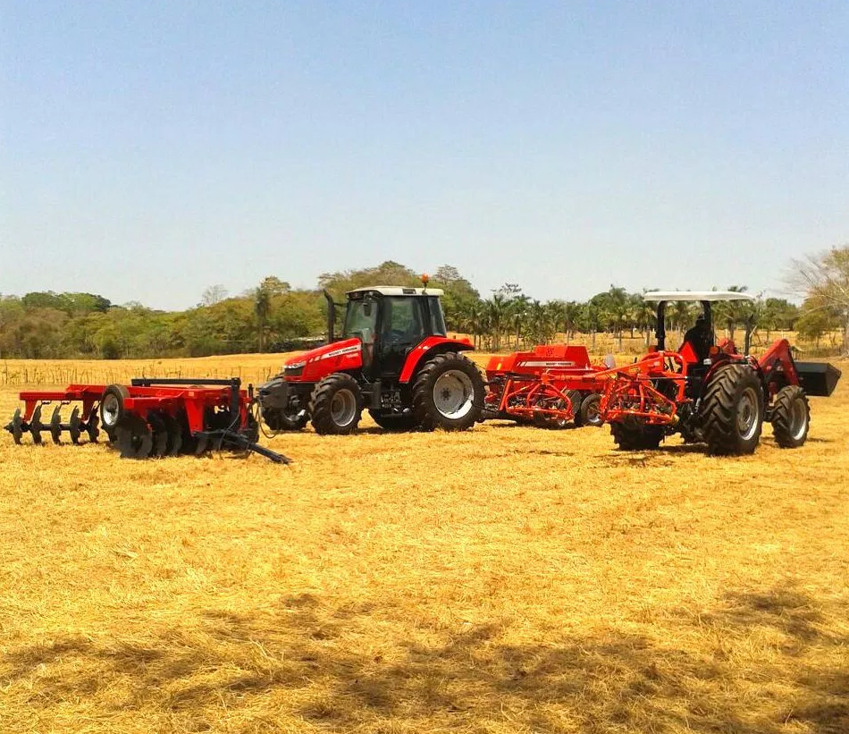
Community Concerns
Four consecutive years of drought
Estimated $25 million economic loss in agricultural production
Drinking water shortage to the local community
Demand on available water resources for all uses in Costa Rica will increase from 5% to 35% until 2020
Photo Credit: Official webpage Presidency of the Republic of Costa Rica
Notes:
Guanacaste has experienced more than four consecutive years of drought, limiting water resources, agriculture, environment, economy, and livelihoods of citizens. This period of drought is considered the worst since 1930, leading the government to declare a state of emergency in 2014 due to these dry conditions. Monitoring and assessment of climatic conditions are a priority for mitigating the negative impacts of drought for the area and the country.
The local economy within the Arenal-Tempisque watershed is highly dependent on agriculture and tourism, requiring a consistent water supply to meet the needs of the area. The well-being of the local community is negatively affected by the shortage of drinking water. The demand of available water resources for all uses in Costa Rica will increase from 5% to 35% until 2020 (Ballestero et al., 2007). Rapid urbanization and overexploitation of water resources are intensifying the rate of demand.
Image Source: http://presidencia.go.cr/

Slide 4
Objectives
Develop a time series for the meteorological and agricultural drought indices for the study area
Create a near-real time drought monitoring tool for the Arenal-Tempisque watershed for partners to utilize in the future
Analyze local water systems using ArcSWAT to produce results that will be incorporated into a water balance assessment toolset
Image Credit: Javier Artinano, SENARA
Notes:
The primary goal of this project was to evaluate drought conditions within the Arenal-Tempisque Watershed in Guanacaste to aid in the creation of decision-support tools to be used by our partners. Using the Standardized Precipitation Index and Standardized Drought Condition Index values calculated by our team, a time series could be created for each weather station. The foundational python script for a near-real time drought monitoring tool was written. This will later provide partners the materials and methods to continually monitor agricultural drought using the SDCI index after the project was completed. We tested the potential of the Soil and Water Assessment Tool (SWAT) for modeling water resources in the area. These ArcSWAT results provided detailed evapotranspiration and superficial flow, which will be used by partners to create a water balance assessment toolset.

Slide 5
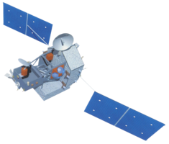
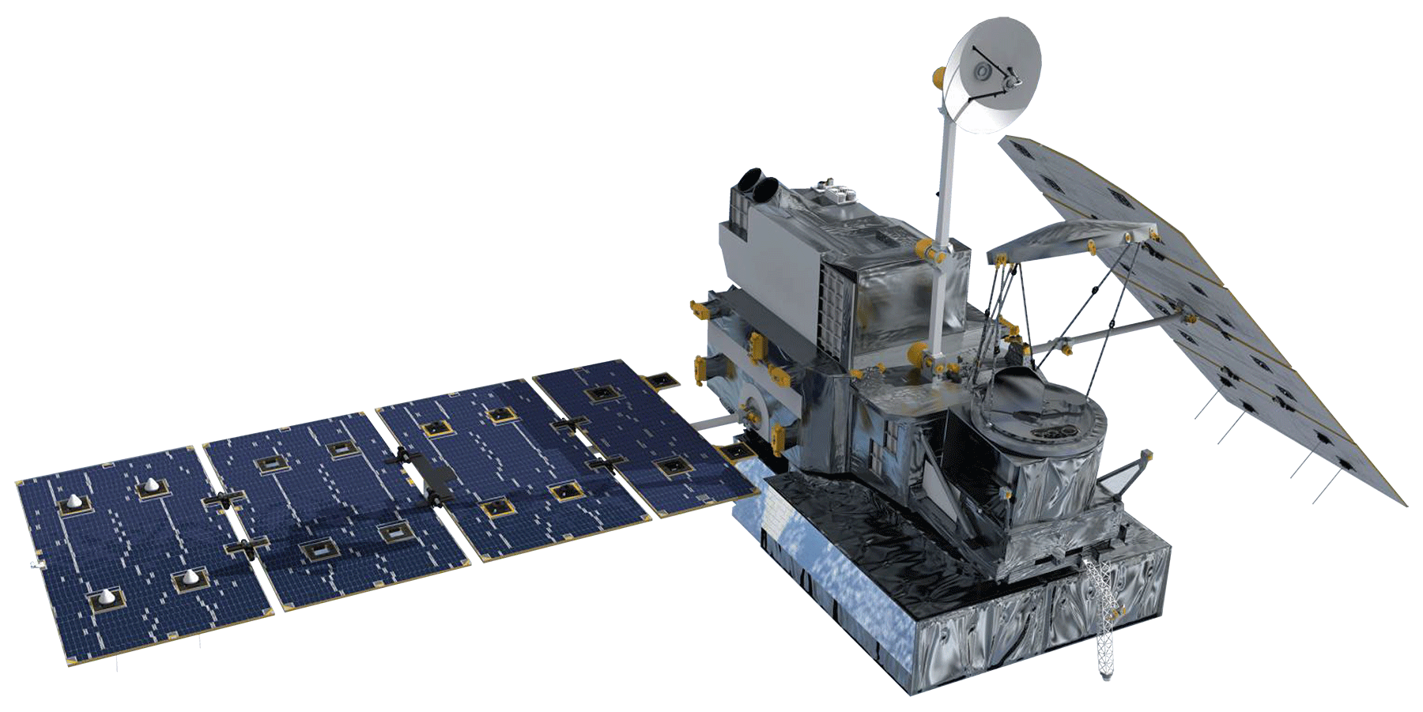
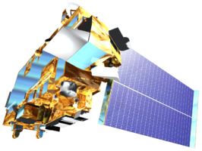
Earth Observations and Parameters
Precipitation
Precipitation
LST, NDVI
Tropical Rainfall Measuring Mission – Precipitation Radar
(TRMM-PR)
January 2000 - March 2016
Terra
MODerate Resolution Imaging Spectroradiometer
(MODIS)
March 2000-March 2016
Global Precipitation Measurement – Dual-frequency Precipitation Radar (GPM- DPR)
April 2015 - Present
Notes:
Precipitation data was acquired for the two drought indices, as well as the near-real time drought monitoring tool. Monthly precipitation data was acquired from the Tropical Rainfall Measuring Mission- Precipitation Radar satellite and sensors from January 2000-present. This was used to calculate the Standardized Precipitation Index, or SPI, and the Scaled Drought Condition Index, or SDCI. Monthly precipitation data is utilized from the Global Precipitation Measurement - Dual-frequency precipitation Radar (GPM-DPR) satellites for the near-real time drought monitoring tool.

Slide 6
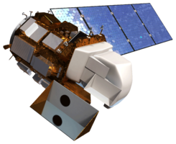
Earth Observations and Parameters
Digital Elevation Models
Surface Reflectance
Shuttle Radar Topography Mission
(SRTM)
February 2000
Landsat 8
Operational Land Imager (OLI)
April 2013
Photo credit: European Space Agency
Notes:
Digital elevation models were retrieved from SRTM v-2 C-Band. The most updated data land use was produced using data from eMODIS and Landsat 8. Finally, soil data was acquired through HWSD and the Soil Digital Map by the Center for Agronomic Research (CIA) at University of Costa Rica.

Slide 7
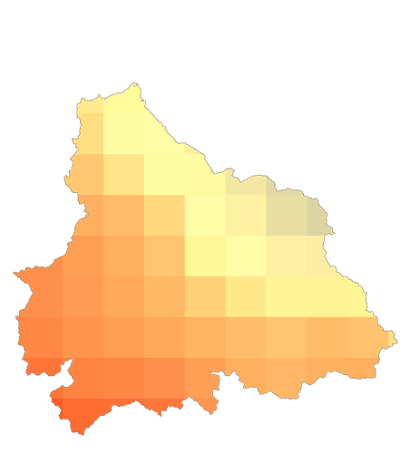
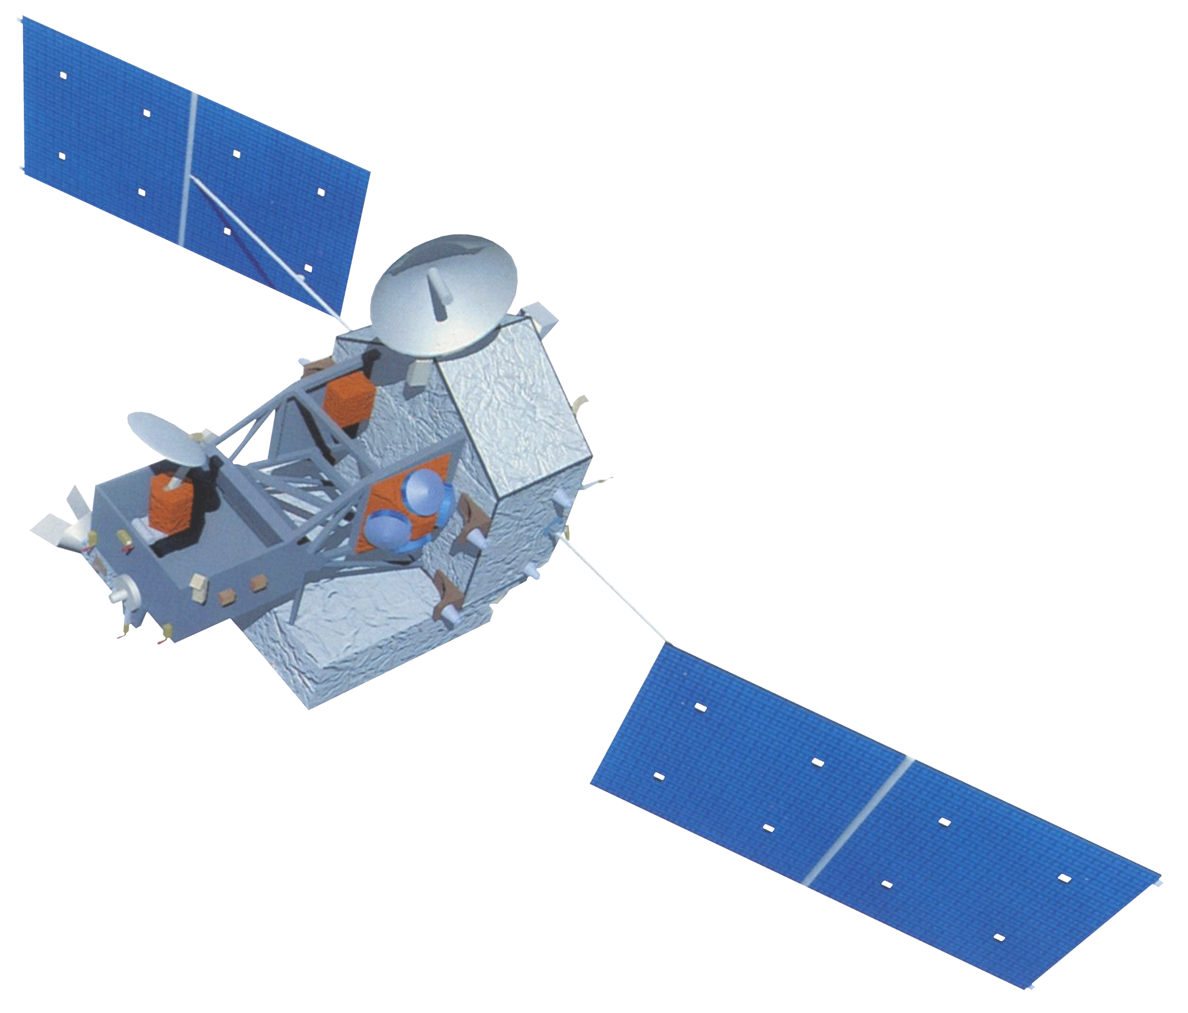
Standardized Precipitation Index (SPI)
Meteorological Drought Time Series
SPI Value | Interpretation
≥ 2.0 | extreme wet condition
1.5 to 1.99 | severe wet condition
1.0 to 1.49 | moderate wet condition
0.5 to 0.99 | mild wet condition
-0.49 to 0.49 | optimum rainfall
-0.5 to -0.99 | mild drought condition
-1.0 to -1.49 | moderate drought condition
-1.5 to -1.99 | severe drought condition
≤ -2.0 | extreme drought condition
TRMM – PR
Monthly precipitation (mm)
0.25°-Spatial Resolution
3B43 Level 3 product
SPI
1-month temporal resolution
Python Script
MATLAB Script
Monthly Precipitation
Resampled to
0.1°-spatial resolution
3
0
-3
Notes:
SPI was calculated to show the conditions of Meteorological Drought in a specific place at a specific time. The TRMM-PR provided monthly precipitation data. The data was processed in MATLAB by fitting it to a Gamma function to convert precipitation measurements to a probability of rainfall in a specific time and area. These probabilities were then standardized, producing the SPI value. The values, which represent a z-score, were ranked according to rainfall conditions, as shown by the table. **MAKE TABLE APPEAR** Drought conditions begin when SPI is less than or equal to -0.5.

Slide 8
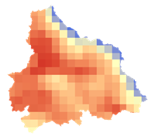
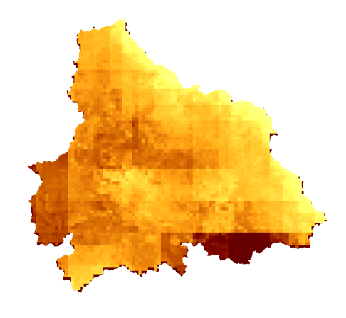
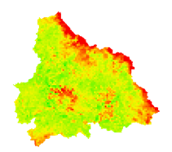
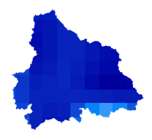
Scaled Drought Condition Index (SDCI)
Agricultural Drought Time Series
SDCI
1-month temporal resolution
Terra MODIS Monthly average LST, NDVI
0.1° & 0.05°-Spatial Resolution
Level 3 Product
LST
1
$\frac{{LST}_{max}−LST}{{LST}_{max}−{LST}_{min}}$
0
NDVI
$$\frac{NDVI−{NDVI}_{min}}{{NDVI}_{max}−{NDVI}_{min}}$$
TRMM-PR
Monthly precipitation (mm)
0.25°-Spatial Resolution
3B42 Level 3 product
Precipitation
$$\frac{X−X_{min}}{X_{max}−X_{min}}$$
SDCI = (0.25 *Scaled LST) + (0.25* Scaled NDVI)
+ (0.5 * Scaled Precip)
Notes:
The Scaled Drought Condition Index uses monthly averages from Terra MODIS for land surface temperature and normalized difference vegetation index, and monthly precipitation from TRMM-PR to assess drought conditions. These variables were each scaled from 0 to 1 from their minimum and maximum values, then weighted using regression analysis and added together to produce a scaled index from 0 to 1, with 0 indicating the driest conditions. Drought conditions begin when SDCI <= 0.5.

Slide 9
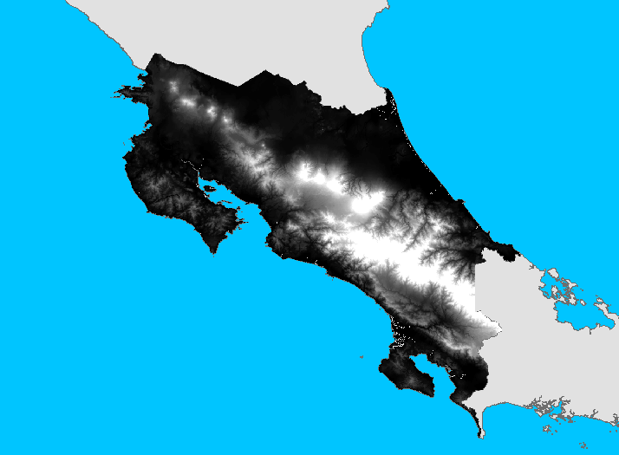
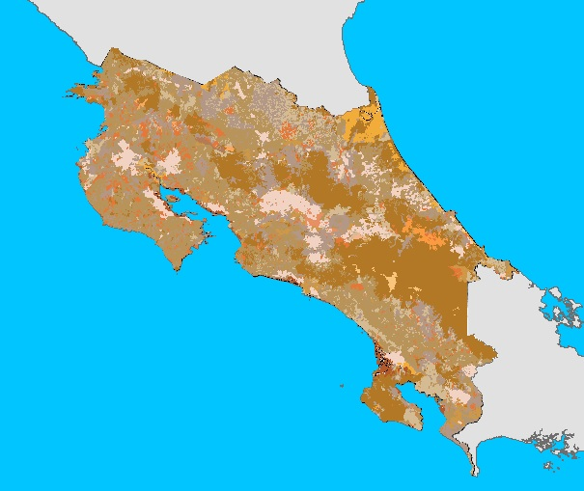
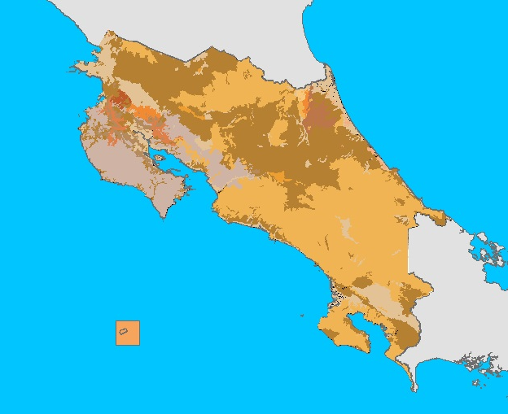
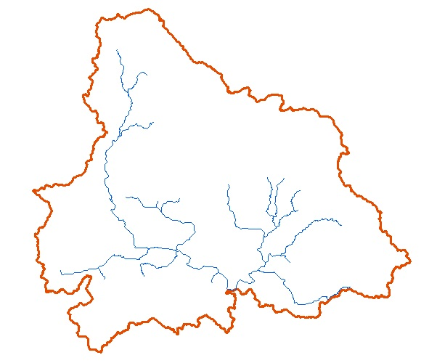
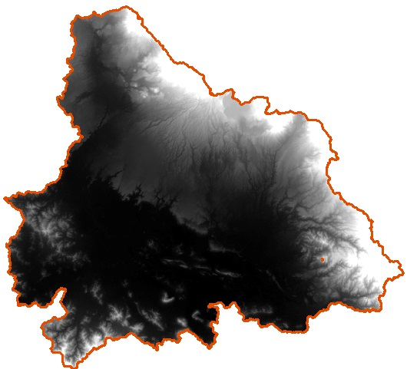
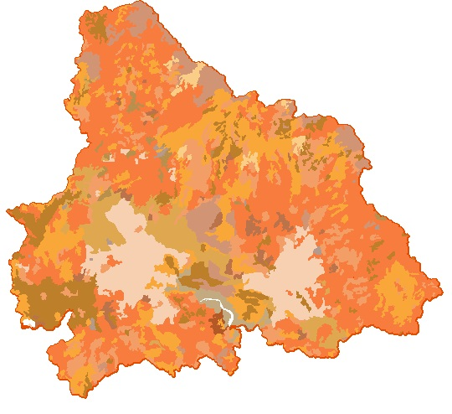
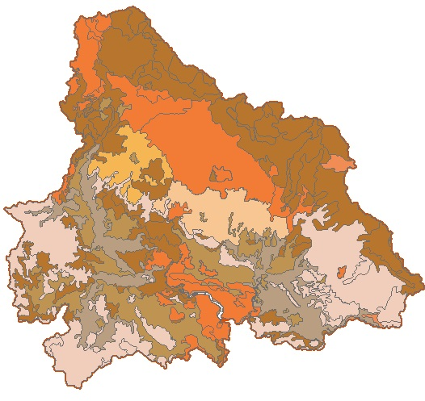
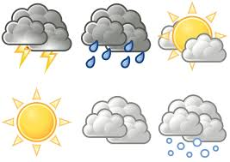
ArcSWAT Inputs
Watershed Delineation
DEM
Land Cover
Soil
Reclassification
Run SWAT Model
DEM
Land Cover
Soil
Weather
Notes:
The DEM used in the ArcSWAT model is from the SRTM, which was used to calculate the flow accumulation and direction in the ArcSWAT watershed delineation. This process resulted in 34 sub-basins, within which the model also calculated the slope, maximum and minimum elevation, and other variables. The soil information was obtained from the Harmonized World DataBase. In the Arenal-Tempisque basin there were 12 different soils classified by texture and hydrologic characteristics. Soil classification was vital in hydrologic modeling because the soil has capacity of increasing the amount of superficial flows or the rate of infiltration.
The meteorological information was obtained from the Meteorological National Institute and provided 14 different stations with daily information. The data provided by the weather was inconsistent by type and temporally, but provided enough knowledge to run the ArcSWAT model to understand the basic hydrological characteristics of the watershed.
Weather Image Source: Clip Art Best, http://www.clipartbest.com/free-printable-weather-symbols

Slide 10
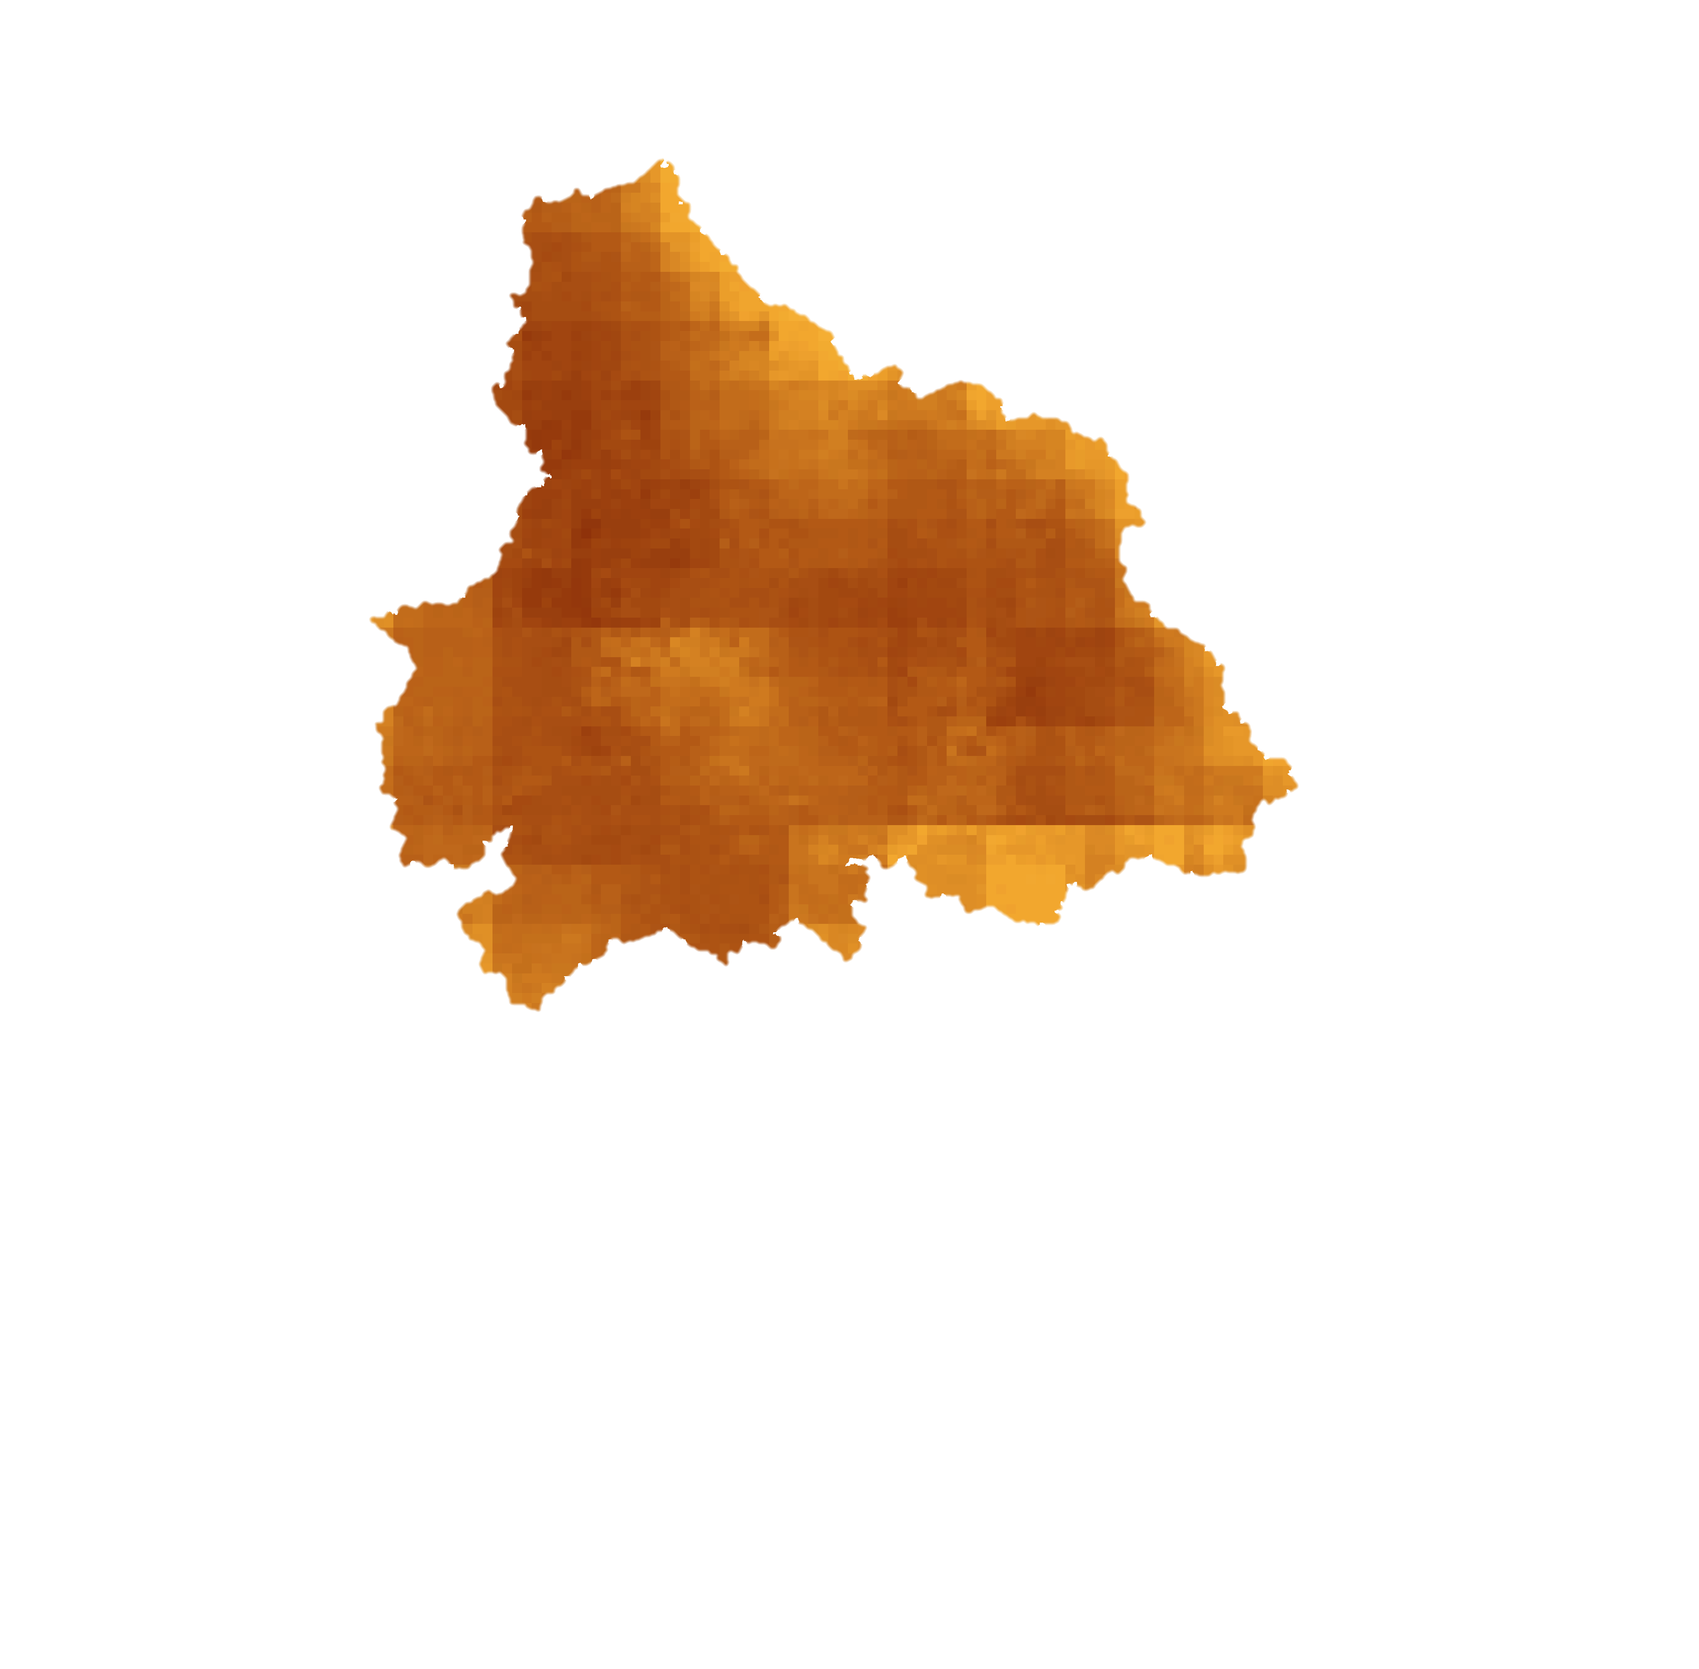
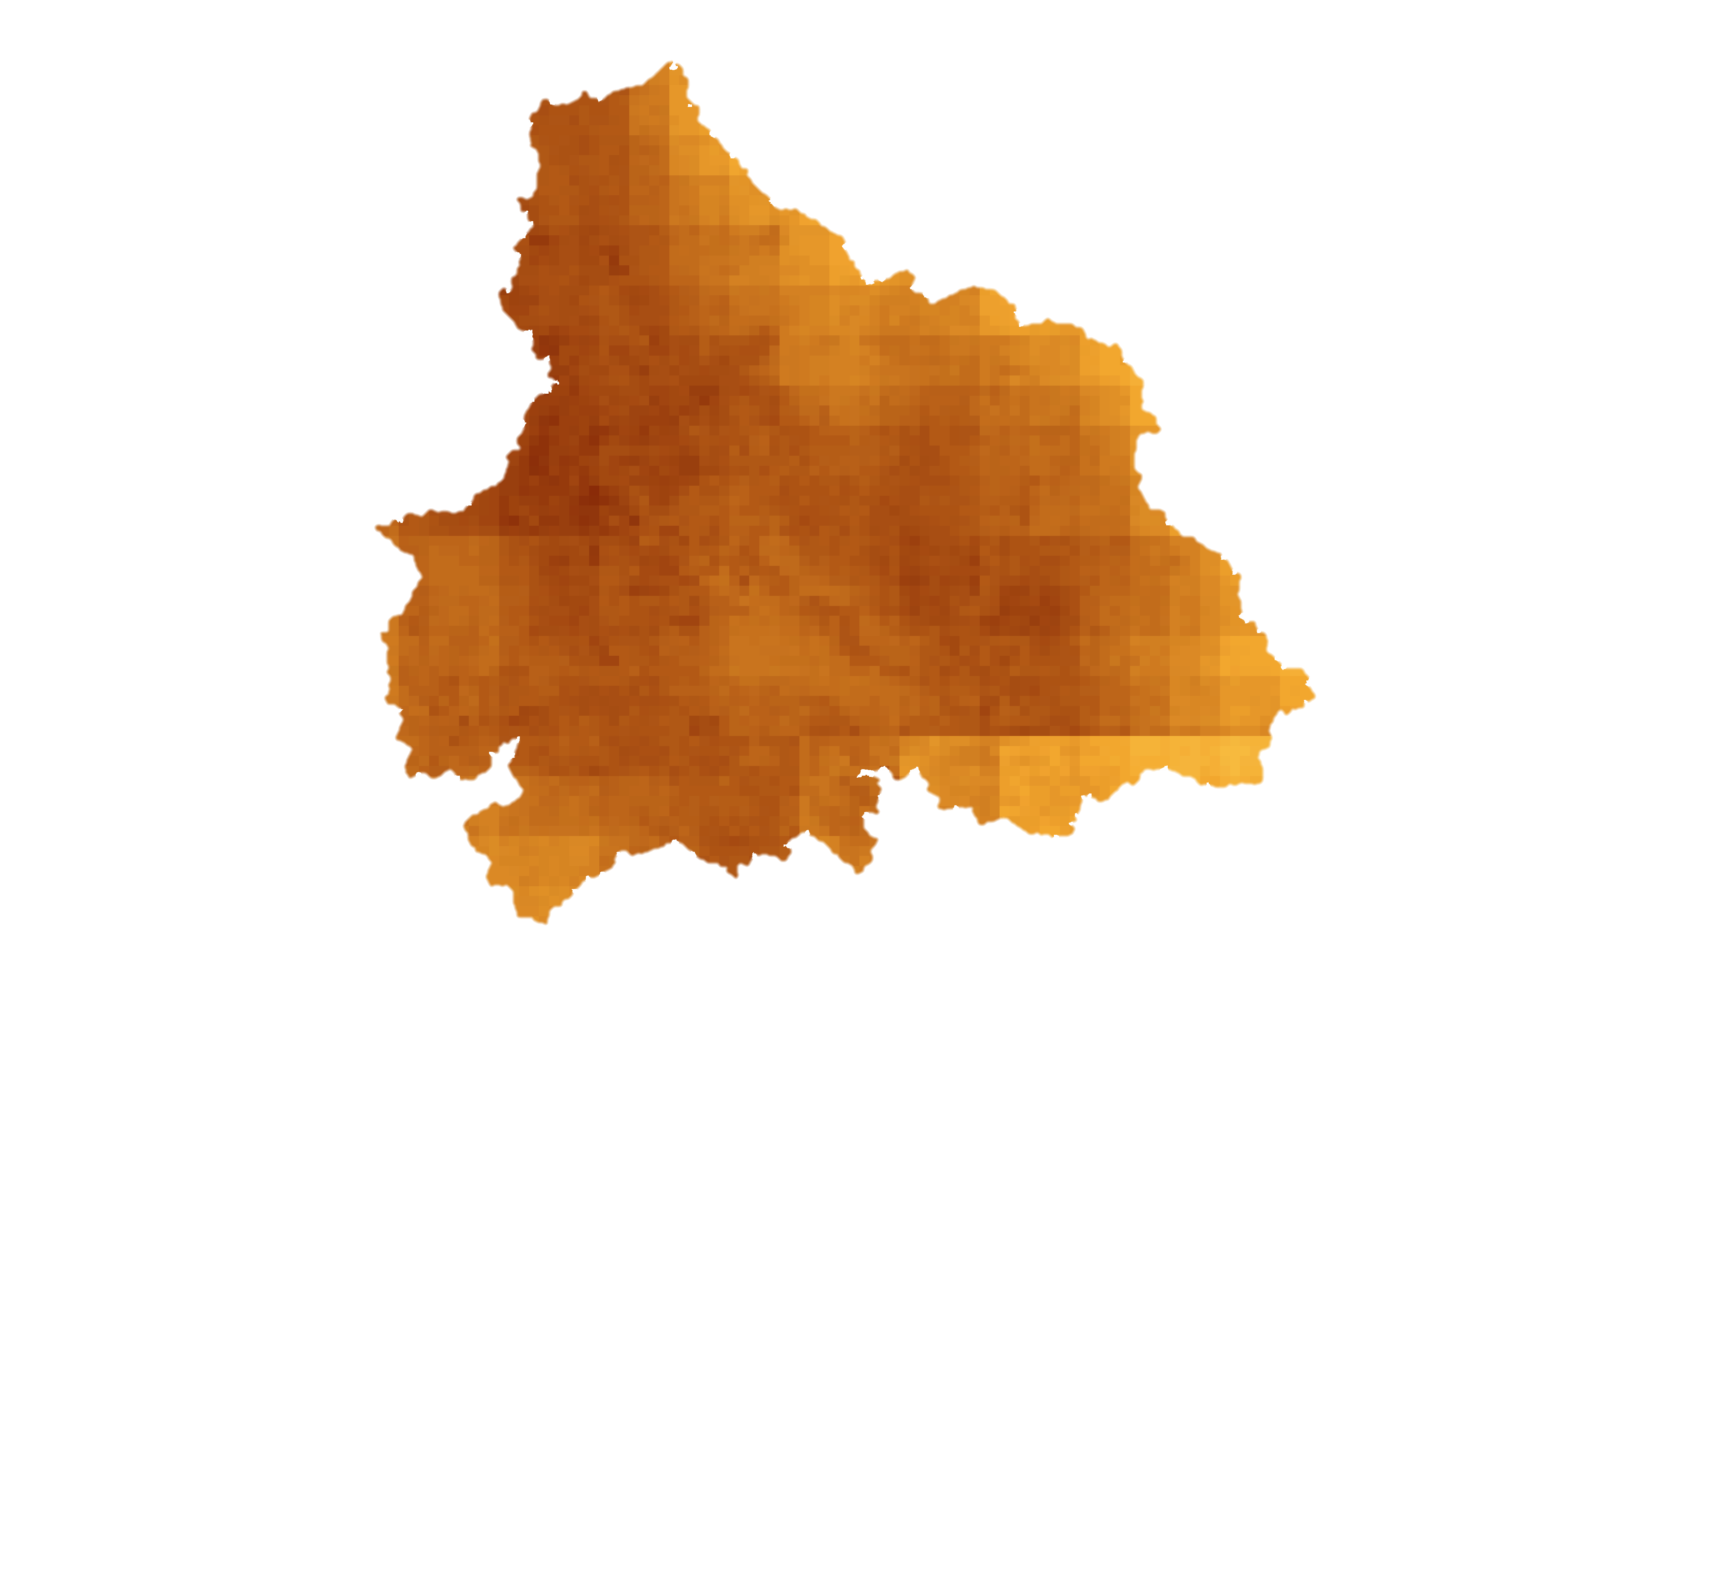
Near-Real Time Monitoring Tool
SDCI Rasters
1-month temporal resolution
Terra MODIS Monthly average LST, NDVI
0.1° & 0.05°-Spatial Resolution
Level 3 Product
Python
Script
GPM IMERG Daily Precipitation
0.1° -Spatial Resolution
Level 3 Product
Daily → Monthly
Notes:
When complete, the near-time monitoring tool will download MODIS and GPM data directly from NASA’s Earth Observations, process these components, and produce monthly SDCI values for the study area. This is a key end product for our partners, as it will provide them with information long after this project is complete.

Slide 11
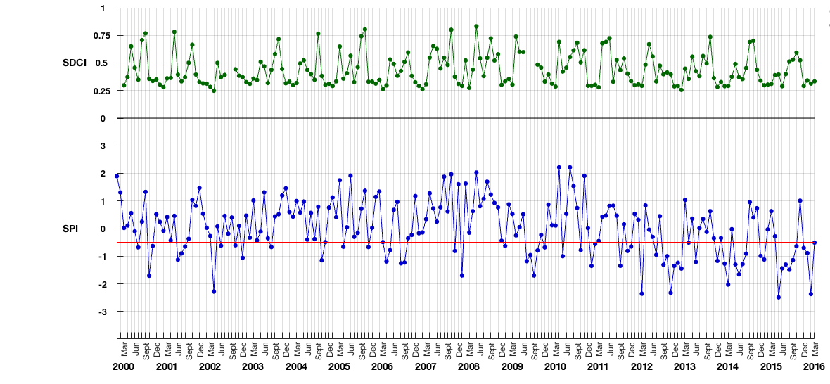
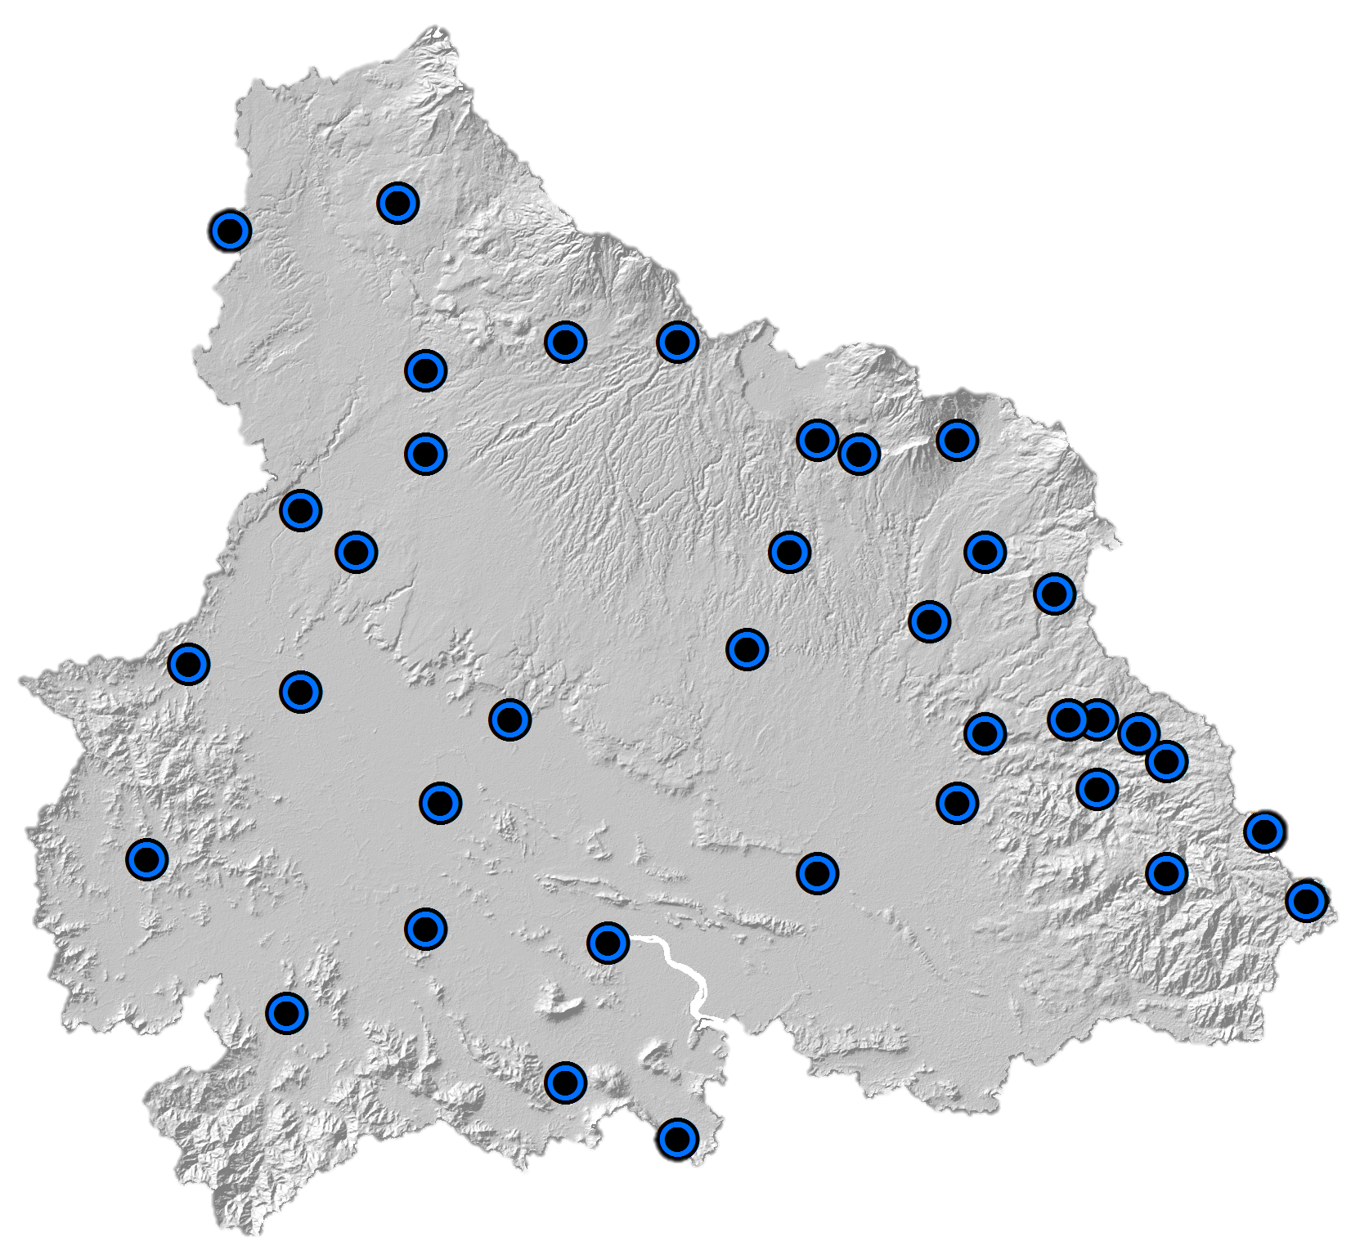
Results and Discussion
Monthly Drought Indices for Estación de Pelon de La Bajura Guanacaste Province: January 2000 - March 2016
Drought condition begins when SDCI ≤ 0.5
Drought condition begins when SPI ≤ -0.5
Notes:
The two indices used to monitor drought were analyzed spatially and temporally. A time series plot was created for the indices for the duration of the study period at any of the weather stations in the study area. From the time series plot for the Pelon de la Bajura Station, located in the central area of the Arenal-Tempisque watershed, it is possible to recognize the drought conditions that characterized the area during throughout the past 4 years. A drought anomaly can be observed during the month of December 2015.

Slide 12
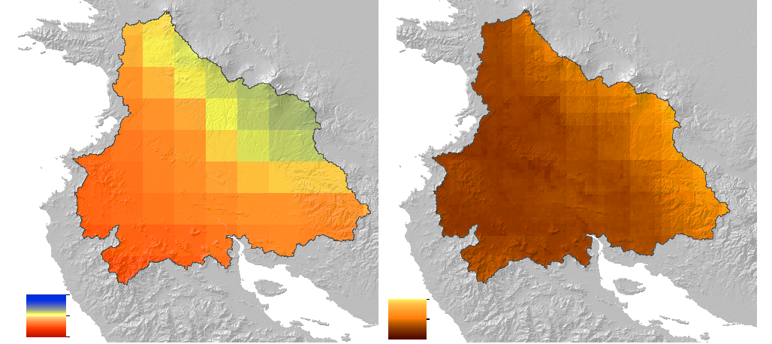
Results and Discussion
Drought Anomaly in December 2015
Drought condition begins when SDCI ≤ 0.5
Drought condition begins when SPI ≤ -0.5
SPI
SDCI
3
1
-3
0
Notes:
The index maps at this time substantiate these conditions throughout the study area. The maps show one of the drought anomalies that took place more recently, in December 2015.

Slide 13
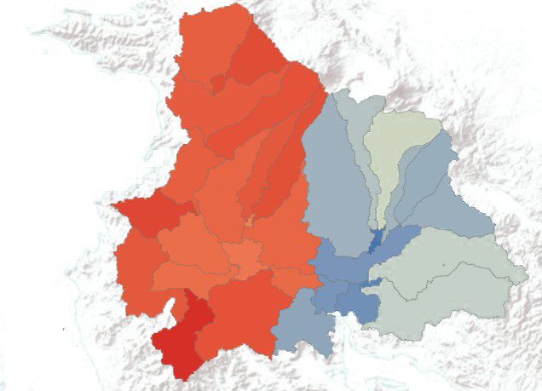
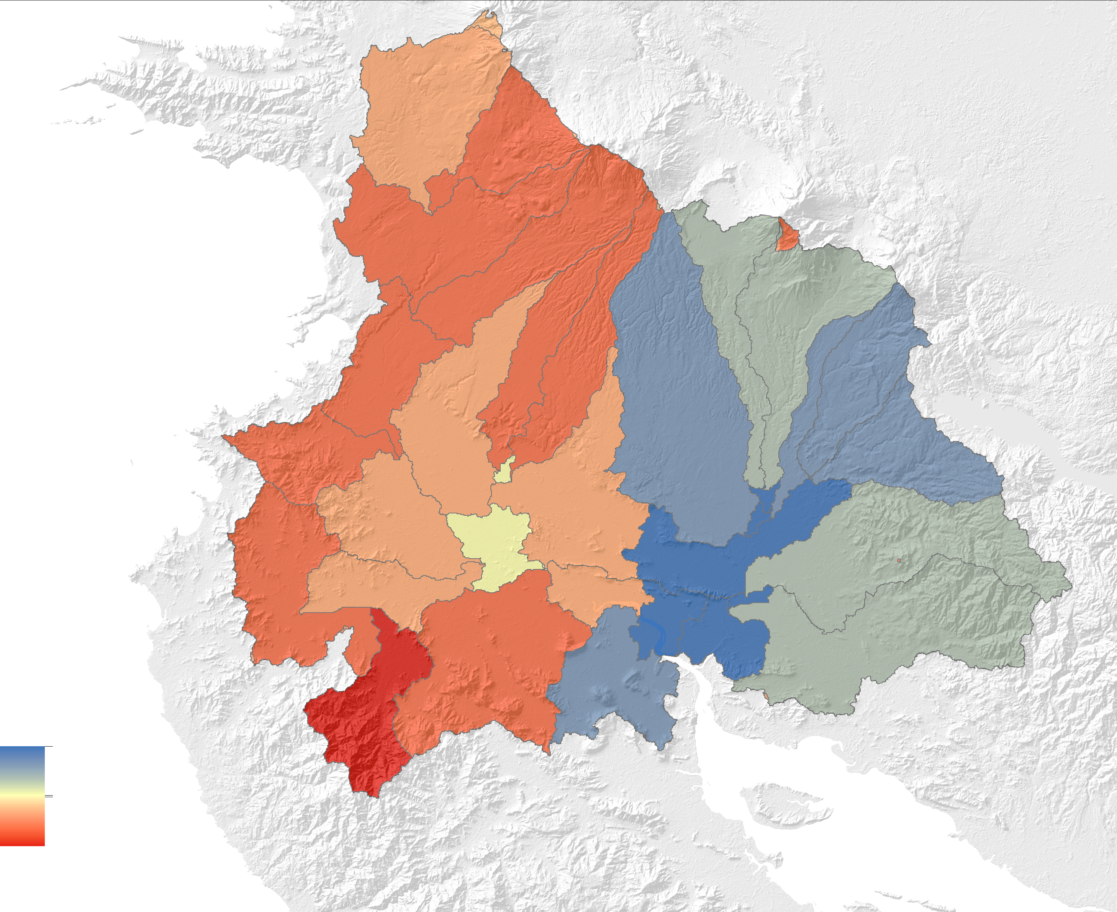
ArcSWAT Results and Discussion
Land Cover
Supervised Classification
Superficial Flow
Identified by the SWAT model
Evapotranspiration Rates
Identified by the SWAT model
High
High
Low
Low
Notes:
The AecSWAT analysis provided a series of averaged outputs per year for the whole watershed and monthly results for each hydrological response unit and subbasin. The maps show the averaged, modeled superficial streamflow and evapotranspiration rates for the whole watershed for the year 2013. In conjunction with the analysis of other factors, both results have a great potential to understand the effect of land use, crop management and orography in the development of drought. Although they were not calibrated, the results suggest that drought had a higher impact in the west part of the watershed. This corresponds with both the drought analyses indices and the record of precipitation for the area, prompting further research in this direction.

Slide 14
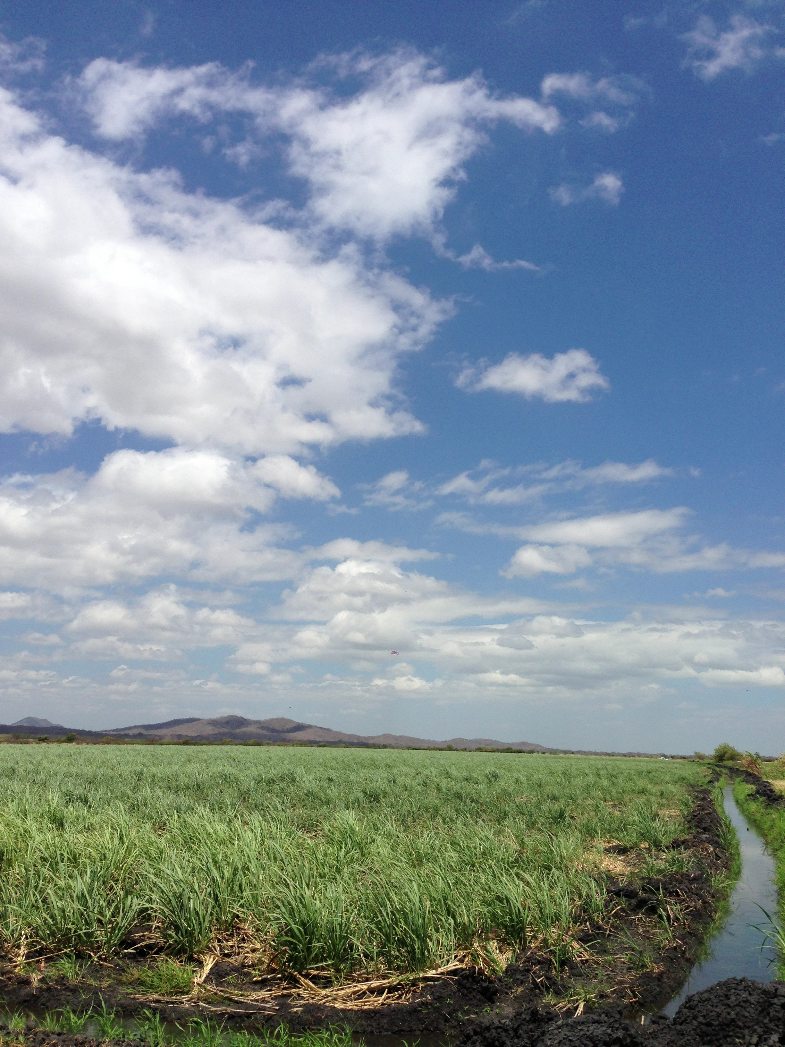
Limitations
Lack of in situ, streamflow measurements
SWAT results are not calibrated
Only fourteen years of meteorological information measured in the study area
Weather station data inconsistent both by type and temporally
Image Credit: Javier Artinano, SENARA
Notes:
Our main limitations included the lack of streamflow in situ data in order to calibrate the outputs of the SWAT model. We had only 14 years of meteorological information as input to the model, with the factors restricted to precipitation and rainfall. in most cases, relative humidity, wind and solar radiation were missing.

Slide 15
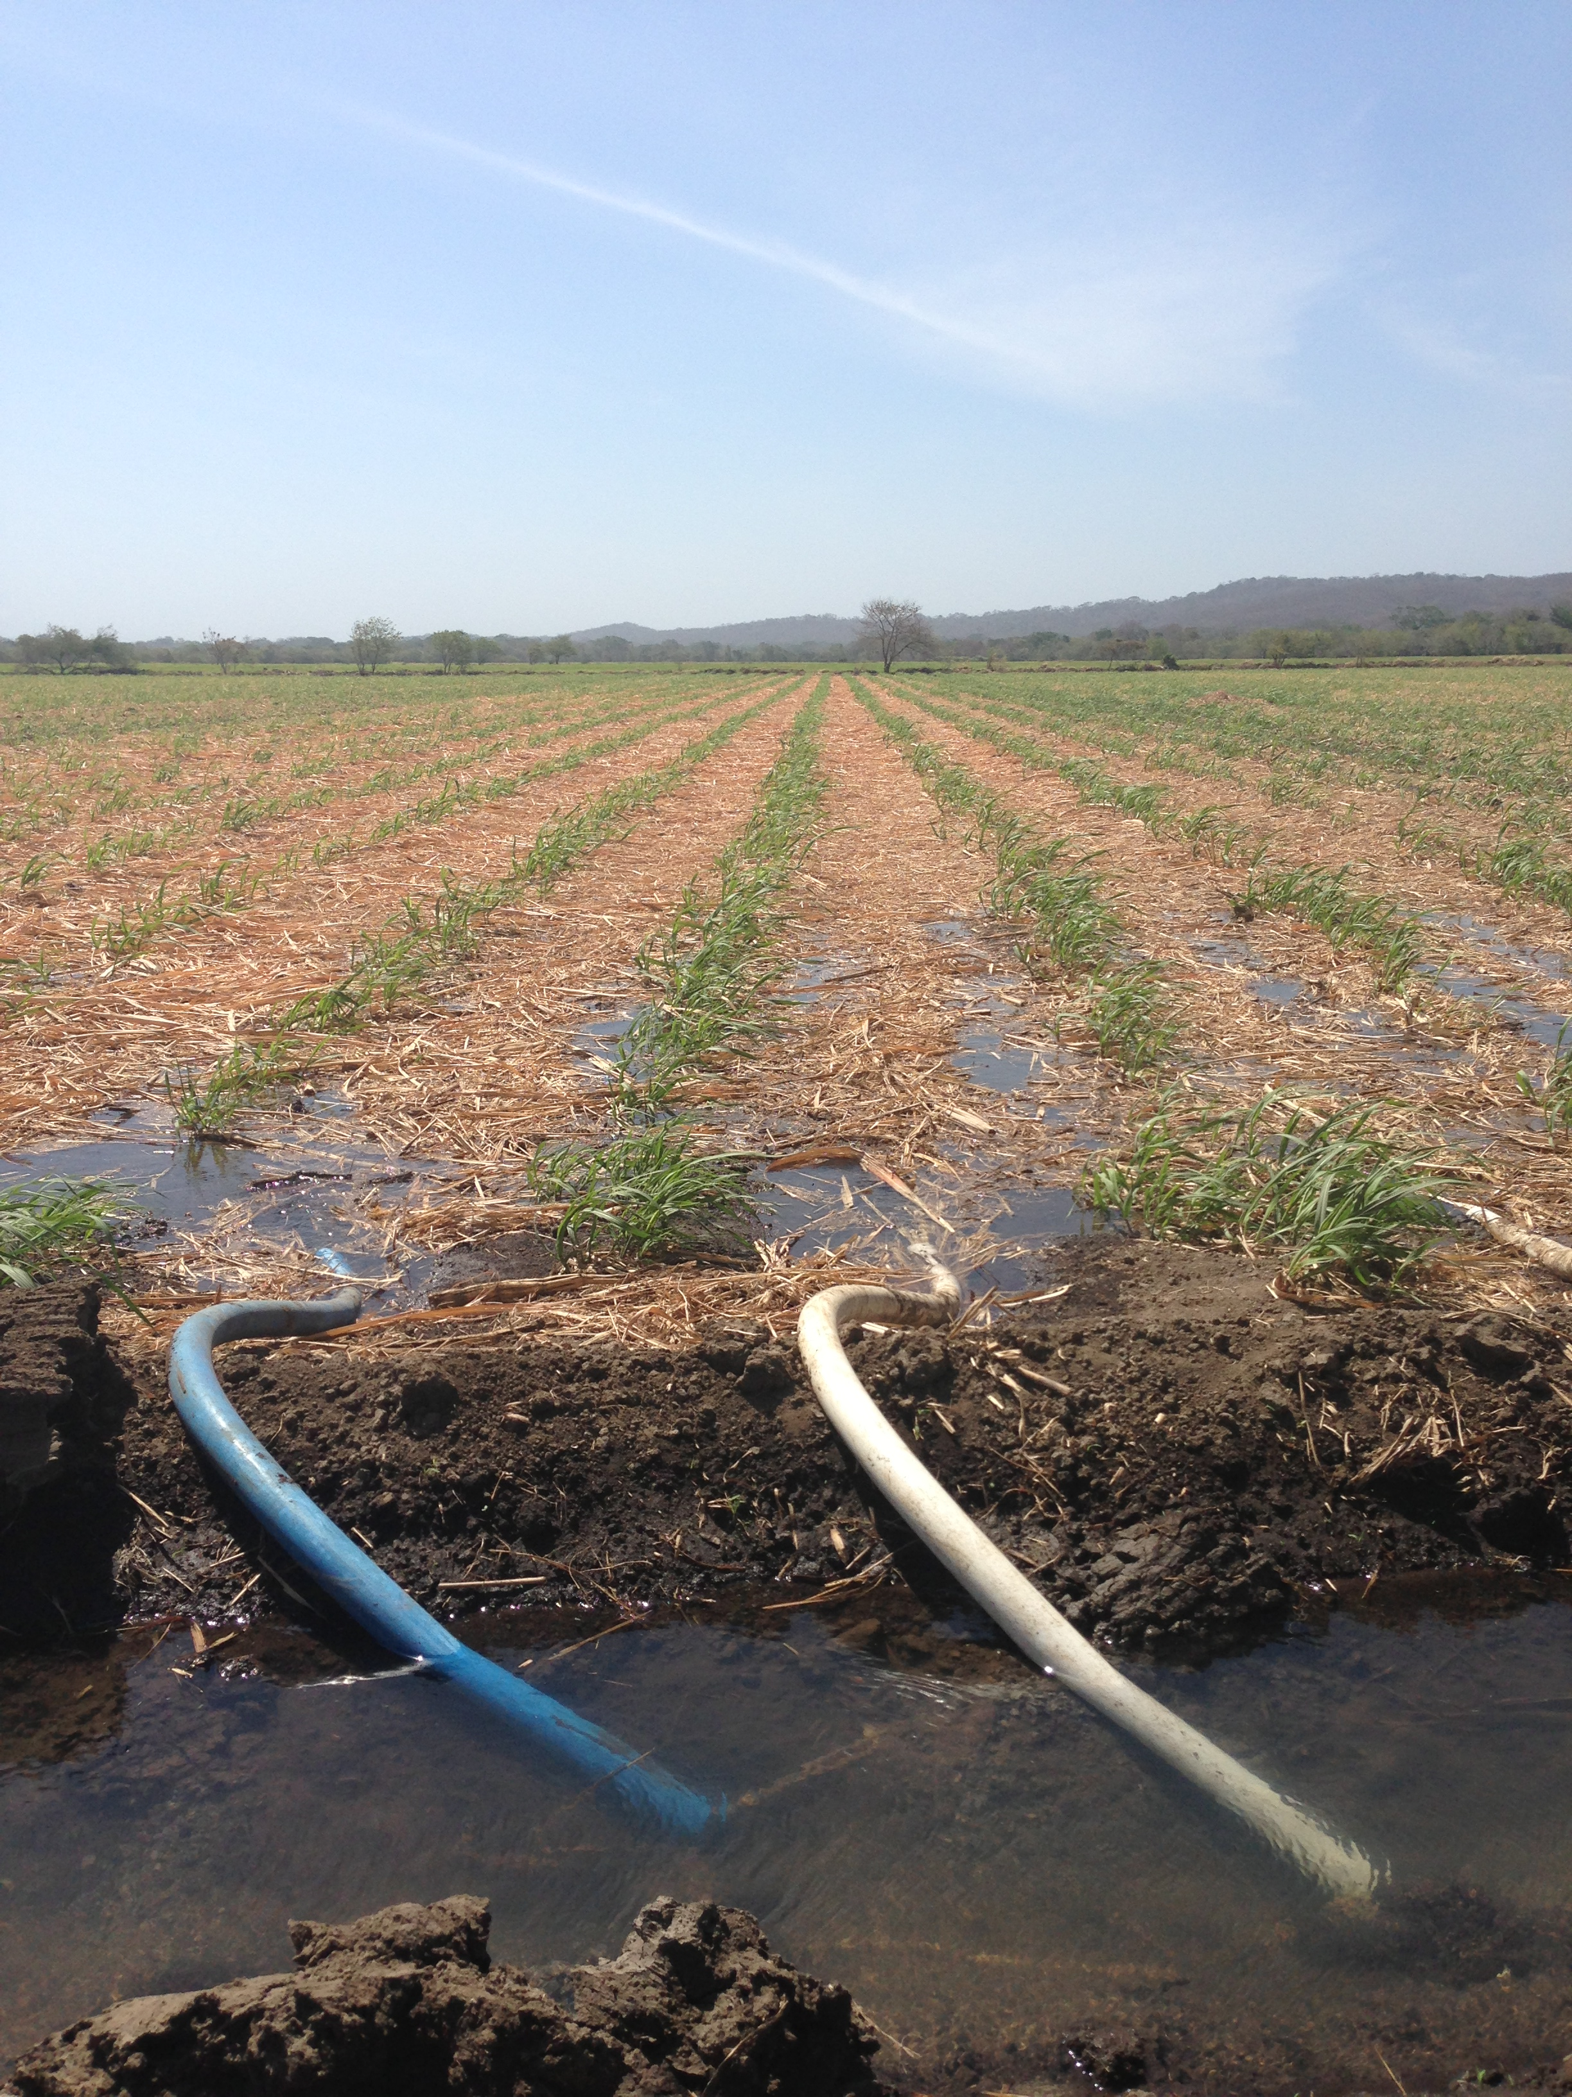
Outcome and Benefits
Data for monthly SDCI and SPI values for 38 weather stations in the Arenal-Tempisque watershed
Updated Land Cover data for future use
SWAT manual for partners for watershed modeling
Working script for near-real SDCI monitoring tool
Better decision-support tools to enhance mitigation of the negative impacts caused by drought
Image Credit: Javier Artinano, SENARA
Notes:
The project contributed to a better understanding of the development of drought through time. This project also addressed NASA’s national water resources application area by contributing to the valuation of water balance metrics in the Arenal-Tempisque watershed. Monitoring the historical development of the drought achieved a better understanding of the drought’s drivers. The end-products for our partners included a foundational script for a near-real time monitoring tool, which will allow them to better assess drought. This tool will be completed by the next team in the upcoming term. Finally, a short manual describing the input, processing and analysis of data to run the SWAT model will be provided to the partners, so they can replicate it in the future.

Slide 16
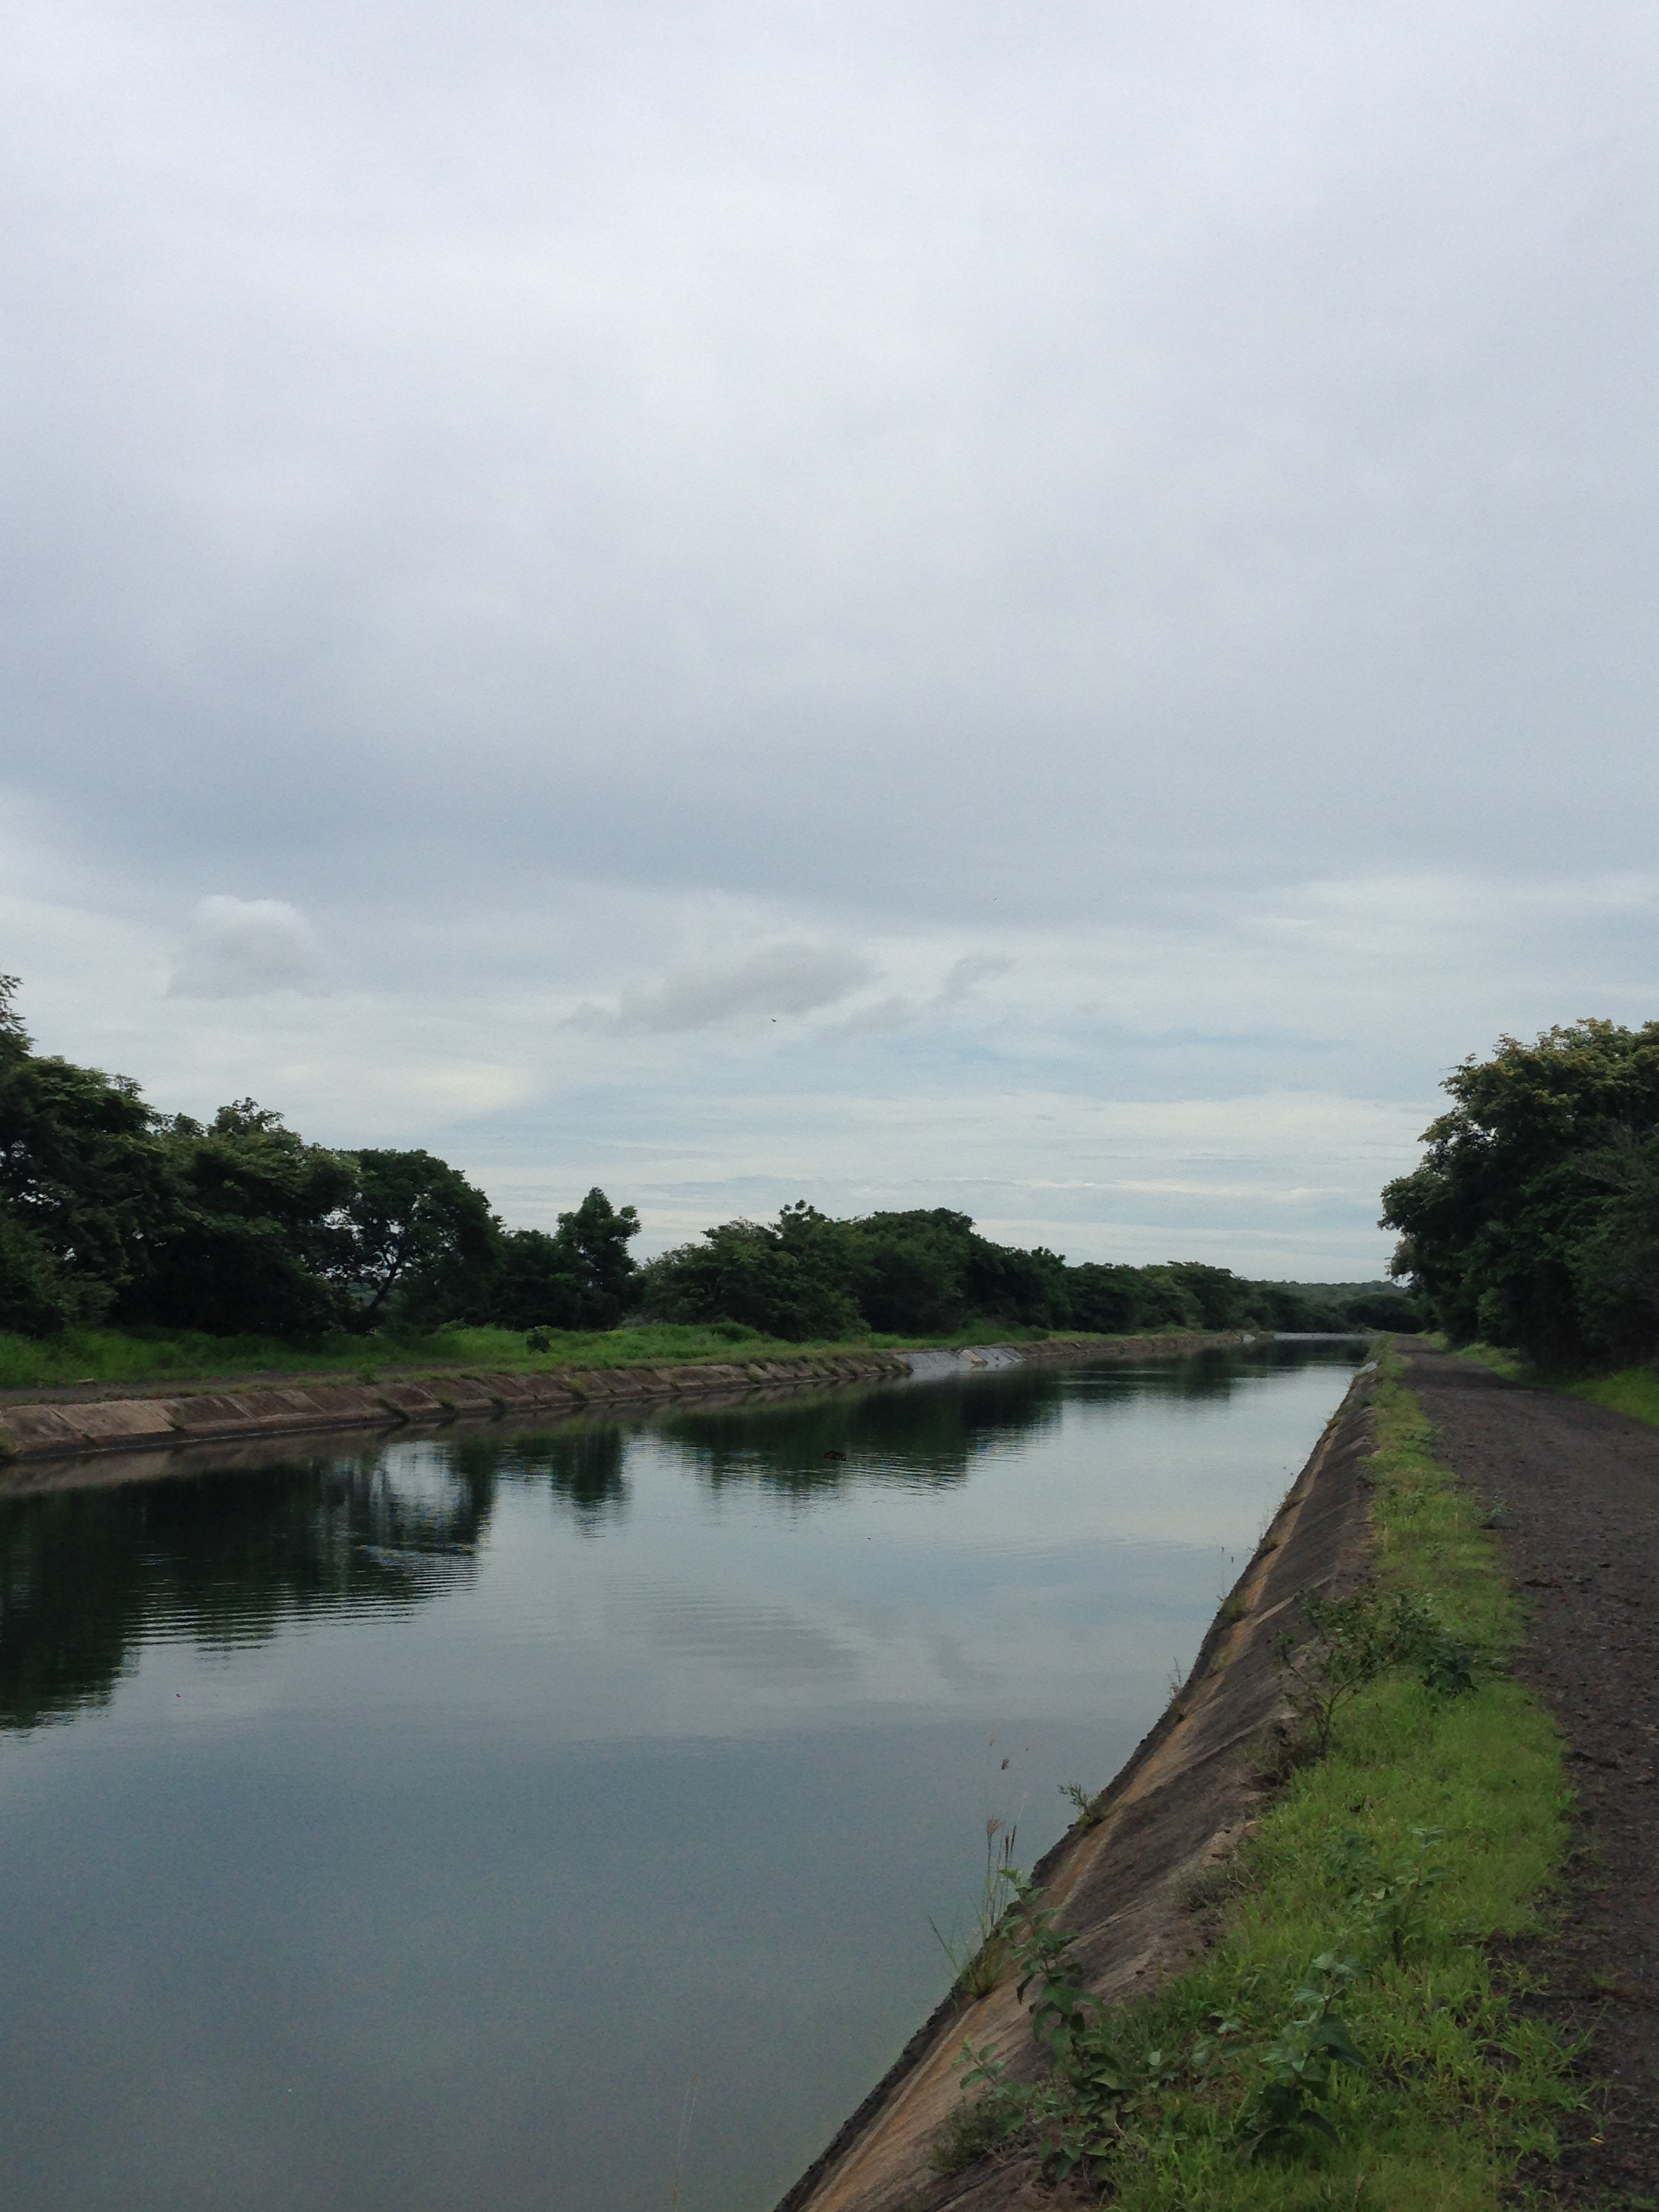
Future Research
Use streamflow in situ data to run SWAT-CUP and calibrate SWAT results
Complete SDCI near-real time monitoring tool for future use by partners
Additional drought indices can be used to produce more detailed spatial and temporal analyses
ArcSWAT outputs can be further studied to understand hydrology of the area
Image Credit: Javier Artinano, SENARA
Notes:
This project will be continued in the future by obtaining in situ data that allows us to calibrate the SWAT model. The python script for the SDCI near-real time monitoring tool will be completed to provide partners with a highly valuable end product to track drought using NASA Earth Observations. Additional spatial and temporal indices could be pursued to monitor drought in this area. ArcSWAT outputs can be further studied to understand hydrology of the area.

Slide 17
Project Partners:
Costa Rica Ministry of Energy and the Environment (MINAE)
Costa Rica’s National Service of Underground Water, Irrigation, and Drainage (SENARA)
Embassy of Costa Rica to the United States
University of Costa Rica (UCR)
Science Advisors & Mentors:
Dr. Marguerite Madden, University of Georgia Department of Geography, Director
Dr. Sergio Bernardes, University of Georgia Department of Geography, Associate Director
Dr. Adam Milewski, University of Georgia Department of Geology, Assistant Professor
Dr. Angelica Gutierrez, National Oceanic and Atmospheric Administration

