Slide 1
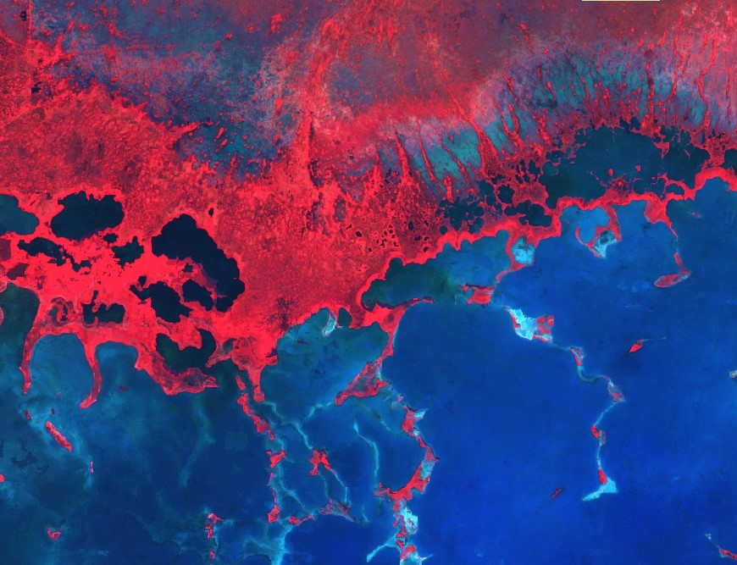
Everglades Ecological Forecasting
Improving the Capacity of Everglades National Park to Monitor Mangrove Extent Using NASA Earth Observations
Donnie Kirk (Project Lead)
Caitlin Toner
Emily Gotschalk
Rachel Cabosky
Brad Gregory
Candace Kendall
Notes:
[Introductions]
Hello, I’m _____________, and I’m _____________, etc
And with that I’d like to thank everyone for coming to our presentation. We are the Everglades Ecological Forecasting Team and our focus was to utilize NASA Earth Observations to monitor the mangrove extent in the Florida Everglades.

Slide 2
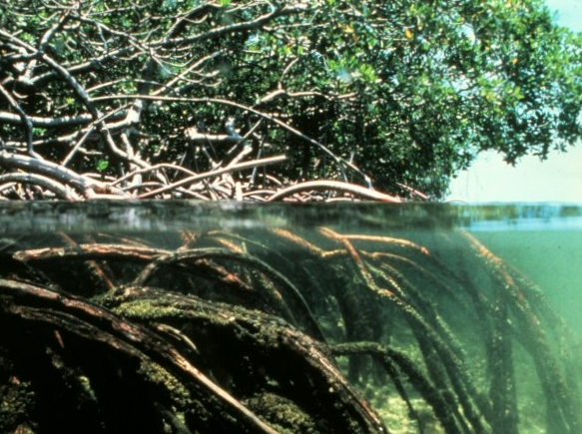
Components
Objectives
Community Concerns
Study Area and Period
NASA Satellites & Sensors
Methodology
Results
Conclusions
Errors & Uncertainties
Future Work
Image Source : Wikimedia
Notes:
Image source: https://upload.wikimedia.org/wikipedia/commons/f/f0/Mangroves.jpg
Credit:
Just to give you a quick outline of what we’d like to cover today,
We will discuss why we are interested in monitoring the Mangrove extent within the Everglades, and how this will help the National Park Service, as well as how we did this, and possible future work that this entails.

Slide 3
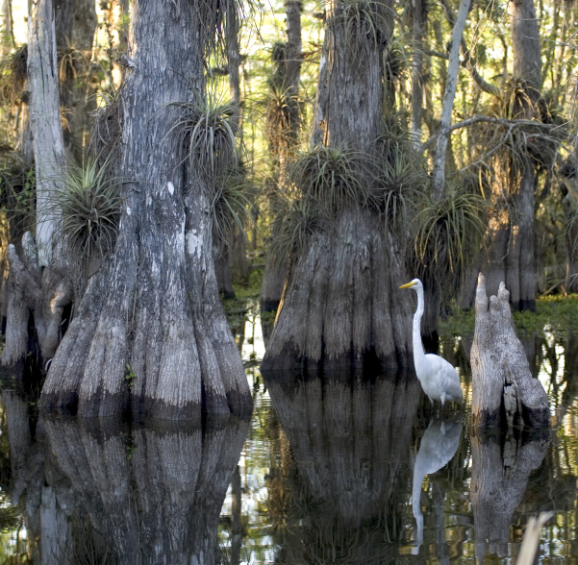
Community Concerns
Freshwater is important for the Everglades
Difficult to map and monitor mangrove extent
The National Park Service (NPS) does not have updated maps
Image Credit : National Park Service
Notes:
Image credit: https://en.wikipedia.org/wiki/Everglades_National_Park
Image source: National Park Service
The ecosystem of the Everglades is reliant on freshwater. Agricultural demand depleted much of the freshwater out of the park. The National Park Service re-routing the freshwater back into the park, and the way to monitoring how this will impact the health of the ecosystem is by monitoring the extent of mangroves. They mark the transition between salt and freshwater. The issue with this is that the park has no way of continuously monitoring the mangrove extent within the park, and are using outdated maps. Our task included providing them an updated map.

Slide 4
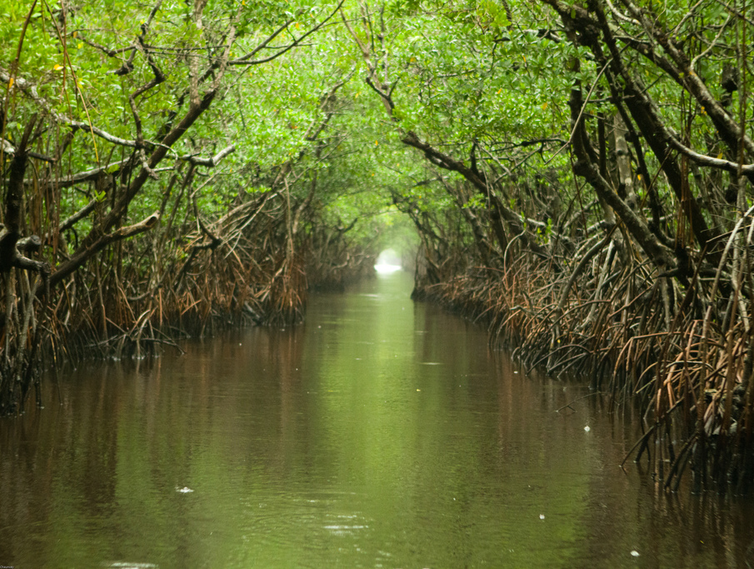
Objectives
Utilize NASA Earth observations and Google Earth Engine
Create a replicable methodology
Map the extent of change
Forecast future changes to the park
Image Source : Wikimedia
Notes:
Photo source: https://commons.wikimedia.org/wiki/File:Everglades_and_Turner_River.jpg
Image source: Chauncey Davis under a Creative Commons Attribution-NonCommercial 3.0 Unported License.
To do this we utilized NASA Earth Observations and Google Earth Engine to create a methodology that the NPS could replicate to monitor the mangrove extent, and potentially forecast this extent into a future year.

Slide 5
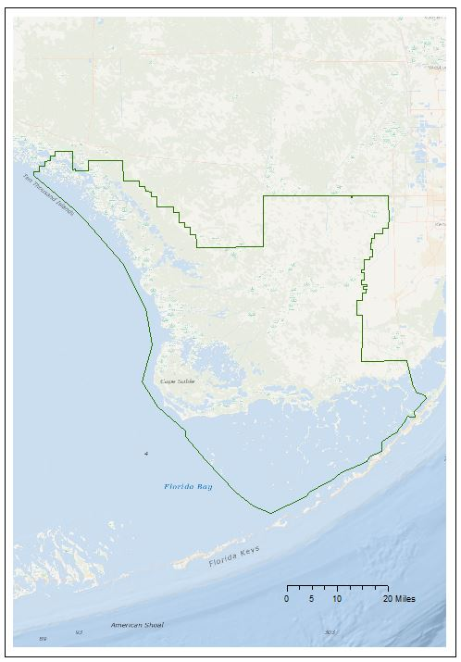
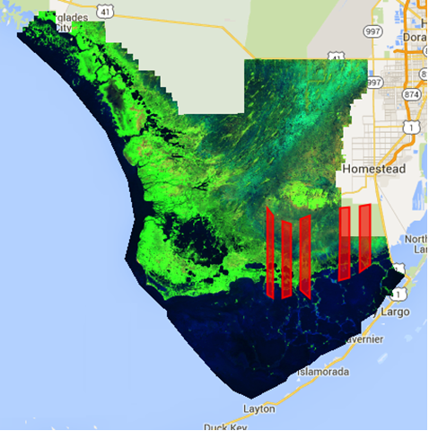
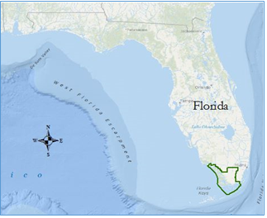
Study Area
Everglades National Park coastline
Stratified random sampling
Temporal analysis
Notes:
Our study area consisted of the Everglades National Park in southern Florida. We used stratified random sampling techniques to break up 10-15% of the coastline to analyze changes within these zones to analyze temporally the changes we saw.

Slide 6
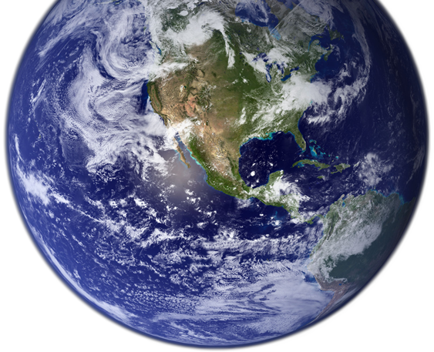
NASA Satellites and Sensors
Landsat 8
Landsat 5
Notes:
Image credit: https://commons.wikimedia.org/wiki/File:Earth_Western_Hemisphere_transparent_background.png
Landsat data was used for map compilation and analysis
It has higher resolution than MODIS data and covers a larger timeframe than sentinel
Landsat 5 was used for the classification of 1995 and 2005
And Landsat 8 was used for 2015

Slide 7
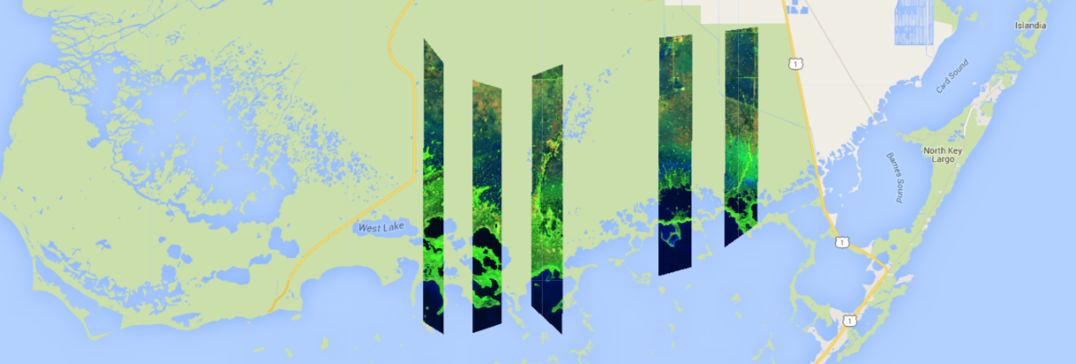
Methodology
This is a Landsat image clipped to the ecotone samples in a false color composite.
Data Collection
Random Sampling
Spatial Analysis
Notes:
We used this imagery to analyze marsh-mangrove transition zones on a decadal scale.
Using stratified random sampling, 5 ecotone boundaries were selected to scale our study area to 10-15% of the coastline.

Slide 8
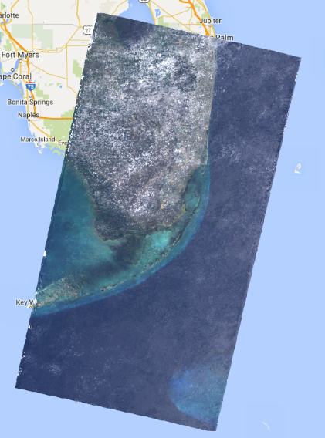
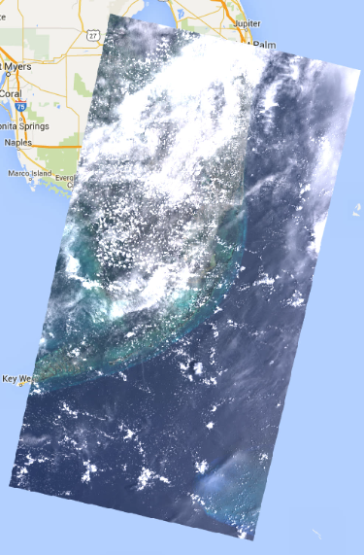
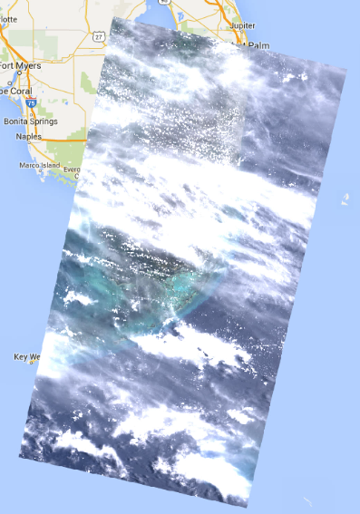
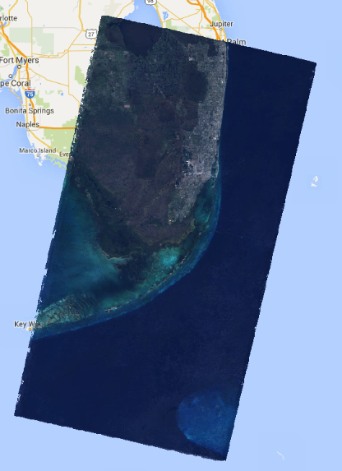
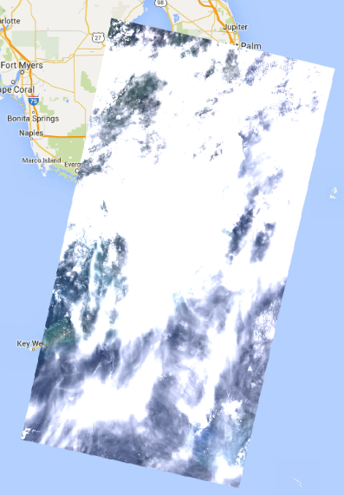
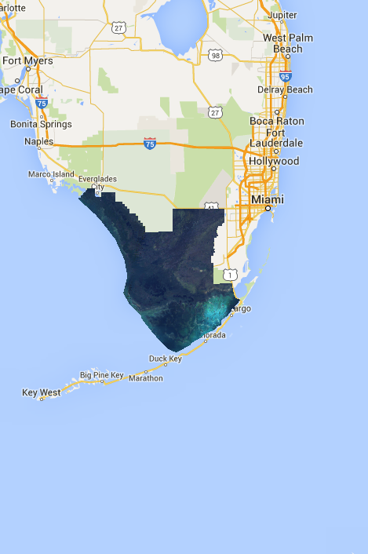
Methodology
Image Modification
Everglades 2015
Notes:
Subtropical zones like the Everglades often experience a large percentage of cloud cover, as you can see in our images from June, July, and August. To remove clouds from our images, we applied an F-mask algorithm that was built into the Landsat collections.

Slide 9
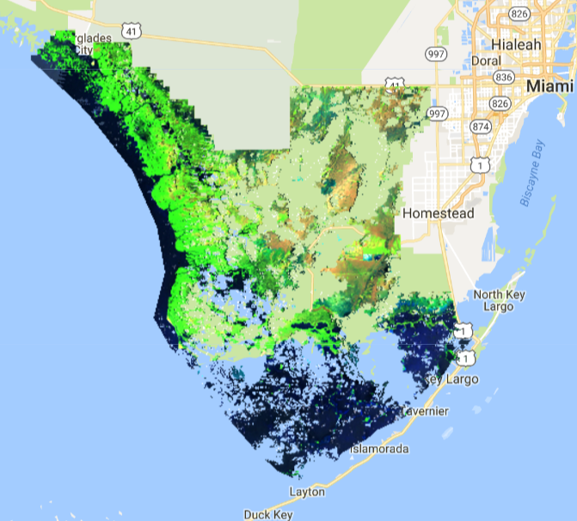
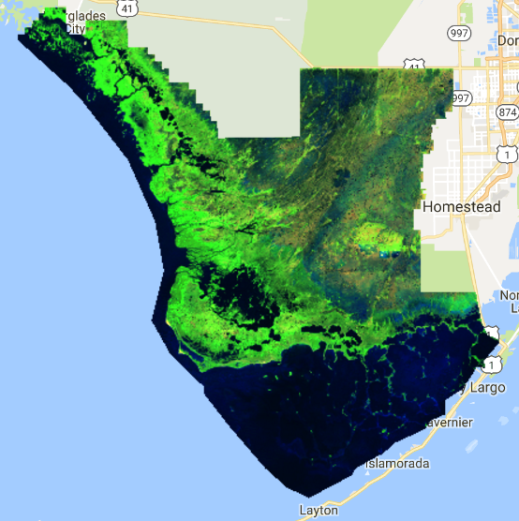
Methodology
Notes:
Fmask works by removing the image data where clouds are– essentially cutting them from the picture
However, this leaves “holes”
Aggregating the year’s data creates a complete, cloudless image.

Slide 10
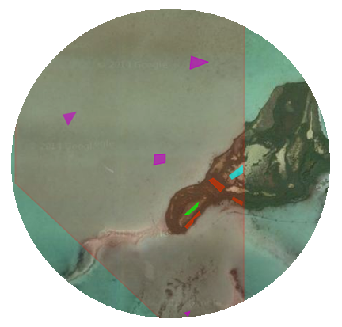
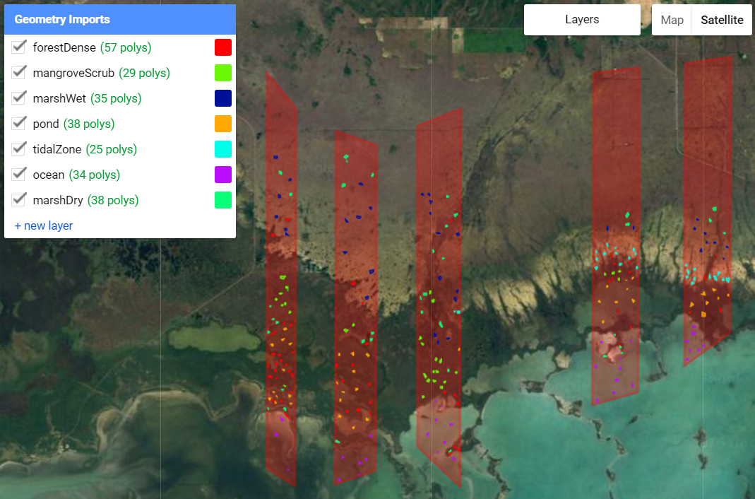
Methodology
Classification
Notes:
Classification For our classification, we have a total of 7 subcategories Water- ponds, tidal zones, ocean Land- Forest Dense, Forest Scrub, Marsh wet, and marsh dry We made our own training points

Slide 11
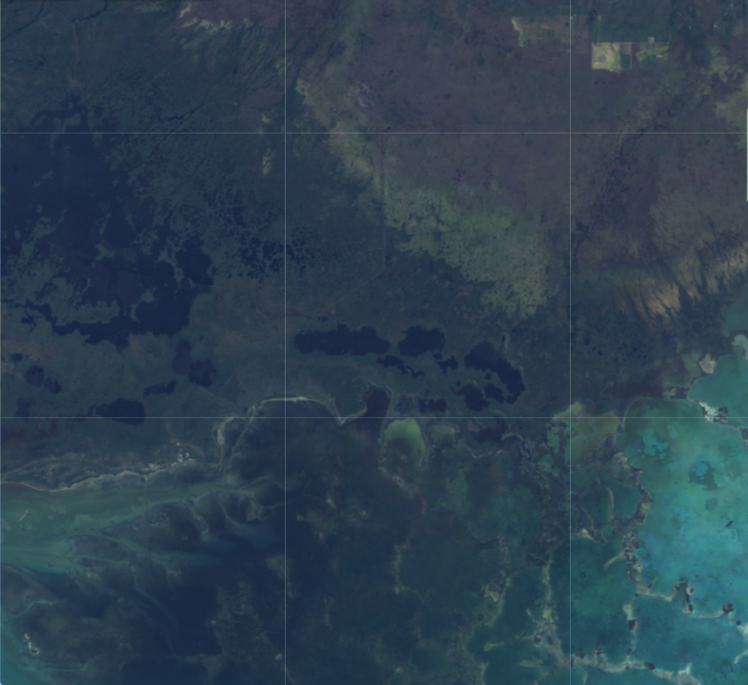
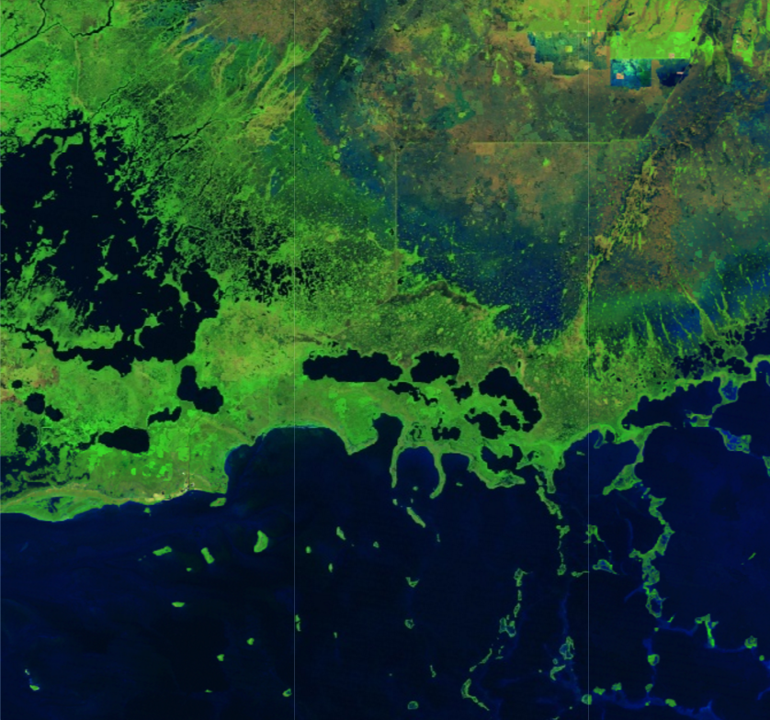
Methodology
Notes:
Looked at true color composite and false color composite. False color used bands used was short wave infrared, near infrared, and red to highlight vegetation in bright green.

Slide 12
Results
Classification of five ecotone samples
Notes:
The classification scheme that was developed within the sample region successfully categorized marsh forest and water, and was then extrapolated to the entire park.

Slide 13
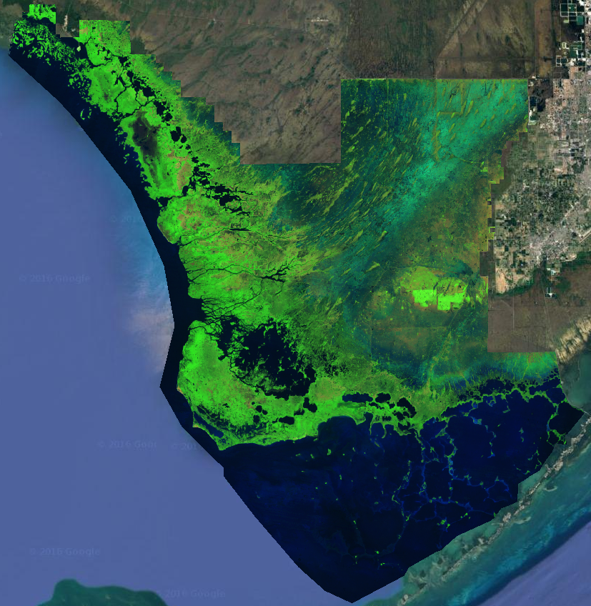
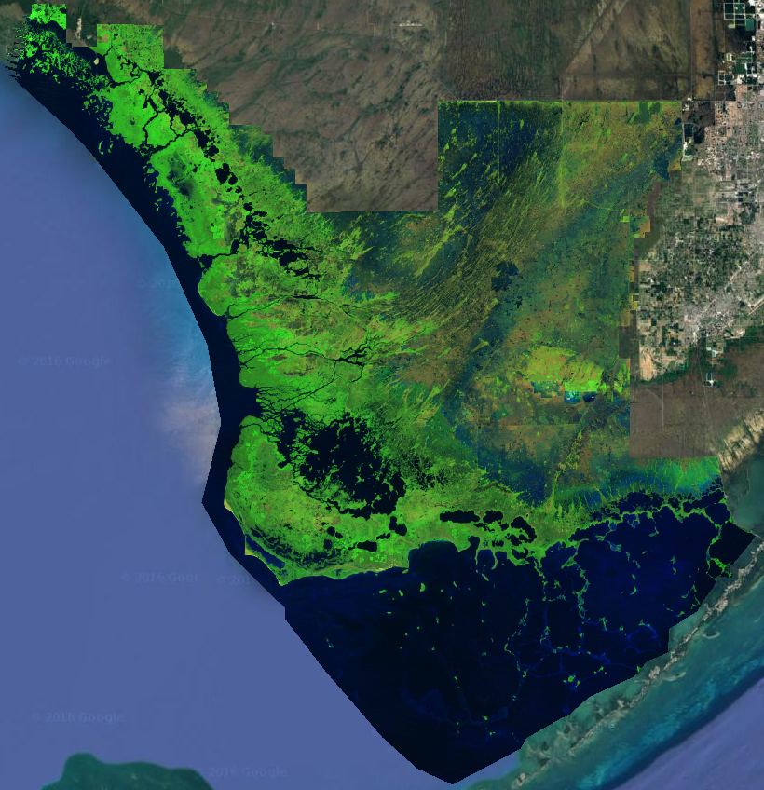
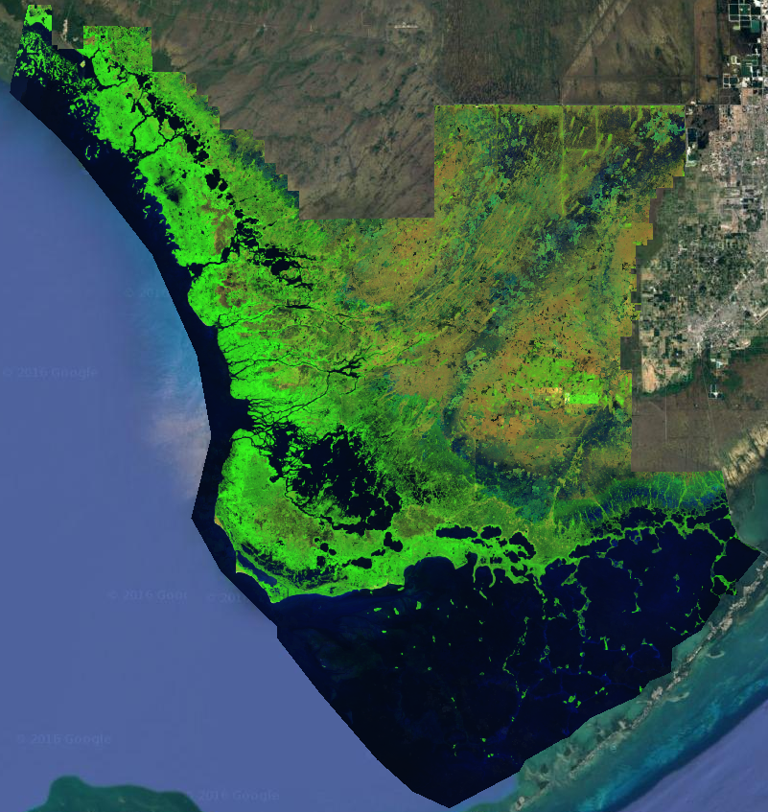
Results
1995
2005
2015
Notes:
The classification scheme was extrapolated to the entire park to give a larger scope of the general trends. Keep in mind leaving the sample area region reduces the accuracy of the classification scheme. A trend we want to highlight is that in 2005 there appears to be less dark green for dense forest vegetation, particularly along the coast. We hypothesize that Hurricane Katrina may have been detrimental to coastal mangroves

Slide 14
Results
2015 Error Matrices
 | seed 1
 | 92 | 11 | 0 | 0 | 0 | 0 | 0
 | 1 | 55 | 0 | 0 | 0 | 0 | 0
 | 0 | 0 | 112 | 0 | 0 | 0 | 0
 | 0 | 0 | 0 | 81 | 2 | 4 | 0
 | 20 | 0 | 13 | 0 | 89 | 0 | 0
 | 0 | 0 | 0 | 12 | 0 | 84 | 0
 | 0 | 3 | 0 | 0 | 0 | 0 | 64 | 577
 |  |  |  |  |  |  |  | 643
 |  |  |  |  |  |  | Accuracy | 0.897356 | %
 | seed 2
 | 117 | 5 | 0 | 0 | 4 | 0 | 0
 | 6 | 44 | 0 | 0 | 0 | 0 | 0
 | 0 | 0 | 52 | 0 | 1 | 0 | 35
 | 0 | 0 | 0 | 97 | 0 | 17 | 0
 | 0 | 0 | 3 | 0 | 30 | 0 | 0
 | 0 | 0 | 0 | 3 | 0 | 84 | 0
 | 0 | 0 | 0 | 0 | 0 | 0 | 120 | 544
 |  |  |  |  |  |  |  | 618
 |  |  |  |  |  |  | Accuracy | 0.880259 | %
 | seed 42
 | 40 | 2 | 0 | 0 | 0 | 0 | 0
 | 17 | 64 | 0 | 8 | 0 | 0 | 4
 | 0 | 2 | 49 | 0 | 0 | 0 | 3
 | 0 | 0 | 13 | 36 | 1 | 44 | 0
 | 0 | 0 | 1 | 8 | 30 | 0 | 0
 | 0 | 0 | 0 | 9 | 0 | 34 | 0
 | 0 | 2 | 3 | 0 | 0 | 0 | 80 | 333
 |  |  |  |  |  |  |  | 450
 |  |  |  |  |  |  | Accuracy | 0.74 | %
 | Average
( | 0.897356 |  | 0.880259 |  | 0.74 | )
 |  |  |  |  | =
 |  |  |  |  | 0.839205 | %
Notes:
To test the accuracy of the sample region, we ran an error matrix. The error matrix randomly selects 10% of the training points to test. The error matrix is run three times to produce a more robust average of accuracy. For 2015, the accuracy averaged to 84%. We did this to the 1995, 2005. The overall average of the three years was 85% accuracy.

Slide 15
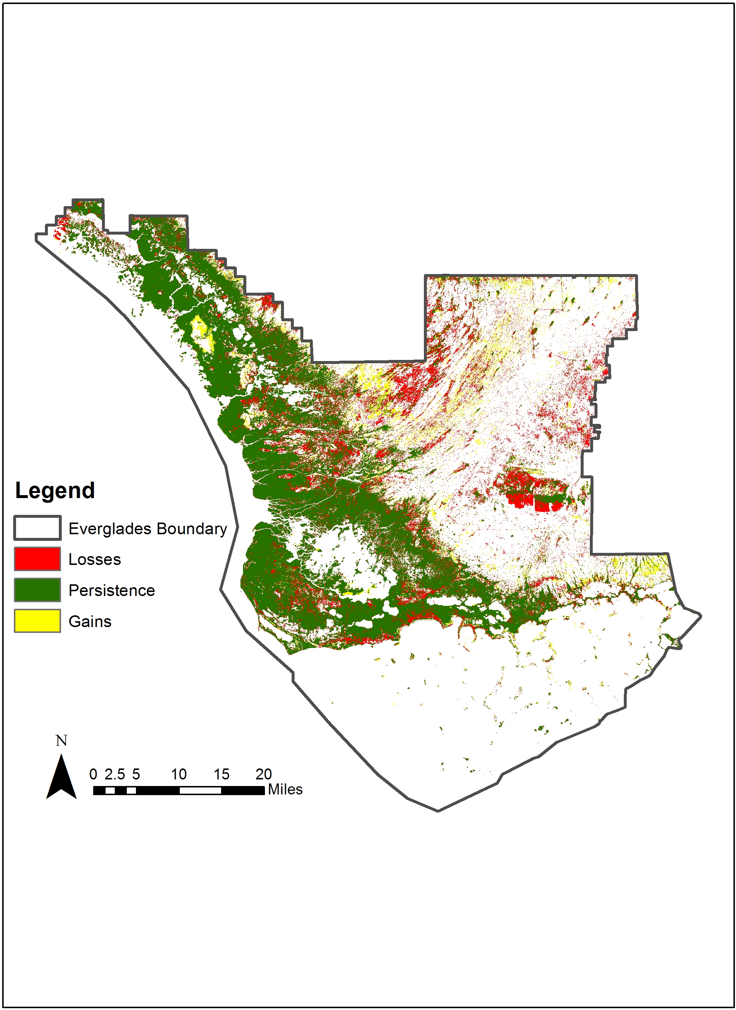
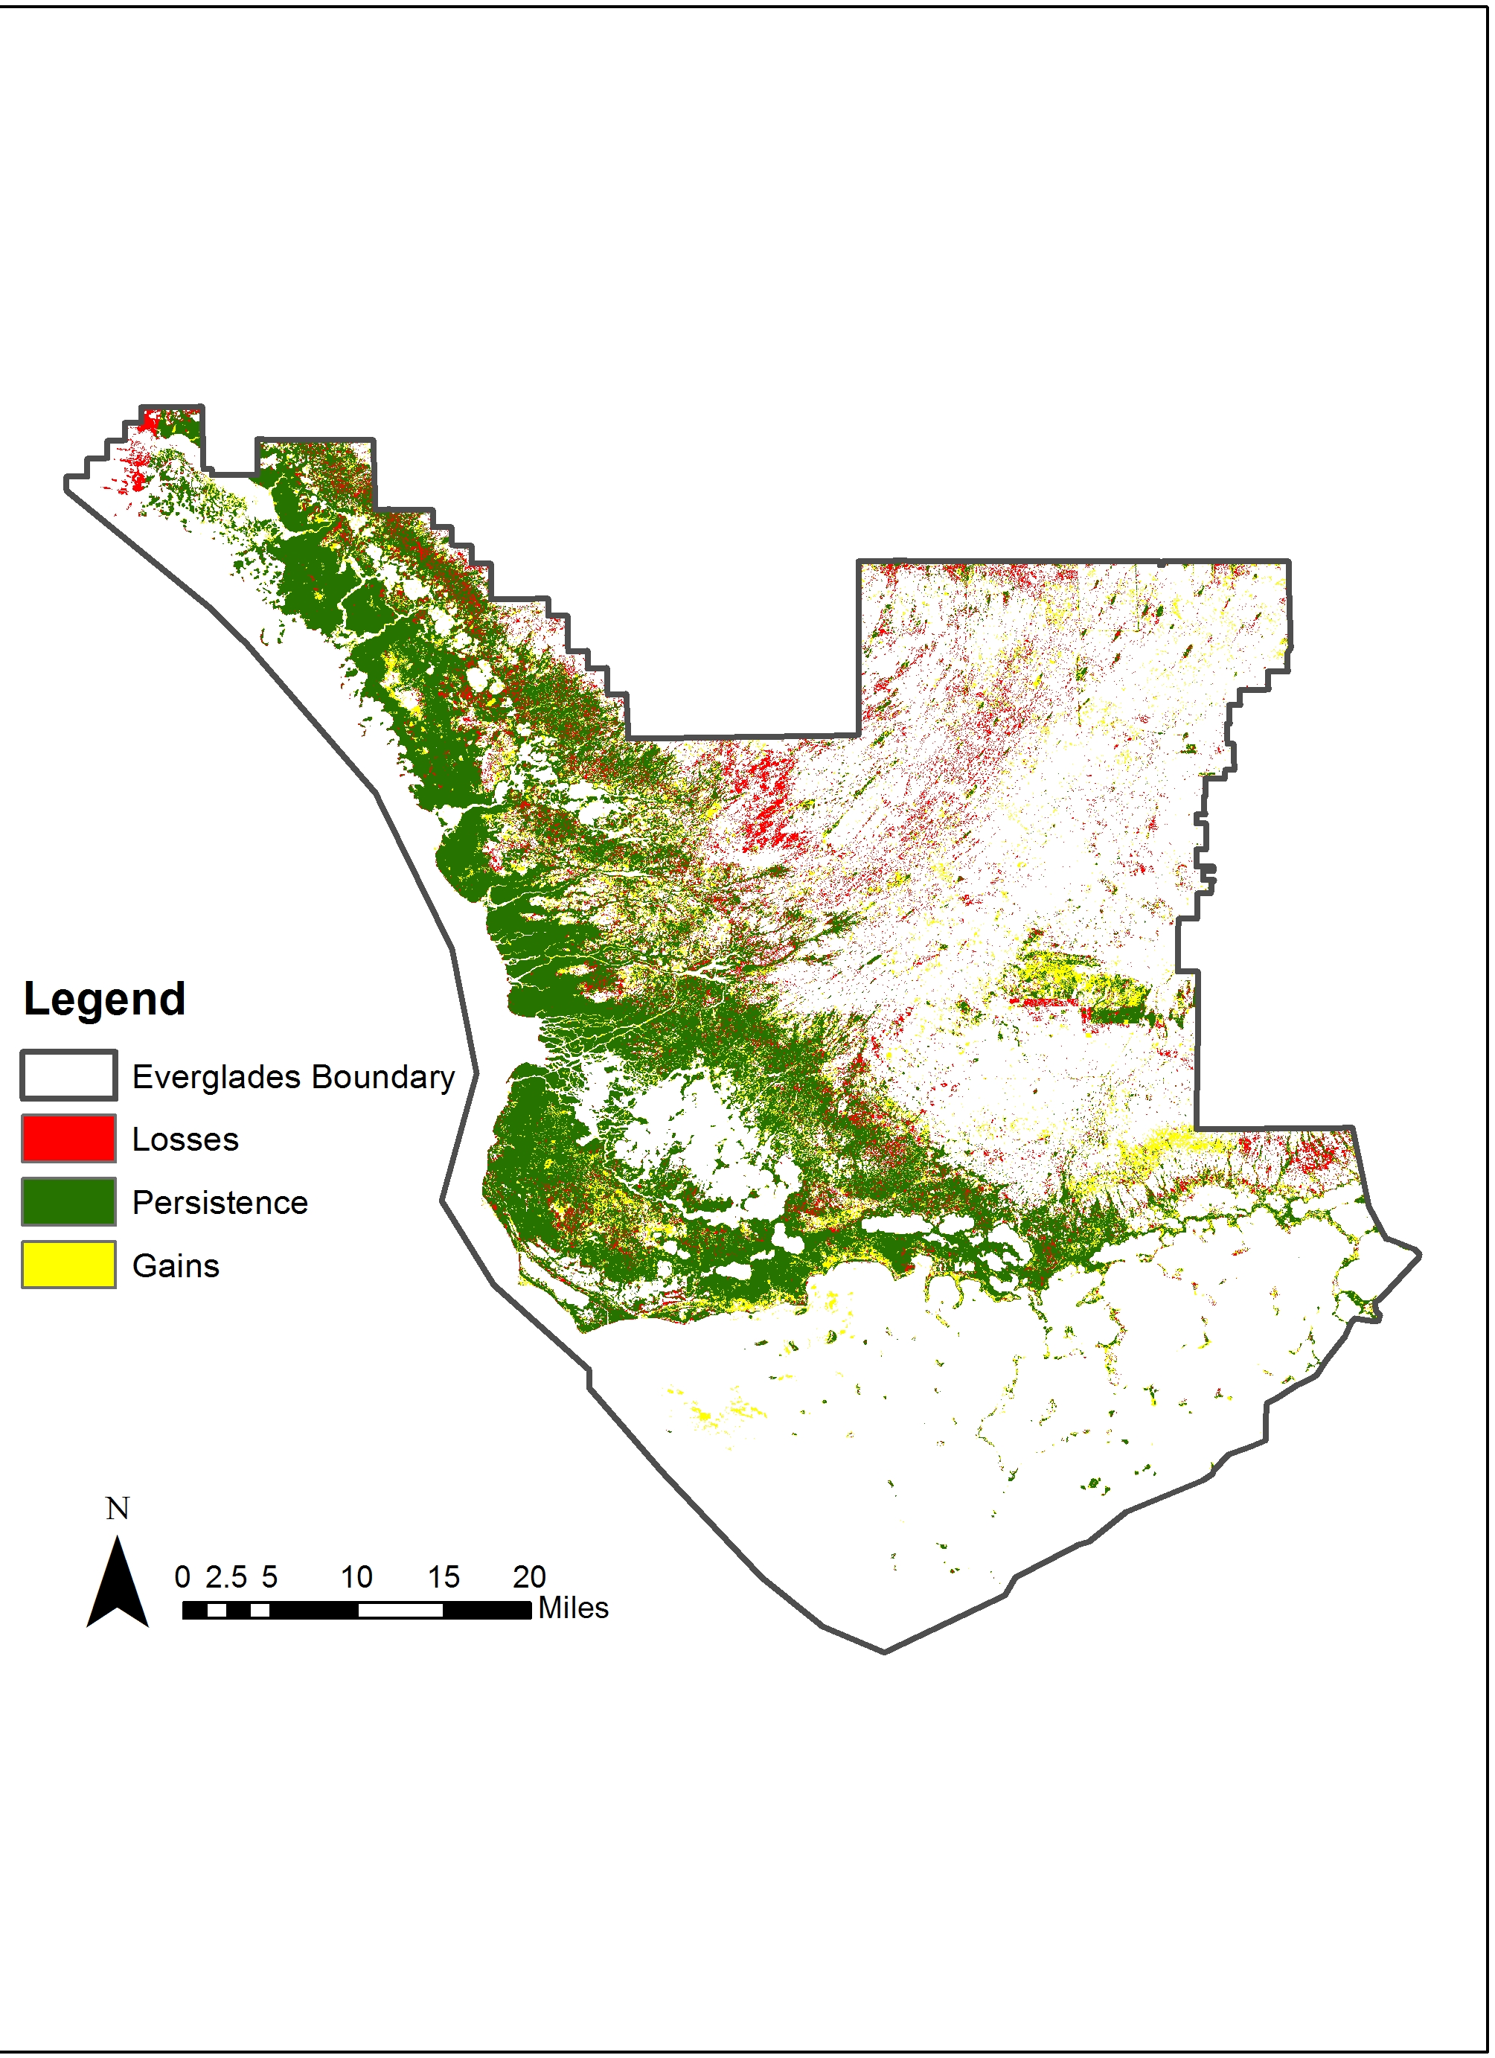
Transition Maps
1995-2005
2005-2015
Notes:
These two maps illustrate the changes in forest cover between the three study years based on TerrSet’s Land Change Modeler. The models were generated using simplified classification images in which marsh classes, forest classes, and water classes respectively (e.g., marshDry and marshWet = marsh; pond, ocean, and tidalZone = water; forestDense and forestScrub = forest). The resulting images show gains, losses, and persistence in forest cover over the two ten year periods. Of particular interest is the changes in forest cover in the southeastern and eastern-central portions of these two maps, which highlight changes in urban development as well as transitions between forest and pasture. Finally, the loss of forests in the coastal zones of the 1995-2005 image may be related to consequences of Hurricane Katrina.

Slide 16
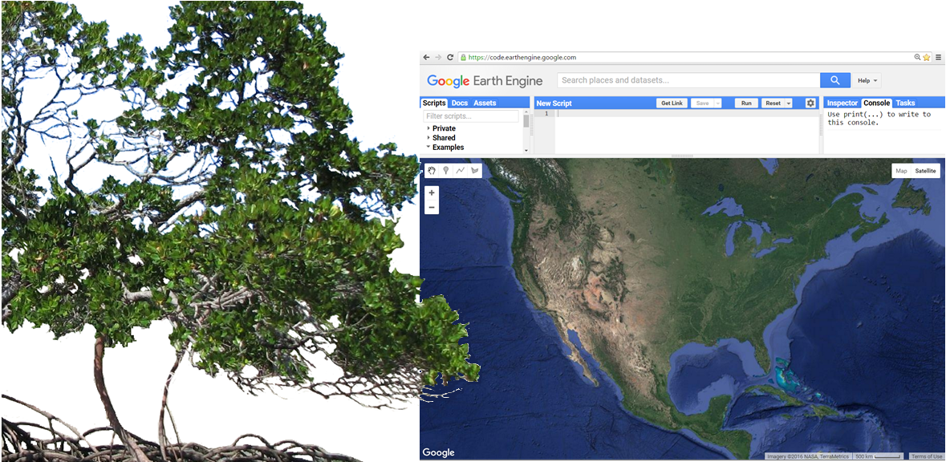
Conclusions
Image Source:
Wikimedia
Notes:
Image Credit: https://www.google.com/search?biw=1280&bih=895&site=imghp&tbs=sur%3Afmc&tbm=isch&sa=1&q=mangroves+cooktown&oq=mangroves+cooktown&gs_l=img.3...1320.2589.0.2773.9.7.0.0.0.0.123.123.0j1.1.0....0...1c.1.64.img..8.0.0.e9Y_8Rs6zDw#imgrc=sumnWMh_sxVv2M%3A
In conclusion, we found that Google Earth Engine is a viable platform for classifying mangroves, and is especially impressive due to the cloud-based data accessibility and the easy-to-use geometry features.
Based on our results, we’ve seen that GEE has many build in capabilities, and is capable of reducing cloud cover, classification, and analysis.

Slide 17
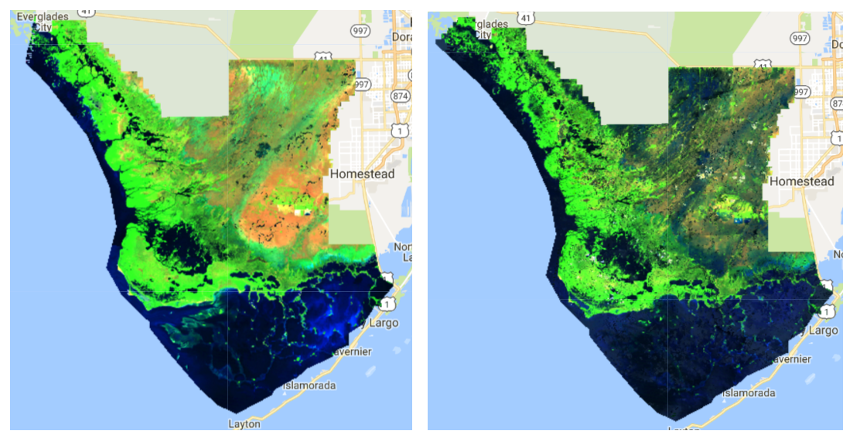
Error and Uncertainties
Interpolation
Classification
Calculations
Seasonality
Winter 2005
Summer 2005
Notes:
Though we feel we were successful, we do have several factors that could impact our results.
First, we only classified a small subset (10-15%) of the coastline, and then interpolated those classifications to the whole national park, which may not be representative samples of the entire coastline or the entire park region.
Secondly, our classification was trained without in situ data making it more difficult to distinguish between tree types.
Our error matrix calculations could also be affected due to the random 10% of the polygons selected. This affects the classifications because each polygon was drawn by hand, and does not have a consistent number of pixels.
Finally, our classifications ignore seasonality, which is present in the Everglades, due to the yearly aggregation of Landsat images in order to reduce cloud cover.

Slide 18
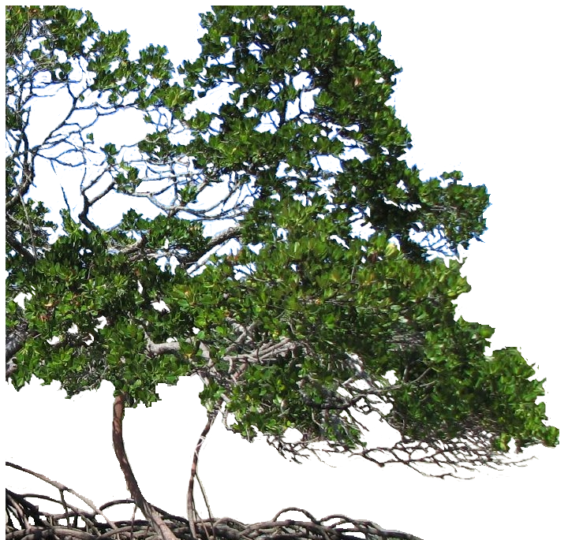
Future Work
Use in situ data
Include more samples
Focus on ecological forecasting
Image Source : Wikimedia
Notes:
Image Credit: https://www.google.com/search?biw=1280&bih=895&site=imghp&tbs=sur%3Afmc&tbm=isch&sa=1&q=mangroves+cooktown&oq=mangroves+cooktown&gs_l=img.3...1320.2589.0.2773.9.7.0.0.0.0.123.123.0j1.1.0....0...1c.1.64.img..8.0.0.e9Y_8Rs6zDw#imgrc=sumnWMh_sxVv2M%3A
For the second term of this project, we would like to include in situ data to validate and train our classification, expand to other sampling methods (e.g., GRTS), and focus on ecological forecasting into the future.

Slide 19
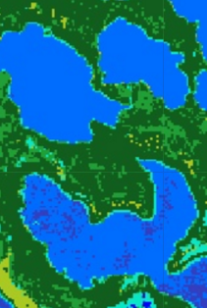
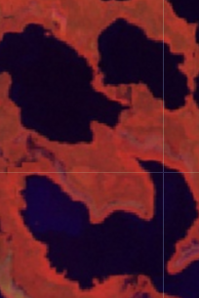
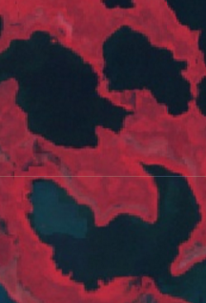
A special thank you to our contributors for their time and assistance with this project
Advisors
Dr. Kenton Ross, NASA DEVELOP National Program Science Advisor
Project Partners
Jed Redwine, National Park Service, Everglades National Park (ENP)
Ecologist, South Florida Natural Resources Center
Dr. Hans-Peter Plag: Group on Earth Observations (GEO) Blue Planet Initiative (BPI) and Mitigation and Adaptation Research Institute (MARI)
Marguerite Madden, University of Georgia
Others
Brittany Zajic, NASA DEVELOP National Program Geoinformatics Fellow
Noel Gorelick, Engineer at Google
Notes:
We would not be where we are today without the help of a lot of patient people:
Our science advisor at DEVELOP Dr. Ross
Our project partners, Jed Redwine, Dr. Plag, and Marguerite Madden.
And for all their help with understanding the GEE coding, Brittany Zajic of DEVELOP and Noel Gorelick of GEE Developers.

