Slide 1
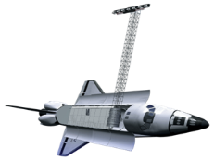
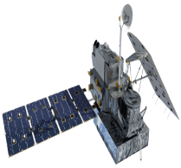
Leigh Sinclair (Team Lead)
Padraic Conner (Co-Team Lead)
Tyler Finley
Jeanné le Roux
Dr. Jeffrey Luvall,
NASA at NSSTC
Dr. Robert Griffin,
University of Alabama in Huntsville
Landsat 8 OLI
SRTM-V2
GPM DPR
TRMM TMPA

Slide 2
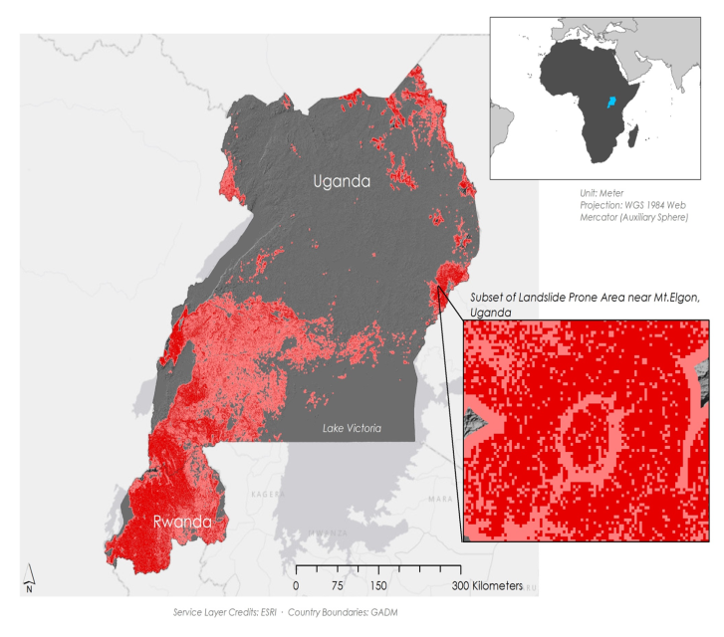
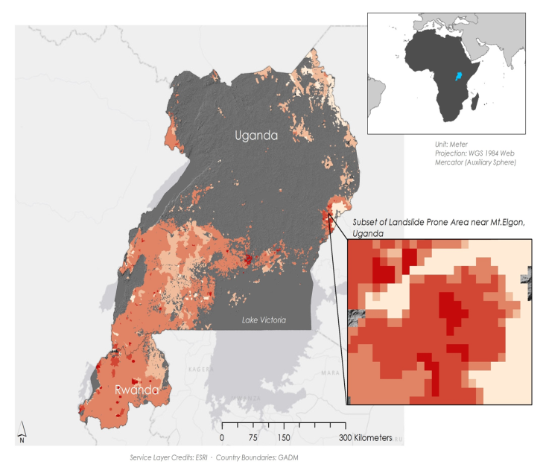
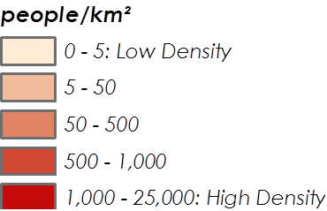
The Landslide Susceptibility Map (Left) shows areas that are highly susceptible to landslides, while the Landslide Hazard Map (Right) shows at-risk populations
Eric Anderson,
SERVIR Coordination Office at MSFC
Dr. Dalia Kirschbaum,
SERVIR Applied Sciences Team at GSFC
Denis Macharia,
RCMRD in Nairobi, Kenya
East Africa, January 2010 – Present Day
Landslides threaten people’s lives as well as croplands that are critical to national economies. They can also block vital roadways for long periods of time. A lack of spatial and temporal information makes landslide risk management difficult for Ugandan and Rwandan officials. A means of mapping landslide susceptibility is needed since many people living in historically at-risk areas are unwilling to relocate for cultural and economic reasons.
This project provided a Landslide Susceptibility Map illustrating areas highly susceptible to landslides, a Landslide Hazard Map highlighting at-risk populations, and a preliminary assessment of the GPM and TRMM satellite missions at predicting landslide conditions. The project also added 13 new landslides to the GLC. These end products will be used by SERVIR and the RCMRD to aid disaster risk management efforts and land use planning in the region.
The East African countries of Uganda and Rwanda have a history of landslide disasters due to a combination of intense rainfall events and populations living on or near steep slopes. This project aimed to assess and map landslide-prone regions of Uganda and Rwanda by utilizing a host of geospatial datasets along with historical landslide accounts recorded in the Global Landslide Catalog (GLC). A more refined understanding of regional landslide triggers will aid local mitigation efforts and help educate those living in susceptible areas about signs of imminent landslides.

