Slide 1
DEVELOP National Program
U.S. Disasters ii
NASA JPL
Summer 2015
Final Imagery

Slide 2
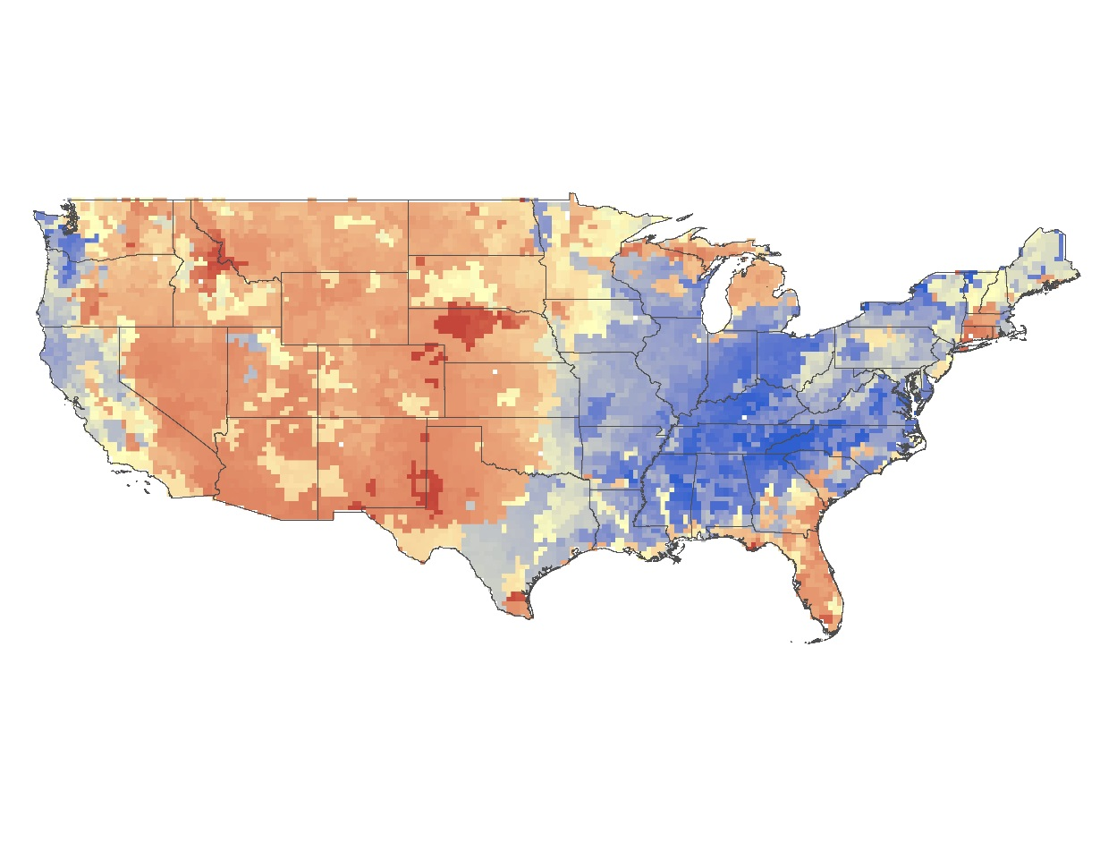
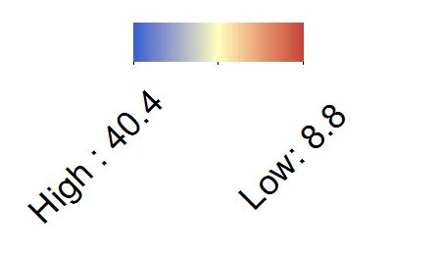
NASA JPL
U.S. Disasters II
Average Surface Soil Moisture Content for 2003-2011. Created from NASA EOS Gravity Recovery and Climate Experiment (GRACE). This image is assimilated soil moisture GRACE data and is an significant variable when considering wildfires, drought, or climatic changes.
The legend is in percentages (8% saturated – 40% saturated).

Slide 3
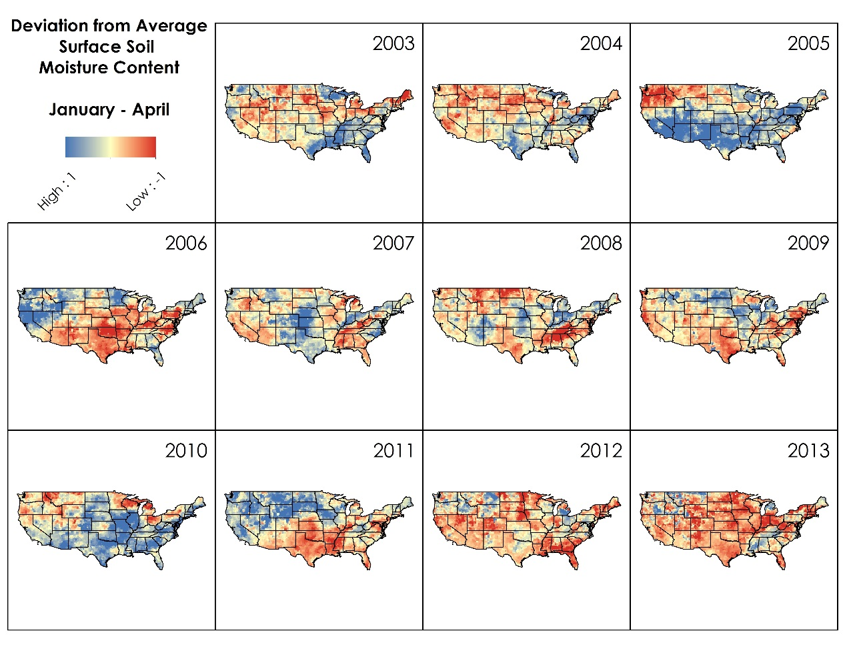
NASA JPL
U.S. Disasters II
Annual deviations from the average value for surface soil moisture content assimilated GRACE data. Created from NASA EOS Gravity Recovery and Climate Experiment (GRACE).

Slide 4
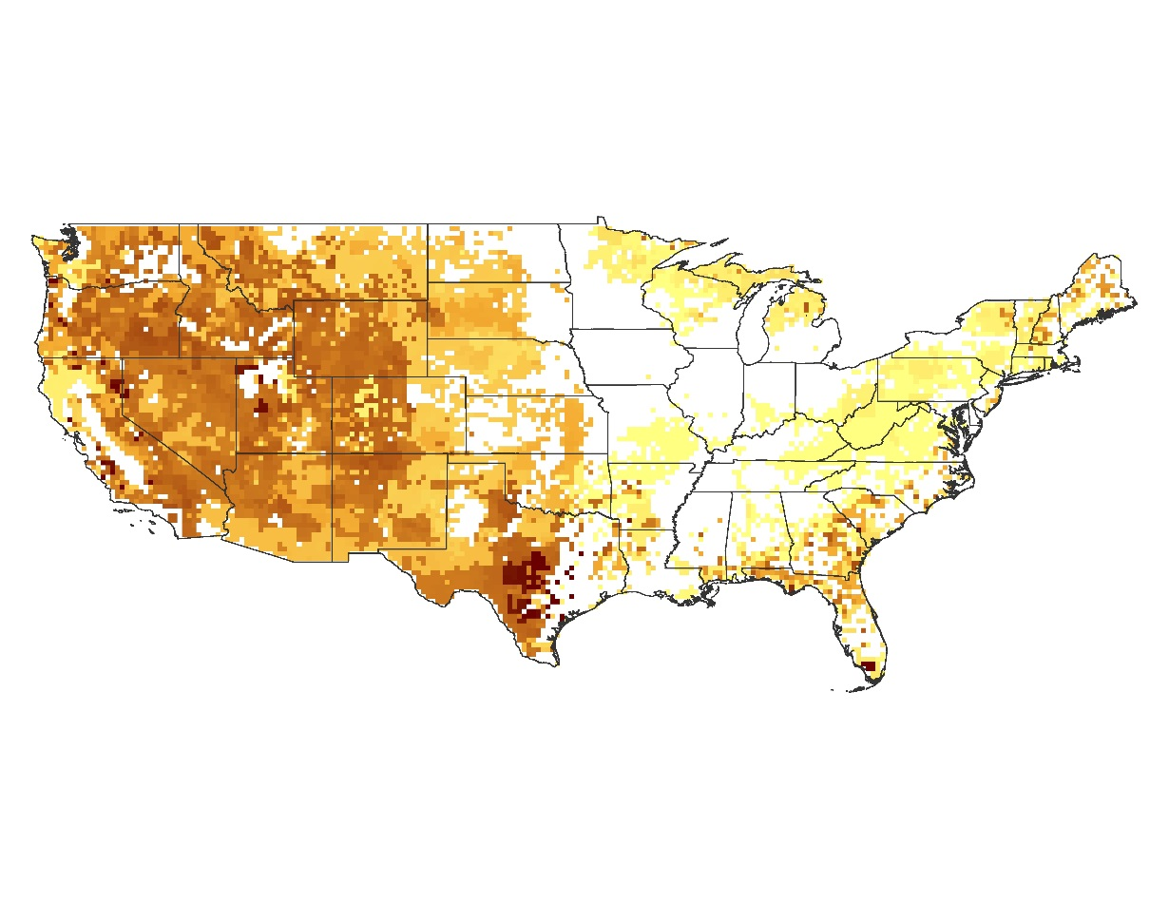
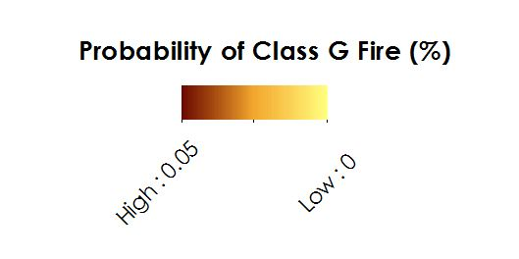
NASA JPL
U.S. Disasters II
This map shows the probability, scaling from 0-5%, of a Class G (over 5,00 acres burned) fire occurring from May 2003-April 2004 based on January-April 2003 average surface soil moisture. Created from NASA EOS Gravity Recovery and Climate Experiment (GRACE).

Slide 5

NASA JPL
U.S. Disasters II
The probability from the image above could then be multiplied by the binned average burned area value corresponding to each cell’s land cover type, resulting in a map of predicted burned area in acres.
This maps shows predicted burned acreage by Class G (over 5,00 acres burned) from May 2003-April 2004. Created from NASA EOS Gravity Recovery and Climate Experiment (GRACE).

