Slide 1
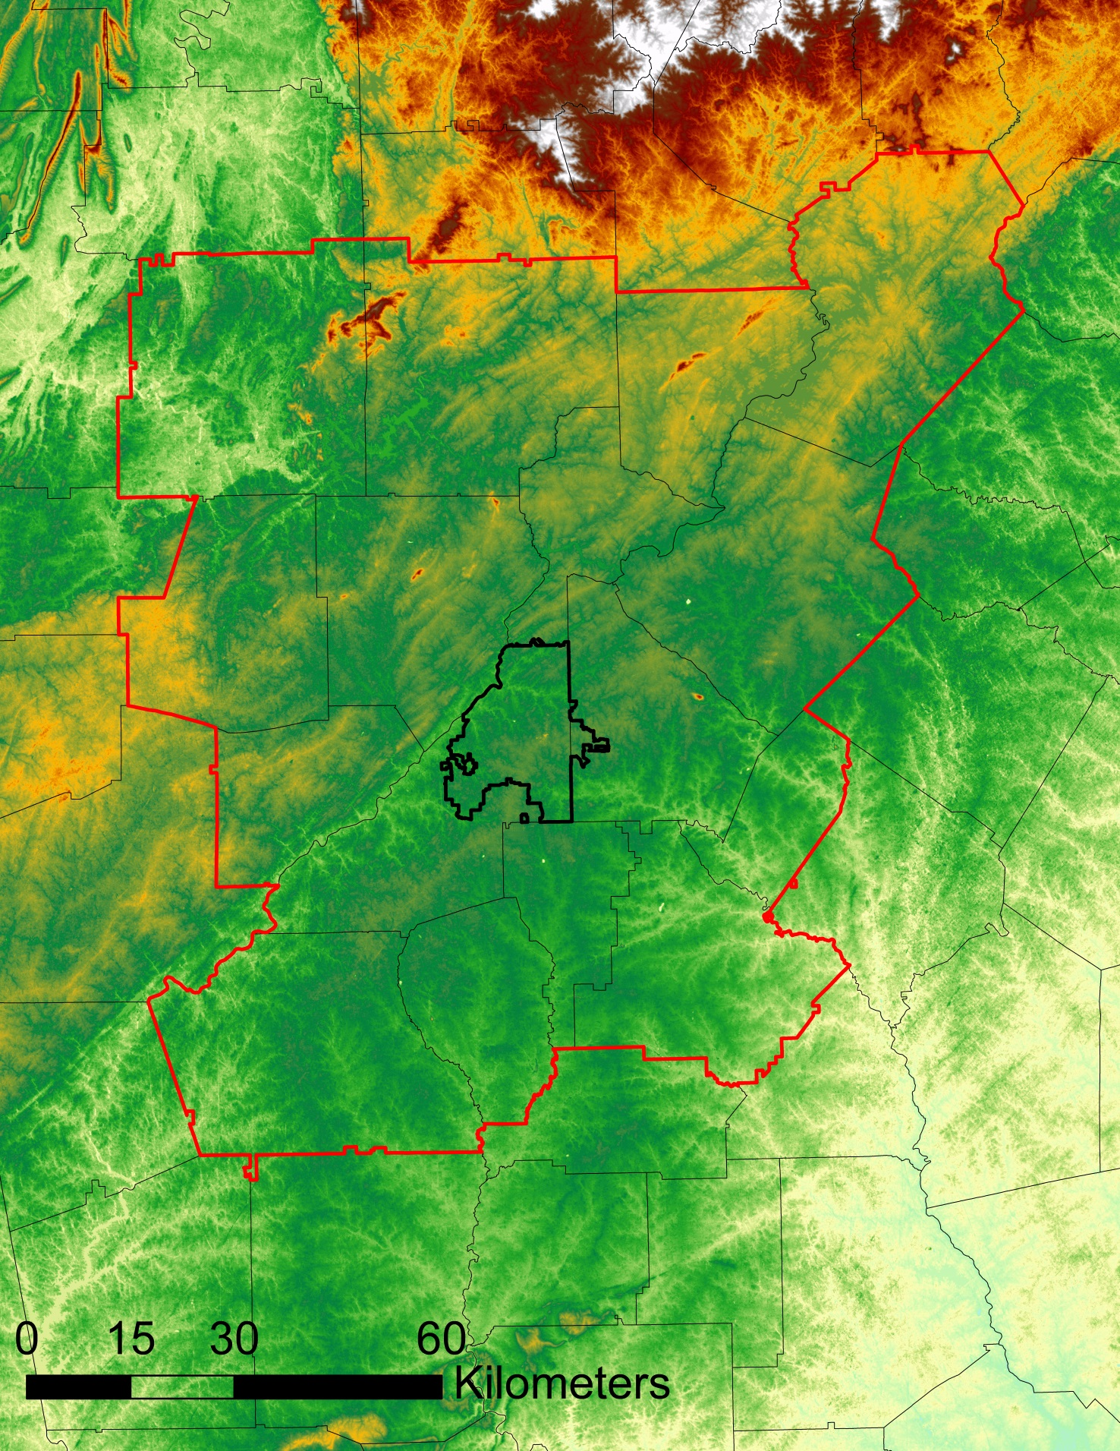
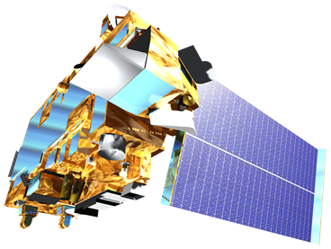
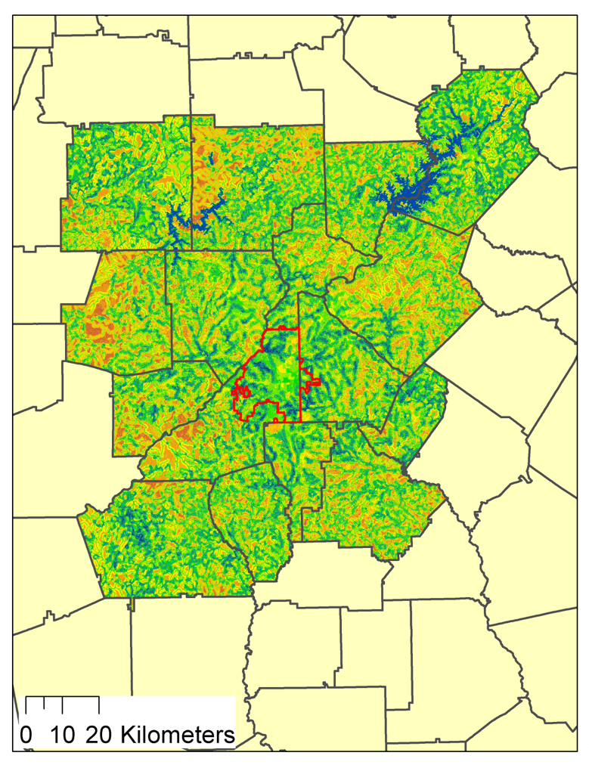
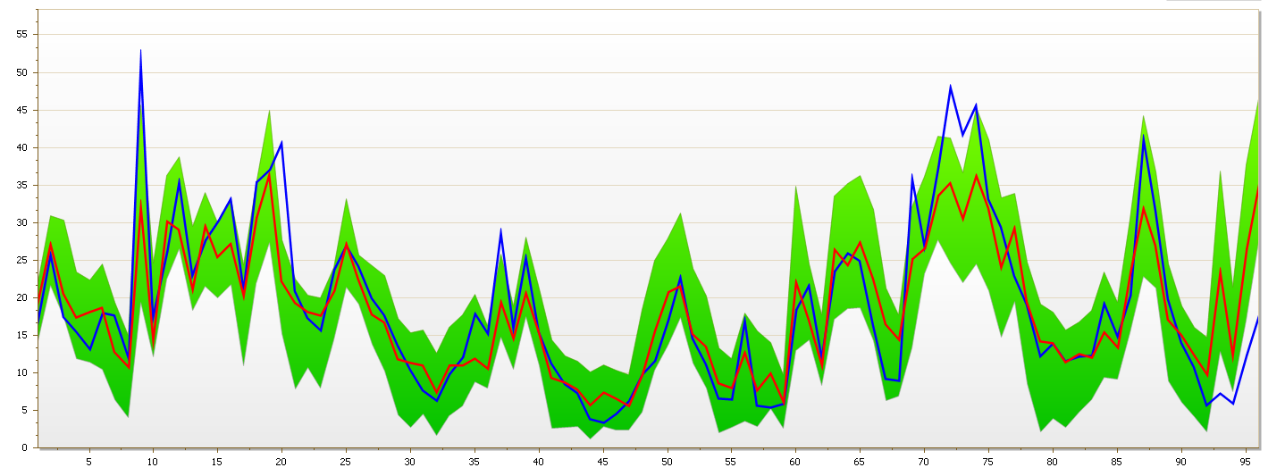
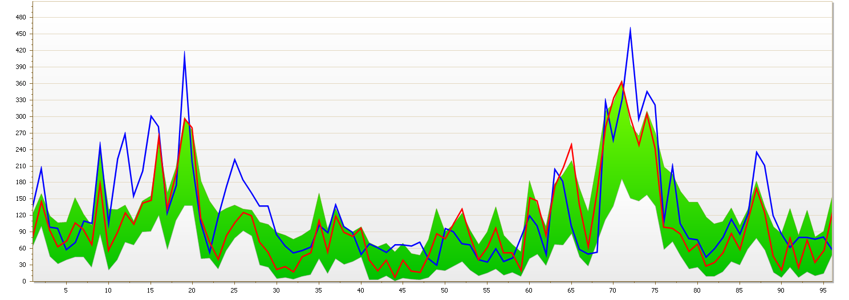
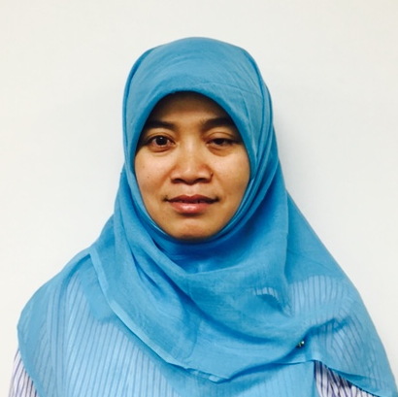
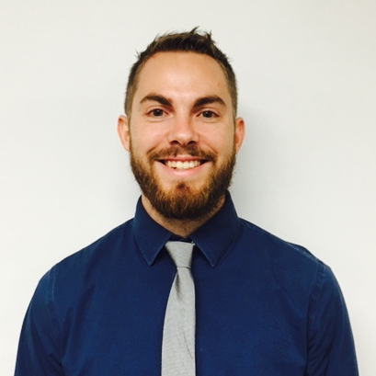
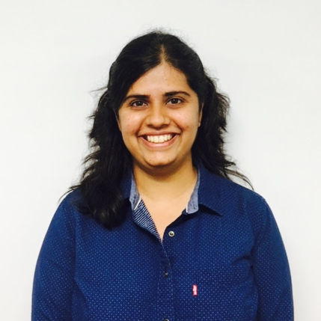
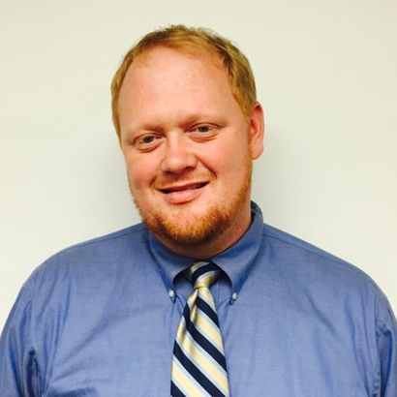
Identifying Key Urban Areas to Reduce Stormwater Runoff and Maximize Conservation Efforts in Metropolitan Atlanta
Abstract
Objectives
Residents of metro Atlanta pay the highest rates in the nation for municipal water and sewer, in part, due to massive recent investments in infrastructure to manage stormwater runoff. Rapid urbanization in this region exacerbates this problem. Loss of forested land accelerates the runoff during storms, increases soil erosion as well as pollution to watersheds. Enabling the protection of existing green infrastructure, or strategically planting more trees to intercept stormwater runoff, will help reduce sediment and nutrient-laden stormwater runoff in local watersheds in addition to limiting the needs of future city infrastructure. The DEVELOP team at the University of Georgia partnered with The Nature Conservancy aimed at identifying conservation targets in the Atlanta region, improving existing green infrastructure and locating additional areas suitable for expansion of reforestation efforts using NASA data from Landsat 8 and Terra satellites. This was accomplished through a combined, watershed-scale assessment of metro Atlanta using the Land-Use Conflict Identification Strategy (LUCIS) and Soil and Water Assessment Tool (SWAT) models. The LUCIS model was employed in this project to identify areas of land use prioritization as it relates to existing and future conservation areas in Atlanta. The SWAT model produced an analysis of streamflow and runoff within the study area. Together, these model results provided project partners with an integrated understanding of water resource issues in metro Atlanta that emphasized land use scenarios.
Locate areas within the Atlanta region for conservation and forested land protection efforts using the LUCIS model
Analyze watershed processes using the SWAT model
Identify reforestation targets to help reduce harmful stormwater runoff in the Atlanta region
Study Area
Methodology
Landsat 8 imagery
U.S. Census
ASTER DEM
Soil & Watershed Assessment Tool (SWAT)
Soils & Geology
Topography
National Hydrography Dataset
Global Weather Data
Input Data
USGS Streamflow & Water Quality
gSSURGO
Land Cover
Climate
National Land Cover Dataset
Stormwater Infrastructure
Proximity to Waterways
Green Spaces
Community Impact
Soil Permeability
Proximity to Forests
Canopy Cover
Associated Land Cover
Proximity to Waterways
Pollution Sources
Open Spaces
Proximity to Waterways
Slope
Minimize Untreated Stormwater Flow from Impervious Surface
Protect existing green infrastructure and identify opportunities for conservation
Identify lands with a high potential to impact water quality
Earth Observations
Atlanta Water Resources II
Suitability Analysis
Land Use Conflict Identification Strategy (LUCIS)
Land Use Prioritization
Results
Landsat 8 OLI
Terra ASTER
Observed vs. SWAT Predicted Stream Flow (Upper Chattahoochee)
95PPU
Conclusions
Observed
Best Estimation
NASA satellite data was successfully integrated into three water resource management goals in the MNGWPD.
The LUCIS suitability maps identified areas with high potential to affect local water resources in the MNGWPD by incorporating a variety of input datasets.
The SWAT model provided information about water quality parameters to be used in the LUCIS methodology for the Upper and Middle Chattahoochee watersheds.
Additional work will involve combining the LUCIS and SWAT methods for the Flint, Ocmulgee, and Etowah watersheds to help refine prioritization scenarios for both conservation and reforestation strategies to aid water resource management in the MNGWPD.
Observed vs. SWAT Predicted Stream Flow (Middle Chattahoochee)
95PPU
Observed
Best Estimation
Study Boundary
Counties
Water Bodies
High Priority
Land Use Prioritization
Low Priority
Team Members
Acknowledgements
Project Partners
We would like to thank our science advisors, Dr. Rosanna Rivero and Dr. Marguerite Madden, for their advice and guidance on this project.
We would like to thank our partners at The Nature Conservancy, Sara Gottlieb, Myriam Dormer, and Whitney Palanci, for their support and involvement throughout the project.
We would also like to thank previous team members Beatriz Avila, Wenjing Xu, Veronica Fay, Jason Reynolds, and Jacob Spaulding.
Any opinions, findings, and conclusions or recommendations expressed in this material are those of the author(s) and do not necessarily reflect the views of the National Aeronautics and Space Administration. This material is based upon work supported by NASA through contract NNL11AA00B and cooperative agreement NNX14AB60A.
Christopher Cameron
Project Lead
Ike Sari Astuti
Mark Beatty
The Nature Conservancy
Manasi Parkhi
Natalia Bhattacharjee
Alex Smith
University of Georgia – Summer 2016

