Slide 1
African Great Lakes Weather II
Utilizing NASA Earth Observations to Identify Indicators to
Help Predict Deadly Storms over African Great Lakes
Annabel White (Project Lead)
Jakub Blach
Kathy Dooley
Michael Brooke
Rajkishan Rajappan
Megan Buzanowicz
Ryan Umberger

Slide 2
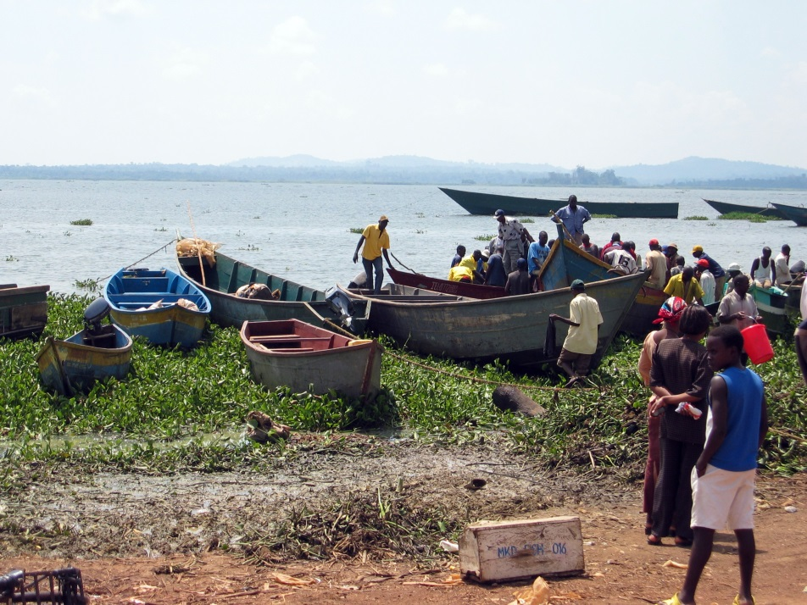
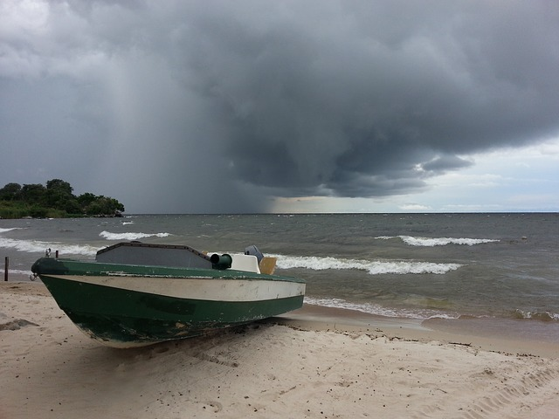
Community Concerns
Deadly storms
  No early warning system
  Frequent casualties
  The affected areas have a high population density
  30 million people
  200,000 fishermen
Image Credit: Wikimedia Commons
Image Credit: Pixabay
Notes:
Storms along the African Great Lakes can arise suddenly and are often not part of larger storm systems that can easily be forecasted.
These storms can bring torrential rainfall, lightning, hail, and/or high winds, producing hazards that pose a major threat to the local infrastructure and population.
No early warning system is in place to inform the public of storm events. This prevents fisherman and others from being able to adequately prepare for the dangers associated with the storms.
As a result, many casualties are associated with these storms and most of the victims are fishermen who depend on the lakes for their livelihood.
The repercussions of these storms are intensified since the affected areas have the highest population density in all of Africa due to the vital economic opportunities of fishing, tourism, and agriculture that the lakes provide.
Image Credit (left): Sarahemcc. (2006). Fishing Boats at Ggaba Landing Site, Lake Victoria [Photograph], Retrieved from (https://upload.wikimedia.org/wikipedia/commons/e/e8/Ugandan_fishing_boats.jpg)
Image Credit (right): Tracy Hammond. (2013). [Photograph], Retrieved from (https://pixabay.com/static/uploads/photo/2014/05/26/13/40/lake-victoria-354533_640.jpg)

Slide 3
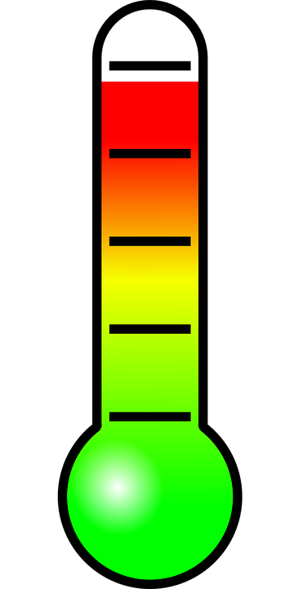
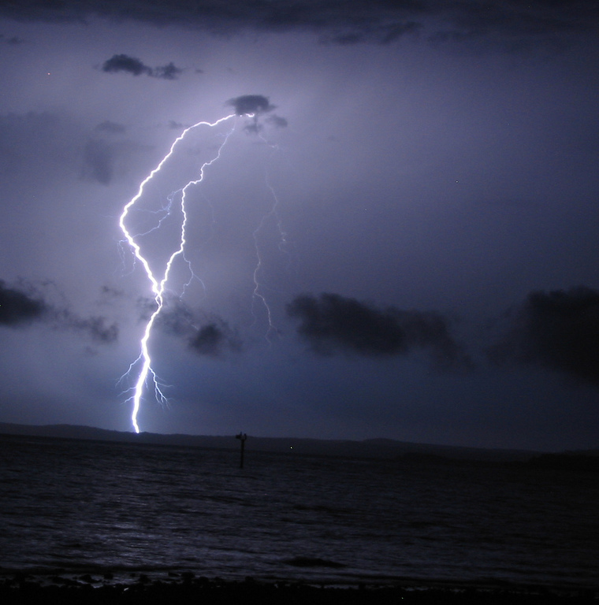


Objectives
Understanding which Weather Variables
Precede Storm Events
?
Image Credits: Pixabay & Public Domain Vectors
Image Credit: Stephen Dann
Notes:
The objective of this project was to contribute to research regarding storm development over the African Great Lakes—focusing on Lake Victoria. Measurements of meteorological variables were compiled at intensity levels chosen to highlight extreme storm activity and typical weather. These parameters were then compared to detect indicators that can be used in forecasting efforts.
Image Credit (Thermometer): OpenClipartVectors. (2013). [Clip Art], Retrieved from (https://pixabay.com/static/uploads/photo/2013/07/12/18/15/thermometer-153138_960_720.png)
Image Credit (Drops): Retrieved from (https://pixabay.com/static/uploads/photo/2013/07/12/14/49/drops-148870_960_720.png)
Image Credit (Wind Turbine): (2013). [Clip Art], Retrieved from (http://publicdomainvectors.org/photos/erlandh_Wind_Turbine.png)
Image Credit (Thunderstorm): Stephen Dann. (2006). Forked Lightning [Photograph], Retrieved from (https://www.flickr.com/photos/stephendann/82967208)

Slide 4
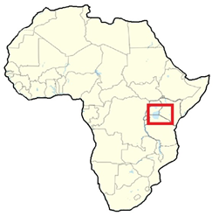
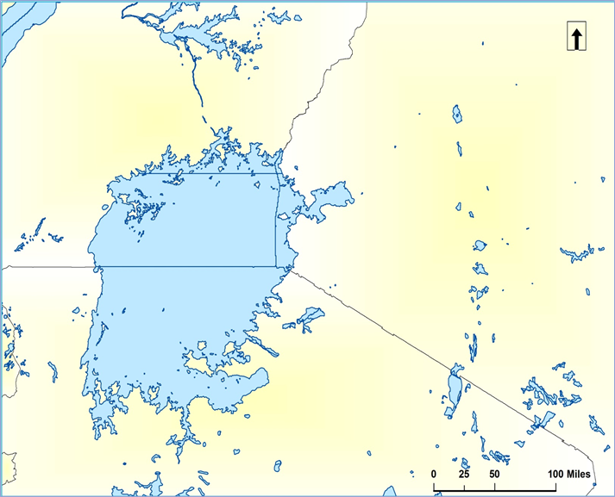
Study Area
Uganda
Uganda
Kenya
Kenya
Lake Victoria
Lake
Victoria
Tanzania
Tanzania
  Date Range: March 2005 – November 2013
Notes:
Our project focused on the largest of the African Great Lakes in terms of surface area: Lake Victoria. The weather over this lake is of paramount importance to our project partner, the Kenya Meteorological Department.
Our temporal study area, spanning March 2005 to Novebwer 2013, was based on availability of data in the Hazardous Storm Event Database, created from overshooting top detections, which we will explain in more detail shortly.

Slide 5
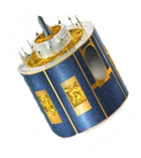

Sensors & Data Used
Meteosat
8 & 9
SEVIRI
Spinning Enhanced Visible and Infrared Imager
Aqua
AIRS
Atmospheric Infrared Sounder
MERRA
Modern-Era Retrospective Analysis for Research and Applications
Notes:
The earth observations, sensors, and data used in this project included:
The SEVIRI sensors on the Meteosat 8 and Meteosat 9 satellite. This data was used to produce the Hazardous Storm Event Database, which is what we used to collect our overshooting top data from.
The atmospheric infrared sounder on Aqua provided the data that was used to generate skew-T plots.
And MERRA meteorological data was used in the bulk of our analysis.
The use of each of these will be explained in depth in the following slides.

Slide 6
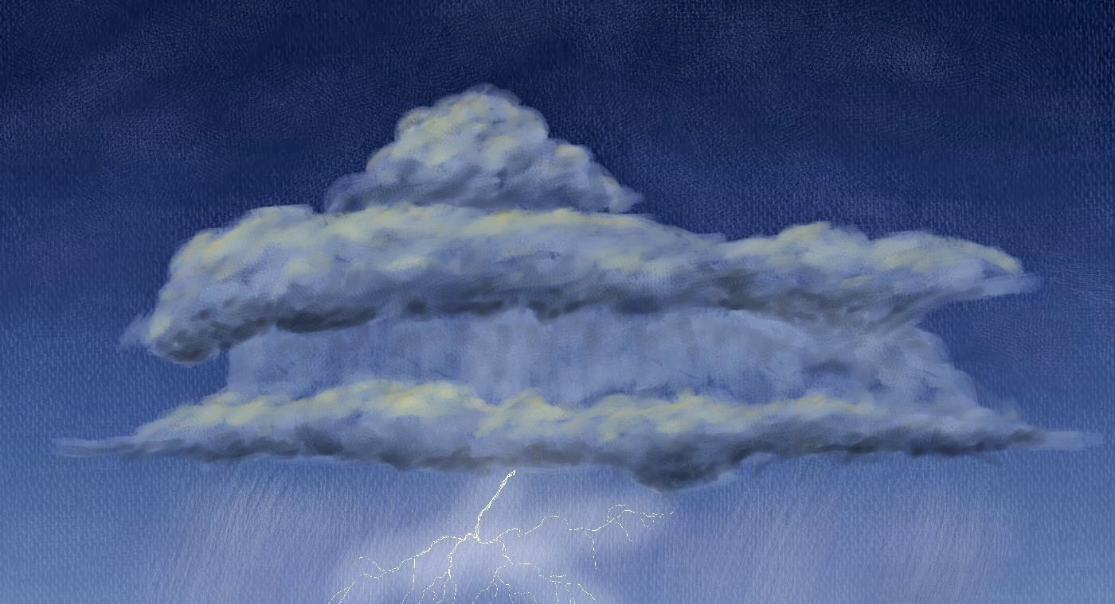
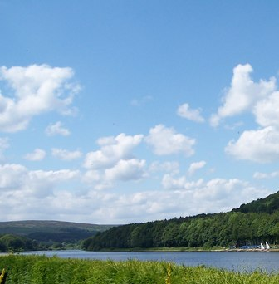
Methodology
Selecting Study Dates
Overshooting Top Detections
Image Credit: Stephen Dann
Image Credit: Jakub Blach
Image Credit: Terry Robinson
Notes:
To select our study dates, this project used the Hazardous Storm Event Database, which is a collection of overshooting top data derived from Meteosat’s SEVIRI sensors.
An overshooting top is a dome-like protrusion that shoots out of the top of the anvil of a storm. Persistent overshooting top activity is known to occur during severe weather, so 30 days were selected in which overshooting top activity was most intense over the study area to serve as our severe weather study dates.
30 days were also selected from days of average overshooting top activity to serve as our control group, or “normal” weather dates
Image Credit: NASA Goddard Space Flight Center. (2013). NASA-NOAA's Suomi NPP Satellite Captures Night-time Look at Cyclone Felleng [Image], Retrieved from (https://flic.kr/p/dRgakQ)
Image Credit: Stephen Dann. (2006). Forked Lightning [Photograph], Retrieved from (https://www.flickr.com/photos/stephendann/82967208)
Image Credit: Terry Robinson. (2009). Sunny Day at Damflask Reservoir, near Sheffield [Photograph], Retrieved from (http://www.geograph.org.uk/photo/1617380)

Slide 7
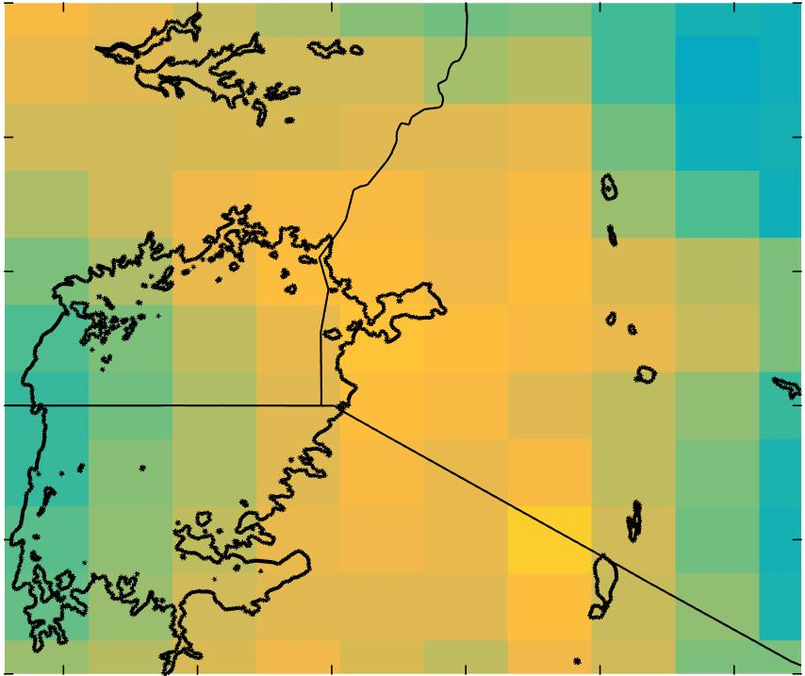
Methodology
Analyzing Storm Indicators
MERRA
30 Day Avg. Specific Humidity
Weather Maps
Generated at various atmospheric pressure levels
Specific Humidity
Temperature
Geopotential Height
Wind Speed
Vertical Pressure Velocity
2°N
1°N
0°
Latitude (degrees)
1°S
2°S
3°S
32°E
34°E
36°E
Longitude (degrees)
Notes:
To identify hazardous weather indicators, data from MERRA and AIRS was used. Thunderstorms typically develop over the land surrounding Lake Victoria during the day and over the Lake itself during the night. 12:00 UTC is typically when the storms are first developing over land and 00:00 UTC is the time when storms are present over the lake. Therefore, data from MERRA and the AIRS sensor was analyzed at these hours.
Weather variables such as temperature, humidity, vertical pressure velocity, and wind speed were collected from MERRA and used to generate 30 day average value maps of each variable at 0:00 and 12:00 UTC for both the severe and average weather days using MATLAB.
Single day maps at 0:00 and 12:00 were also created for each variable, as well as hourly maps for select days to analyze how the climatic variables change over the course of a day.

Slide 8
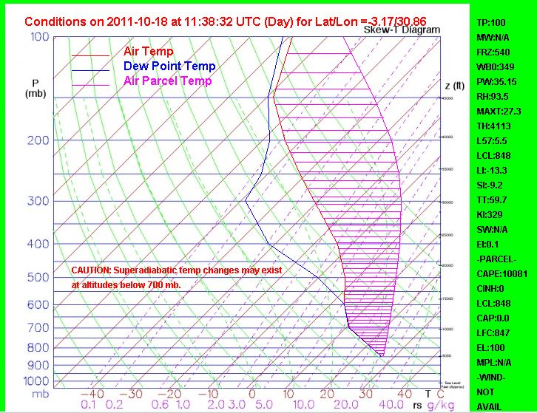
Methodology
Analyzing Storm Indicators
Aqua - AIRS
Skew-T Log-P Plots
CAPE
Convective Available Potential Energy
Weak instability CAPE < 1,000 J/kg
Strong instability CAPE 2,500 – 4,000 J/kg
Notes:
Skew-T plots are typically produced from weather balloon data, and are powerful tools used in weather forecasting. The skew-T’s for this project were created using AIRS sensor data and the AIRS Skew-T plotting tool, which is housed on JPL’s website. Along the x-axis is temperature and the y-axis is pressure on a logarithmic scale.
These graphs contain a lot of information, but one of particular importance to storm forecasting is CAPE, or convective available potential energy, illustrated by this fuscia area (point to fuscia area)
CAPE is the positive area in which the theoretical parcel temperature is warmer than the actual temperature at each pressure level in the troposphere and serves as a measure of instability through the depth of the atmosphere. Higher CAPE values indicate greater potential for severe weather.

Slide 9
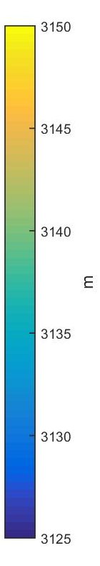
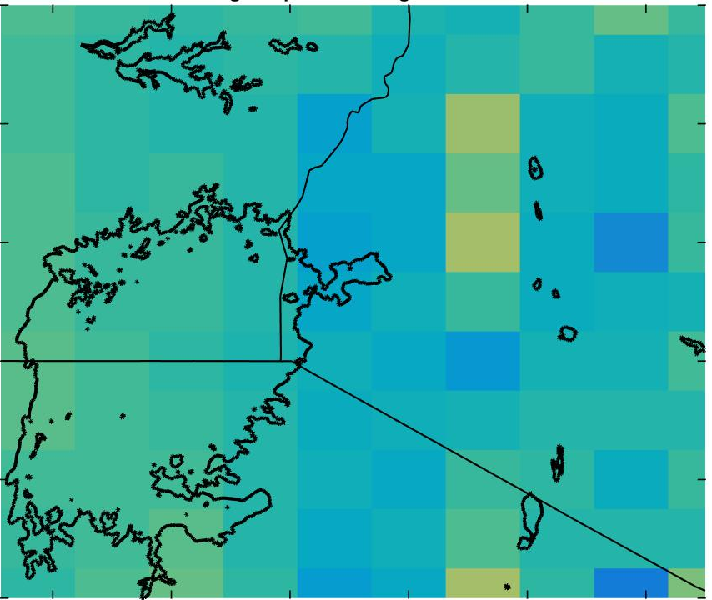
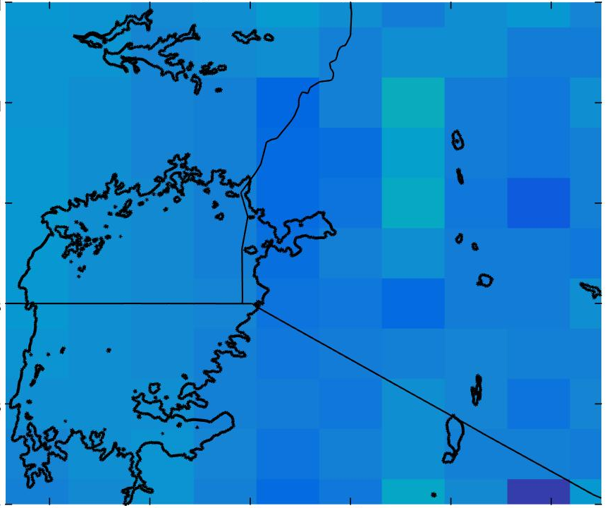
Results & Conclusions
Average Geopotential Height
700 mb Pressure, 0:00 UTC
3150
Average Days
Severe Days
3150
3145
3140
3135
3130
3125
2°N
2°N
3145
1°N
1°N
0°
0°
3140
Latitude (degrees)
Latitude (degrees)
1°S
1°S
M
3135
2°S
2°S
3°S
3°S
3130
32°E
34°E
36°E
32°E
34°E
36°E
Longitude (degrees)
Longitude (degrees)
3125
Notes:
On the following slides are some of the weather maps generated from the MERRA data. These maps used the data from the 30 days of average weather and 30 days of intense weather at 0 UTC, when the storms are most likely to form over the lake. The color bar on the right shows the min and max values possible for each variable. On these graphs, we are looking at geopotential height, with purple representing the lowest altitudes and yellow representing the highest altitude.
Decreased geopotential height was observed at the 700 mb level for the hazardous days, which indicates lower pressure over the region, which can be favorable for storm development.

Slide 10
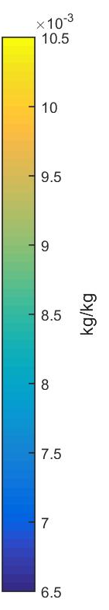
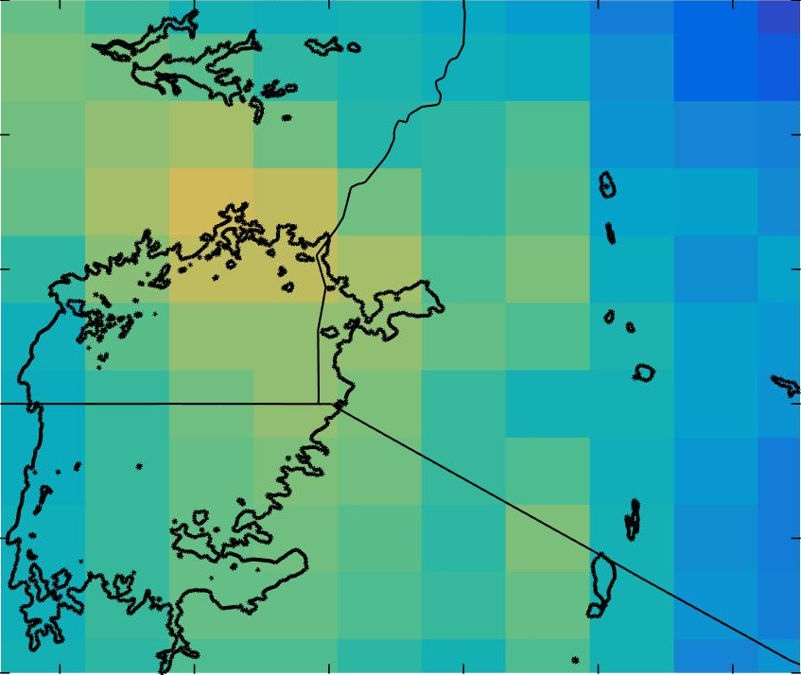
Results & Conclusions
Average Specific Humidity
700 mb Pressure, 0:00 UTC
x10⁻³
Average Days
Severe Days
10.5
10
9.5
9
8.5
8
7.5
7
6.5
2°N
2°N
1°N
1°N
0°
0°
Latitude (degrees)
Latitude (degrees)
1°S
1°S
kg/kg
2°S
2°S
3°S
3°S
32°E
34°E
36°E
32°E
34°E
36°E
Longitude (degrees)
Longitude (degrees)
Notes:
Greater moisture was observed at the 700 mb level during the severe weather days, which paired with decreased geopotential height can produce increased instability to drive the storms.

Slide 11
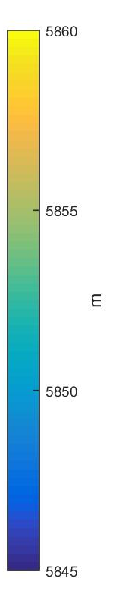
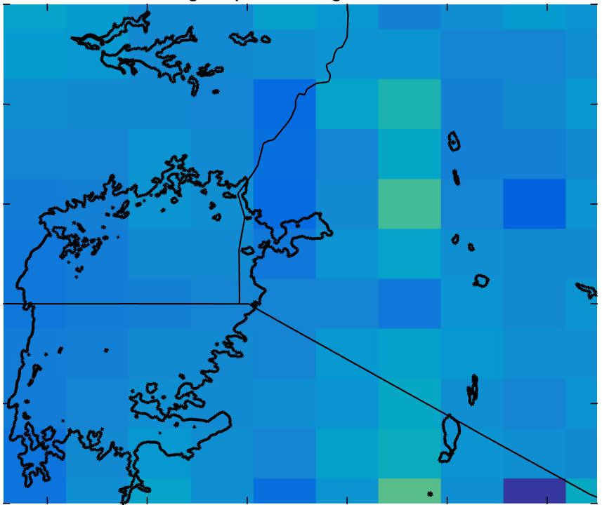
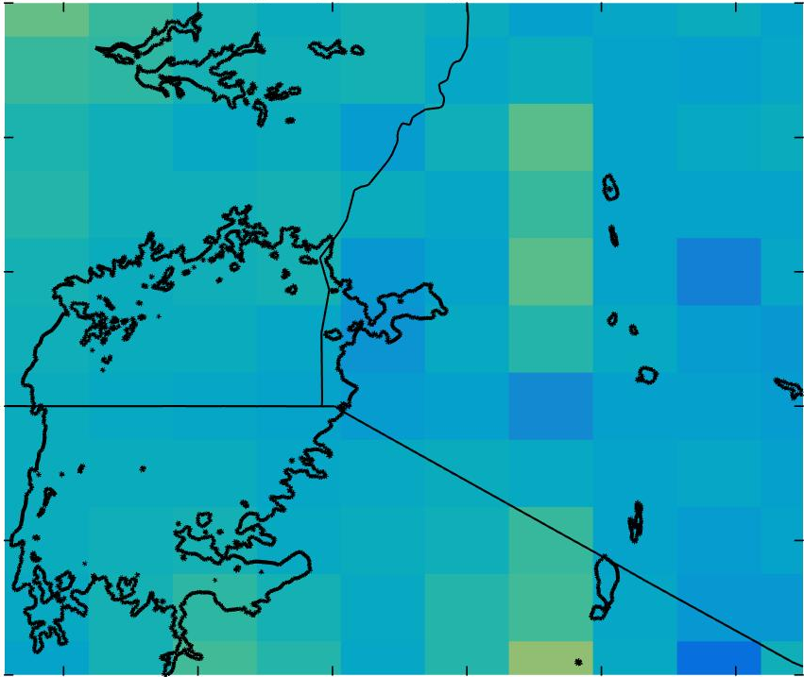
Results & Conclusions
Average Geopotential Height
500 mb Pressure, 0:00 UTC
Average Days
Severe Days
5860
2°N
2°N
1°N
1°N
5855
0°
0°
Latitude (degrees)
Latitude (degrees)
1°S
1°S
M
2°S
2°S
5850
3°S
3°S
32°E
34°E
36°E
32°E
34°E
36°E
Longitude (degrees)
Longitude (degrees)
5845
Notes:
Minimal differences in 500 mb height (~3 meters) and temperature (approx. 1 degree) were observed between the severe and average weather days.

Slide 12
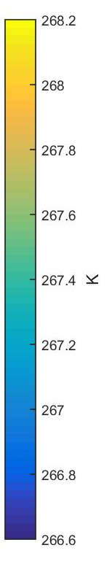
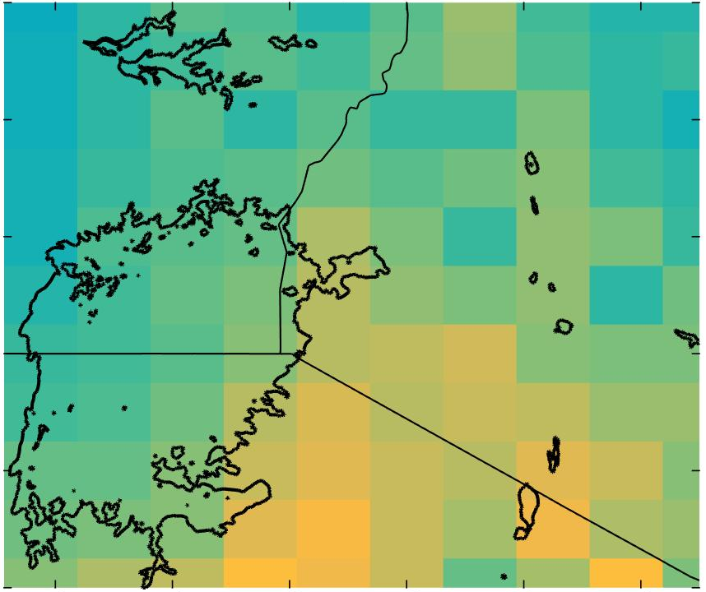
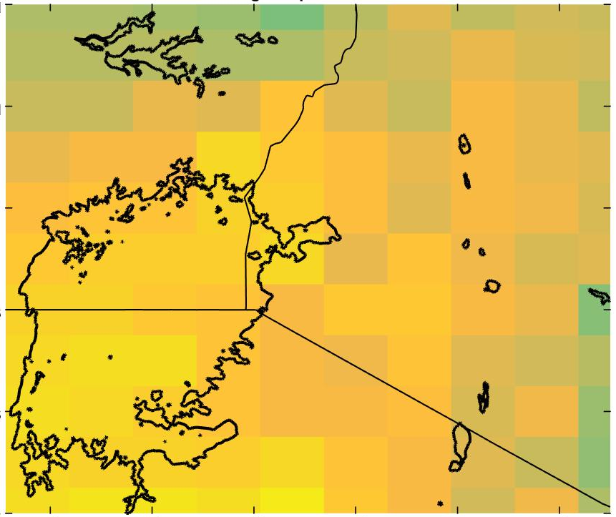
Results & Conclusions
Average Temperature
500 mb Pressure, 0:00 UTC
268.2
Average Days
Severe Days
A
a
2°N
2°N
1°N
1°N
267.8
0°
0°
Latitude (degrees)
Latitude (degrees)
1°S
1°S
267.4
K
2°S
2°S
267.0
3°S
3°S
32°E
34°E
36°E
32°E
34°E
36°E
Longitude (degrees)
Longitude (degrees)
266.6
Notes:
Minimal differences in 500 mb height (~3 meters) and temperature (approx. 1 degree) were observed between the severe and average weather days.

Slide 13
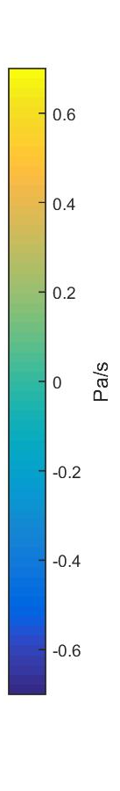
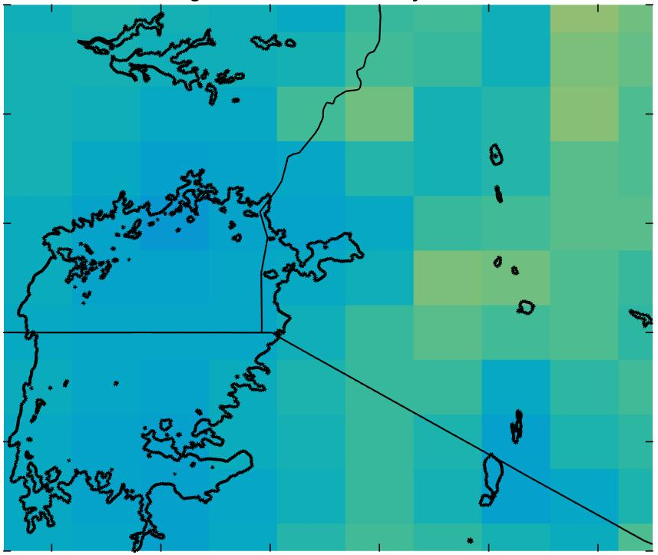
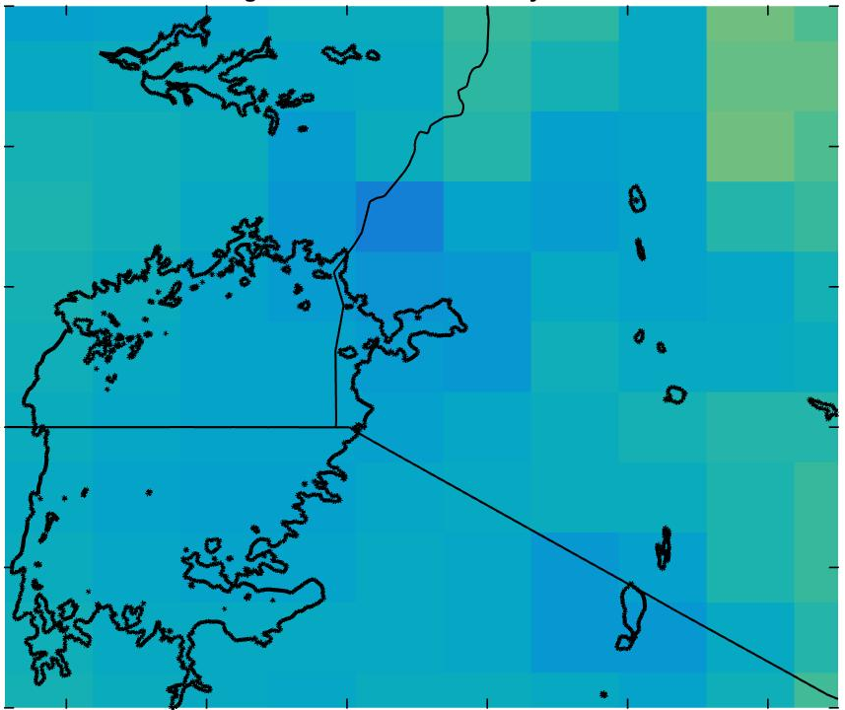
Results & Conclusions
Average Vertical Pressure Velocity
700 mb Pressure, 0:00 UTC
Average Days
Severe Days
A
a
2°N
2°N
0.6
1°N
1°N
0°
0°
Latitude (degrees)
Latitude (degrees)
1°S
1°S
0
Pa/s
2°S
2°S
3°S
3°S
32°E
34°E
36°E
32°E
34°E
36°E
Longitude (degrees)
Longitude (degrees)
-0.6
Notes:
Vertical pressure velocity showed rising air over the lake at 00 UTC for both the average and severe days as a result of the lake being warmer than the surrounding air. Negative values actually indicate rising air and positive values sinking air. Additionally, during the severe days, rising air over the NE corner at night for the severe days could be a signal of the storm’s initial formation over the mountains.

Slide 14
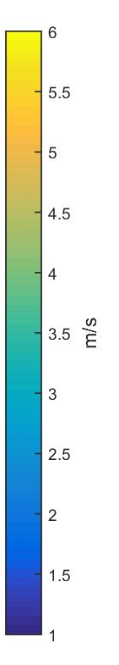
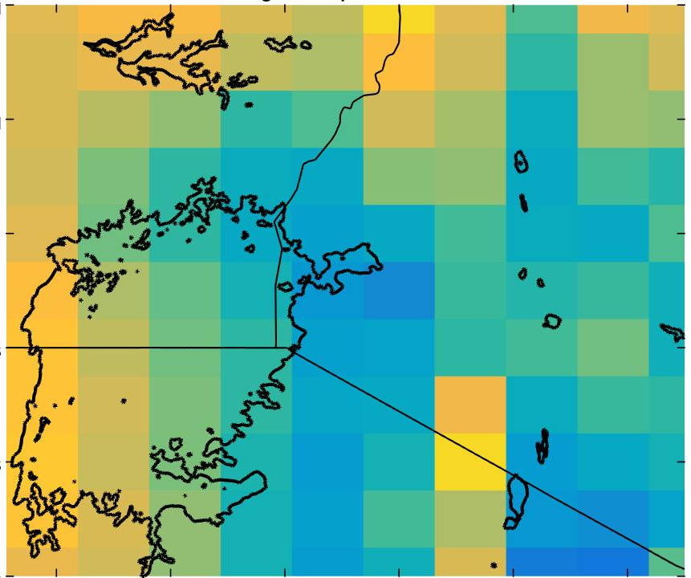
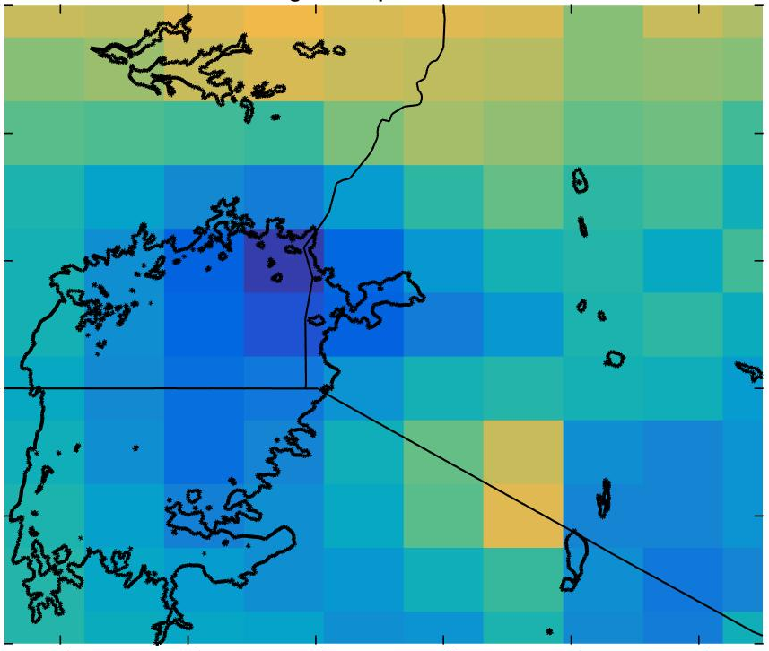
Results & Conclusions
Average Wind Speed
700 mb Pressure, 0:00 UTC
A
a
6
Average Days
Severe Days
2°N
2°N
5
1°N
1°N
4
0°
0°
Latitude (degrees)
Latitude (degrees)
m/s
1°S
1°S
3
2°S
2°S
3°S
3°S
2
32°E
34°E
36°E
32°E
34°E
36°E
Longitude (degrees)
Longitude (degrees)
1
Notes:
Weaker wind speed was observed at 700 mb for the severe days which is a bit peculiar. Stronger winds are more favorable for storm development and maintenance.

Slide 15
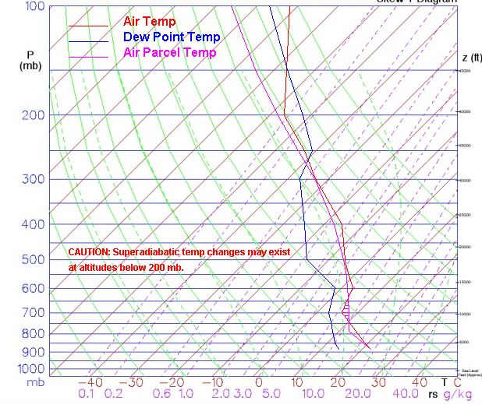
Results & Conclusions
Aqua - AIRS Skew-T Plots
Conditions for Daytime Storm over Land
Conditions for Nighttime Storm over Lake
Notes:
These are two Skew-T plots generated from AIRS data.
Both of these plots were generated from days representing severe storms.
While a large amount of information is present on these plots, one major typical indicator of a severe storm is a large CAPE value, which is represented by the fuschia area between the red and fuschia lines.
The plot on the left was generated over land, about 100 km from Lake Victoria. The plot on the right was generated directly over Lake Victoria.
As you can see, the CAPE area is relatively small on the plot over the lake, while it is high, as expected, on the plot over land. Plots from other days show a similar trend. This suggests that one of the major drivers of typical storm events is not present for the storms which occur over Lake Victoria.

Slide 16
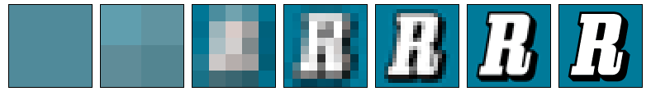
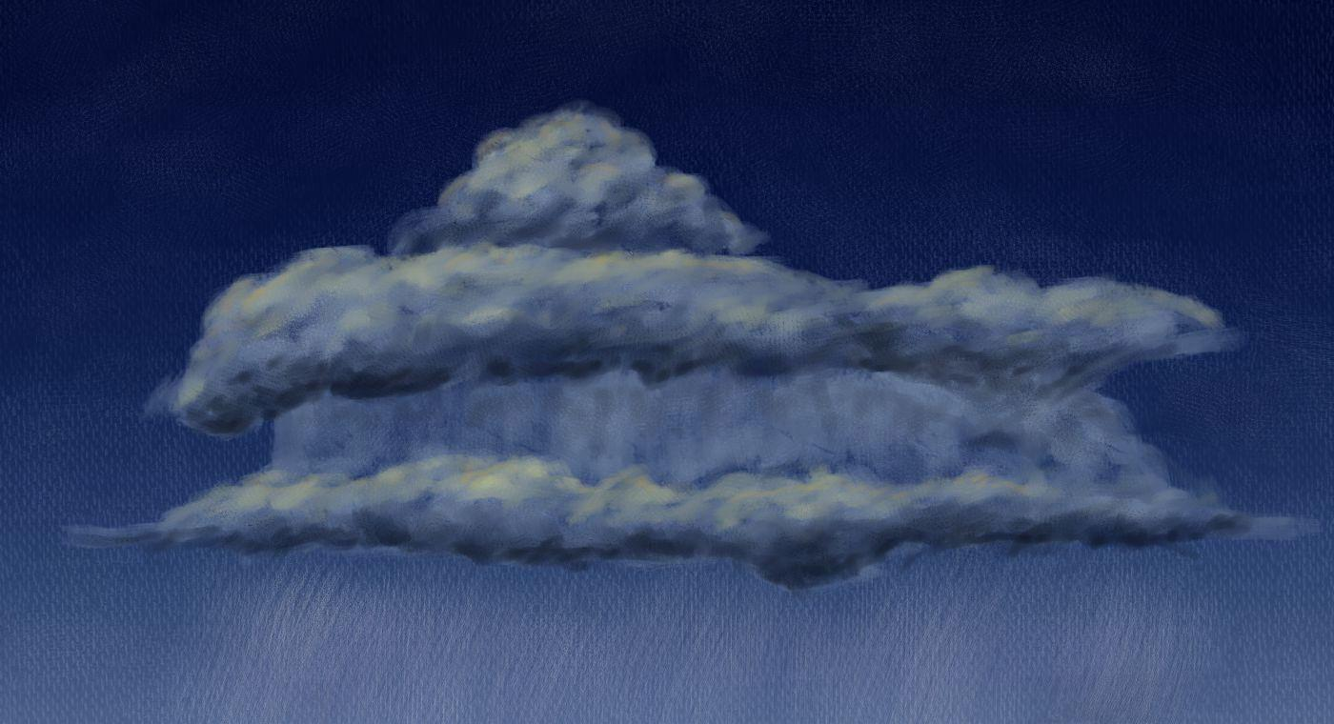
Errors & Uncertainties
Resolution
Image Credit: Wikipedia
OTs as Storm Indicators
Image Credit: Jakub Blach
Image Credit: Jakub Blach
Sample Size
vs
Notes:
Our project had several limitations. The largest limitation was our data resolution. MERRA Data is roughly 60 by 70 km, while the typical thunderstorm is around ½ to ⅓ that size. Because of this, the we were unable to pick up on changes in atmospheric conditions immediately surrounding the storms, which may be diluted when averaged out over a larger area. **have a suggestion on how to improve data quality for future studies**
Furthermore, our results would benefit from more robust studies validating the correlation between overshooting top detections and severe storms. The creator of the Hazardous Storm Event Database, Kristopher Bedka, cites in _____ that an OT was found near 47% of the confirmed European Severe Weather Database events. However, there is no record of historical severe weather events in our study area, and therefore it would be benefit to know the flip side of this correlation: what percentage of overshooting top detections have a corresponding confirmed storm event in the vicinity.
Finally, our analysis would always benefit from a larger sample size. Expanding our study beyond our current 30 days would further validate any statistical tests.
Image Credit (Resolution): Cfalonso. (2006). Resolution Illustration, Retrieved from (https://commons.wikimedia.org/wiki/File:Resolution_illustration.png).
Image Credit (Clouds): Jakub Blach (Wise County NASA DEVELOP). (2015). Overshooting Top [Original artwork].
----------------------------------------------------------------------------
Potential error and uncertainties in our project arise from 3 major sources: the first is in assuming intense overshooting top activity implies the presence of a thunderstorm. The creator of the Hazardous Storm Event Database, Kristopher Bedka, cites in _____ that an OT was found near 47% of the confirmed European Severe Weather Database events. While we did our best to minimize the effect by selecting only the most severe cases, it is still not as accurate as working from a record of confirmed storm events.
The second is our relatively small sample size; while we added 20 days to the original 10 studied by the first part of this project for both the severe and average weather sample space, an even greater sample size would minimize the effects of potential outliers in our analysis.
The third is the issue of resolution. The MERRA data used in this project has a resolution of roughly 56 km by 74 km at the equator, while a typical thunderstorm is approximately 24 km in diameter. From this information and the results of our MERRA analysis, the logical conclusion is that the MERRA data is not capable of picking up on the local factors driving these storms.

Slide 17



Future Work
Hourly averages across all study
dates
Image Credit: PIxabay
Study date percentiles based on early morning OT occurrences
Image Credit: PIxabay
Compare OT detections with lightning data
Image Credit: Wikimedia
Notes:
There are still many ways the results of our project can be built upon in future work:
Currently, the majority of our analysis looks at two hours for each day: midnight and noon. It would be beneficial to further break down each of our study dates on an hourly analysis to increase our temporal daily resolution.
During our study we confirmed that overshooting top detections generally occurred over land during the day and at lake at night. Because we are primarily concerned with storms over the lake, it may make sense to choose our percentile ranking based on nighttime overshooting top occurrences.
Finally, in order to further validate our use of overshooting tops as indicators of severe storms, we could compare lightning data with our overshooting top detections.
Image Credit (Clock): Pixabay. (2014). Clock [Clip Art]. Retrieved from (https://pixabay.com/static/uploads/photo/2014/03/24/17/15/clock-295201_960_720.png)
Image Credit (Calendar): Pixabay. (2015). Calendar [Clip Art]. Retrieved from (https://pixabay.com/static/uploads/photo/2015/10/21/10/27/calendar-999172_960_720.jpg)
Image Credit (Correlation): Sewaqu. (2010). Linear Regression [Graph]. Retrieved from (https://en.wikipedia.org/wiki/Regression_analysis#/media/File:Linear_regression.svg)
----------------------------------------------------------------------------
To eliminate errors caused by averaging information???
hourly averages across all study days
Redefining the study dates based on OT occurrences around 0:00 UTC as opposed to OT occurrences throughout the entire day, since storms occur over the lake during this time and they are of primary interest.
Conducting statistical analysis of OT location and climatic variables to show the strength of correlation between different variables and proposed storm events could help highlight which variables are the strongest predictors of storms.

Slide 18
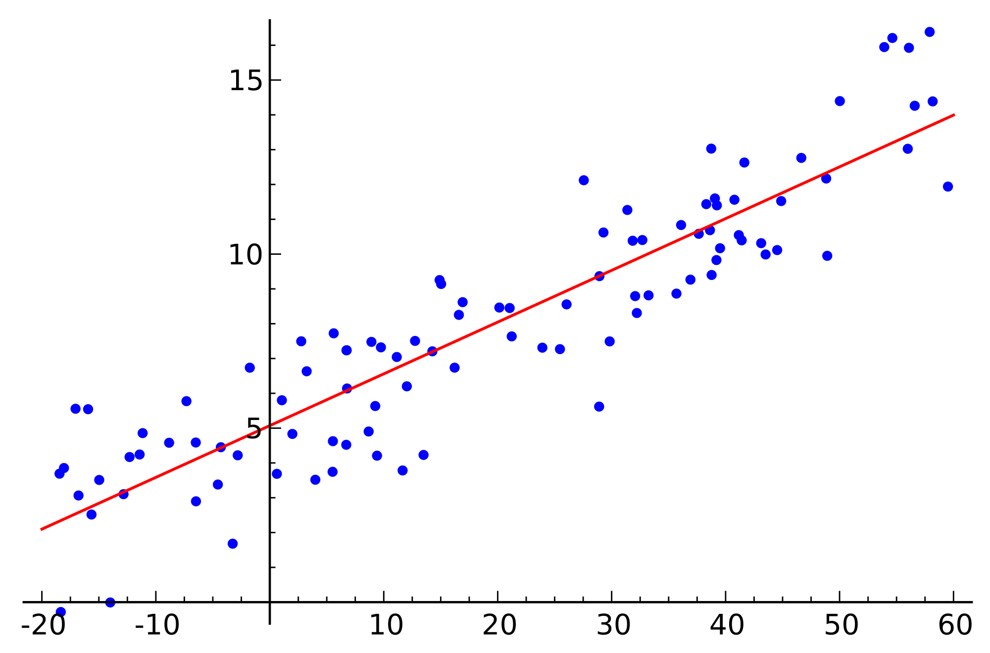
Future Work
Include additional weather variables
Image Credits: Pixabay &
Public Domain Vectors
Statistical correlations between OT and weather data
Image Credit: Wikimedia
Notes:
In our analysis, we looked at ___ climatic variables. However, there are several others that we did not include in our study. Combining more factors, such as ___, ___, and ___, would provide a more complete picture of atmospheric conditions surrounding these storms.
Furthermore, more statistical correlations between overshooting tops and climatic data would provide more hard numbers to complement our daily average conditions and observations from our weather maps.
Image Credit (Thermometer): OpenClipartVectors. (2013). [Clip Art], Retrieved from (https://pixabay.com/static/uploads/photo/2013/07/12/18/15/thermometer-153138_960_720.png)
Image Credit (Drops): Retrieved from (https://pixabay.com/static/uploads/photo/2013/07/12/14/49/drops-148870_960_720.png)
Image Credit (Wind Turbine): (2013). [Clip Art], Retrieved from (http://publicdomainvectors.org/photos/erlandh_Wind_Turbine.png)
Image Credit (Lightning Bolt): UniCollab. (2013). Harry Potter Lightning. (https://commons.wikimedia.org/wiki/File:Harry_Potter_Lightning.svg)
--------------------------------------------------------------------------------------------------------------------
Adding more weather variables will help create a more robust weather forecasting model.
Comparing overshooting top detections to lightning data such as that produced by TRMM’s LIS will help validate the use of OTs as storm predictors, and provide a wider temporal study range, past the availability of the hazardous storm event database.

Slide 19
Advisors
Dr. Kenton Ross, NASA DEVELOP National Program
Kristopher Bedka, NASA Applied Sciences Climate Science Branch
Dr. DeWayne Cecil, Global Science & Technology, National Centers for Environmental Information (NCEI)
Robert VanGundy, University of Virginia’s College at Wise
Partners
Kenya Meteorological Department
Others
William Wilson, Past contributor
Grant Bloomer, Past contributor
Juan Antonio Chacón Castro, Past contributor
Steve Licata, Jet Propulsion Laboratory, Atmospheric Infrared Sounder Project
April Huff, NASA DEVELOP/Wise County Clerk of Court’s Office
Notes:
We would like to acknowledge the help and support of all the wonderful people who have contributed to this project.

Slide 20
End of Presentation

Slide 21
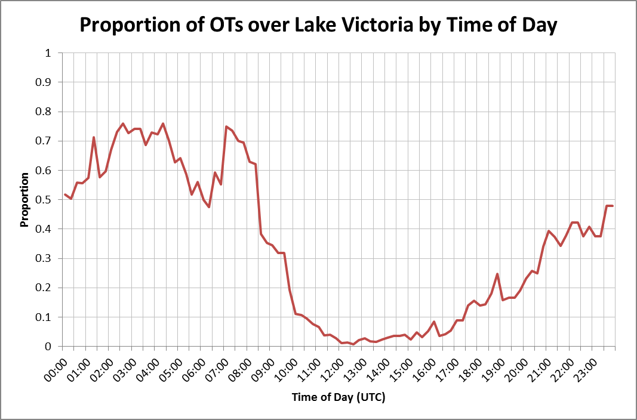

Slide 22
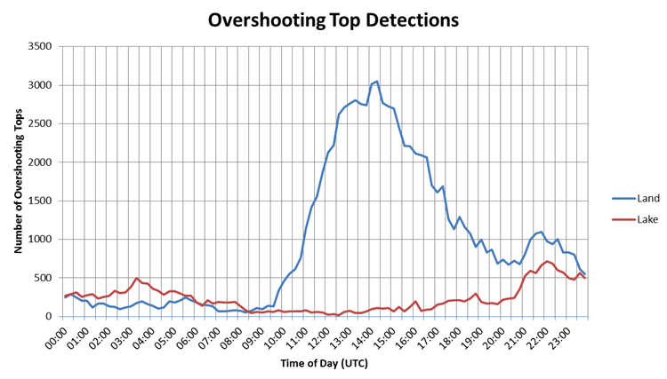

Slide 23
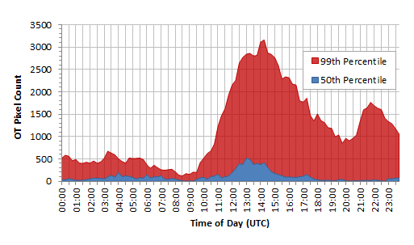

Slide 24
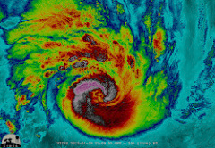
SEVIRI & the HSED
Date | Lat | Long | Temp | Temp_Diff | QC | Storm_ID
'2005-01-01-0000' | 0.3256 | 32.0194 | 205.9 | -6.3 | 0.78 | 7
'2005-01-01-0000' | 0.2977 | 32.0193 | 203.2 | -9 | 0.78 | 7
'2005-01-01-0000' | 0.2977 | 32.0541 | 203.6 | -8.6 | 0.78 | 7
'2005-01-01-0000' | 0.2977 | 32.089 | 204.6 | -7.6 | 0.78 | 7
'2005-01-01-0000' | 0.2978 | 32.1938 | 203.6 | -5.3 | 0.69 | 8
'2005-01-01-0000' | 0.2978 | 32.2288 | 203.2 | -5.8 | 0.69 | 8
'2005-01-01-0000' | 0.2698 | 32.0192 | 201.7 | -10.5 | 0.78 | 7
'2005-01-01-0000' | 0.2698 | 32.054 | 200.7 | -11.5 | 0.78 | 7
'2005-01-01-0000' | 0.2698 | 32.0889 | 201.7 | -10.5 | 0.78 | 7
'2005-01-01-0000' | 0.2699 | 32.1938 | 201.2 | -7.7 | 0.69 | 8
'2005-01-01-0000' | 0.2699 | 32.2287 | 200.7 | -8.2 | 0.69 | 8
'2005-01-01-0000' | 0.2699 | 32.2637 | 202.7 | -6.3 | 0.69 | 8
'2005-01-01-0000' | 0.2419 | 32.019 | 202.7 | -9.5 | 0.78 | 7
'2005-01-01-0000' | 0.2419 | 32.0538 | 201.7 | -10.5 | 0.78 | 7
'2005-01-01-0000' | 0.2419 | 32.0887 | 201.2 | -11 | 0.78 | 7
'2005-01-01-0000' | 0.242 | 32.1936 | 201.7 | -7.2 | 0.69 | 8
'2005-01-01-0000' | 0.242 | 32.2285 | 201.2 | -7.7 | 0.69 | 8
Image Credit: NASA GSFC
Notes:
The HSED contains a repository of OT related pixels derived from the SEVIRI sensors on Meteosat 8 & 9. An algorithm developed by Kristopher Bedka, one of our science advisors for this project, takes the infrared images produced from the SEVIRI data and looks at temperature differences in cloud cover to determine the presence of an overshooting top.

