Slide 1
Cascade & Sierra Nevada Mountains Water Resources
A Comparison of Remotely-Sensed Climate Data Records for Improved Climate Monitoring
Sam Swanson (Project Lead)
Kevin Rapa

Slide 2
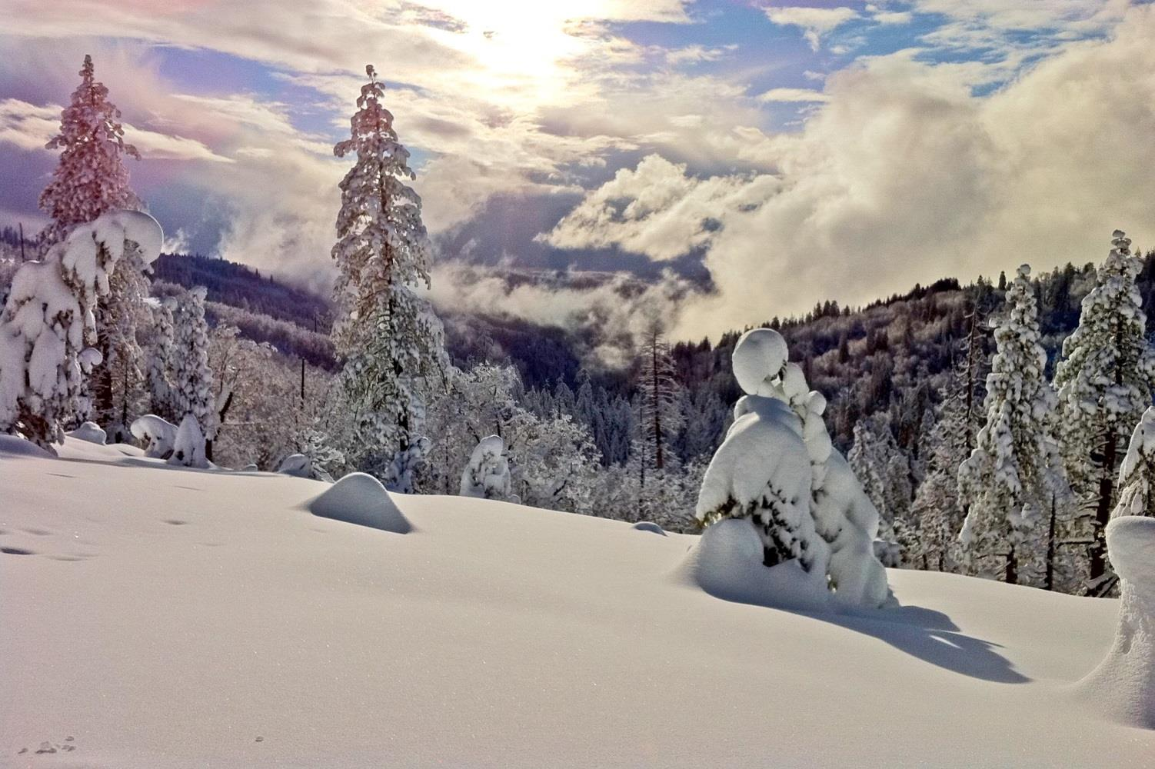
Background
Water resources are a major priority in the West
Primarily stored in natural reservoirs of snowpack
Image Credit: NOAA
Notes:
-The primary water source for human and ecological use in the Western US is stored in the natural reservoirs of snowpack at high elevations during the winter and spring (Mote et al 2005; Vicuna and Dracup 2007).
-Water in the riverbed, which flows from the Central Sierras, also supports irrigation for farmers downstream,
while diverted water from the Hetch Hetchy Reservoir upstream travels via above- and below-ground tubes to San Francisco and the Bay Area.
Image Credit:
http://research.noaa.gov/News/NewsArchive/LatestNews/TabId/684/ArtMID/1768/ArticleID/9984/Saharan-and-Asian-dust-biological-particles-end-global-journey-in-California.aspx

Slide 3
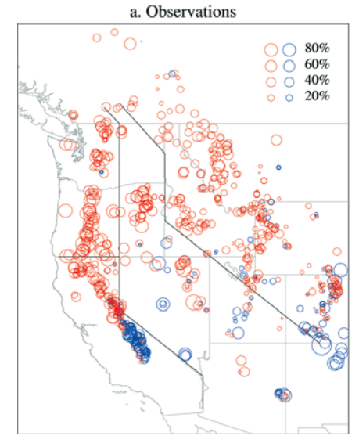

Background
Linear Trends in April 1 SWE
Observations 1950-1997
Decreasing trend in snow
water equivalent (SWE)
80% Percent
60% change
40% since
20% 1950
Red: Negative
Blue: Positive
Increasing trend in temperature
Image Credit: Mote et al. 2005
Notes:
However, since 1950, studies have shown a decreasing trend in snowpack and snow-water equivalent (SWE) in mountainous areas. This trend has been repeatedly correlated with temperature increases hypothesized to be a result of human-induced climate change (Melillo et al 2014; Vicuna and Dracup 2007; Mote et al 2005). This image, drawn from a study titled “Declining Mountain Snowpack in Western North America”, shows the magnitude of percent change in mountain snowpack on the 1st of April. The Cascades, as well as Northern and Central Sierras, have seen large decreases in SWE, while the Southern Sierra stands as a stronghold against temperature increases due to it’s relatively high elevation.
Image Credit:
Mote, Philip W., Alan F. Hamlet, Martyn P. Clark, and Dennis P. Lettenmaier. "Declining Mountain
Snowpack In Western North America*." Bull. Amer. Meteor. Soc. Bulletin of the American
Meteorological Society 86.1 (2005): 39-49.

Slide 4
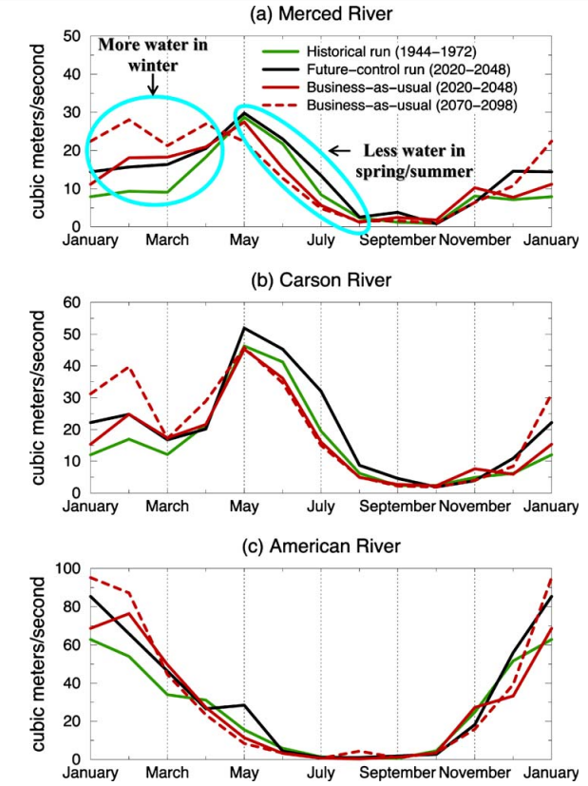

Background
The fraction of precipitation falling as snow has decreased
Peak snowmelt runoff occurs earlier in the spring
Shifting Peak Streamflow on the Carson River to Earlier in the Spring
Shifting Peak Streamflow on the Merced River to Earlier in the Spring
Shifting Peak Streamflow on the American River to Earlier in the Spring
More water in winter
Historical run (1944 – 1972)
Future – control run (2020 – 2048)
Business-as-usual (2020-2048)
Business-as-usual (2070-2098)
More water in winter
Historical run (1944 – 1972)
Future – control run (2020 – 2048)
Business-as-usual (2020-2048)
Business-as-usual (2070-2098)
More water in winter
Less water in spring/summer
Streamflow in cubic meters per second
Streamflow in cubic meters per second
Streamflow in cubic meters per second
Less water in spring/summer
Less water in spring/summer
Image Credit: Vicuna and Dracup 2005
Notes:
One driver of this trend is the increasing fraction of precipitation falling as rain rather than snow at low- to mid-elevations. Although precipitation on the whole hasn’t tapered dramatically in the Western US, rain events during winter months cause premature snowmelt, early flood events, and a reduced snowpack to prepare for the dry summer months (Vicuna and Dracup 2007; Knowles et al 2007; Stewart et al 2005; Maurer et al 2007).
Image Credit:
Vicuna, S., and J. A. Dracup. "The Evolution of Climate Change Impact Studies on Hydrology and
Water Resources in California." Climatic Change 82.3-4 (2007): 327-50.

Slide 5
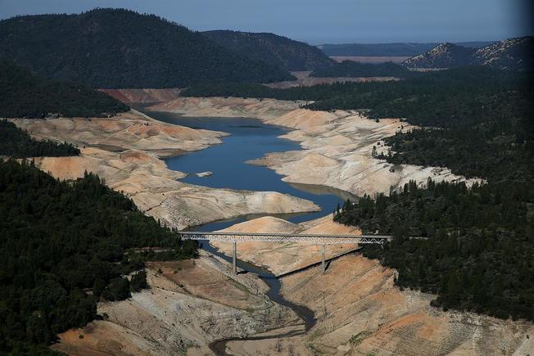
Community Concerns
Image Credit: US News
These trends make water management difficult
Use includes: human needs, agricultural demands, recreation, and fish and wildlife.
Notes:
Low snowpack and early-onset snowmelt lead to abnormally low summertime reservoir levels, like at Lake Oroville on the Feather River in the Northern Sierras, pictured above. Dam managers are forced to rethink their storage regimes in a changing climate, and accurate monitoring efforts of orographic precipitation are in high demand in order to thoroughly assess the impact of the drought in the Western US.
Image Credit:
http://www.usnews.com/news/articles/2015/10/15/el-nino-may-ease-california-drought-but-not-end-it-noaa-says

Slide 6
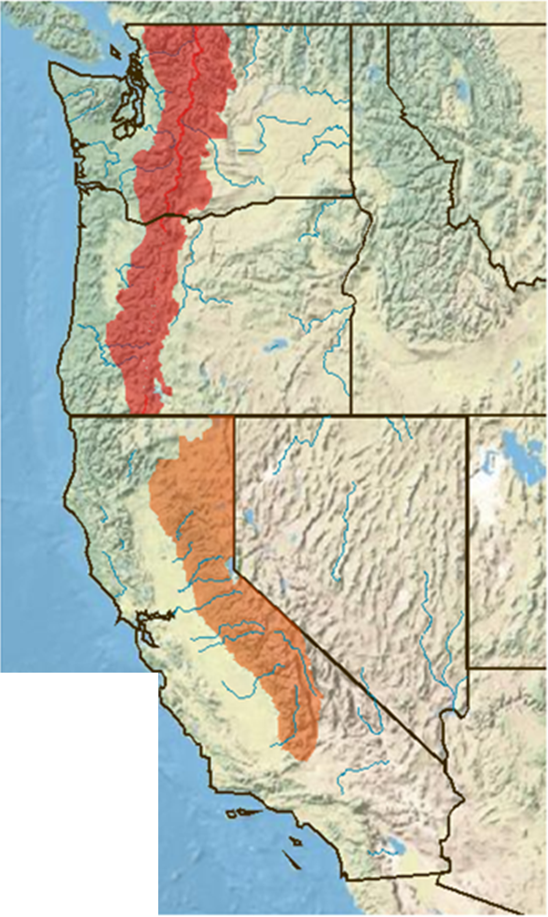



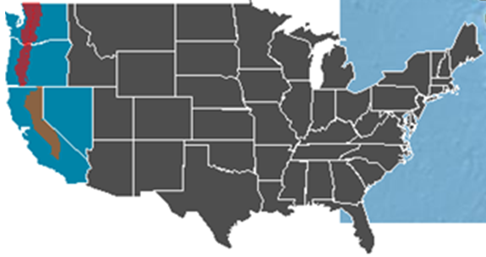
Study Area
WA
Winter Months (Oct 1 – Mar 31)
Divided by RFC
Time period depends on dataset
OR
Legend
NV
Cascades
Sierra Nevada
CA
Notes:
The Cascade Mountains range from above the Canadian border through western Washington and Oregon, and boast several photogenic volcanoes along their length. Annually, Mt Baker in NW Washington records the highest accumulation of snowfall in the continental US, some years topping over 800 inches of snow.
The Sierra Nevadas are often divided into three sections along latitudinal divides: Northern, Central, and Southern. The high altitude Sierras promote precipitation from the ocean to fall on the western slope, and leave the eastern slope and much of Nevada in its rain shadow. The major rivers that flow off of the western slope, including the Feather, the Sacramento, and the American, supply water to major cities like San Francisco, Sacramento, and the agricultural machine of the Central Valley.
We divided our research roughly between the Cascades and Sierra Nevada by the regions of the River Forecast Centers: Northwest Region and California/Nevada Region. By Nina Oakley’s request, we analyzed precipitation and snowpack in winter months only (October 1 through March 31). Study period for each dataset were limited by satellite-derived availability, as noted above.
Sources:
Basemap – Esri. “USA_Topo_Maps” ArcGIS Online. N.P., n.d. Web. 18 Feb. 2016.
State boundaries – FracTrackerAlliance. “US State Boundaries” ArcGIS Online. N.P., n.d. Web. 18 Feb. 2016.
River layer -
Sierra NV area - SNCAdmin. "SNC." ArcGIS Online. N.p., n.d. Web. 18 Feb. 2016.
Cascade lay- Consbio. "Conifer Cover for the Eastern Cascades Oregon." ArcGIS Online. N.p., n.d. Web. 18 Feb. 2016.
Consbio. "Conifer Cover for the Eastern Cascades Washington." ArcGIS Online. N.p., n.d. Web. 18 Feb. 2016.
Consbio. “Broadleaf cover for the Oregon West Cascades." ArcGIS Online. N.p., n.d. Web. 18 Feb. 2016.
Consbio. “Broadleaf cover for the Western Cascades Washington." ArcGIS Online. N.p., n.d. Web. 18 Feb. 2016.

Slide 7
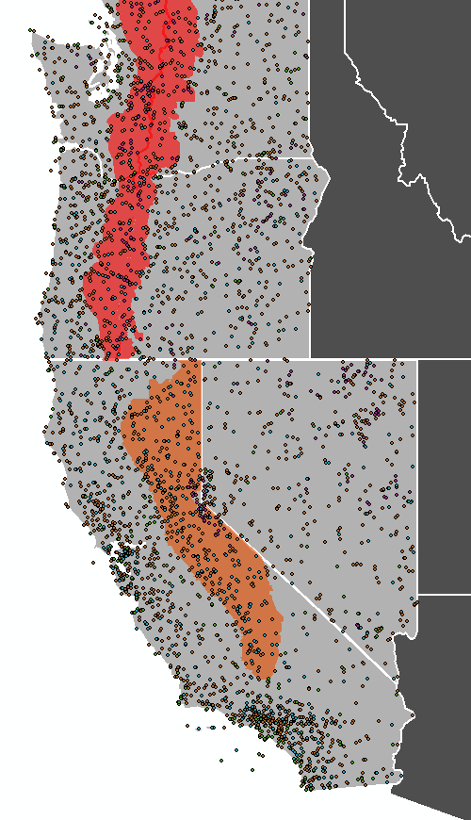
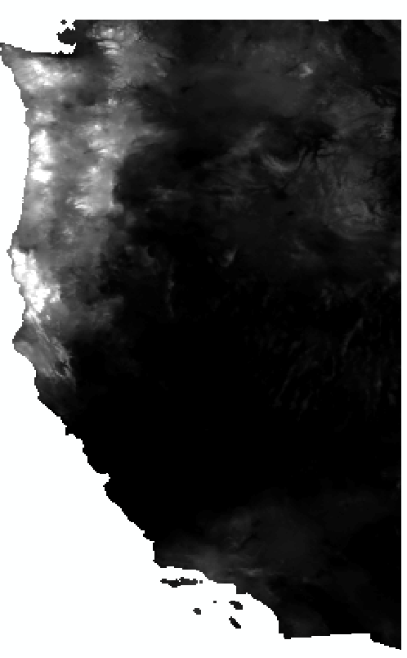
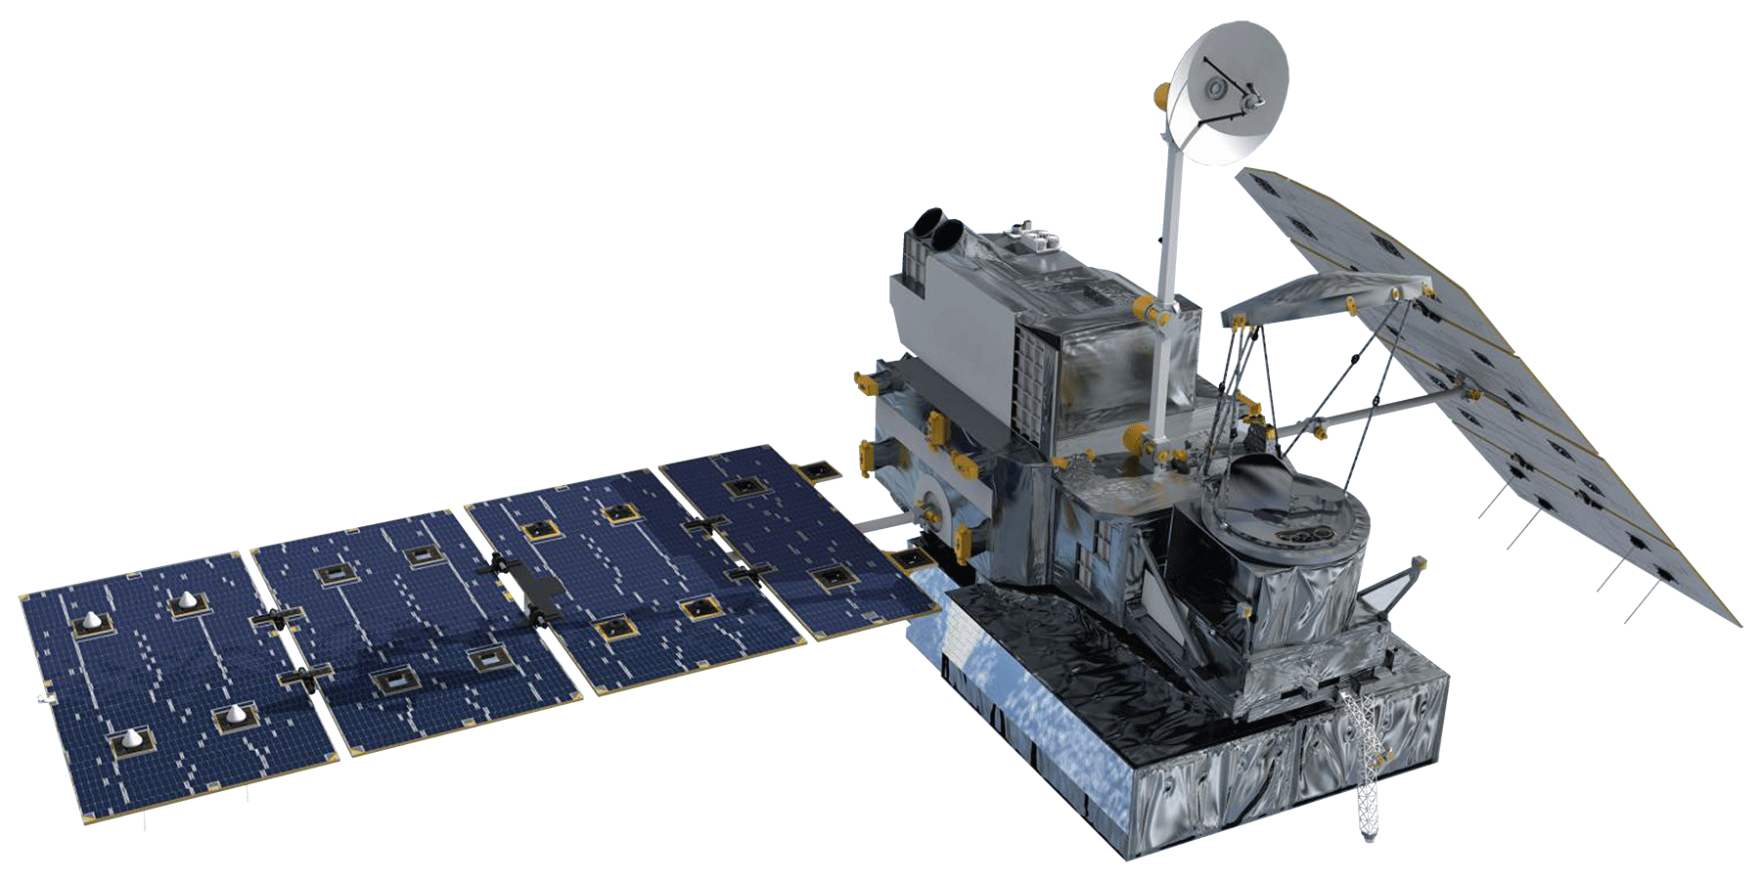
Datasets - Precipitation
Ground
:
SNOTEL, COOP,
and ASOS
Format: dat & txt
PRISM
GHCN
4km², Daily
Format: bil
Satellites
NASA’s GPM Microwave Imager
NOAA’s CMORPH CDR
Integrates NASA SSM/I, AMSU-B, AMSR-E, and TMI sensors
Earth Observation
11km², 30 minute
Format: tif
Oct 1 – Dec 31 2015
8km², 30 minute
Format: tif
Oct 1 1998 – Dec 31 2013
Notes:
* Include small images of raster samples from each. 2 or 4
Ground datasets
-GHCN – Conglomerate of numerous data sources. We are using ASOS, COOP, and SNOTEL. 3724 stations total
ASOS – 100% automated. For meteorological and aviation needs. 900 total.
COOP – Of the NWS. Thousands of volunteers take measurements from a variety of areas all over the United States. So, works where people are.
SNOTEL – Over 730 of these. National Resources Conservation service. Generally in remote, high-mountain watersheds. Only one that measures SWE
-PRISM – raster dataset interpolating from numerous point datasets, incl. GHCN.
Introduce satellite datasets
-CMORPH – NOAA product using NASA, NOAA, and US Dept. of Defense satellites
SSM/I (Air Force), AMSU-B (NOAA), AMSR-E and TMI (NASA)
Fine spatial (.072 degree, 8km) and temporal resolutions (30 min). 8km resolution actually from interpolated coarser data
Method of combining precipitation algorithms from other satellites
-GPM – Continuation of TRMM at higher latitude. NASA product
(.1 degree, 11 km, 30 minutes)
Fine temporal resolution, covers small time period though (Since March of 2015)

Slide 8
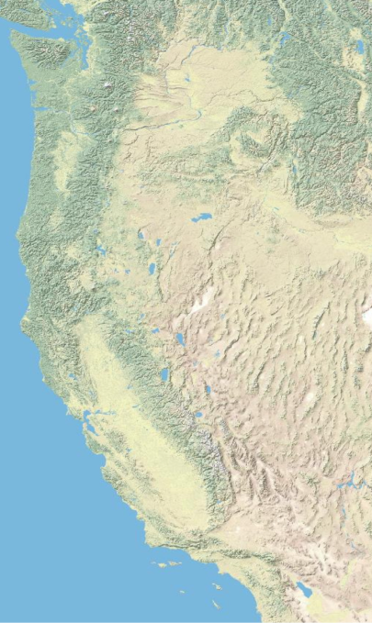




Datasets - SWE
Ground
SNOTEL
262 stations, many times daily
Format: csv
Satellite
SNODAS
1 km², hourly
Merged product
(ground-, airborne-, and satellite-based)
Format: dat & hdr
Oct 1 2003 – Dec 31 2015
Notes:
As a preliminary study of SNODAS, a merged dataset provided by NOAA and the NWS’s National Operational Hydrologic Remote Sensing Center that estimates snow water equivalents (SWE) by merging ground, airborne, and satellite data, we compared SNODAS estimates and SNOTEL observations of SWE in our study area from October 2003 – December 2013.

Slide 9
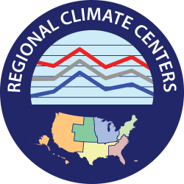
Partners & Objectives
Nina Oakley
Assistant Research Climatologist
Western Regional Climate Center
Andrea Bair
National Weather Service
Western Region
Climate Services Division
1
Satellite and ground station comparisons of precipitation
2
Difference and benefits maps for project partners
3
Similar analyses for SWE
Notes:
The WRCC is one of six regional climate centers in the United States.
The WRCC itself conducts climatic research to collect high quality information of the western United States and store it.
This climate data gives the WRCC a valuable resource to provide climate services on national, regional, and state levels.
The WRCC and its partners including NCEI, other NOAA institutes, and NWS work to provide climate information to the American public.
(Others: The American Association of State Climatologists, and the Regional Sciences and Assessment Program, Department of Interior Climate Science Centers and Landscape Conservation Cooperatives)
The WRCC use station-based datasets, but not satellite-based ones, to collect precipitation measurements. They both would like to integrate them if they prove useful.
A popular source of precipitation information to the WRCC is PRISM, an interpolated ground-based model. Less commonly used are GHCN and NCEP/NCAR reanalysis.
Reanalysis proved inaccurate, while PRISM is simply a more useful version of GHCN for their purposes.
The NWS is a component of NOAA, all under the US department of Commerce.
The NWS shares the WRCC’s goal of providing high-quality climate information. The NWS works on a national level to support and enhance the United States economy.
Its infrastructure includes 13 river forecasting centers- 2 of which we are using to organize our data.

Slide 10

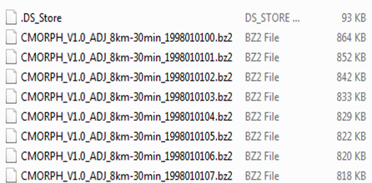
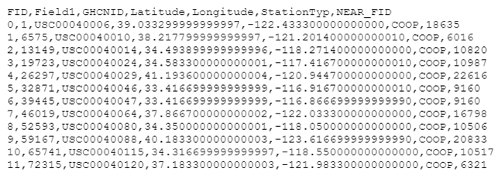

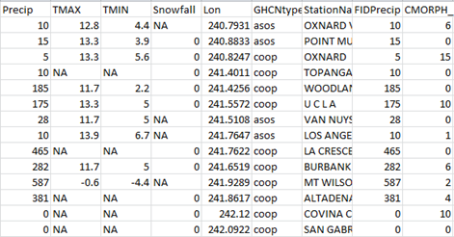

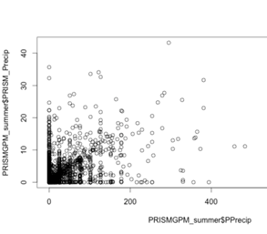
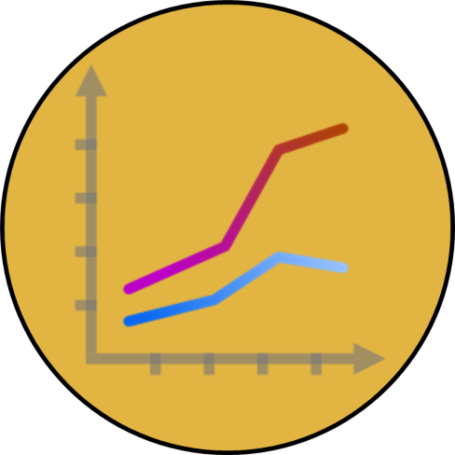
Methods
Satellite and spatial difference maps
Satellite data
Station data
Merged table
Graphs and maps

Slide 11

Results
Satellite Differences from GHCN
GPM minus GHCN
CMORPH minus GHCN
Satellite difference
From GHCN
Satellite
underestimate
Small
difference
Satellite
overestimate
Notes:
CMORPH is from October 1998 to March 2013 (Include a timeline)
GPM is from October 2015 to December 2015
These maps are not good for comparison because of the different timescales.
GPM looks better, but it is only 3 months. Less precipitation than 6 months, differences are smaller
GPM still overestimates in some places where CMORPH underestimates
The general picture here is that CMORPH and GPM both underestimate in the mountains, but are better on flatland.

Slide 12
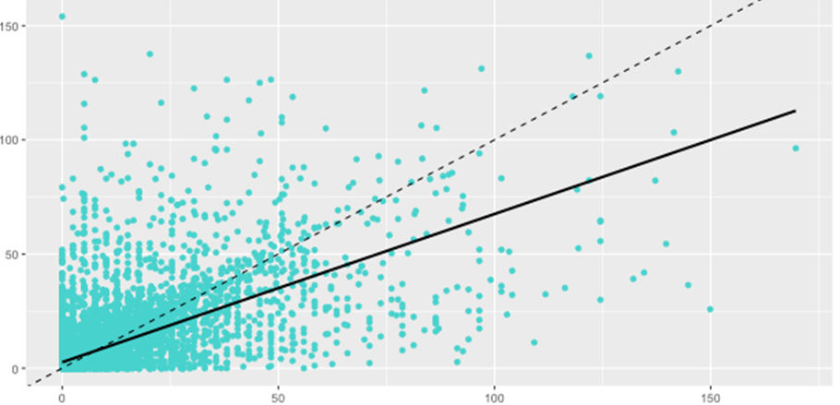
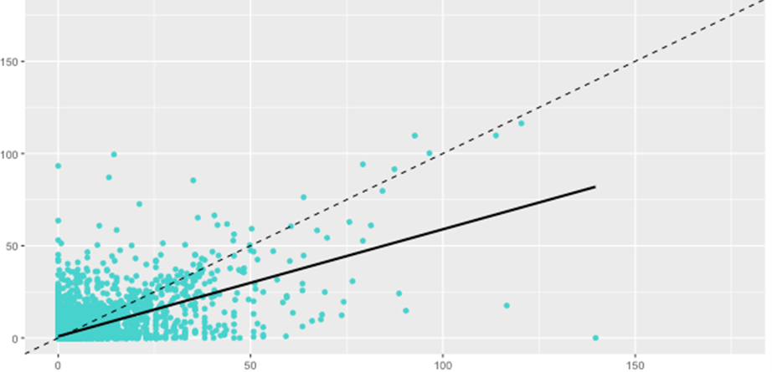
Results
NW RFC
PRISM vs GHCN,
October 2015 –
December 2015
PRISM (mm/day)
RMSE: 11.90
GHCN (mm/day)
CA/NV RFC
RMSE: 5.84
PRISM (mm/day)
GHCN (mm/day)
Notes:
All scatterplots comparing winter and seasonal averages for PRISM and GPM here
PRISM listed first, as it should have the best correlation
Data time period is limited by GPM. Only 9 months of data are available
PRISM has a visible 1:1(ish) correlation with GHCN, which is expected, and happily seen as we’ve run our analysis correctly. PRISM overestimates as GHCN approaches zero
The results from the analysis between GPM and GHCN stations showed underestimation by GPM. In both the Northwest and California/Nevada RFC’s, PRISM shows a lower RMSE (11.90 and 5.84 vs 12.88 and 8.06, respectively) and therefore a stronger correlation with GHCN data than GPM estimates. Perhaps a longer study period, rather than the 3 months (October 1 – December 31, 2015) available for this research, will show a stronger correlation between the two datasets. However, these results early in GPM’s lifetime led further investigation to be devoted to CMORPH, PRISM, and GHCN comparisons. For similar graphics concerning the California/Nevada RFC, see Appendix A.

Slide 13
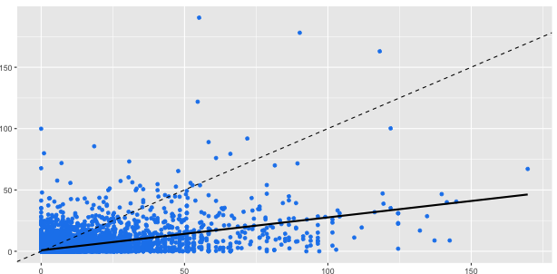
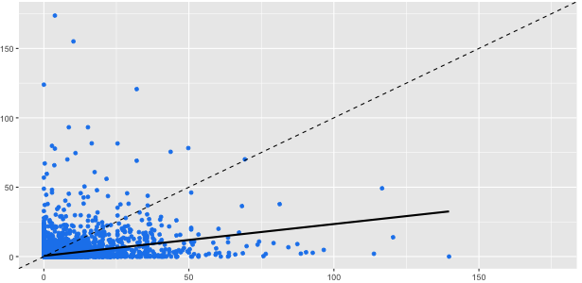
Results
NW RFC
GPM vs GHCN,
October 2015 –
December 2015
GPM (mm/day)
RMSE: 12.88
GHCN (mm/day)
CA/NV RFC
GPM (mm/day)
RMSE: 8.06
GHCN (mm/day)
Notes:
The results from the analysis between GPM and GHCN stations showed underestimation by GPM. In both the Northwest and California/Nevada RFC’s, PRISM shows a lower RMSE (11.90 and 5.84 vs 12.88 and 8.06, respectively) and therefore a stronger correlation with GHCN data than GPM estimates. Perhaps a longer study period, rather than the 3 months (October 1 – December 31, 2015) available for this research, will show a stronger correlation between the two datasets. However, these results early in GPM’s lifetime led further investigation to be devoted to CMORPH, PRISM, and GHCN comparisons. For similar graphics concerning the California/Nevada RFC, see Appendix A.

Slide 14
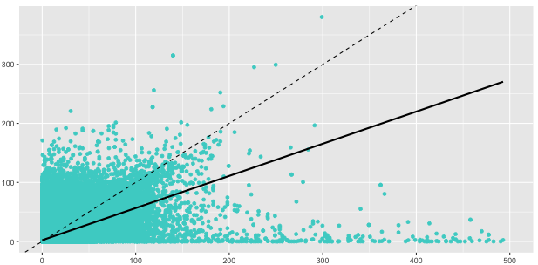
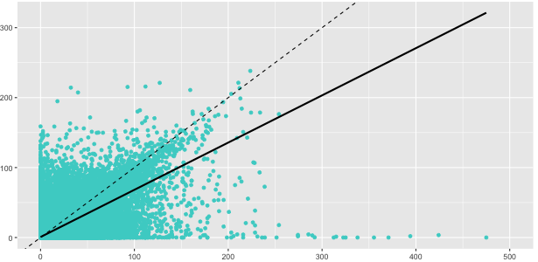
Results
NW RFC
PRISM vs GHCN,
October 1998 –
December 2013
PRISM (mm/day)
RMSE: 9.19
GHCN (mm/day)
CA/NV RFC
PRISM (mm/day)
RMSE: 5.85
GHCN (mm/day)
Notes:
Unlike GPM, daily estimates of precipitation by CMORPH between 1998 and 2013 show overestimation of GHCN measurements. Over the same time period, PRISM shows greater correlation with an RMSE of 9.19 in the Northwest and 5.85 in California/Nevada, compared to CMORPH’s 17.29 and 12.95, respectively. Distribution of data points above and below the R² = 1 line, shown as dashes, show general overestimation by CMORPH and slight underestimation by PRISM. Best-fit regression lines should be recognized as greatly swayed by outliers – long right tails in both graphs “pull” regression lines downwards. Neither CMORPH nor PRISM, it seems, accurately estimate precipitation events over 250 mm/day. Severe underestimation at high measurements by GHCN work visually to CMORPH’s favor, whose best-fit line would otherwise mirror the greater trend towards overestimation.

Slide 15
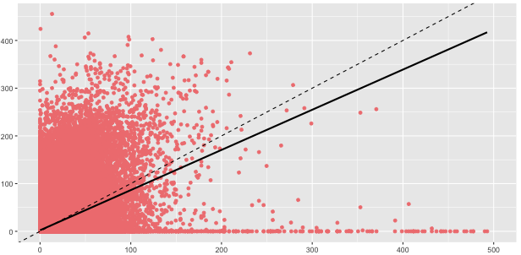
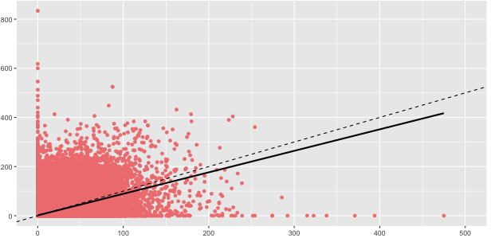
Results
NW RFC
CMORPH vs GHCN,
October 1998 –
December 2013
CMORPH (mm/day)
RMSE: 17.26
GHCN (mm/day)
CA/NV RFC
RMSE: 12.95
CMORPH (mm/day)
GHCN (mm/day)
Notes:
Unlike GPM, daily estimates of precipitation by CMORPH between 1998 and 2013 show overestimation of GHCN measurements. Over the same time period, PRISM shows greater correlation with an RMSE of 9.19 in the Northwest and 5.85 in California/Nevada, compared to CMORPH’s 17.29 and 12.95, respectively. Distribution of data points above and below the R² = 1 line, shown as dashes, show general overestimation by CMORPH and slight underestimation by PRISM. Best-fit regression lines should be recognized as greatly swayed by outliers – long right tails in both graphs “pull” regression lines downwards. Neither CMORPH nor PRISM, it seems, accurately estimate precipitation events over 250 mm/day. Severe underestimation at high measurements by GHCN work visually to CMORPH’s favor, whose best-fit line would otherwise mirror the greater trend towards overestimation.

Slide 16
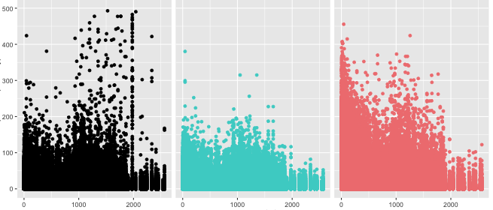
Results
GHCN, PRISM, & CMORPH by Elevation
NW RFC
GHCN
PRISM
CMORPH
Precipitation (mm/day)
Elevation (meters)
Notes:
Once again, PRISM shows some underestimation of GHCN data, especially during extreme events above 250 mm/day and in the Northwest RFC. CMORPH largely overestimates at all elevations. It should be noted that because daily estimates are numerous, some resolution is lost due to point overlaps in these and the above scatterplots. To account for this, daily data were aggregated to 15-year normals to spot general trends.

Slide 17
Results
CMORPH / PRISM Differences
Satellite difference
From PRISM
CMORPH underestimation
CMORPH is most similar
CMORPH overestimation
October
November
December
January
February
March
Notes:
Each map represents a month. Each month represents an average of those 15 months from 1998 to 2013.
CMORPH came as 30 minute files. Average to day, days were summed to a monthly total. Each occurance of that month until 2013 was averaged together.
From October to March, it seems that the differences become most obvious in December to January, which makes sense.
With less rainfall, differences cannot be that large anyway.
We can see that CMORPH does underestimate in the mountains, seems to be better on flatter land, and overestimates over 'lakes'. (WHY?)
Perhaps they create suddenly higher brightness temperatures which create anomalies in the sensor reading.

Slide 18
Results
CMORPH Benefits
GHCN Densities
Combined Benefits
Magnitude of difference
Between CMORPH
and PRISM
0.00 - 0.56 mm/day
0.57 - 1.11 mm/day
1.12 - 1.67 mm/day
1.68 - 2.23 mm/day
2.24 - 2.79 mm/day
Notes:
This map is based from the January CMORPH vs. PRISM map, and a GHCN density map.
Consistent with the previous maps, this shows benefits to be highest in certain areas at lower elevations.

Slide 19
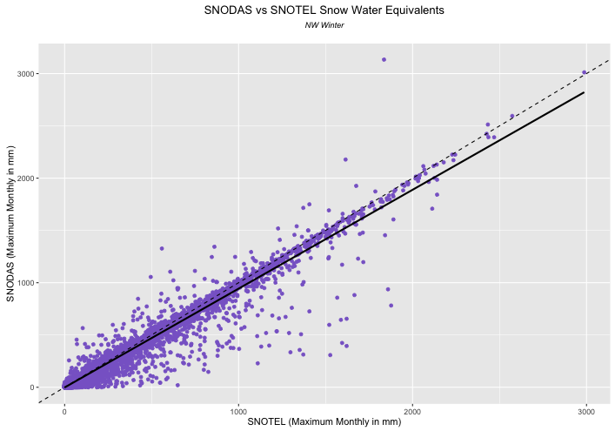
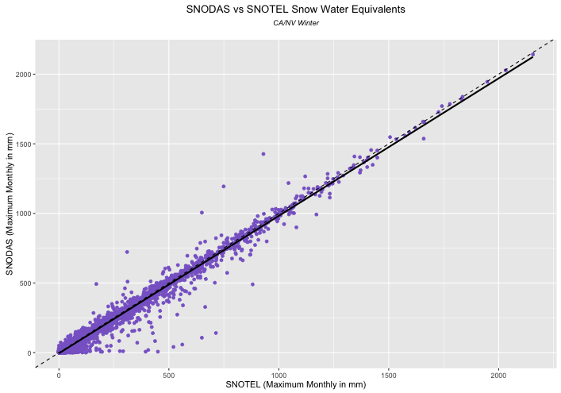
Preliminary Results
NW RFC
SNODAS vs SNOTEL,
October 2003 –
December 2013
SNODAS (Monthly Max, mm)
Adjusted R²: 0.95
SNOTEL (Monthly Max, mm)
CA/NV RFC
SNODAS (Monthly Max, mm)
Adjusted R²: 0.98
SNOTEL (Monthly Max, mm)
Notes:
SNODAS estimates and SNOTEL observations show unusually high correlation for independent variables (0.95 and 0.98 for the Northwest and California/Nevada RFC’s). Monthly maximums are used as an indicator variable for SWE as SWE is an accumulating variable. Unlike precipitation, which occurs in singular events, SWE accumulates throughout the winter season. So, monthly maximum SWE is used to visualize our data. Each data point on these graphs represents one station’s maximum SWE in one month between October 2003 and December 2013.

Slide 20
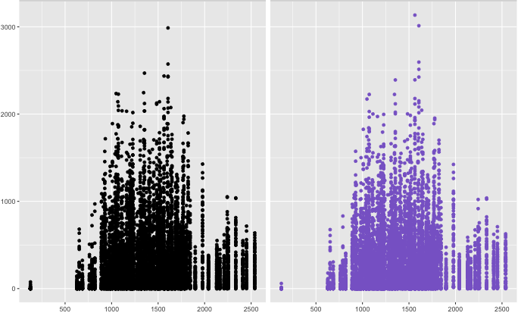
Preliminary Results
SNOTEL & SNODAS by Elevation
SNOTEL
NW RFC
SNODAS
SWE (Monthly Maximum, mm)
Elevation (meters)
Notes:
SNODAS data mirrors SNOTEL observations, almost exactly. SNOTEL is included in the SNODAS algorithm for predicting SWE, apparently with a heavy weighting. A personal communication between Gregory Fall of NOAA, the keeper of the SNODAS dataset, informed our team that “SNOTEL observations figure prominently in SNODAS assimilation…, so a strong correlation between the two would be unsurprising”. Therefore, although we find these results promising, we recommend further investigation as to the usefulness of SNODAS in the Cascades and Sierra Nevada by comparing SNODAS SWE estimates with independent SWE measuring stations, like the CDEC/CA Snow Survey, as recommended by Mike Kruk and Nina Oakley.

Slide 21
Conclusions
Measuring precipitation…
PRISM > CMORPH & GPM
Future satellite data use…
Use CMORPH as a supplemental dataset
Measuring snowpack…
Further studies are suggested
Notes:
From our study, we can draw several meaningful conclusions for the WRCC and the NWS. Neither GPM nor CMORPH outperforms PRISM, especially at high elevations, and we recommend continuing use of PRISM in those areas. However, if ground station data is unavailable for any reason, we recommend consulting CMORPH Climate Data Records as a supplemental dataset in the highlighted areas of greatest benefit, specifically southern California and east of the Cascades and Sierras. Furthermore, we believe future studies concerning SNODAS’s ability to measure SWE, especially at high elevations. Our preliminary results show too strong of a correlation between SNODAS and SNOTEL observations to draw conclusions on our results alone. By the recommendation of Nina Oakley and Mike Kruk, and the advice of Gregory Fall, we suggest further validation of SNODAS by comparing to the California Snow Survey, CDEC snow observations, or other datasets available that aren’t assimilated into SNODAS.

Slide 22
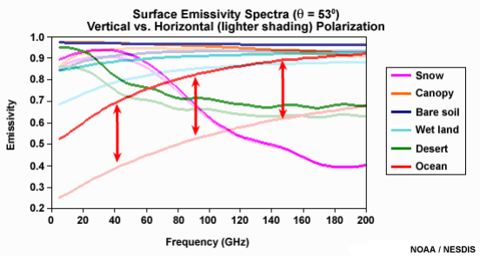
Errors & Uncertainties
Image Credit: NOAA / NESDIS
Ocean
Terrain
Inherent flaw in passive
microwave sensing
12:00 AM – 12:00 AM
7:00 AM – 7:00 AM
Time intervals
unaccounted for
Notes:
SSM/I - 15 x 13 km(85.5 GHz) ] DMSP 13, 14 & 15
AMSU-B - 16 or 17 km ] NOAA 15-18
AMSR-E - 6 x 4 km (89.0 GHz), 14 x 8 km (36.5 GHz) ] NASA Aqua
TMI - 11 x 8 km ] NASA TRMM
CMORPH - 8 x 8 km
CMORPH includes some interpolation.
CALCULATED ERROR:
Passive microwaves are inherently more inaccurate over land.
Brightness temperature is the basis for passive microwave sensing.
Oceans are a better as a background for precipitation measuring; cold background
Oceans emit polarized microwaves
Land emits unpolarized microwaves
Precipitation (AKA hydrometeors) scatter microwaves.
Land provides a warm background on which to measure, so scattering technique is more optimal.
Scattering technique is less direct of a measurement than emission based technique
Cloud cover can be interpreted as precipitation, especially light rain.
Snow and ice also has a high emissivity, which can be falsely interpreted as rain clouds.
Footprints of these scanners can be large compared to rain events.
HUMAN ERROR:
In the future, with careful calculations, the hourly intervals that determine a 'day' can be synchronized.
Some datasets define a 'day' as 7 AM to 7 AM, while others do 12 AM to 12 AM
Before downloading these datasets, we didn't have a full grasp of the complexity of the data.
Many different forms of each dataset exist, each may have a different unit of measure.
* The letters and numbers above are examples of PRIAM datasets
We didn't realize this until after downloading, so miscalculations on units of measure may have arose.
Graph - (NOAA / NESDIS) http://www.meted.ucar.edu/npoess/microwave_topics/resources/print.htm#s8p1

Slide 23
Science Advisor
Michael Kruk, ERT Inc
Partners
Nina Oakley – Western Regional Climate Center
Andrea Bair – National Weather Service Western Region
Climate Services Division
DEVELOP & NCEI staff
Jessica Sutton – Center Lead
Emma Baghel – Assistant Center Lead
Mike Squires, NESDIS
Dr. Olivier Prat, CICS
Ronald Leeper, CICS
Jonathan Brannock

Slide 24
Appendix A. Glossary of Acronyms

Slide 25
CA/NV – California/Nevada
CICS – Cooperative Institute for Climate and Satellites
CMORPH – Climate Prediction Center (CPC) Morphing Technique
ERT, Inc – Earth Research Technologies, Incorporated
GHCN – Global Historical Climatology Network
GPM – Global Precipitation Measurement
NASA – National Aeronautics and Space Administration
NCEI – National Centers for Environmental Information
NESDIS – National Environmental Satellite, Data and Information Service
NOAA – National Oceanic and Atmospheric Administration
NW – Northwest
NWS – National Weather Service
PRISM – Parameter - Elevation Regression on Independent Slopes Model
RFC – River Forecast Center
SNODAS – Snow Data Assimilation System
SNOTEL – Snow Telemetry
SWE – Snow-water equivalent
WRCC – Western Regional Climate Center

Slide 26
Appendix B. Excluded Graphs and Maps

Slide 27
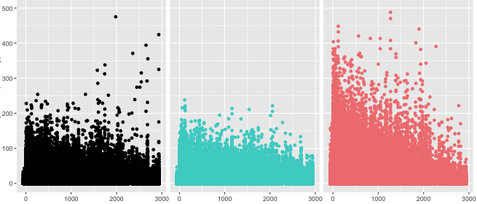
Excluded Results
GHCN, PRISM, & CMORPH by Elevation
CA/NV RFC
GHCN
PRISM
CMORPH
Precipitation (millimeters)
Elevation (meters)
Notes:
The California/Nevada RFC sees fair estimation of GHCN precipitation measurements by PRISM at most elevations, excepting at very high altitudes (<2500 m). CMORPH strongly overestimates at low- and mid-elevations.

Slide 28
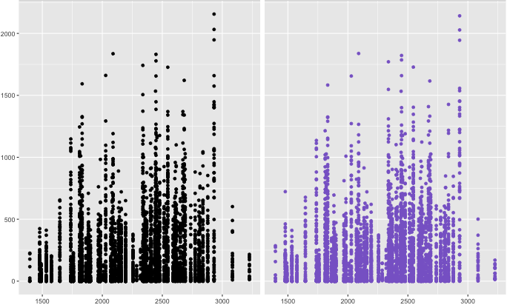
Excluded Results
SNOTEL & SNODAS by Elevation
SNOTEL
CA/NV RFC
SNODAS
SWE (Monthly Maximum in mm)
Elevation (meters)
Notes:
Across all elevations, SNOTEL and SNODAS observations and estimates agree very well. At very high elevations, SWE drops due to extremely cold temperatures and snowpack with small percentages of water content.

Slide 29
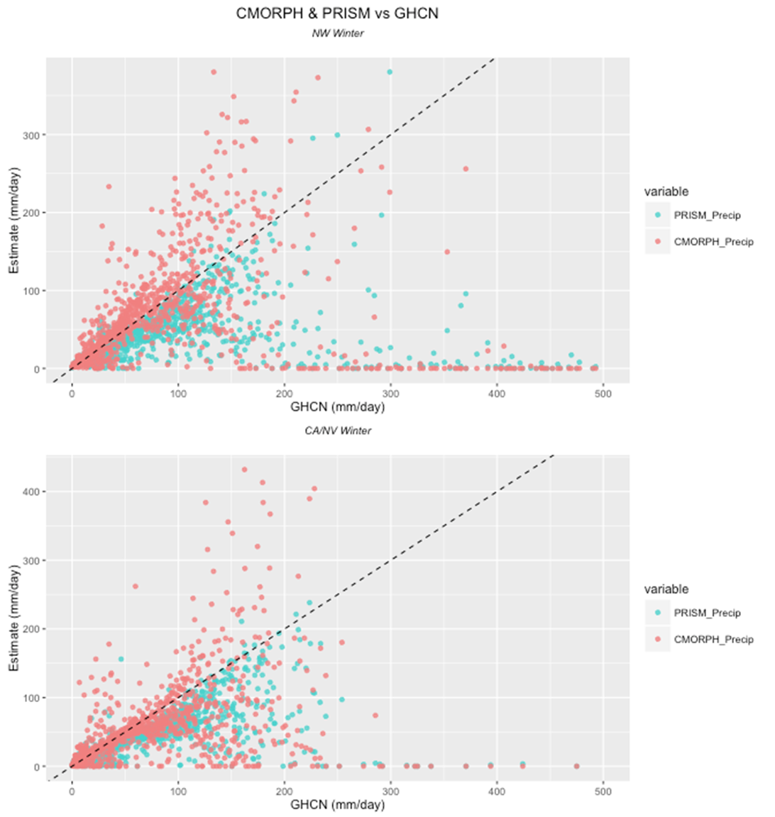
Excluded Results
Notes:
Across all elevations, SNOTEL and SNODAS observations and estimates agree very well. At very high elevations, SWE drops due to extremely cold temperatures and snowpack with small percentages of water content.

Slide 30
Background
The fraction of precipitation falling as snow has decreased
Peak snowmelt runoff occurs earlier in the spring
Shifting Peak Streamflow on the American River to Earlier in the Spring
More water in winter
Streamflow in cubic meters per second
Less water in spring/summer
Image Credit: Vicuna and Dracup 2005
Notes:
One driver of this trend is the increasing fraction of precipitation falling as rain rather than snow at low- to mid-elevations. Although precipitation on the whole hasn’t tapered dramatically in the Western US, rain events during winter months cause premature snowmelt, early flood events, and a reduced snowpack to prepare for the dry summer months (Vicuna and Dracup 2007; Knowles et al 2007; Stewart et al 2005; Maurer et al 2007).
Image Credit:
Vicuna, S., and J. A. Dracup. "The Evolution of Climate Change Impact Studies on Hydrology and
Water Resources in California." Climatic Change 82.3-4 (2007): 327-50.

Slide 31
Background
The fraction of precipitation falling as snow has decreased
Peak snowmelt runoff occurs earlier in the spring
Shifting Peak Streamflow on the Carson River to Earlier in the Spring
More water in winter
Less water in spring/summer
Streamflow in cubic meters per second
Image Credit: Vicuna and Dracup 2005
Notes:
One driver of this trend is the increasing fraction of precipitation falling as rain rather than snow at low- to mid-elevations. Although precipitation on the whole hasn’t tapered dramatically in the Western US, rain events during winter months cause premature snowmelt, early flood events, and a reduced snowpack to prepare for the dry summer months (Vicuna and Dracup 2007; Knowles et al 2007; Stewart et al 2005; Maurer et al 2007).
Image Credit:
Vicuna, S., and J. A. Dracup. "The Evolution of Climate Change Impact Studies on Hydrology and
Water Resources in California." Climatic Change 82.3-4 (2007): 327-50.

Slide 32


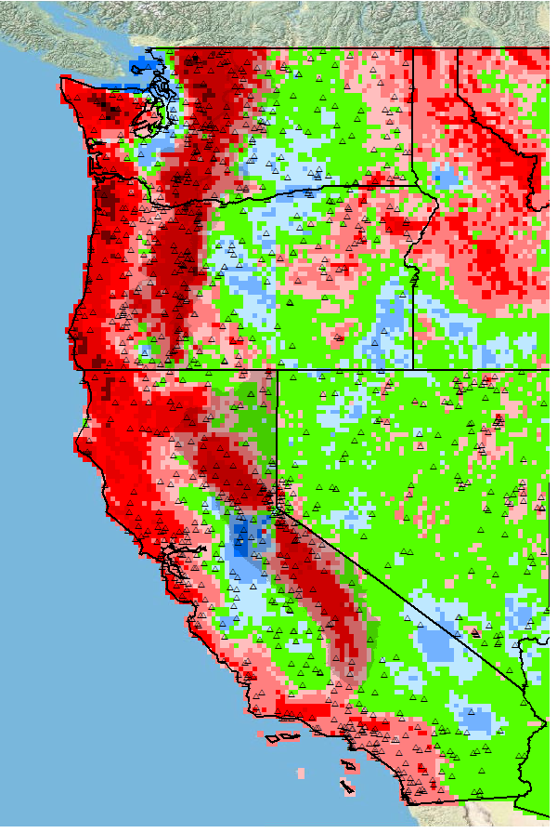
Methods
Satellite &
Graphs and maps
Merged table
Station data
Notes:
Acquired raw compressed satellite data and station data from various websites.
CMORPH, PRISM, and GPM were converted into .tif format, clipped to study area, and aggregated to daily timescales
Area weighted averages were calculated of ground station observations according to correlating raster pixels in CMORPH, PRISM, and GPM, in order to average ground station data across pixels for comparison
Raster estimates were extracted using R for each day and station over the study period, for comparable ground-based and satellite-derived precipitation and SWE estimates
These comparisons were visualized graphically using R, and in maps using ArcMap 10.3

