Slide 1
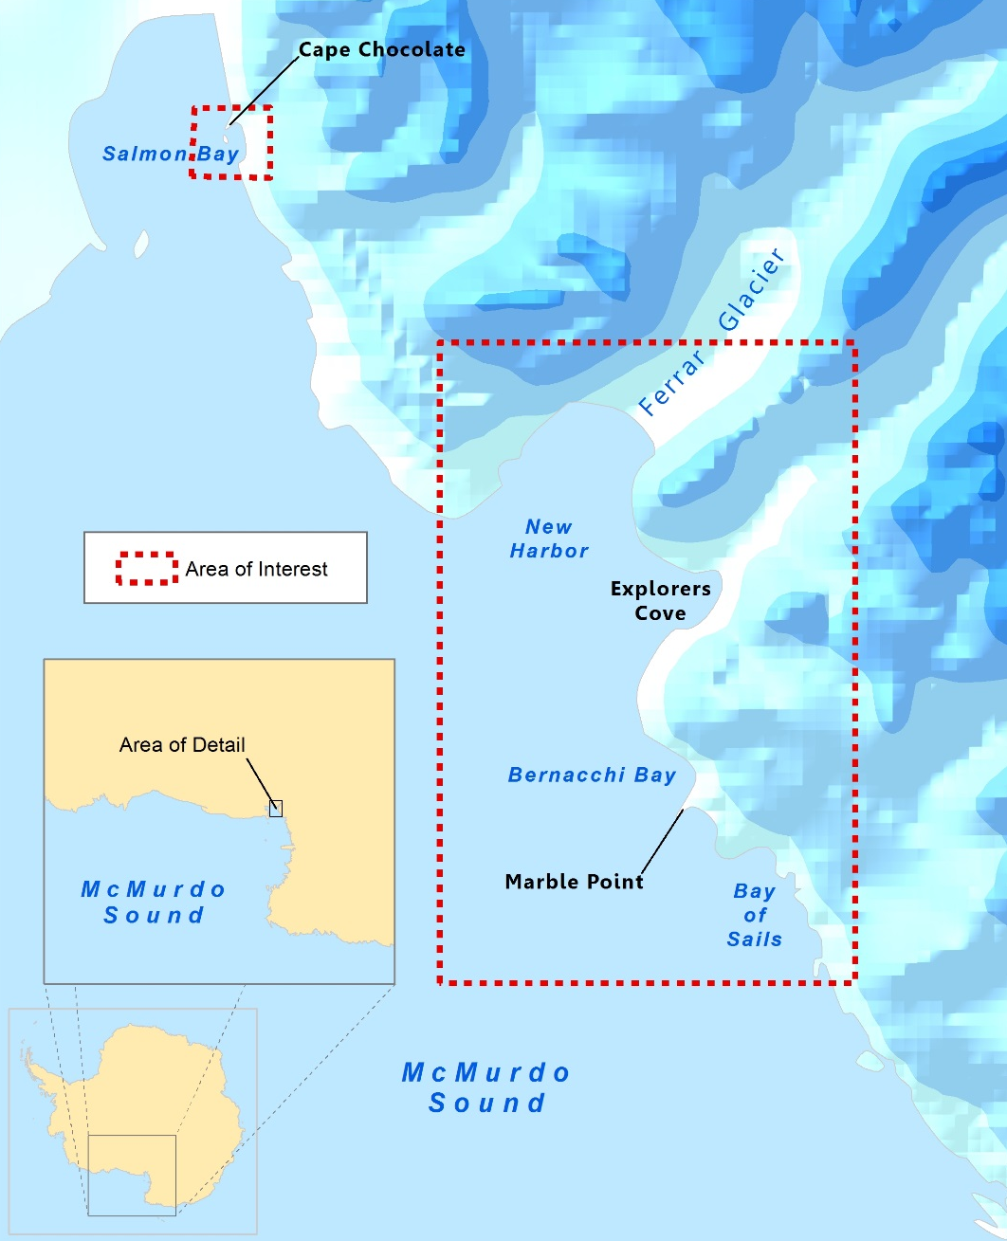
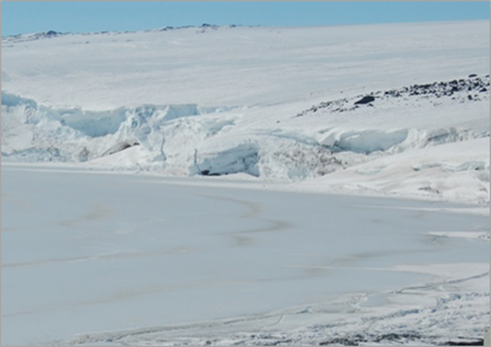
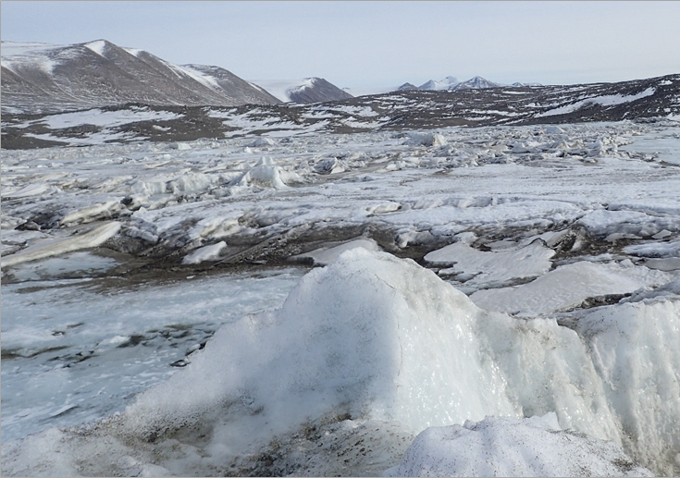
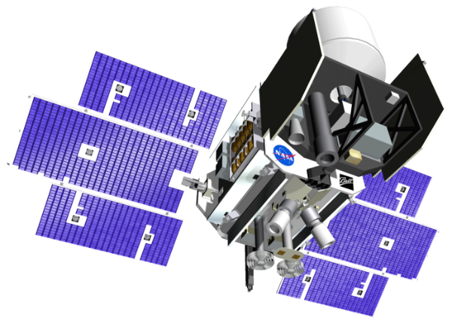
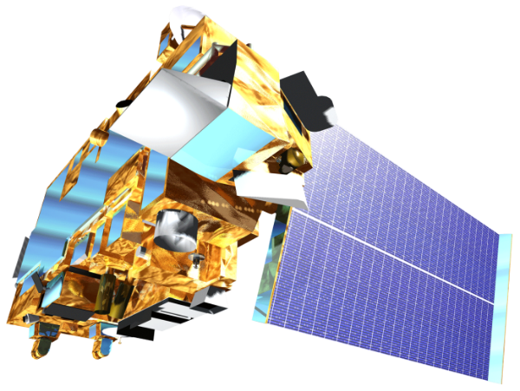
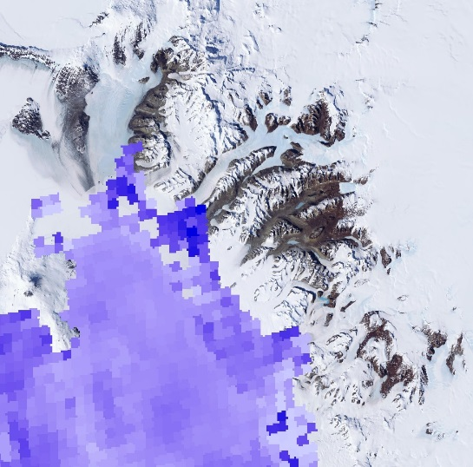
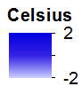
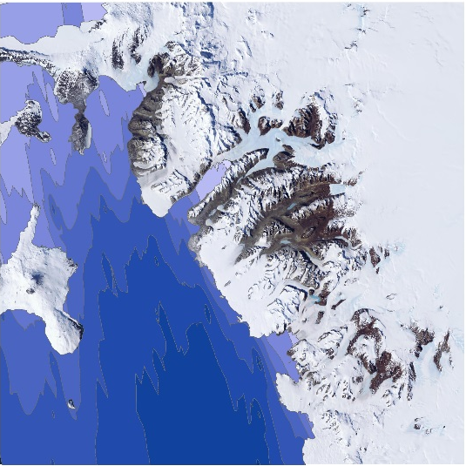
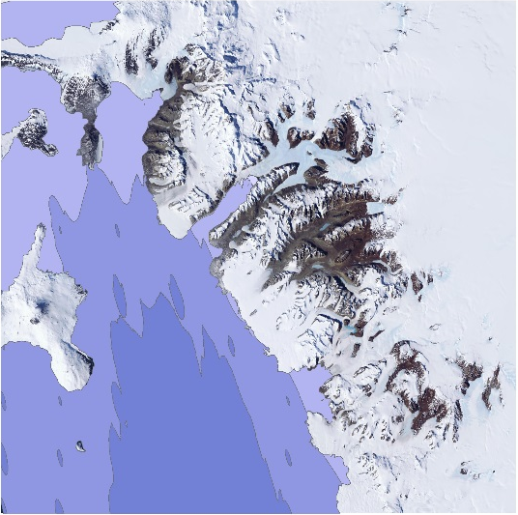
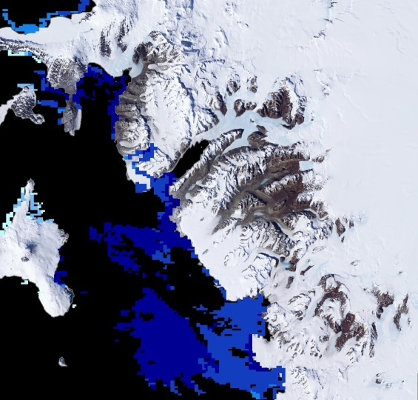
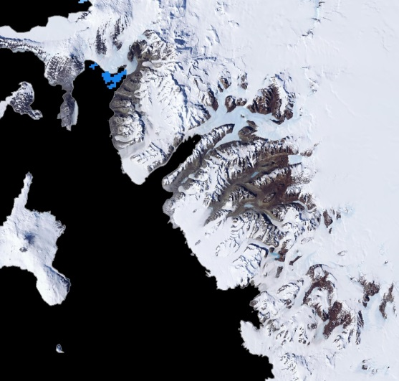
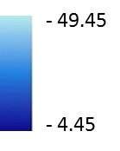
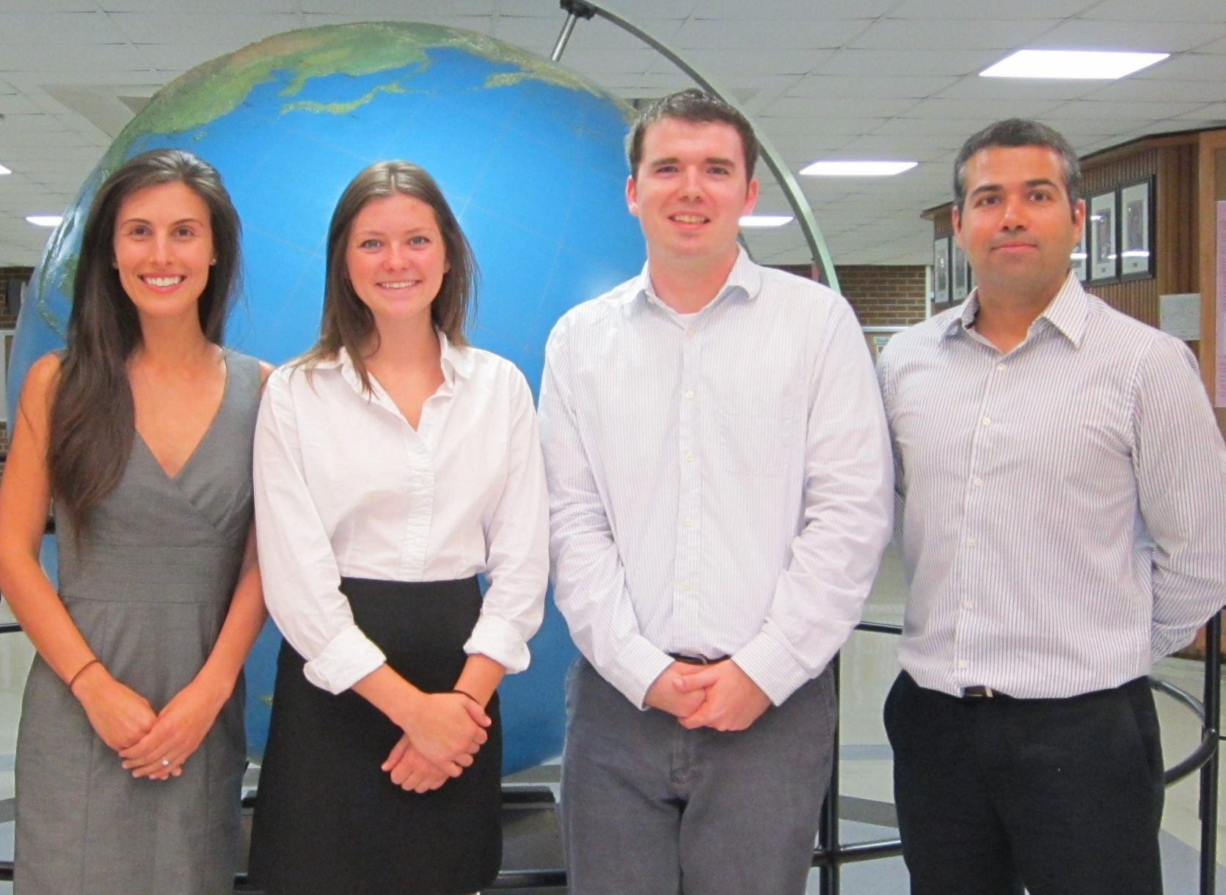
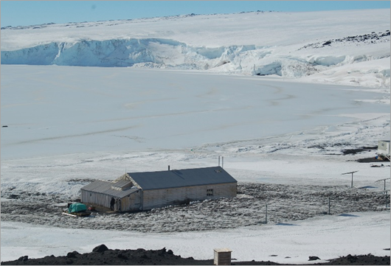
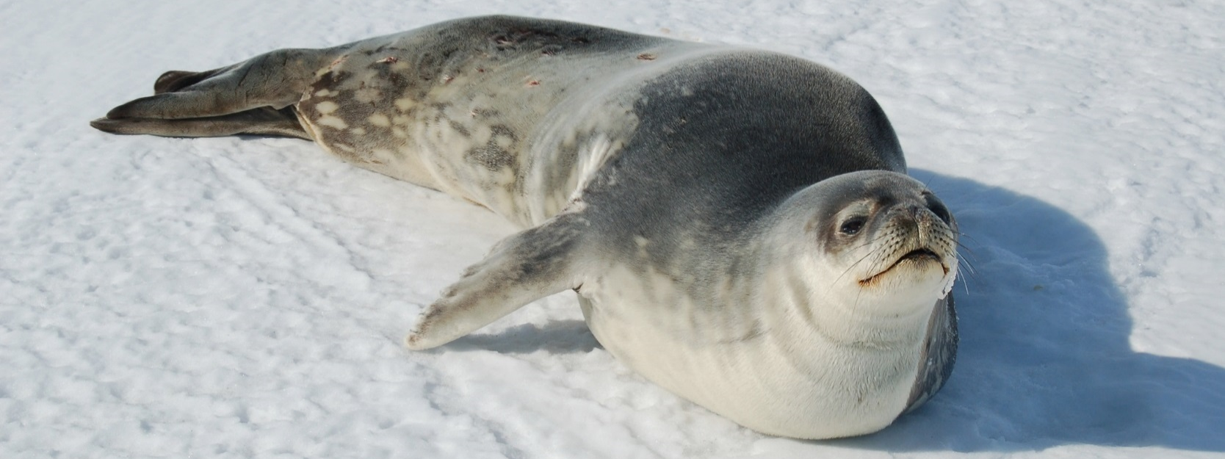
Antarctica Climate
Applying NASA Earth Observations to Assess the Seasonal and Inter-annual Variability of Sea Ice Dynamics in McMurdo Sound, Ross Sea, Antarctica
Elizabeth Benyshek (Project Lead), Christopher Cameron, Caren Remillard, Eduardo Rendon
DEVELOP National Program at The University of Georgia
Abstract
Objectives
This project employed the Ice, Cloud, and land Elevation Satellite (ICESat) and the Moderate Resolution Imaging Spectrometer (MODIS) to derive sea ice and temperature measurements in McMurdo Sound, Antarctica from 2003 to 2008. Time series maps were produced to illustrate both seasonal and inter-annual variability in sea ice characteristics within three partner-identified ecologically significant regions: Explorers Cove, Bay of Sails, and Ferrar Glacier. The team used parameters including sea ice thickness, ice surface temperature, and sea ice extent along with sea surface temperature to improve understanding of local sea ice dynamics. Additionally, the team evaluated potential spatio-temporal correlations between these parameters. Remote sensing datasets enhanced project partners’ ability to assess sea ice characteristics on a larger spatial and temporal scale, broadening their limited study area and field season to the wider McMurdo Sound and the western Ross Sea throughout the entire year.
Examine ICESat datasets from 2003 to 2008 to characterize seasonal and inter-annual variability in sea ice topography.
Examine Terra datasets to characterize seasonal and inter-annual variability in sea surface temperature, ice surface temperature, and sea ice extent.
Provide project partners with information about sea ice variability to enhance their understanding of how ecological health and productivity are affected by changing conditions in McMurdo Sound.
Methodology
Study Area
Data Acquisition
Data Processing and Analysis
End-Products
ICESat/GLAS
Cryosphere Science Research Portal
Extraction and aggregation of seasonal data
Seasonal sea ice topography maps
Image Credit: Dr. Sally E. Walker
Terra/MODIS
National Snow and Ice Data Center and NASA’s Giovanni
Georeferencing and extraction of sea and ice surface temperature data
Seasonal temperature maps
Image Credit: Dr. Samuel Bowser
Earth Observations
Results
Sea Surface Temperature
Spring Variability
Sea Ice Thickness
Sea Surface Temperature
Ice Surface Temperature
ICESat, GLAS
Terra, MODIS
Conclusions
December 2003
Sea Ice Thickness
December 2008
Terra sea surface temperature data showed a positive trend from 2003 to 2008.
ICESat data for McMurdo Sound revealed an overall decrease in sea ice thickness from 2003 to 2008.
Spring sea ice surface temperature decreased from 2003 to 2005 and increased from 2005 to 2007. Summer sea ice surface temperature increased from 2004 to 2006 and decreased from 2006 to 2008.
The ICESat 2 campaign will further enhance knowledge of sea ice in the polar regions and provide more data coinciding with MODIS observations.
Results will improve project partners’ understanding of changing sea ice conditions in relation to ecological health and productivity.
Summer Variability
Sea Ice Thickness
Sea Surface Temperature
Ice Surface Temperature
Summer 2004
Summer 2008
Ice Surface Temperature
October 2003
October 2008
Team Members
Project Partners
Acknowledgements
Dr. Samuel Bowser (The Wadsworth Center)
Dr. Adam Milewski (University of Georgia)
Dr. Sally E. Walker (University of Georgia)
Linli Zhu (DEVELOP, University of Georgia)
The Wadsworth Center
The University of Georgia
From left to right: Caren Remillard, Elizabeth Benyshek, Christopher Cameron, Eduardo Rendon
Image Credit: Dr. Sally E. Walker
Image Credit: Dr. Sally E. Walker
The University of Georgia

