Slide 1
Brazil Health & Air Quality
Utilizing NASA Earth Observations for Forecasting Dengue Virus Outbreaks
Lorena Lopez (California State University, Northridge)
Scott Barron (University of California, Los Angeles)
Elise Lorenzana (University of California, Los Angeles)

Slide 2

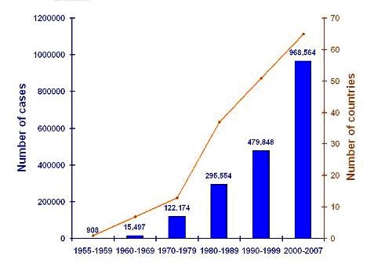
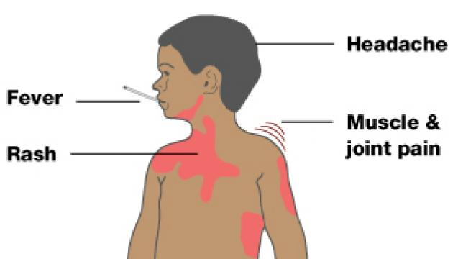
Background: Dengue
Vector-borne diseases claim millions of lives annually.
Dengue fever is the world’s fastest growing vector-borne disease globally (WHO, 2013).
In 2010, there were over 980,000 cases of dengue reported in Brazil.
No vaccine currently exists to cure dengue.
Number of countries with and number of cases of Dengue Fever reported to the World Health Organization.
Graph source URL: http://www.humanosphere.org/2013/08/dengue-fever-spreading-brazil/

Slide 3
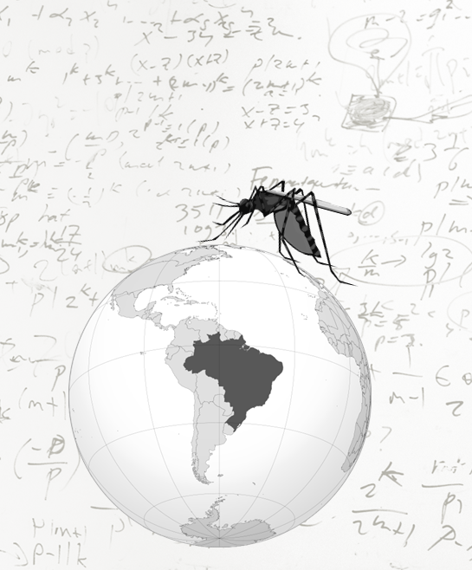
Background: Mitigation Strategies
Aedes aegypti mosquitos spread dengue
Current disease surveillance methods include time consuming and expensive field surveys.
Remote-sensing techniques are powerful tools to characterize mosquito-breeding habitats.
Image provided by Diane Garcia-Gonzales
Notes:
Not sure how this point fits in this slide: For future preparation, it is imperative to institute surveillance protocols that enhance timely mitigation in regions with limited resources.

Slide 4
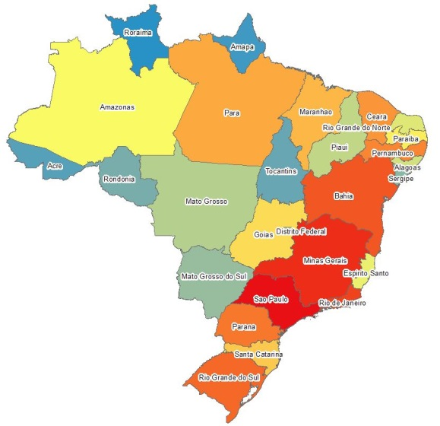
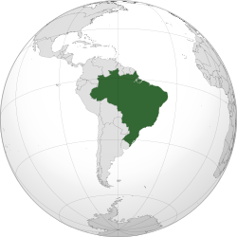
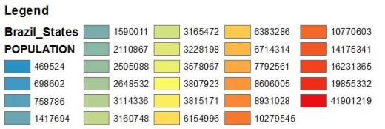
Study Region
27 Federative Units (states)
Total Area: 8,515,767 km²
Current Population: 201,032,714
Image created in ESRI’s ArcMap using the GADM database, Brazil shapefile, and population information from Wikipedia.

Slide 5
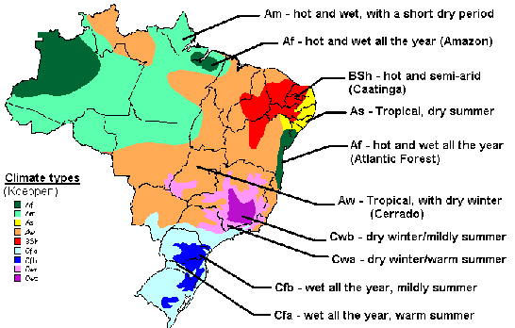
Study Region: Climatic Variability
9 Different Climate Types
Af
Am
As
Aw
BSh
Cfa
Cfb
Cwa
Cwb
Image source: National Travel Health Network and Centre website. URL: http://www.nathnac.org/pro/factsheets/dengue.htm
Notes:
Each environmental factor behaves differently throughout the year depending on location and climate of each state.

Slide 6
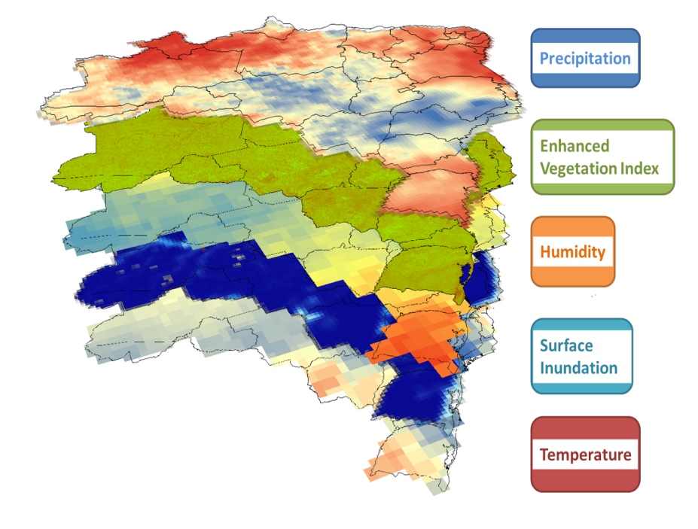
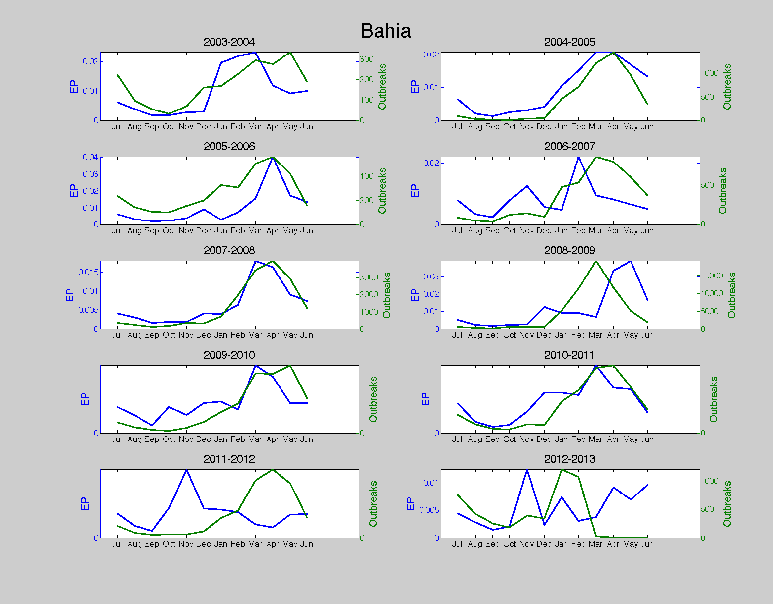
Project Objectives
To predict dengue outbreaks in regions of Brazil before they occur.
Efficiently collecting and analyzing satellite datasets
Using an epidemic potential model (EP) to link remote sensing observations to potential disease risk
Notes:
Picture of four layers without the mosquito lifecycle?

Slide 7



Satellite Data
Temperature and Humidity: data from Aqua’s AIRS sensor at approximately 100 km resolution
Vegetation: obtained from the MODIS sensor onboard Aqua at 1km resolution
Precipitation: data obtained from TRMM’s PR and TMI sensors at 25km resolution
Surface Inundation: data obtained from QuikScat and AMSR-E (onboard Aqua) at 25 km resolution
Aqua
TRMM
QuikScat

Slide 8
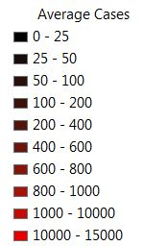

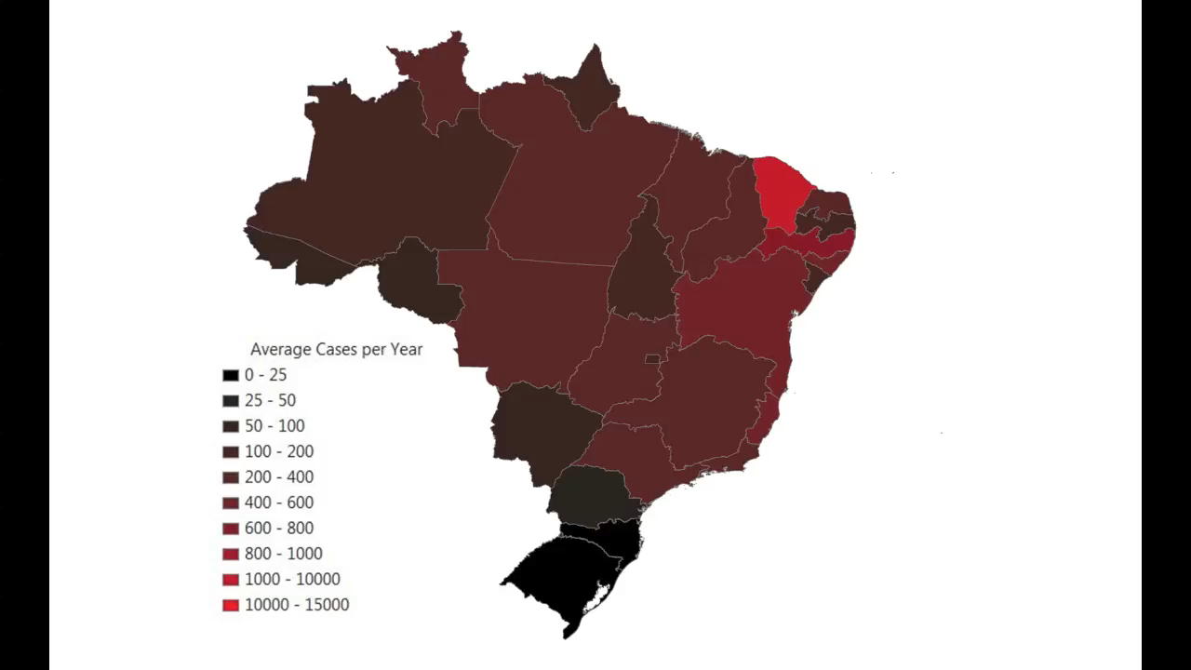

Methods: Data
Monthly dengue outbreaks over study period
Acquired global temperature, humidity, surface inundation, vegetation, and precipitation data
Extracted environmental data for the study period, 2003-2013 over Brazil
Converted data to the same spatial and temporal resolutions
Notes:
Note: I grouped all superimposed shapes and titles
Using Python programming language and ArcMap,

Slide 9
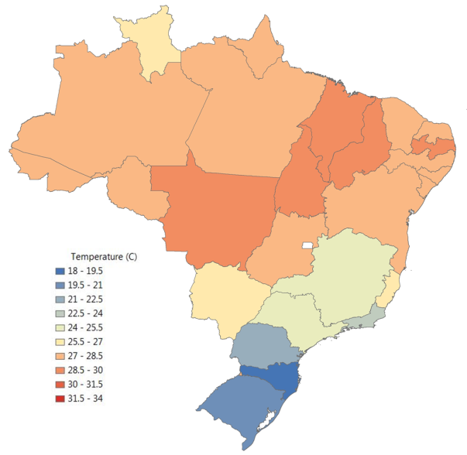
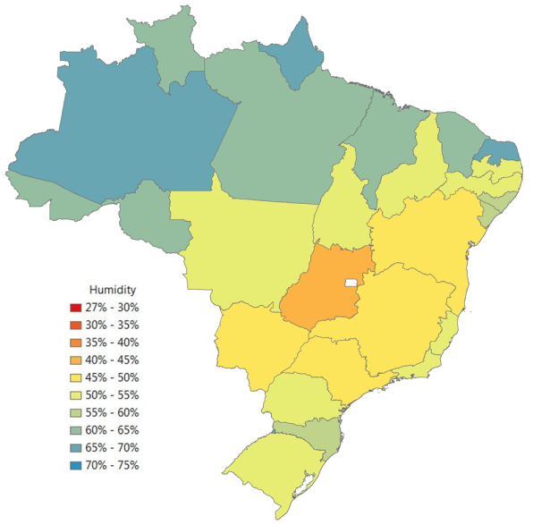
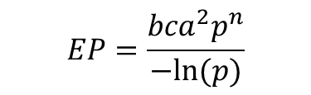
Methods: process
EP calculates the mean number of potential contacts infected by a mosquito population per infectious person per unit time.
Temperature (T)
Relative Humidity (RH)
c = probability of mosquito acquiring dengue
b = probability of dengue transmission
a = bites per person: a=a(T)
p = mosquito survival rate: p=p(T,RH)
n = extrinsic incubation period: n=n(T)
Notes:
EP plot corresponds to Sao Paulo
EP describes the capacity of a disease to remain in a population as a function of vector lifecycle and activity, mortality and the required incubation period of the disease.

Slide 10
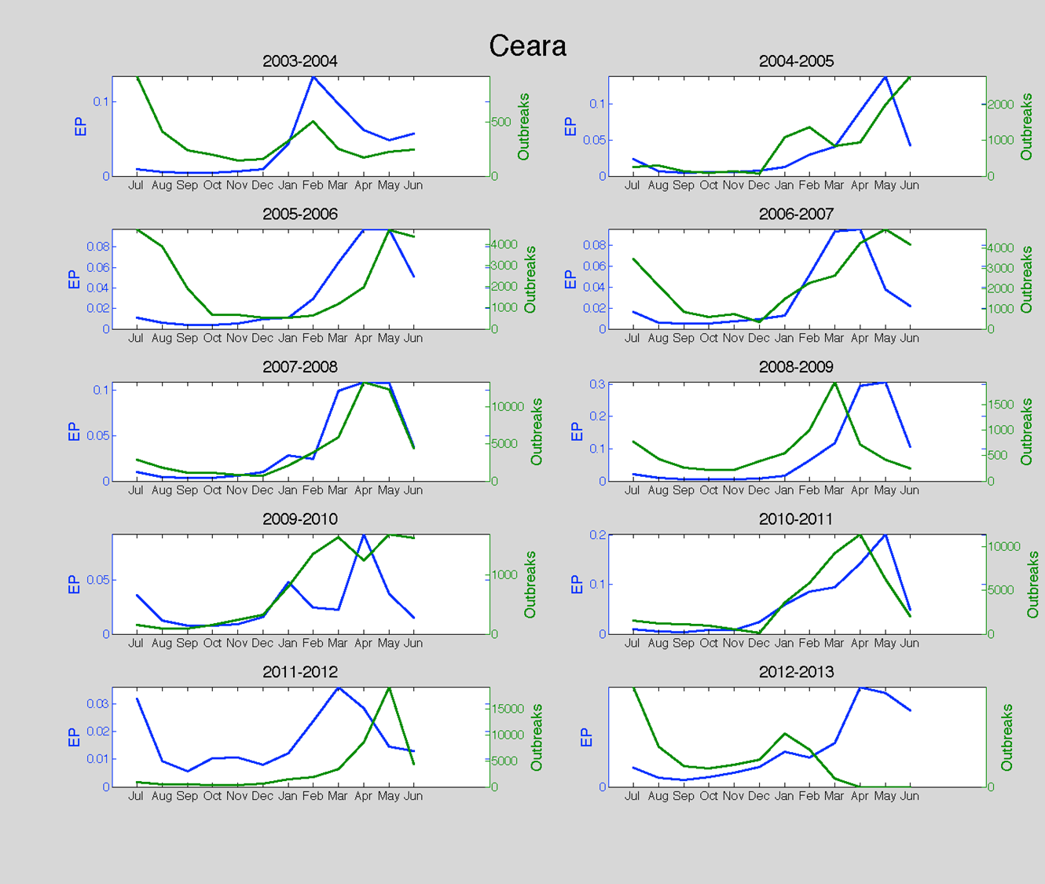
Methods: Data Comparison
Compared EP values, generated by our model, to historic dengue outbreaks.
Some states showed strong relationships, i.e. the general trend of the lines are the same, between the two variables.

Slide 11
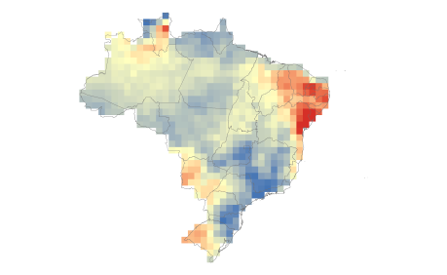
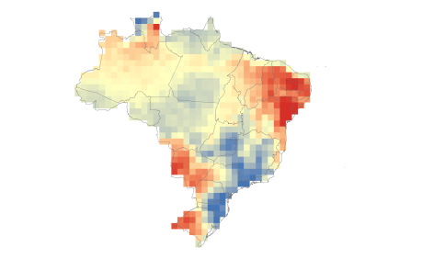
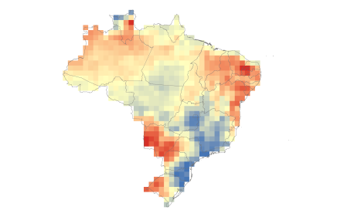
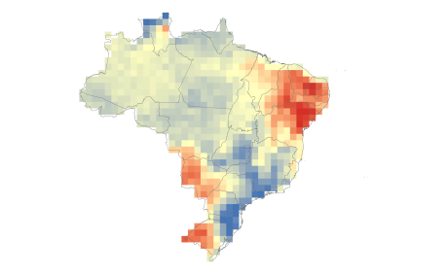
Methods: Statistical Approach
In addition to the EP model, anomaly graphs were created to highlight variations from historical averages.
January 2003
January 2003
Overall January Average
January Anomaly Graph
Overall January Average
Overall January Average
January 2004
January 2004
Overall January Average
January 2012
January 2012

Slide 12
Anomaly Graphs
Anomaly graphs make it possible to identify any trends that coincide with abnormally large outbreaks.

Slide 13
Sao Paulo Anomaly
During the beginning of 2010, Sao Paulo experienced an abnormally large amount of dengue cases.
Comparing this outbreak with the temperature and humidity data, we don’t see any noticeably unusual values at the same time.
However, in the preceding months, we can see an unusually cool, and unusually humid event.
This shows that there can be lags between anomaly events and outbreaks.

Slide 14
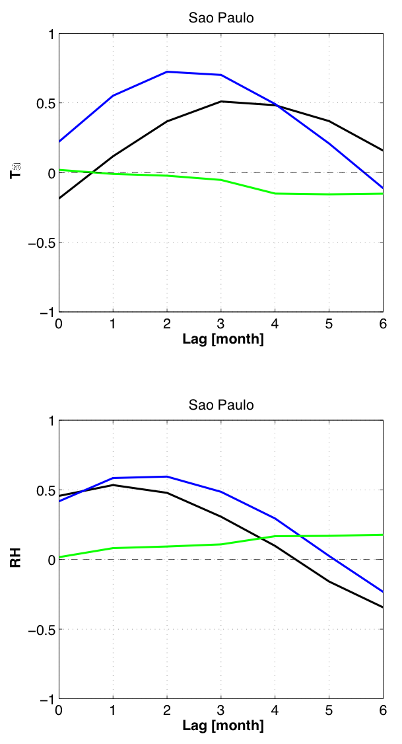

Effect of Time Lags
Correlation: Temp & Outbreaks
Correlation: Humidity & Outbreaks
Day
Night
Day- Night Difference
Introducing lags increases correlations between environmental factors and dengue outbreaks.
Correlations peak at two to three months for temperature, and one to two months for humidity.

Slide 15
Conclusions
Temperature and humidity have strong, significant correlations to dengue incidence across Brazil.
These correlations are generally highest at a lag of one or more months.
Remotely sensed surface climate variables can provide a predictive capability for dengue outbreaks.
Image provided by Diane Garcia-Gonzales

Slide 16
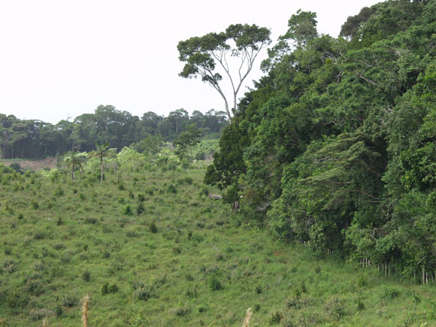

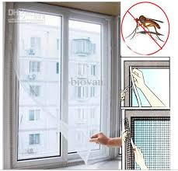
Future Research
Additional environmental variables to incorporate
  Soil moisture
  Land cover change: agriculture and forests
  Wind patterns
Social trends can be collected and analyzed
  Track migration of people with dengue
  Distribution of wealth
Image source: worldwatch.org
Image source: dhgate.com
Notes:
Track migration of people with dengue are moving to areas where it is less prevalent
Distribution of wealth: some wealthier states have air conditioning and screens

Slide 17
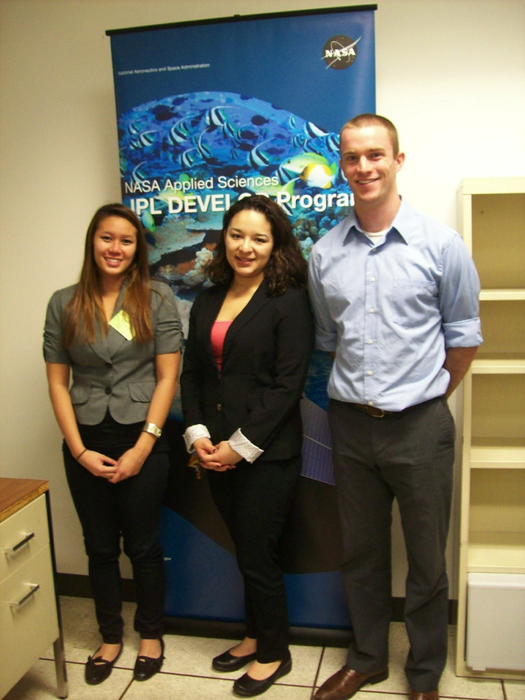
Acknowledgements
Dr. Darren Drewry and Dr. Erika Podest, the project advisors, for their professional guidance throughout the project.
Dr. Ben Holt and Christine Rains for their leadership and assistance in the DEVELOP program.
Dr. Stephen Waterman at the Centers for Disease Control and Prevention (CDC), the project partner for his collaboration.
Elise Lorenzana, Lorena Lopez, Scott Barron
Image provided by Christine Rains

