Slide 1
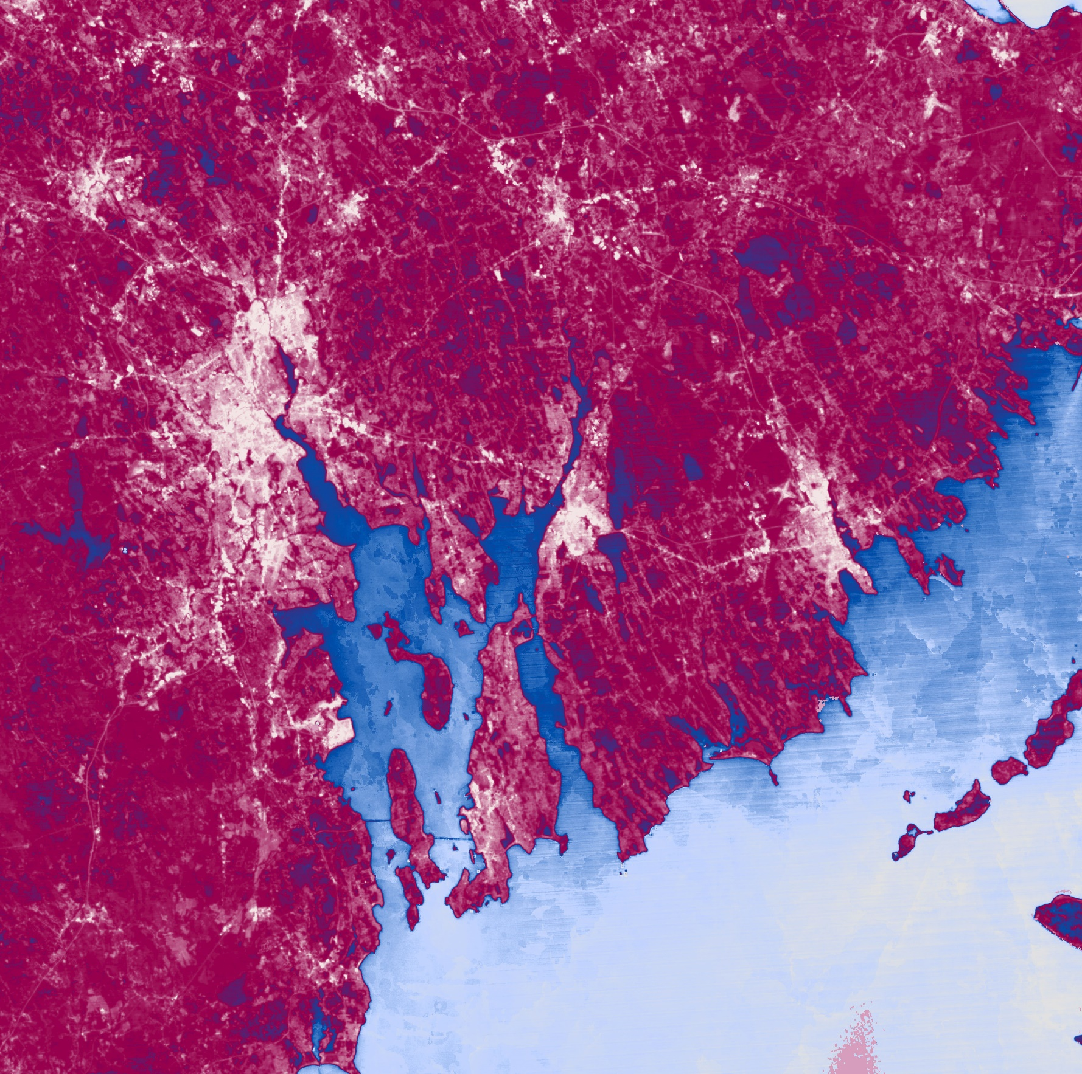
PROVIDENCE & ELIZABETH URBAN DEVELOPMENT
Utilizing NASA Earth Observations to Explore Heat and Flood-Related Vulnerability in Urban Settings
Holly Gould
Sarah Aldama
Colton Avila
Heather Dulaney
Virginia – Langley | Spring 2019
Notes:
Team introductions

Slide 2
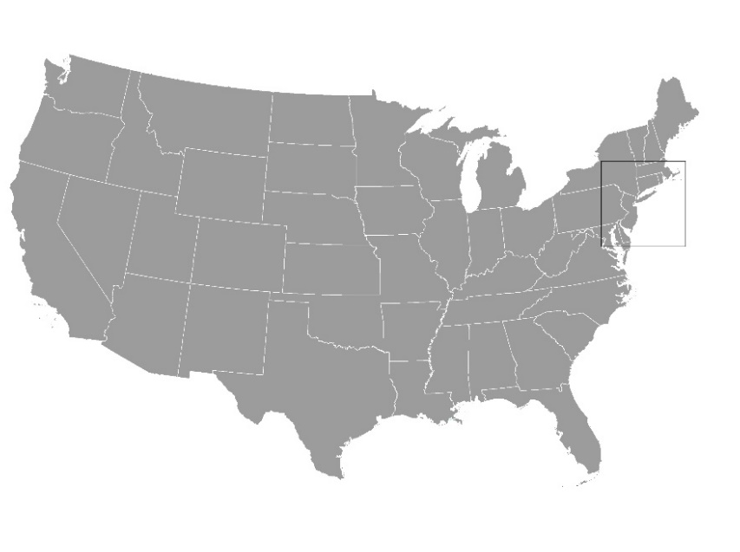
Study Area Overview
Notes:
Our project focused on two areas within two different states along the northeastern U.S. coast

Slide 3
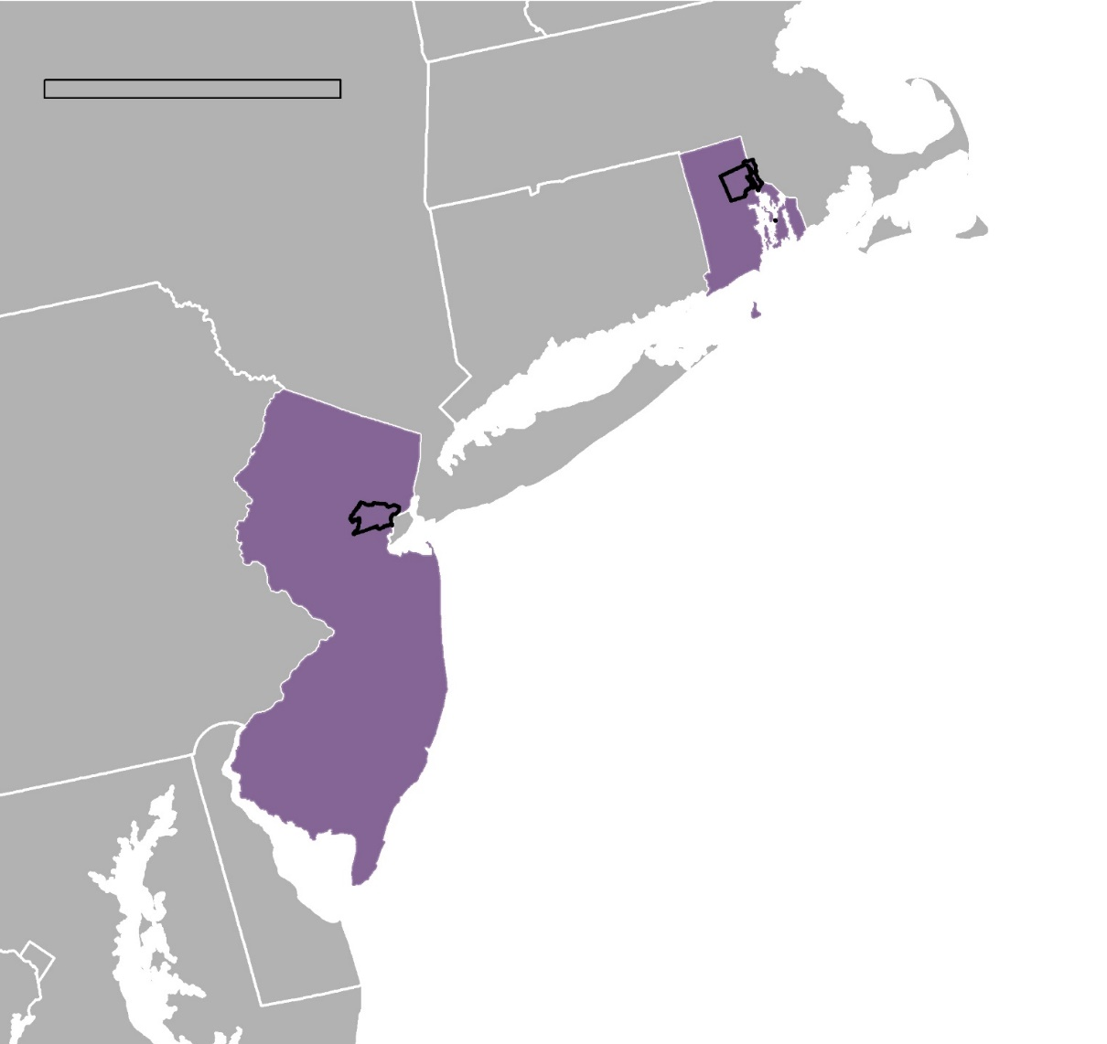
Study Area Overview
100
mi
Rhode Island
New Jersey
Atlantic Ocean
N
Notes:
One is in the state of Rhode Island, and one the other is in the state of New Jersey.

Slide 4
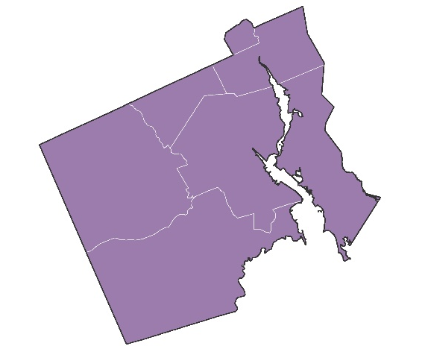
Study Area Overview
100
mi
1
Rhode Island
New Jersey
Atlantic Ocean
N
Notes:
One is in the state of Rhode Island,

Slide 5
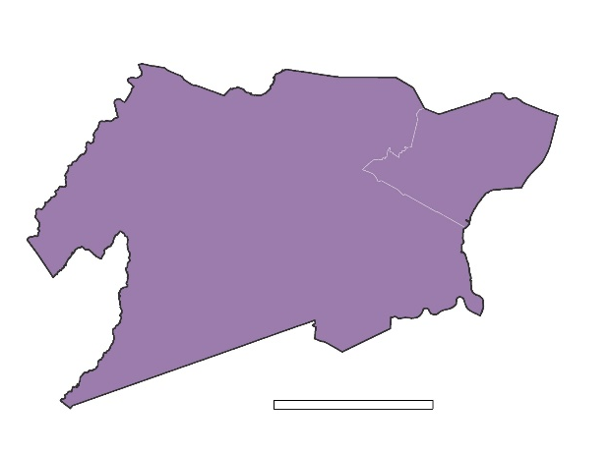
Study Area Overview
100
mi
1
Rhode Island
2
New Jersey
Atlantic Ocean
N
Notes:
and the other is in the state of New Jersey.

Slide 6
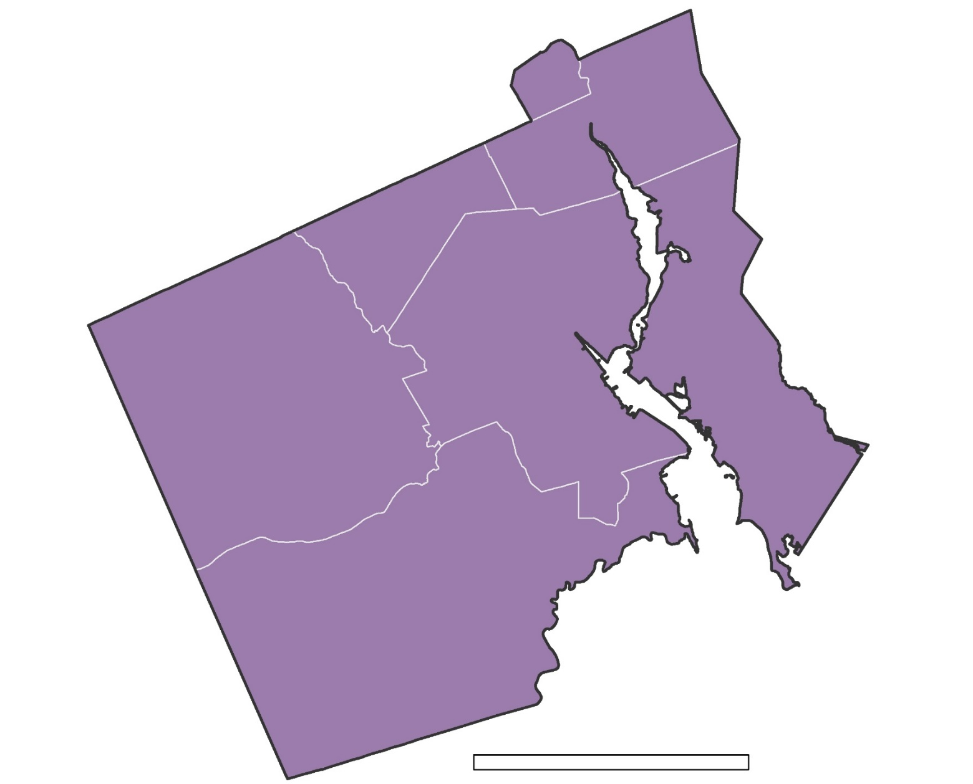
1: Providence, RI
Central Falls
Pawtucket
Providence
Johnston
Cranston
5 miles
N
Notes:
In Rhode Island, our study area included the capital city of Providence, along with Pawtucket and Central Falls to the north, and other nearby cities. Providence is situated along the Providence River and Narraganset Bay, and has a population of over 178,000 people. The city hosts a vibrant arts community and house many higher education institutions.

Slide 7
1: Providence, RI
Central Falls
Pawtucket
Providence
Johnston
Providence River
Cranston
Narragansett Bay
5 miles
N
Notes:
In Rhode Island, our study area included the capital city of Providence, along with Pawtucket and Central Falls to the north, and other nearby cities. Providence is situated along the Providence River, which feeds into the Narraganset Bay. and hosts a population of over 178,000 people. The city hosts a vibrant arts community and house many higher education institutions.

Slide 8
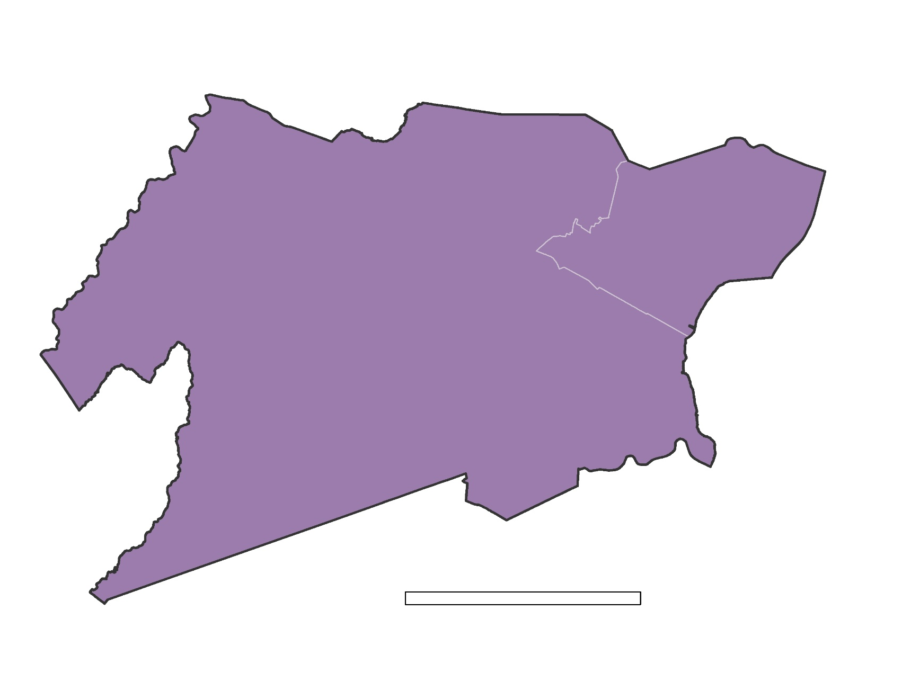
2: Elizabeth, NJ
Union County
Elizabeth
5 miles
N
Notes:
Our second study area consisted of Elizabeth, NJ, along with the county it resides in – Union County.

Slide 9
2: Elizabeth, NJ
Union County
Newark International Airport
Elizabeth
Newark Bay
5 miles
N
Notes:
Our second study area consisted of Elizabeth, NJ, which sits on the northeast corner of Union County. Elizabeth was founded in 1662 by English settlers, formerly as “Elizabethtown.” The city’s coast sits on Newark Bay to the East, making it an ideal location to host a major international airport and one of the busiest ports in the world. Today, Elizabeth is home to over 125,000 people.

Slide 10
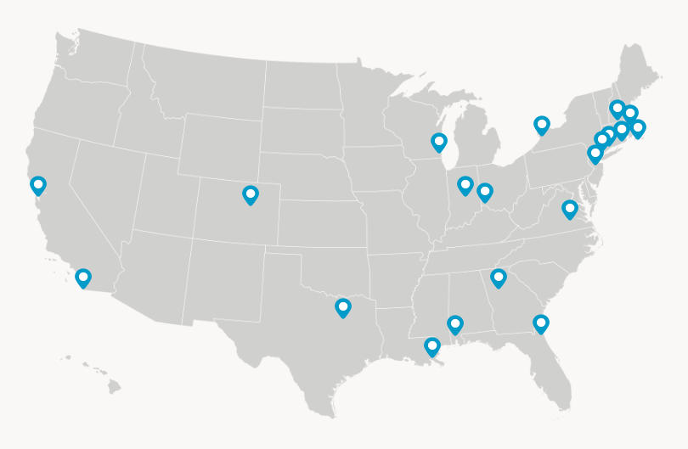
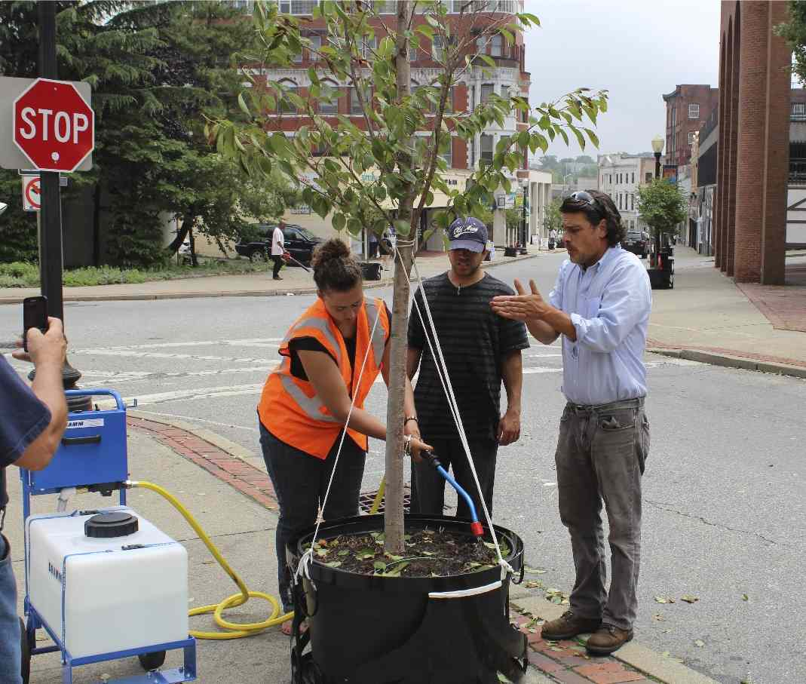
Partners: Groundwork USA
Groundwork USA
Groundwork USA
Map from Groundwork USA
Notes:
We partnered with GWUSA, which is a community based, environmental non-profit organization aimed at promoting environmental, economic, and social well-being within marginalized communities through the enhancement of urban spaces.
The organization has 20 local trusts across the United States where they utilize data and perform various environmental projects.
One of their current projects is, Climate Safe Neighborhoods which is aimed at reducing heat and flood related risks that are currently being faced by urban populations and advance the value of climate resiliency. They are focusing this project in 5 of their locations and plan to map historic flooding and heat events, produce solutions, and apply these efforts throughout the community
Elizabeth, NJ and Providence, RI are two of the cities that this project is being implemented in
Image Retrieved from: https://groundworkusa.org/groundwork-network, Written Permission from Groundwork USA

Slide 11
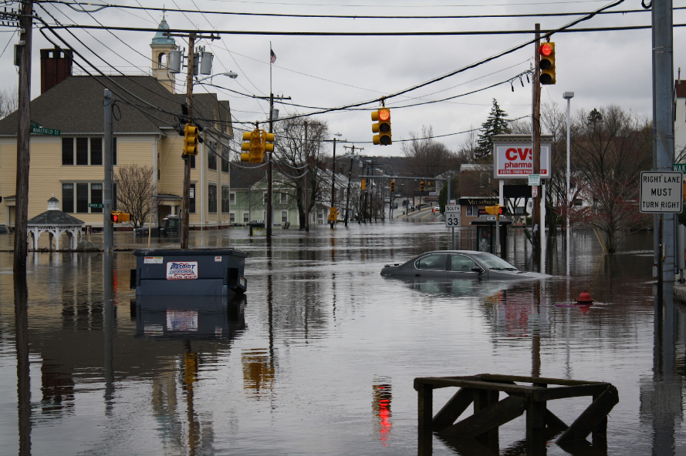
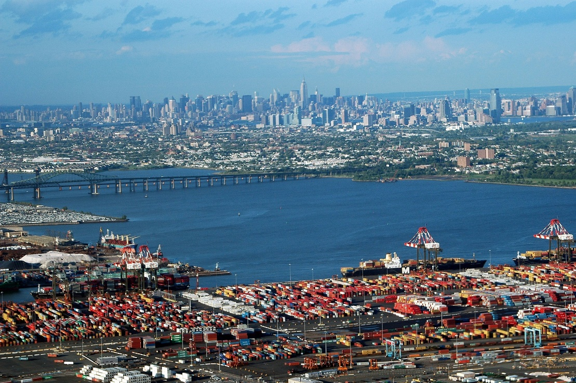
Community Concerns
Highly urbanized and low-lying coastal regions
More frequent and intense heat and flooding events
Include at-risk, low-resource communities in climate resilience planning efforts
No current methodology for assessing these vulnerabilities
amerune
Flickr
Newark Bay and surrounding cities
in New Jersey and New York
Notes:
Elizabeth and Providence are both highly urbanized cities that are situated in low-lying regions, right along a body of water. Image references: https://commons.wikimedia.org/wiki/Category:Port_Newark%E2%80%93Elizabeth_Marine_Terminal#/media/File:Manhattan.jpg , Creative Commons

Slide 12
Community Concerns
Highly urbanized and low-lying coastal regions
More frequent and intense heat and flooding events
Include at-risk, low-resource communities in climate resilience planning efforts
No current methodology for assessing these vulnerabilities
National Weather Service
Near the Providence River in Warwick, RI
Notes:
Due to these factors, the communities are susceptible to intense flooding and increase in heat.
Image references: army truck (Rhode Island) : https://www.weather.gov/nerfc/crar1_flood

Slide 13
Community Concerns
Highly urbanized and low-lying coastal regions
More frequent and intense heat and flooding events
Include at-risk, low-resource communities in climate resilience planning efforts
No current methodology for assessing these vulnerabilities
Graphics: Pixabay
Notes:
Groundwork wants to help the cities enhance their resiliency planning by providing data to stakeholders and marginalized communities to make more data-driven decisions about future development of their communities.
Image references:
earth - https://pixabay.com/vectors/earth-planet-earth-space-2092185/ , Creative Commons
People talking - https://www.sdcoe.net/student-services/early-education/Pages/Early-Years-Conference.aspx , Creative Commons

Slide 14
Community Concerns
Highly urbanized and low-lying coastal regions
More frequent and intense heat and flooding events
Include at-risk, low-resource communities in climate resilience planning efforts
No current methodology for assessing these vulnerabilities
How To:
Graphic: Free Icons Library
Notes:
For Groundwork to do this, they need data and maps showing these vulnerabilities and they currently do not have a method for assessment.
Image references: army truck (Rhode Island) :
Paper graphic - http://chittagongit.com/icon/document-icon-vector-22.html , Creative Commons

Slide 15
Objectives
Generate data and maps to allow Groundwork USA to inform the public and make data driven decisions for their communities
Identify areas of Providence, RI, and Elizabeth, NJ, that are vulnerable to urban heat and flooding events
Develop a replicable methodology for assessing urban heat and flood in various locations
Notes:
We wanted to create a way for Groundwork to visualize locations in the cities that are experiencing more heat and flooding increases to take these methods and apply them to other cities. For heat vulnerabilities, the team produced annual heat distribution maps for the years 2014 and 2018 and 5-year heat distribution for 2014-2018. For flooding, the team produced 30 annual flood distribution maps for the years 1988-2018 and 2 decadal maps for 1988-1998, 1998-2008, and 2008-2018

Slide 16
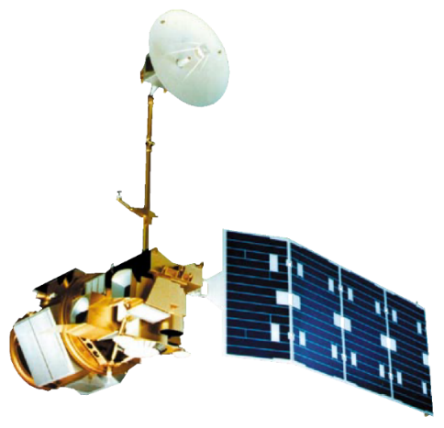
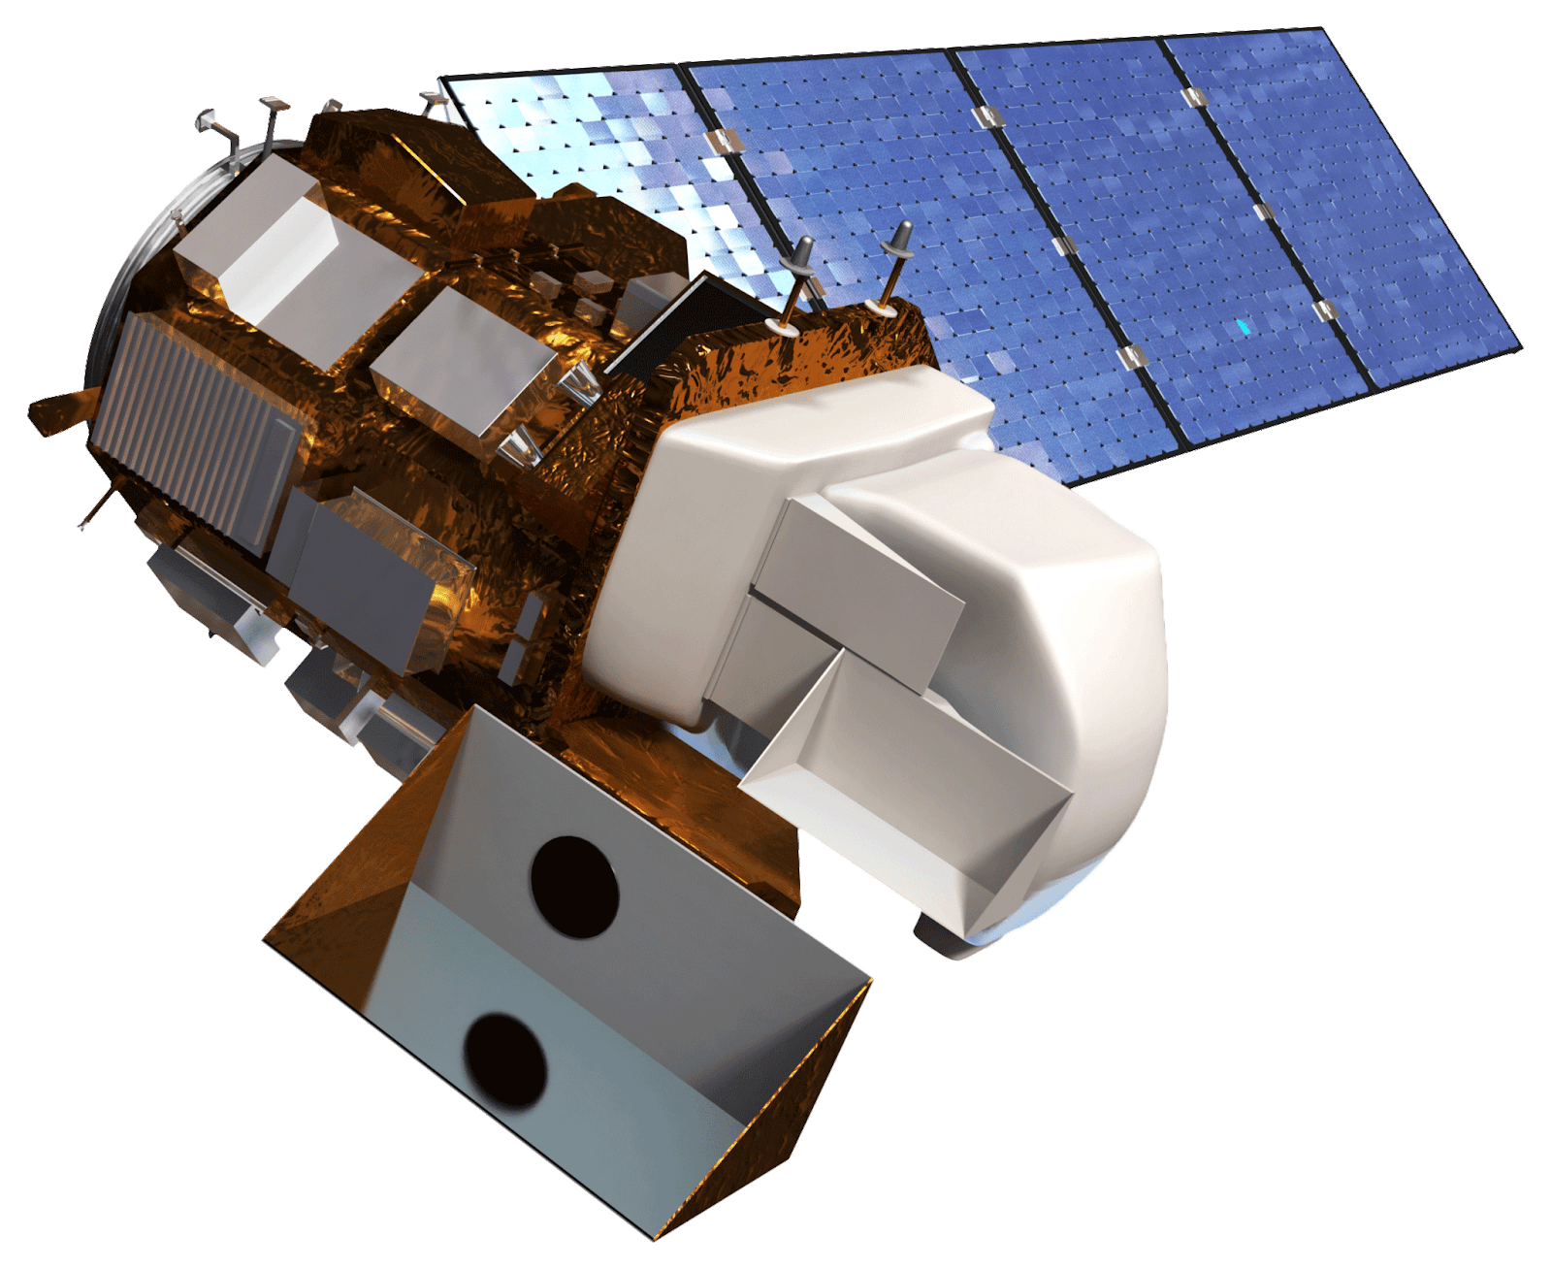
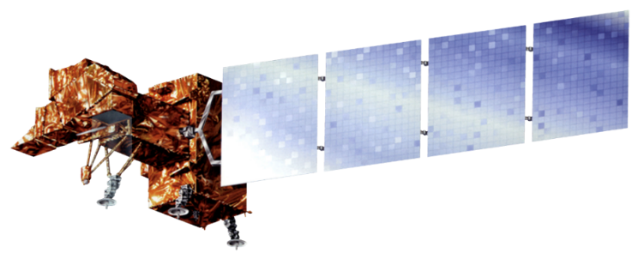
NASA Satellites and Sensors
Landsat 5 TM
Landsat 7 ETM+
Landsat 8 OLI/TIRS
Terra
MODIS & ASTER
Notes:
For our heat and flood mapping, we utilized Earth observation imagery from:
Landsat 5 Thematic Mapper,
Landsat 7 Enhanced Thematic Mapper Plus, and
Landsat 8 Operational Land Imager and Thermal Infrared Sensor.
Additionally, we used:
Terra Moderate-resolution Imaging Spectroradiometer (MODIS) and
Advanced Spaceborne Thermal Emission and Reflection Radiometer (ASTER)
…for a cross-validation analysis, which we will get to later.

Slide 17
Heat Methodology
STP: The USGS’s Level-2 Provisional Land Surface Temperature Product
Download
NLDC 2011 data
Reclassify
DATA COLLECTION
DATA PROCESSING
ANALYSIS & RESULTS
Download
STP scenes from USGS
Cloud Mask using
PIXELQA band & ArcGIS QA Toolbox
Mean LST Maps
4-year – NJ
5-year - RI
Analyze relationship between LST and land cover type
LST + Land Cover Maps
CROSS-VERIFICATION: STP, Terra MODIS and ASTER
Download LST products from ASTER & MODIS
Determine STP accuracy using LST products
Boxplots
Notes:
For our heat mapping, we utilized the Level-two Provisional Land Surface Temperature Product, which was released by the USGS on November 29, 2018. This is what the USGS calls “Analysis-Ready-Data,” meaning that it requires minimal steps for land surface temperature mapping. Past heat mapping methodologies have required extensive conversion steps to get the same results this product provides. So that’s exciting!
We downloaded scenes for each study area for the summer months of July, August, September between 2014 and 2018.
OLD SCRIPT:
To even begin discussing LST calculations, first one must utilize the USGS EarthExplorer as a tool by which they will procure the Level-2 Provisional Land Surface Temperature Product (STP). Having already converted top-of-atmosphere brightness to LST, this product is the base on which the rest of our calculations are built (to see more information regarding this product go to the USGS website).
After downloading the STP we had to create a cloud mask for our scenes. Since we were limited in the number of scenes due to the temporal range of our study area, summer months for only 5 years, every image, regardless of cloud cover percentage, had to be used. But, since this is a provisional product, we thought it would be important to mask using the provisional quality band. STQA is the quality assessment band in the STP and its pixel values are calculated using distance to clouds estimates and the error in emissivity. To use this layer in the cloud mask we first had to decide the threshold value for the STQA band. This is where the PIXELQA band came into play. Using the “Clear” pixels within the PIXELQA band, our team compared the extent of these values to different threshold values for the STQA band. By having the extent of the STQA layer approach but never cross 90% - 95% similarity with the “Clear” PIXELQA layer, we can then identify the necessary threshold to set the STQA band to.
Since we now have cloud-masked surface temperature layers, each pixel should be relatively accurate. To verify this, our team downloaded LST products from both ASTER and TERRA MODIS over our study area. We then compared the values of those LST products to the values from the masked-STP. By checking the % error of this calculation, we can establish a possible standard deviation for this product.
From here we calculated mean LST values for both cities. These were done for both the entire timespan as well as for each year. Using the “Cell Statistics” tool in ArcGIS, we calculated the mean and median LST pixel. Importing the NLDC into ArcPRO, we identified zones, and the land cover beneath them, that were prone to the urban heat island effect.

Slide 18
Heat Methodology
STP: The USGS’s Level-2 Provisional Land Surface Temperature Product
Download
NLDC 2011 data
Reclassify
DATA COLLECTION
DATA PROCESSING
ANALYSIS & RESULTS
Download
STP scenes from USGS
Cloud Mask using
PIXELQA band & ArcGIS QA Toolbox
Mean LST Maps
4-year – NJ
5-year - RI
Analyze relationship between LST and land cover type
LST + Land Cover Maps
CROSS-VERIFICATION: STP, Terra MODIS and ASTER
Download LST products from ASTER & MODIS
Determine STP accuracy using LST products
Boxplots
Notes:
Next, we utilized Python script to apply a cloud mask to all of our scenes (41 total). We used an ArcGIS QU Toolbox PixelQA band
OLD SCRIPT:
To even begin discussing LST calculations, first one must utilize the USGS EarthExplorer as a tool by which they will procure the Level-2 Provisional Land Surface Temperature Product (STP). Having already converted top-of-atmosphere brightness to LST, this product is the base on which the rest of our calculations are built (to see more information regarding this product go to the USGS website).
After downloading the STP we had to create a cloud mask for our scenes. Since we were limited in the number of scenes due to the temporal range of our study area, summer months for only 5 years, every image, regardless of cloud cover percentage, had to be used. But, since this is a provisional product, we thought it would be important to mask using the provisional quality band. STQA is the quality assessment band in the STP and its pixel values are calculated using distance to clouds estimates and the error in emissivity. To use this layer in the cloud mask we first had to decide the threshold value for the STQA band. This is where the PIXELQA band came into play. Using the “Clear” pixels within the PIXELQA band, our team compared the extent of these values to different threshold values for the STQA band. By having the extent of the STQA layer approach but never cross 90% - 95% similarity with the “Clear” PIXELQA layer, we can then identify the necessary threshold to set the STQA band to.
Since we now have cloud-masked surface temperature layers, each pixel should be relatively accurate. To verify this, our team downloaded LST products from both ASTER and TERRA MODIS over our study area. We then compared the values of those LST products to the values from the masked-STP. By checking the % error of this calculation, we can establish a possible standard deviation for this product.
From here we calculated mean LST values for both cities. These were done for both the entire timespan as well as for each year. Using the “Cell Statistics” tool in ArcGIS, we calculated the mean and median LST pixel. Importing the NLDC into ArcPRO, we identified zones, and the land cover beneath them, that were prone to the urban heat island effect.

Slide 19
Heat Methodology
STP: The USGS’s Level-2 Provisional Land Surface Temperature Product
Download
NLDC 2011 data
Reclassify
DATA COLLECTION
DATA PROCESSING
ANALYSIS & RESULTS
Download
STP scenes from USGS
Cloud Mask using
PIXELQA band & ArcGIS QA Toolbox
Mean LST Maps
4-year – NJ
5-year - RI
Analyze relationship between LST and land cover type
LST + Land Cover Maps
CROSS-VERIFICATION: STP, Terra MODIS and ASTER
Download LST products from ASTER & MODIS
Determine STP accuracy using LST products
Boxplots
Notes:
Summer months of July, August, September between 2014 and 2018.
OLD SCRIPT:
To even begin discussing LST calculations, first one must utilize the USGS EarthExplorer as a tool by which they will procure the Level-2 Provisional Land Surface Temperature Product (STP). Having already converted top-of-atmosphere brightness to LST, this product is the base on which the rest of our calculations are built (to see more information regarding this product go to the USGS website).
After downloading the STP we had to create a cloud mask for our scenes. Since we were limited in the number of scenes due to the temporal range of our study area, summer months for only 5 years, every image, regardless of cloud cover percentage, had to be used. But, since this is a provisional product, we thought it would be important to mask using the provisional quality band. STQA is the quality assessment band in the STP and its pixel values are calculated using distance to clouds estimates and the error in emissivity. To use this layer in the cloud mask we first had to decide the threshold value for the STQA band. This is where the PIXELQA band came into play. Using the “Clear” pixels within the PIXELQA band, our team compared the extent of these values to different threshold values for the STQA band. By having the extent of the STQA layer approach but never cross 90% - 95% similarity with the “Clear” PIXELQA layer, we can then identify the necessary threshold to set the STQA band to.
Since we now have cloud-masked surface temperature layers, each pixel should be relatively accurate. To verify this, our team downloaded LST products from both ASTER and TERRA MODIS over our study area. We then compared the values of those LST products to the values from the masked-STP. By checking the % error of this calculation, we can establish a possible standard deviation for this product.
From here we calculated mean LST values for both cities. These were done for both the entire timespan as well as for each year. Using the “Cell Statistics” tool in ArcGIS, we calculated the mean and median LST pixel. Importing the NLDC into ArcPRO, we identified zones, and the land cover beneath them, that were prone to the urban heat island effect.

Slide 20
Heat Methodology
STP: The USGS’s Level-2 Provisional Land Surface Temperature Product
Download
NLDC 2011 data
Reclassify
DATA COLLECTION
DATA PROCESSING
ANALYSIS & RESULTS
Download
STP scenes from USGS
Cloud Mask using
PIXELQA band & ArcGIS QA Toolbox
Mean LST Maps
4-year – NJ
5-year - RI
Analyze relationship between LST and land cover type
LST + Land Cover Maps
CROSS-VERIFICATION: STP, Terra MODIS and ASTER
Download LST products from ASTER & MODIS
Determine STP accuracy using LST products
Boxplots
Notes:
After making the heat distribution maps, we analyzed the relationship between land surface temperatures and land cover type. To do this we reclassified the NLCD 2011 data and extracted LST values from each land cover class.
OLD SCRIPT:
To even begin discussing LST calculations, first one must utilize the USGS EarthExplorer as a tool by which they will procure the Level-2 Provisional Land Surface Temperature Product (STP). Having already converted top-of-atmosphere brightness to LST, this product is the base on which the rest of our calculations are built (to see more information regarding this product go to the USGS website).
After downloading the STP we had to create a cloud mask for our scenes. Since we were limited in the number of scenes due to the temporal range of our study area, summer months for only 5 years, every image, regardless of cloud cover percentage, had to be used. But, since this is a provisional product, we thought it would be important to mask using the provisional quality band. STQA is the quality assessment band in the STP and its pixel values are calculated using distance to clouds estimates and the error in emissivity. To use this layer in the cloud mask we first had to decide the threshold value for the STQA band. This is where the PIXELQA band came into play. Using the “Clear” pixels within the PIXELQA band, our team compared the extent of these values to different threshold values for the STQA band. By having the extent of the STQA layer approach but never cross 90% - 95% similarity with the “Clear” PIXELQA layer, we can then identify the necessary threshold to set the STQA band to.
Since we now have cloud-masked surface temperature layers, each pixel should be relatively accurate. To verify this, our team downloaded LST products from both ASTER and TERRA MODIS over our study area. We then compared the values of those LST products to the values from the masked-STP. By checking the % error of this calculation, we can establish a possible standard deviation for this product.
From here we calculated mean LST values for both cities. These were done for both the entire timespan as well as for each year. Using the “Cell Statistics” tool in ArcGIS, we calculated the mean and median LST pixel. Importing the NLDC into ArcPRO, we identified zones, and the land cover beneath them, that were prone to the urban heat island effect.

Slide 21
Heat Methodology
STP: The USGS’s Level-2 Provisional Land Surface Temperature Product
Download
NLDC 2011 data
Reclassify
DATA COLLECTION
DATA PROCESSING
ANALYSIS & RESULTS
Download
STP scenes from USGS
Cloud Mask using
PIXELQA band & ArcGIS QA Toolbox
Mean LST Maps
4-year – NJ
5-year - RI
Analyze relationship between LST and land cover type
LST + Land Cover Maps
CROSS-VERIFICATION: STP, Terra MODIS and ASTER
Download LST products from ASTER & MODIS
Determine STP accuracy using LST products
Boxplots
Notes:
As a result, we created boxplots to quantify the land cover and LST relationship in R.
Old Script:
To even begin discussing LST calculations, first one must utilize the USGS EarthExplorer as a tool by which they will procure the Level-2 Provisional Land Surface Temperature Product (STP). Having already converted top-of-atmosphere brightness to LST, this product is the base on which the rest of our calculations are built (to see more information regarding this product go to the USGS website).
After downloading the STP we had to create a cloud mask for our scenes. Since we were limited in the number of scenes due to the temporal range of our study area, summer months for only 5 years, every image, regardless of cloud cover percentage, had to be used. But, since this is a provisional product, we thought it would be important to mask using the provisional quality band. STQA is the quality assessment band in the STP and its pixel values are calculated using distance to clouds estimates and the error in emissivity. To use this layer in the cloud mask we first had to decide the threshold value for the STQA band. This is where the PIXELQA band came into play. Using the “Clear” pixels within the PIXELQA band, our team compared the extent of these values to different threshold values for the STQA band. By having the extent of the STQA layer approach but never cross 90% - 95% similarity with the “Clear” PIXELQA layer, we can then identify the necessary threshold to set the STQA band to.
Since we now have cloud-masked surface temperature layers, each pixel should be relatively accurate. To verify this, our team downloaded LST products from both ASTER and TERRA MODIS over our study area. We then compared the values of those LST products to the values from the masked-STP. By checking the % error of this calculation, we can establish a possible standard deviation for this product.
From here we calculated mean LST values for both cities. These were done for both the entire timespan as well as for each year. Using the “Cell Statistics” tool in ArcGIS, we calculated the mean and median LST pixel. Importing the NLDC into ArcPRO, we identified zones, and the land cover beneath them, that were prone to the urban heat island effect.

Slide 22
Heat Methodology
STP: The USGS’s Level-2 Provisional Land Surface Temperature Product
Download
NLDC 2011 data
Reclassify
DATA COLLECTION
DATA PROCESSING
ANALYSIS & RESULTS
Download
STP scenes from USGS
Cloud Mask using
PIXELQA band & ArcGIS QA Toolbox
Mean LST Maps
4-year – NJ
5-year - RI
Analyze relationship between LST and land cover type
LST + Land Cover Maps
CROSS-VERIFICATION: STP, Terra MODIS and ASTER
Download LST products from ASTER & MODIS
Determine STP accuracy using LST products
Boxplots
Notes:
At the same time, we performed a cross-verification analysis between Landsat, ASTER, and MODIS. This allowed us to verify the accuracy of the new STP data.
OLD SCRIPT:
To even begin discussing LST calculations, first one must utilize the USGS EarthExplorer as a tool by which they will procure the Level-2 Provisional Land Surface Temperature Product (STP). Having already converted top-of-atmosphere brightness to LST, this product is the base on which the rest of our calculations are built (to see more information regarding this product go to the USGS website).
After downloading the STP we had to create a cloud mask for our scenes. Since we were limited in the number of scenes due to the temporal range of our study area, summer months for only 5 years, every image, regardless of cloud cover percentage, had to be used. But, since this is a provisional product, we thought it would be important to mask using the provisional quality band. STQA is the quality assessment band in the STP and its pixel values are calculated using distance to clouds estimates and the error in emissivity. To use this layer in the cloud mask we first had to decide the threshold value for the STQA band. This is where the PIXELQA band came into play. Using the “Clear” pixels within the PIXELQA band, our team compared the extent of these values to different threshold values for the STQA band. By having the extent of the STQA layer approach but never cross 90% - 95% similarity with the “Clear” PIXELQA layer, we can then identify the necessary threshold to set the STQA band to.
Since we now have cloud-masked surface temperature layers, each pixel should be relatively accurate. To verify this, our team downloaded LST products from both ASTER and TERRA MODIS over our study area. We then compared the values of those LST products to the values from the masked-STP. By checking the % error of this calculation, we can establish a possible standard deviation for this product.
From here we calculated mean LST values for both cities. These were done for both the entire timespan as well as for each year. Using the “Cell Statistics” tool in ArcGIS, we calculated the mean and median LST pixel. Importing the NLDC into ArcPRO, we identified zones, and the land cover beneath them, that were prone to the urban heat island effect.

Slide 23
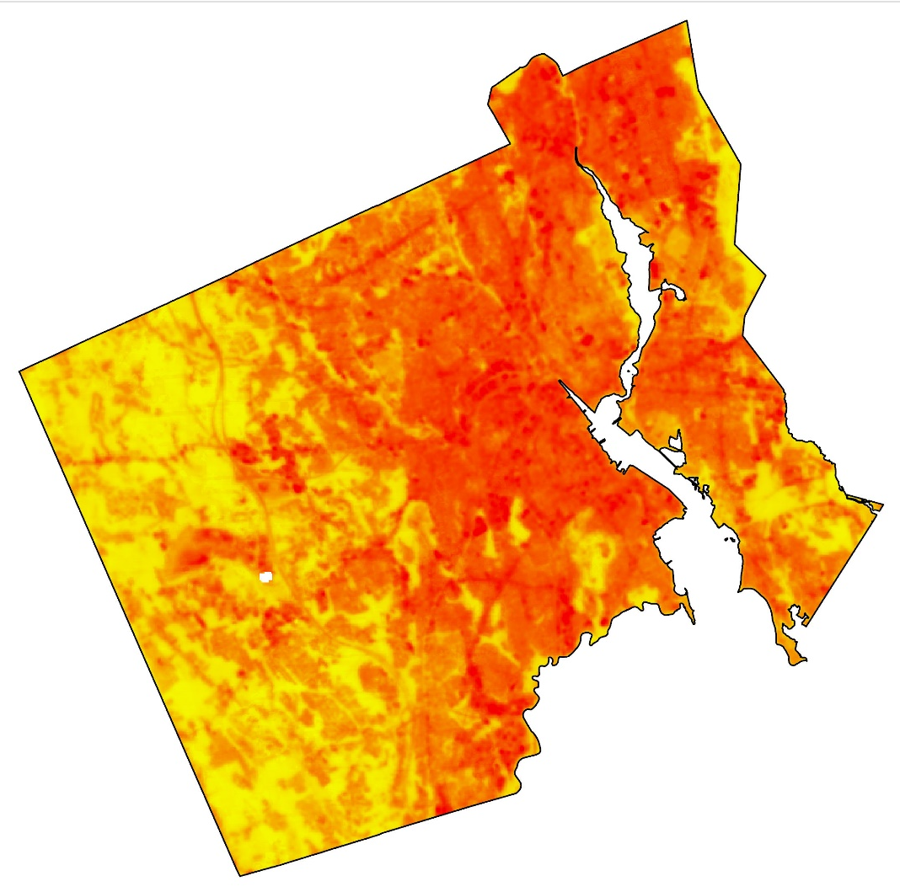
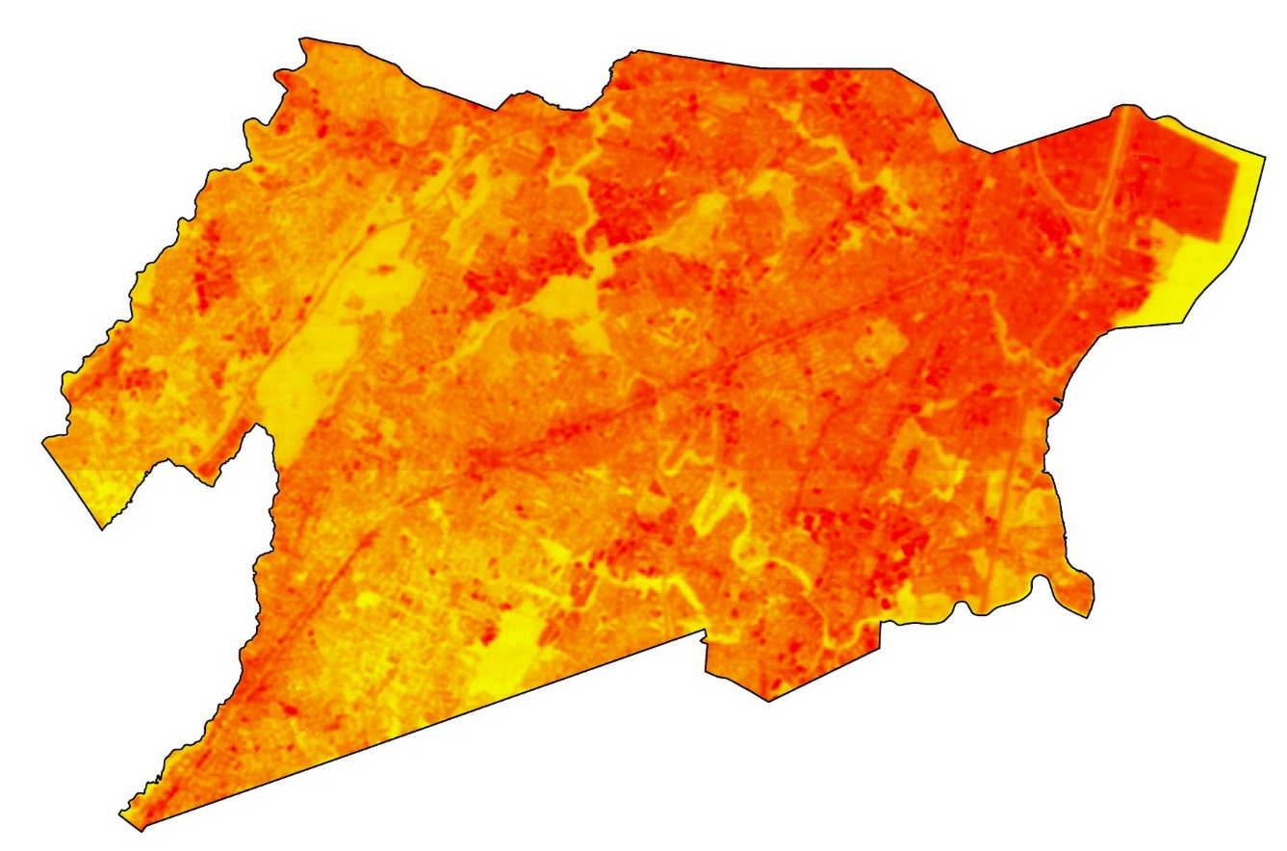
Land Surface Temperature (°F)
Providence, RI
Union County, NJ
72°
129°
72°
145°
5 miles
Notes:
Here are the initial surface temperatures visualized. These are directly from the USGS. As you can see the average temperature is higher in Union county compared to Providence. This may be due to larger amount of industrial areas and less green spaces.

Slide 24
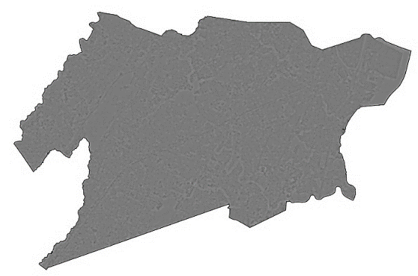
Results: Zoom-In NJ
1 mile
Notes:
Note the areas that the arrows are pointing to. The upper left has a significantly forested area, the arrow below is pointing to a winding river

Slide 25
Results: Zoom-In NJ
1 mile
Notes:
Take note also of these arrows. They point to roads and areas with a lot of impervious surfaces.

Slide 26
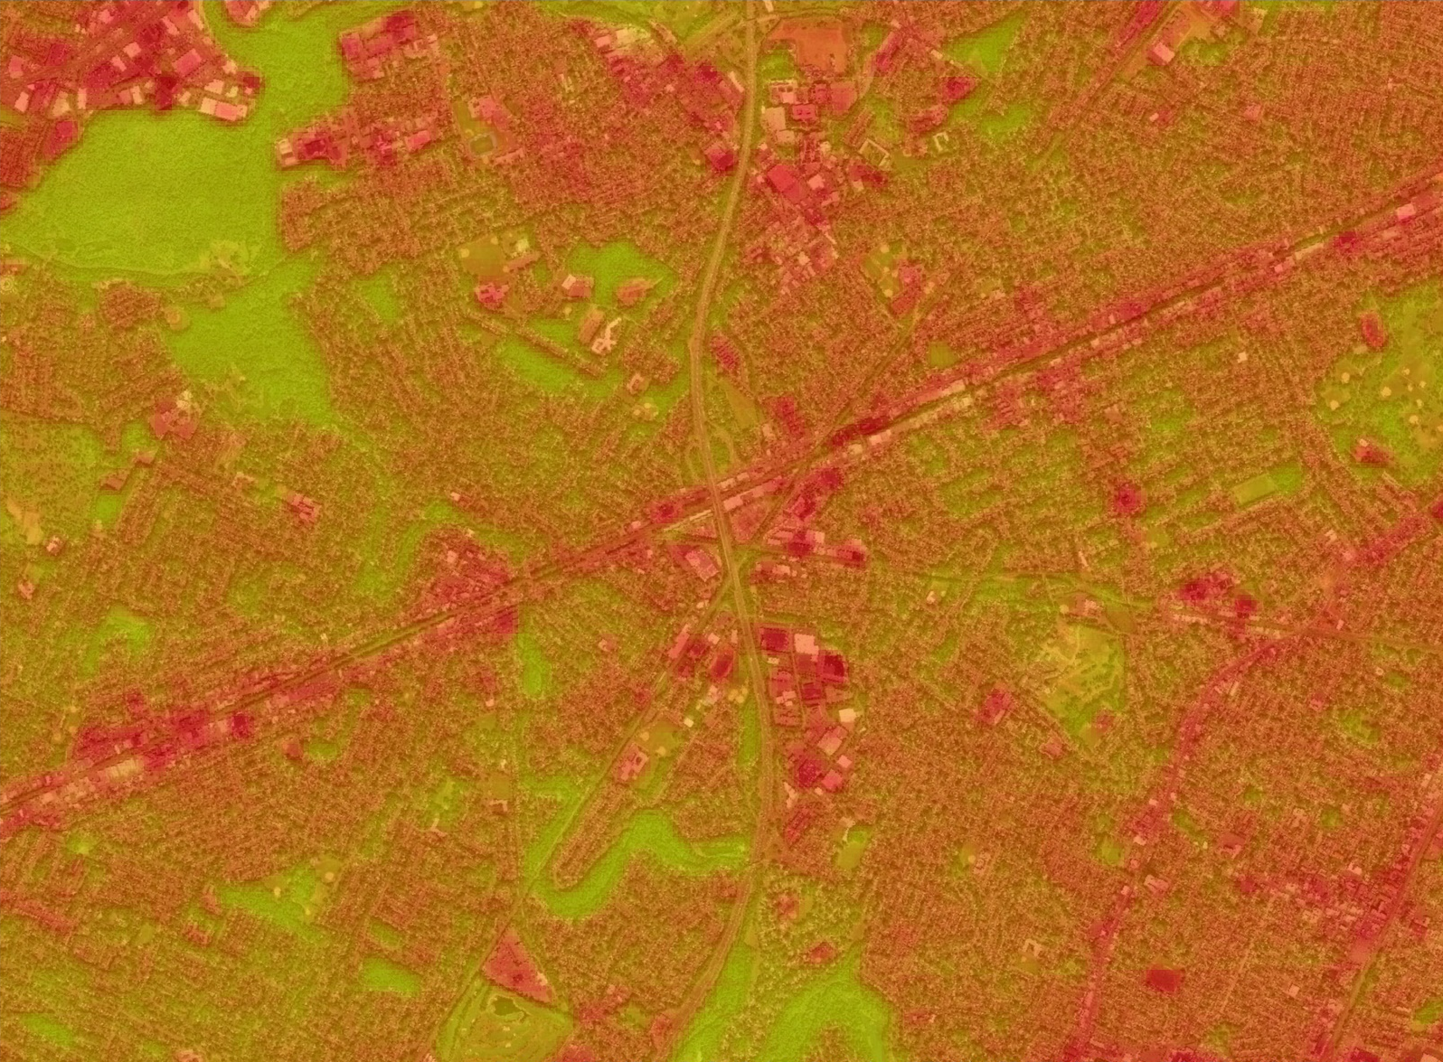
Results: Zoom-In NJ
145° F
72 ° F
1 mile
Notes:
BAM. The vegetation is cooler and the impervious areas, hotter. The forest is uniform and cool while larger buildings / complexes give off a larger amount of heat.

Slide 27
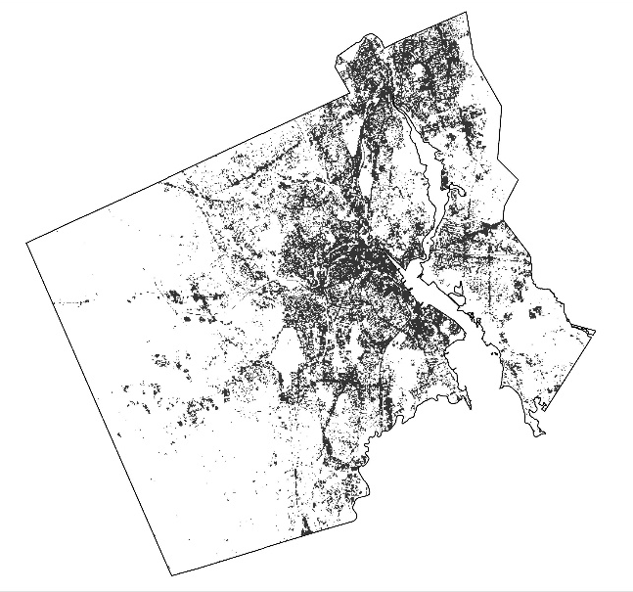
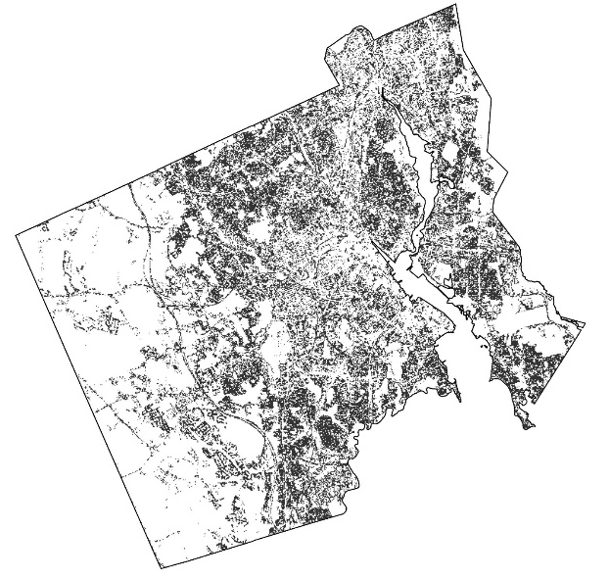
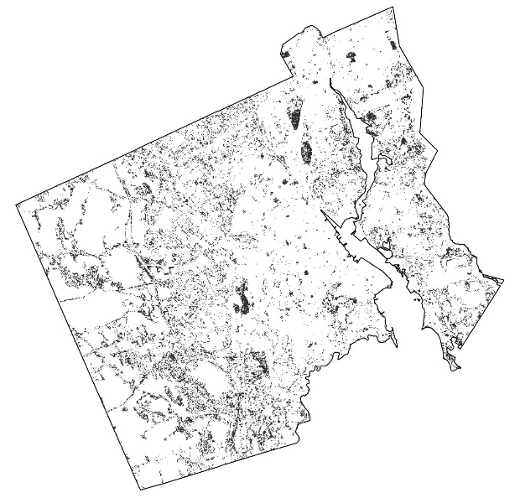
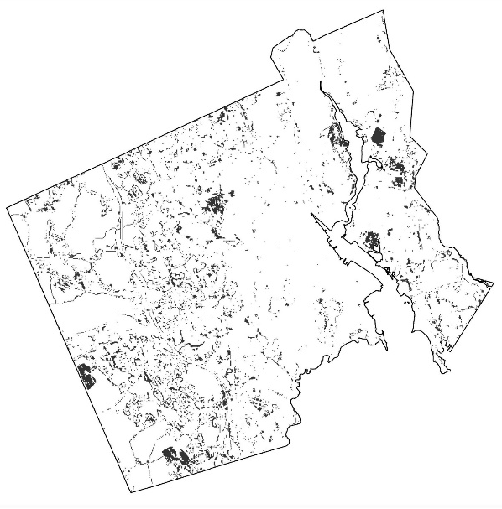
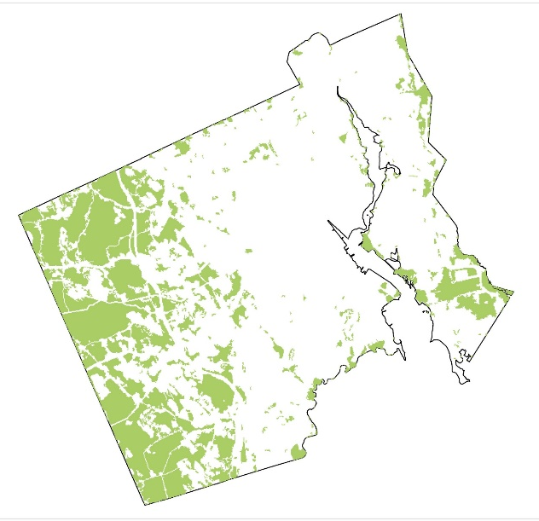
Land Cover
NLCD 2011
5 miles
Combined Vegetation
Urban Development
HIGH
MEDIUM
LOW
OPEN
VEGETATION
Notes:
Analyzing that photo was broken down into 5 different parts: High Development, Medium , Low , Open, and finally all forms of vegetation.

Slide 28
Land Cover and Surface Temperatures?
5 miles
Combined Vegetation
Urban Development
HIGH
MEDIUM
LOW
OPEN
VEGETATION
LST Values
LST Values
LST Values
LST Values
LST Values
Notes:
What do y’all think the LST values of the different land covers will result in?

Slide 29
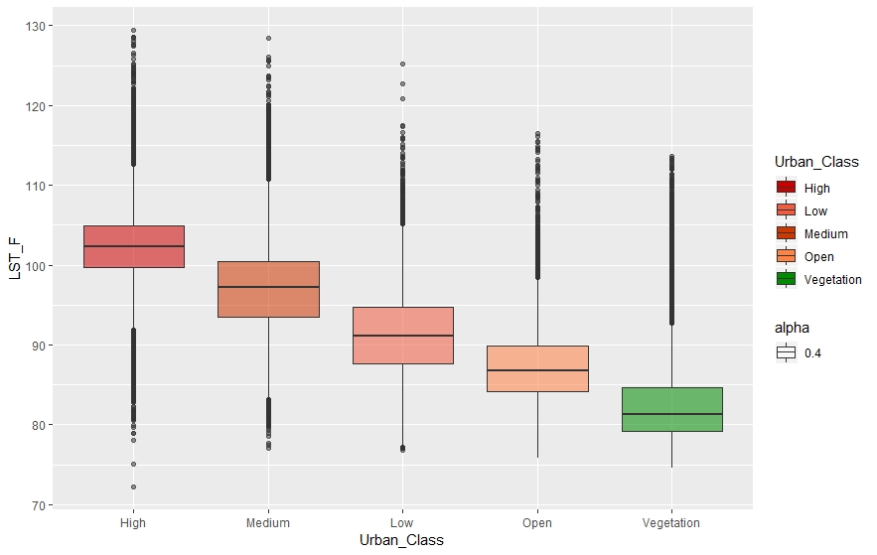
Results: Overlay Analysis
130°
120°
110°
Land Surface Temperature (°F)
100°
90°
80°
70°
High
Medium
Low
Open
Vegetation
Land Cover Type (by NLCD 2011 Class)
Notes:
WHAMO. Higher urbanization leads to higher level of urban heat. As we reduce the amount of impervious surfaces the temperature gradually declines.

Slide 30
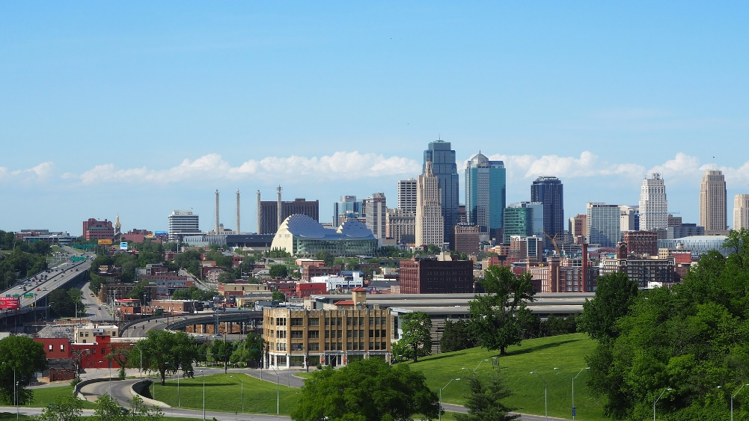
Cross-Validation: Overview
Verify the accuracy of the USGS Level-2 Land Surface Temperature Science Product (STP)
Determine the areas where ASTER , MODIS, and LANDSAT captured the same area on the same date
Resample ASTER & LANDSAT from 30 m and 90 m resolutions to 1000 m
Calculate the correlation between the satellites’ land surface temperature values and whether the results change depending on different land cover types
Source: Pixabay
Notes:
Now we move onto whether or not those land surface temperatures were even right! We aimed to verify the STP so that our partners would feel comfortable with using a provisional product. We had to triangulate an areas where all three satellites, Landsat, ASTER, and MODIS all crossed on the same day. We found a few areas but went with Kansas City as our study area since the overlap between the scenes produced from all of the satellites was the largest out of any of the other areas. We resampled Landsat and Aster to 1000m so that the resolution would match that of MODIS. From here we calculated the validity of the STP by comparing it to the other two land surface temperature products. We divided this calculation up based on different land cover types in order to better describe the relationships

Slide 31
Cross-Validation: Overview
Notes:
Here we have a graph of the three satellites with their surface temperature values at varying points across the study area. One thing to note here is the general trend that ASTER will typically have the highest value. This is due to the fact that the Landsat and MODIS scenes were taken around 10am while ASTER was taken around 5. This 7 hour difference leads to higher temperatures due to surface heating. What you should focus on is the change between points. What we would have hoped for is the steepness of the lines to match from point to point. However if you look around the 5-6th point you can see that clearly isn’t the case. So…

Slide 32
Cross-Validation: Vegetation
Notes:
We’ll ignore those parts for now. Plotting the temperatures against each other we look for a 1 to 1 relationship. For every point we sampled, in a perfect world of course, due to the later time the Aster value was collected, each Landsat temperature should have an Aster temperature about 5 degrees hotter. However we see that linear relationship is not perfect, but there is moderate correlation. The MODIS satellite begins to show it’s differences here. With a low R^2 value, it seems that Landsat doesn’t match up as well.

Slide 33
Cross-Validation: High Urbanization
Notes:
Something horrible has happened here. In the chaos and swamp of uncertainties that come with an area of high urban development, Landsat and ASTER have come out of the fog, strong. Well, moderately significant. But look. Deep into the muck. MODIS has failed. Areas of high urbanization are were this pair falls short. What’s import is to remember that the R^2 value is calculating a linear relation ship. What I thought would be a better measure of validity would be…

Slide 34
Cross-Validation: Pearson Correlation
Land Cover | Landsat – ASTER | Landsat – MODIS | ASTER – MODIS
Vegetation | 0.81 | 0.41 | 0.49
Water | 0.64 | 0.28 | 0.37
Open | 0.65 | 0.34 | 0.31
Low Urban | 0.78 | 0.47 | 0.48
Medium Urban | 0.73 | 0.43 | 0.45
High Urban | 0.59 | 0.00 | 0.19
All | 0.85 | 0.58 | 0.60
Surface temperature values for Landsat – Aster correlated and verified the validity of the STP.
Terra MODIS had low correlation values between both satellites and had significantly low correlation values over areas of high urbanization
Notes:
Taking the Pearson Correlation of each satellite we see some trends and MODIS performs a bit better than previously shown. LS – AST have a moderate correlation across the board. As one increases, so will the other. Not necessarily linearly, but they do move together. On average any satellite that pairs with MODIS will have a smaller, less significant correlation. At the top, over vegetation, LS – AST have the highest correlation rates. MODIS shows no correlation to Landsat in areas of high urbanization.

Slide 35
Flooding Distribution Methodology
NDWI (Normalized Difference Water Index):
$\text{NDWI}\text{ = }\frac{\text{NIR} \text{−} \text{Green}}{\text{NIR}\text{ + }\text{Green}}$
MNDWI (Modified Normalized Difference Water Index):
M$\text{NDWI}\text{ = }\frac{\text{M}\text{IR} \text{−} \text{Green}}{\text{M}\text{IR}\text{ + }\text{Green}}$
Acquire Landsat scenes from 1988 to 2018
Select bands needed and clip to study area
Calculate NDWI and MNDWI
Calculate frequency of inundated pixels
Download and unzip data using Python
Apply cloud mask using Python
Apply 2 separate Thresholds
Generate flood distribution maps
Notes:
We started the Flood distribution maps by collecting Landsat 5,7,and 8 scenes between the years of 1988 and 2018. We then downloaded and unzipped the data.

Slide 36
Flooding Distribution Methodology
NDWI (Normalized Difference Water Index):
$\text{NDWI}\text{ = }\frac{\text{NIR} \text{−} \text{Green}}{\text{NIR}\text{ + }\text{Green}}$
MNDWI (Modified Normalized Difference Water Index):
M$\text{NDWI}\text{ = }\frac{\text{M}\text{IR} \text{−} \text{Green}}{\text{M}\text{IR}\text{ + }\text{Green}}$
Acquire all Landsat scenes from 1988 to 2018
Select bands needed and clip to study area
Calculate NDWI and MNDWI
Calculate frequency of inundated pixels
Download and unzip data using Python
Apply cloud mask using Python
Apply 2 separate Thresholds
Generate flood distribution maps
Notes:
Using a python script, we were able to cut down the scenes by down selecting the bands and clip the scenes to the study area. For our analysis, we kept the red, blue, green, Near-infrared, mid-infrared, and pixel QA bands.
Continuing with a Python script, we applied a cloud mask to take out any pixels that are covered with clouds.

Slide 37
Flooding Distribution Methodology
NDWI (Normalized Difference Water Index):
$\text{NDWI}\text{ = }\frac{\text{NIR} \text{−} \text{Green}}{\text{NIR}\text{ + }\text{Green}}$
MNDWI (Modified Normalized Difference Water Index):
M$\text{NDWI}\text{ = }\frac{\text{M}\text{IR} \text{−} \text{Green}}{\text{M}\text{IR}\text{ + }\text{Green}}$
Acquire all Landsat scenes from 1988 to 2018
Select bands needed and clip to study area
Calculate NDWI and MNDWI
Calculate frequency of inundated pixels
Download and unzip data using Python
Apply cloud mask using Python
Apply 2 separate Thresholds
Generate flood distribution maps
Notes:
Next, we calculated a Normalized Difference Water Index and Modified Normalized Difference Water Index. An NDWI helps identify open water features and enhance their presence in the Landsat scenes. This index using the green and near-infrared bands. The MNDWI also enhances open water features and eliminates excess land, vegetation, and soil noise. This band uses the green and mid-infrared bands.
We then applied a threshold that designates every water pixel to be equal to 1 and every land pixel to be equal to 0. The second threshold distinguishes all valid pixels from invalid pixels, setting valid pixels equal to 1 and non-valid pixels equal to 0.

Slide 38
Flooding Distribution Methodology
NDWI (Normalized Difference Water Index):
$\text{NDWI}\text{ = }\frac{\text{NIR} \text{−} \text{Green}}{\text{NIR}\text{ + }\text{Green}}$
MNDWI (Modified Normalized Difference Water Index):
M$\text{NDWI}\text{ = }\frac{\text{M}\text{IR} \text{−} \text{Green}}{\text{M}\text{IR}\text{ + }\text{Green}}$
Acquire all Landsat scenes from 1988 to 2018
Select bands needed and clip to study area
Calculate NDWI and MNDWI
Calculate frequency of inundated pixels
Download and unzip data using Python
Apply cloud mask using Python
Apply 2 separate Thresholds
Generate flood distribution maps
Notes:
To find the frequency of the inundated pixel by dividing the amount of water pixels from the first threshold and dividing them by the number of valid pixels from the second threshold.
This gave us our final maps.

Slide 39
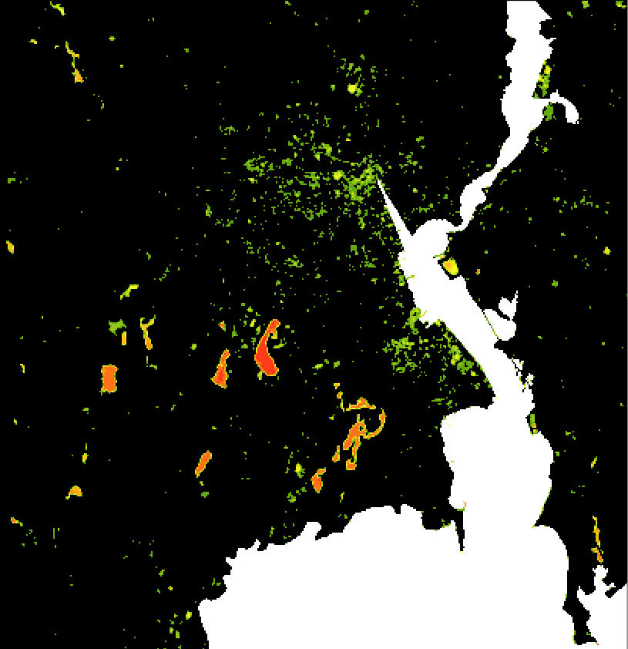
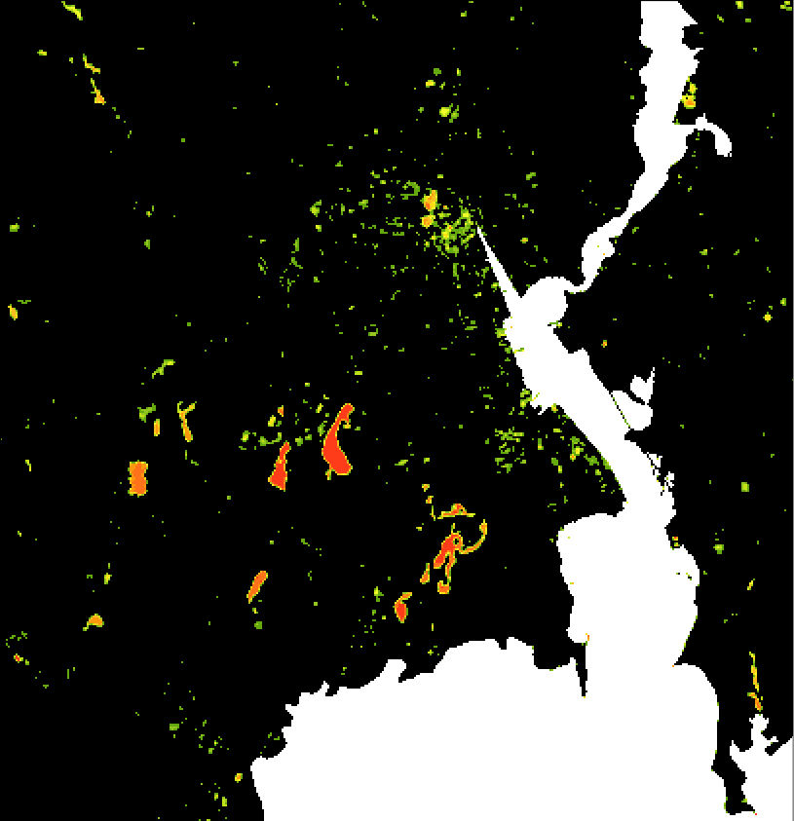
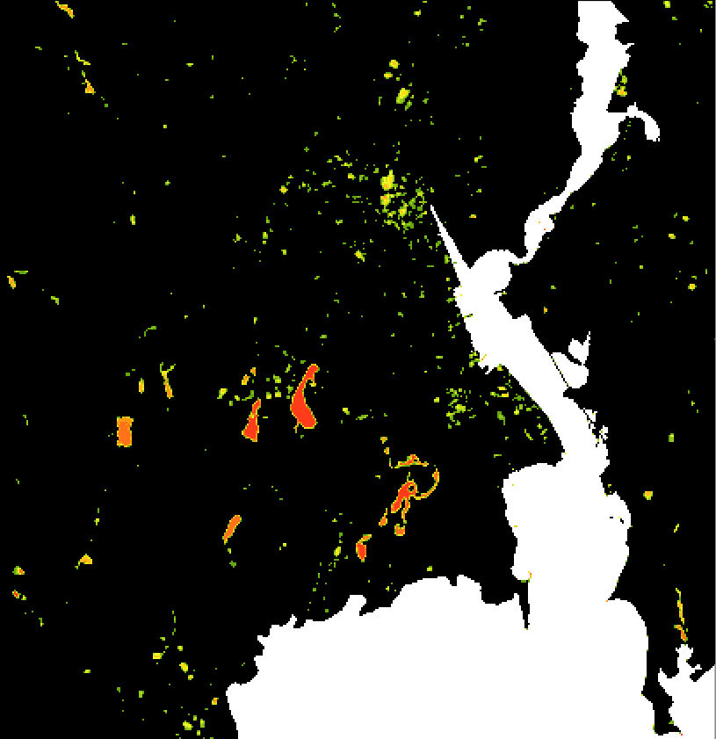
Providence, RI Decadal Flood Maps
0
2
91-100
41-50
0-10
1988 –1997 Flooding Distribution (%)
1998-2007 Flooding Distribution (%)
2008-2018 Flooding Distribution (%)
Notes:
Here are the decadal flood maps that we created through this process. These show the percentage of the amount of times the pixel was inundated.

Slide 40
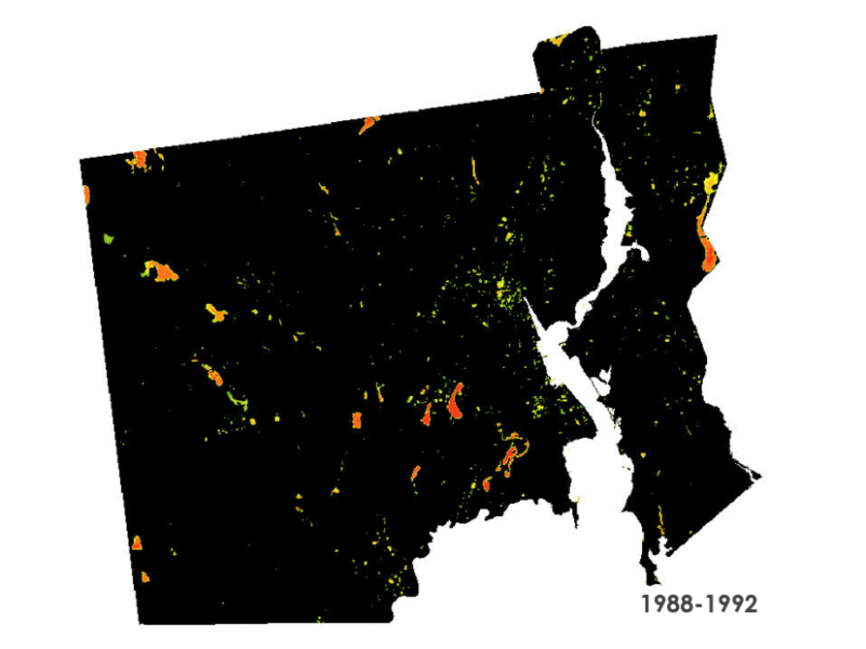
5-Year Change GIF: Providence, RI
91-100
41-50
0-10
Notes:
Here is a GIF that shows all of the 5-year distributions through time.

Slide 41
Conclusions
HEAT
Higher land surface temperatures were concentrated in areas with higher impervious surface cover such as asphalt, concrete, and large buildings.
Cooler LST’s were concentrated in densely vegetated areas.
The STP proved a viable and accurate option for heat distribution mapping in urban landscapes.
Terra MODIS surface temperature values did not correlated with Landsat and ASTER measurements over areas of high urban development.
Notes:
For heat, we concluded that Higher land surface temperatures were concentrated in areas with higher impervious surface cover such as asphalt, concrete, and large buildings. Cooler LST’s were concentrated in densely vegetated areas. The STP proved a viable and accurate option for heat distribution mapping in urban landscapes, and Terra MODIS surface temperature values did not correlate with Landsat and ASTER measurements over areas of high urban development.

Slide 42
Conclusions
FLOODING
Scale of flood frequency analysis influences interpretation of trends.
Local vs. Regional
Higher flood frequencies are commonly found in urban and suburban areas.
NDWI and MNDWI indices are more effective in non-urban areas.
Notes:
For flooding, we concluded that Scale of flood frequency analysis influences interpretation of trends. Higher flood frequencies are commonly found in urban and suburban areas, and NDWI and MNDWI indices are more effective in non-urban areas.

Slide 43
Errors and Uncertainties
HEAT
Provisionary nature of STP – released November 29, 2019
Cloud masking confidence – Pixel QA
Land Cover Classification
Resampling of ASTER & Landsat
LST Products for ASTER & MODIS
Notes:
Heat:
“Provisionary nature of STP”
Given the provisionary nature of the STP data, we were limited to certain dates for which we could collect usable scenes.
There were also locations across the U.S. where usable scenes were missing.
Cloud masking - confidence: we used the typical QA band to mask our scenes. However, there may be a better way to mask using the Pixel Quality Assessment band. We believe this process may have left out usable data.
For the land cover analysis, the reclassification of the NLCD land cover data may have oversimplified the relationship of surface temperature and land cover.
Resampling Landsat and Aster from 30m and 90m respectively, to 1000m to match MODIS might have introduced a new level of error
Alongside this, there are errors within the LST products for both Aster and MODIS that also may have influenced the analysis
With an initial threshold value of 0.0, the indices were failing to identify permanent bodies of water, suggesting that areas that are normally “water” were not being highlighted in the results.
To resolve this problem, we readjusted the threshold from 0.0 to 0.02

Slide 44
Errors and Uncertainties
FLOODING
Large flat roofs mislead pixel flood frequency values
Early thresholding issues – major water bodies undetected
Readjusted threshold from 0.00 → 0.02
No ground data to cross-reference with results
Not accounting for “mixels” – pixels with nearly equal amounts of water and land
Landsat scenes may not be captured at exact flooding events
Notes:
Flooding:
Large flat roofs mislead pixel flood frequency values
Early thresholding issues – major water bodies undetected
No ground data to cross-reference with results
Not accounting for “mixels” – pixels with nearly equal amounts of water and land
Landsat scenes may not be captured at exact flooding events
With an initial threshold value of 0.0, the indices were failing to identify permanent bodies of water, suggesting that areas that are normally “water” were not being highlighted in the results.
To resolve this problem, we readjusted the threshold from 0.0 to 0.02

Slide 45
Lawrence Hoffman | GIS Program Manager, Groundwork USA
Cate Mingoya | Director of Capacity Building, Groundwork USA
Steve Burrington | Executive Director, Groundwork USA
Amelia Rose | Executive Director, Groundwork Rhode Island
Jonathan Phillips | Executive Director, Groundwork Elizabeth
Dr. Kenton Ross | Science Advisor, NASA DEVELOP National Program
Lance Watkins | PhD Candidate, Arizona State University
Patrick Frier | Center Lead at DEVELOP Langley

