Slide 1
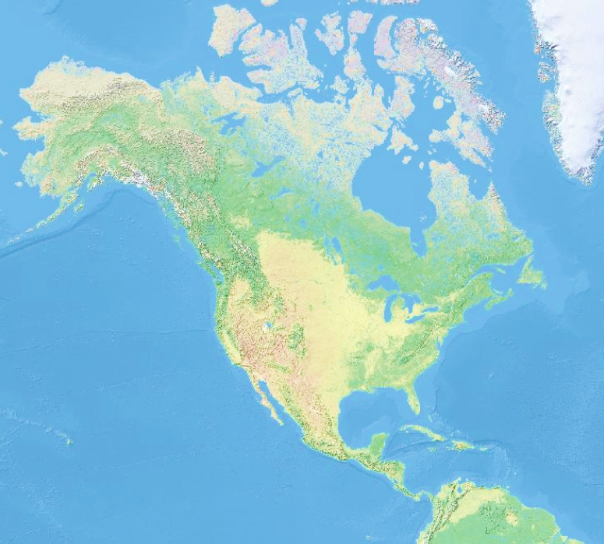
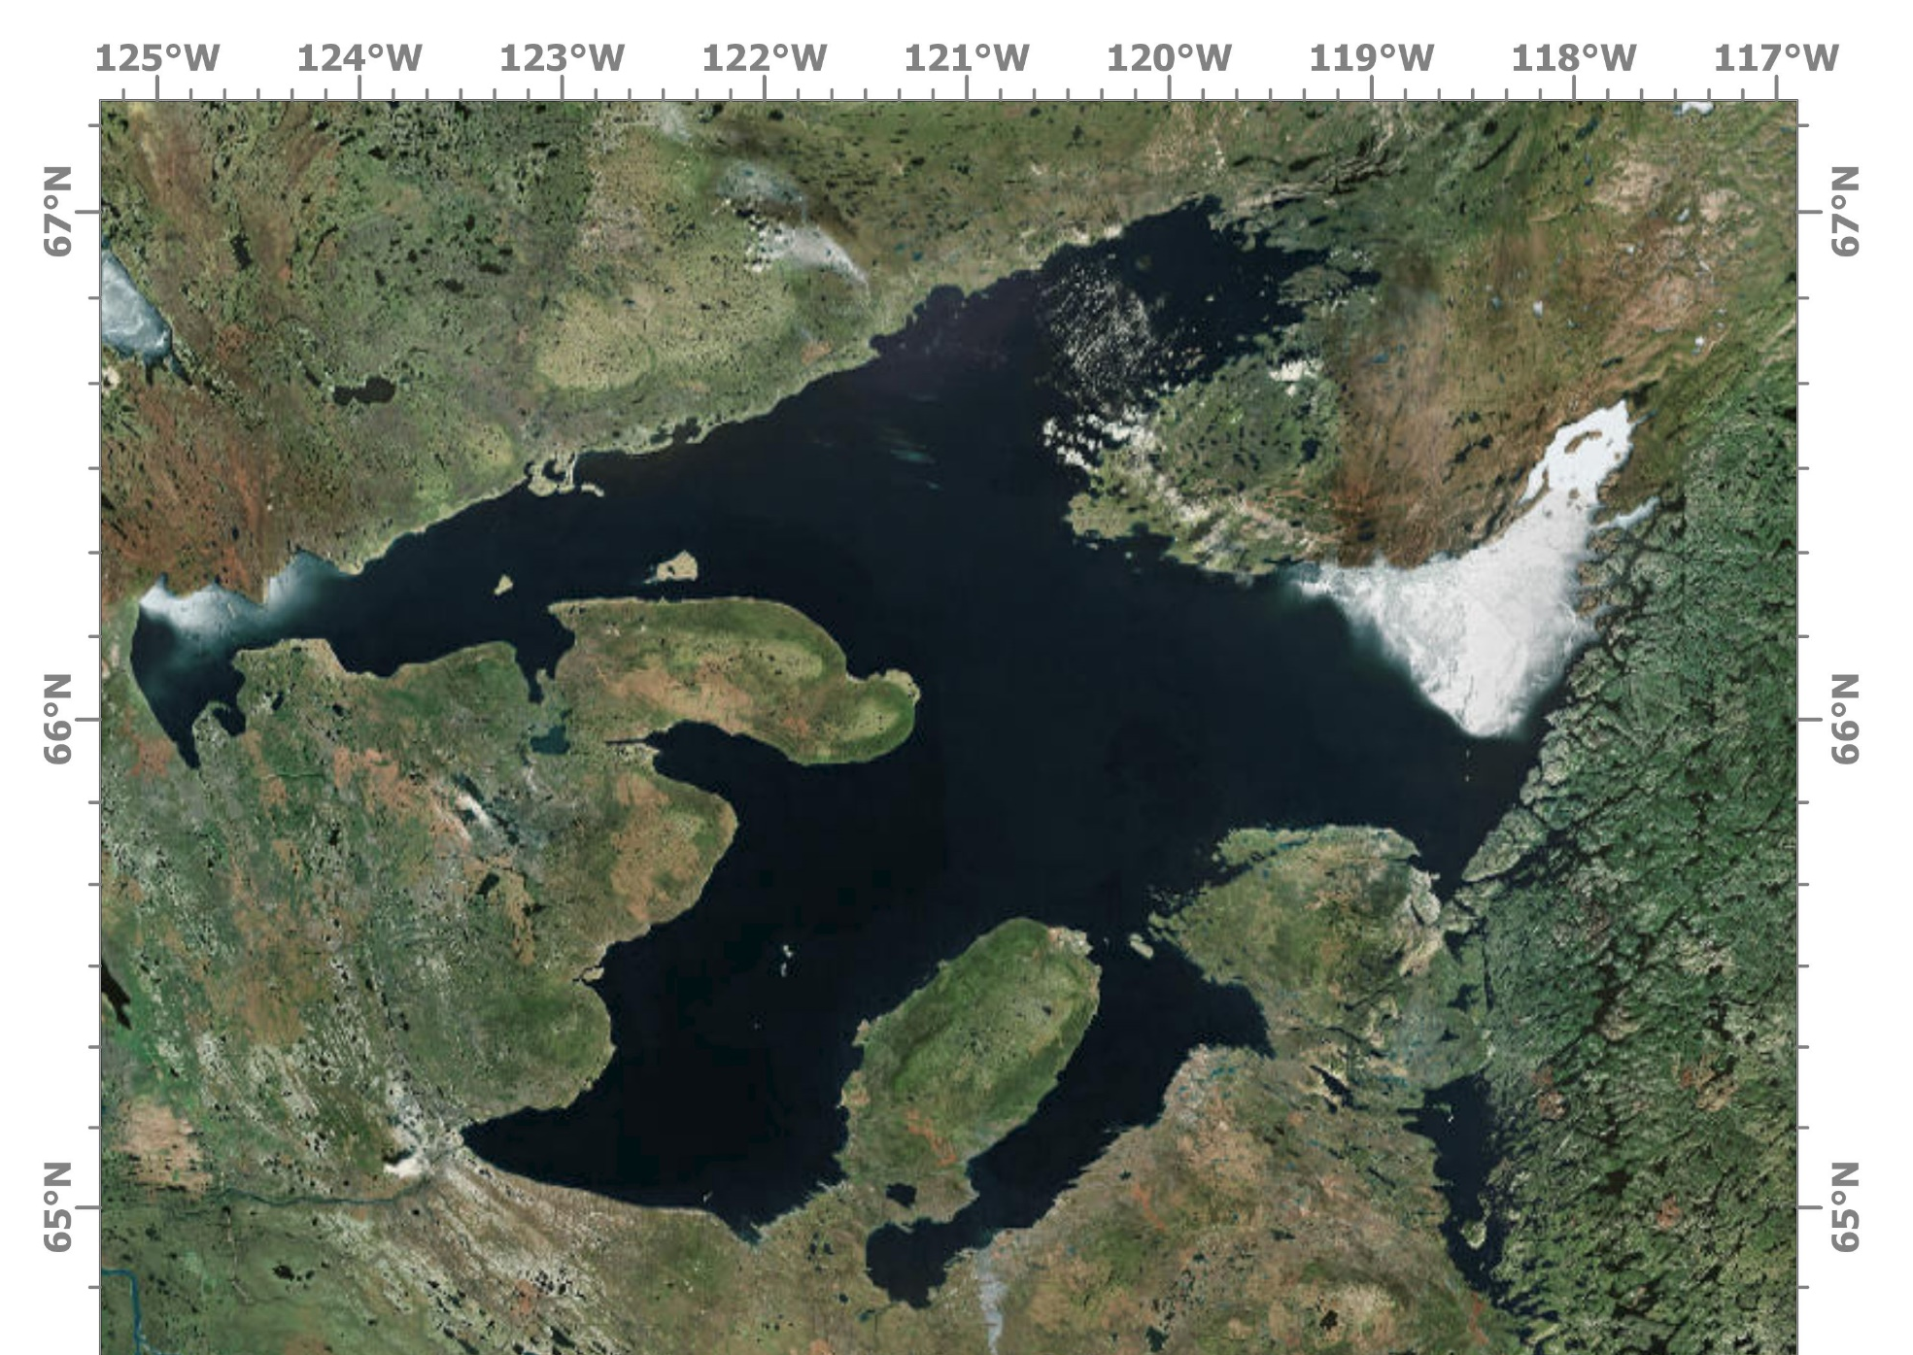

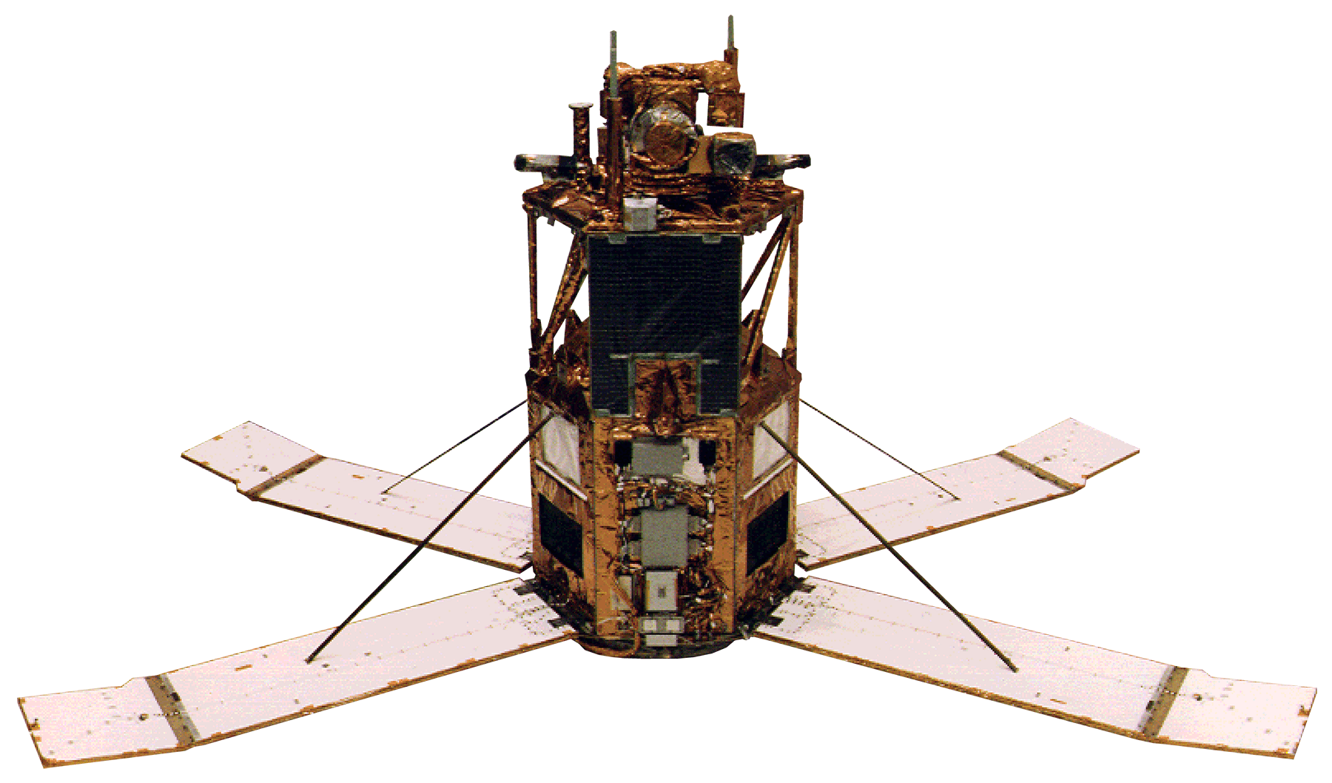
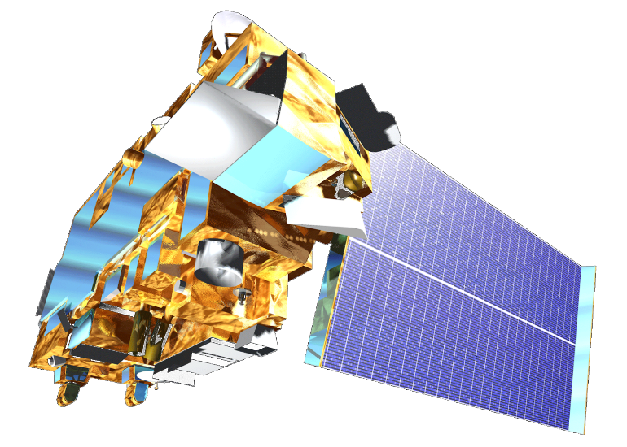
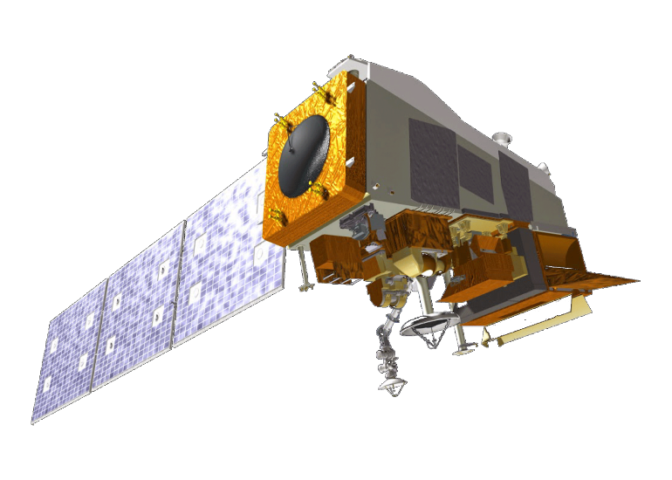




A Long-Term Remote Sensing Analysis to Evaluate Changes in Water Quality of Great Bear Lake
Abstract
Methodology
The Sahtu Dene people of Délįnę have a strong traditional tie to Great Bear Lake (GBL), which they refer to as “The Water Heart.” The indigenous community is concerned with how changes in the lake may affect their livelihoods and fisheries. Arctic lakes like the GBL, the largest lake in Canada, are sensitive to increasing global temperatures. However, assessing the changing climate’s impacts on large water bodies is challenging and requires long-term time series analyses across large datasets. The scarcity of continuous monitoring has constrained the spatiotemporal evaluation of the GBL’s responses to climate variability in past years. Previous research of GBL primarily consists of ice phenology and fisheries studies. To complement previous studies in the region and support environmental monitoring done by project partners in the Délįnę Renewable Resources Council, Environment and Climate Change Canada, and Fisheries and Oceans Canada, the fall 2018 NASA DEVELOP Massachusetts team analyzed long-term remote sensing data to assess the water quality changes of GBL over the past 20 years. The data were acquired from Aqua and Terra Moderate Resolution Imaging Spectroradiometer (MODIS), Sea-Viewing Wide Field-of-View Sensor (SeaWiFS), Suomi NPP Visible Infrared Imaging Radiometer Suite (VIIRS), and the ARCLake Database to evaluate changes in lake surface water temperature (LSWT), Chlorophyll-a, and chromophoric dissolved organic matter (CDOM). We did not observe any significant trends. More work must be done to assess long term water quality trends in arctic lakes.
Data
Acquisition
Processing
Analysis
SeaWiFS: 1998-2010
Aqua MODIS: 2002-2018
Terra MODIS: 2000-2018
VIIRS: 2012-2018
ARCLake: 1995-2012
Dataset extraction from global coverage datasets
Data cleaning using mask
Parameters calculation
Trends analysis in August
Challenges with unreliable data
Temporal trends of LSWT, Chl-a, and CDOM
Spatial trends of LSWT, Chl-a, and CDOM
Results
Chl-a
CDOM
Objectives
Evaluate changes in Great Bear Lake over the past 20 years for the following parameters: lake surface water temperature (LSWT), chlorophyll-a (Chl-a), and CDOM content
Provide the end user with maps and data visualizations to display how GBL has changed over time
Create an ArcGIS Story Map to easily communicate the results and conclusions of the project
Share the potential benefits of using NASA Earth observations and remote sensing for water resource management
Study Area
Artic
Ocean
Alaska
Conclusions
Canada
Great Bear Lake
Arctic lakes present many unique challenges to satellite remote sensing, which must be addressed for future studies of Great Bear Lake to be successful.
Surface reflectance in blue and green bands presented the greatest discrepancies between sensor datasets. This compromised chlorophyll-a and CDOM estimation.
No drastic changes in water quality parameters were observed over the 20 year study period.
Visual inspection showed a non-significant, decreasing trend in water temperature.
Pacific
Ocean
United States
Atlantic
Ocean
Délįnę
Image: ArcGIS-Pro
Source: ESRI
Earth Observations
Acknowledgements
Dr. Cédric G. Fichot, Assistant Professor, Boston University
Dr. Marlene Evans, Environment and Climate Change Canada
Dr. Kimberly Howland, Fisheries and Oceans Canada
Ed Reeves, Délįnę Renewable Resources Council
Mandy Bayha & Gina Bayha, UNESCO World Biosphere Reserve of Tsá Tué
Aqua MODIS
SeaWiFS
Terra MODIS
Suomi NPP VIIRS
Team Members
Project Partners
Délįnę Renewable Resources Council
Environment and Climate Change Canada
Fisheries and Oceans Canada
Krishna Sharma
Project Co-Lead
Juan Jaimes
Project Co-Lead
Mahrokh Moknatian
Huan Mi
Great Bear Lake Water Resources
Massachusetts – Boston| Fall 2018

