Slide 1
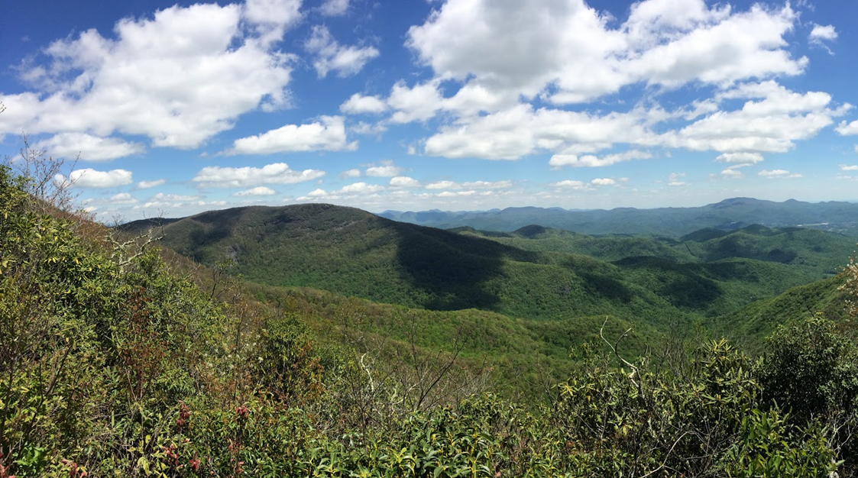
Appalachian Trail Health & Air Quality
Amy Wolfe (Project Lead)
Monitoring Ozone in the Troposphere to Help Regulate Point Source Emissions and to Improve Ozone Advisory Messages by the National Park Service
Amber Showers
Emily Beyer
Eric White
Tyler Rhodes
Notes:
Hello!
I am Amy Wolfe the project lead,
And I am Amber Showers,
And I am Emily Beyer,
And I am Eric White,
And I am Tyler Rhodes, and we are the Appalachian Trail Health and Air Quality Team.
Our project focuses on using NASA Earth observations to measure the tropospheric ozone along the Appalachian Trail to assess the effectiveness of incorporating satellite sensors with the National Park Service’s ground monitoring stations.
VPS photo source courtesy of Tyler Rhodes

Slide 2
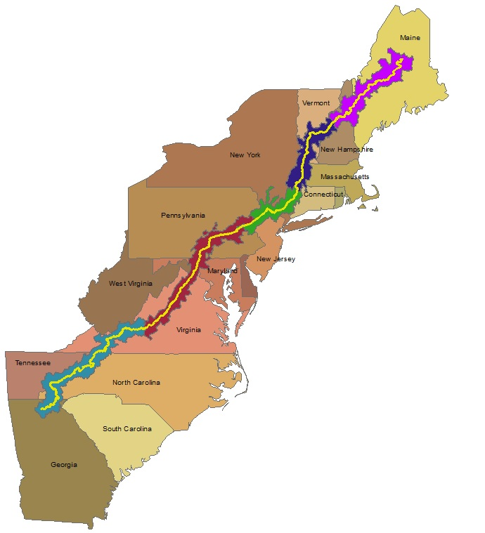
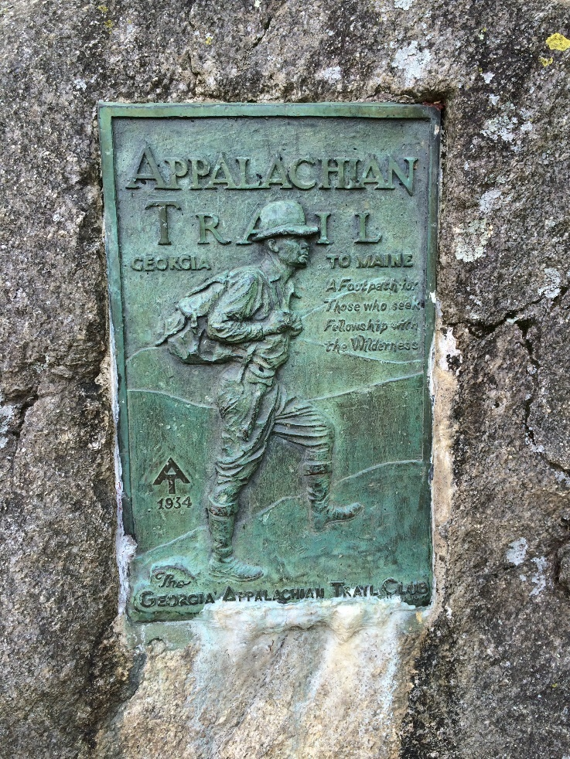
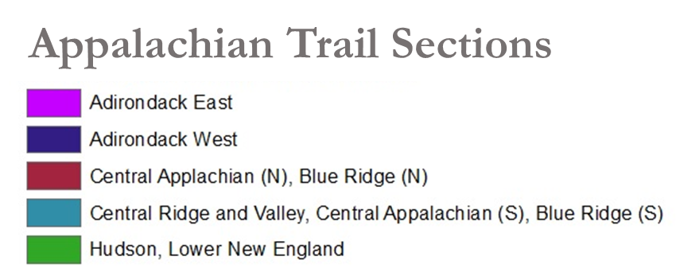
Study Area
The Appalachian Trail passes through CT, GA, MA, MD, ME, NC, NH, NJ, PA, TN, VA, WV, NY, VT.
Study Period:
2012 – 2015
May – September
Notes:
The Appalachian Trail extends the majority of the East coast of the United States from Georgia to Maine,
And is home to a variety of flora and fauna such as the black bear, the American Chestnut tree, and the tulip poplar.
We focused on the highest ozone months from May to September during the years 2012 to 2015 over the entire Appalachian Trail.

Slide 3
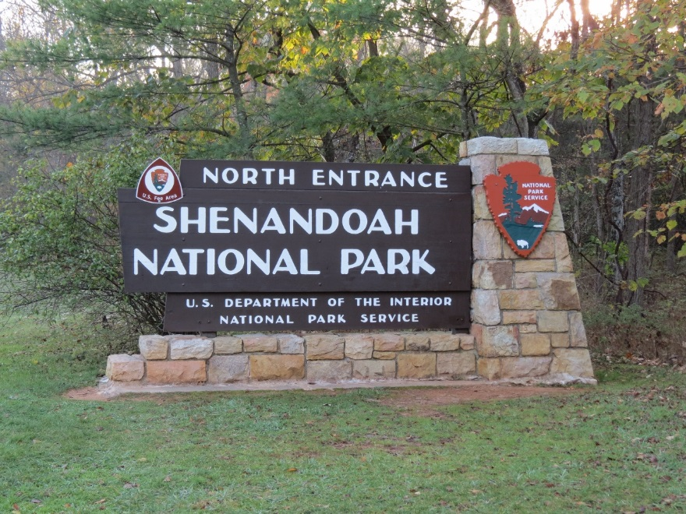
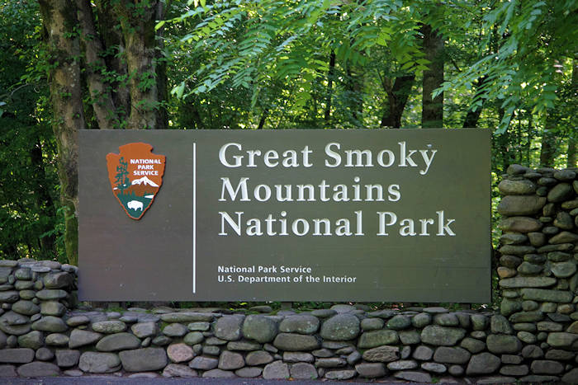
Study Area
Study Period:
2012 – 2015
May – September
Ground Monitoring Stations
Images Credit: Blogspot, Romaticasheville
Notes:
We chose two ground monitoring locations:
Big Meadows (Shenandoah National Park) and Cove Mountain (Great Smoky Mountains National Park) to compare to NASA Earth observations.
Image: http://2.bp.blogspot.com/-TkDgqWLSE6E/UnYnko1YDFI/AAAAAAAATdE/6jc6P7mvbdA/s1600/IMG_0415+(1280x960).jpg
Image: https://www.romanticasheville.com/sites/default/files/images/basic_page/great_smoky_mountains_sign.jpg

Slide 4
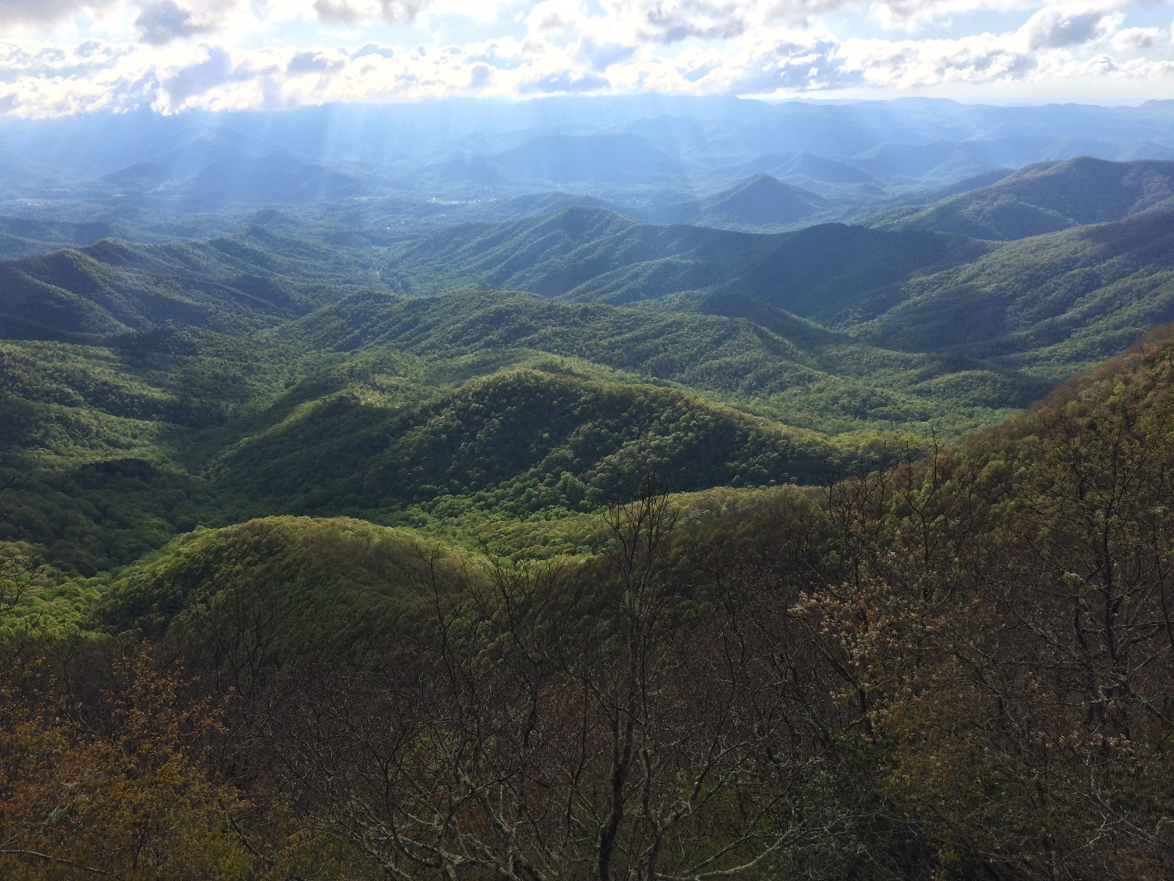
Partners
Shenandoah National Park
Harpers Ferry National Historical Park
Northeast Region National Park Service
Great Smoky Mountains National Park
Appalachian National Scenic Trail
Northeast Temperate Network Marsh-Billings - Rockefeller National Historic Park
Air Resources Division
Notes:
Our partners include several National Parks, National Historical parks, and the National Park Service’s Air Resource Division.
Image Credit: Tyler Rhodes

Slide 5
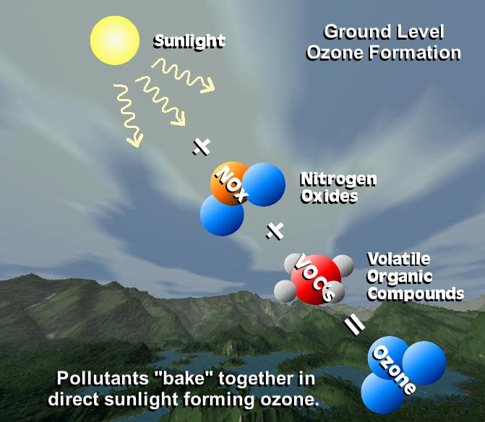
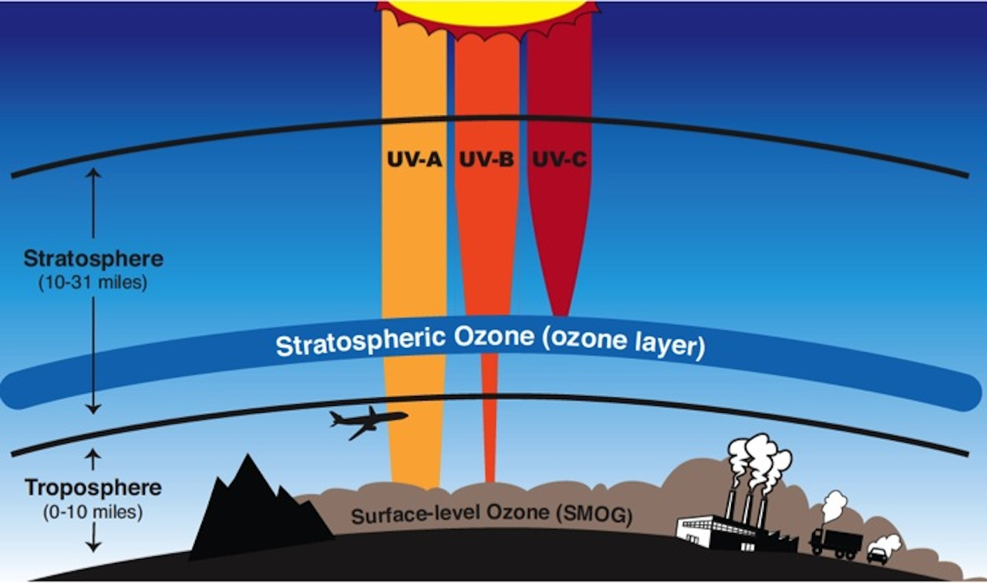
Background
In the stratosphere, ozone is formed naturally and acts as a thin sheet boundary protecting life on the surface from harmful ultraviolet rays.
Images Credit: NASA
Notes:
Ozone can occur in the stratosphere and the troposphere
Stratospheric ozone is considered “good” ozone because it is naturally formed in the atmosphere and protects humans and plants from harmful ultraviolet rays emitted by the Sun.
*Click*
Ozone formed in the Troposphere is considered “bad” ozone.
Tropospheric ozone, or ground-level ozone, is the product from a reaction between sunlight,
*Click*
Nitrogen oxides,
*Click*
And volatile organic compounds which are found in many household products such as paints and cleaning products.
Image: https://www.nasa.gov/sites/default/files/layersofozone_1.jpeg
Image: https://aura.gsfc.nasa.gov/images/features/ground_ozone.jpg

Slide 6
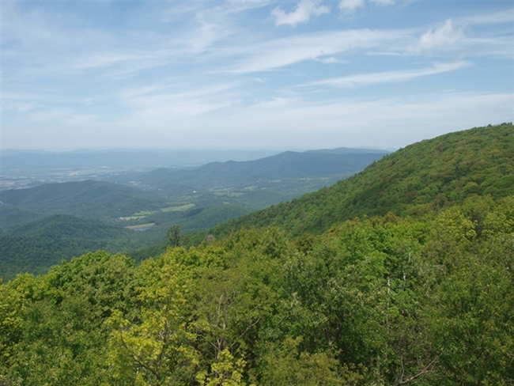
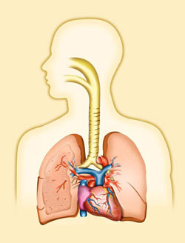
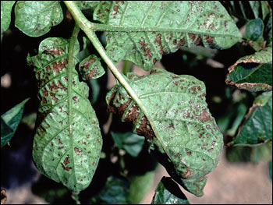
Community Concerns
Air pollution affects scenic and natural resources in national parks
Significant health risks to plants and humans
Increases vegetation’s susceptibility to drought, invasive species infestation, and wildfire
Images Credit: Shenandoah National Park, NASA, EPA
Notes:
Air pollution impacts National Parks in several ways.
One pollutant, Ground-level ozone, poses significant health risks to
*Click*
plants and humans.
Ozone increases the vegetation’s susceptibility to drought, invasive species infestation, and wildfire.
Image Source: http://www.nature.nps.gov/air/WebCams/parks/shencam/shencam.cfm
Image Source: http://earthobservatory.nasa.gov/Features/OzoneWeBreathe/Images/ozone_potatoes.jpg
Image Source: https://www.epa.gov/ozone-pollution/health-effects-ozone-pollution

Slide 7
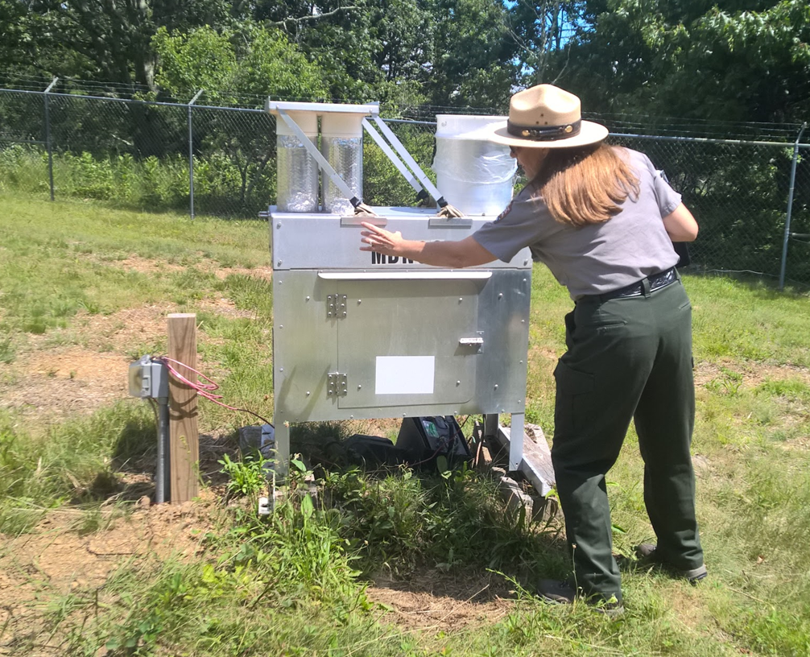
Objectives
Introduce applications of NASA Earth observations to the National Park Service to supplement current monitoring method
Display maps of the seasonal variation of ozone along the Appalachian Trail
Assess the effectiveness of using the MLS/OMI sensors on board Aura to measure air pollutants
Notes:
Currently, the National Park Service contains air monitoring stations that focus on three measurements visibility, gaseous pollutants, and atmospheric deposition. However, these monitoring stations are sparse and the NPS has to extrapolate their data over a large area.
*Click*
Another objective was to assess the usefulness of using two of the satellite’s sensors to calculate ozone.
*Click*
Therefore, NASA Earth observations were used to determine whether satellites could provide an accurate measurement of ozone for the National Park Service.
*Click*
Lastly, the changes in ozone were displayed for the summer months of May to September over the entirety of the Appalachian Trail.

Slide 8
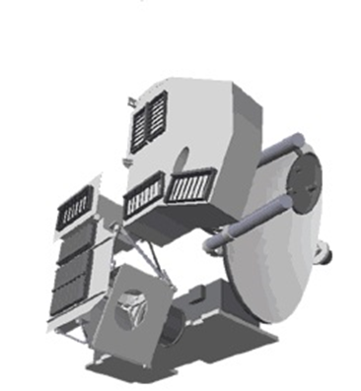
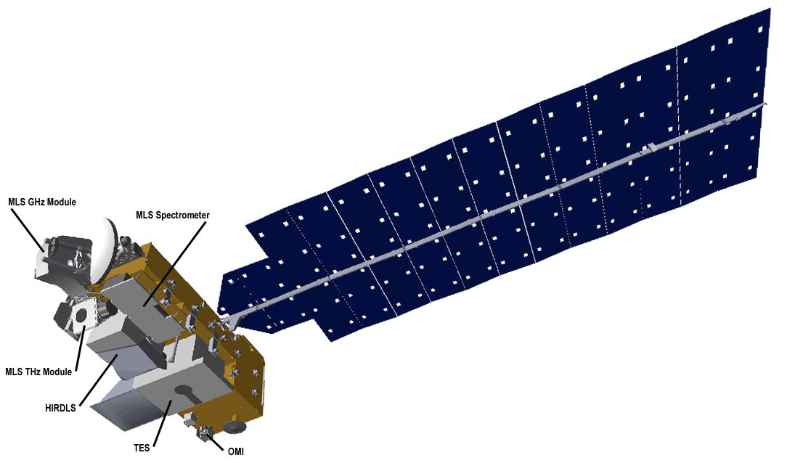
NASA Earth Observations
MLS Sensor
Aura Satellite
OMI Sensor
Notes:
We gathered data from the Aura satellite, which launched July 15, 2004, and used two of its sensors:
*click
The MLS sensor which measures the stratospheric ozone and the OMI sensor which measures the total column ozone.

Slide 9
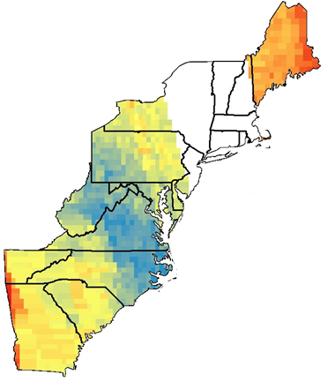
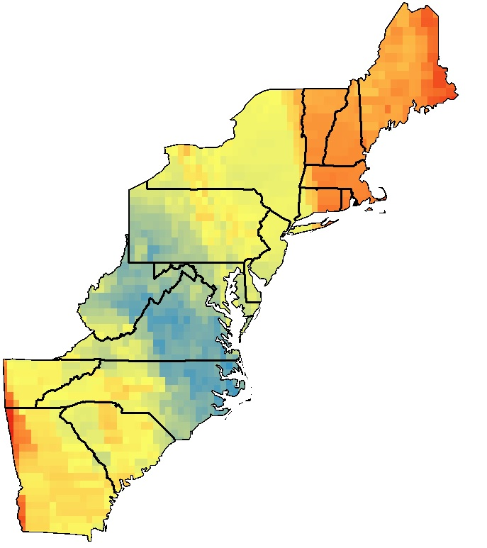
Methodology
Problem: Missing data in diurnal OMI images.
Solution: Geostatistical autocorrelation method to fill in the missing data.
Empirical Bayesian Kriging
Notes:
The daily OMI images contained missing swaths of data due to the multiple row anomalies that have occurred since 2007.
For this reason, we used a geostatistical autocorrelation method
*Click*
The Empirical Bayesian Kriging method was used to fill in the missing area.

Slide 10
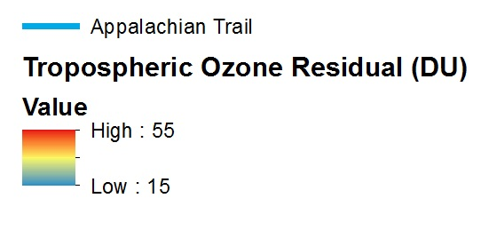
Methodology
Combined OMI and MLS data
Subtracted Stratospheric Ozone from the Total Column Ozone to obtain the Tropospheric Ozone Residual (TOR).
Empirical Bayesian Kriging to obtain average monthly measurements
TOR = Total Column Ozone (OMI) – Stratospheric Ozone (MLS)
Notes:
Since neither of the two Aura sensors directly measures tropospheric ozone, we used a method that subtracted the stratospheric ozone from the total column ozone in order to obtain the ozone present in the troposphere.
*Click*
First, in ArcGIS we combined the OMI and MLS data using bilinear interpolation where the two sensors overlap.
*Click*
To get the tropospheric ozone residual (TOR) we subtracted the Stratospheric Ozone obtained from the MLS sensor from the Total Column Ozone obtained from the OMI sensor.
*Click*
Lastly, we used Kriging to estimate the monthly ozone measurements over our study area.

Slide 11
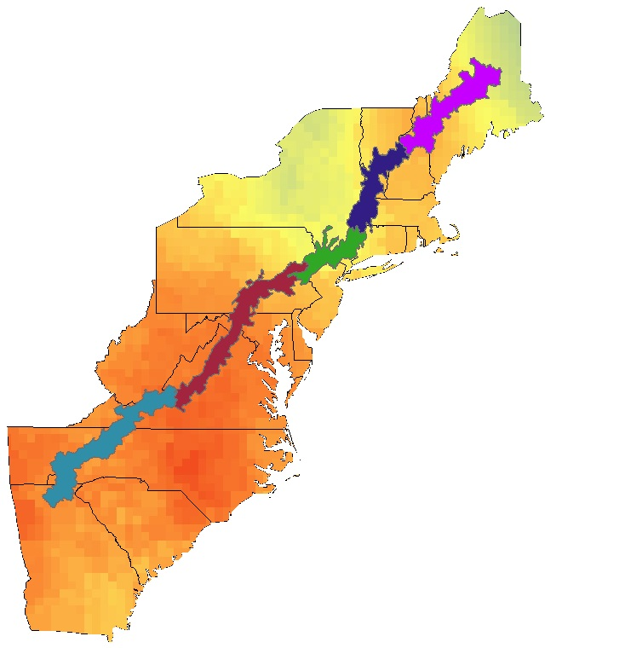
Methodology
Segmented analyses of the Appalachian Trail along ecological regions and Hydrologic Unit Code 10 (HUC10) boundaries.
August 2015
Appalachian Trail Ecoregion/Air Shed Association | Min Ozone (DU) | Max Ozone (DU) | Average Ozone (DU)
Central Appalachian (N), Blue Ridge (N) | 35 | 49 | 44
Hudson, Lower New England | 33 | 39 | 35
Adirondack West | 35 | 41 | 38
Adirondack East | 31 | 42 | 38
Central Ridge and Valley, Central Appalachian (S), Blue Ridge (S) | 43 | 49 | 46
Notes:
After collaboration with our partners from the National Park Service, a segmented analysis was performed over the Appalachian Trail.
The Appalachian Trail was sectioned based on the Hydrologic Unit Code 10 taking into account watersheds and then also based on different ecological regions.
This was performed using zonal statistics to obtain the minimum, maximum, and average ozone in the selected regions.
This sectioning was completed to help the National Park Service with potential policy issues.

Slide 12
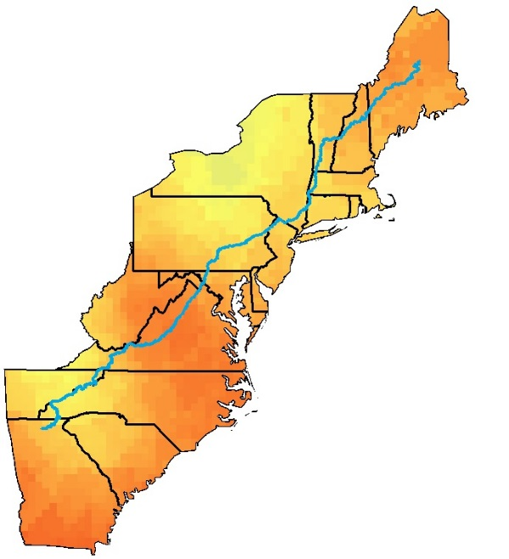
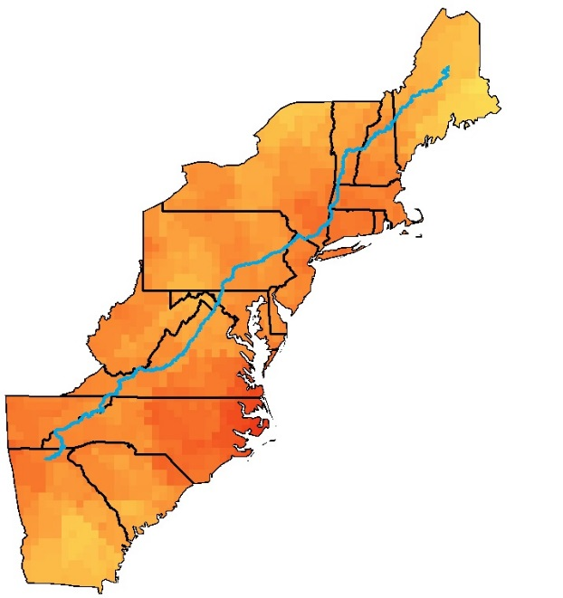
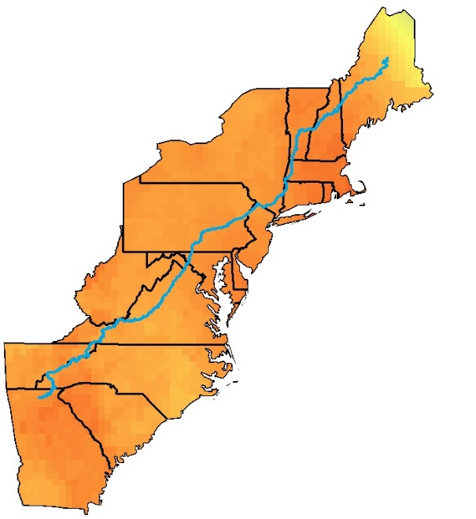
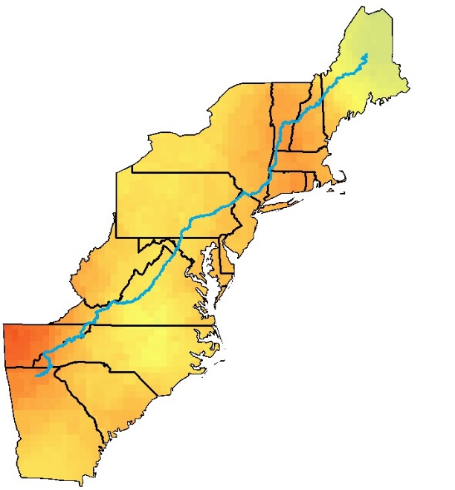
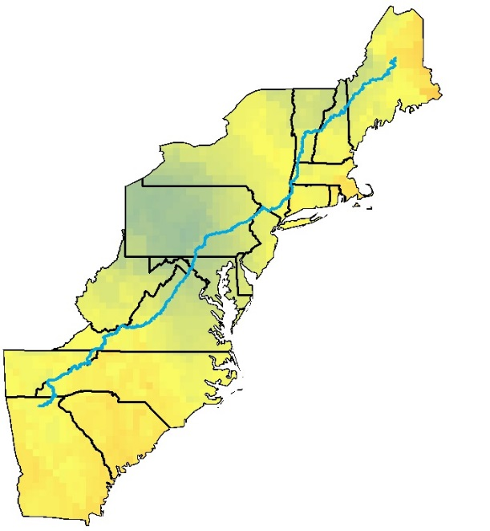
Results
Monthly averages of tropospheric ozone residual (TOR) for the year 2012
May
June
July
August
September
Notes:
These maps display an example of the tropospheric ozone residual calculated for the months of May to September for the year 2012.
We observed, June and July were peak months experiencing the highest tropospheric ozone while ozone continued to decrease from August to September.

Slide 13
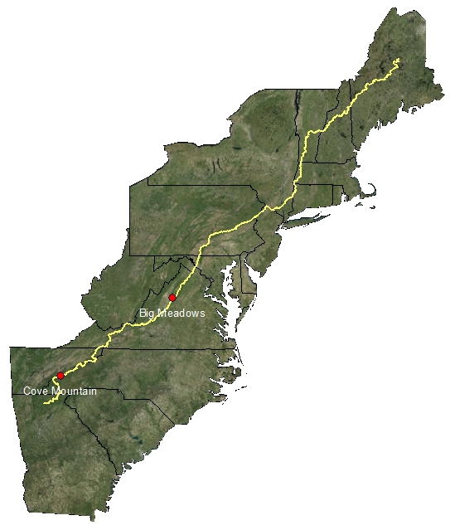
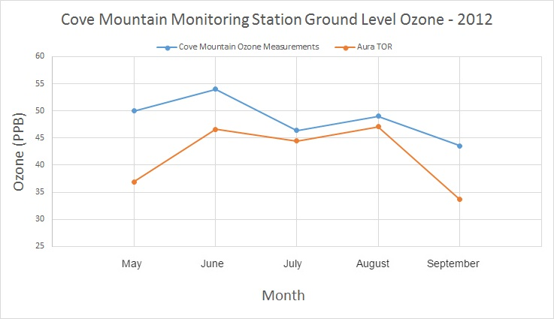
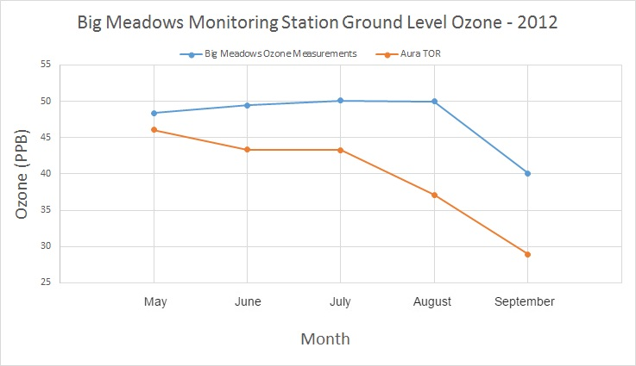
Results
Comparisons of the calculated TOR with surface level monitoring stations
Notes:
We used the monitoring stations at Big Meadows and Cove Mountain
*Click*
To create validation graphs
*Click*
First, we had to convert the TOR calculation from Dobson units to parts per billion using temperature, barometric pressure, and an estimated tropopause height.
After the conversion, we plotted the monthly values for each year to compare the values from the ground monitor to the satellite TOR.
The overall trend for the ground monitors and satellites are similar and the largest difference is observed in
May and
September

Slide 14
Image Credit: Tyler Rhodes
Conclusions
The Tropospheric Ozone Residual calculations displayed similar trends to the NPS surface measurements, with the largest differences observed for the months of May and September.
We were unable to calculate daily tropospheric ozone, however NASA Earth observations can help partners observe monthly trends in areas of the parks not monitored by ground stations.
Notes:
The trends between the ground monitors and the Earth observations are similar, but the differences could be a result of random variability, scaling, or changing tropopause height. With this being said, Daily tropospheric ozone is not recommended because of the missing swaths and the limited coverage of MLS sensors. However, ozone trends can be monitored where parks do not currently monitor ozone to help predict when high levels of ozone could be present.

Slide 15
Errors and Uncertainties
OMI contained missing swaths of data
Notes:
One discrepancy among the data was that the OMI data was in the form of raster's while MLS was in the form of points.
One limitation with the daily OMI data was the missing swaths.
A limitation for the MLS data was that the points overlapping our study area were sparse due to the orbit of the Aura satellite.
Therefore, because of the two different types of measurements made by the sensors and its scarcity, the measurements could not provide us with enough data to do daily measurements for our study area. So, to compensate we performed monthly averages.

Slide 16
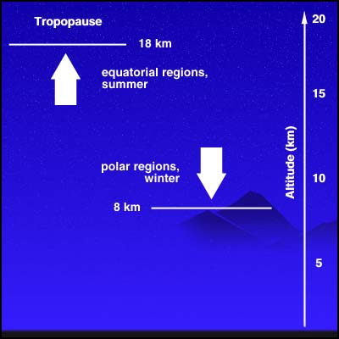
Uncertainties
Conversion from Dobson Units (DU) to parts per billion (PPB)
Images Credit: Wordpress, NASA
Notes:
The OMI and MLS sensors measure atmospheric ozone in Dobson units, meanwhile, the ground monitors measure in parts per billion. The conversion from Dobson units to ppb requires multiple components like:
Temperature
Pressure
And tropopause height.
Image: https://trustworks.files.wordpress.com/2013/06/thermometer.jpg
Image: https://changedj.files.wordpress.com/2012/09/high-pressure-danger-sign-s-0513.gif
Image: http://disc.sci.gsfc.nasa.gov/acdisc/images/Tropopause.jpeg

Slide 17
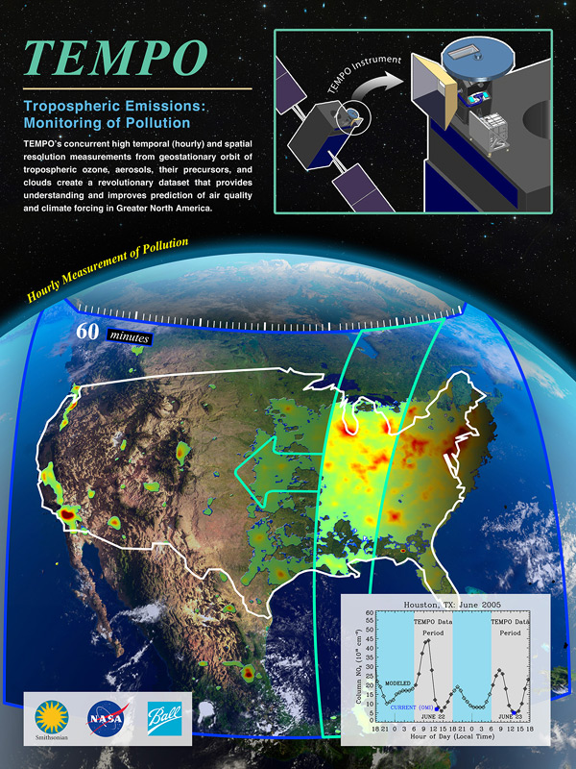
Future Work
Utilize more advanced satellites to monitor air pollutants, such as TEMPO scheduled to launch in 2019.
Perform a more precise calculation of the TOR including more variables such as changing tropopause height.
Study other atmospheric species such as nitrogen oxides, sulfur oxides, and aerosols.
Study visibility impairment from air pollution.
Image Credit: NASA
Notes:
Future work should consider using more variables when calculating TOR, and consider using more advanced satellites such as TEMPO.
TEMPO (Tropospheric Emissions: Monitoring of Pollution) is planned to be completed mid calendar year 2017, and launch at the earliest date possible. This instrument will be in a geostationary Earth orbit (GEO) about 22,000 miles above Earth's equator.
TEMPO will maintain a constant view of North America and make scans every hour during the day from the East to the West coast.
The pixels will be a few square miles, rather than the current sensors which are around 100 square miles.
This will allow for tracking at a much smaller scale, and could help partners track pollutants movement across each park.
Image: http://www.nasa.gov/centers/langley/science/TEMPO.html

Slide 18
Project Partners
Andrew Lee, Resource Management Specialist (Harpers Ferry National Historical Park)
Barkley Sive, Program Manager for Gaseous Pollutant Monitoring Program (Air Resources Division)
Fred Dieffenbach, Environmental Monitoring Specialist (Inventory & Monitoring Program, Northeast Temperate Network)
Holly Salazar, Air Resources Coordinator of Natural Resources Program (Northeast Region)
Jalyn Cummings, Program Manager of Air and Water Quality (Shenandoah National Park)
Jim Renfro, Air Quality Specialist (Great Smoky Mountains)
Jim Von Haden, Integrated Resources Program Manager (Appalachian National Scenic Trail)
Liz Garcia, Physical Science Technician (Shenandoah National Park)
Science Advisors
Dr. Travis Knepp, SSAI Langley Research Center Science Advisor
Dr. Kenton Ross, NASA DEVELOP National Program Science Advisor
Other Contributors
Tyler Rhodes, DEVELOP National Program Center Lead
Emily Gotschalk, DEVELOP National Program Center Lead

