Slide 1
Bolsa Chica Ecological Forecasting
Analyzing the Success of the Bolsa Chica Wetland Restoration Using Multi-spectral NASA Earth Observations
Christine Elowitt (Project Lead)
Steven Kerns
Nick Rousseau
Notes:
[Team introductions]
Hi. We’re the Bolsa Chica Ecological Forecasting Team. I’m Christine Elowitt, Graduate student at Cal State University Northridge in Geography and GIS certificate. My career goal is to teach Geography and GIS at the community college level.
Steven Kerns: Undergraduate student at Cal State University Long Beach with a major in Environmental Science and Policy and a minor in Biology.
Nick Rousseau: Graduate student at Cal State University Northridge in Geology.
Our project involves analyzing the success of the Bolsa Chica Wetlands Restoration using multi-spectral NASA Earth Observations.

Slide 2
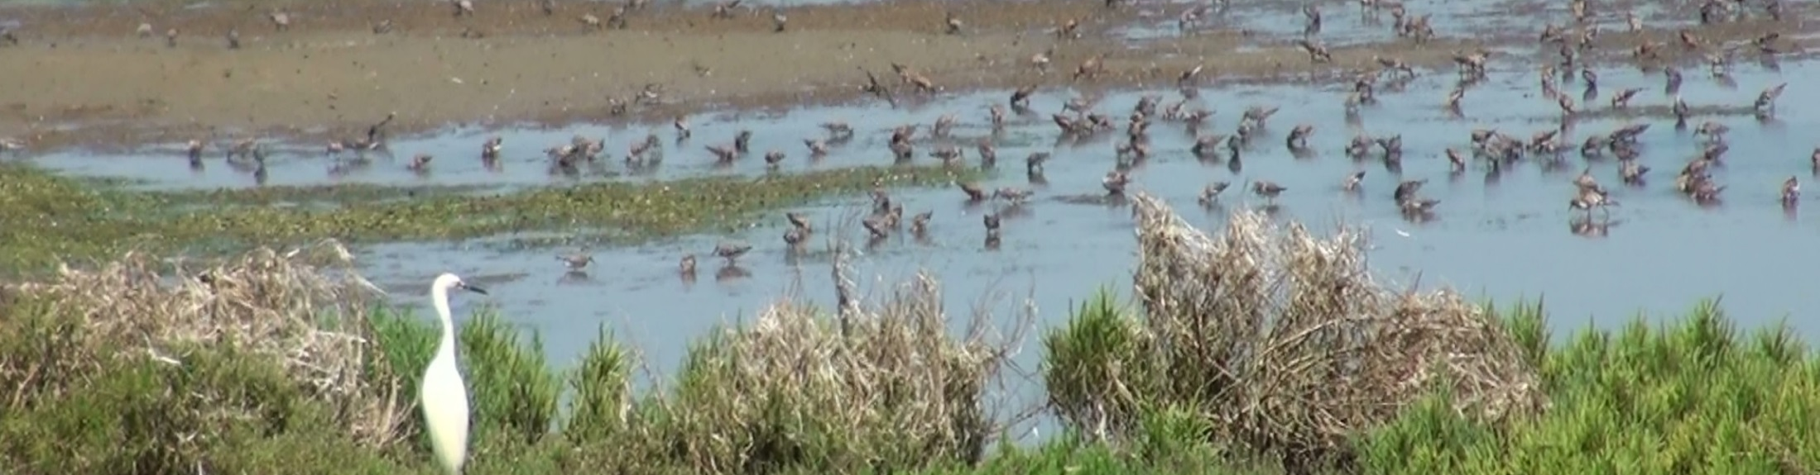
Introduction
The US has lost over 50% of wetland habitat in the past 200 years.
California leads the nation in this historic loss of wetlands, with a decline of as much as 91%.
Southern California and the San Francisco Bay area lead the state in percentage of wetlands habitat lost.
Notes:
During the last two centuries, the contiguous United States has lost over half of its wetland habitats; averaging a rate of 60 acres lost per hour (Dahl 1990). California leads the nation in this historic loss of wetlands, sustaining as much as 91% of environmental degradation and human–induced changes to wetland habitats (Zedler 1996). The San Francisco Bay and the southern regions of the state are home to the most significant losses in wetland habitats (Larson 2001, Goodwin et al. 2001).

Slide 3
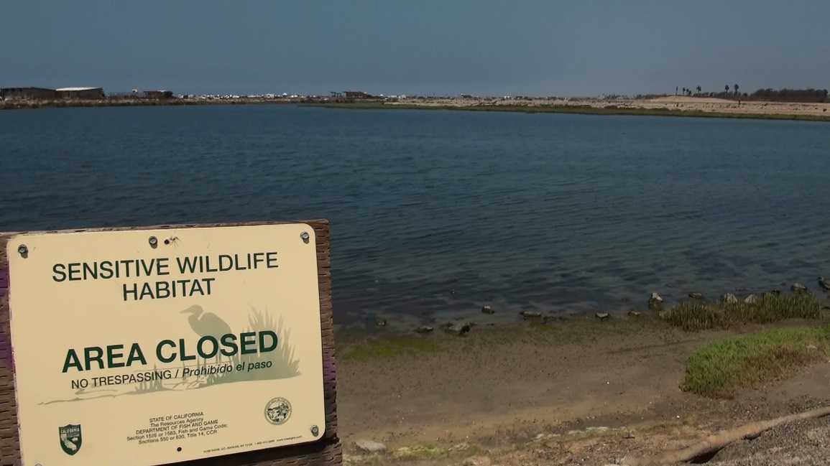
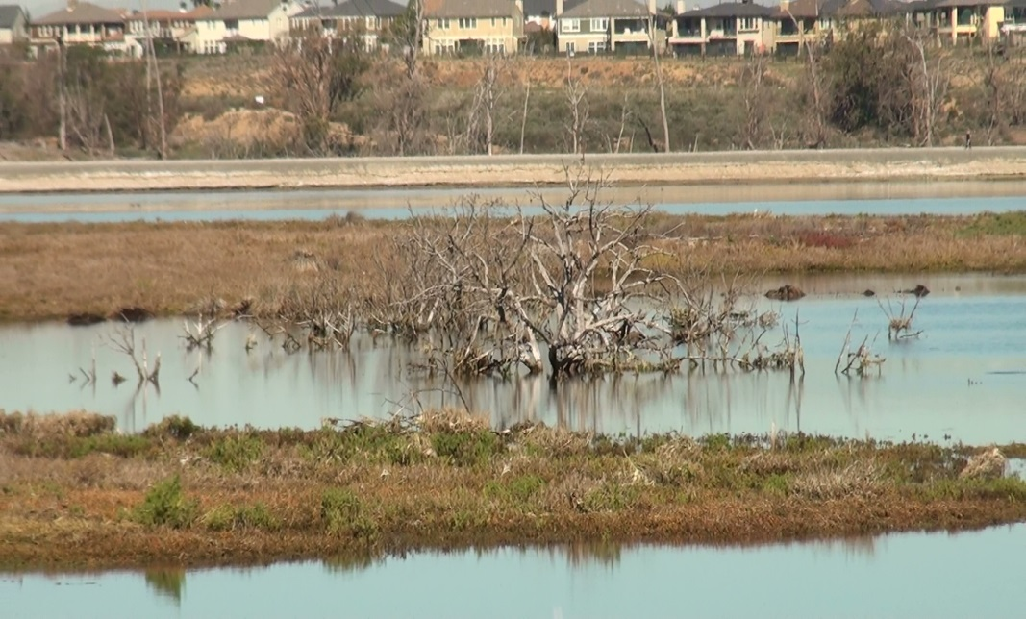
Introduction
The Bolsa Chica Wetlands provide critical habitat for migratory and endangered avifauna.
Remained undeveloped due to oil extraction operations
Acquired by the state of California in 1997 and is now managed by the CA Department of Fish and Wildlife.
Notes:
Migratory birds traveling along the Pacific Flyway were once estimated to be 60 million in number but now oscillate between 2-4 million waterfowl and 1-2 million shorebirds (Bryant 2003, Larson 2001). Given the dramatic drop in avifauna population, wetlands such as Bolsa Chica serve an increasingly important role in the sustainment of migratory bird populations along the Pacific Flyway.
Formerly the site of an oil drilling operation, the wetlands at Bolsa Chica were acquired by the state of California in 1997 and are currently being managed by the California Department of Fish and Wildlife.

Slide 4
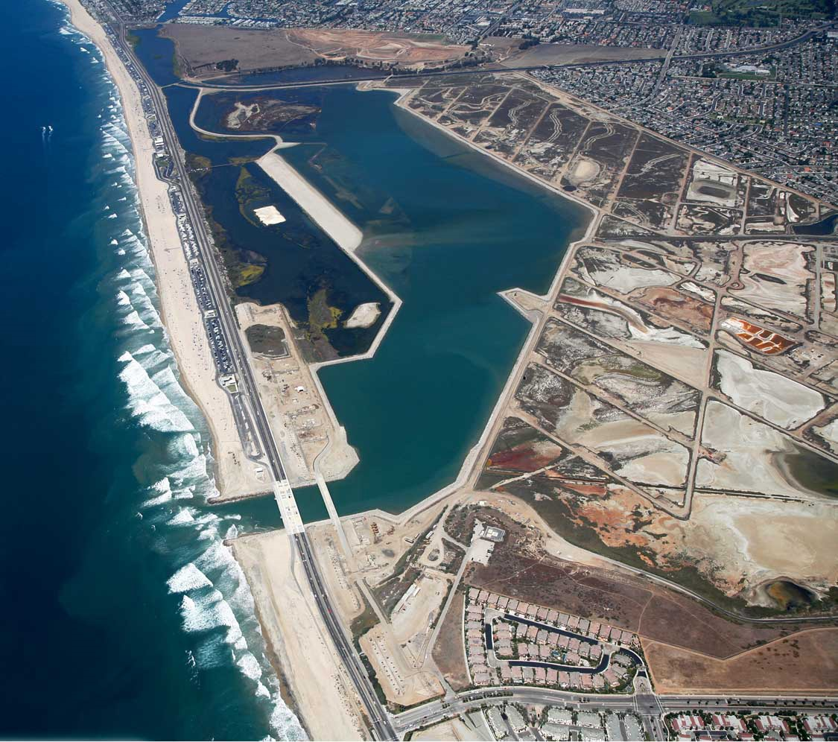
Introduction
Increased effort to restore the native vegetation and tidal flows.
Amigos de Bolsa Chica
Non-profit volunteer
advocacy group
Started in 1976
One of two non-profit groups affiliated with the site
Prioritize community involvement and education
Image Credit: NOAA
Notes:
In an effort to mitigate wetland loss in the Bolsa Chica Ecological Reserve, several conservation and restoration projects have been created. Coastal wetlands are an endangered ecoregion in Southern California that provide ecosystem services such as endangered species habitat, water filtering, and carbon sequestration (Noss 1995). Bolsa Chica is one of the few wetlands in Southern California that has been steady increasing in size and health.
There have been vast improvements in management and maintenance practices since restoration efforts began, however, no attempt has been made to develop a qualitative assessment of the extent of restoration efforts or whether the restoration has been truly successful.
The Amigos de Bolsa Chica is a non-profit volunteer advocacy group founded in 1976. Their priorities include community involvement and educating the public.
This project is of interest to the Amigos as it allows them to better inform the public on the wetland’s restoration success, as well as expand their citizen scientist education program FLOW. The Amigos will decide how to best implement our end products into their education programs and public outreach campaigns. The Amigos will directly benefit from being provided with NASA remote sensing data, enabling them to better understand, share, and protect the Bolsa Chica Ecological Reserve.

Slide 5
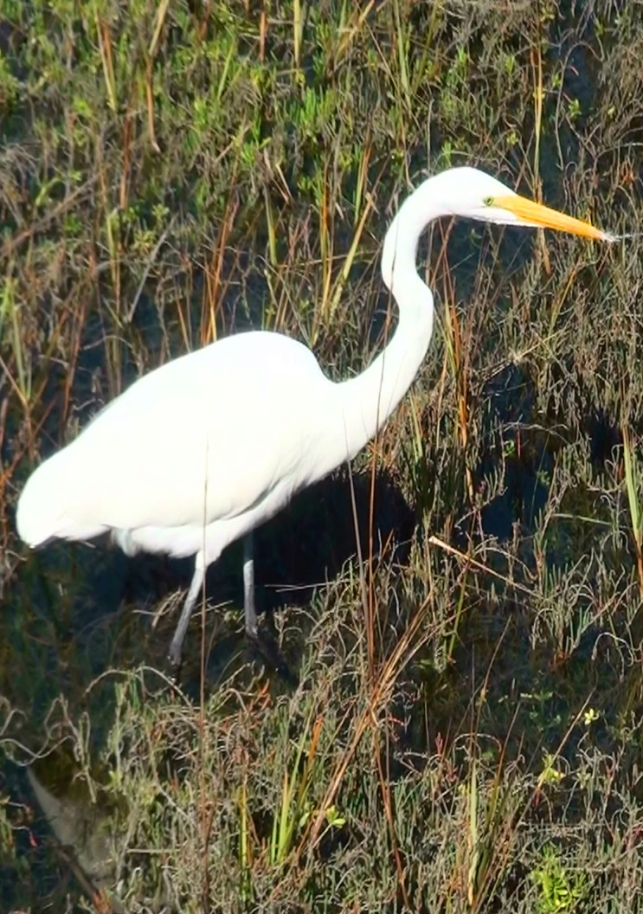
Objectives
Create a time-series analysis to demonstrate Bolsa Chica wetland restoration success from 2002-2015.
Determine the location of different vegetation types and water extent throughout the site using NASA remote sensing technologies.
Expand the Amigos de Bolsa Chica’s education and outreach program by creating maps, images, and statistics of the restoration to be incorporated into their website and brochures.
Notes:
The goals of this project include:
-Creating a time-series analysis to demonstrate Bolsa Chica Wetland restoration success from 2002 – 2015.
-Determining the location of different vegetation types and water extent throughout the site using NASA remote sensing technologies.
-Expanding the Amigos de Bolsa Chica’s education and outreach program by creating maps, images, and statistics of the restoration to be incorporated into their website and brochures.

Slide 6
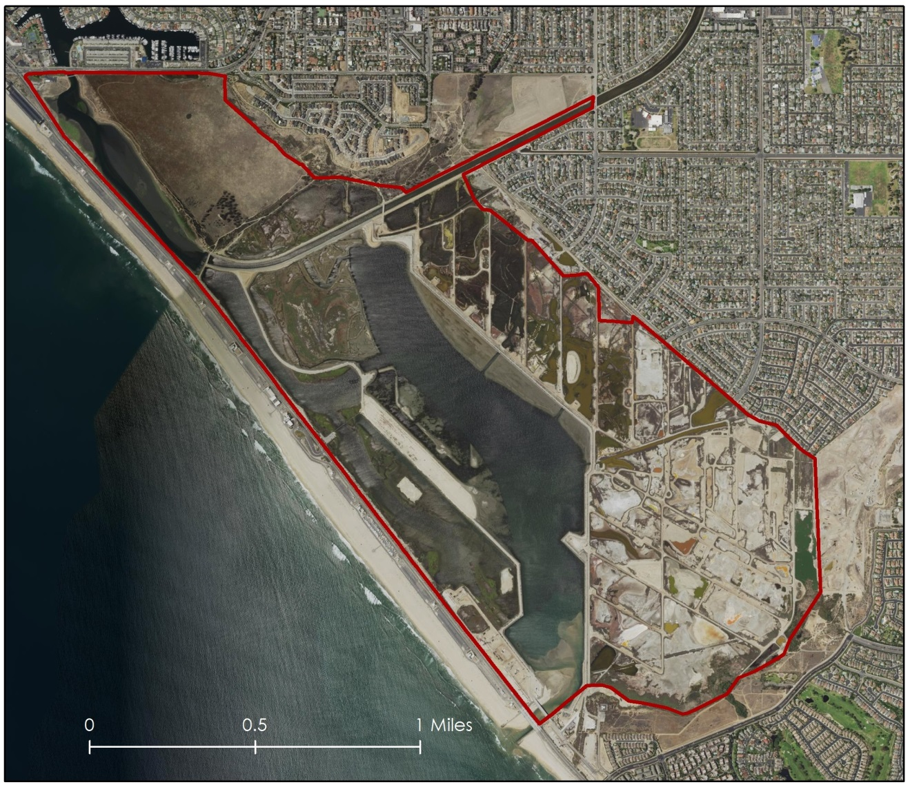
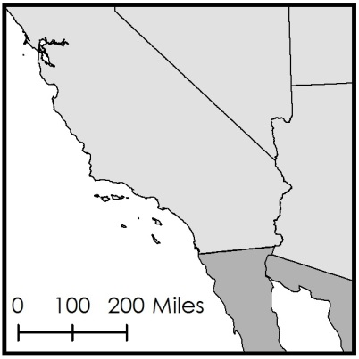
Study Period
and Area
California
Study Site
Location:
Bolsa Chica Ecological Reserve
Huntington Beach, CA
Study Period: 2002-2015
Study Area
Notes:
The Bolsa Chica Ecological Reserve is an undeveloped, 2-square mile stretch of wetland habitat in Huntington Beach, California. This map shows an aerial image of the site. The red outline indicates the boundary of the Ecological Reserve. Our study period ranges from October 7th 2002 to October 21st, 2015 allowing us to study the changes created by the reintroduction of tidal flow that occurred in 2006.

Slide 7
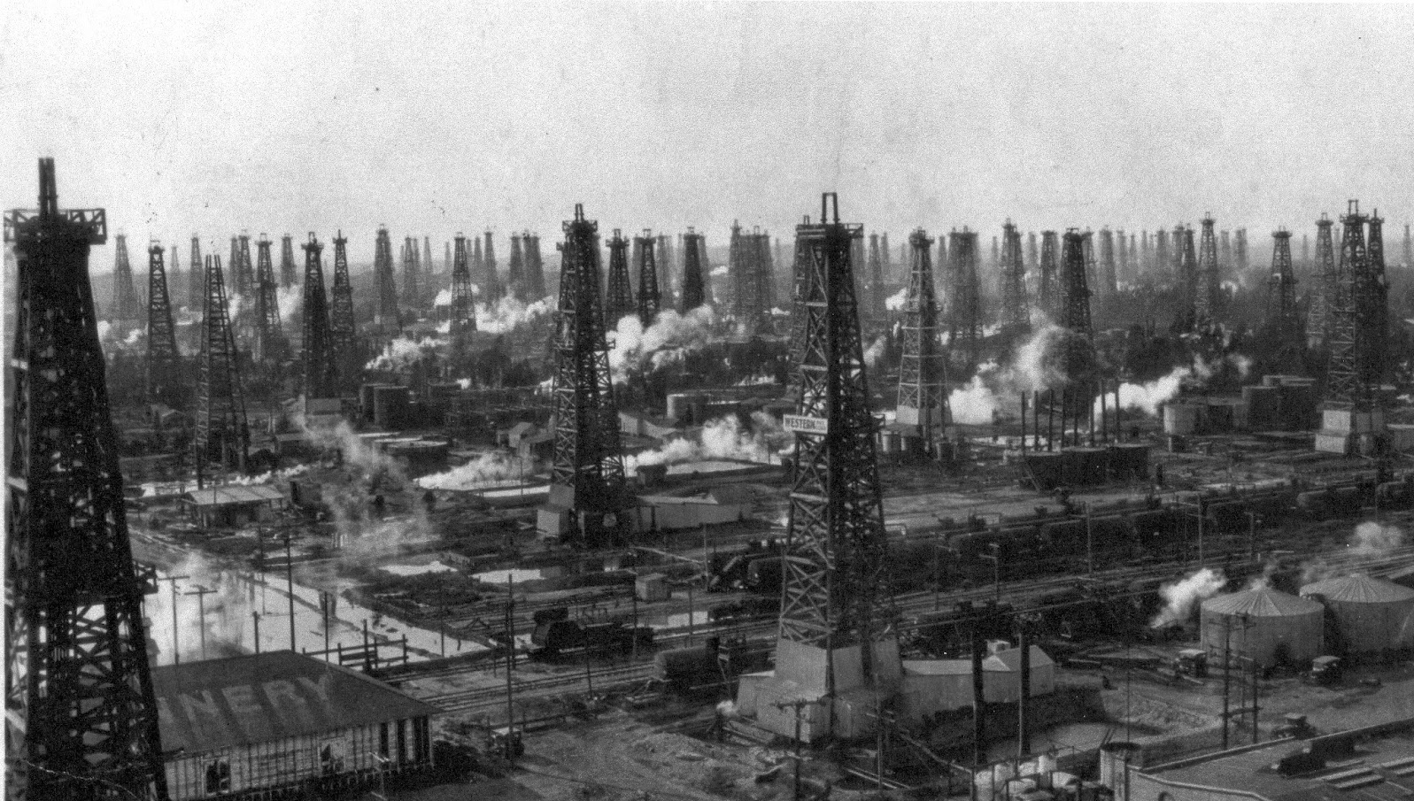
Community Concerns
Human impacts on the wetlands
Gauging the success of restoration
Effective utilization of tax dollars
Providing habitat for endangered species
Photo Credit: J.F. Hoyer
Notes:
This project is of importance to the community for a number of reasons:
First, the landscape of the wetlands has been impacted by past human activity, including farming and oil extraction.
Second, there are few other nesting options along the Southern California coast, so restoring tidal flow and vegetation to their more natural state provides habitat for endangered species and other wildlife.
Third, no analysis has previously been done gauging the success of the restoration.
Lastly, California residents want to know that the Department of Fish and Wildlife has effectively used their tax dollars to restore their wetland.

Slide 8
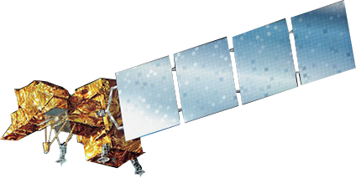



NASA Sensors
Landsat 7 ETM+
Landsat 8 OLI
ER-2 AVIRIS
Notes:
Many parts of Bolsa Chica aren’t accessible on foot, so groups affiliated with the wetlands haven’t been able to fully study the extent of the habitats, many of which provide shelter to endangered species. NASA Earth Observations provide remote sensing capabilities allowing us to analyze the full extent of the site, including inaccessible areas.

Slide 9
Project Methodology
Acquire
Analyze
Produce
AVIRIS Imagery (2015)
Classify land cover types (ENVI)
Land cover classification
Landsat Imagery (2002, 2015)
Index and index change maps
Calculate NDVI and NDWI indices (QGIS)
USDA NAIP and USGS Imagery
(2003, 2005, 2014)
Land cover maps and statistics
Panchromaticallysharpen images (ArcGIS)
NOAA Coastal Change Analysis (1996 to 2010)
Graphics for the Amigos’ website and brochures
Create land cover vector layers (ArcGIS)
Notes:
Landsat 8 OLI, Landsat 7 ETM+, and ER-2 AVIRIS are the NASA sensors that offer the best coverage of the study site during the time frame of the restoration. We also acquired ancillary datasets from NOAA, the US Geological Survey, and the US Department of Agriculture’s NAIP program to use as cross referencing sources.

Slide 10
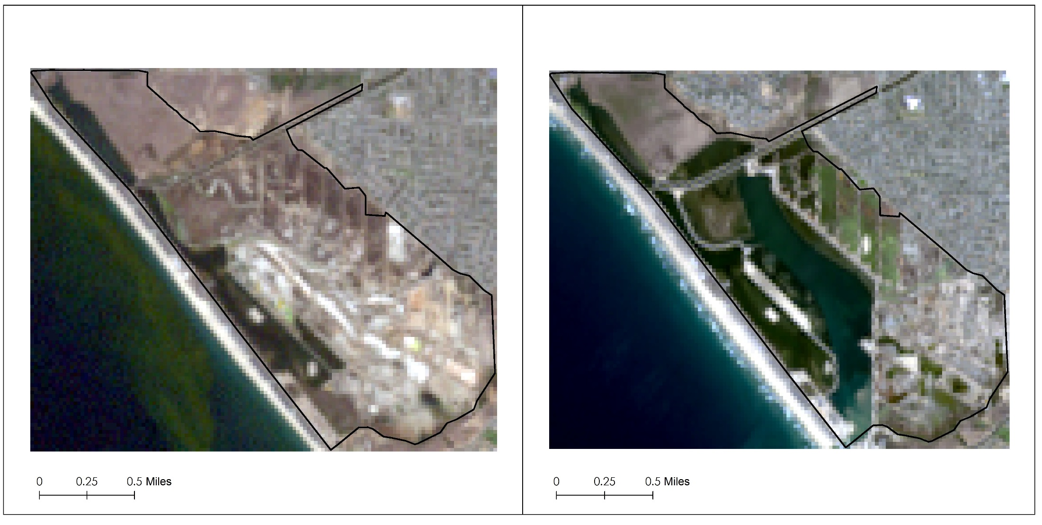

Data Acquisition
2002 LANDSAT IMAGERY 2015
Notes:
Due to the longevity and consistency of Landsat’s data, we were able to select a recent image of the site as well as a comparable image from early in the restoration process. The “before” image is from Landsat 7 ETM+ on October 7, 2002. The “after” image is from Landsat 8 OLI on September 24, 2015.

Slide 11
Project Methodology
Acquire
Analyze
Produce
AVIRIS Imagery (2015)
Classify land cover types (ENVI)
Land cover classification
Landsat Imagery (2002, 2015)
Index and index change maps
Calculate NDVI and NDWI indices (QGIS)
USDA NAIP and USGS Imagery
(2003, 2005, 2014)
Land cover maps and statistics
Panchromaticallysharpen images (ArcGIS)
NOAA Coastal Change Analysis (1996 to 2010)
Graphics for the Amigos’ website and brochures
Create land cover vector layers (ArcGIS)
Notes:
Much of the analysis we did utilized the Landsat imagery. First, to provide finer detail, we sharpened the images in ArcMap, using the higher resolution panchromatic band. We also utilized Landsat’s multi-spectral capabilities to calculate water and vegetation indices using QGIS. Then, using the ancillary datasets for reference, we drew land cover maps in Arc Map.

Slide 12
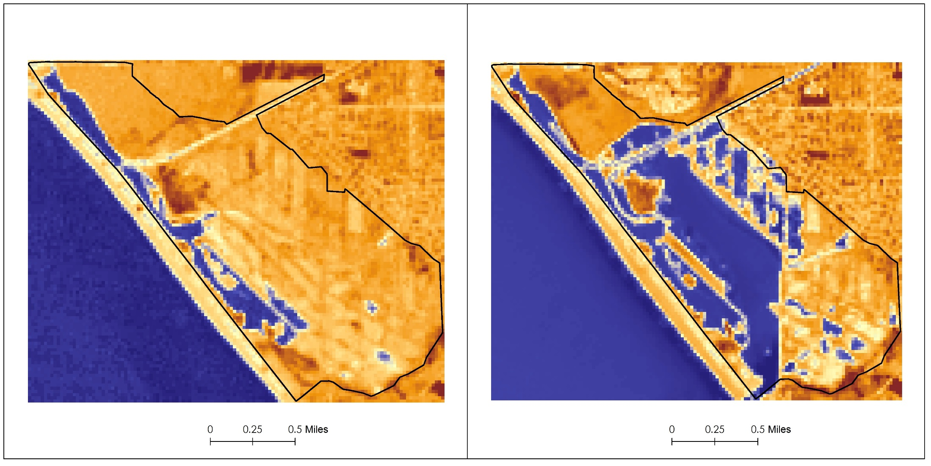

Data Analysis
2002 WATER INDEX 2015
Notes:
The Normalized Difference Water Index also known as NDWI, can be calculated using the green and near infrared wavelengths of light. It shows where there’s water present in an image. In this example, blue indicates the presence of water, while the orange indicates a lack of water.

Slide 13
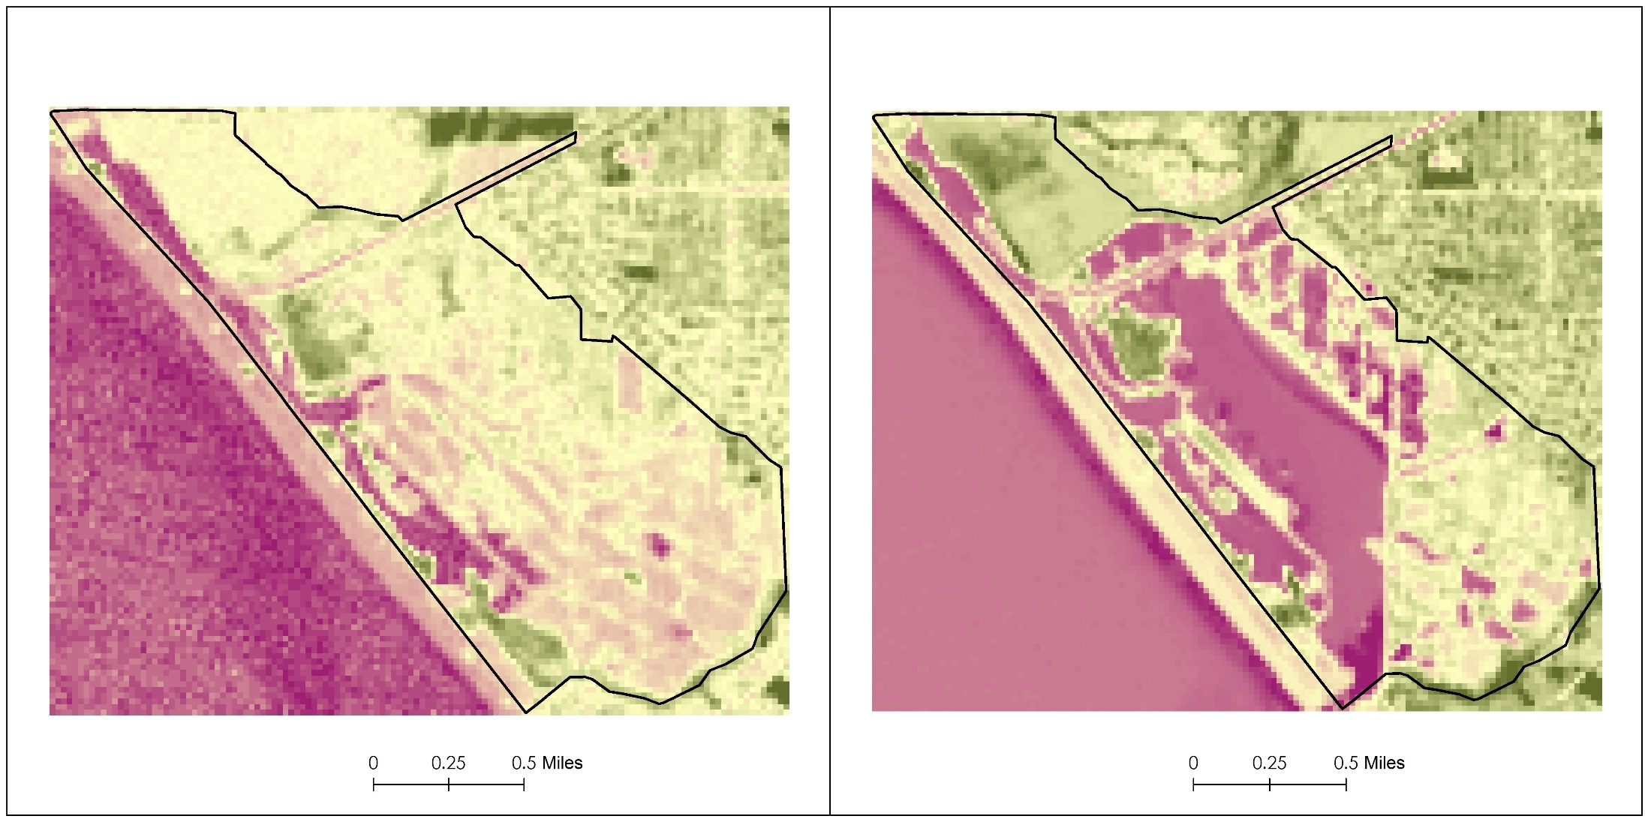

Data Analysis
2002 VEGETATION INDEX 2015
Notes:
The Normalized Difference Vegetation Index also known as NDVI, can be calculated using the Red and near infrared wavelengths of light. It shows where there is vegetation present in an image. Here, the green color shows where healthy vegetation is, while the purplish color shows areas without vegetation present.

Slide 14
Project Methodology
Acquire
Analyze
Produce
AVIRIS Imagery (2015)
Classify land cover types (ENVI)
Land cover classification
Landsat Imagery (2002, 2015)
Index and index change maps
Calculate NDVI and NDWI indices (QGIS)
USDA NAIP and USGS Imagery
(2003, 2005, 2014)
Land cover maps and statistics
Panchromaticallysharpen images (ArcGIS)
NOAA Coastal Change Analysis (1996 to 2010)
Graphics for the Amigos’ website and brochures
Create land cover vector layers (ArcGIS)
Notes:
Using the index and land cover maps we created, we were able to produce a wide variety of graphics and statistics detailing the changes at Bolsa Chica due to the restoration, all of which can be incorporated into the brochures and web pages that the Amigos use for public outreach and education.

Slide 15
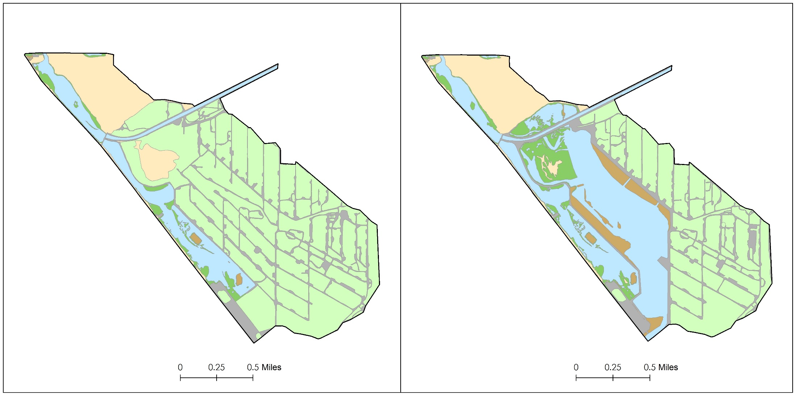
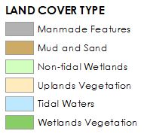
Results
2002 Land Cover 2015
Notes:
These are before and after maps comparing land cover types from October 7, 2002 and September 24, 2015. These maps show six categories of land cover – manmade features, mud and sand, non-tidal wetlands, uplands vegetation, tidal waters, and wetlands vegetation. These results show a greater expanse of tidal waters and wetland vegetation in of the restoration.

Slide 16
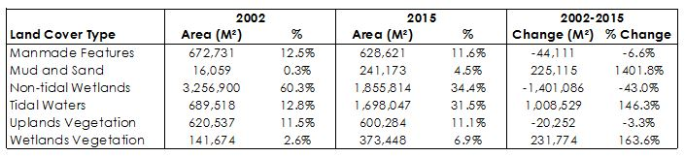
Results
146% increase in tidal waters
164% increase in wetlands vegetation
Corresponding decrease in manmade features and non-tidal wetlands
Notes:
The data chart emphasizes land cover statistics that highlight some of the major changes to the Bolsa Chica Ecological Reserve. From 2002 to 2015, the Bolsa Chica Ecological Reserve experienced a 146% increase in tidal waters from 13% of the site in in 2002, to 32% in 2015. Likewise, wetlands vegetation underwent an increase of 164% from less than 3% in 2002 to 7% in 2015.
These data corresponds to the decrease in manmade features and non-tidal wetlands. Non-tidal wetlands have had a significant drop -43.0% decrease from 60.3% in 2002 to 34.4% in 2015.

Slide 17
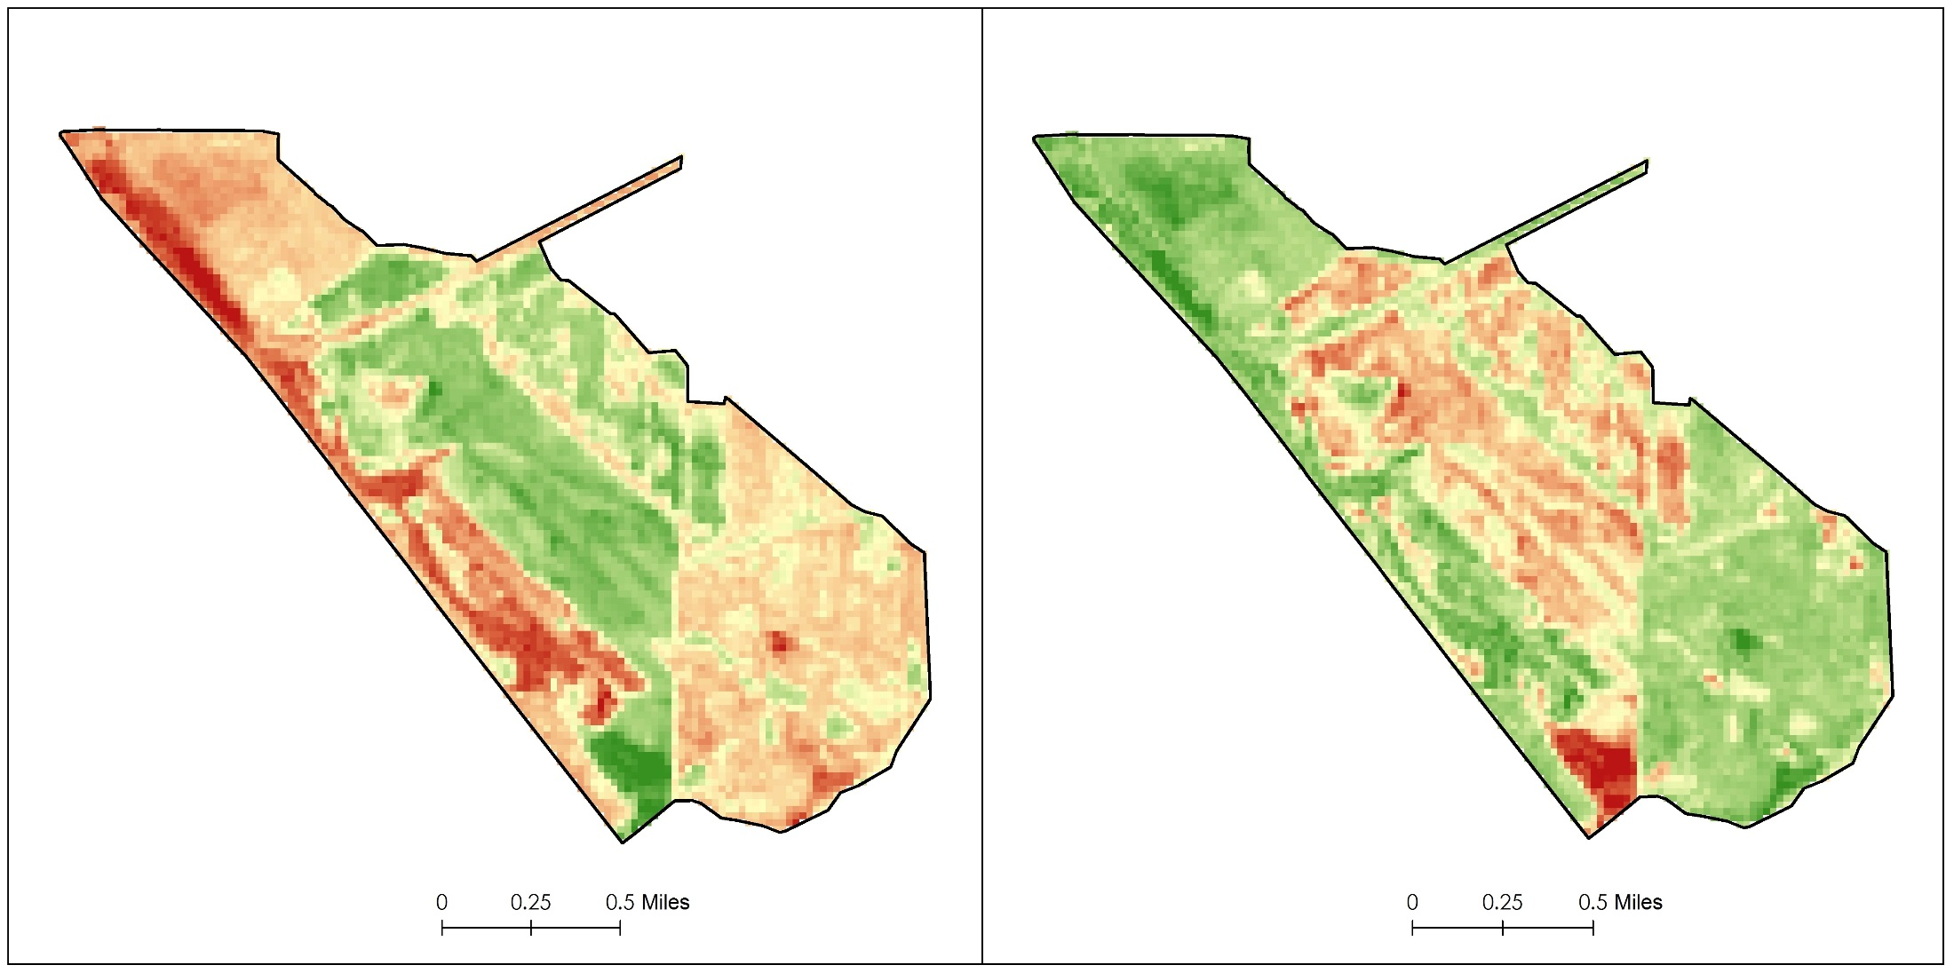


Results
Change in Water Extent
Change in Vegetation Extent
Notes:
The diagram on the left shows the change in Normalized Difference Water Index (NDWI). The green color highlights areas which have more water in 2015 in water with red showing less water.
The diagram on the right indicates change in NDVI with green highlighting areas with more vegetation in 2015 and red showing less vegetation.
If we compare the maps to each other, we can see that they are nearly inverses of each other. That means that in areas of the map that haven’t experienced an increase in water, there is more vegetation.

Slide 18
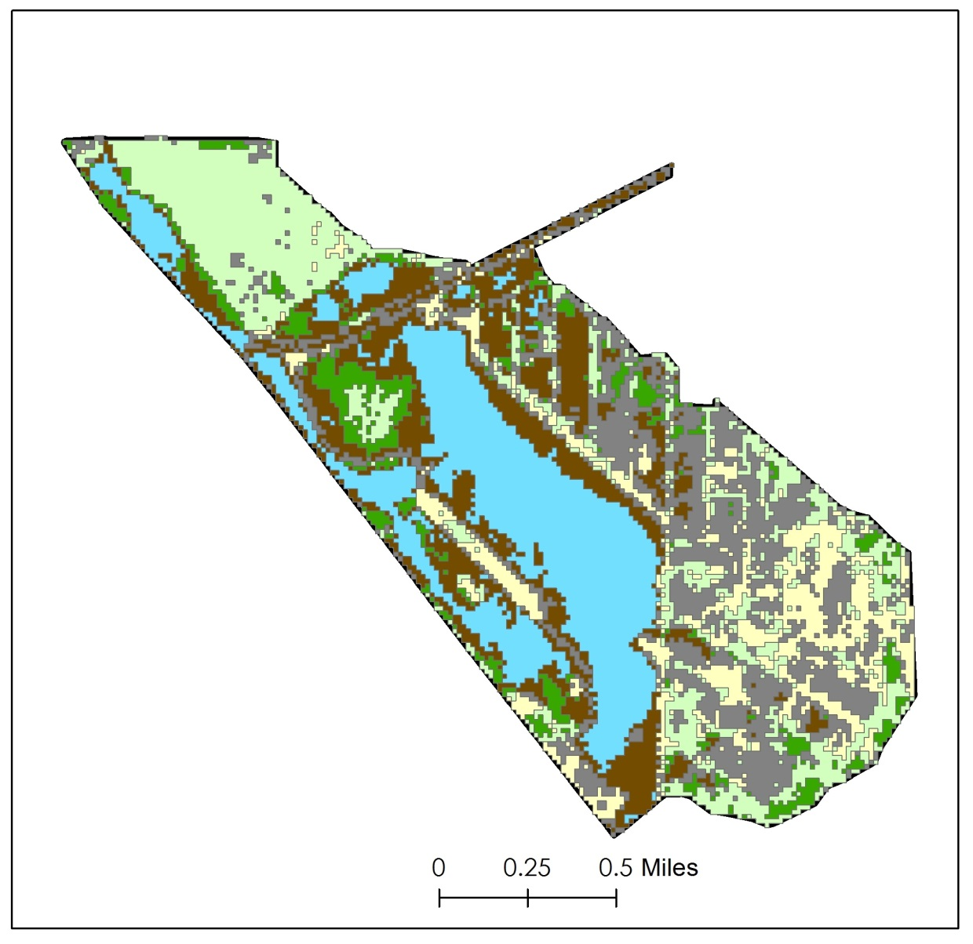
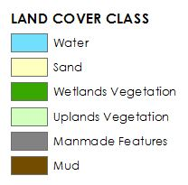
Errors and Uncertainties
Not able to effectively use AVIRIS imagery
No imagery from before 2013
Pixel size of 15 meters
Had hoped to classify and measure the extent of different vegetation types
Notes:
We had high expectations of being able to differentiate plant species using AVIRIS data and ENVI software, due to the 224 different wavelengths of light that AVIRIS measures.
While we were able to produce classifications, but they were inferior to the other land cover maps we made.
It is likely that resolution was a factor. Since each pixel of an AVIRIS image encompasses about 15 square meters of land, most pixels are likely to contain more than one type of vegetation or other land cover.

Slide 19
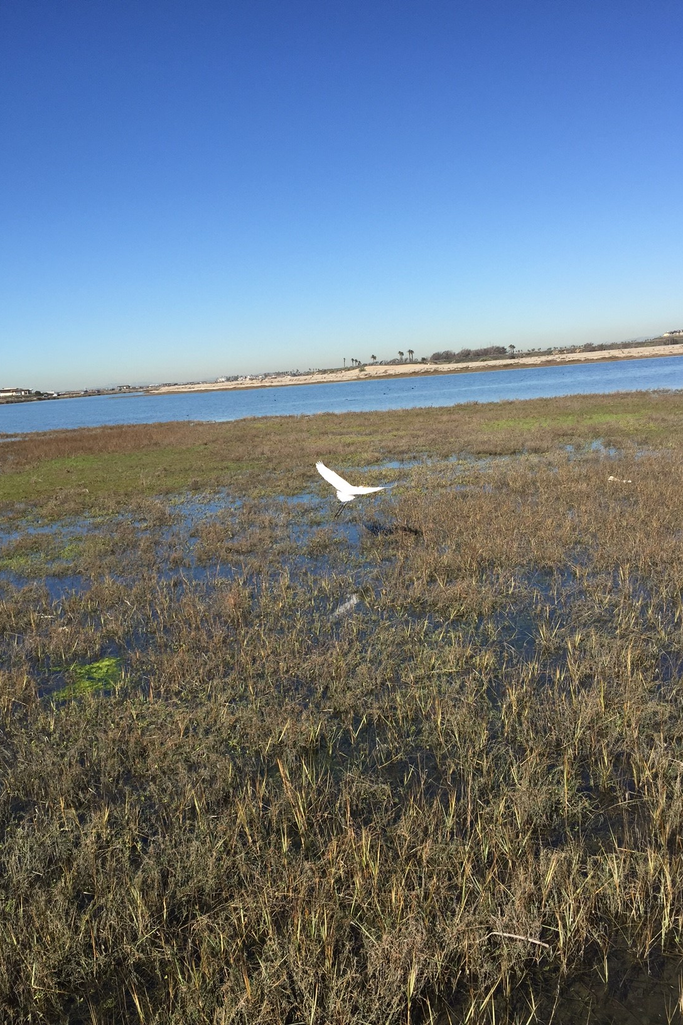
Conclusion
The restoration efforts have been successful
Tidal inflow was restored
Increased wetland vegetation
Decreased man-made features
With restoration still in progress, established a baseline to compare the future state of the site
Added scientific rigor to the Amigos’ outreach efforts
Notes:
The remote sensing images obtained through NASA Earth Observations clearly demonstrate that restoration efforts conducted within the Bolsa Chica Ecological Reserve have been successful. Ten years after the re-establishment of the tidal inflow, there exists denser vegetation which provides higher-quality habitat, there are fewer man-made features, and greatly expanded aquatic resources, including the full-tidal basin. The increased vegetation and greater water extent lend powerful quantitative support to the argument that the restoration efforts at the Bolsa Chica wetland have been successful and serve as important metrics of wetland health.

Slide 20
Advisor
Cedric Fichot, NASA Jet Propulsion Laboratory
Partners
Joana Tavares-Reager, Vic Leipzig, Jerry Donohue, Amigos de Bolsa Chica
Others
Benjamin Holt, NASA Jet Propulsion Laboratory
Bruce Chapman and David Thompson, NASA Jet Propulsion Laboratory
Brittany Zajic, Emily Beck, Erika Higa, Rebecca Trinh, and Gwen Miller of NASA DEVELOP

Slide 21
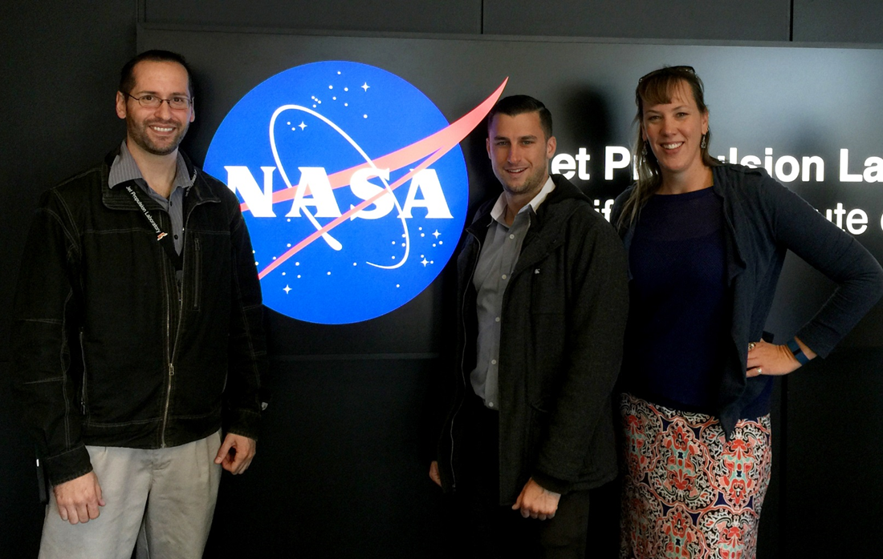
Questions?
Bolsa Chica Ecological Forecasting Team, Spring 2016
From left to right: Nick Rousseau, Steven Kerns, Christine Elowitt

