Slide 1
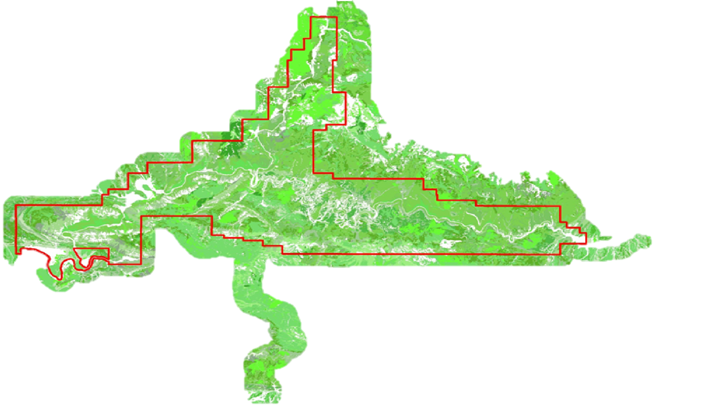
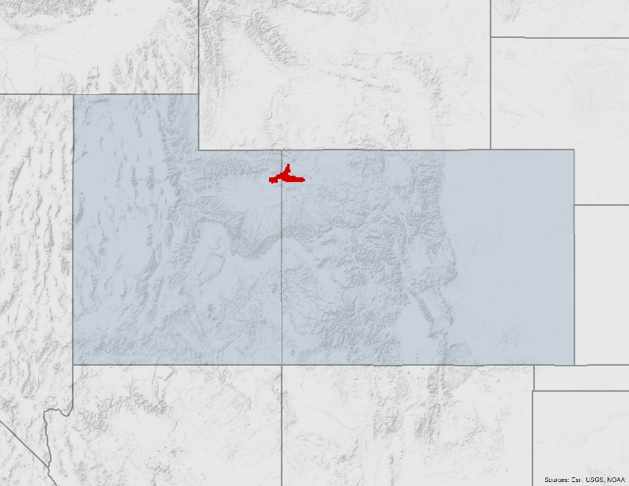
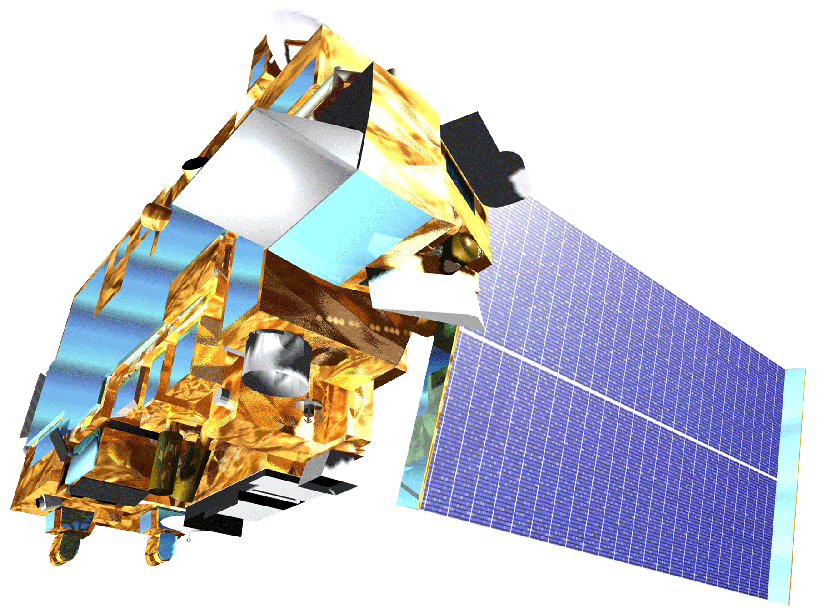
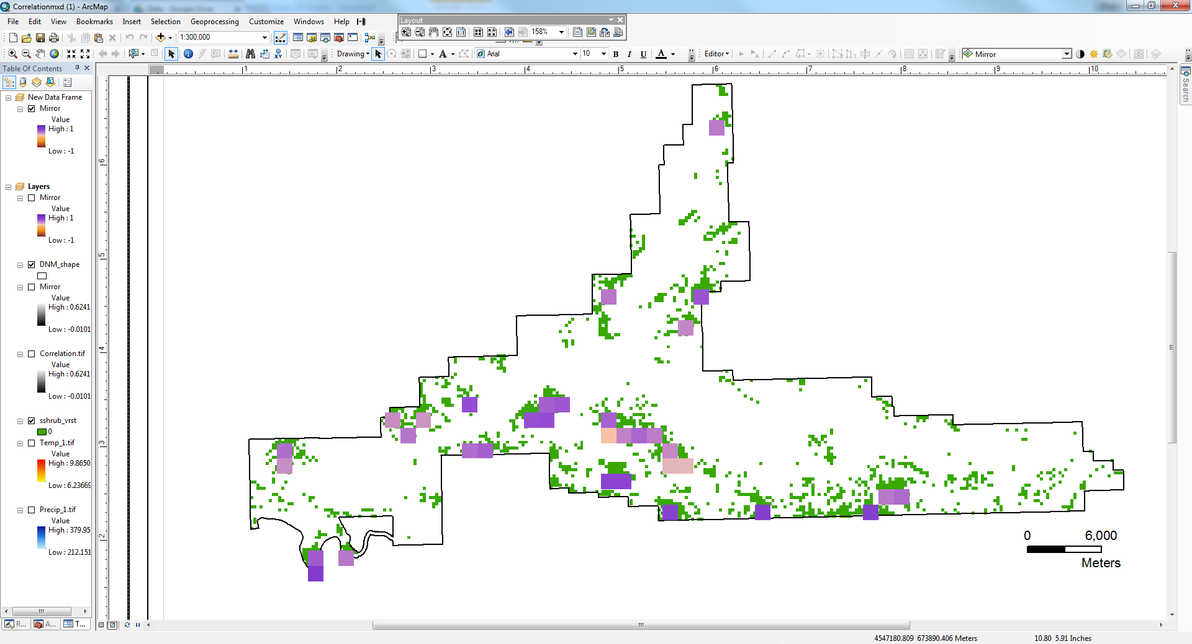
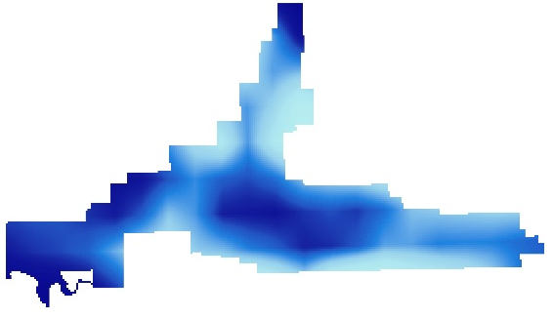
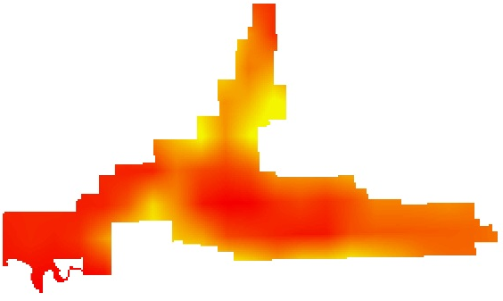
Assessing Landscape Vulnerability to Drought
and Climate Change in National Parks of the Western United States
Abstract
Objectives
Increased surface temperatures and a trend towards more severe drought in the western United States can impact the vulnerability of vegetation across the region. Land managers specifically seek to estimate the threshold, known as a pivot point, at which ecosystems begin to lose productivity due to increased heat or decreased water. NASA Earth observations provide the National Park Service (NPS) and United States Geological Survey (USGS) with necessary data to monitor vegetation response at a regional scale. The sagebrush shrubland ecosystem in Colorado and Utah’s Dinosaur National Monument was analyzed to determine how bioclimatic variables have impacted vegetation trends for the study area. These relationships were analyzed by the use of a stepping window written in R. The stepping window evaluated a five by five pixel matrix throughout the raster to output a correlation between annual change in vegetation and precipitation, temperature, and evapotranspiration. Based on the strength of the correlation, a multiple linear regression model was implemented. Vegetation data were acquired for a 15-year period using the Normalized Difference Vegetation Index (NDVI) from the ForWarn dataset. The model used mean temperature and precipitation from PRISM and the MODIS evapotranspiration datasets. Combining a moving window approach with remote sensing yielded a robust methodology for determining climate pivot points for western park units.
Understand how climate shifts impact vegetation throughout the western United States national park units
Incorporate remote sensing to expand the established pivot point framework using a stepping window approach
Provide end users with a generalized application for monitoring climate impacts for additional vegetation ecotypes
Study Area
Earth Observations
Project Partners
UTAH
COLORADO
Terra MODIS
Dinosaur National Monument
Methodology
Results
Pivot Point Extraction
Regression & pivot point extraction table
Correlation
Window Location | Adjusted R-Squared | Pivot Point
26-24 | 0.274 | 297.24
26-25 | 0.279 | 294.68
28-28 | 0.306 | 330.50
28-34 | 0.374 | 317.24
28-41 | 0.358 | 371.40
32-5 | 0.386 | 209.50
Determine Regression Conditions
Western U.S. Water Resources II
Stepping Window
Optimize Sample Size
Processing
Clip, Mask Slope, Resample, Calculate ∆NDVI
Data Acquisition
Evapotranspiration, Soil Type, Precipitation, Elevation, Temperature, Vegetation Type
Stepping Window
Vegetation to Precipitation Correlation
R-Value
1
-1
NDVI
Precipitation
Temperature
Evapotranspiration
Conclusions
Results indicate that the Colorado Sagebrush Shrubland is more vulnerable to changes in precipitation than to changes in temperature and evapotranspiration.
The stepping window methodology optimized sample size and effectively identified the climate parameter with a meaningful relationship to ∆NDVI.
Pivot point calculations for precipitation indicate that the sagebrush ecotype is currently productive, but is nearing the threshold where productivity may begin to decrease.
Acknowledgements
Team Members
Dr. Seth Munson, Plant Ecologist, United States Geological Survey Southwest Biological Science Center
Dr. David Thoma, Ecologist, National Park Service Inventory and Monitoring Program
Dr. Kent Ross, NASA Langley Research Center
Western US Water Resources LaRC Summer 2016 team: Kelly Meehan, Teresa Fenn, Thomas Smith, Molly Spater, Grant Jaccoud, and Kaylie Taliaferro
Andrea Martinez
Team Lead
Amanda Clayton
Christine Sadlik
Taryn Smith
Aubry Eaton
This material is based upon work supported by NASA through contract NNL11AA00B and cooperative agreement NNX14AB60A. Any mention of a commercial product, service, or activity in this material does not constitute NASA endorsement. Any opinions, findings, and conclusions or recommendations expressed in this material are those of the author(s) and do not necessarily reflect the views of the National Aeronautics and Space Administration and partner organizations.
NASA Langley Research Center – Fall 2016

