Slide 1
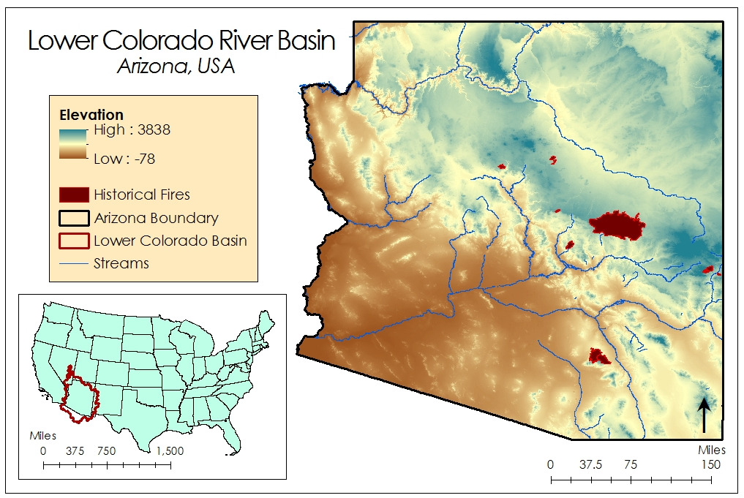
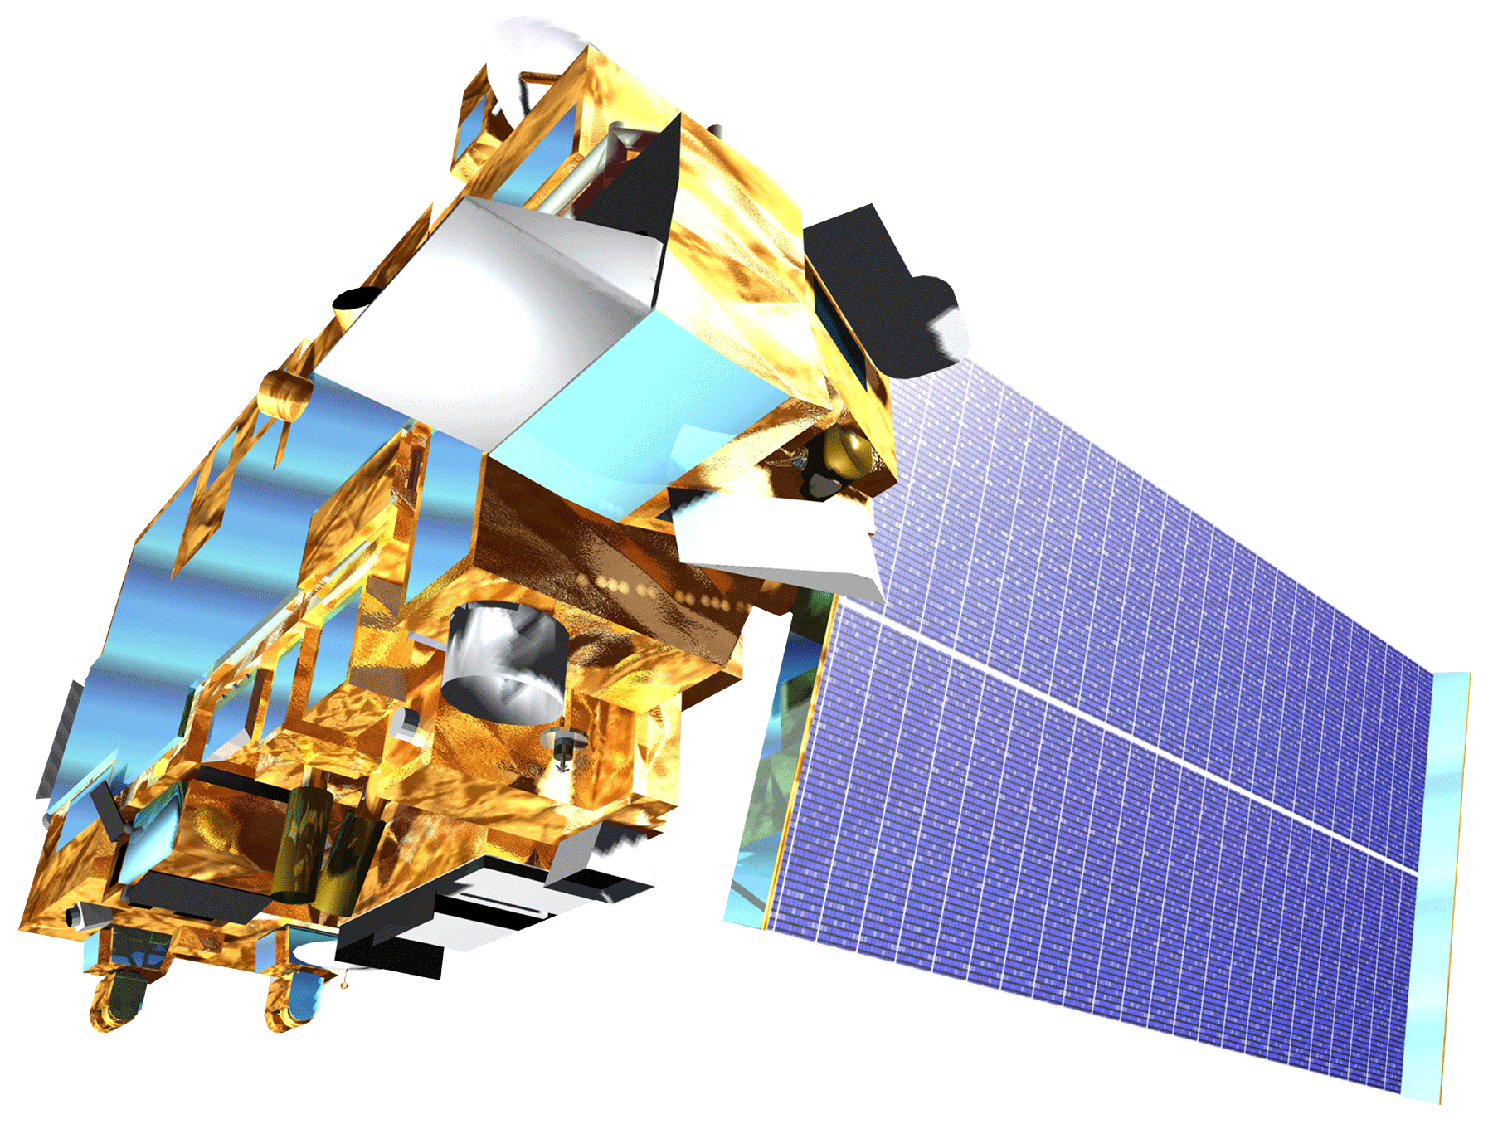
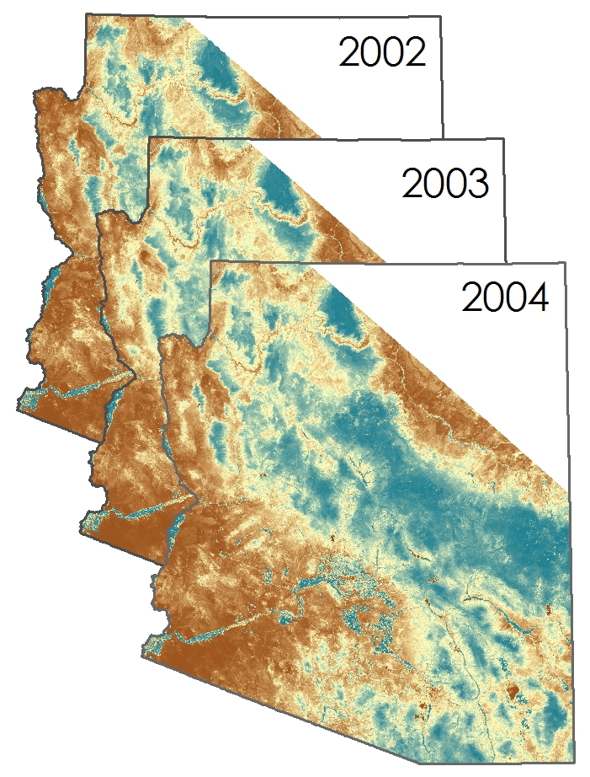
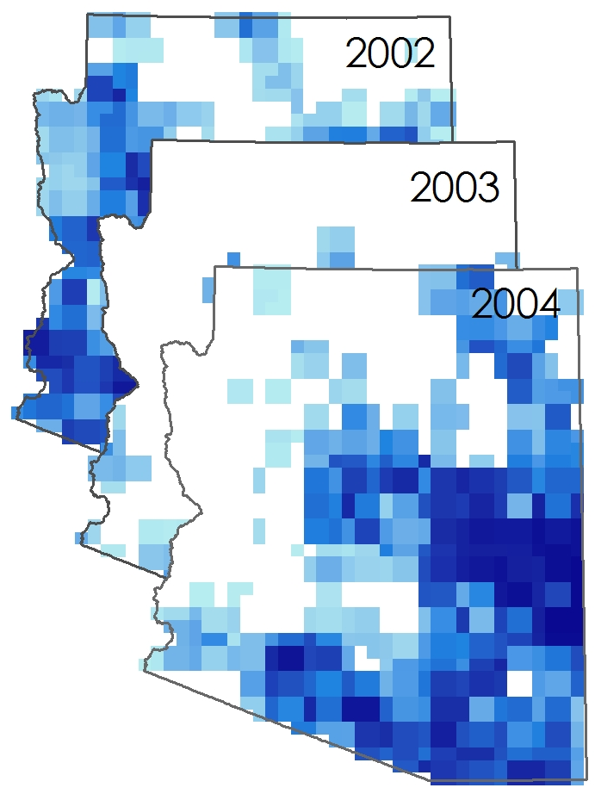
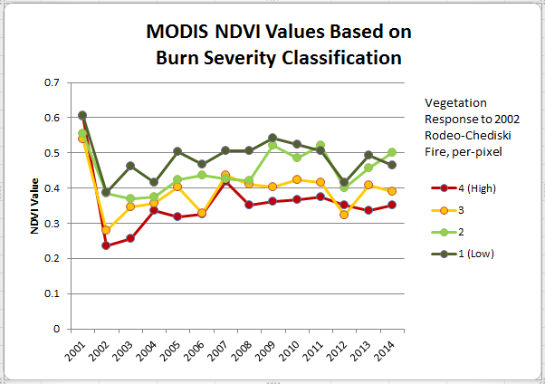
Southwest United States Disasters
Incorporating CDRs and MODIS to create a predictive model of post-burnout vegetation regrowth in relation to flood risk
Jason Zylberman (Project Lead), Jennifer Holder, Lance Watkins
Affiliation(s)
Abstract
Objectives
Keep this blank for now.
Body text point size should be at least 24.
Caption text point size should be at least 16.
Feel free to rename, move, and resize sections as needed.
Establish a spatio-temporal relationship between vegetation regrowth as a function of NDVI and post-fire runoff hazard, over a 10-year period, for greater Tuscon, Arizona area within the Lower Colorado River Basin
Generate a raster surface indicating vegetation regrowth rate after historical wildfires on a per-pixel basis
Identify precipitation rates associated with increased post-wildfire flooding risk based on historical runoff events
Study Area
Methodology
Fetch Modis
Extract NDVI
Reproject Raster
Clip to Arizona
Apply Scale Factor
Clip NDVI layers to fire outline
Average NDVI for each year
Calculate 10-year average
Acquire BARC Raster
Reclassify Burn Severity
Raster to Polygon
Dissolve to Outline
Buffer by 5km
Currently working on methods for precipitation component
Earth Observations
Still need to attain an appropriate graphic for PERSIANN and CMORPH products.
Finally, methods comparing precipitation and NDVI will be included here.
TERRA
Results
Results will be included once products are created.
Image showing several layers of NDVI average surfaces across several years (in a stack)
Image of several layers of precip surfaces across several years (in a corresponding stack)
Image similar to the one below, comparing NDVI and precipitation products over time
Conclusions
Conclusions will be added in complete sentences once conclusions have been reached.
Team Members
Project Partners
Acknowledgements
Team photo will be taken and included here, identifying Jason Zylberman, Jennifer Holder, and Lance Watkins
DeWayne Cecil (Chief Climatologist and Program Manager, Global Science & Technology (GST) National Centers for Environmental Information (NCEI))
Gregg Garfin (Investigator, Climate Assessment for the Southwest (CLIMAS))
Tim Brown (Director, Western Regional Climate Center (WRCC))
Dennis Staley (Research Physical Scientist, USGS Landslide Hazards Program)
Jason Kean (Research Hydrologist, USGS Landslide Hazards Program)
NOAA National Centers for Environmental Information

