Slide 1
California disasters ii
A New Method for Providing Near-Real-Time Active-Fire Support to Fire Responders Using NASA’s Uninhabited Aerial Vehicle Synthetic Aperture Radar (UAVSAR)
By: Jerry Heo
Christine Rains
Erika Higa
Mark Barker
Notes:
We are
Farmers
Badabum bum bum bum BUM

Slide 2
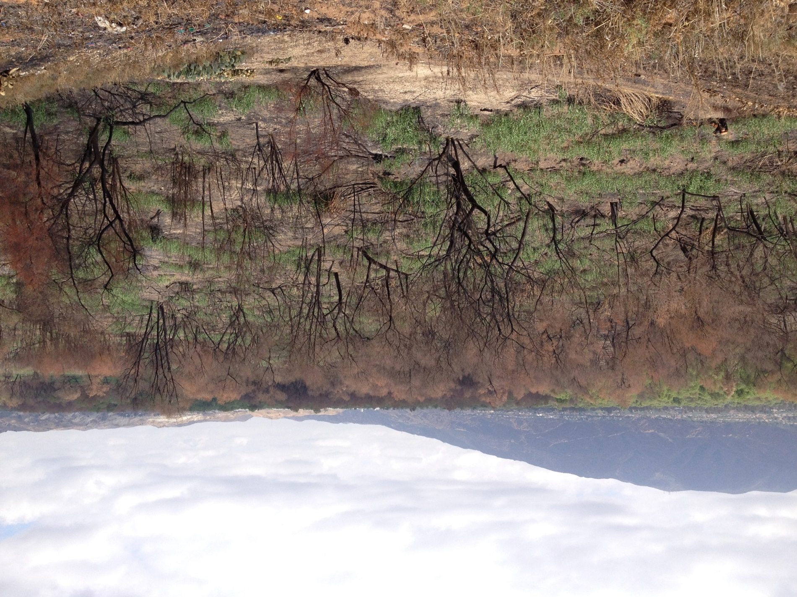
Introduction
Wildfires a familiar threat in California
Increasing in size and severity
Credit: Jerry Heo
Notes:
Californians have always lived with the threat of wildfires, but in the past few decades, wildfires have been growing in size and severity in California due to a number of factors such as changing climate patterns, an increasing expansion of human habitats into previously wild areas and drought conditions. Traditional firefighting techniques for fire suppression have also affect the vulnerability of the land to the effects of severe fires because of the buildup of dead vegetation and undergrowth which would normally be cleared out be regular fires. This is an image of the Highway fire, which occurred in Chino Hills in April 2015.

Slide 3
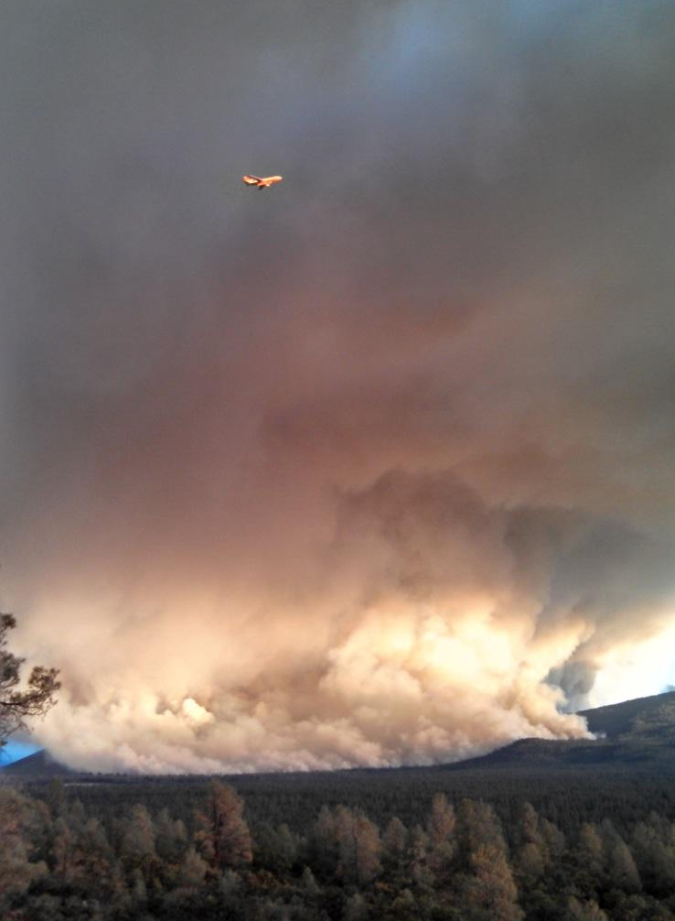
Remote Sensing and Fire Response
Obscured by clouds and smoke
Low spatial (MODIS) and temporal resolution
Nighttime support best due to thermal imagery analyses
Credit: CAL FIRE Battalion Chief Chris Waters
Notes:
Current California fire responders use spectral imagery either from Landsat or MODIS imagery or infrared instruments mounted in planes that fly out from Idaho.
There are limits within each fire response method. MODIS has low spatial resolution; Landsat may provide high resolution imagery at approximately 30m but has a temporal resolution of 16 days.
The best infrared remote sensing support is the airborne NIROPs operation, but there is only one center for the entire West and the planes are limited to night.

Slide 4
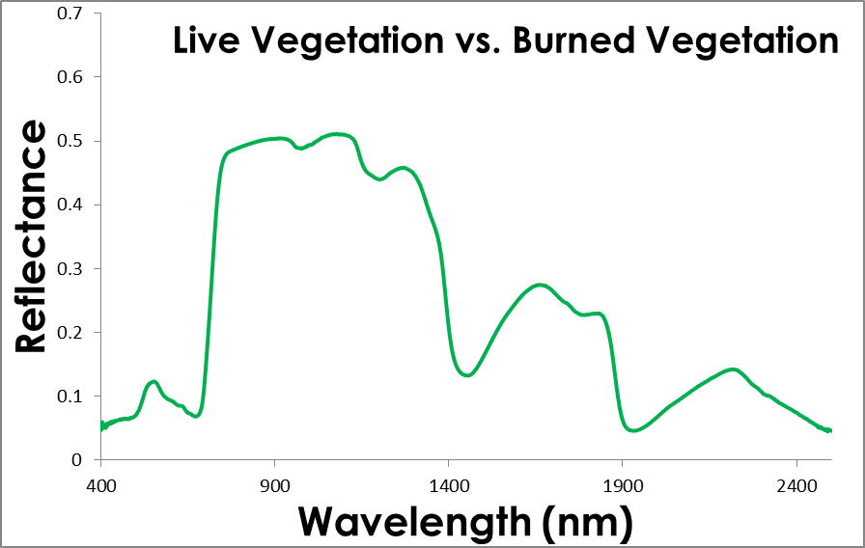
Differenced Normalized Burn Ratio (dNBR)
Live Plants
Burned Plants
Near Infrared (NIR)
Shortwave Infrared (SWIR)
Normalized Burn Ratio
dNBR = NBR_{preburn} – NBR_{postburn}
Notes:
Normalized Burn Ratio (NBR) is an index that determines the spectral response of fire affected vegetation using Near Infrared and Shortwave Near Infrared bands.
This involves using bands 4 and 7 in Landsat 7 TM/ETM+ products, and bands 5 and 7 in Landsat OLI products.
Differenced Normalized Burn Ratio (dNBR) is a differenced NBR image, and thus shows a change image that discriminates between burned and unburned areas.
dNBRs are used by the US Forest Service’s Remote Sensing Activities Center to assign vegetation burn severity levels.

Slide 5
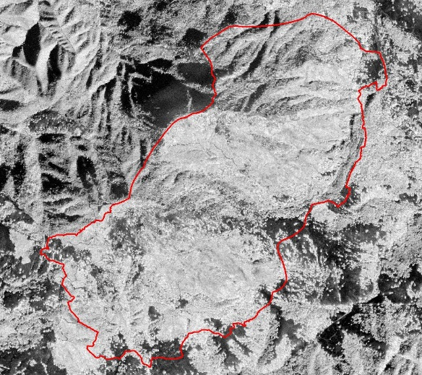
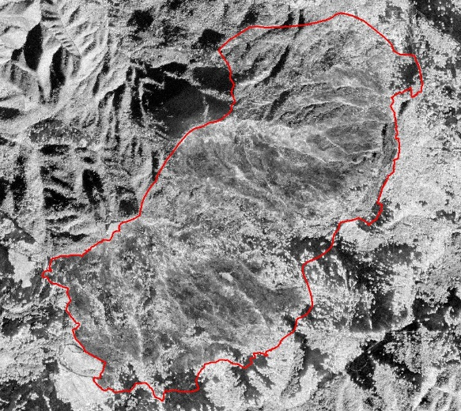
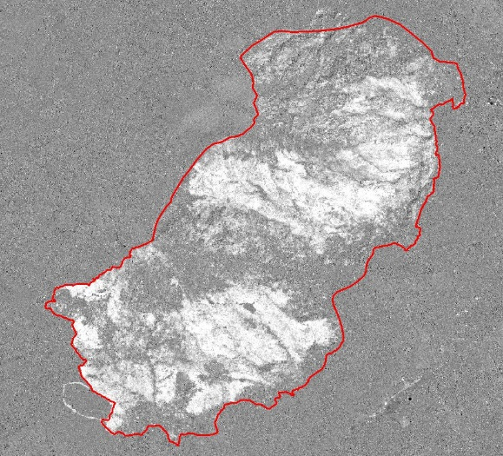
Methodology
UAVSAR
Before
After
Difference
Landsat
Notes:
Our methodology consisted of gathering before and after UAVSAR datasets from the years 2012-2014.
We then processed the UAVSAR data using a simple algorithm to acquire the final output.
For the dNBRs we gathered Landsat imagery, conducted atmospheric correction, and applied the formula to create the dNBRs.

Slide 6
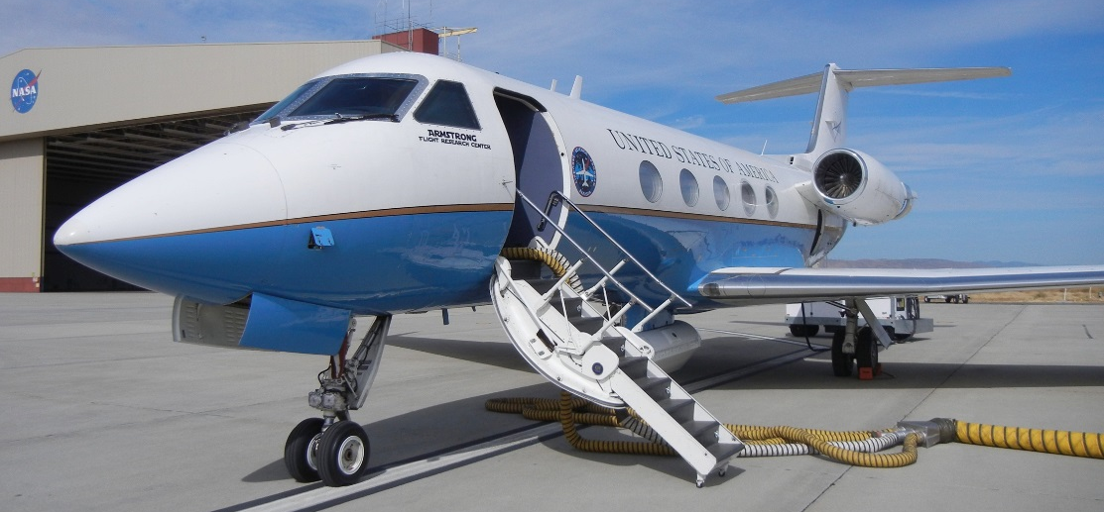
UAVSAR
Active Sensor
Day or night flights possible
High spatial resolution (5m)
Penetrates clouds and smoke
Credit: Jerry Heo
Notes:
The Uninhabited Aerial Vehicle Synthetic Aperture Radar (UAVSAR) is perfect to help fill in the gaps in fire remote sensing.
The radar sensor is currently adapted for a plane—NASA’s C20-A, which flies out of Armstrong Flight Research Center.
The benefits of the UAVSAR are many [read slide points].
It also flies at a very high altitude of 40,000 ft—far above other fire-responding aircraft.

Slide 7
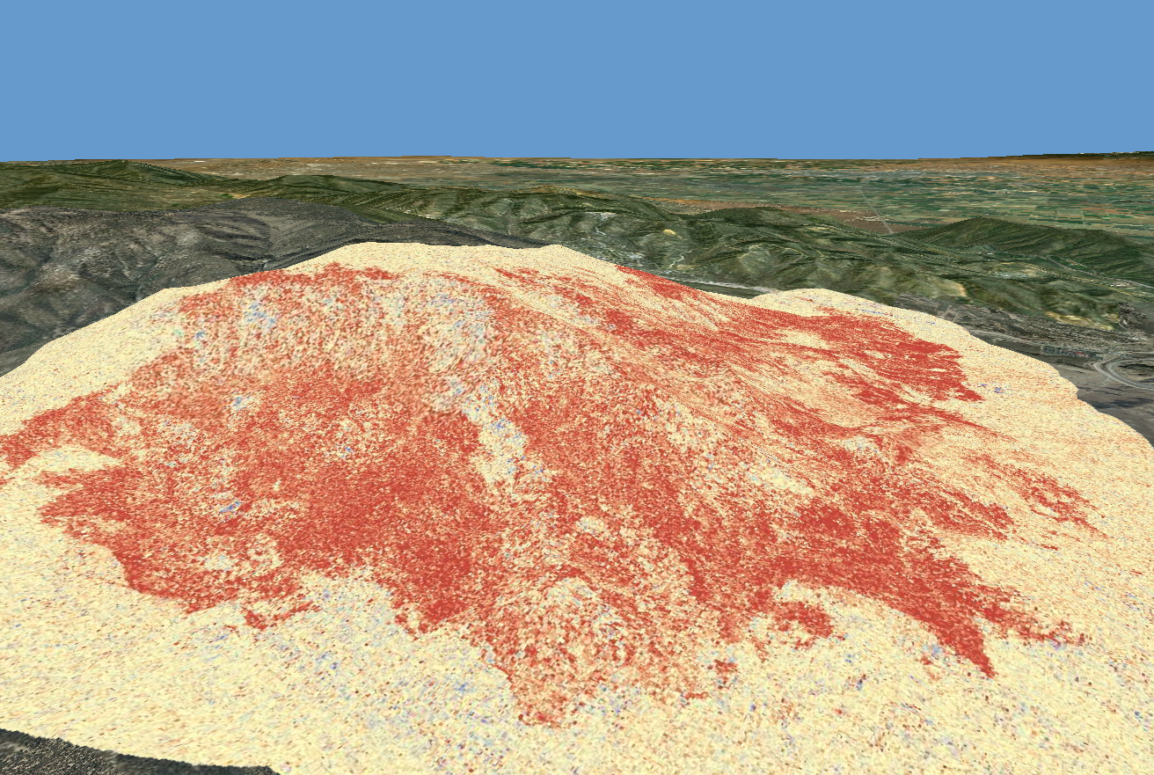
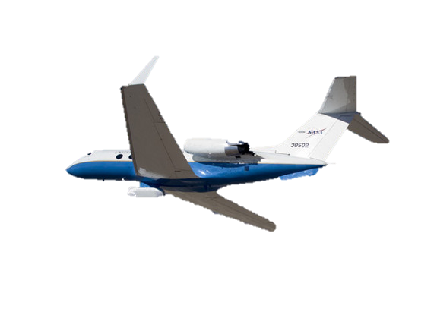
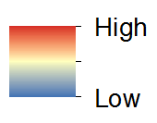
Notes:
This is a case study of the Grand Fire overlain on the basemap in ArcGlobe to show a 3D view of the study area.
The overlain layer is the UAVSAR output called the difference cross-polarized amplitude (dCA) map.
A color scheme was chosen by my team to show that red is where the greatest amount of change occurs whereas the yellow and blue show little to no change.

Slide 8
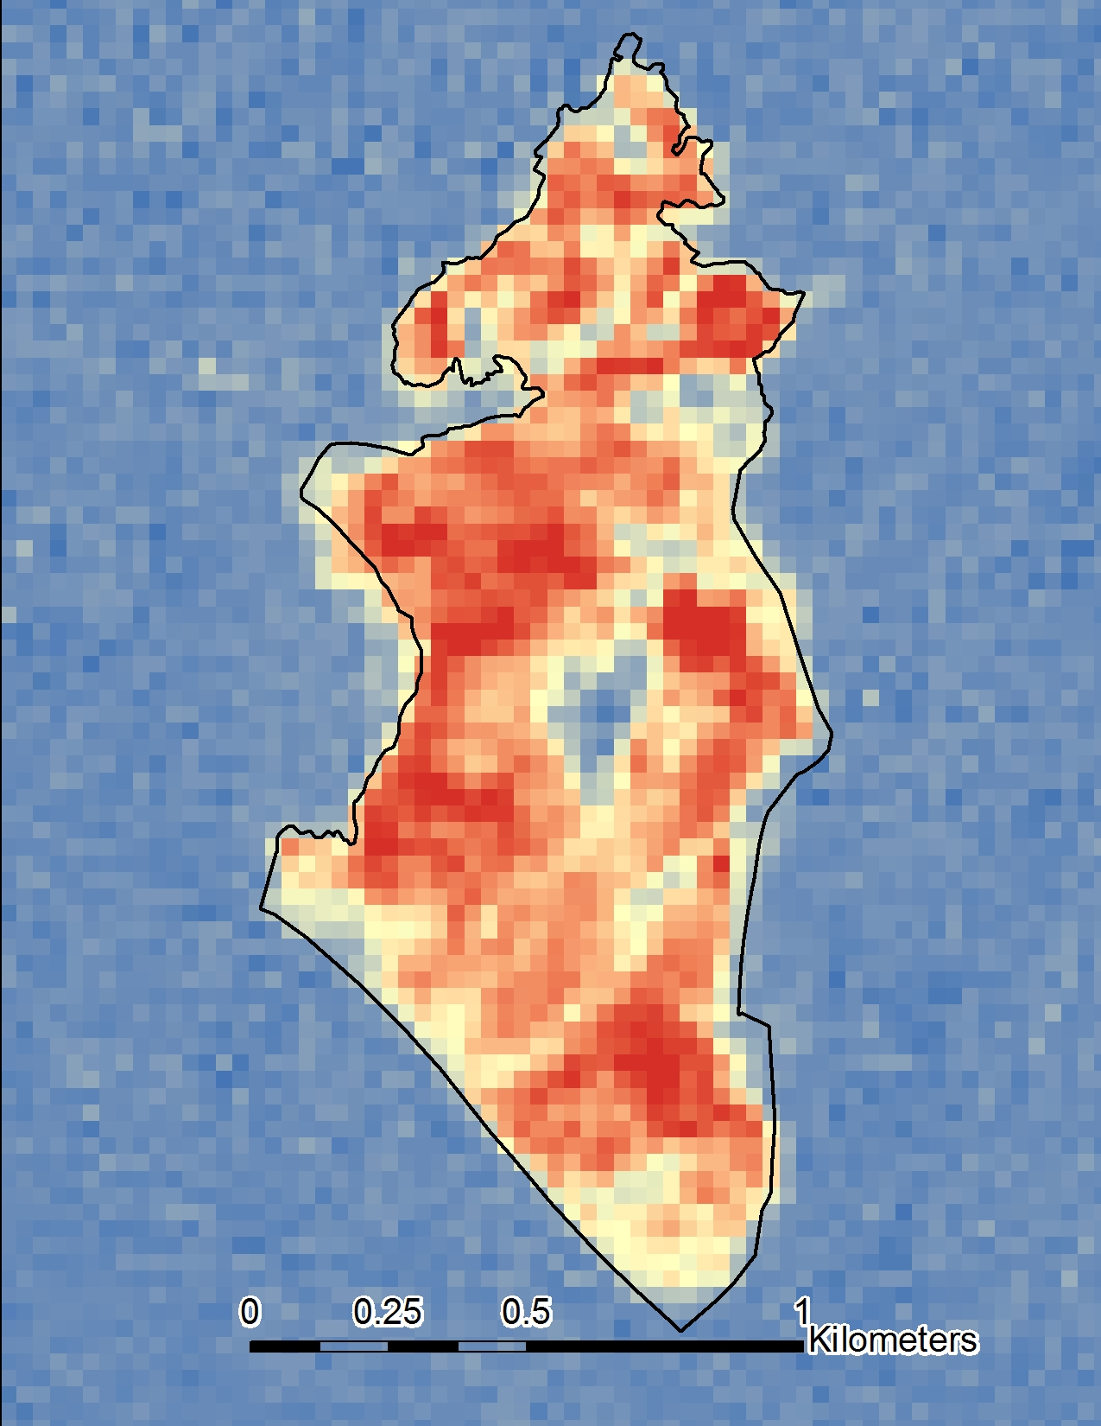
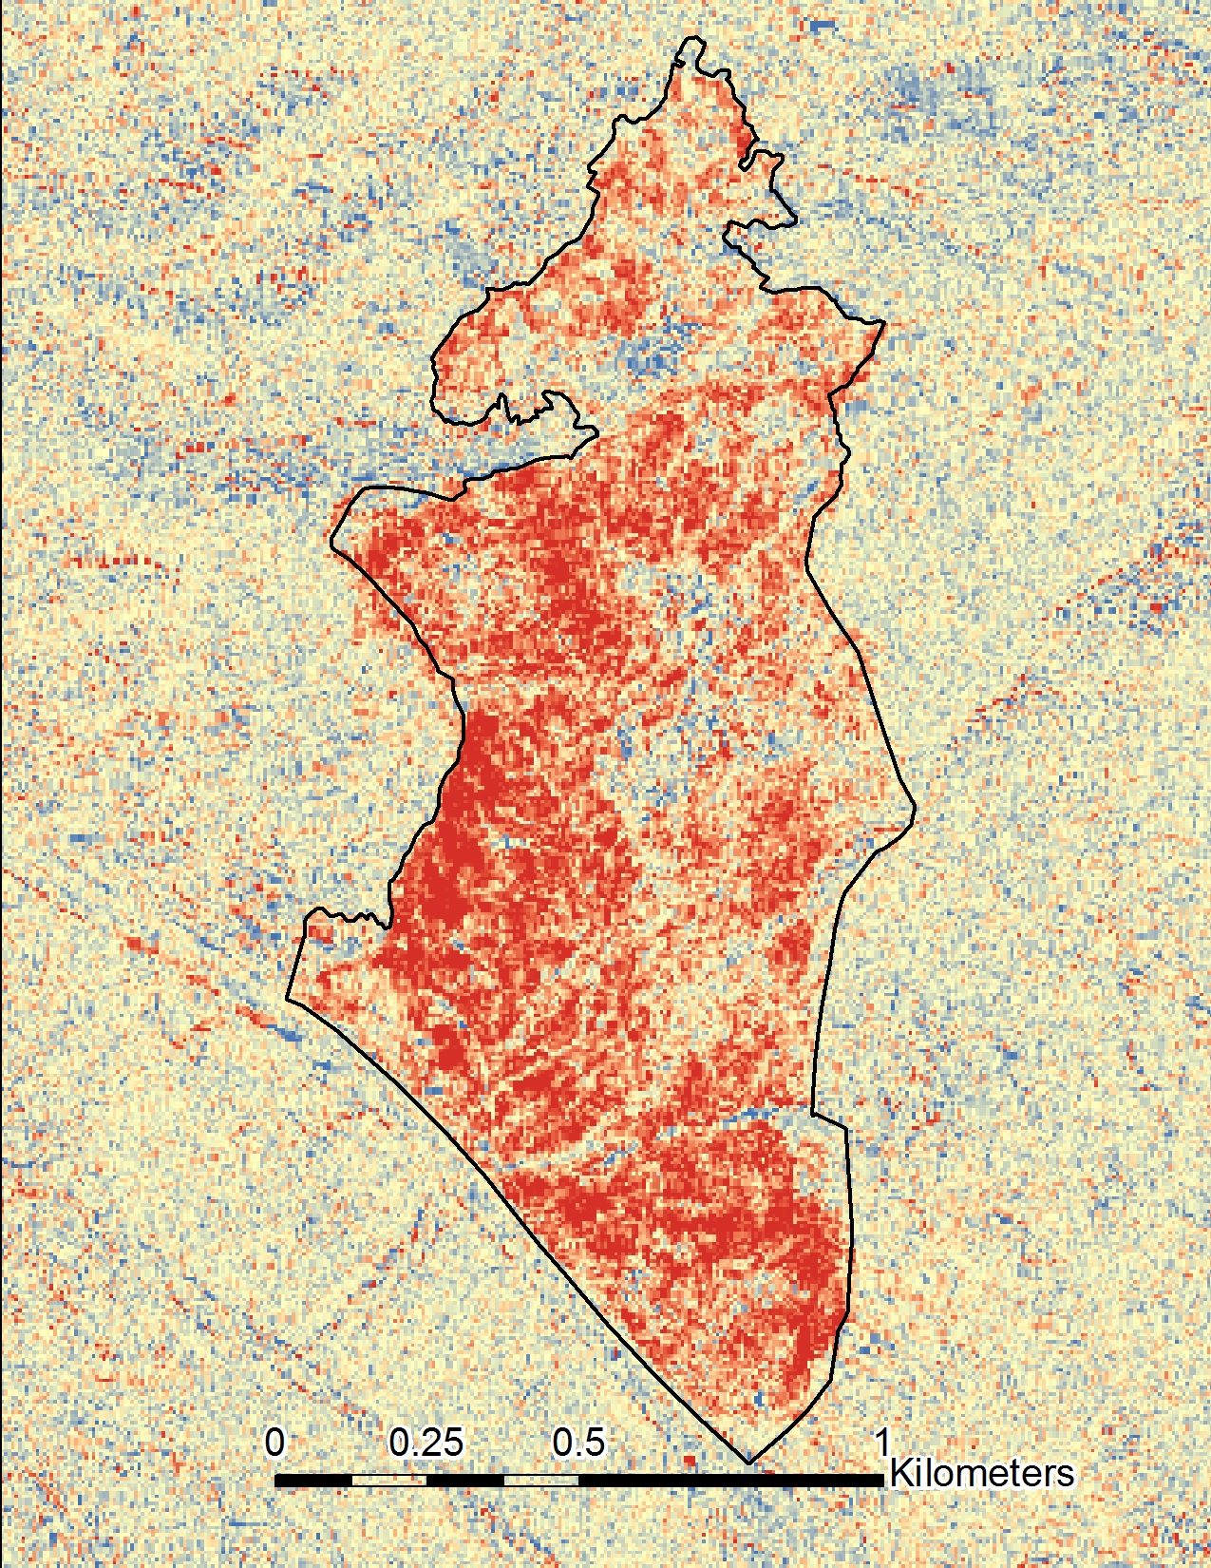
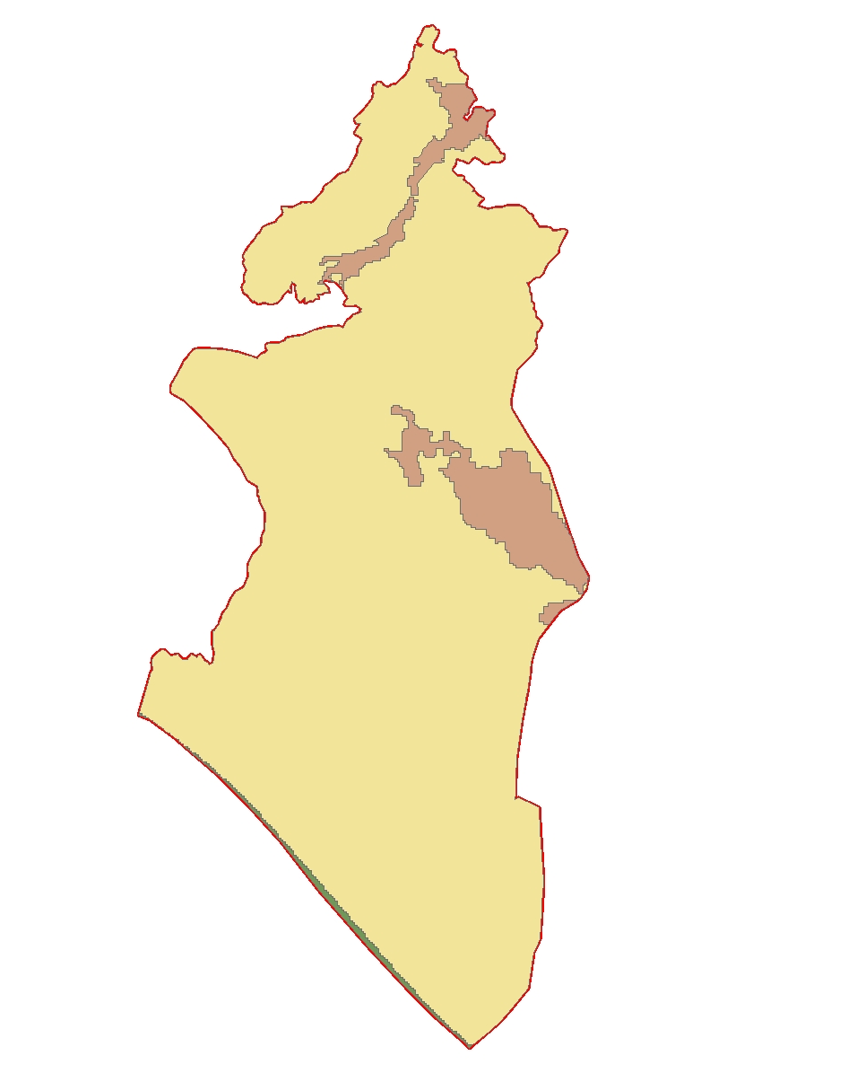
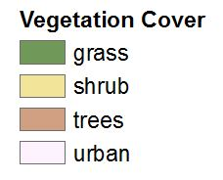
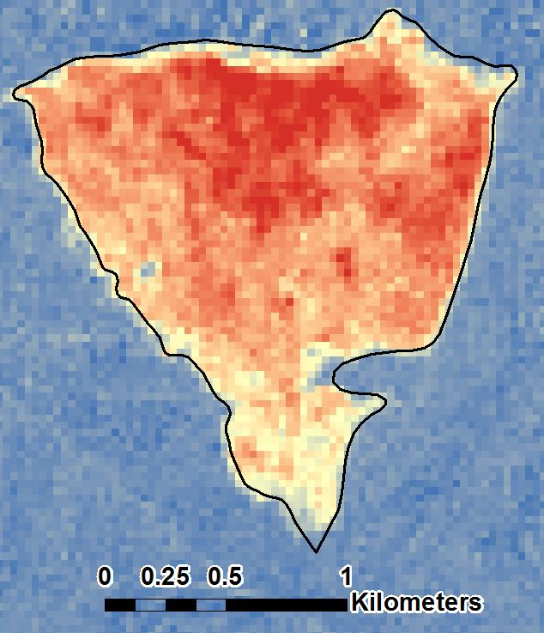
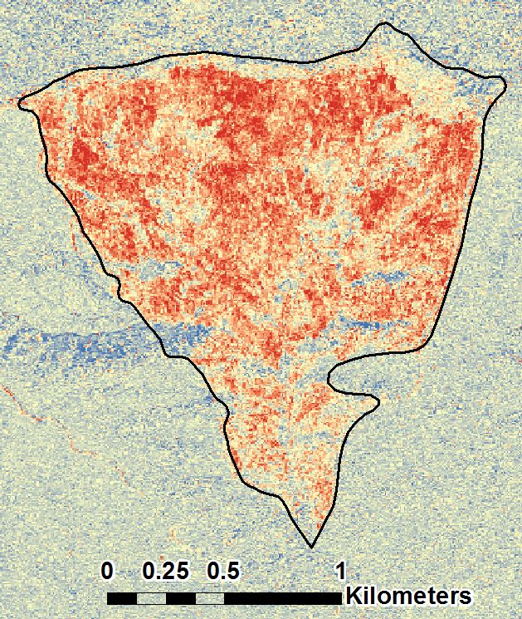
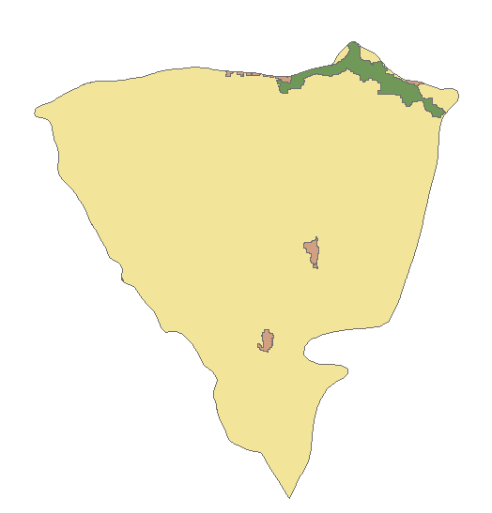
Case Studies: Shrubland
dNBR
dCA
dNBR
dCA
Notes:
Here are only but a few examples of our case studies that highlight what we have found.
We created our own Landsat derived dNBRs and analyzed them alongside our dCAs to see any possible correlations.
In both case studies the dominating vegetation type is shrubs or shrubland.
Throughout our project we noticed a pattern in which UAVSAR detects changes in shrub-type vegetation more effectively than other types of vegetation like grassland or even trees.

Slide 9
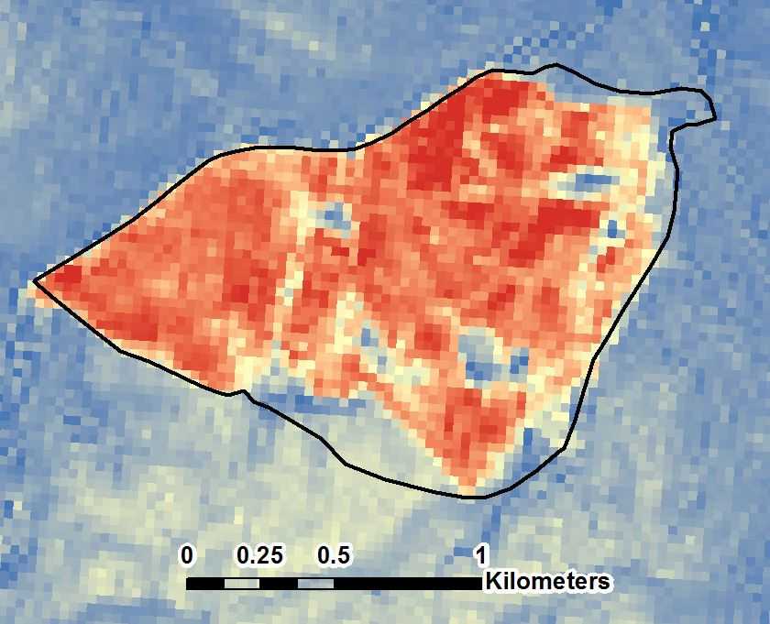
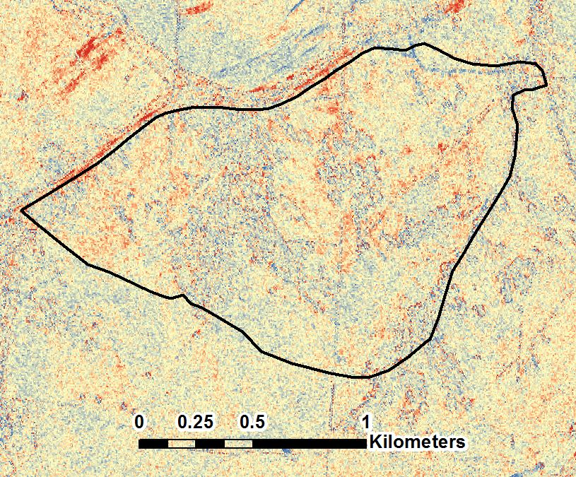
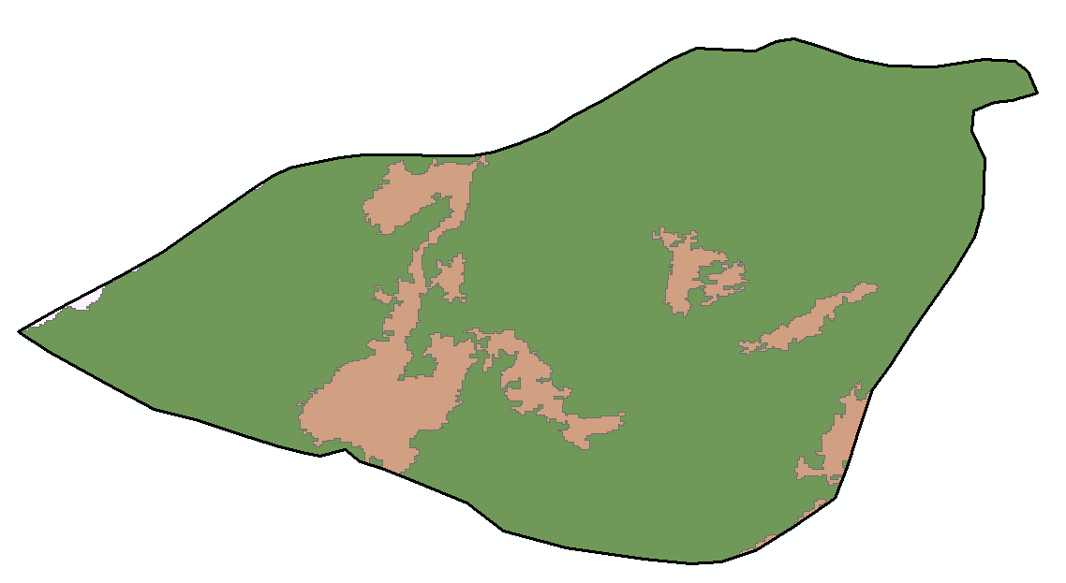
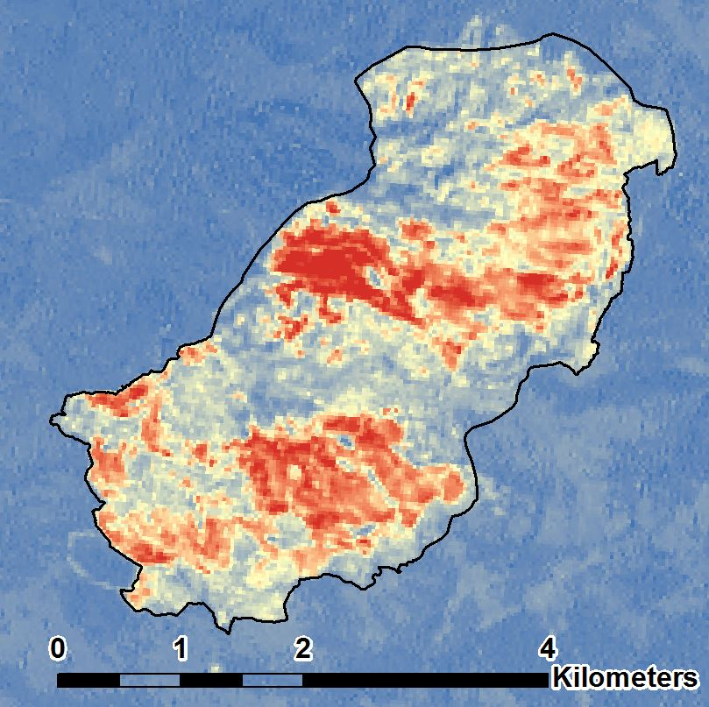
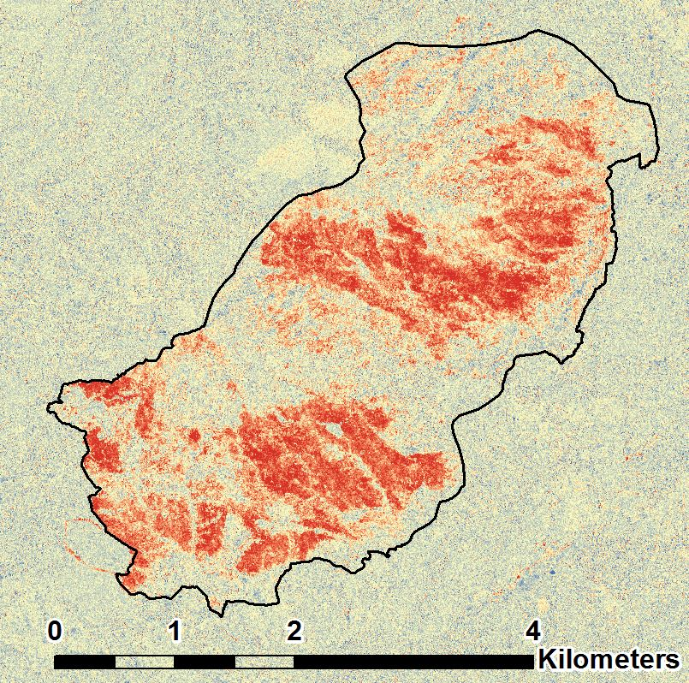
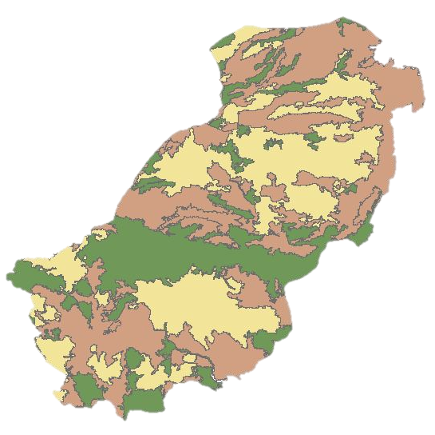
Case Studies: Grassland vs Mixed
dNBR
dCA
dNBR
dCA
Notes:
For some of our case studies in regions of grassland ecosystems, the UAVSAR instrument was unable to detect anything.
The Morgan Fire (bottom) depicts precisely that. The Morgan Fire is a unique case study in that it has mixed vegetation. And in this mixed vegetation areas correlating with where the shrub was displayed greatest amount of change in the dCA

Slide 10
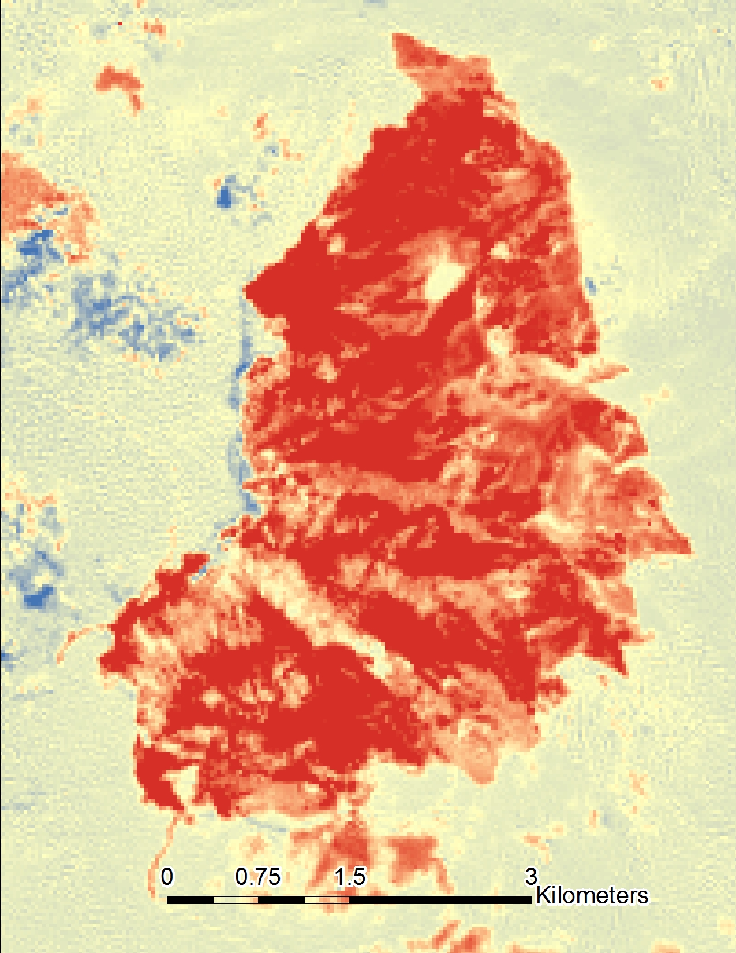
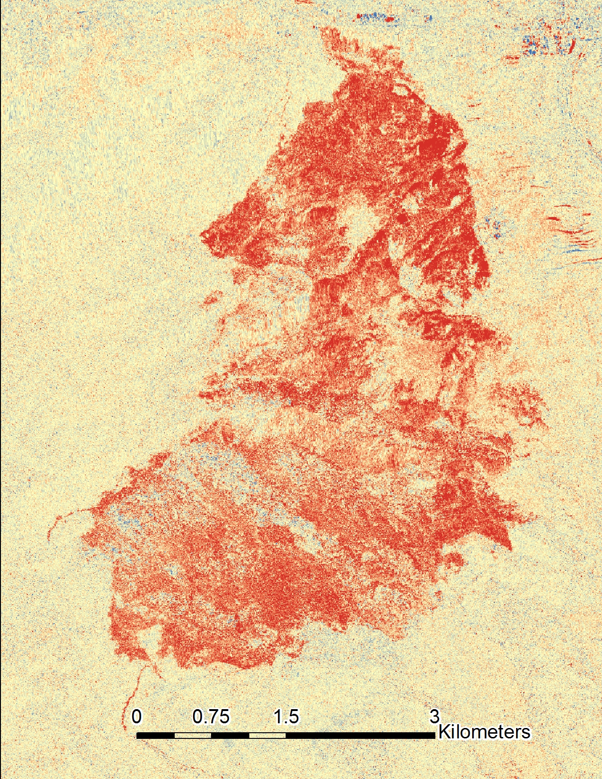
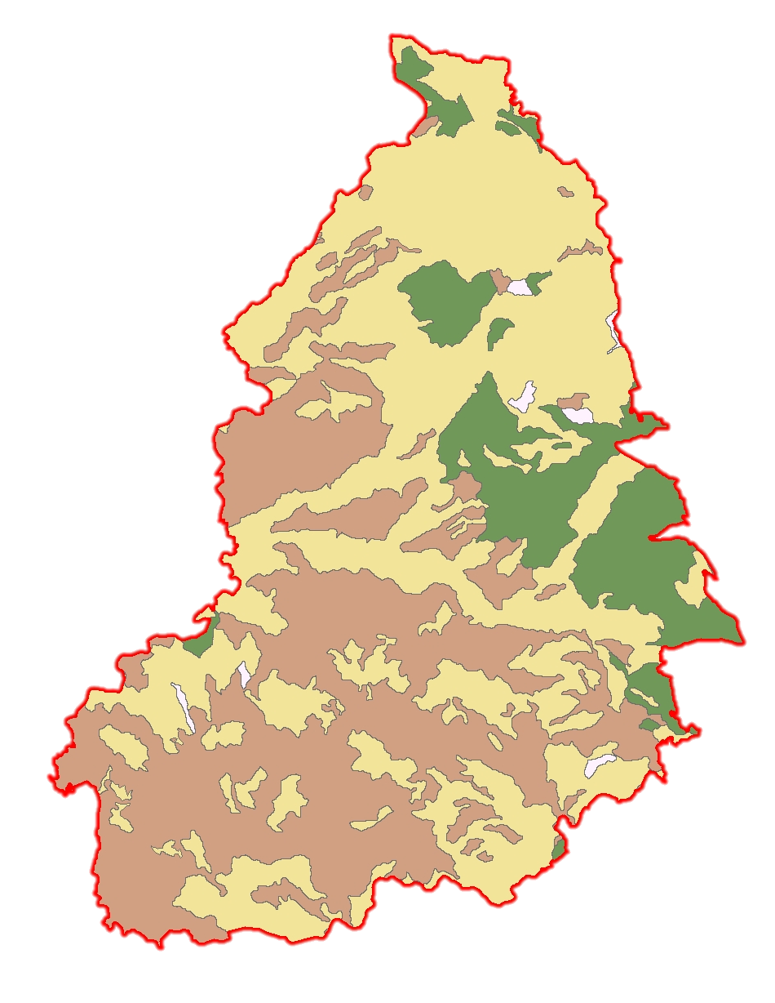
Results & Conclusions
dNBR
dCA
Notes:
Burn scars can be detected by UAVSAR
Estimating pixel values within each fire a promising outlook
Where values greater than 1-1.5 depict greater change and values at or below 1.5 imply little to no change
We are currently working on an in-depth analysis of the statistics of the performance of the fire detection method using UAVSAR products and results are very promising.
Initial correlation between dNBR and dCA
low values
There is yet to be a more efficient method for quantitative analysis

