Slide 1
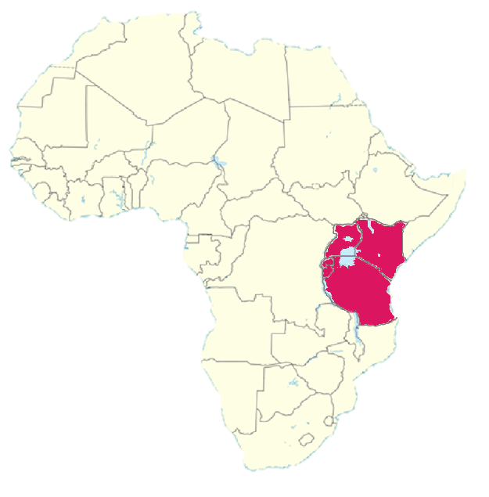
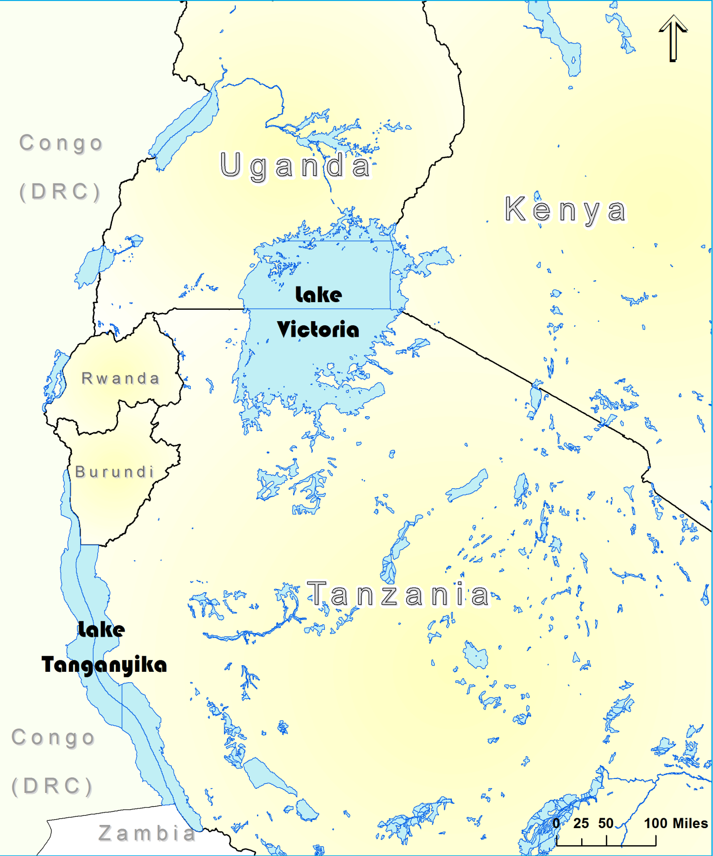
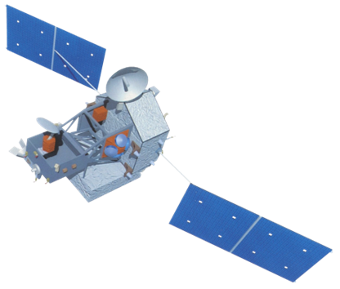
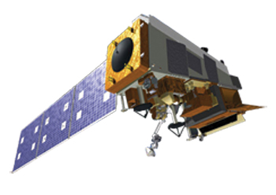
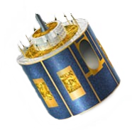
African Great Lakes Weather
Utilizing NASA Earth observations to identify indicators to help predict deadly storms over the African Great Lakes
Will Wilson (Project Lead), Anabelle White, Grant Bloomer, Juan Antonio Chacon Castro
NASA DEVELOP National Program at Wise County Clerk of Court’s Office
Abstract
Objectives
Keep this blank for now.
Body text point size should be at least 24.
Caption text point size should be at least 16.
Feel free to rename, move, and resize sections as needed.
Figure out temporal domain of further study by reducing the Hazardous Storm Events Database to summary sets of data. Extract sample dates at the 50th and 99th percentiles.
Determine what Earth observations and other data products will be useful for analysis. .
Statistics will be run through the data compiled at these respective dates. This will serve to highlight contributing environmental aspects present during days at the 99th percentile
Methodology
Study Area
Intensity
99%
Threshold
Hazardous Storm
Event Database
M.E.R.R.A
L.
I.
S.
Intensity
50%
Threshold
Earth Observations
TRMM
Aqua
Eumetsat - SEVIRI
Conclusions
Results
Use bullets.
Use complete sentences with periods.
Use images.
Make sure that it has some sort of flow, that it makes sense. Show your results in a logical order.
No bullets.
Team Members
Project Partners
Acknowledgements
Use a professional-looking photo.
Individual headshots are ok, if they aren’t pixelated and are all the same size.
Include a caption that states the team members’ names.
Dr. Kenton Ross, Science Advisor (NASA DEVELOP)
Kristopher Bedka, NASA Climate Science Branch
Dr. DeWayne Cecil, Science Advisor (Global Science and Technology Inc. )
Professor Robert Vangundy (UVA –Wise)
Ms. Melanie Salyer, NASA DEVELOP Mentor
Kenya Meteorological Department
Wise County Clerk of Court’s Office

