Slide 1
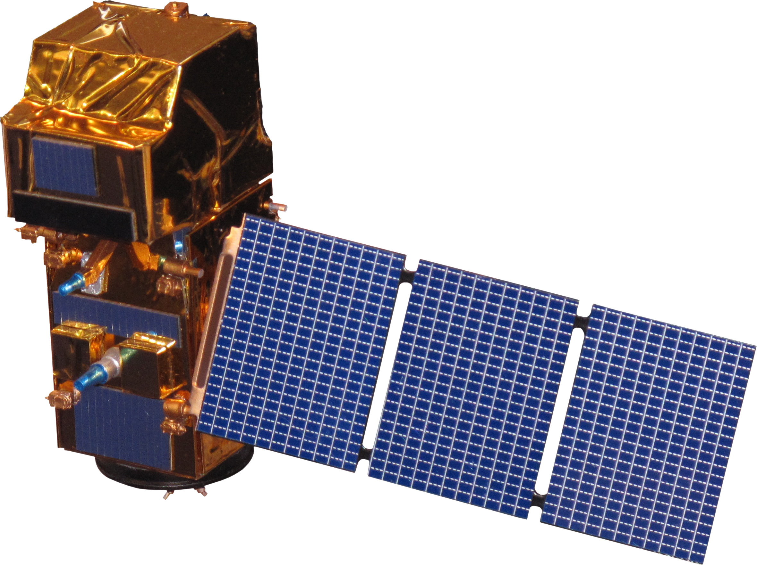
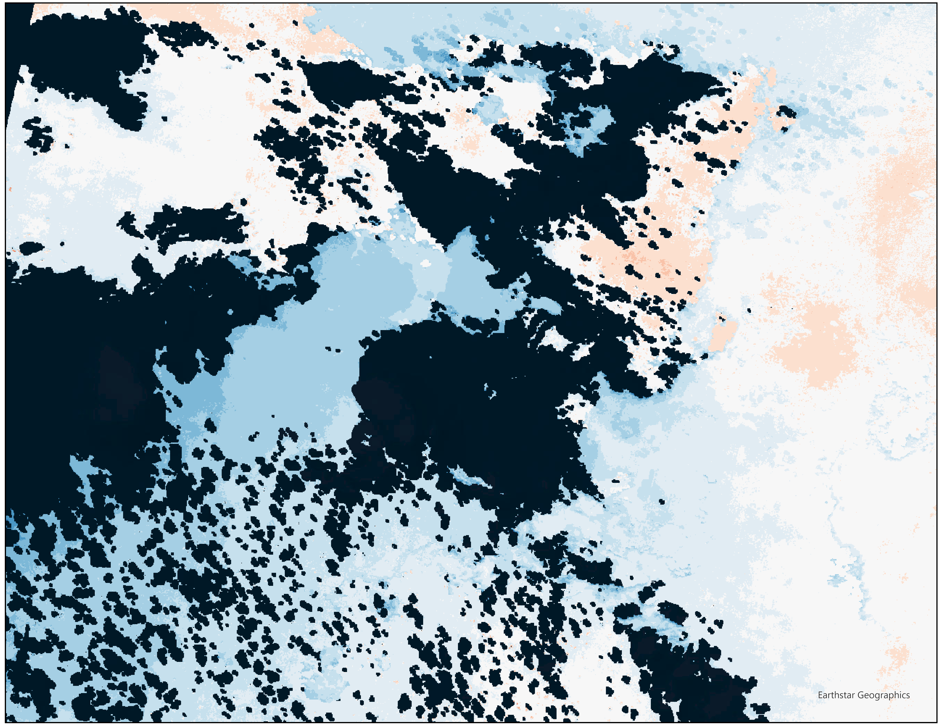
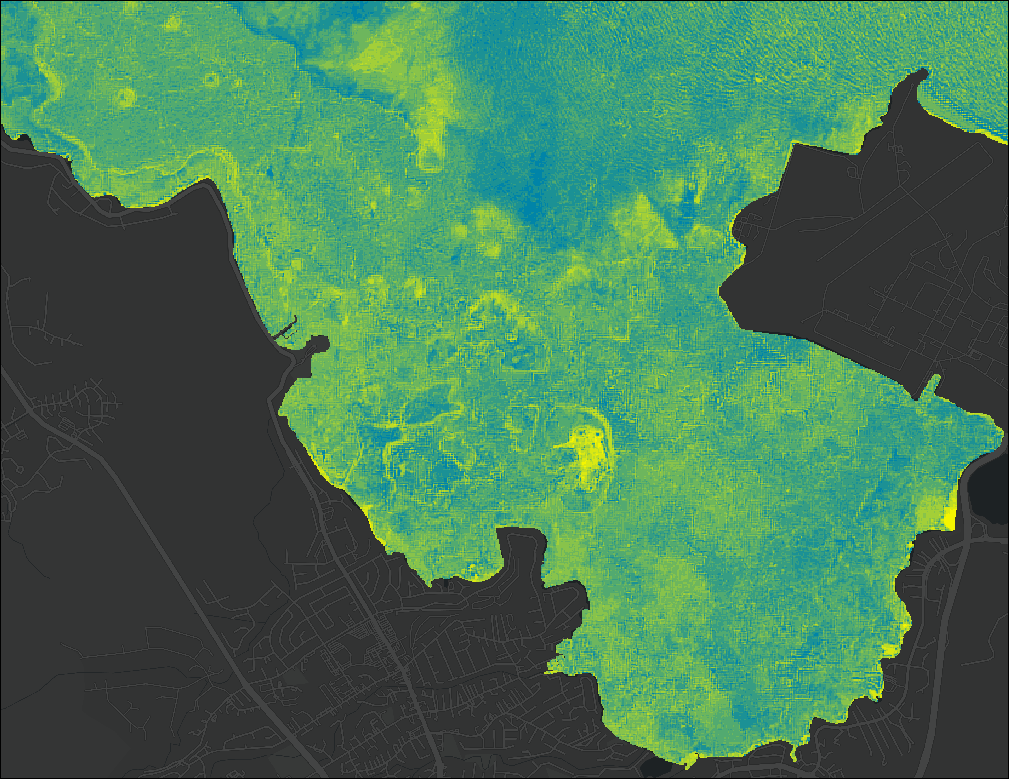
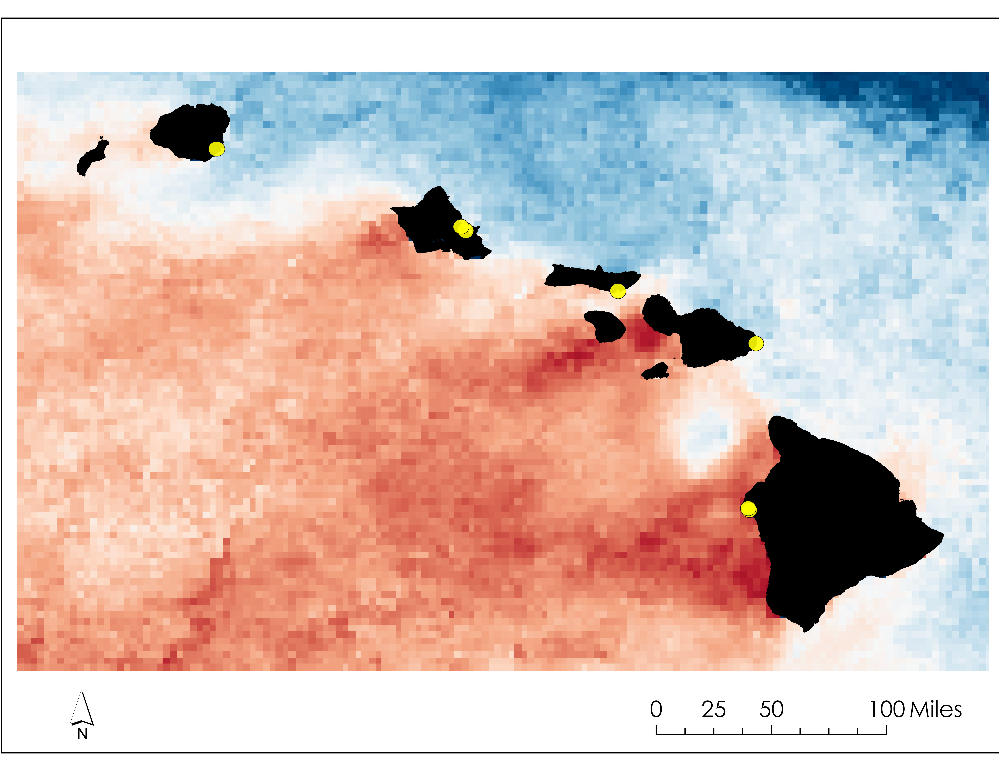
Hawai'i Climate
Utilizing NASA Earth Observations to Assess Thermal Stress Impacts on Coastal Hawaiian Fishponds
Background
Project Objectives
Fishponds (loko i'a) are ancient Hawaiian aquacultural systems that mimic estuaries for native fish species such as 'ama 'ama (striped mullet) and awa (milkfish). Historically, loko i'a have provided up to 2 million pounds of fish harvest per year, but colonial driven land changes drastically decreased the number of loko i'a thriving today. Restoration of these areas provides a means of retaining cultural knowledge, and an opportunity to obtain food security within the Hawaiian islands. Combining earth observations and cultural knowledge from fishpond practitioners could offer predictive insights for the strategic conservation of loko i'a in the face of increasing climate change.
Assess regional sea surface temperature changes from 2002-2021 with a focus on marine heatwaves in 2015 and 2019
Investigate temperature changes within loko i'a from 2013 – 2023
Quantify thermal habitat suitability for fish species: 'ama 'ama (striped mullet, Mugil cephalus) and awa (milkfish, Chanos chanos)
Inform partner organizations of ponds with the highest potential for successful restoration efforts
Earth Observations
Methodology
Gathered and Processed Satellite Imagery
Created regional and small scale timeseries
Assessed patterns during 2015 & 2019 Marine Heatwaves
Determine pond restoration feasibility based on fish threshold temperatures
Aqua MODIS
2019
2015
Sentinel-2 MSI
(Chl a: 2019 - 2024)
Aqua MODIS
(SST & Chl a: 2002 – 2021)
Landsat 8 TIRS
(SST: 2013 – 2024)
Landsat 8
Sentinel-2 MSI
Results
Menehune Kahouna He'eia Keawanui Haneo'o Kaloko Aimakapa'a
"Unsheltered" Fishponds
"Sheltered" Fishponds
Western coast fishponds located in island shadow consistently exposed to higher temperatures
Eastern coast fishponds located outside of the island shadow
40
40
35
35
Habitable Threshold
30
30
Temperature (°C)
Temperature (°C)
25
25
20
Aqua-MODIS Sea Surface Temperature displaying ocean circulation "island shadow" phenomena around Hawai'i
20
15
2014
2015
2017
2019
2020
2023
2024
0
50
100 miles
15
2013
2016
2018
2021
2022
25°C
30°C
2013
2014
2015
2016
2017
2018
2019
2020
2021
2022
2023
2024
Marine Heatwave Years
Marine Heatwave Years
Conclusions
Project Partners
Small, unsheltered fishponds are more likely to exceed thermal thresholds for juvenile fish (awa and 'ama'ama) than larger, sheltered ponds
NASA Earth observations are viable for large-scale regional monitoring; however, In-situ data is needed to observe small coastal ponds.
Kua'aina Ulu 'Auamo
University of Hawai'i at Manoa
NOAA, Pacific Islands Regional Office
Acknowledgements
Team Members
Advisors:
NASA Jet Propulsion Laboratory, Caltech - Dr. Christine Lee, Dr. Kelly Luis, Dr. Angelica Rodriguez, & Benjamin Holt
Partners:
Kua'aina Ulu 'Auamo - Brenda Asuncion, Kevin Chang
NOAA - Dr. Charles Littman, Tia Brown, Ariel Jacobs
University of Hawaii - Dr. John Burns, Dr. Haunani Kane, Kainalu Steward, Briana Ninomoto
NASA DEVELOP:
Michael Pazmino, California – JPL Lead
Jane Zugarek, California – JPL Communications Fellow
Raz Wachtel
Project Lead
Danielle Sonobe
Tyler Morgan
Mina Nada
California – JPL | Spring 2024

