Slide 1
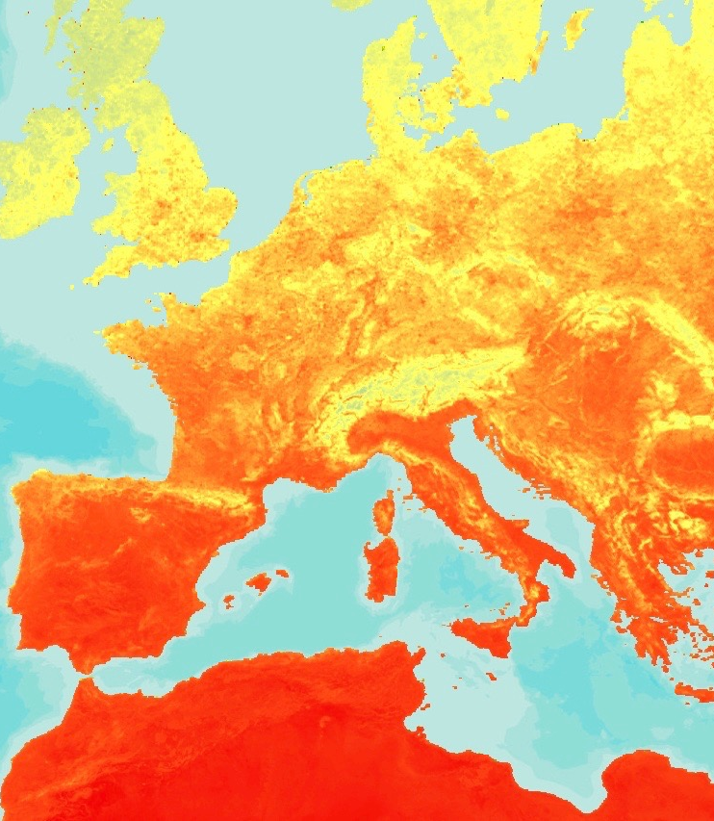


WESTERN EUROPE HEALTH & AIR QUALITY
Monitoring Mosquito Abundance and Distribution to Assist Vector-Borne Disease Management in Western Europe
Gia Mancini
Helen Plattner
Douglas Gardiner
Luisa Silva
Victor Lenske
Alison Thieme
Sara Lubkin, PhD
Aaron Warga
Maryland - Goddard
Fall 2017
Notes:
Introductions: Names and schools
Gia: Hello, we are the NASA DEVELOP team at Goddard Space Flight Center. The project that we have been working on over the past 10 weeks focused on integrating citizen science data and NASA Earth observations to help combat vector-borne illness in Western Europe.

Slide 2
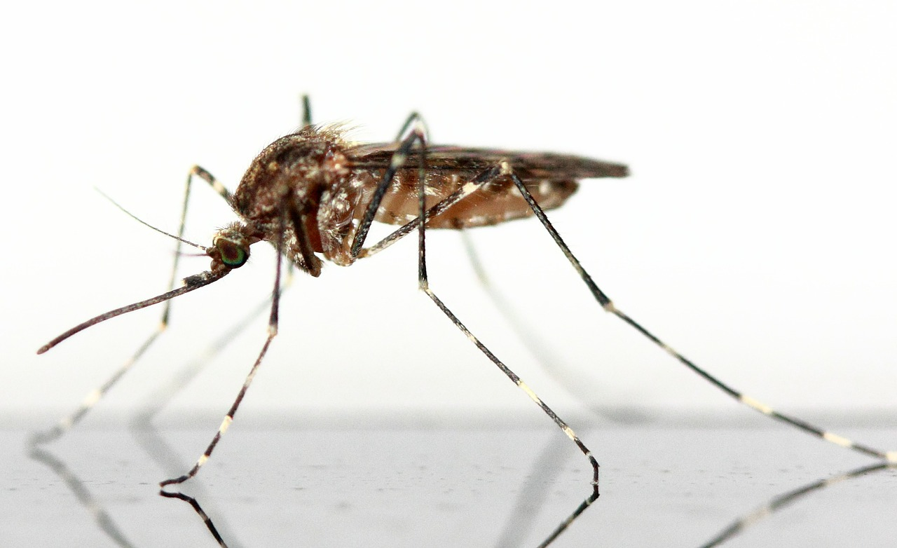
Vector-borne Illness
17% of infectious diseases
1 million deaths per year
Common vectors:
  Mosquitoes
  Ticks
  Blackflies
Image Credit: Pixabay
Notes:
Gia: Vector-borne illnesses are prevalent throughout the world, accounting for 17% of infectious diseases and causing over 1 million deaths each year. Some common vectors include mosquitoes, ticks, and blackflies.
Image Source: https://pixabay.com/en/mosquito-insect-schnake-fly-animal-83639/

Slide 3
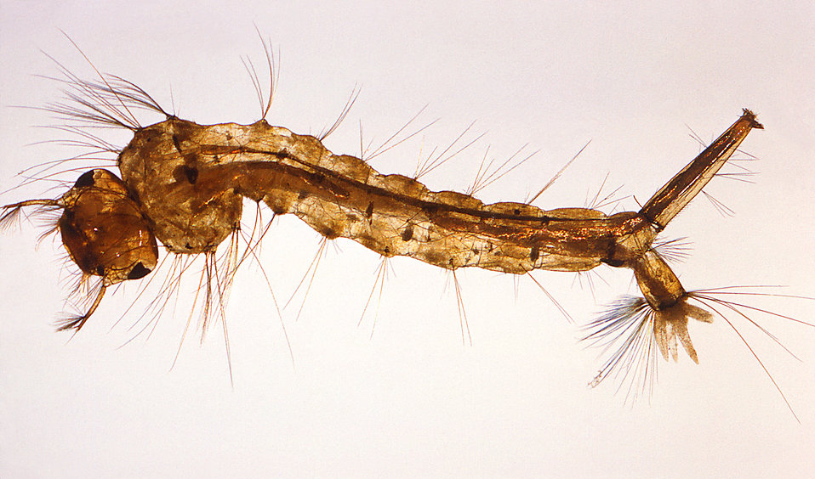
Mosquito-borne Disease
Common Diseases:
Zika
West Nile Virus
Chikungunya
Malaria
Dengue
Yellow fever
Image Credit: Free Stock Photos
Notes:
Gia: Mosquitoes are the most common and well-known vectors. They spread diseases like Zika and malaria. Historically, most of these diseases have occurred in tropic regions, however, in recent years they have spread to more temperate regions of the world, such as Western Europe.
Image Source: http://www.freestockphotos.biz/stockphoto/17031

Slide 4
Project Partners
Global Mosquito Alert Consortium
  The Woodrow Wilson International Center for Scholars
  Citizen Science Association
  European Citizen Science Association
  Wageningen University
  Sapienza Università Di Roma
Institute for Global Environmental Strategies
Notes:
Gia: For this project we partnered with the Global Mosquito Alert Consortium and all of its constituents and the Institute for Global Environmental Strategies.

Slide 5
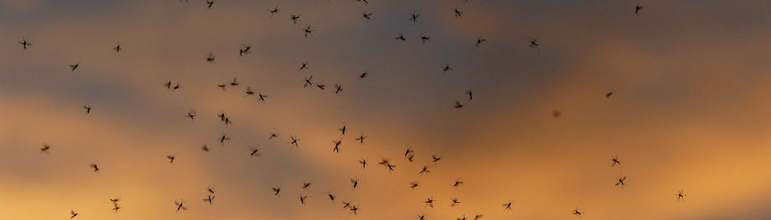
Partner Concerns
Image Credit: Max Pixel
Rising temperatures expand mosquito population range
Spread of vector-borne diseases
Integrating citizen science data from multiple countries
Notes:
Luisa: The partners’ main concern is the spread of vector-borne illnesses. Rising temperatures are expanding mosquito population ranges, thus furthering the ability of diseases to spread. Incorporating citizen science data into scientific research is a relatively new endeavor. By integrating NASA Earth observations and citizen science data, our work will assist project partners in streamlining datasets from multiple countries and help with public health preparedness in the face of disease outbreaks.
Image Source: http://maxpixel.freegreatpicture.com/Dance-Schools-Mass-Mosquitoes-En-Masse-1837658

Slide 6
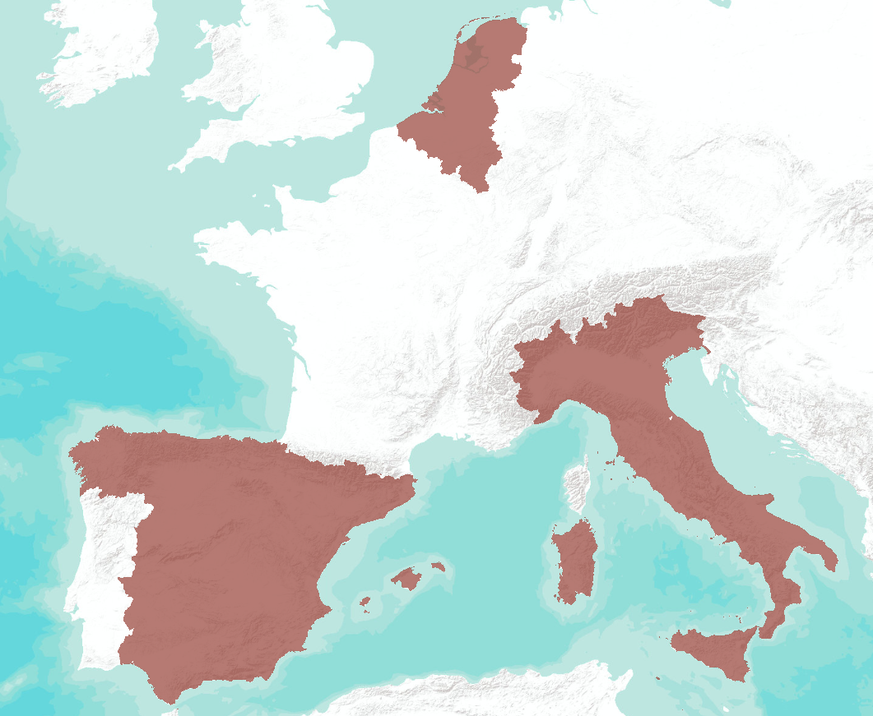

Study Area: Western Europe
Study Period:
June 2016 – September 2017
Notes:
Luisa: Our study area for this project is Western Europe. The study period is from June 2016 to September 2017.

Slide 7




Study Area: Western Europe
Italy
Belgium
The Netherlands
Spain
Image Credits: Max Pixel; PEXELS; Pixabay; Unsplash
Notes:
Luisa: Specifically, the countries we looked at included: Belgium, Italy, The Netherlands, and Spain.
Image Sources:
http://maxpixel.freegreatpicture.com/Water-Fjord-Belgium-River-Dinant-Urban-City-2220459
http://maxpixel.freegreatpicture.com/Cathedral-Catalonia-City-Architecture-Girona-Spain-2342015
https://www.pexels.com/photo/architecture-boats-buildings-canal-417344/
https://pixabay.com/en/windmill-netherlands-garden-europe-858143/

Slide 8

Citizen Science in Europe
Image Credit: Pexels
Research collected by citizens
Geo-capable mobile apps
Questionnaires when exposed to mosquitoes
Pros:
Cons:
Community involvement
Convenience
Unreliable
Awareness
Notes:
Luisa: Citizen science is research conducted and collected by the general public. Using geo-capable mobile apps, citizens can answer questionnaires and take photos when exposed to mosquitoes or mosquito breeding grounds. The pros of citizen science data are that there is a large push for community involvement and that it is also convenient, because anyone can collect data from wherever they are just by accessing the app through their phone. There are some cons, however. The data collected is not always reliable. Some citizens send in samples of what they find, and sometimes they are not seeing mosquitos. Awareness is another issue. Not many people know about these apps, so the amount of data is limited. After media events, more observations are submitted.
Image source: https://www.pexels.com/photo/cell-cell-phones-cellphone-chat-163118/

Slide 9
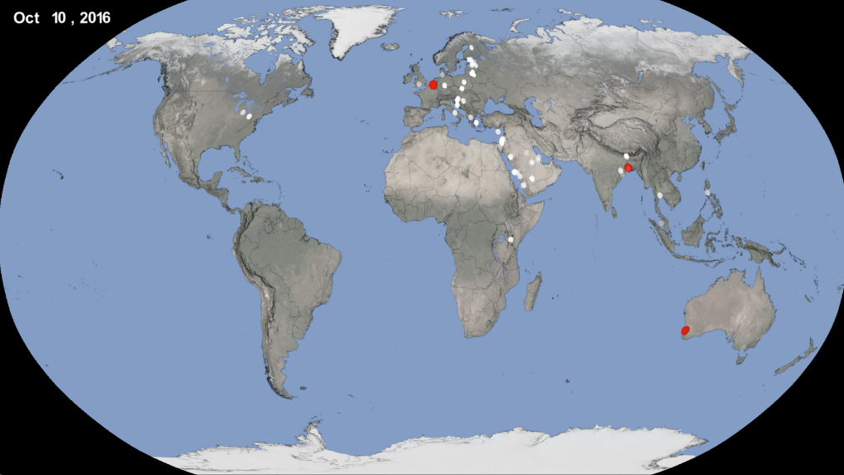
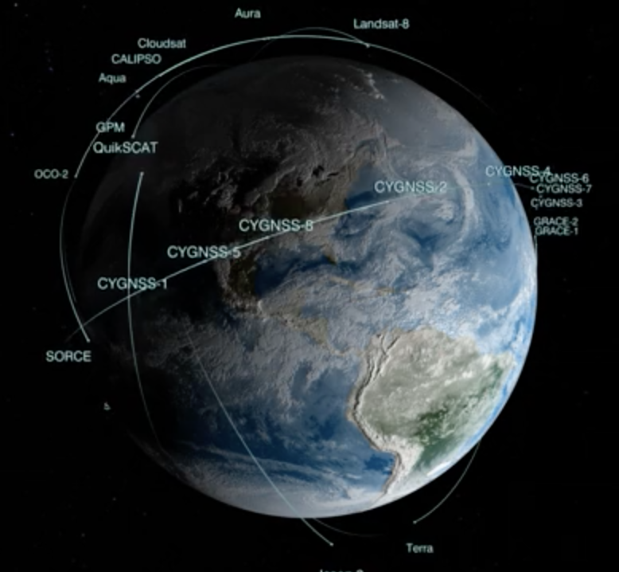
Objectives
Combine citizen science data with NASA’s remote sensing capabilities
Identify key environmental factors that signal prime conditions for mosquitoes
Create a methodology to incorporate additional countries in the Global Mosquito Alert Consortium
Image Credit: NASA Visualization Studio
Notes:
Aaron/Sara: Our objectives for this project were to combine citizen science data with NASA’s remote sensing capabilities in order to help our partners at the Global Mosquito Alert Consortium to identify key environmental factors that signal prime conditions for mosquitoes. With citizen science data we can verify mosquito presence and utilize NASA Earth observations to determine the environmental conditions under which mosquitoes thrive. The methodology we created will continue to be used to collect data about mosquito activity as data from additional countries becomes available.
Image Sources:
https://svs.gsfc.nasa.gov/4558
https://svs.gsfc.nasa.gov/4524

Slide 10
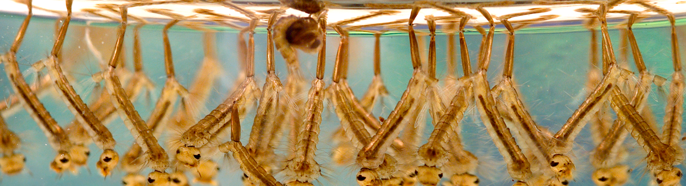

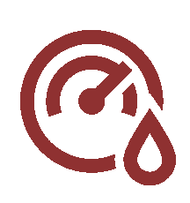




Environmental Factors
Image Credit: CDC/ James Gathany
Precipitation
NDVI
Elevation
Land Surface Temperature
Soil Moisture
Humidity
Notes:
Aaron/Sara: We identified several environmental factors that could influence mosquito life cycles and population dispersion. These include elevation, land surface temperature, precipitation, vegetation, soil moisture, and humidity. In addition to these environmental factors, we also looked at land cover and population density.
Image Source: https://en.wikipedia.org/wiki/File:Culex_sp_larvae.png

Slide 11
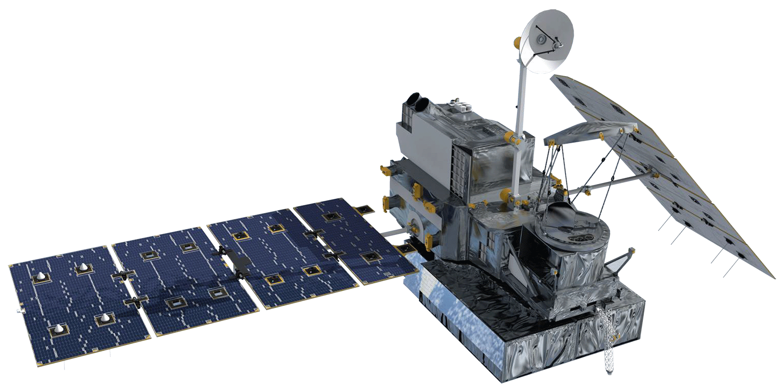

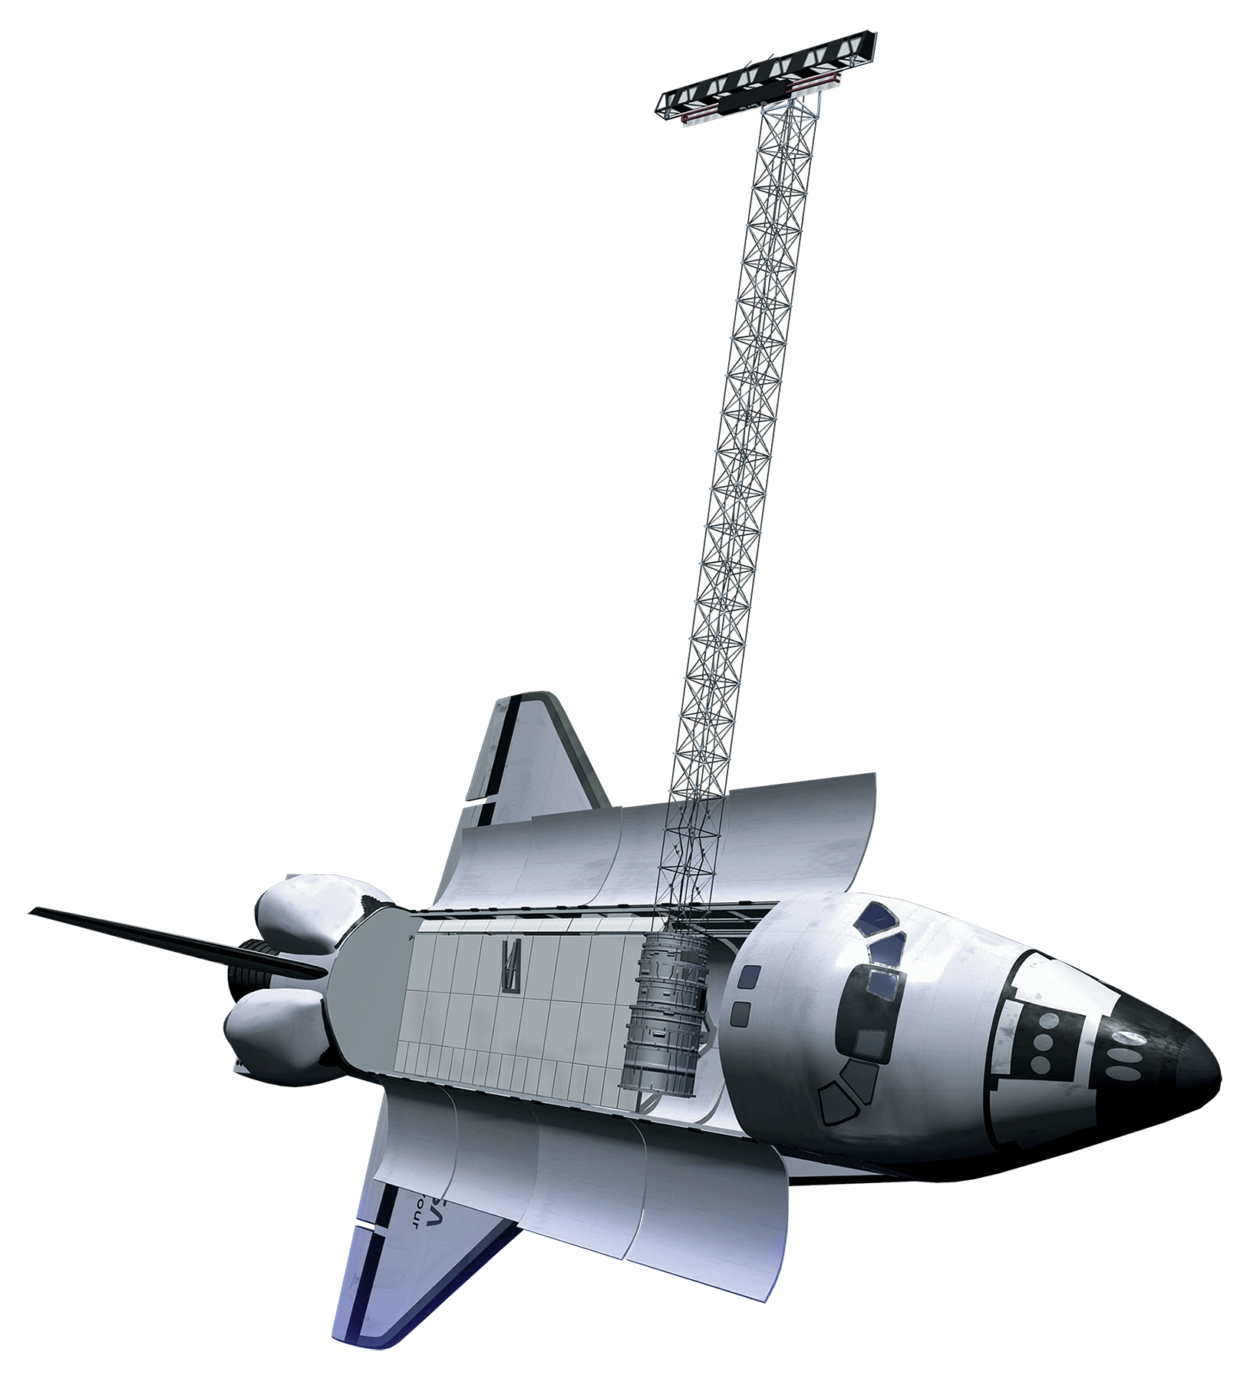

NASA Earth Observations
Global Precipitation Measurement (GPM)
Aqua Atmospheric Infrared Sounder (AIRS)
Terra Moderate Resolution Imaging Spectroradiometer (MODIS)
Shuttle Radar Topography Mission
(SRTM)
Image Credit: NASA Visualization Studio
Notes:
Aaron/Sara: We used NASA Earth observations to collect environmental data in order to assess which factors influence mosquito population sites. We used the Aqua AIRS and Terra MODIS instruments to measure land surface temperature and vegetation indices, GPM to collect precipitation data, and SRTM to map out elevation.
Image Source: http://www.publicdomainfiles.com/show_file.php?id=13520172014021

Slide 12
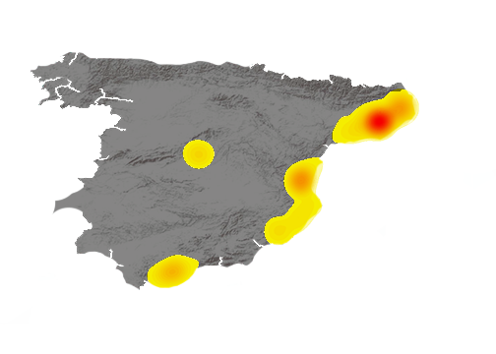
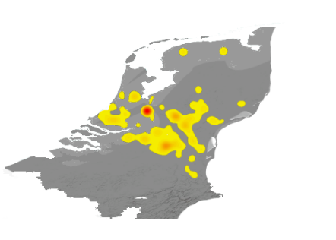
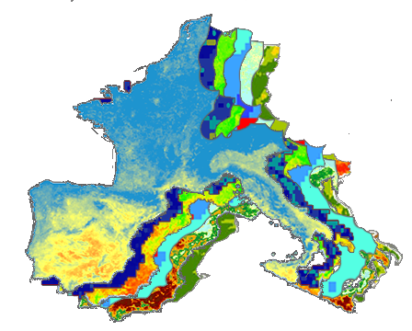
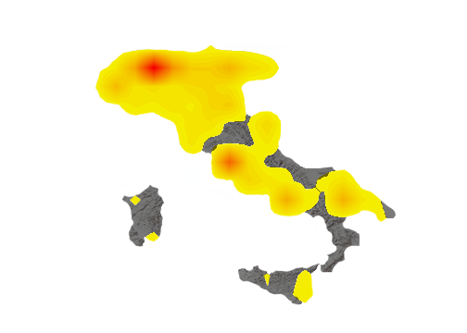
Methodology
Citizen Science Data
Environmental Factors
Hotspot Map
NASA Earth Observations
Western Europe:
Belgium
Italy
The Netherlands
Spain
Land Surface Temperature
Soil Moisture
NDVI
Humidity
Elevation
Precipitation
Mosquito
Activity
Density
Hotspot
TERRA
AQUA
GPM
SRTM
MaxEnt Habitat Suitability
Notes:
Doug: The methodology for our project began with collecting two types of data: citizen science data and the environmental data. Using the geographic coordinates from the citizen science data, the team created a map showing how dense mosquito activity was for the study area. The team ran the datasets through the MaxEnt habitat suitability modeling software by layering the environmental variables along with the citizen science data collected. MaxEnt uses the data to determine which factors have the most weight for influencing mosquito activity.

Slide 13
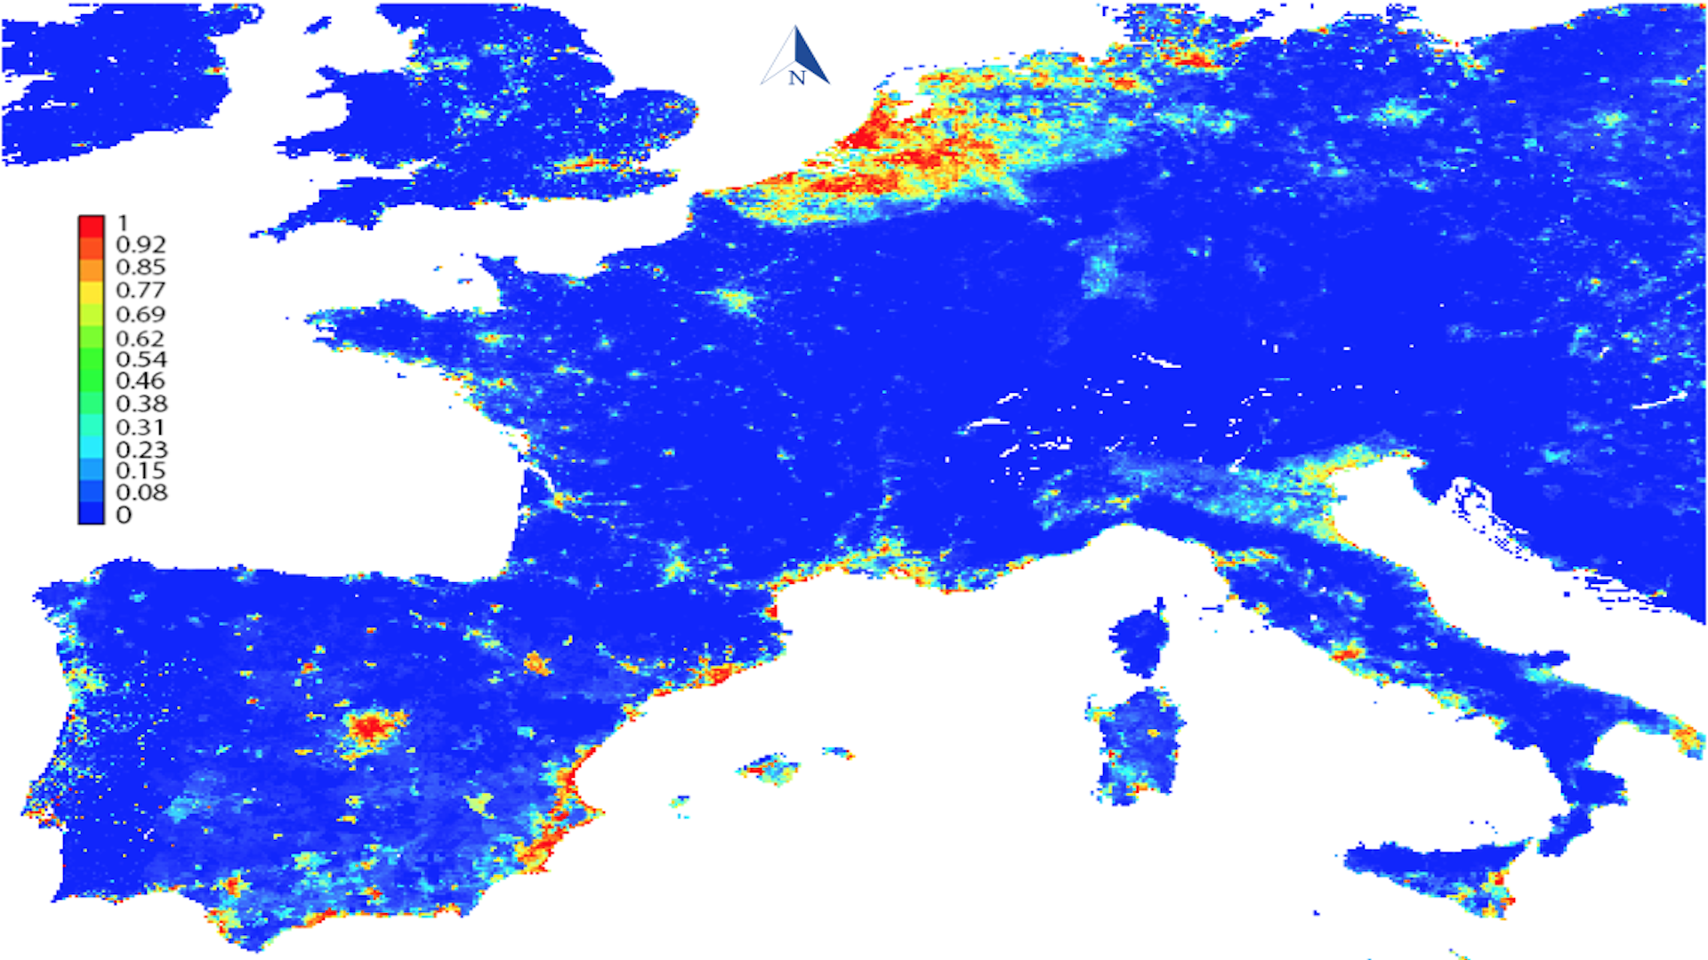
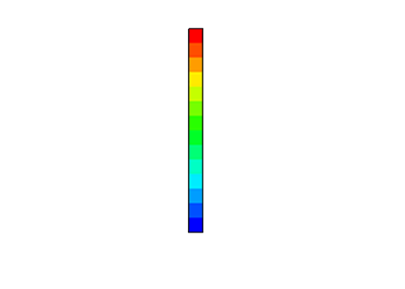
Results: Habitat Suitability Map
200 mi
Notes:
Doug: The results of our habitat suitability model show the probability of mosquito activity occurrence on a scale of 0 to 1 – blue showing low mosquito likelihood and red showing high mosquito likelihood. After analysis, it was determined that population density and elevation are the two most important variables correlated with mosquito activity. Population density will need to be normalized in future projects to account for larger data sets and data availability.

Slide 14
Results: Habitat Suitability Data
Notes:
Doug: The graph here shows the probability weight for different environmental variables on a month to month basis. The top two factors for the graph are population density in purple and elevation in orange. The remaining variables were consistently around or under 5% contribution to the model except for land surface temperature and land cover.

Slide 15
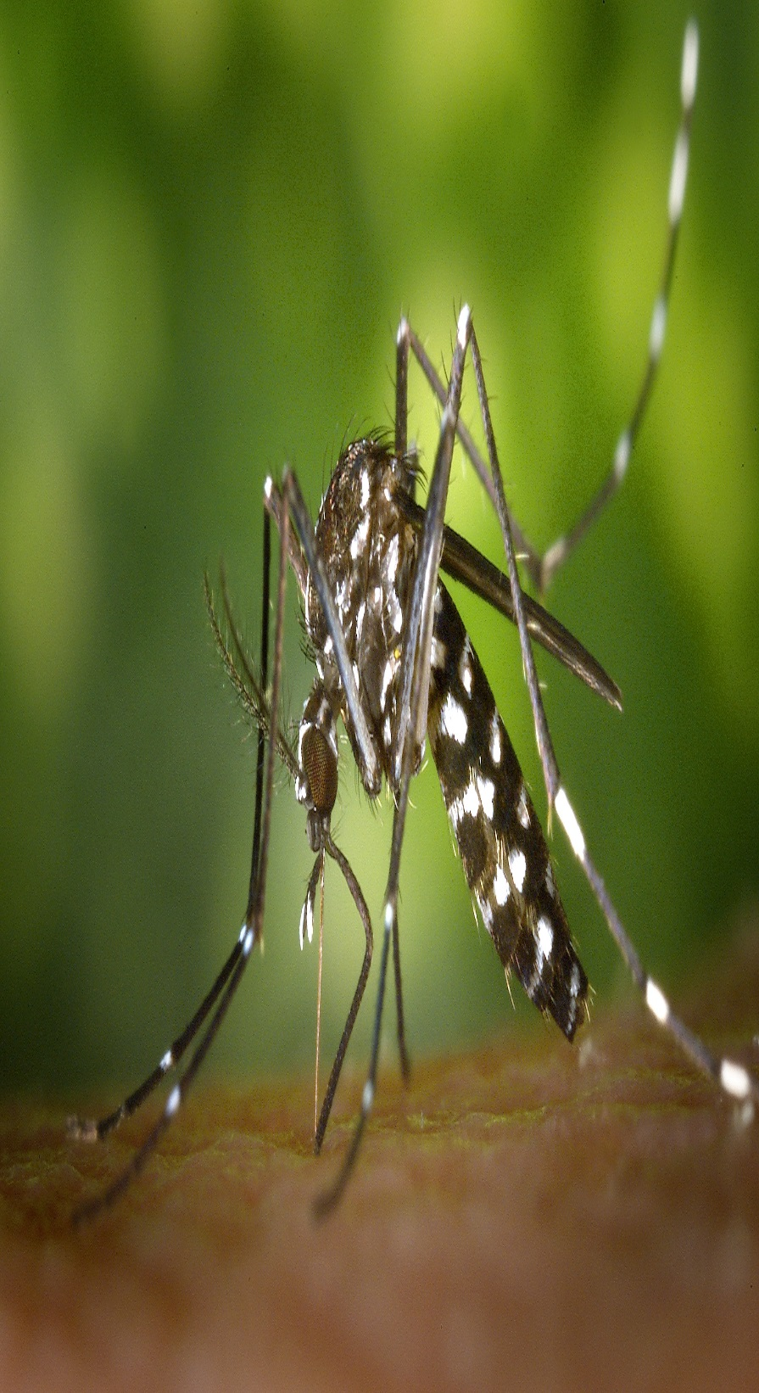
Conclusions
Mosquito activity occurrence is correlated with areas of high population density and low elevation.
Mosquito activity increases and is more widespread during the summer months.
The Global Mosquito Alert Consortium and participating organizations would benefit from standardizing citizen science data collection questionnaires in order to readily compare datasets across time and space.
Image Credit: PEXELS
Notes:
Doug: From the research and analysis the team concluded that mosquito activity is correlated with areas of high population density and low elevation. The model also showed trends indicating higher activity during the summer months. This can be in part contributed to the influx of data points from the summer for the citizen science data and should be carefully considered in the future. The team recommends that the Global Mosquito Alert Consortium create a standardized citizen science data collection questionnaire to make data collection and analysis easier.
Image Source: https://www.pexels.com/photo/black-white-mosquito-86722/

Slide 16
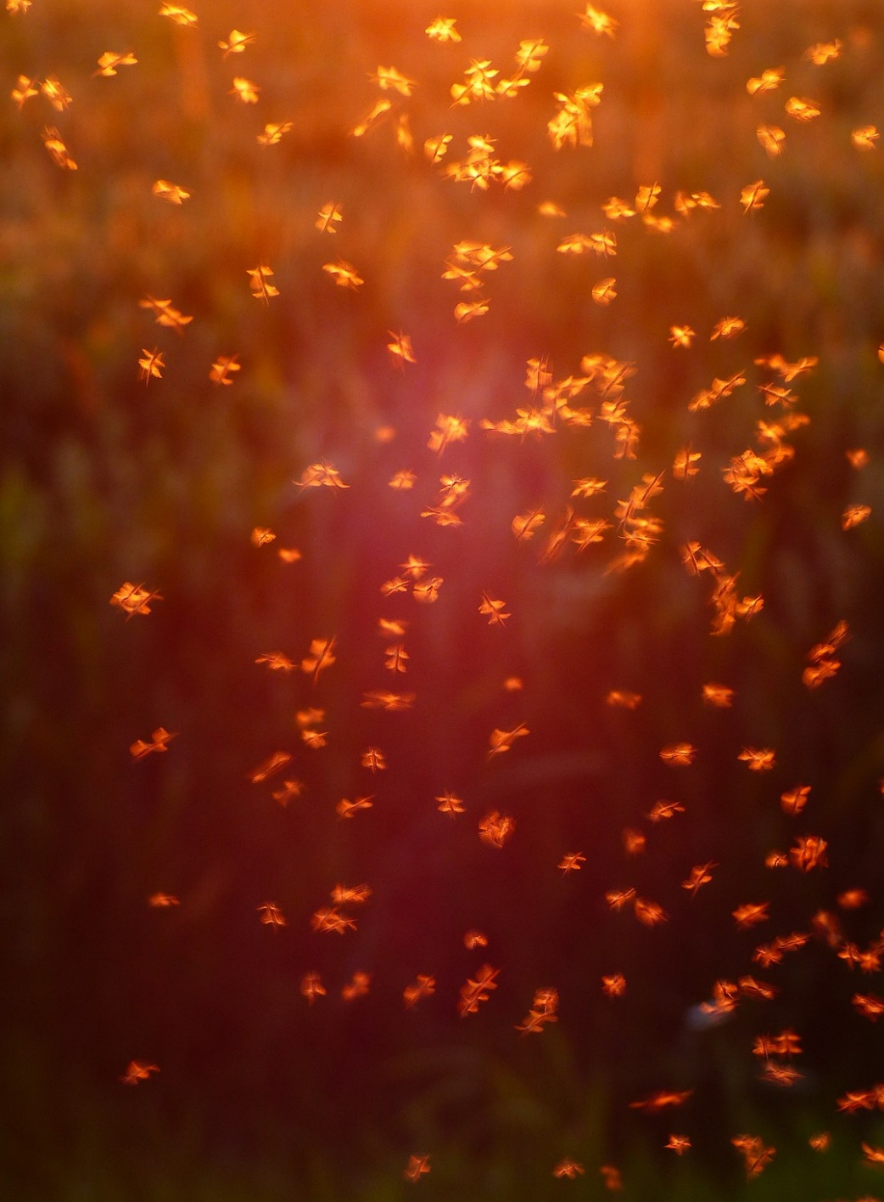
Future Work
This project will continue on for a second term
Products will be implemented as an interactive map
Open-source platform
  Google Earth Engine
Image Credit: Pixabay
Notes:
Gia: This project will continue on for a second term so that the products may be implemented as an interactive map on an open source platform, such as Google Earth Engine.
Image Source: https://pixabay.com/en/non-biting-midges-chironomidae-1837621/

Slide 17
Acknowledgements
Assaf Anyamba, PhD, Universities Space Research Association, NASA Goddard Space Flight Center
John Bolten, PhD, NASA Goddard Space Flight Center
John Palmer, PhD, Global Mosquito Alert Consortium
Anne Bowser, PhD, Woodrow Wilson International Center for Scholars
Greg Newman, PhD, Citizen Science Association
Martin Brocklehurst, European Citizen Science Association
Russanne Low, PhD, Institute for Global Environmental Strategies
Arnold van Vliet, PhD, and Sander Koenraadt, PhD, Wageningen University
Beniamino Caputo, PhD, and Alessandra Dellatorre, PhD, Sapienza Università Di Roma
Notes:
Gia: Lastly, we would like to acknowledge our science advisors, project partners, and all of the people who made this project possible. Thank you.

Slide 18


