Slide 1
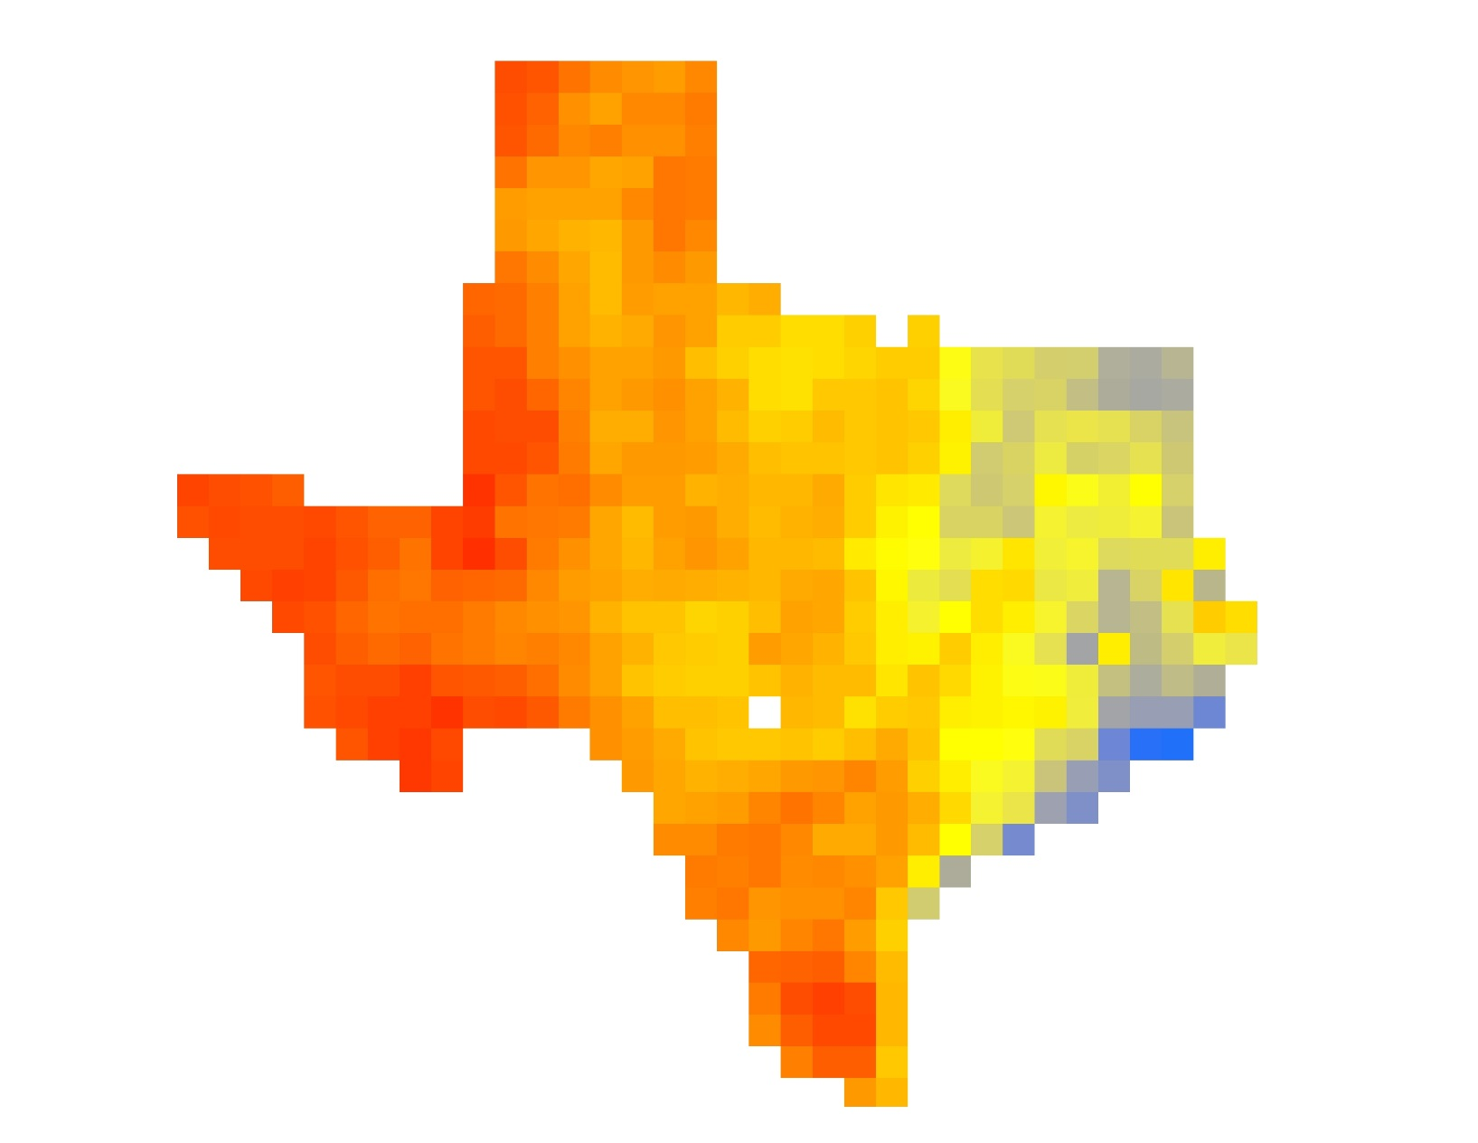
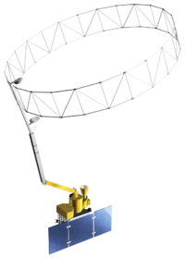

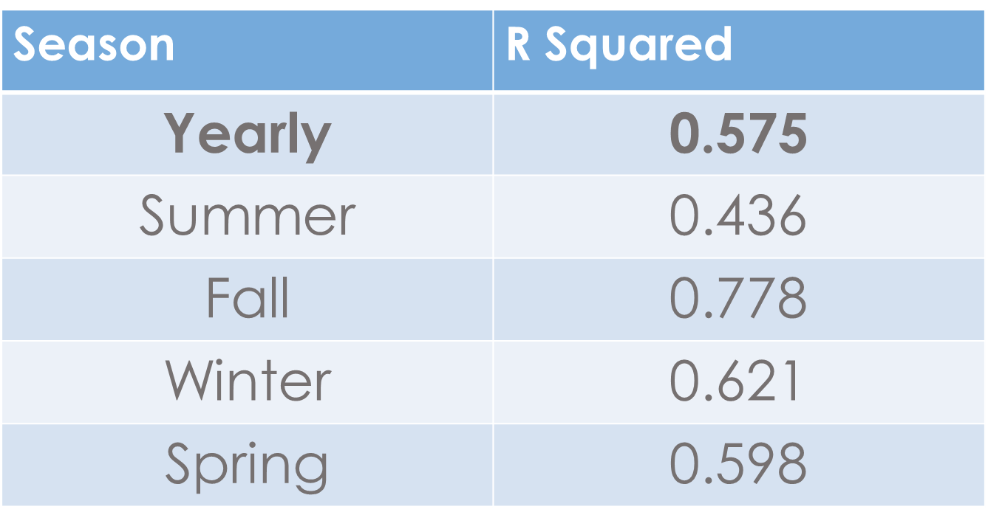
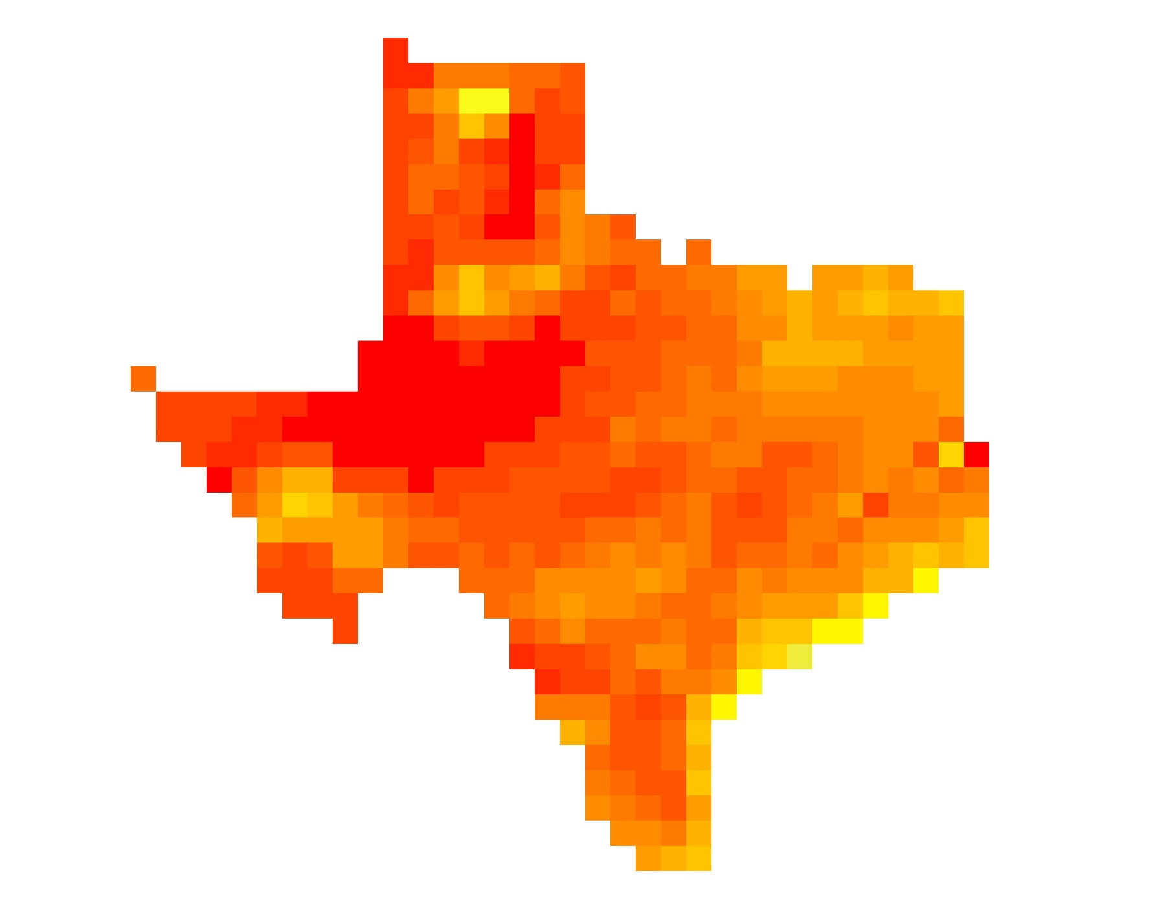

Texas Water Resources II
Using NASA Earth Observations to Assess Soil Moisture in Texas for Wildfire Prediction and Mitigation
Greggory Hoobchaak (Project Lead), Jessica Jozwik, Alyx Riebeling
DEVELOP National Program at NASA Langley Research Center
Abstract
Each year, Texas experiences severe droughts, making large areas of the state vulnerable to wildfires that damage agriculture, infrastructure, and habitats across Texas. Texas Fire Services stated in their most recent report that just under 18,500 wildland fires occurred in 2014 causing nearly two million dollars in damages. The Texas Forest Service utilizes precipitation, temperature, vegetation, and soil moisture data to identify particular areas in danger of wildfires. Several methods exist to monitor soil moisture, but these methods rely on estimates from precipitation and temperature data or from testing specific locations with sensors. By incorporating satellite data into their monitoring practices, the Texas Forest Service can monitor and compare changing soil moisture levels throughout the year. Soil Moisture data obtained from NASA’s Soil Moisture Active Passive (SMAP) satellite was correlated with in situ data from the Slow Climate Analysis Network (SCAN) and Texas A&M University (TAMU) Soil Moisture Database. A single correction model for Texas was created from trends identified in the data.
Objectives
Results
Combine three dates of data to visualize soil moisture across Texas
Relate SMAP data with SCAN data.
Establish a Day of Year Baseline Climatology.
Create a Rolling 3 Day Minimum Data Set
Study Area
Earth Observations
Soil Moisture
High: 0.6
Low: 0
Figure 1. SMAP data for the state of Texas where red shows areas of low soil moisture and blue shows areas of high soil moisture
Study Area: Texas
Study Period:April 2015-January 2016
Soil Moisture Active
Passive (SMAP)
Relate SMAP and
SCAN Data
Methodology
Acquire Data:
Soil Moisture Active Passive (SMAP) & Soil Climate Analysis Network (SCAN)
Figure 2. R squared values for the correlation of SMAP to SCAN data by seasonal increments.
Create a rolling 3 day minimum dataset
Relate SMAP and
SCAN Data
Create a baseline climatology
Normalized soil moisture
Using Excel:
-Establish Day of Year
-Find average for each DOY using a Pivot Table
Using ArcMap:
--Ordinary Krig
-Create 7 day rolling average
-Calculate Baseline Climatology
Using Excel:
-Create daily files
Using ArcMap:
-Match Raster to Point
Using Excel:
-Create one table with SMAP and SCAN Data
-Relate SMAP and SCAN data
0 – 0.1
0.1 – 0.2
0.2 – 0.3
0.3 – 0.4
0.4 – 0.5
0.5 – 0.6
0.6 – 0.7
0.7 – 0.8
0.8 – 0.9
0.9 – 1.0
1.0 – 1.1
1.1 – 1.2
1.2 – 1.3
1.3 – 1.4
1.4 – 1.5
1.5 – 1.6
1.6 – 1.7
1.7 – 1.8
1.8 – 1.9
1.9 – 2.0
2.0 – 2.2
2.2 – 2.4
2.4 – 2.6
2.6 – 2.8
2.8 – 3.0
Greater than 3
Using ArcGIS Model Builder:
-Mosaic to New Raster by
minimum values
-Manually set rolling 3 day window
Establish Baseline Climatology
Figure 3. SMAP data normalized by SCAN data climatology where red shows areas of lower than average soil moisture and blue shows areas of higher than average soil moisture.
Conclusions
SMAP and SCAN have strong correlation overall, but the strength of the correlation varies by season
Explore additional spatial and temporal factors (e.g. to explain seasonal fluctuation
Results showed that the soil moisture from April 1, 2015-Febuary 1, 2016 was lower than average
Team Members
Project Partners
Acknowledgements
Left to right:
Alyx Riebeling, Jessica Jozwik, Gregory Hoobchaak (Project Lead)
Texas Forest Service
Curt Stripling, Geospatial System Coordinator
Tom Spencer, Department Head of Predictive Services
Emily Adams, Center Lead at DEVELOP NASA Langley Research Center
Dr. Kenton Ross, NASA DEVELOP National Program Office National Science Advisor
NASA DEVELOP Texas Water Resources I Team:
Megan Buzanowicz, Laura Lykens, Zacary Richards, Jeff Close
NASA Langley Research Center

