Slide 1
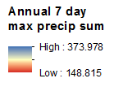
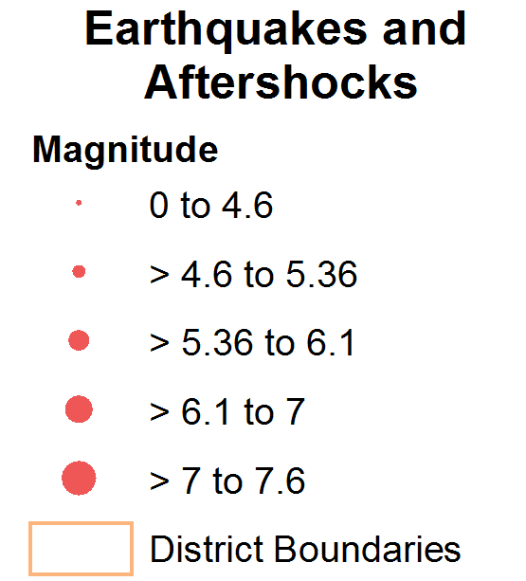
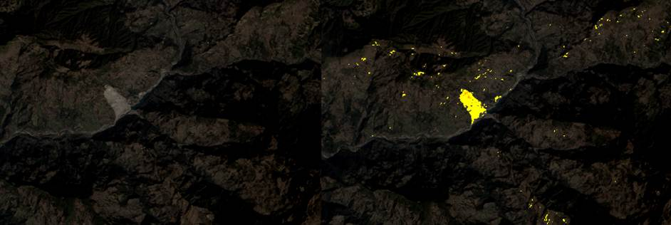
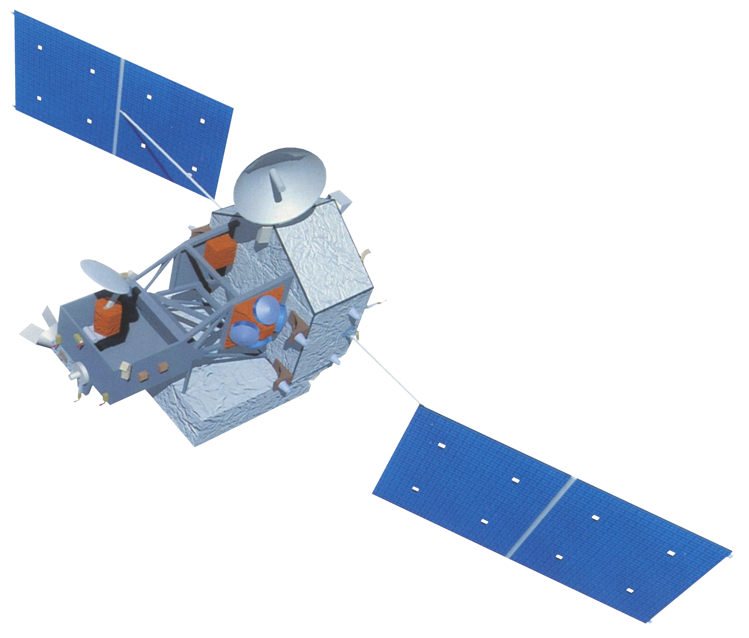
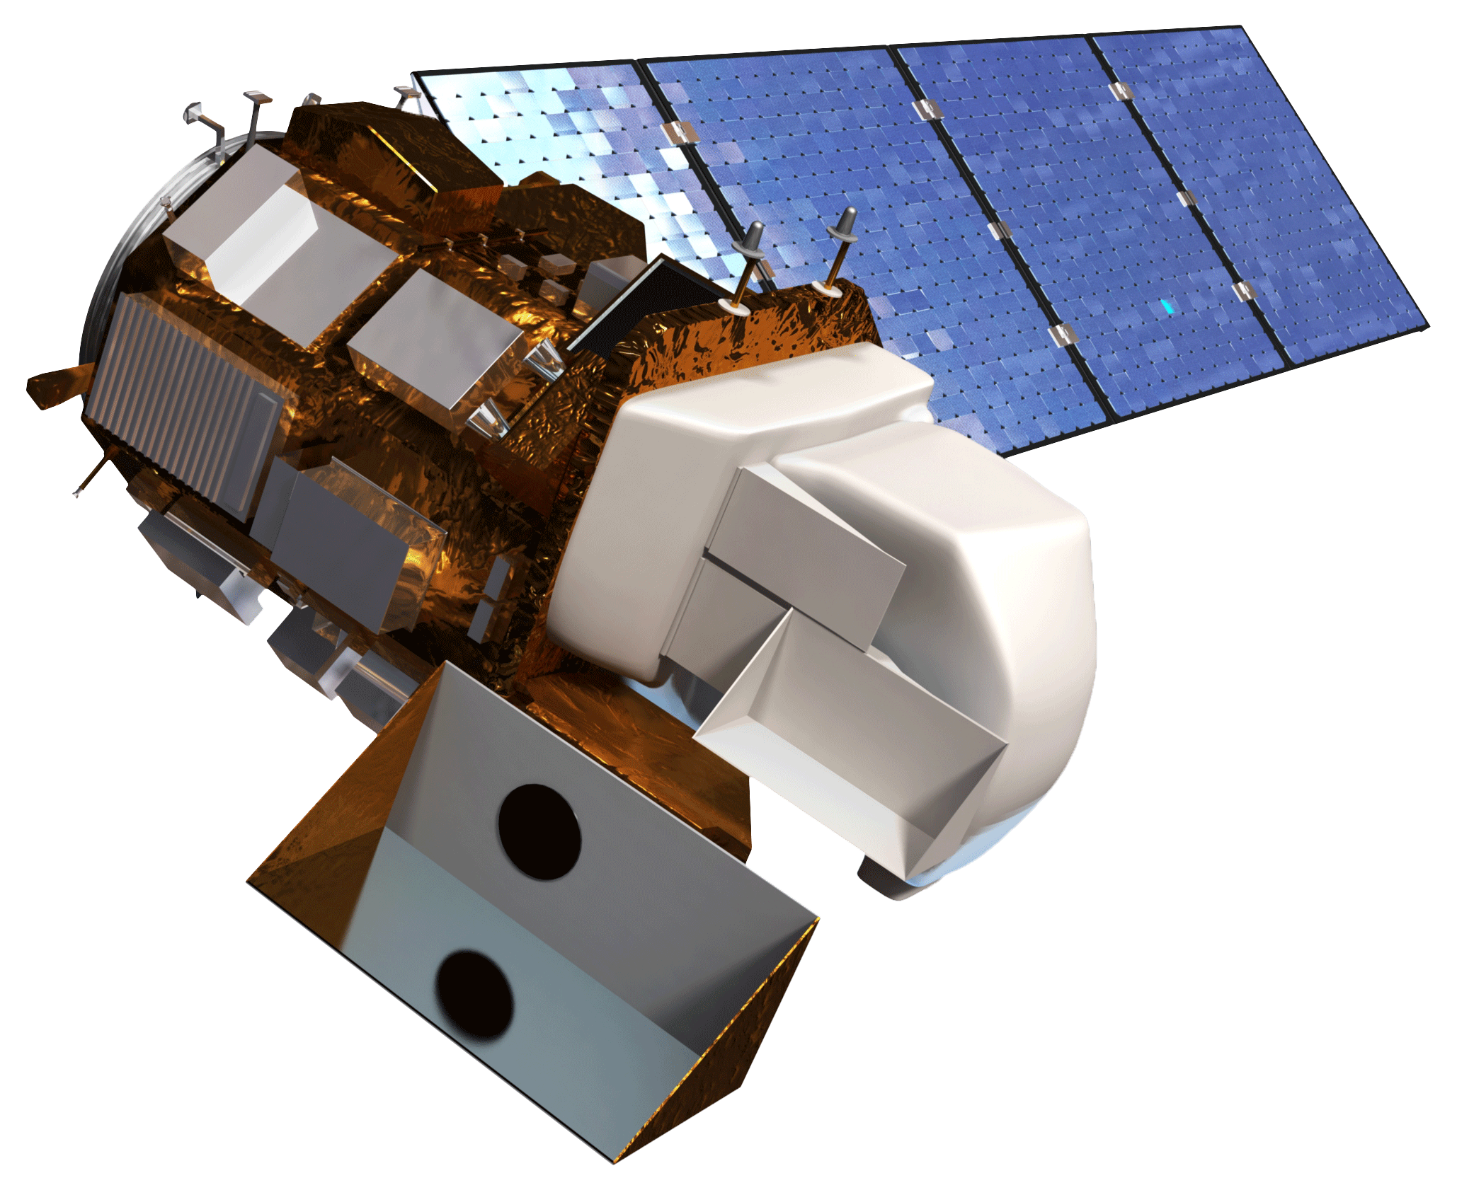
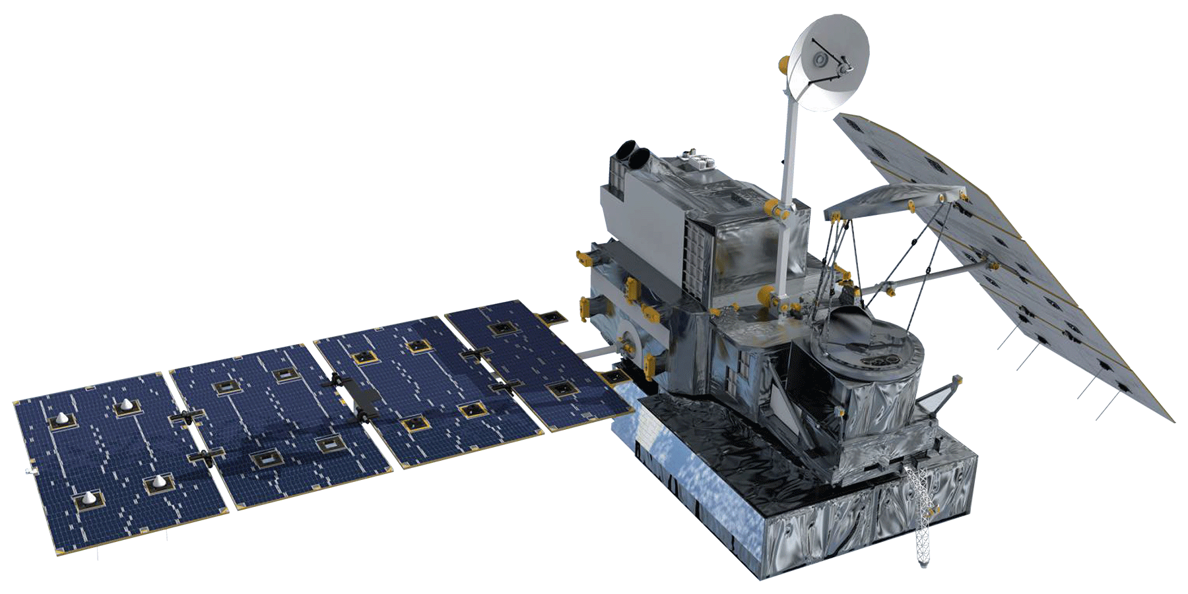
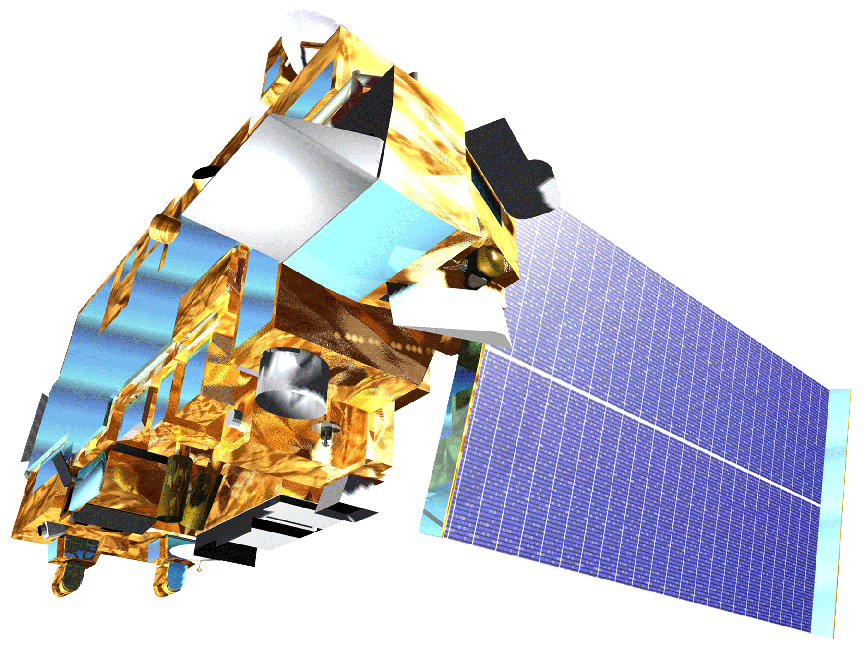
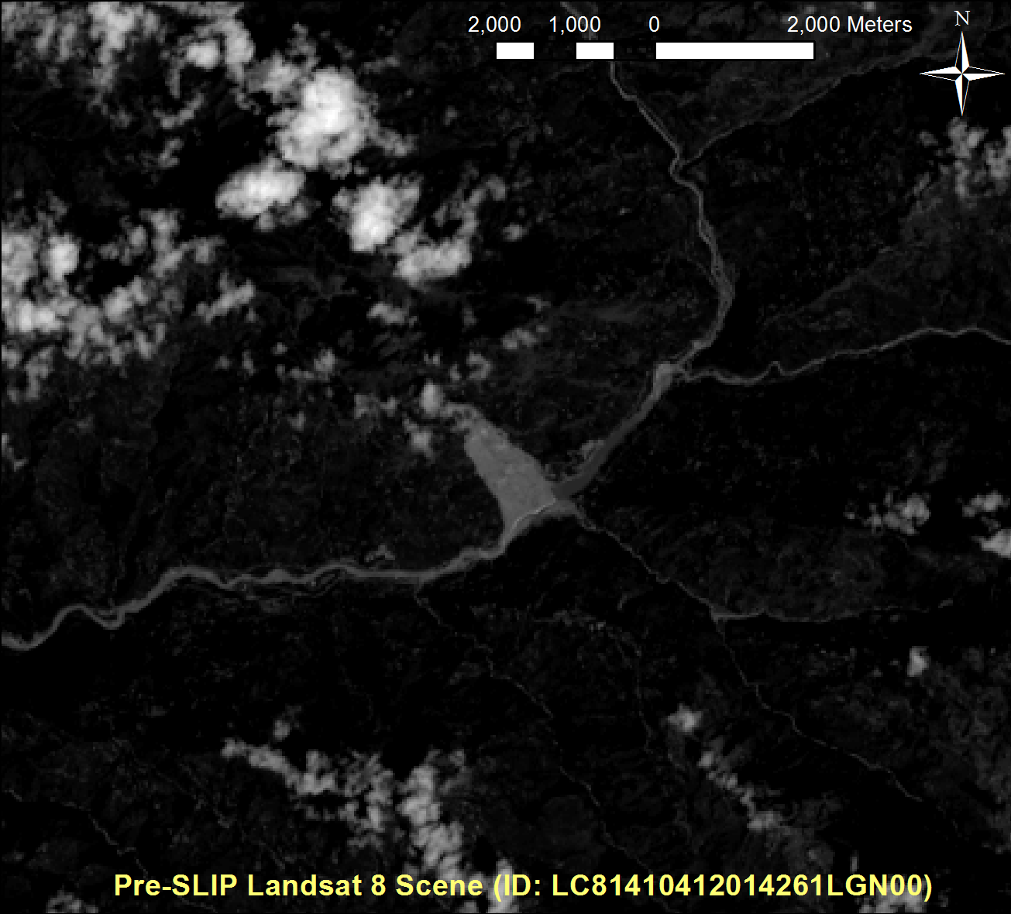
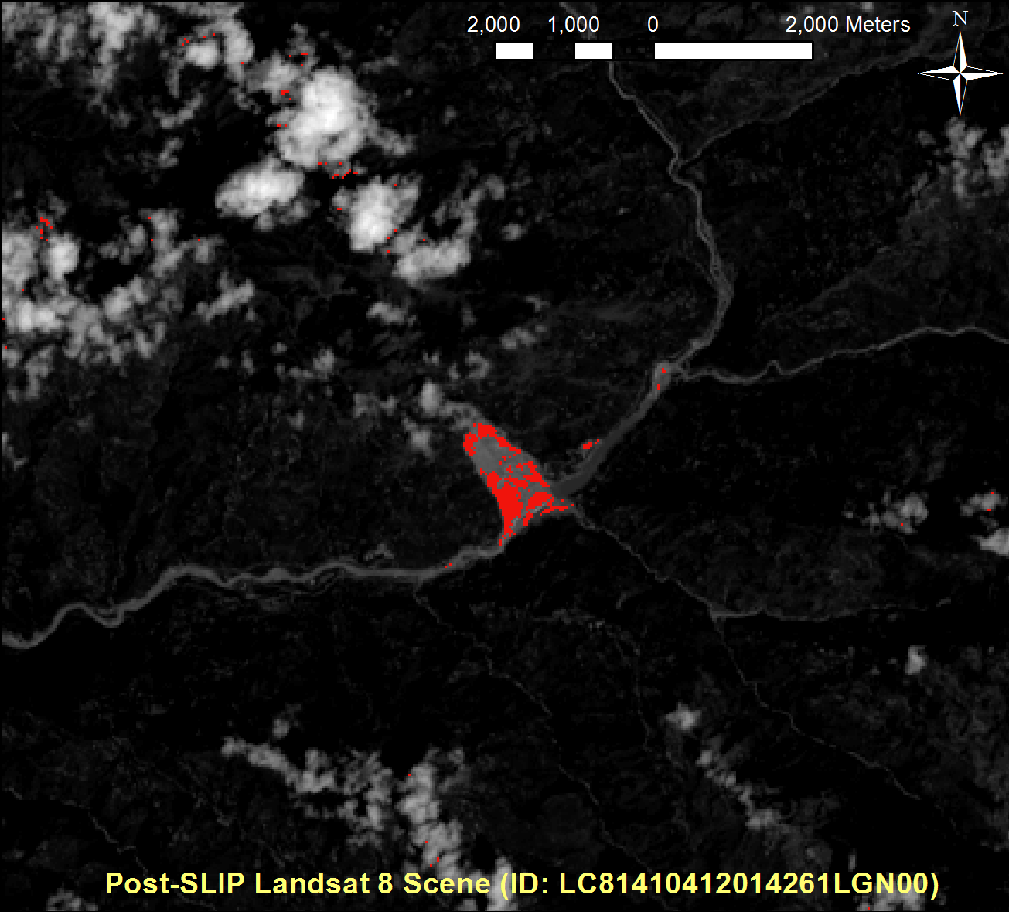
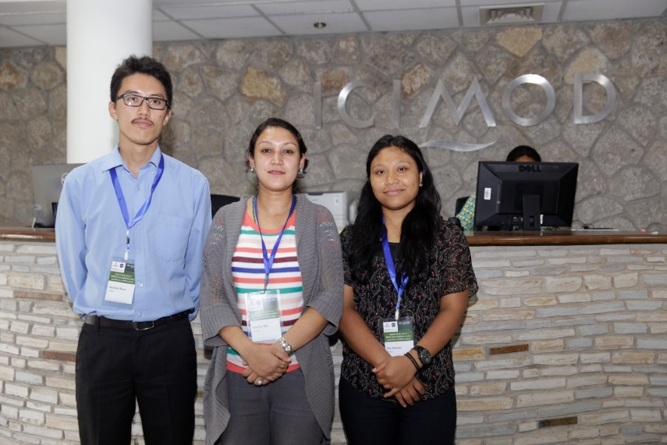
Himalayan Disasters II
Utilizing near real-time landslide identification and precipitation monitoring products for enhanced landslide detection
GSFC: Justin Roberts-Pierel (Project Lead), Aakash Ahamed, Jessica Fayne
ICIMOD: Kanti Sen Ojha, Ang Dawa Sherpa, Binu Maharjan, Amanda Schochet
NASA DEVELOP
Abstract
Objectives
Nepal and the Himalayan region are hotspots for landslide activity due to mountainous topography, complex terrain, and monsoon rains. This study combined NASA Earth Observation data from Landsat 8, Shuttle Radar Topography Mission (SRTM), Advanced Spaceborne Thermal Emission and Reflection Radiometer (ASTER), Tropical Rainfall Measuring Mission (TRMM) and the Global Precipitation Measurement Mission (GPM) with various ancillary datasets to create two products for use in the region: the Sudden Landslide Identification Product (SLIP), and Detecting Real-time Increased Precipitation (DRIP). SLIP will help identify landslides in near real-time using Landsat 8 and elevation products, as well as provide damage assessments by mapping landslides automatically after a disaster such as the Gorkha earthquake in May 2015. DRIP will monitor precipitation levels extracted from the GPM-IMERG 30-minute product to create alerts when current rainfall levels exceed calculated threshold values. SLIP and DRIP were also integrated to provide a more comprehensive landslide notification system for the region. The DRIP-SLIP model combination will be used by the International Centre for Integrated Mountain Development (ICIMOD) to: 1) protect and manage ecosystems and villages in Nepal, 2) prevent future loss of life and infrastructure due to landslides, and, 3) reduce poverty through integrated natural resource management and regional cooperation.
Better characterize landslide hazards within Nepal and the Himalaya region
Utilize newly available high resolution remote sensing data and international landslide mapping efforts following the Gorkha earthquake to develop a landslide identification product
Analyze historical precipitation data and create a near real-time precipitation monitoring system
Develop a near real-time tool incorporating the identification product and precipitation monitoring system
Methodology
Study Area
GPM data is downloaded using Python 3 in near real-time
Historical TRMM data was used to calculate monthly mean thresholds used to detect anomalies in near real-time with GPM
Monitors GPM IMERG data every 30 minutes looking for anomalies compared with calculated threshold values
DRIP
GPM
IMERG 30-Minute
Data Collection
Thresholds
Comparison
TRMM
TMPA-RT 3B42
Example of precipitation monitoring by DRIP
Landsat 8 data is downloaded using Python 3 in near real-time
QA band from Landsat 8 is used to remove clouds from the other bands
Nepal
Landsat 8
Cloud Mask
IR
SWIR
Red Increase
Calculate percent change between two Red band images
Source: ICIMOD
SLIP
Red
QA
Earth Observations
SRTM
Data Collection
Moisture Index
Compare two images’ moisture using IR and SWIR bands
Example of a successful landslide detection by SLIP (Yellow region)
TRMM
ASTER
Remove Flat Terrain
Remove pixels with slopes lower than 15%
Alert!
Landsat 8
If current rainfall levels are significantly higher than thresholds, an alert is created for the affected area
Results
GPM
Terra (ASTER)
Conclusions
Landslides can be mapped in near-real time using NASA Earth Observations.
DRIP helps detect vulnerable areas based on current rainfall conditions.
The DRIP-SLIP model combination will be used by ICIMOD to protect and manage ecosystems and villages in Nepal, as well as to reduce poverty through integrated natural resource management and regional cooperation.
Future work on DRIP-SLIP will incorporate newly identified landslides into the Global Landslide Catalog (GLC) , an online system to digest landslide reports from multiple news agencies into a unified spatial reference.
DRIP-SLIP outputs will be used to support the GLC by adding detailed spatial attributes and increasing relative accuracy.
Above: Example of SLIP detection capabilities applied to the the Jure Sunkoshi event on August 2, 2014. Red area shows where the landslide occurred. The area at the center of the landslide is not highlighted because it is also the location of a much smaller previous landslide.
Right: Example of DRIP precipitation monitoring in near real time for a 24 hour window (Top: July 22, 2014) and 72 hour window (Bottom: July 19-22, 2014). Red areas represent those with more precipitation while blue areas represent areas with less precipitation. Areas that
Team Members
Project Partners
Acknowledgements
International Centre for Integrated Mountain Development (ICIMOD), Kathmandu, Nepal
Advisors: Dr. Dalia Kirschbaum (GSFC), Thomas Stanley (GSFC), Sebastian Wesselman (ICIMOD),
Past Contributors: Amanda Rumsey, Jamie Shiplet
From Left to Right: Justin Roberts-Pierel (GSFC), Aakash Ahamed (GSFC), Binu Maharjan (ICIMOD), Kanti Sen Ojha (ICIMOD), Ang
Dawa Sherpa(ICIMOD Jessica Fayne (GSFC), Amanda Rumsey (GSFC), Jamie Shiplet (GSFC), Amanda Schochet (JPL)
NASA Goddard Space Flight Center

