Slide 1
Himalaya Disasters III
Utilizing a Landslide Identification Product and a Real-Time Rainfall Detection Tool for Enhanced Landslide Detection
Amanda Rumsey (Project Lead)
Jessica Fayne
Jordan Scheffler

Slide 2
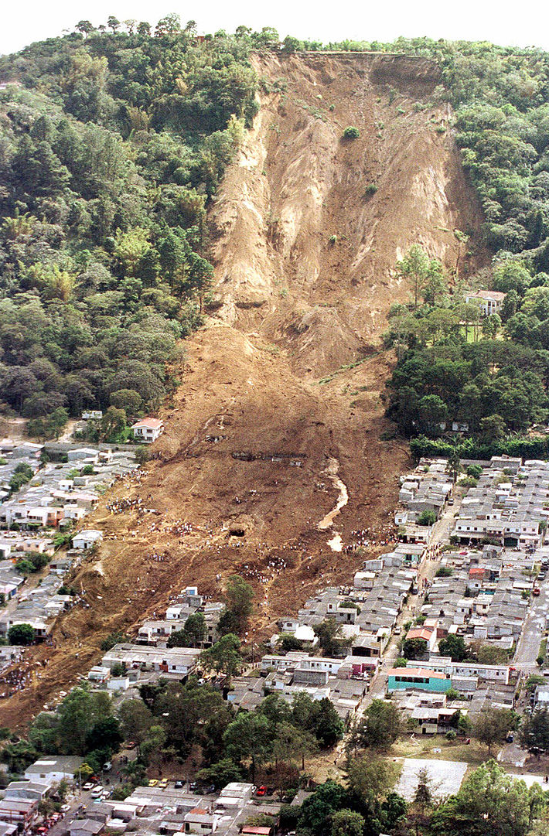
Introduction
What is a Landslide?
Mass Wasting Event
Impact of Landslides
Economic Damage
Loss of Life
Resource Availability
Why Nepal?
Mountainous Terrain
Infrastructure
Monsoonal Rains
Wikimedia: Orlovic, 2007
Notes:
What is a landslide?
A landslide is a type of mass wasting event that occurs when down-slope forces exceed the strength of the slope materials.
Impacts of landslides
As a global natural hazard, landslides have the ability to cause immense economic damage, significant loss of life, and can have adverse effects on a variety of available resources.
Nepal
Nepal is particularly susceptible to landslides due to its mountainous terrain, active geodynamics, infrastructure, and heavy monsoonal rains.
https://upload.wikimedia.org/wikipedia/commons/7/73/ElSalvadorslide.jpg

Slide 3
Study Area: Nepal
Population
31.5 million
Location
Southern Asia
Precipitation
160 mm – 5000 mm
Elevation
70 – 8850 meters
Notes:
Speaker Notes:
Location: Nepal is a landlocked, mountainous East Asian country that is slightly larger than the state of Arkansas.
Area: The country is 147,181 square kilometers in size.
Climate: 8 Climatic zones across the country due to large gradients in altitude and precipitation.

Slide 4
Pixabay: Simon Steinberger, 2007
Community Concerns
Hundreds of fatalities and millions of dollars lost annually due to landslide damages
Of the 3402 landslides reported between 2000 and 2010, 88.9% of the landslides affected at least one person
Landslide are responsible for greater damage than currently recognized due to:
Under-reporting
Misclassification
Notes:
-On average, Nepal experiences 135 casualties and loses millions of dollars annually due to landslide damages.
-According to the ICIMOD landslide dataset, 88.9% of the landslides reported between 2000 and 2010 affect one or more people
-With current under estimation of landslide impacts and increasing trend in frequency and intensity of landslide events due to anthropogenic factors, it is critical to develop a landslide identification product and a landslide hazard assessment model that have the ability to accurately quantify hazard and serve as a decisions support tool for end-users.
Picture Source
Author: Simon Steinberger
Source: Pixabay
URL:http://pixabay.com/en/mount-everest-himalayas-nuptse-276995/
Date: 1/28/2007
*its creative commons

Slide 5
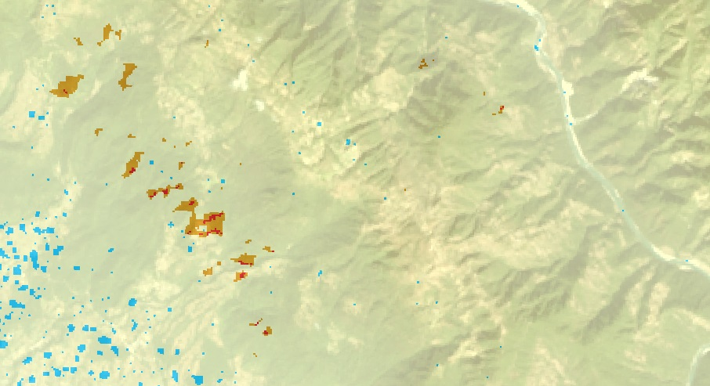
Previous Work
Developed a Sudden Landslide Identification Product (SLIP)
Created Detecting Real-time Increased Precipitation (DRIP)
Produced a Landslide Susceptibility Map for the Koshi River Basin
Notes:
Term 1 focused on understanding the physical parameters of landslides, by creating the Sudden Landslide Identification Product SLIP and producing a Susceptibility Map for the original study are of Koshi River Basin
The second term took a more vigorous look at precipitation, creating the Detecting Real-Time Increased Precipitation product, to help find the approximate date and time landslides might occur.

Slide 6
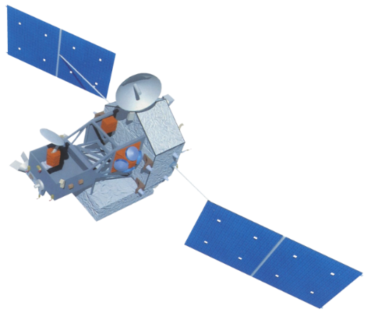
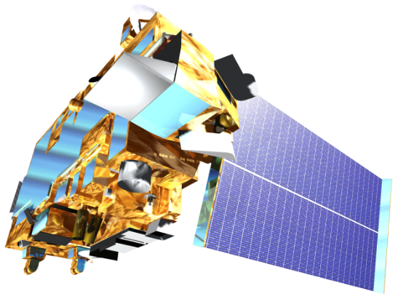
Objectives
Validate the results of SLIP using digitized landslide event information
Develop a web-based platform to display the results of SLIP and DRIP products
Perform rainfall threshold analysis
Notes:
http://www.devpedia.developexchange.com/dv/images/c/c2/03_Landsat8.png
http://www.devpedia.developexchange.com/dv/images/1/1a/04_TRMM.png
http://www.devpedia.developexchange.com/dv/images/9/91/05_Terra.png
For our last term, it was important to validate the results of SLIP to understand how well it performs for future calibration, display the results of SLIP and DRIP on a web platform to share with the scientific community and our end-user, and finally to perform a rainfall threshold analysis to help understand the relationships between rainfall amounts and landslides.

Slide 7
Methodology: DRIP
GPM
GPM data is downloaded in near real-time
TRMM
IMERG 30-Minute
TMPA-RT 3B42
Data Collection
Thresholds
Comparison
Alert
Monthly mean thresholds calculated from historical TRMM data
Monitors 30 min GPM IMERG data; looks for anomalies compared with thresholds
If current rainfall levels are significantly higher than thresholds, alert is issued for the affected area
Notes:
Image Source:
Aakash Ahamed, Justin Roberts-Pierel
Speaker Notes: Schematic of workflow for DRIP model. DRIP used to monitor precipitation in Nepal.
Detecting Real-Time Increased Precipitation was created by calculating rainfall thresholds associated with landslide events in the area using multi-satellite derived precipitation products IMERG and TMPA. DRIP works by collecting recent IMERG precipitation data to compare with historical thresholds from TRMM to find anomalously high rainfall measurements and sending alerts that the area might be at risk.

Slide 8
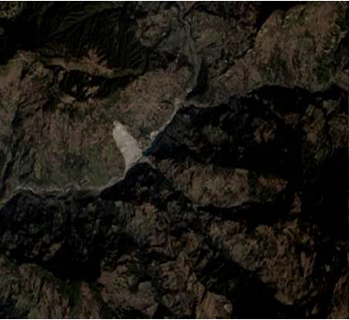
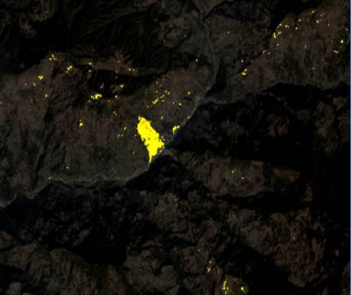
Methodology: SLIP
Data Collection
Collect Landsat scenes and extract R, IR,SWIR and QA bands
Use the QA Band to Remove Clouds from the R, IR, and SWIR images
Cloud Mask
Landsat Imagery
Red Increase
Calculate percent change between two Red images
Calculate moist areas using the IR and SWIR bands, comparing two images
Moisture Index
Remove pixels with slopes lower than 15 degrees
Remove Flat Terrain
SLIP Output
Notes:
The Sudden Landslide Identification Product SLIP was created by looking for landslide features that can be observed from space using optical imagery. SLIP identifies landslides the way the human eye would, but with additional help from infrared bands, but without using remote sensing image classification software that can be expensive and operating system specific. Focusing on the presence of increased red reflectance using the red wavelength and increases in soil moisture using the near infrared and shortwave infrared bands, SLIP creates image composites by removing cloud cover and backfilling with older imagery. Composite images are compared using simple subtraction to identify areas of change. Finally, flat areas are removed using a combined digital elevation model from ASTER and SRTM.

Slide 9
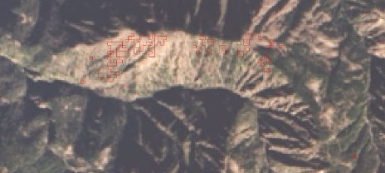
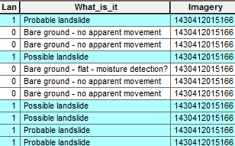
Methodology: SLIP Validation
SLIP Output Converted to Polygon
SLIP Polygons are Assigned 60 Meter Buffer
50 Largest Features are Selected for Validation
Not Landslide | Landslide
Barren- No Evidence of Change | Forest Slide / Vegetation Movement
Farm Land | Water/ Ice/ Snow Melt
Mountainside- No Vegetation Change
Unidentifiable- Cloud Obstruction
Riverbed
Urban
Classify 50 Landslide into Categories
Perform Accuracy Assessment
Notes:
We selected 18 of the SLIP output files to test the validity of the SLIP model. The detections are in raster image format, so they are first converted into polygons and given a 60 meter buffer to cluster landslide events spatially. The 50 largest features of the buffered polygon were then selected for visual assessment.

Slide 10
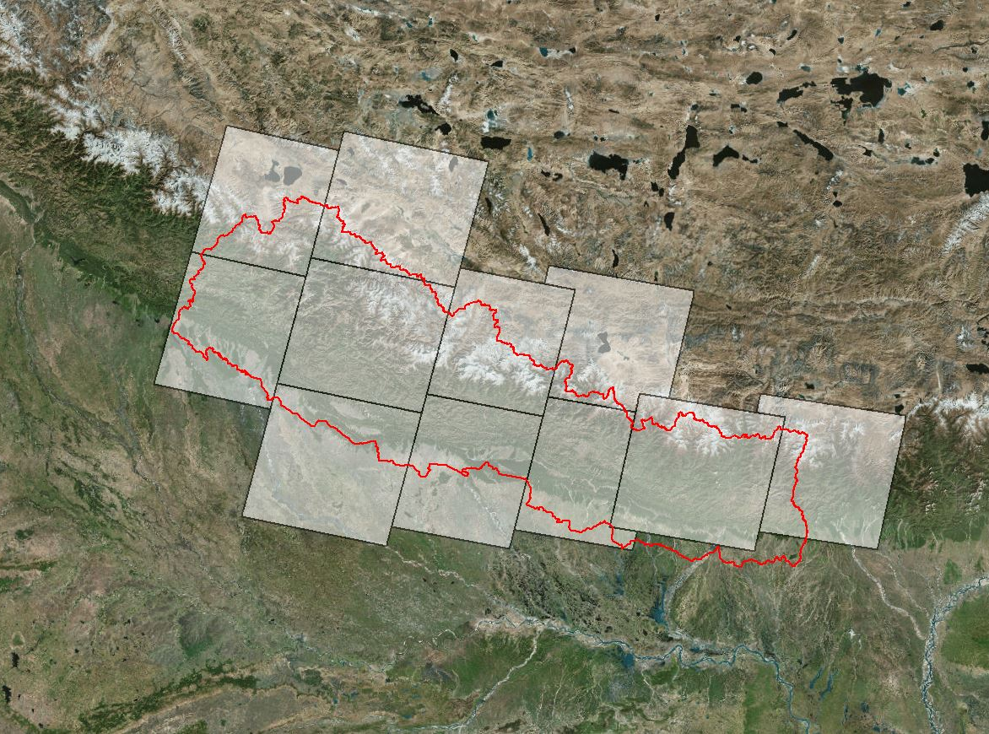
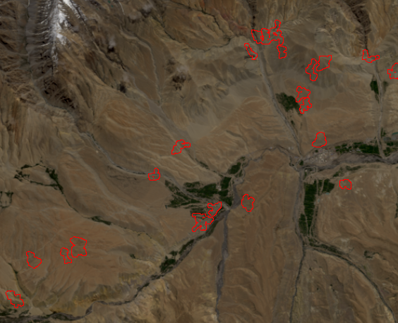
Results: SLIP Validation
Detection | High Confidence | Low Confidence
139_041_2015_250 | 35.4% | 79.2%
140_041_2014_110 | 23.8% | 64.3%
141_040_2014_021 | 30.0% | 94.0%
141_040_2014_229 | 27.7% | 70.2%
141_041_2014_309 | 21.2% | 39.4%
141_041_2015_216 | 66. 7% | 96.7%
143_039_2015_118 | 28.6% | 100.0%
143_039_2015_214 | 16.0% | 46.0%
143_040_2014_275 | 36.0% | 80.0%
143_040_2015_198 | 24.4% | 51.1%
143_041_2015_166 | 6.0% | 20.0%
144_041_2014_042 | 29.0% | 49.5%
Notes:
At least two reviewers looked at each of the detection scenes independently and recorded their assessments. A rating of ‘High Confidence’ was given in locations where both reviewers agreed that the detection was accurate, and ‘Low Confidence’ was given in locations where only one reviewer believed there is a landslide. The results of the validation show that about 30% of landslides can be detected and classified.

Slide 11
Methodology: Rainfall Threshold Analysis
Calculated the 95% Percentile of Daily TRMM Values for Nepal
Delineate Clustered Areas with Similar Rainfall Characteristics
Collected a Subset of Landslide Events from the Global Landslide Catalog
Separated Landslide Events Based on Cluster Areas
Determined the Maximum Daily Rainfall Value for Each Landslide Event
Created A Probability Density Function Displaying the Distribution of Rainfall
Notes:
Rainfall triggering thresholds are calculated using the following methodology:
First the 95% of daily TRMM values are calculated for each TRMM pixel
Next the 95% layer is run through cluster analysis toolset to get statistically significant rainfall clusters
Next a subset of landslide events from the GLC are separated into two datasets based on the location of landslide events
Next the Max daily value for each landslide event is taken and these values are plotted on a PDF

Slide 12
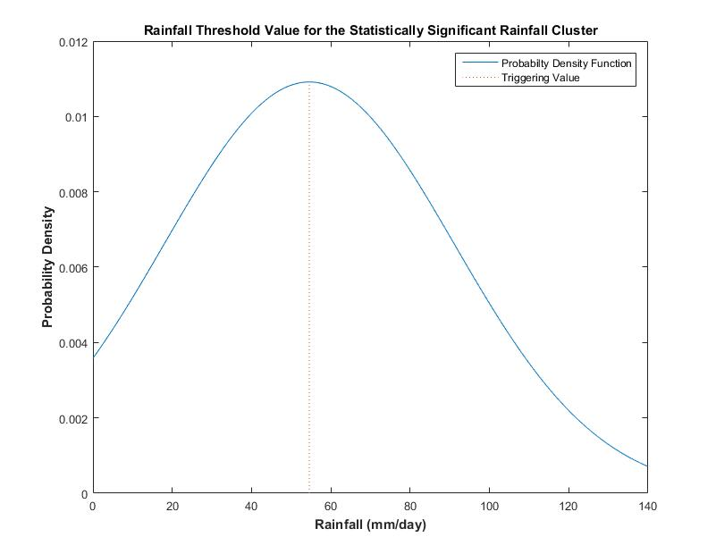
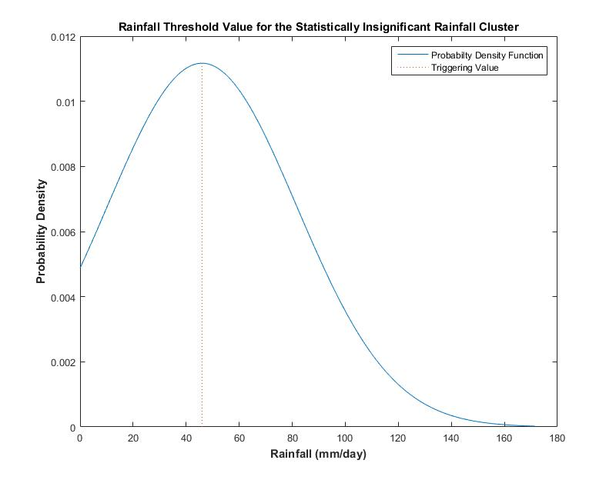
Results: Rainfall Threshold Analysis
Triggering Threshold for Statistically Significant Cluster: 54.54 mm/day
Triggering Threshold for Statistically Insignificant Cluster: 45.97 mm/day
Notes:
The triggering thresholds are the 50% of the PDF
For the high rainfall cluster the TV is 54
For the low rainfall cluster the tv is 45

Slide 13
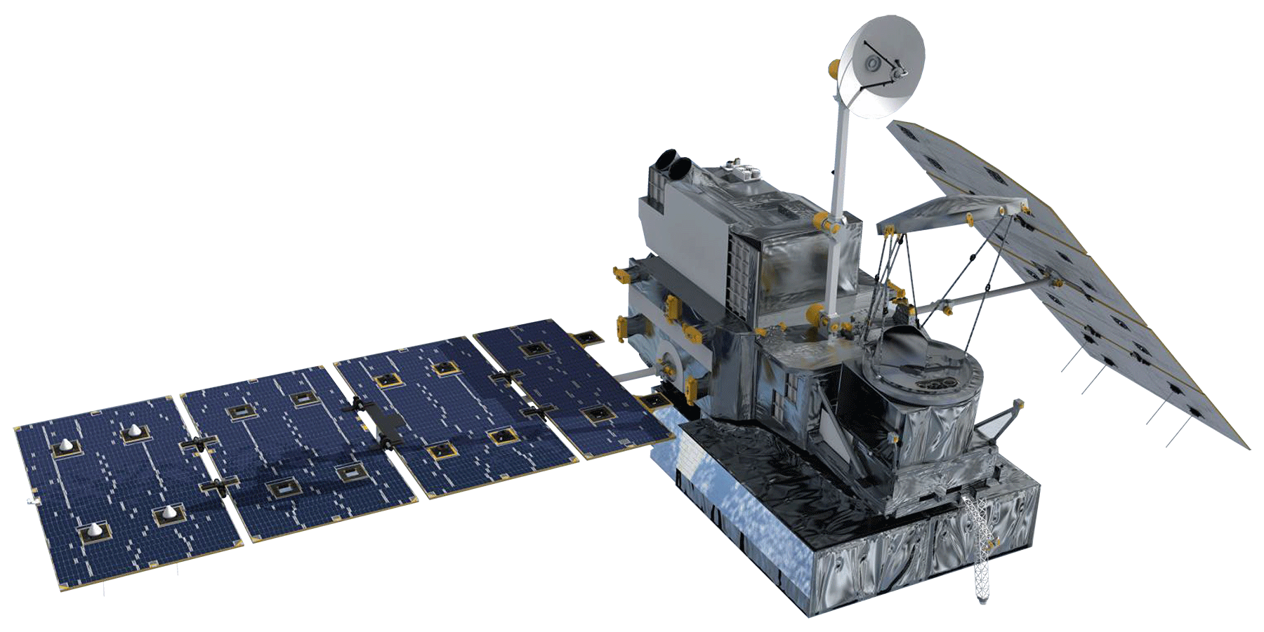
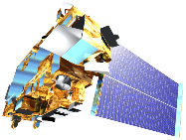
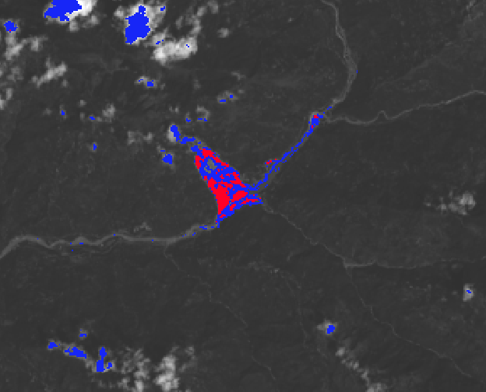
Conclusion
Landslides can be mapped automatically in near-real time using NASA Earth Observations
DRIP can detect vulnerable areas based on current rainfall conditions
SLIP has been updated to reduce the amount of landslide over-detection in mountainous regions, cloud shadow, and improved the soil moisture component
The DRIP-SLIP models will be used by ICIMOD to protect lives, preserve infrastructure, and manage local ecosystems
Notes:
Landslides can be mapped automatically in near-real time using NASA Earth Observations
DRIP can detect vulnerable areas based on current rainfall conditions
SLIP has been updated to reduce the amount of landslide over-detection in mountainous regions, cloud shadow, and improved the soil moisture component
The DRIP-SLIP models will be used by ICIMOD to protect lives, preserve infrastructure, and manage local ecosystems

Slide 14
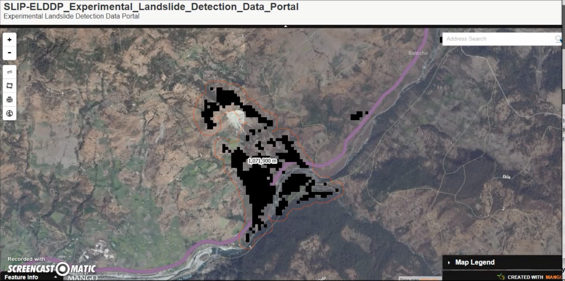
Future Work
Improve the user interface capabilities of the online web platform
Analyze the addition of runoff and soil moisture data from the Global Land Data Assimilation System (GLDAS) in the SLIP algorithm
Modify current threshold values to reduce the number of false positives
Notes:
Improve the static web portal
Analyze the addition of runoff and soil moisture
Modify the current threshold values

Slide 15
Advisors
Dr. Dalia B. Kirschbaum, NASA Goddard Space Flight Center
Dr. John D. Bolten, NASA Goddard Space Flight Center
Thomas A. Stanley, NASA Goddard Space Flight Center
Partners
International Centre for Integrated Mountain Development (ICIMOD)
Former Teammates
Justin Roberts-Pierel, DEVELOP National Program at GSFC
Aakash Ahamed, DEVELOP National Program at GSFC
Jamie Shiplet, DEVELOP National Program at GSFC

