Slide 1
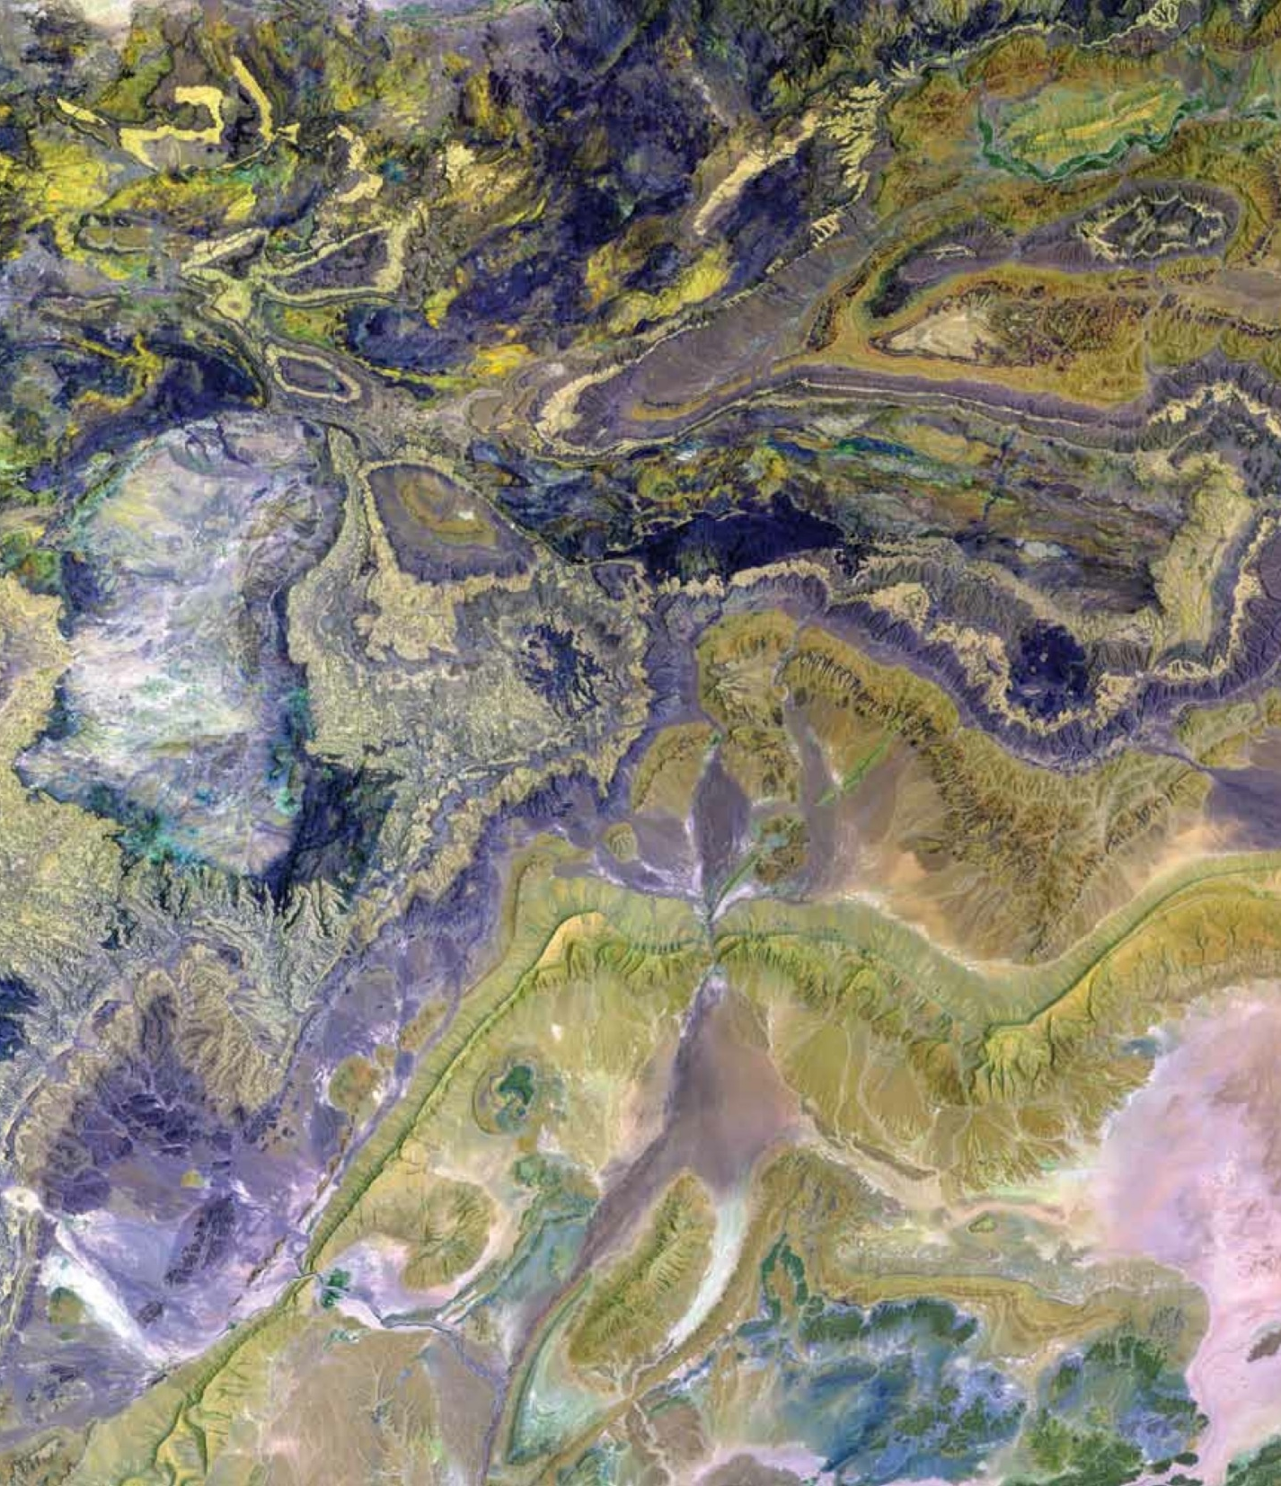
DEVELOP National Orientation (2022)
Module 9. Personalities

Slide 2


PERSONALITIES
Why? DEVELOP teams must storm – form – norm – perform in only 10 weeks! Part of working together is understanding each other and ourselves.
Personality typing provides an opportunity for:​
Introspection: to understand your tendencies and motivations, strengths and weaknesses, and innate preferences​
Interpersonal skill development: recognize these traits in others​
Common language: provides terminology for identifying inherent nature​
Freedom: identifies inherent needs, and helps alleviate pressure, all so you can be accepted for just being you

Slide 3

PERSONALITIES
Practical Applications of Personality Typing
What else could be true?
Compassion – Perspectives and work styles naturally differ, there is no “correct” type for a DEVELOP participant
Flexibility – These assessments are guides that help facilitate discussion. Many people do not identify with their given “types” and that is ok
If you notice your teammates...
Don’t ask questions verbally on calls
Ask all the questions and lead the conversation
Ask for constant updates on progress
Don’t share progress until a task is done
…consider approaching this from a compassionate and flexible perspective.

Slide 4
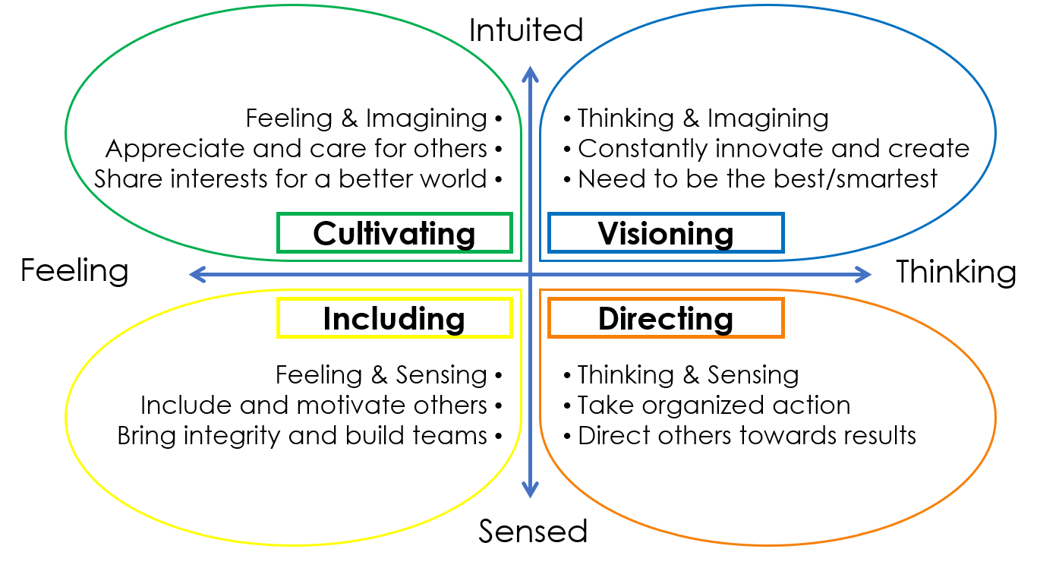
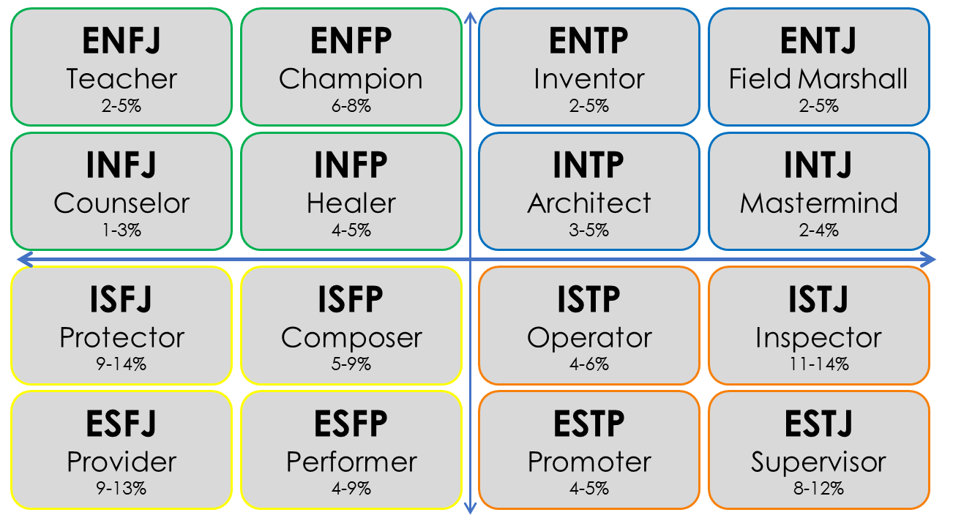
PERSONALITIES
Two Types
NASA 4D
Created to help science/engineering teams (like those at NASA) boost performance and avoid mistakes​
MYERS – BRIGGS TYPE INDICATOR
Created to put psychological theory to practical use - assisting women entering the WWII workforce with job selection

Slide 5
PERSONALITIES
Myers-Briggs Type Indicator (MBTI)
16 personalities based on four dimensions of personality
Four dichotomies
Attitude
Where do we get our energy?
Extroversion
(E)
Introversion
(I)
Information Gathering
How do we take in our information?
Intuiting
(N)
Sensing
(S)
Decision-Making
How do we make our decisions?
Thinking
(T)
Feeling
(F)
Lifestyle
How do we organize our world?
Judging
(J)
Perceiving
(P)

Slide 6
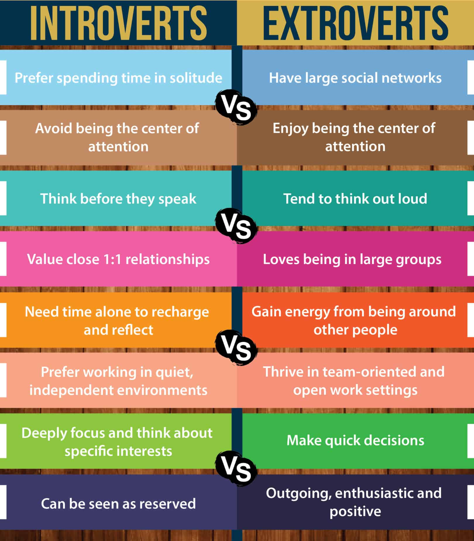
PERSONALITIES
Extroversion (E) & Introversion (I)
Where do you get your energy?
Extroverts recharge and get energy from spending time with people
Introverts recharge and get energy from time spent alone
Ambiverts- in the middle
JamBoard: Where are you on the introvert-extrovert scale?

Slide 7


PERSONALITIES
Sensing (S) & Intuition (N)
How do you take in information?
Sensing trusts information that is concrete, tangible, present (info collected by your senses)
  Experiences
  Details and facts
Intuition trusts information that is abstract and theoretical
  Concepts
  Future possibilities & big picture
JamBoard: Are you more detail-oriented or big picture?

Slide 8

PERSONALITIES
Thinking (T) & Feeling (F)
How do you make your decisions?
Thinking people make their decisions more objectively, measuring what is reasonable, logical, and matching a given set of rules
  Value truth, fairness and honesty
  Motivated by achievement
Feeling people make their decisions more based on measuring from the inside and associating or empathizing
  Value harmony, peace, and compassion
  Motivated by appreciation
JamBoard: What matters more to you: honesty and directness or peace and harmony?

Slide 9
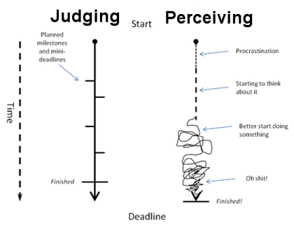
PERSONALITIES
Perceiving (P) & Judging (J)
Judging people like to have things settled, pay close attention to time, and find comfort in schedules and organization
  Work in a task-oriented, steady pace
  Typically plan work to avoid rushing before a deadline
Perceiving people tend to be more spontaneous, less aware of time, and find comfortability in flexibility and freedom
Work in bursts of energy
Motivated by approaching deadlines
  JamBoard: Do you work at a steady pace or in bursts?

Slide 10
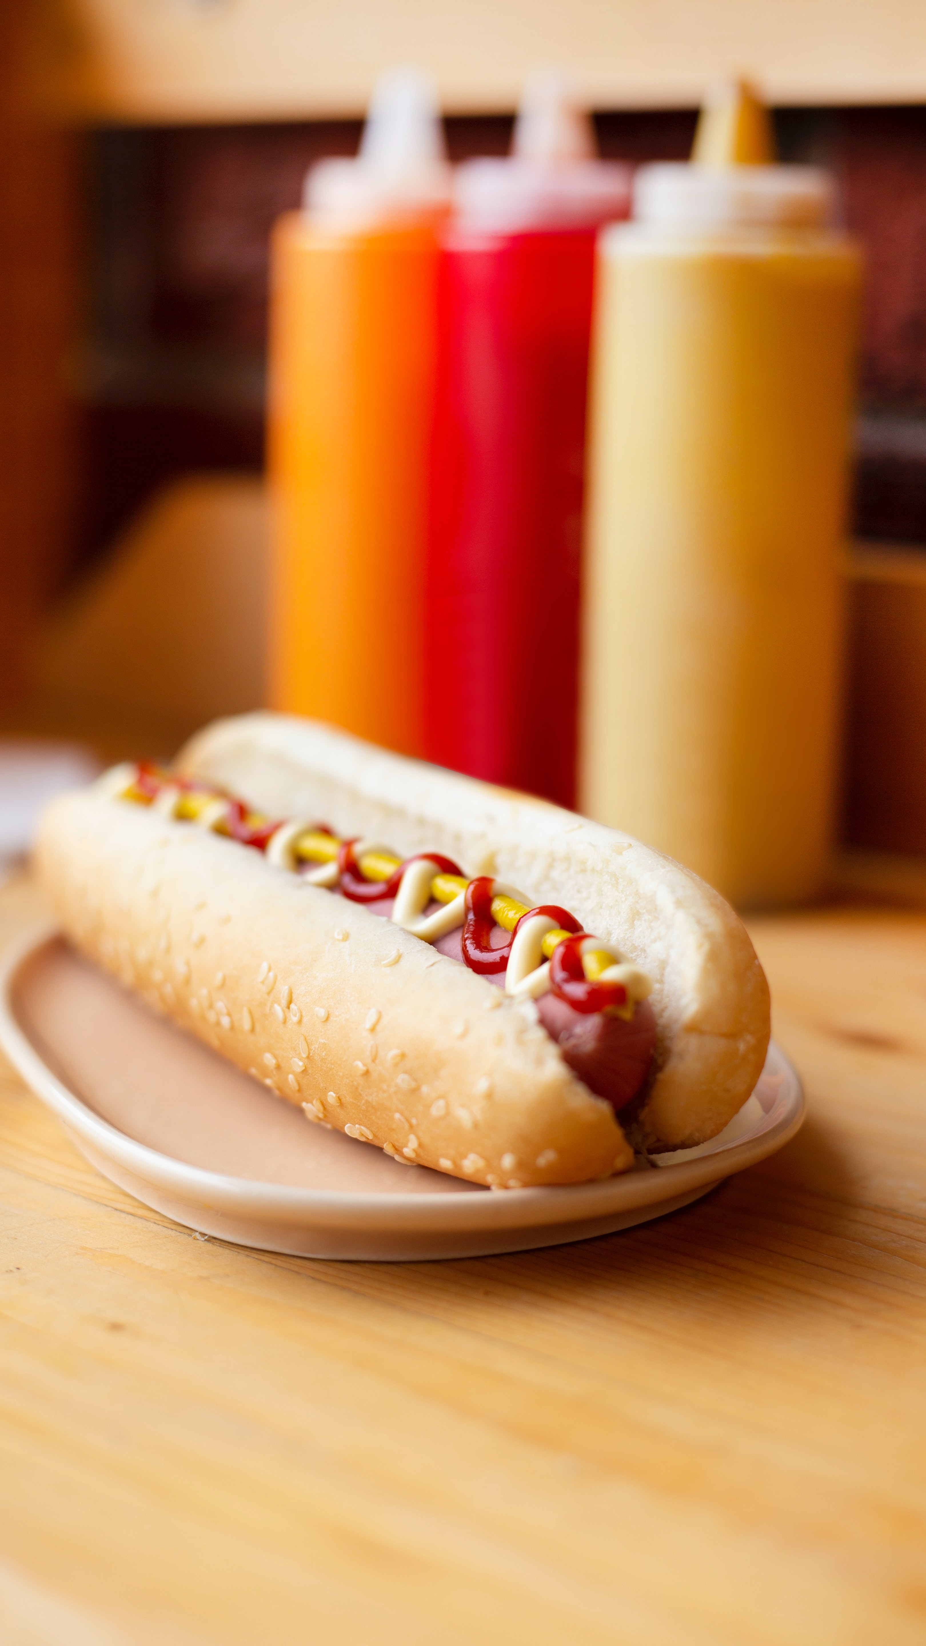
PERSONALITIES
Hot Dogs: Sandwich or Not a sandwich?
What is a sandwich really?
  A split roll v. two pieces of bread
Webster's definitions?
  JamBoard: Is a hot dog a sandwich?

Slide 11

PERSONALITIES
NASA 4D Personality Types
Developed by Charles Pellerin
Uses a foundation of MBTI but refines personalities into four types
Applicable to individuals and organizations
Created to help science/engineering teams at NASA boost performance and avoid mistakes
Green
"Cultivating" People Builders
Yellow
"Including" Team Builders
"Directing" System Builders
Blue
"Visioning" Idea Builders
Orange

Slide 12
PERSONALITIES
NASA 4D
Intuited
Created to help scientific teams to collaborate and work together more effectively
Four quadrants / types named by color
Feeling & Imagining
Appreciate and care for others
Share interests for a better world
Thinking & Imagining
Constantly innovate and create
Need to be the best/smartest
Cultivating
Visioning
Feeling
Thinking
Including
Directing
Feeling & Sensing
Include and motivate others
Bring integrity and build teams
Thinking & Sensing
Take organized action
Direct others towards results
Sensed

Slide 13
PERSONALITIES
NASA 4D & Myers-Briggs
ENFJ
Teacher
2-5%
ENFP
Champion
6-8%
ENTP
Inventor
2-5%
ENTJ
Field Marshall
2-5%
INFJ
Counselor
1-3%
INFP
Healer
4-5%
INTP
Architect
3-5%
INTJ
Mastermind
2-4%
ISFJ
Protector
9-14%
ISFP
Composer
5-9%
ISTP
Operator
4-6%
ISTJ
Inspector
11-14%
ESFJ
Provider
9-13%
ESFP
Performer
4-9%
ESTP
Promoter
4-5%
ESTJ
Supervisor
8-12%

Slide 14

PERSONALITIES
Breakout: Scenarios
Your Fellow will read out and describe three scenarios sometimes experienced in DEVELOP teams.
Your team will go into a breakout room to discuss how as a group you would address the situation.
After 5 minutes, return to the main call and share your thoughts or solutions!

Slide 15

PERSONALITIES
Scenario #1:
Your tech paper deadline is rapidly approaching! Some team members want to continue refining certain sections, while others are ok with it as is. What do you do?

Slide 16

PERSONALITIES
Scenario #2:
Members of your team have been working on different products and parts of the project throughout the term. How do you want to keep everyone up to date?

Slide 17

PERSONALITIES
Scenario #3:
Some team members are working 29 hours per week and others are working 20 hours per week. What conversations should you have early in the term to discuss how this might influence logistics, deadlines, or work distribution?

Slide 18

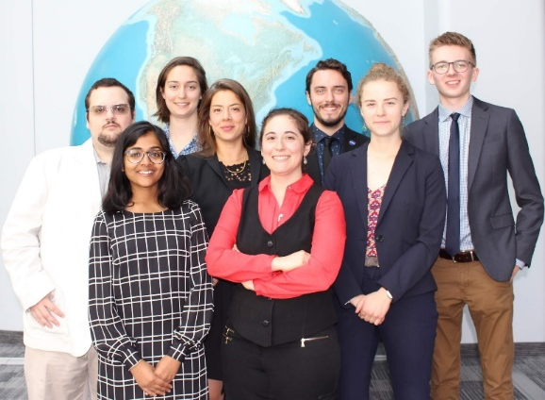
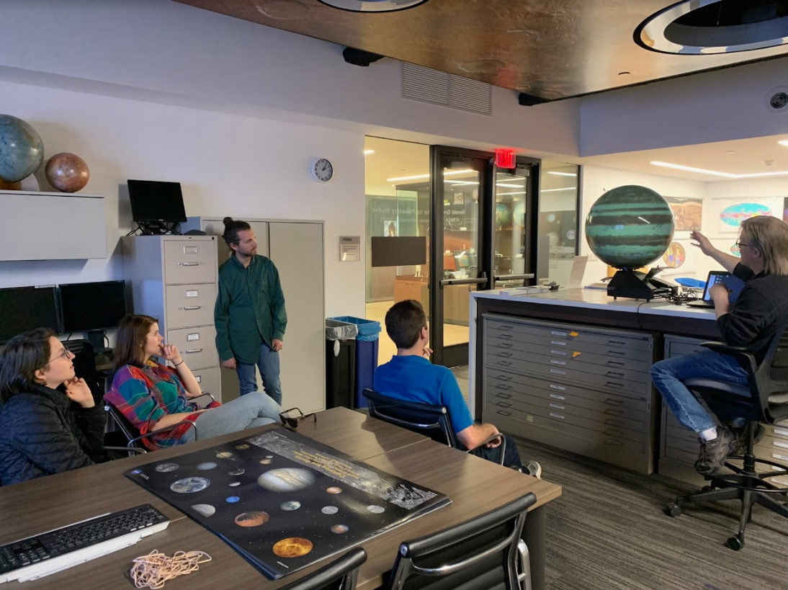
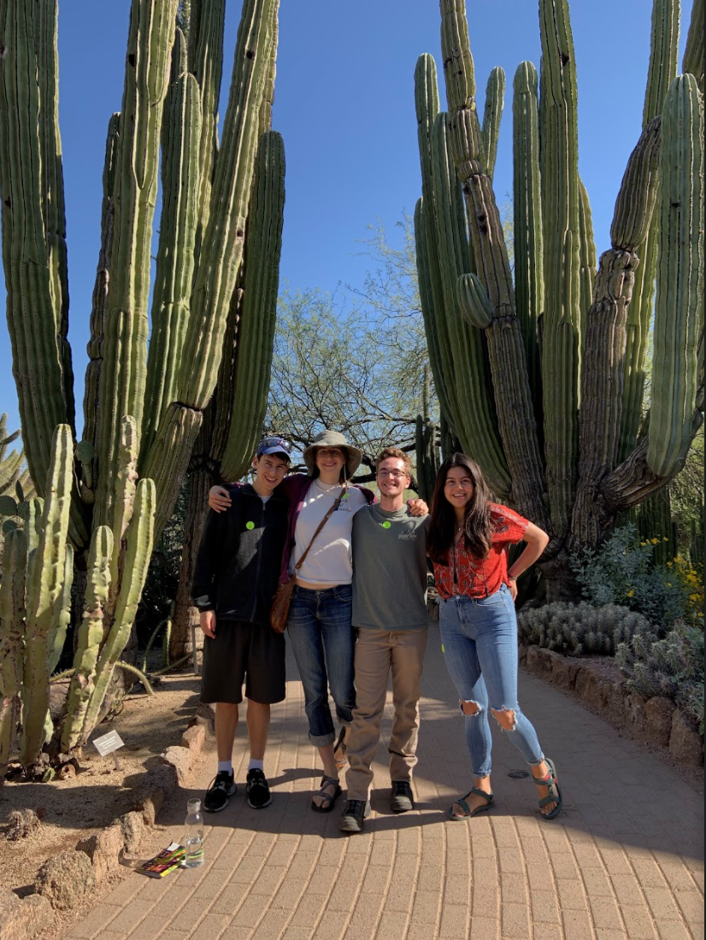
PERSONALITIES
Keep in Mind
Our personalities influence our approach to work and how we work with others
It’s important to identify our personality styles and recognize potential personality trait conflicts and find balance
Remember, your team members are your coworkers, and are your future network, treat them as such

Slide 19

PERSONALITIES
Things Happen! Issues Will Arise!
Amanda/Stephanie
Make all efforts to maintain a positive ‘virtual’ work environment. Be kind to each other!
Participants can feel comfortable coming to their node’s Fellow/Lead or reach out to Amanda or Stephanie.
If you would like counseling for how to respond to a specific situation, reach out to Amanda or Stephanie.
#1 – Don’t put anything in writing. Should a personnel issue arise, immediately and verbally communicate the situation up the chain.
Do not send emails about the situation – remember that NASA/SSAI emails are NOT private.
Microsoft Teams chats are also NOT private (even if it’s only your team on it)
Lead/Fellow
Participant

Slide 20



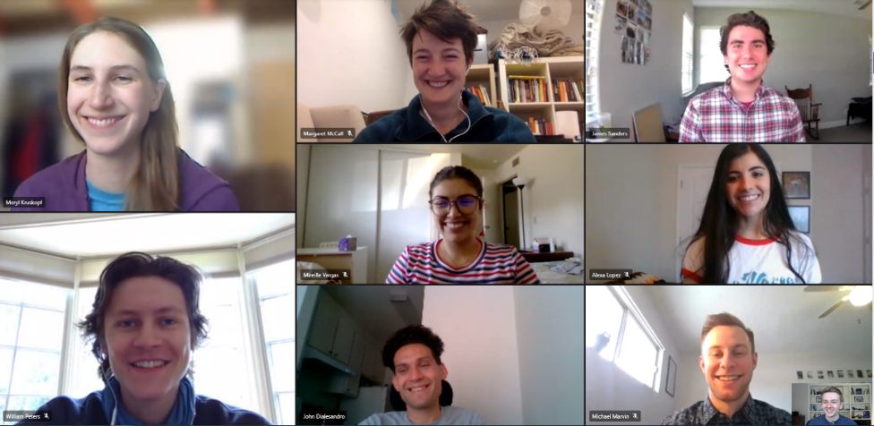
PERSONALITIES
Considerations Working Virtually
In addition to scheduled partner calls, advising calls and node calls, how do you want to work together as a team?
Does our team want to stay on a call all day?
Do we meet up throughout the day as need arises?
Or do we meet only during scheduled times?

Slide 21
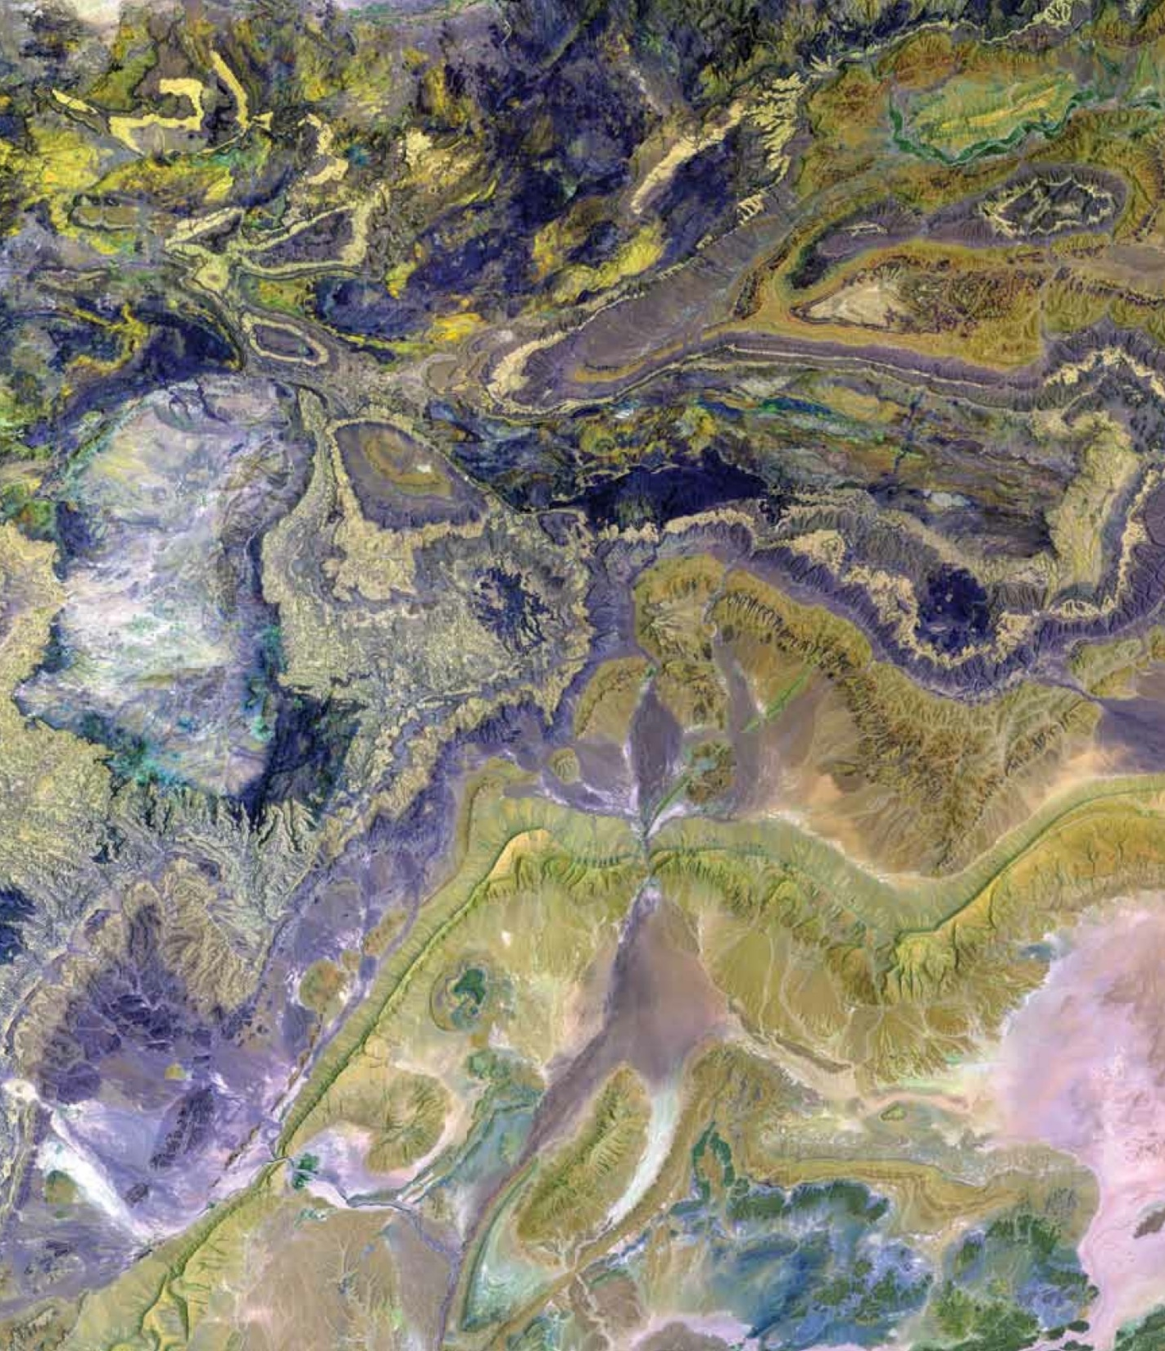
Thank You.
“Be excellent to each other!”
--- William Preston & Theodore Logan ---

