Slide 1
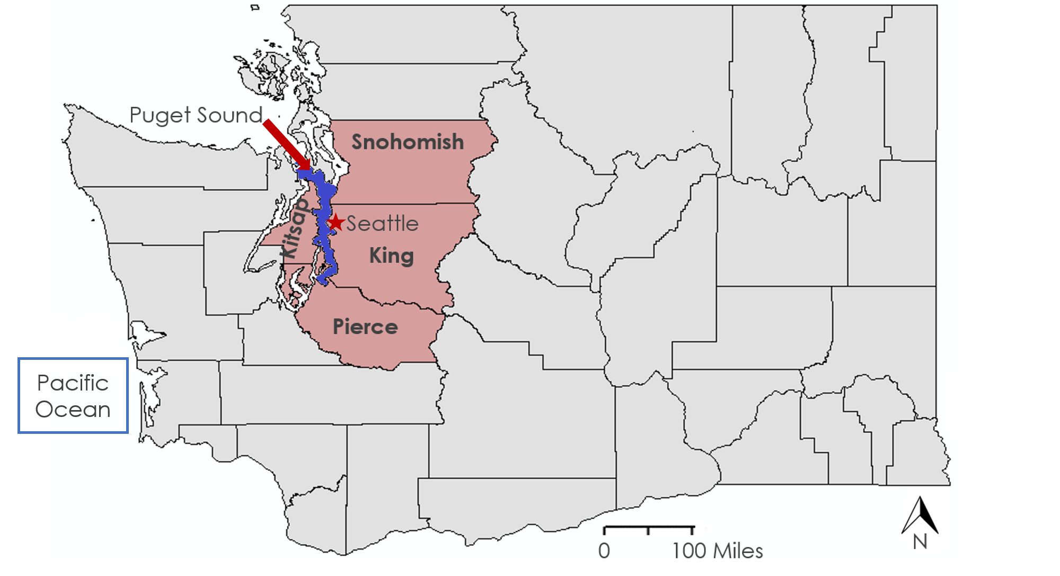
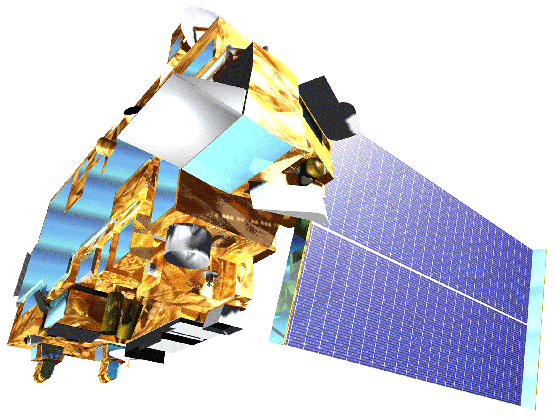
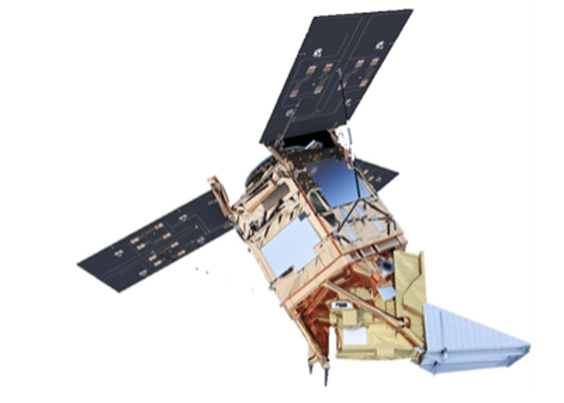
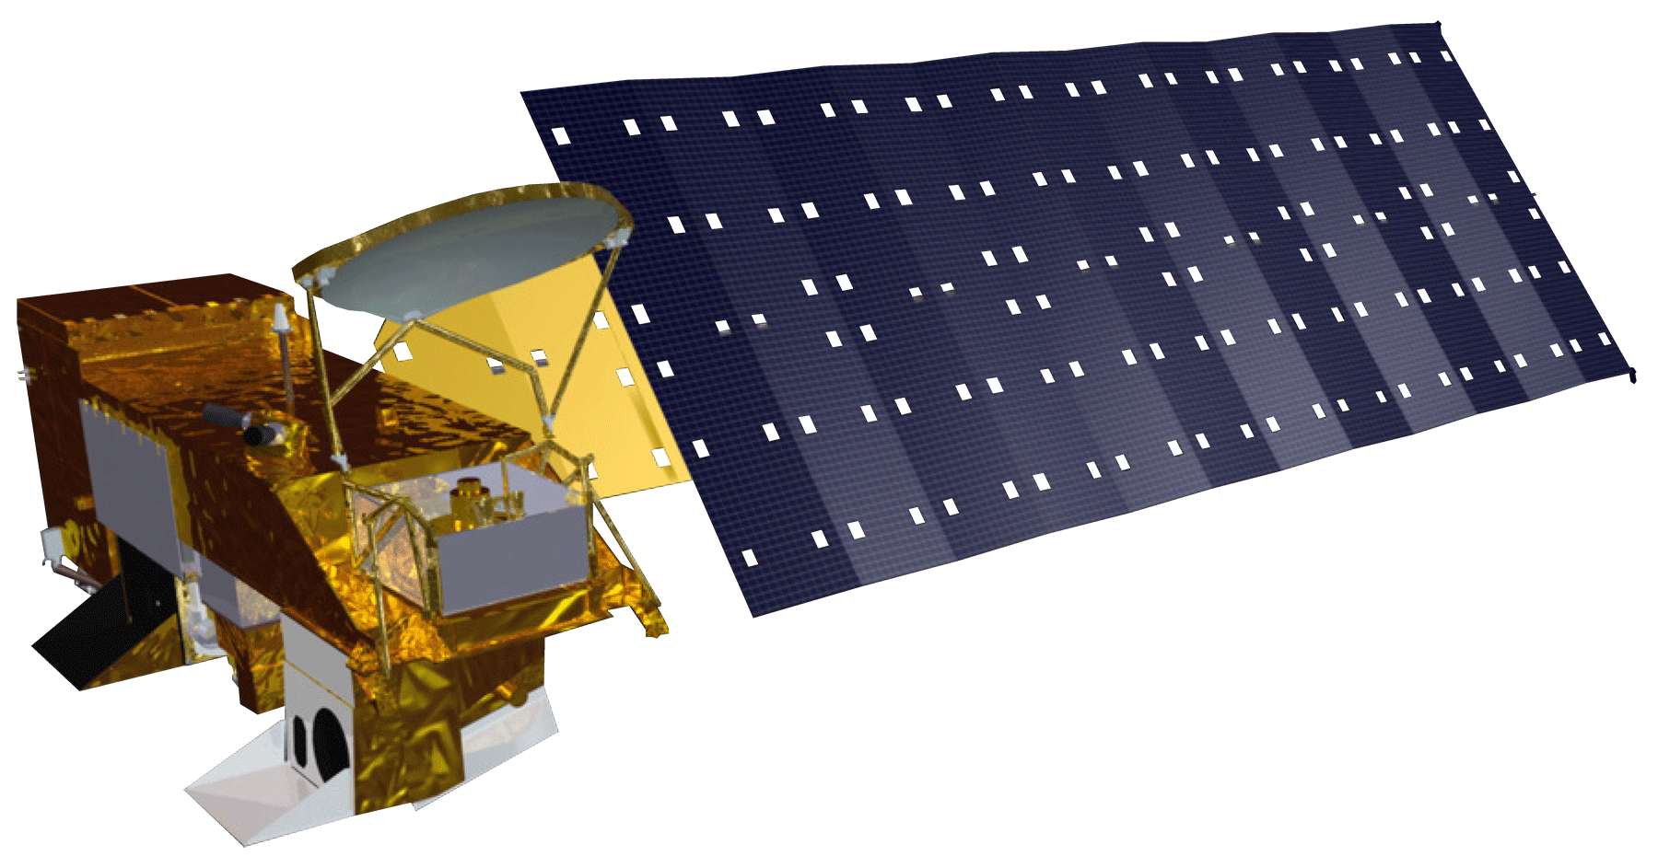
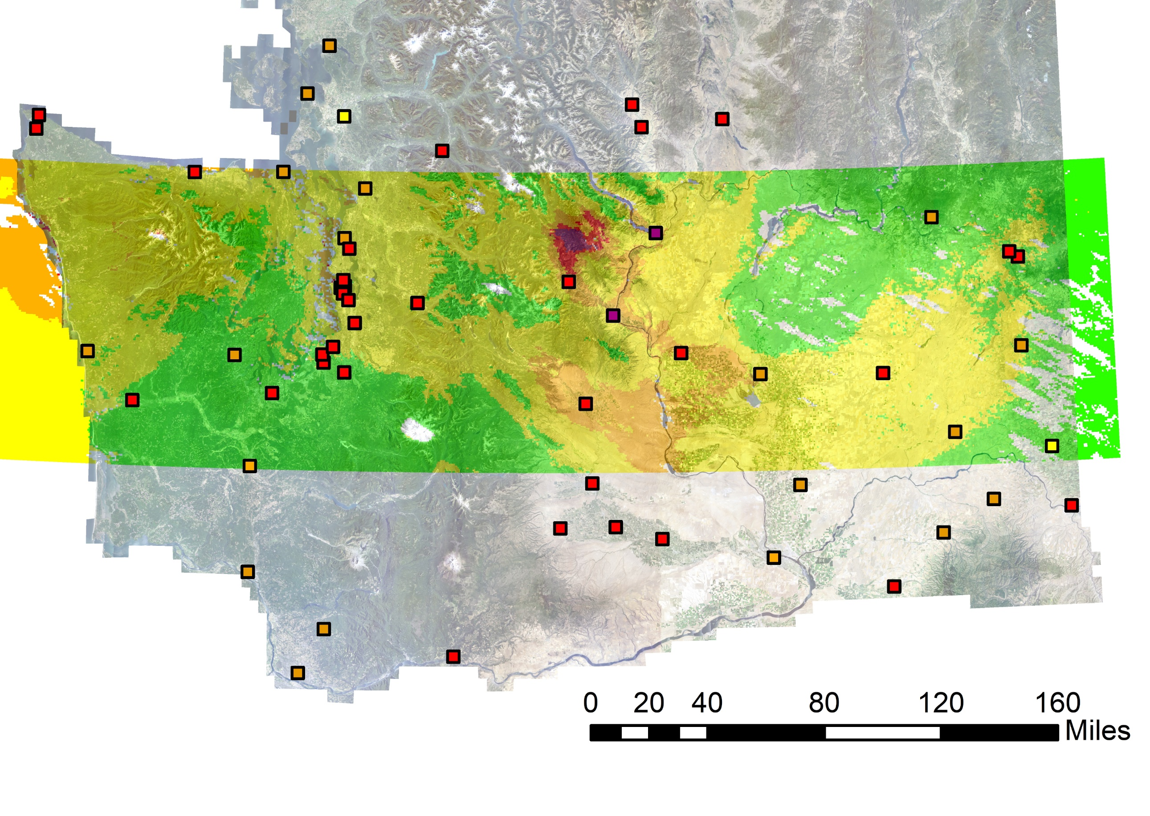
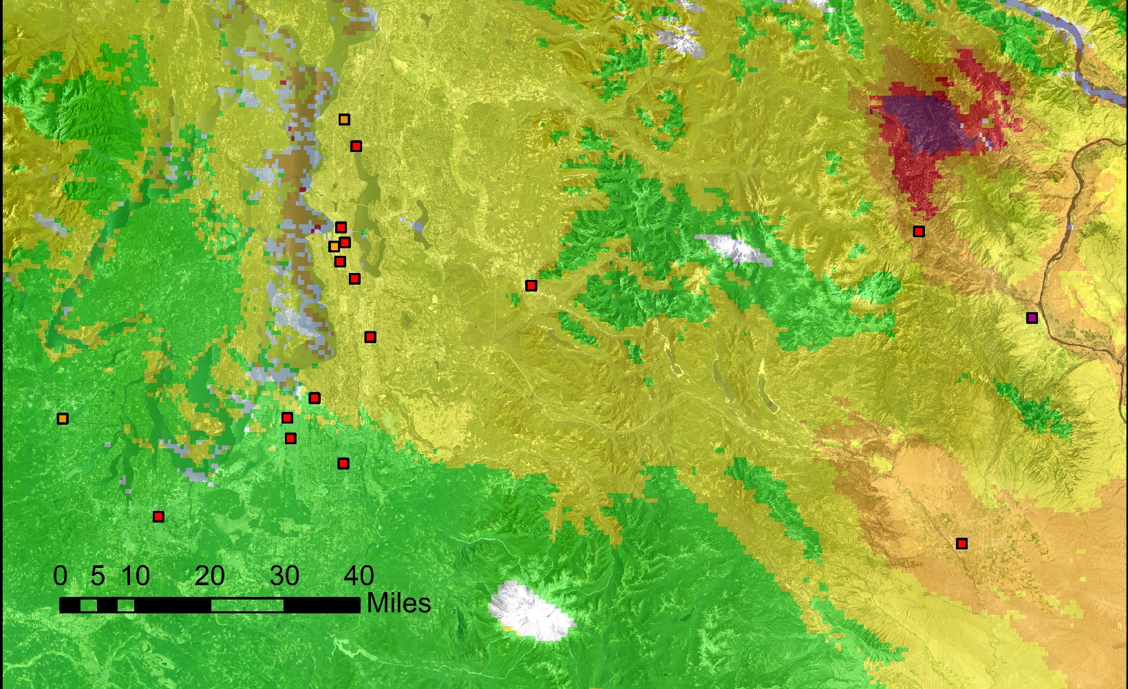
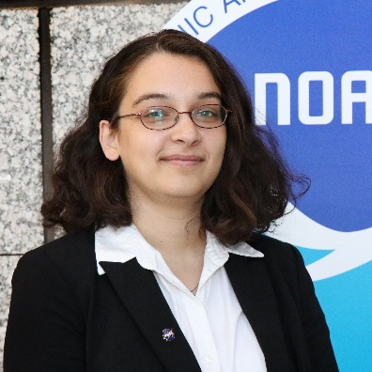
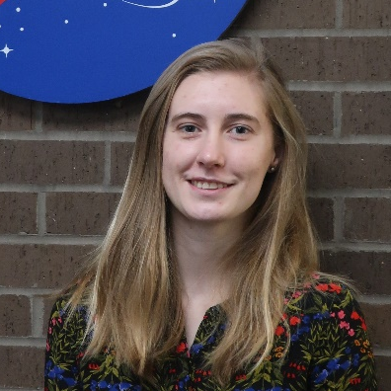
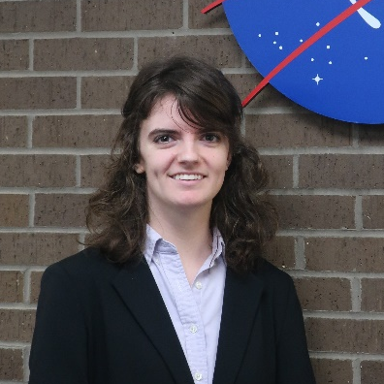
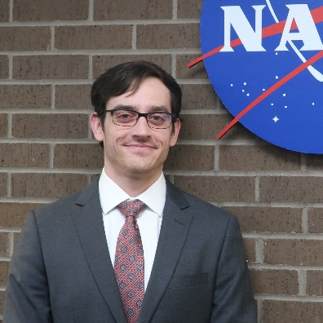
Quantifying Air Quality Parameters and Validating Air Pollution Sources Impacting the Health of Puget Sound Residents Through the Use of NASA and ESA Remote Sensing Data
Abstract
Study Area
Washington Health & Air Quality
In the Puget Sound region of Washington, high levels of air pollutants put residents’ health at risk by increasing their likelihood of developing critical respiratory conditions. This project used remotely-sensed data to investigate aerosol optical depth (AOD) from NASA satellite sensors including the Terra and Aqua MODerate resolution Imaging Spectroradiometer (MODIS) and European Space Agency Copernicus Sentinel-5 Precursor TROPOspheric Monitoring Instrument (TROPOMI). The team visualized the most recent data in Google Earth Engine (GEE) API to display air pollution trends from Northern California to British Columbia, which will support the Puget Sound Clean Air Agency’s (PSCAA) decision-making processes. The team performed linear regressions using the Multi-Angle Implementation of Atmospheric Correction (MAIAC) algorithm to form a relationship between ground-level microscopic particles (PM_{2.5}) and AOD in the Puget Sound region, validating the relationship using concentration readings taken from Environmental Protection Agency (EPA) air quality monitors. The team utilized estimated PM_{2.5} and other satellite data to produce a web-based tool and to evaluate the effectiveness of using such a tool for near real-time air quality monitoring within a particular region. The team found that the tool provides useful supplementary data that fills in the gaps of the PSCAA’s air monitoring network.
Fig 1: Study area map with the four counties under the PSCAA’s jurisdiction shaded.
Methodology
Data Acquisition
Data Processing
End Products
Objectives
Sentinel-5P
TROPOMI
Google Earth Engine
AirPIT
Identify sources and dispersion patterns of air pollutants that cause heightened health risks to vulnerable communities by creating a web-based tool that identifies current trends in spatial distribution of air pollutants
Validate the data produced by the web-based tool using in situ data provided by the PSCAA’s ground sensors
Aqua/Terra MODIS
MAIAC
ALGO
Statistical Approach
Two Variable
ArcGIS Story Map
Results
Relationship Between Measured and Predicted PM_{2.5} Concentrations
AirData
Validation Map
140
Earth Observations
120
100
80
PM_{2.5} Concentration Derived from AOD
60
Aqua MODIS
Terra MODIS
Sentinel-5P TROPOMI
40
20
0
0
20
40
60
80
100
120
140
160
180
PM_{2.5} Concentration of EPA Sensors
Fig 2: Scatterplot of validation data showing the relationship between measured and predicted PM2.5 concentrations in Washington State on August 14, 2018; R2 value is equal to 0.1512, indicating no statistically significant correlation between the two variables.
Fig 3a: Sensor map focusing on the Puget Sound; the color outside of the sensor points shows PM_{2.5} estimates from MAIAC AOD data, and does not accurately match the sensor readings.
AQI Category
Good (0-50)
Moderate (51-100)
Unhealthy for Sensitive (101-150)
Unhealthy (151-200)
Very Unhealthy (201-300)
Sensors:
N
Conclusions
Fig 3b: Map showing MODIS measurements of PM_{2.5} concentrations over the Puget Sound region, with high concentrations being shown over the Cascade Mountains; ground sensors are colored according to the recorded concentrations by EPA Air Quality Index classifications.
MAIAC provides high-quality, high-resolution aerosol data which is useful for remote sensing air quality studies.
The two-variable method is viable for estimating PM_{2.5} from AOD, but not as accurate as the multi-variable or modeling methods, which affects the accuracy and utility of remote sensing air quality studies using this method.
Project Partner
Puget Sound Clean Air Agency
Acknowledgements
Team Members
Dr. Robert Griffin (University of Alabama in Huntsville), Dr. Jeffrey Luvall (NASA Marshall Space Flight Center), Dr. Mohammad Al-Hamdan (NASA Marshall Space Flight Center), Dr. Mike Newchurch (University of Alabama in Huntsville), Erik Saganić (Puget Sound Clean Air Agency), A. R. Williams (NASA DEVELOP), Helen Baldwin (NASA SERVIR), Christine Evans (University of Alabama in Huntsville), Madison Murphy (Optimal GEO), Tim Mayer (NASA SERVIR), Dr. Manil Maskey (NASA Marshall Space Flight Center), Dr. Sundar Christopher (University of Alabama in Huntsville)
Amiya Kalra
Project Lead
Rachel Deininger
Rachel Earwood
Richard Murray
Alabama – Marshall

