Slide 1
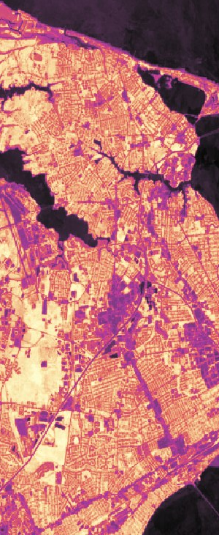
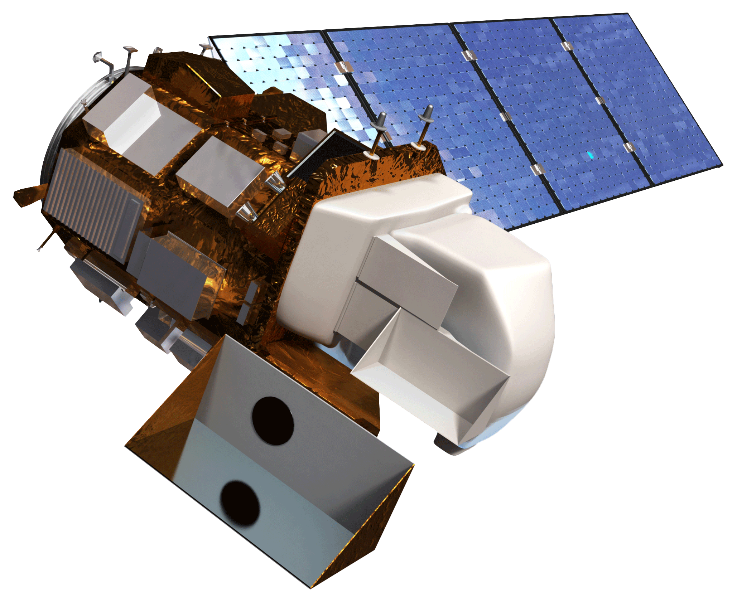
Resources
Bibliography
(2019) About DEVELOP. Retrived from https://develop.larc.nasa.gov/about.php
Livesely, S., McPherson, E., & Calfapietra, C. (2016). The urban forest and ecosystem services: Impacts on urban water, heat, and pollution cycles at the tree, street, and city scale. Journal of Environmental Quality, 45(1), 119-124. https://doi.org/10.2134/jeq2015.11.0567
Weng, Q. (2012). Remote sensing of impervious surfaces in the urban areas: Requirements, methods, and trends. Remote Sensing of Environment, 117, 34-49. doi:10.1016/j.rse.2011.02.030
Sources
DEVELOP Logo, Retrived from http://www.devpedia.developexchange.com/dp/index.php?title=Main_Page
Globe Image, Retrived from https://commons.wikimedia.org/wiki/File:Earth_(blank).png
Satellite image, Retrived from http://www.devpedia.developexchange.com/dp/images/c/c2/03_Landsat8.png; DEVELOPedia
“Figure 1” Photo provided with permission by Jamie Chapman
“Figure 2” Photo provided with permission by Velva Goodman
NASA DEVELOP
The DEVELOP Program, part of NASA’s Applied Sciences Program, bridges the gap between NASA Earth Science and society. DEVELOP helps to prepare participants and partner organizations for challenges that face our society and future generations. DEVELOP addresses environmental and public policy issues through interdisciplinary research projects using remote sensing.
NASA DEVELOP National Program - LaRC
Hampton Roads Urban Development II – Summer 2019
Stephanie Kealy, Sophie Barrowman, Paige Haley, Alina Schulz
http://develop.larc.nasa.gov
in collaboration with
City of Hampton
Waggonner & Ball Architects
Tree Canopy & Impervious
Surface in Hampton, VA
WHAT IS REMOTE SENSING?
Remote sensing is the scanning of the earth by satellite in order to obtain information about it, similar to taking a photograph. NASA shares this data publicly- anyone can use it!
Any opinions, findings, and conclusions or recommendations expressed in this material are those of the author(s) and do not necessarily reflect the views of the National Aeronautics and Space Administration.
This material is based upon work supported by NASA through contract NNL16AA05C.
NP-2017-10-000-LaRC

Slide 2
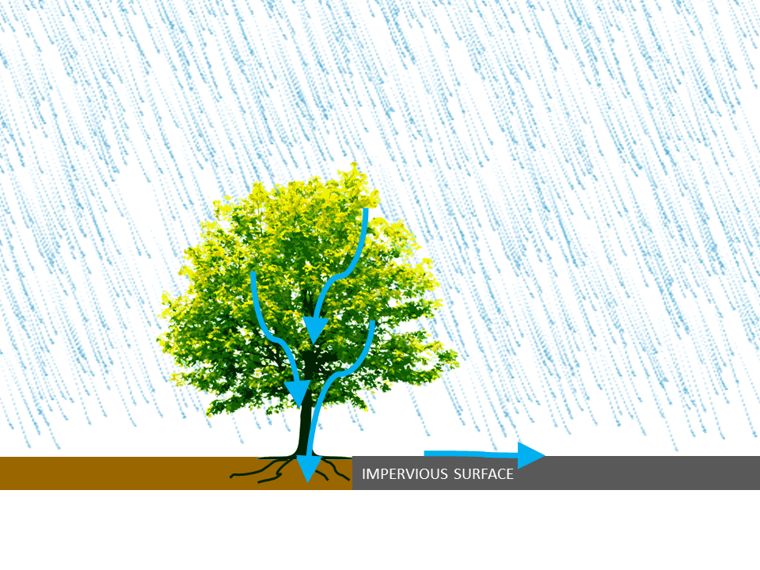
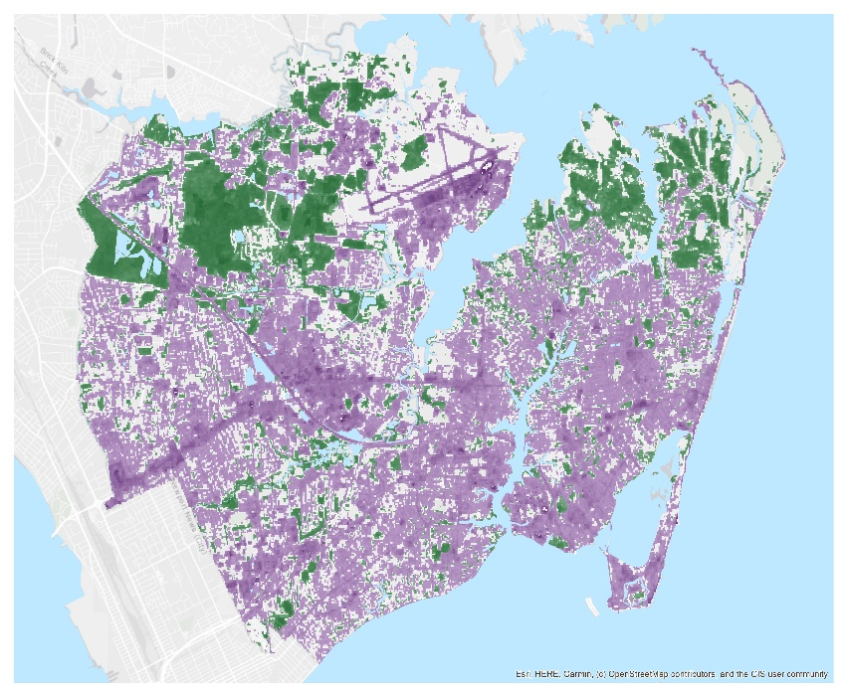
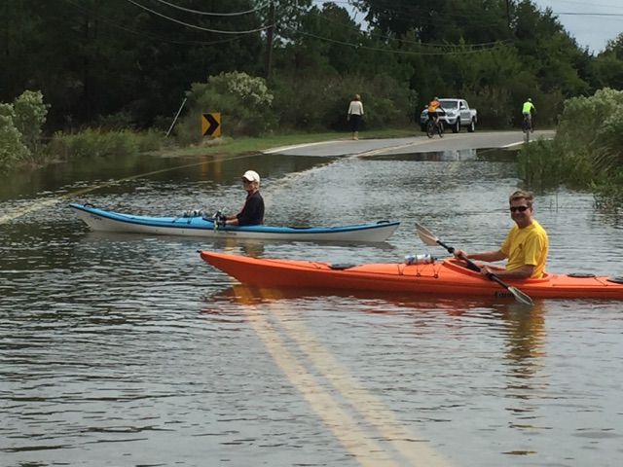
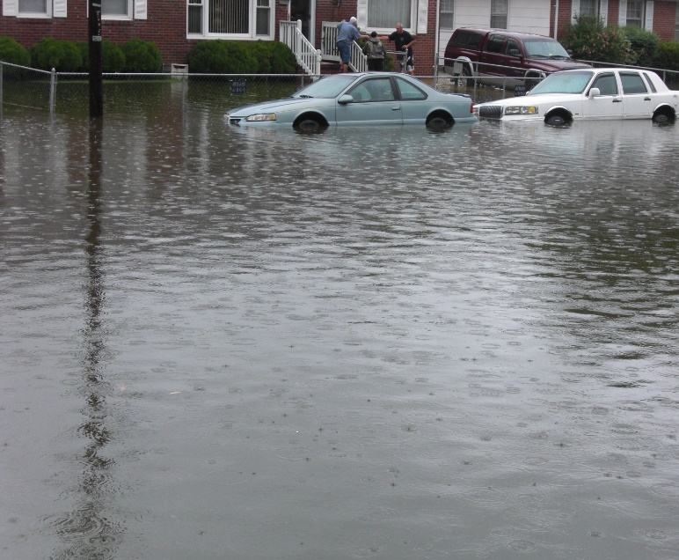
Remote Sensing of Hampton, VA
The City of Hampton is an urban, low-lying, coastal community that experiences recurring flooding due to sea level rise and extreme weather.
Fig. 4. >
Map of trees
and impervious
surface
Increasing impervious surfaces and decreasing forested areas may be making the flooding worse.
Tree canopy includes all the leaves and branches. When it rains, tree canopy catches raindrops, and slows down precipitation. Groundwater is also absorbed by tree roots.
The DEVELOP team partnered with Hampton city officials to use NASA satellite data that will help understand flood risk within Hampton using remote sensing to map where tree canopy and impervious surface exists.
WHAT NASA DISCOVERED
The team calculated that in 2019, 64% of the City of Hampton is covered in impervious surface, and that number has increased by 8% since 2000. Tree canopy was 23% of the city.
<
Fig. 1. Roads blocked
by flooding in
Hampton
Fig. 3. Diagram of how trees help reduce surface runoff.
Impervious surface cover is a surface that prevents water from draining into the ground, such as roads, parking lots and buildings. These surfaces increase water runoff and therefore flooding.
23%
64%
Tree Canopy
< Fig. 2. Extreme
recurring flooding
in Hampton
Impervious Surface
While tree canopy cover is mostly concentrated in natural areas and parks, impervious surface is found in public, residential and commercial areas.

