Slide 1
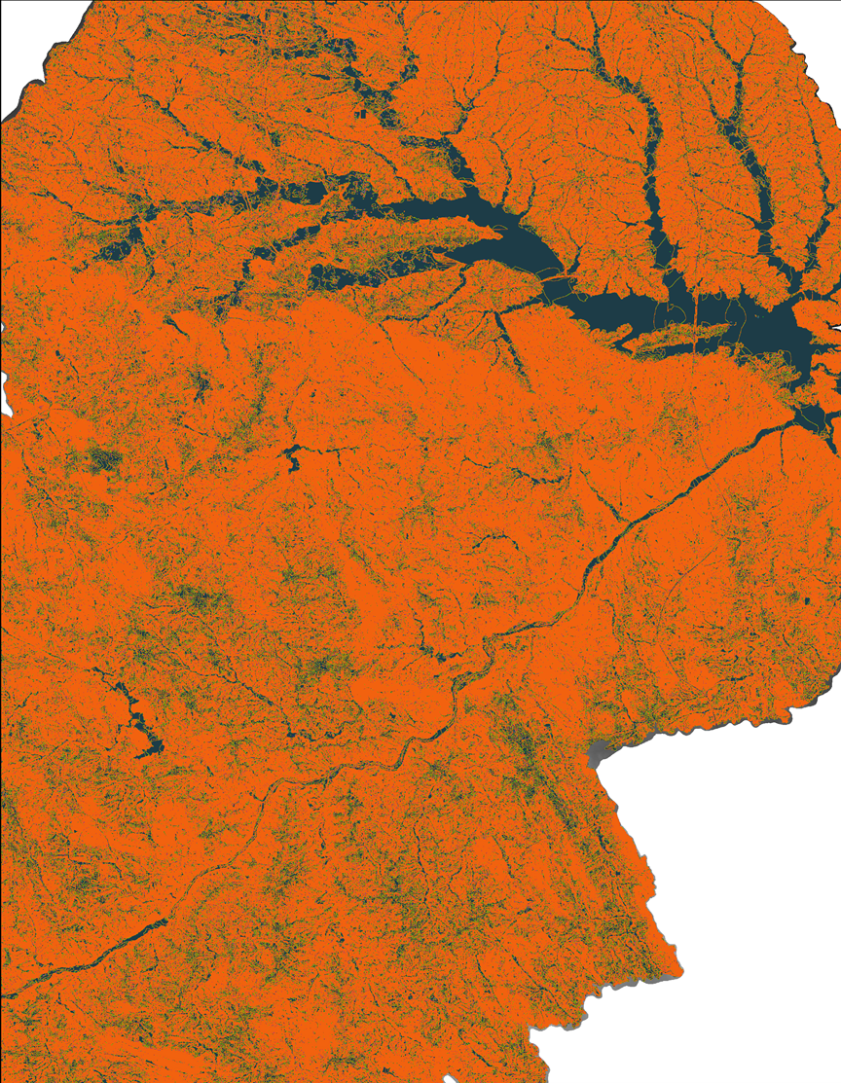
North Carolina Water Resources
Tammy Ashraf (Project Lead)
Elisa Ahern
Utilizing NASA Earth Observations and Hydrological Modeling to Monitor Nutrient Levels in Jordan Lake, North Carolina for Improved Water Quality Management
Jessica Fayne
John Fitz
Dr. Sara Lubkin
Sean McCartney
Notes:
Welcome and thank you for attending this presentation today. We are the North Carolina Water Resources team and our project involves utilizing NASA Earth observation data along with other datasets to track nutrient levels in Jordan Lake, North Carolina, to support water quality management efforts.

Slide 2
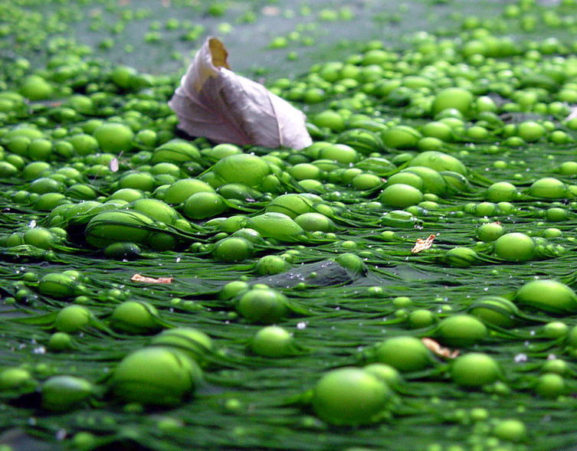
Introduction: Water Quality
Eutrophication
Excessive nutrients (nitrogen and phosphorus) from fertilizers and sewage flow into an aquatic system
Nutrients alter the balance of algae and macrophytes
Decay of algae and plants consumes dissolved oxygen from water
Reduced water quality affects wildlife, increases incidence of fish kills, and reduces shellfish populations
Image Credit: F. Lamiot
Notes:
We used NASA Earth observations to track nitrogen and phosphorus levels in Jordan Lake, NC
Clean water is something that we all depend on. Here on the East Coast, we have plenty of lakes and streams – so we tend to think of access to clean water as a third world problem, but clean water is a limited resource even in North Carolina.
Eutrophication refers to high levels of nutrients in a water supply which promote algal growth, resulting in the depletion of dissolved oxygen and the death of aquatic life. These nutrients come from agricultural runoff, storm water drainage and wastewater treatment.
Eutrophication in reservoirs used for drinking water is of special concern because algal blooms may decrease water quality and affect human health.
Image credit: https://www.flickr.com/photos/48722974@N07/4464986156

Slide 3
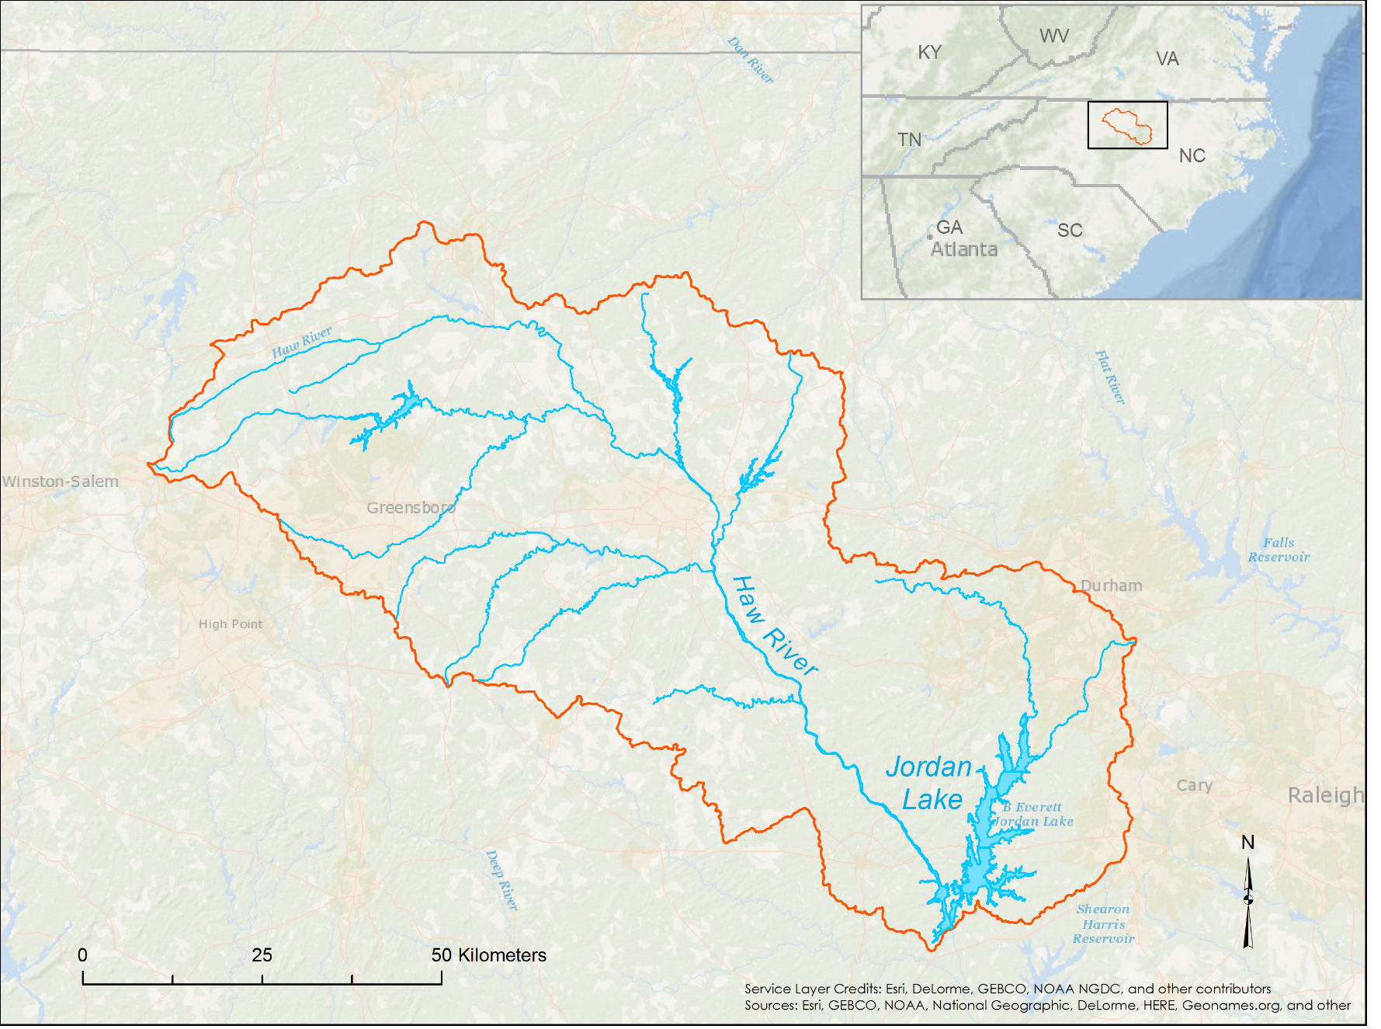
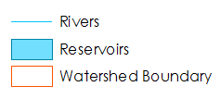
Study Area
Image Credit: NASA
Haw River Basin
Study Area:
Jordan Lake Watershed (Haw River Basin)
Study Period:
January 2009 to December 2014
North Carolina
Notes:
Our study area is the Jordan Lake Watershed:
The Jordan Lake watershed covers roughly 4,375 square kilometers of agricultural and urban areas in Alamance, Gilford, Orange, Durham, Wake, Chatham, Rockingham and Caswell counties in North Carolina.
The study period is from January 2009 to December 2014.
Map service layer credits: Esri, DeLorme, GEBCO, NOAANGDC. Sources: Esri, GEBCO, NOAA, National Geographic, DeLorme, HERE, Geonames.org

Slide 4
Jordan Lake
Background
Built by Army Corps of Engineers in 1983 to support flood control
56 square kilometers
300 kilometers of shoreline
Used for boating, camping, hiking, and swimming
Supplies drinking water to 250,000 people in North Carolina
Notes:
Jordan Lake Background:
Our area of water quality focus is B. Everett Jordan Lake reservoir (Jordan Lake). It is a man-made reservoir located in the Haw River Basin of central North Carolina. The lake provides drinking water for more than 250,000 residents within the Triangle Region, which includes the cities of Durham, Chapel Hill, and Raleigh, NC (NC Department of Environmental Quality [NCDEQ], 2016).
56 square kilometers, 300 kilometers of shoreline
Used for boating, camping, hiking, and swimming
Supplies water to 250,000 people in North Carolina
Agricultural and urban runoff from eight different counties (Alamance, Gilford, Orange, Durham, Wake, Chatham, Rockingham and Caswell)
Image credit: NASA (false color composite of L8 – coastal blue, blue, and green)

Slide 5
Community Concerns
Increased eutrophication
Federal legislation requires ongoing monitoring and management
Current nutrient monitoring practices are inconsistent and infrequent
Complaints about water taste and odor
Strict construction and development restrictions add expense to projects
Image Credit: Nara Souza
Notes:
Since the completion of the reservoir in 1983, eutrophication of Jordan Lake has been a growing problem.
The North Carolina Environmental Management Commission (EMC) has consistently rated Jordan Lake as eutrophic or hyper-eutrophic (NCDEQ, 2016).
Eutrophication has resulted in dense blooms of cyanobacteria and anoxic water conditions (Yang et al., 2008).
In 2006, the lake exceeded the state’s chlorophyll-a limits, and the EMC determined that Jordan Lake is “impaired”.
Although the water can still be used for drinking, fishing, and recreation, complaints about taste and odor problems have prompted the Town of Cary to add chemical treatment to its drinking water process.
Current problems with water quality include:
Algal blooms
Fecal matter
Hydrilla
Runoff
Sewage
Pollution
Trash
Tires
Image Source: https://www.flickr.com/photos/48722974@N07/5120227735

Slide 6
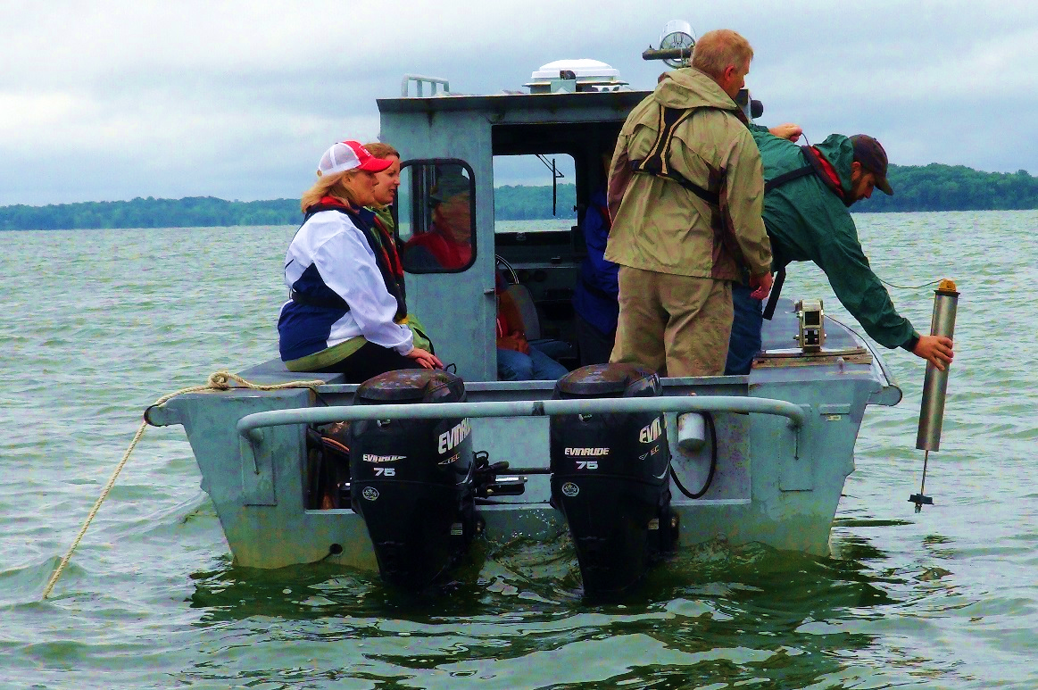
Current Management Practices
Policy enforcement
Water sampling at six sites
Riparian buffers
Solar Bees
Educational outreach
Image Credit: Army Corps of Engineers
Notes:
The Clean Water Responsibility Act of 1997, or House Bill 515, requires the North Carolina Environmental Management Commission (EMC) to implement management plans and establish improvement goals for nutrient-impaired waters. As a result, phosphorus limits were imposed after Jordan Lake was designated a Nutrient Sensitive Water (NSW) in 2002.
A later law, S.L. 2005-190, or Senate Bill 981, directed the EMC to adopt permanent rules and long-term management strategies to protect drinking water supply reservoirs. The Division of Water Quality held public meetings and solicited public comments on a rules framework after the 2005 law was passed.
The Jordan Lake Nutrient Management Strategy (“Jordan Rules”) was established in June of 2008 to meet these requirements following the approval of the North Carolina Rules Review Commission (RRC). These rules, which became effective on August 11, 2009, require a calibrated nutrient response model, specific reductions for nutrients from all sources, a timeline for implementation, cost analysis, stakeholder involvement, and progress evaluation reports.
The Jordan Rules also require local city and town governments to implement Stage One programs that include public education, mapping of the Municipal Separate Storm Water Systems (MS4s), and the establishment of best management practices (BMPs) maintenance.
Bi-monthly water sampling is carried out by the U.S. Geological Survey at six sampling locations to aid in water treatment and management decisions. At each location, temperature, dissolved oxygen, pH, chlorophyll, nutrient levels, metals, and conductivity are recorded and analyzed.
Residents are also making an effort. Local property owners have been educated on BMPs, such as reducing fertilizer use, decreasing lawn irrigation, and installing and maintaining riparian buffers.
Residents are asked to contact the Town’s Storm Water Engineering Department before clearing trees and other vegetation to request a “buffer call.”
Residents are also encouraged to submit a soil test to the North Carolina Department of Agriculture (NCDA) before applying fertilizer and lime.
Image credit: https://commons.wikimedia.org/wiki/File:Nashville_teachers_graduate_STEM_curriculum_with_Corps_externships_%289203468499%29.jpg

Slide 7
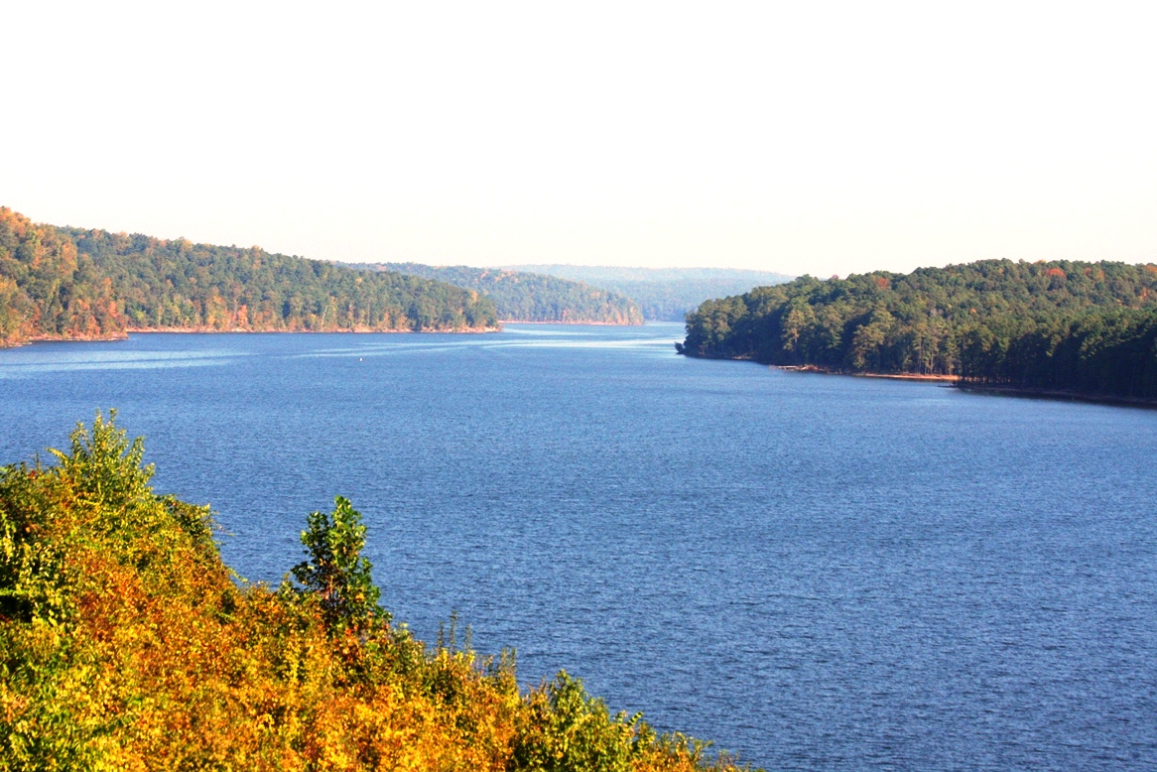
Objectives
Support Jordan Lake’s water quality management strategy
Utilize ancillary datasets, in situ measurements, and NASA Earth observation data to calibrate and validate the Soil and Water Assessment Tool (SWAT)
Create an operational SWAT model for ongoing monitoring of nitrogen and phosphorus in Jordan Lake
Image credit: Town of Cary, NC
Notes:
Purpose of Project:
In order to address these community concerns, our DEVELOP team at Goddard Space Flight Center (GSFC) used NASA Earth observations (EO), in situ data, and ancillary datasets to calibrate and validate a Soil and Water Assessment Tool (SWAT) to model water quality in Jordan Lake and its watershed. The model was used to construct an operational GIS-based tool that will provide near-real time monitoring of nutrient levels for the Hazen and Sawyer’s Decision Support System (DSS) and help guide efforts to improve water management in the reservoir.
Project Objectives:
Calibrate and validate the SWAT model using ancillary datasets, NASA Earth observation data and in-situ data nitrogen and phosphorus data from January 2009 to December 2014. Then provide the end-user a calibrated model they can incorporate into their Decision Support System to assist with water quality management efforts.
Image credit: provided by Jeff Adkins, Town of Cary.

Slide 8
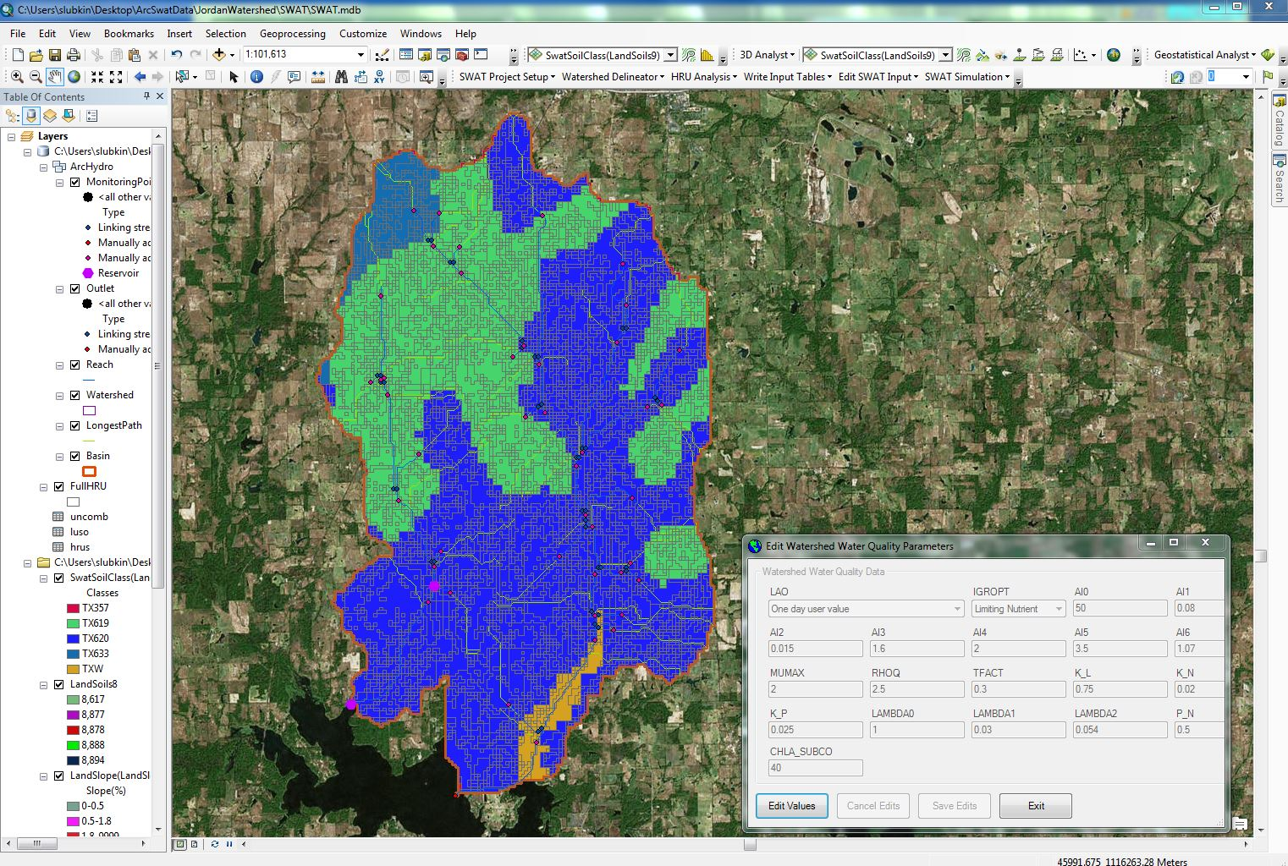
SWAT (Soil and Water Assessment Tool)
Jointly developed by USDA Agricultural Research Service (ARS) and Texas A&M AgriLife Research
Quantifies the impact of land management practices in large, complex watersheds
Predicts the effect of management decisions on water, sediment, nutrient and pesticide yields
Image Credit: Nara Souza
Notes:
The Soil and Water Assessment Tool (SWAT) is a public domain model jointly developed by USDA Agricultural Research Service (USDA-ARS) and Texas A&M AgriLife Research.
SWAT is a watershed to river basin-scale model that simulates the quality and quantity of surface and ground water and predicts the environmental impact of land use, land management practices, and climate change.
SWAT is widely used in assessing soil erosion prevention and control, non-point source pollution control and regional management in watersheds.
We are using SWAT to support our project objectives of using Earth observations and ancillary data to model nutrient loadings into the Jordan Lake watershed. This will be used in creating a near real-time tool to monitor N & P in the watershed, provided to our end users at the Town of Cary, NC to better manage their water supply.

Slide 9
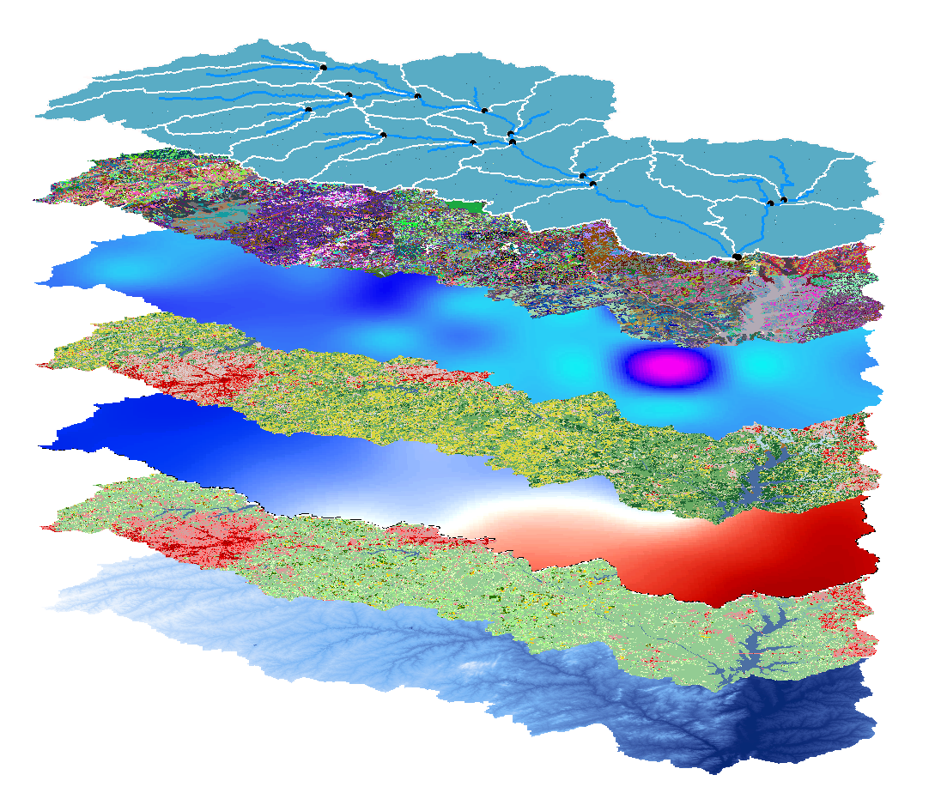
Ancillary Datasets
Digital Elevation Model (DEM), USGS
Land Cover Data (CDL), USDA
Soil Data (SSURGO), USDA
USGS Stream Gauges
Climate Data, Earth observations
Image credit: Town of Cary, NC
Image Credit: Nara Souza
Notes:
The following ancillary datasets were used:
DEM, Land cover data (CDL), Crop Layer Data (NCLD), Soil Data (SSURGO), USGS stream gauge data and NASA Earth observations for climate data

Slide 10
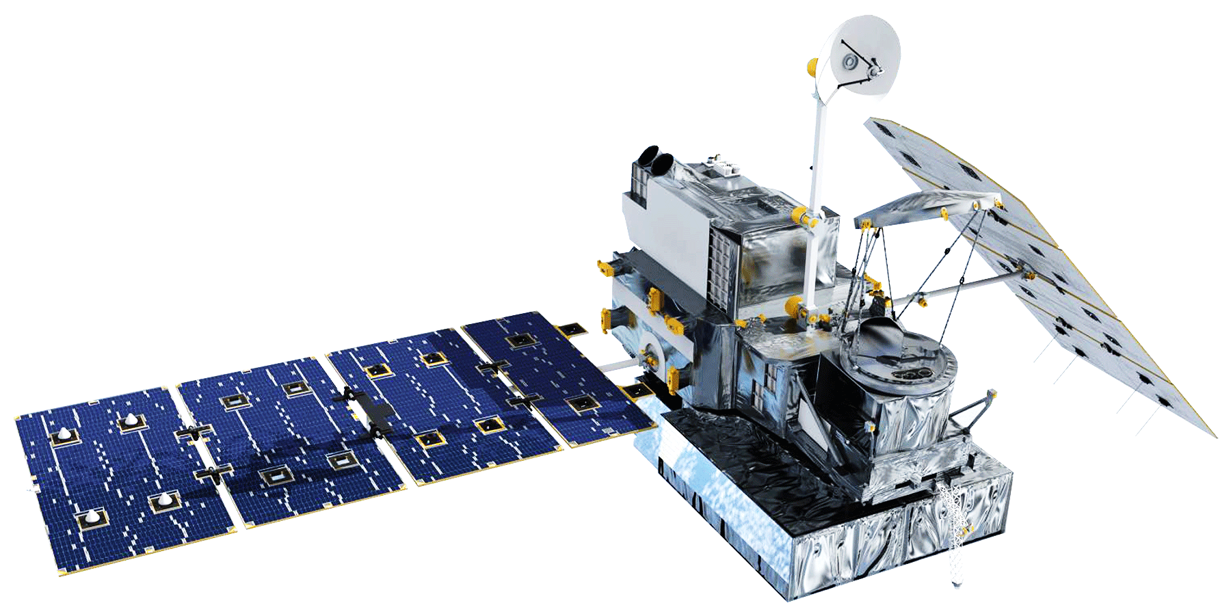
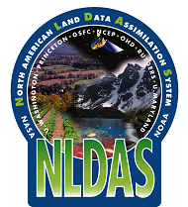
NASA Earth Observations
Tropical Rainfall Measuring Mission (TRMM)
Global Precipitation Measurement (GPM)
Image Credit: NASA
Image Credit: Nara Souza
Notes:
NASA Earth observations used in this project were the Tropical Rainfall Measuring Mission (TRMM) Microwave Imager (TMI) Multi-satellite Precipitation Analysis (TMPA) and the Global Precipitation Measurement (GPM) Integrated Multi-satellite Retrievals for GPM (IMERG).
Both GPM and TRMM were used to obtain precipitation data from 2009-2014.
North American Land Data Assimilation System (NLDAS) was used to obtain: temperature, humidity, wind speed, surface radiation
Image source: https://upload.wikimedia.org/wikipedia/commons/2/22/Earth_Western_Hemisphere_transparent_background.png

Slide 11
Methodology: Calibration
SWAT Model
In Situ: Nitrogen and Phosphorus
Data Collection
TRMM/GPM: Daily Precipitation
.
NLDAS: Daily Relative Humidity, Surface Wind Speed, Maximum and Minimum Temperatures
Statistical Analysis
Model Output: Estimated Nitrogen and Phosphorus
Adjust Model Parameters
USGS: DEM, Land Cover,
and Soil Datasets
Calibrated SWAT Model
Image Credit: Nara Souza
Notes:
SWAT model is run using Earth observations and ancillary data.
Model output includes many variables, including estimated nitrogen and phosphorus.
These are statistically compared to in-situ data.
Parameters are adjusted as needed to calibrate the model.
Explain time period (warm up of 2 years and 2009-2014)
We have been comparing SWAT model output with in-situ data and statistically analyzing the data
The next step is to calibrate the model to improve the output to better match in-situ data

Slide 12
SWAT Model Statistical Output
Notes:
The SWAT model produces estimates of water flow, nitrogen, and phosphorus for each section of the watershed.
These results shows the SWAT model output
These results show N, P, and Flow for each section of the watershed (this graph depicts Reach 28)
Simulated data includes ancillary datasets with weather generator for climate data
The next graph shows data with NASA Earth Observations included in place of weather generator data
You can see that the estimates are not the same.

Slide 13
SWAT Model Statistical Output
Notes:
There is a comparison of N and P in each model (simulated and satellite data) and corresponding R2 values. The low R2 values show that there is little correlation between the two models.

Slide 14
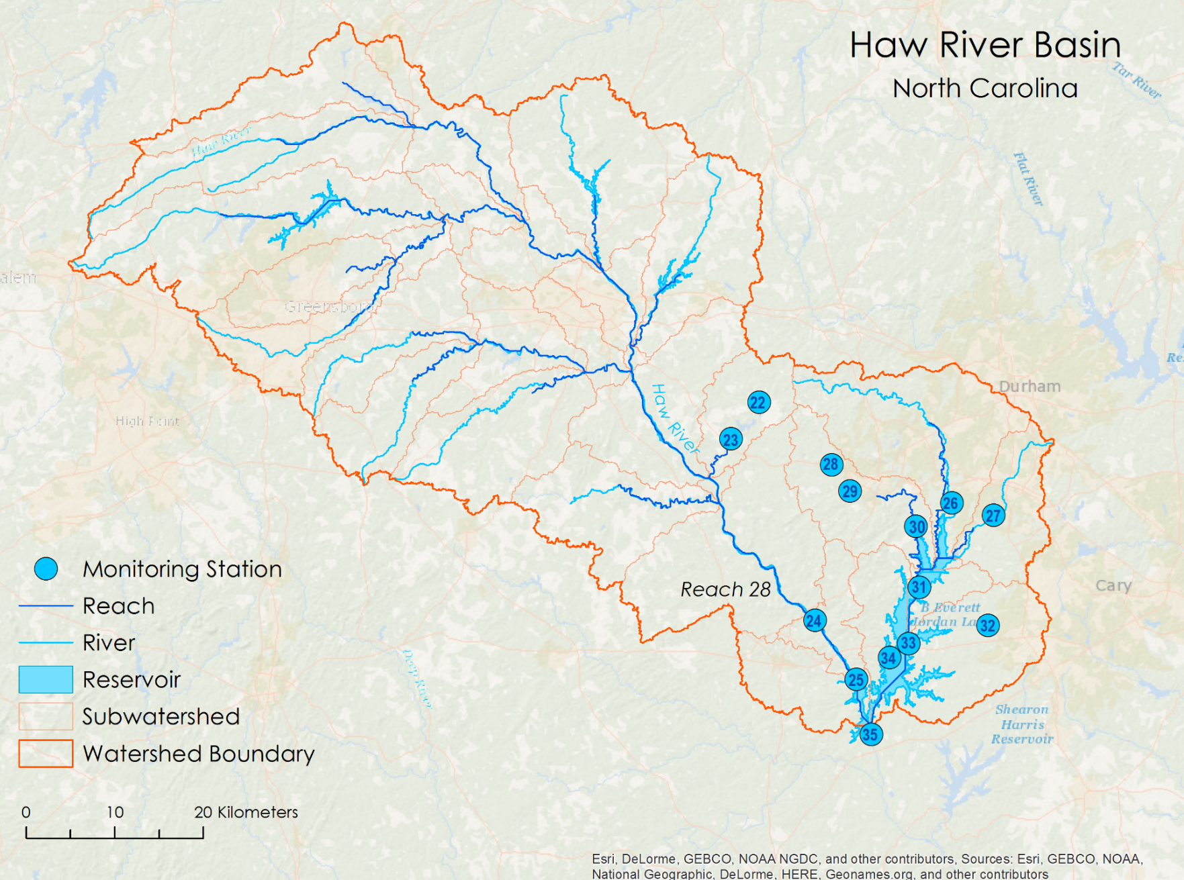
SWAT Modeling: Reach 28
Despite numerous USGS monitoring stations, the data collected is sporadic
Each station collects different data
No consistency in collection time intervals and data collected
Station 24 located on Reach 28 included daily flow data for entire study period
Notes:
Our in situ data came from USGS monitoring stations.
There are numerous USGS monitoring stations in the watershed, but each station collected different data at different time intervals for different time periods. We chose to test our model against data fro Station 24, which is located at5 the outlet of reach 28 because the station included daily flow data for the entire study period.

Slide 15
In situ Nitrogen and Phosphorus
Notes:
Nitrogen and phosphorus data was also available, but not for our study period. There were also gaps in the data.
So, we chose to look at in-situ flow data for station 24

Slide 16
SWAT Model Statistical Output
Notes:
This graph shows the in-situ average monthly flow rate (red) and the monthly average flow rates calculated by SWAT with both simulated data (green) and Earth observation data (blue). You can see that the models produced very different measurement of flow rate. When these were compared to each other, we obtained a very low R2 value of 0.0475.

Slide 17
SWAT Model Statistical Output
Notes:
This graph shows the in-situ average monthly flow rate (red) and the monthly average flow rates calculated by SWAT with both simulated data (green) and Earth observation data (blue). You can see that the models produced very different measurement of flow rate. When these were compared to each other, we obtained a very low R2 value of 0.0475.

Slide 18
Methodology: Calibration
SWAT Model
In Situ: Nitrogen and Phosphorus
Data Collection
TRMM/GPM: Daily Precipitation
.
NLDAS: Daily Relative Humidity, Surface Wind Speed, Maximum and Minimum Temperatures
Statistical Analysis
Model Output: Estimated Nitrogen and Phosphorus
Adjust Model Parameters
USGS: DEM, Land Cover,
and Soil Datasets
Calibrated SWAT Model
Image Credit: Nara Souza
Notes:
The next step is to improve R squared value by adjusting the model parameters

Slide 19
Methodology: Validation
Calibrated SWAT Model
Data Collection
In Situ: Nitrogen and Phosphorus
TRMM/GPM: Daily Precipitation
.
NLDAS: Daily Relative Humidity, Surface Wind Speed, Maximum and Minimum Temperatures
Model Output: Estimated Nitrogen and Phosphorus
VALIDATION
Statistical Analysis
USGS: DEM, Land Cover,
and Soil Datasets
Image Credit: Nara Souza
Notes:
Once the model is calibrated, we will test its accuracy on another time period.

Slide 20
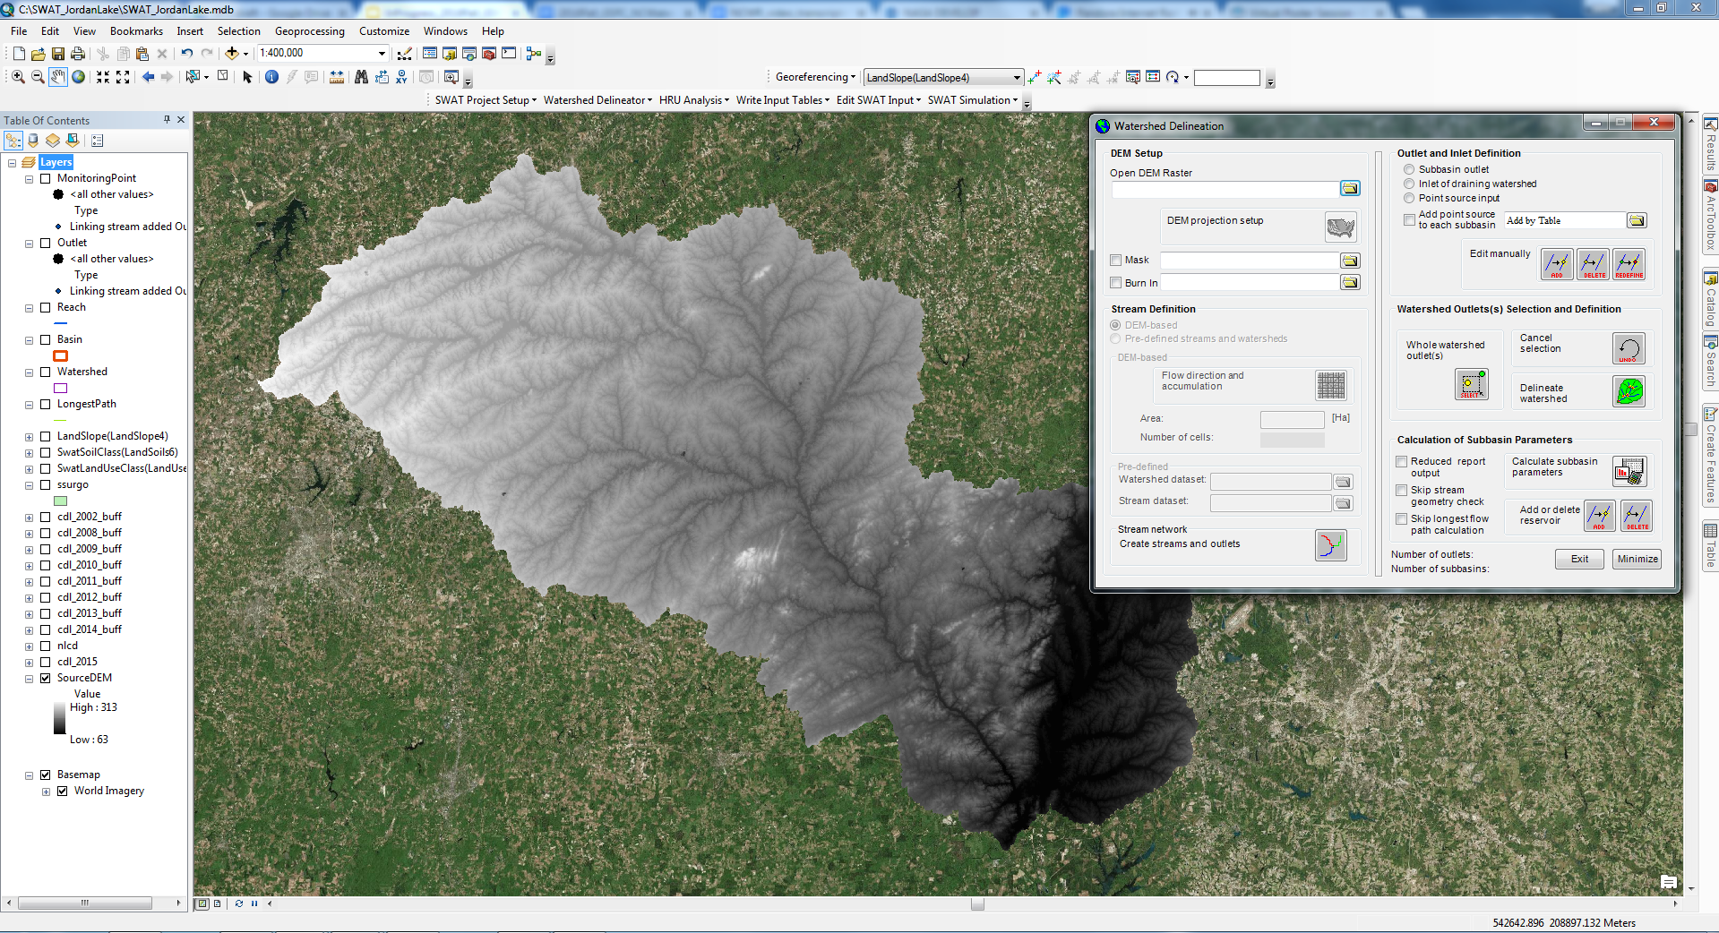
Conclusion
SWAT flow estimates using NASA EO data show less variability from in situ data compared to SWAT flow estimates using weather generator
Using NASA EO data instead of simulated weather data increased the accuracy of the SWAT model
Notes:
SWAT flow estimates using NASA EO data are more similar to in situ data as compared to SWAT flow estimates using weather generator. Using NASA EO data instead of simulated weather data increased the accuracy of the SWAT model.

Slide 21
Future Work
Total Nitrogen
Monthly Output | Average |  | Standard Deviation |  | Statistics
 | Measured | Simulated | Measured | Simulated | R² | PBIAS (%) | NSE
Total Nitrogen (Kgs) | 87582.6 | 92633.3 | 113949.5 | 136332.5 | 0.88 | -6 | 0.81
Continue to refine SWAT model calibration with additional in situ data and parameter adjustments
Validate model in separate time period
Develop scripts to dynamically refresh SWAT model data and provide statistical output for water quality decision support
Notes:
Our next steps are to continue calibrating this model and validate it in a separate time period. Then we will develop a script that fetches data dynamically and provides statistical output of N and P levels in Jordan Lake for the end user to use for water quality decision support purposes.

Slide 22
Dr. Amita Mehta, NASA GSFC-UMBC (Science Advisor)
Dr. Prasad Daggupati, University of Guelph
Dr. Josh Weiss, Water Resources Engineer, Hazen and Sawyer, P.C.
Notes:
We’d like to thank our science advisors and partners for their help and support with this project.

