Slide 1
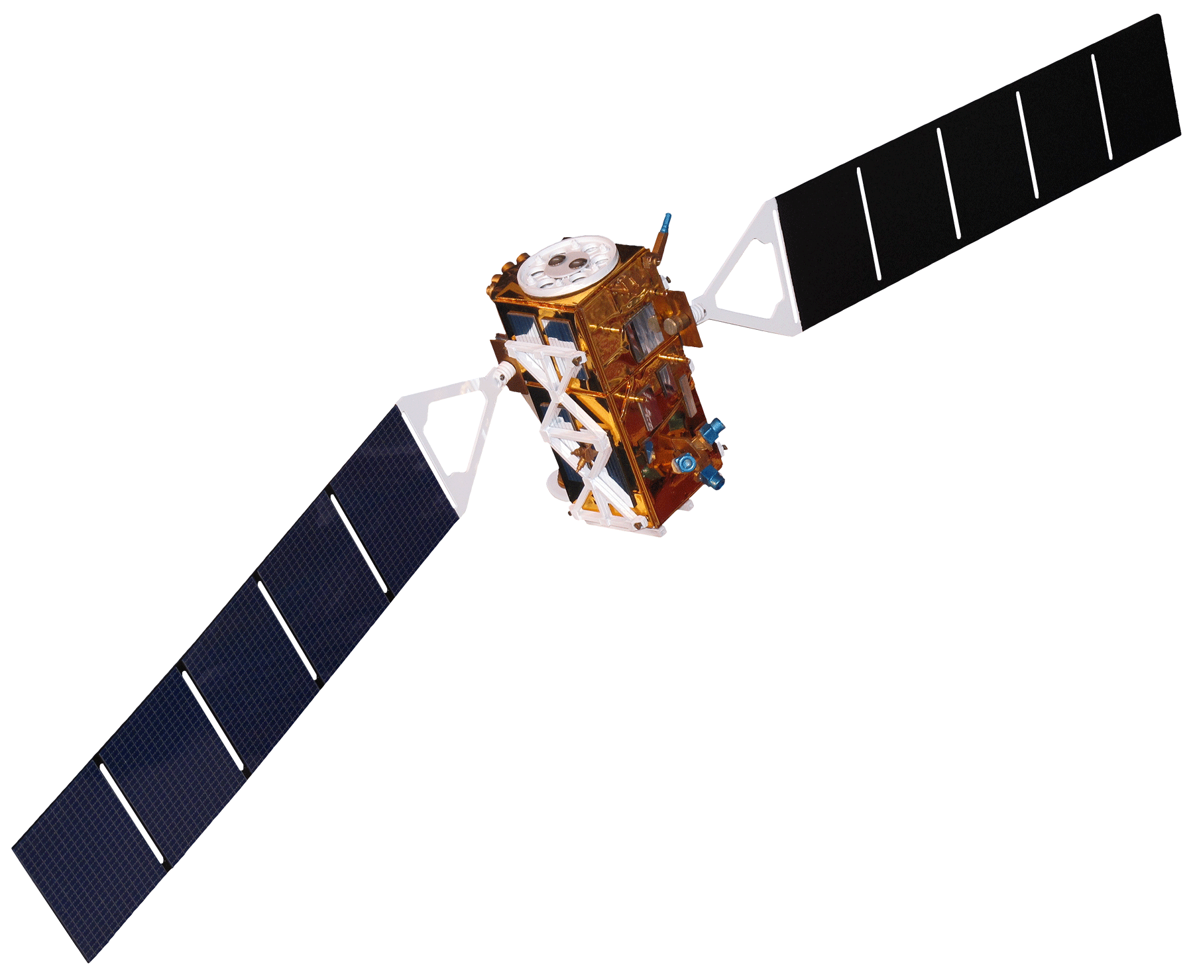
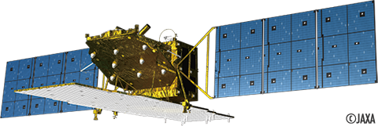
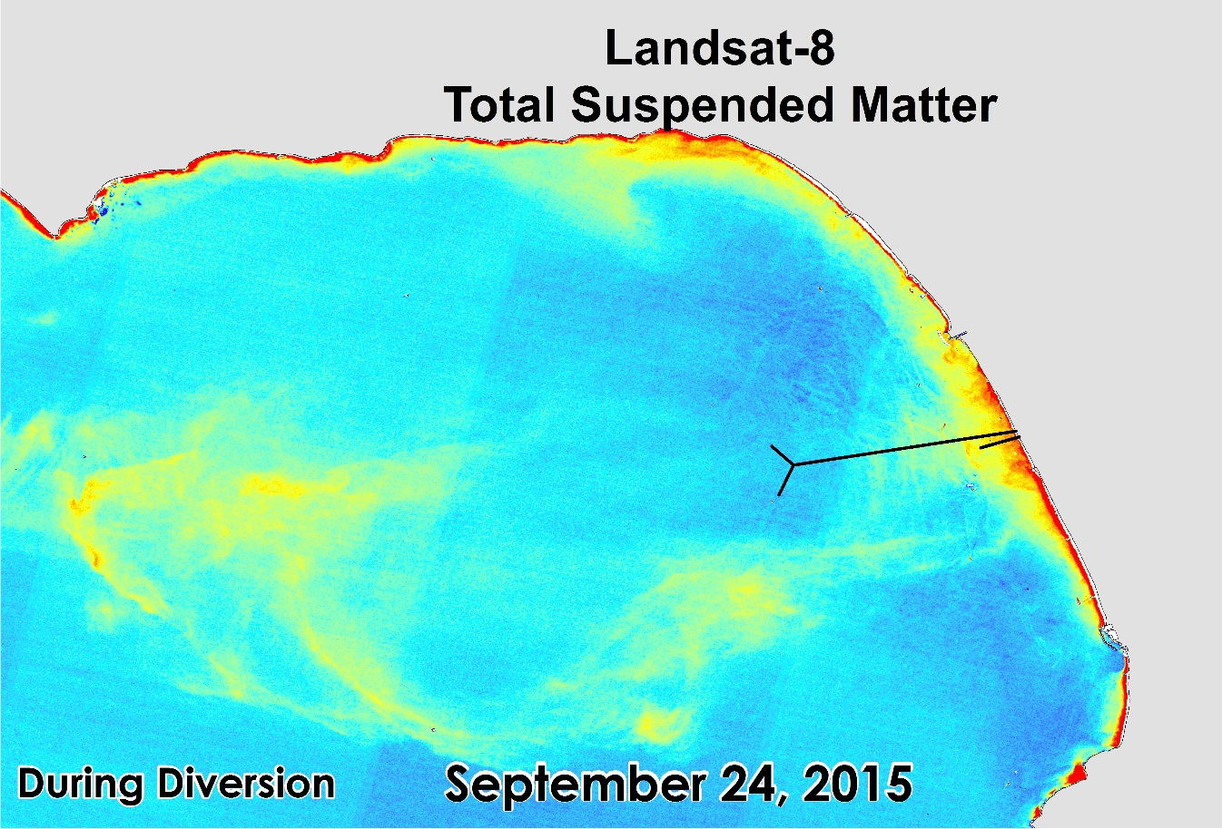
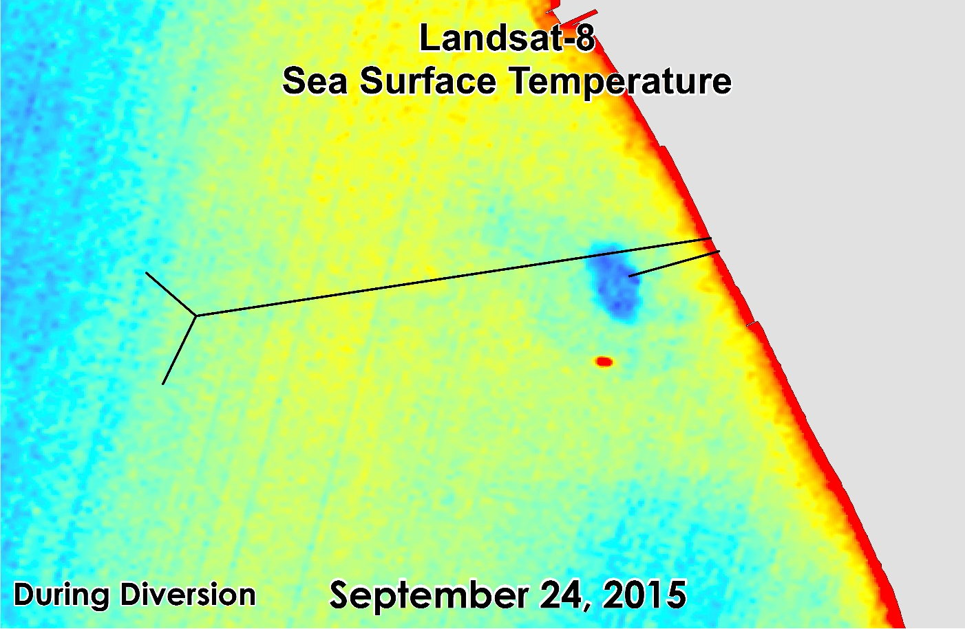
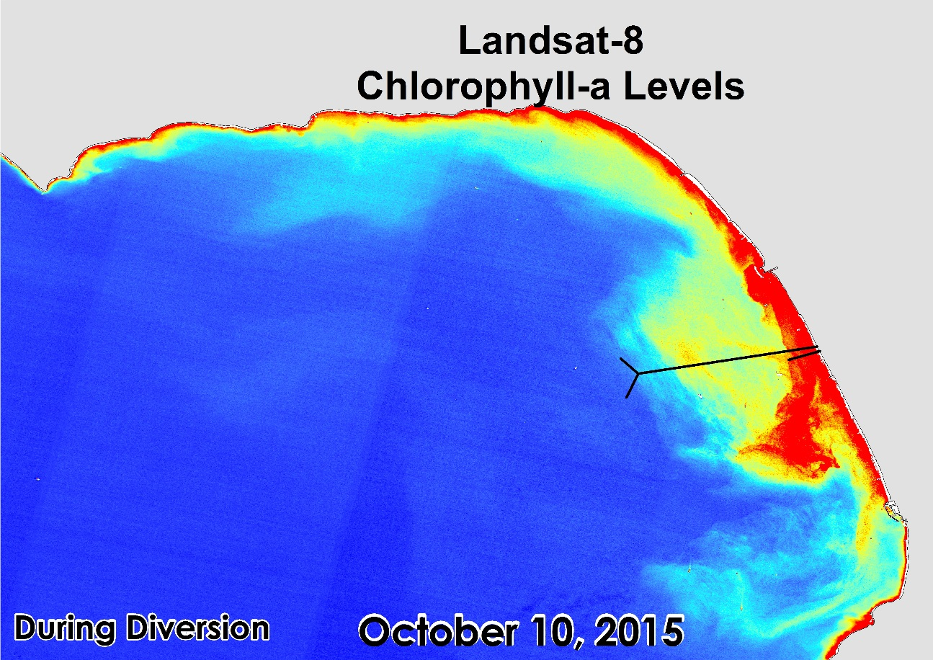
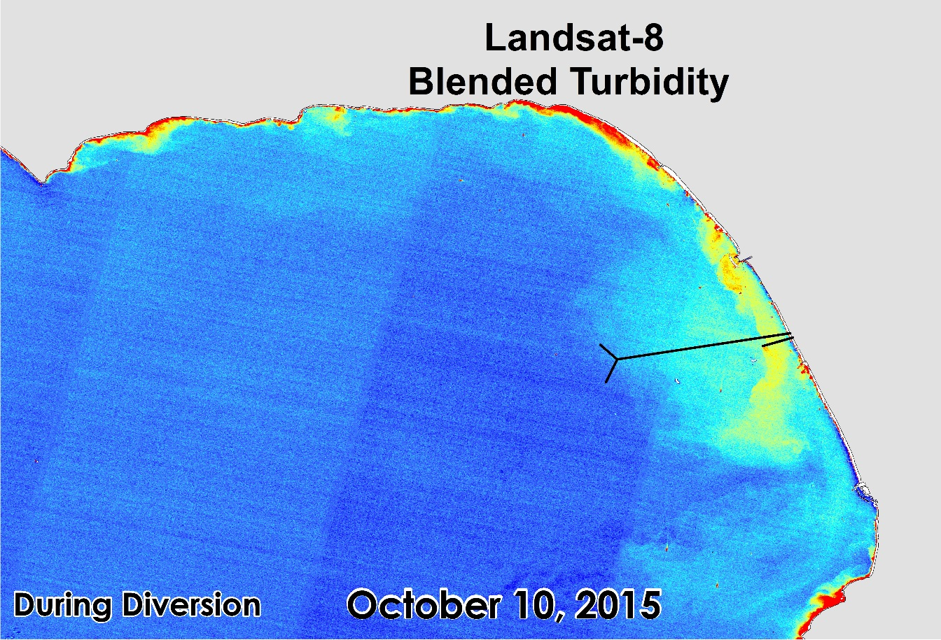
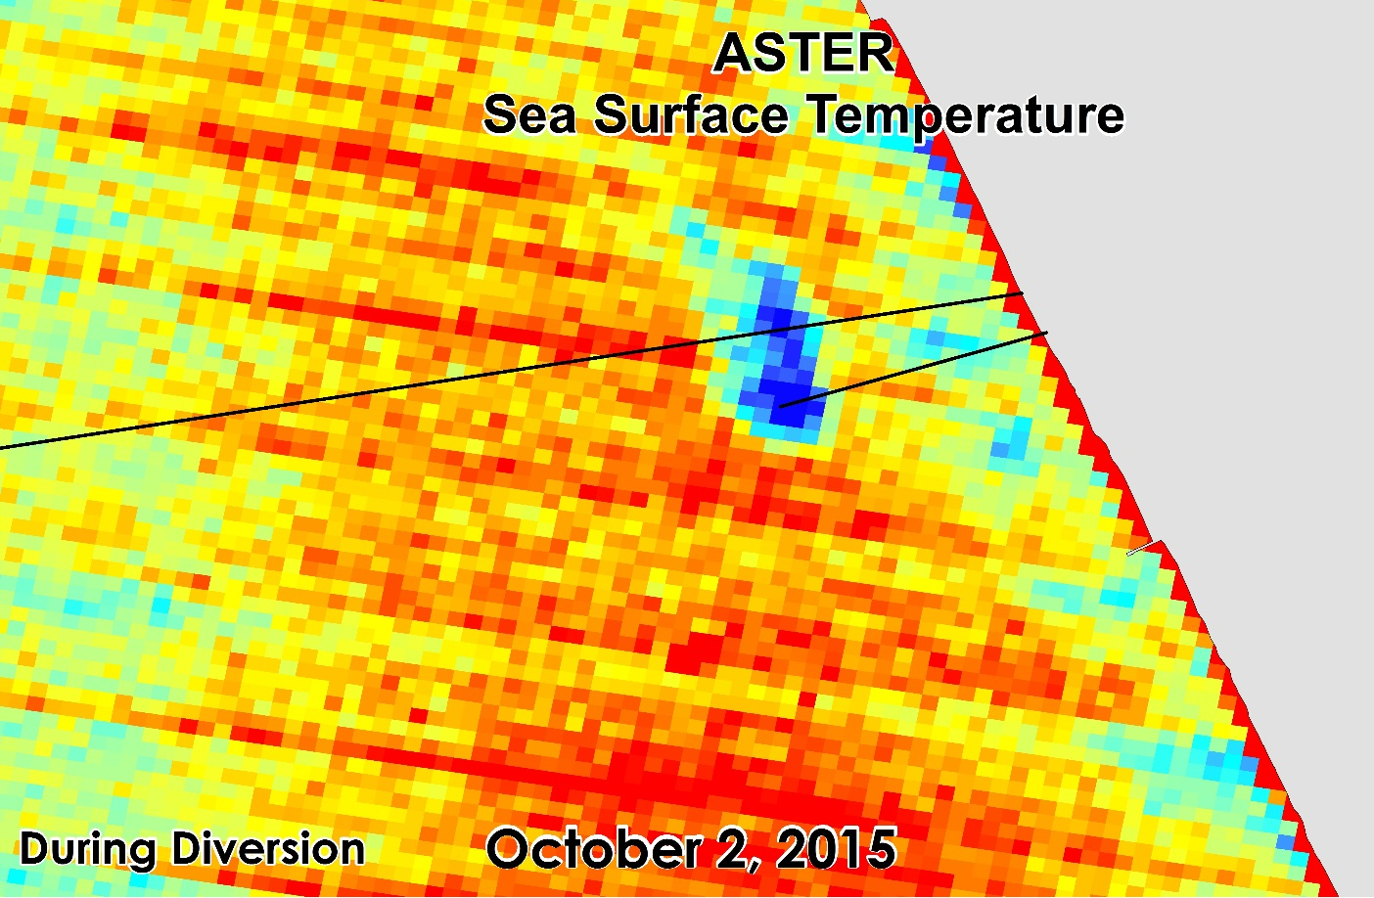
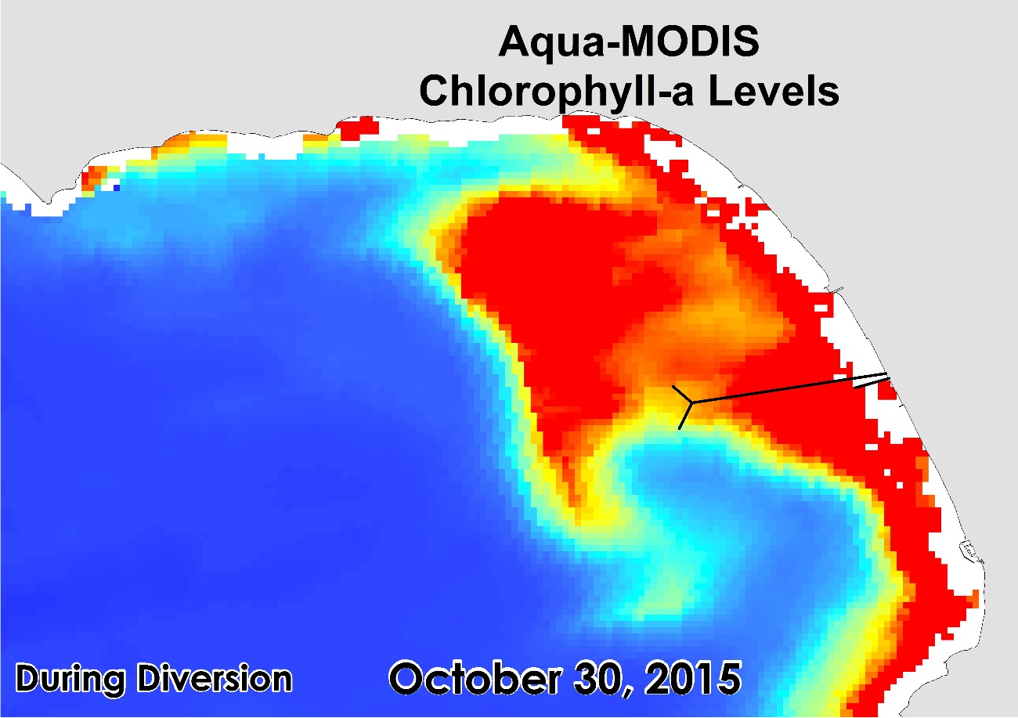
Los Angeles Oceans
Using Remote Sensing to Detect Wastewater Plumes and Assess Their Impact on Public Water Quality in Los Angeles County, California
Rebecca Trinh (Project Lead), Lindsay Almaleh, Mark Barker
DEVELOP National Program at NASA Jet Propulsion Laboratory
Abstract
Objectives
The Hyperion Treatment Plant is one of the largest wastewater treatment plants in the western United States. Treated sewage is generally released at depths of approximately 60 m through 8.05 km outfall pipes into the deep coastal waters of the Santa Monica Bay. In times of repair and maintenance, services on the main outfall pipe are temporarily suspended and require the plant to divert treated sewage to a shorter 1.6 km pipe that extends into shallow coastal zones. These shallow zones make it possible for the buoyant freshwater plumes to reach the surface, potentially contaminating the local environment. This study highlights the use of concurrent satellite data analysis of thermal signature, surface movement, and ecosystem response to the planned wastewater diversion undertaken at HTP from September 21 to November 2, 2015. By combining remotely-sensed observations with GPS-equipped drogue surface drifters and in situ readings of temperature, salinity, dissolved oxygen, pH, conductivity, transmissivity, colored dissolved organic matter (CDOM), and chlorophyll-a florescence, an accurate assessment of the full impact and extent at which these effluent plumes affect the Los Angeles Basin is possible.
Coordinate with the Hyperion Treatment Plant research team in obtaining in-situ readings taken in the LA Basin
Combine NASA Earth observations and in situ readings taken during the outflow event
Determine whether the expelled effluent is negatively impacting the local plant and wildlife or washing ashore to potentially contaminate popular beaches
Study Area
Methodology
NASA Earth observations:
Chlorophyll-a
Surface Sediment
Turbidity
Santa Monica
Bay
LAX
Landsat-8, TIR
Aqua, MODIS
Spatiotemporal
Analysis of combined
datasets
Effluent
impact
on local ecosystem and human health
Hyperion
Treatment
Plant
Terra, ASTER
Sea Surface Temperature
Partner Agency SAR Data:
Study Period: August 31 – November 20, 2015
ALOS – 2 (JAXA)
Sentinel – 1 (ESA)
Sea Surface Roughness
Earth Observations
In Situ Measurements
Landsat 8
Terra-ASTER
Aqua - MODIS
Results
Sentinel - 1
ALOS - 2
Conclusions
Remote sensing techniques can be used to detect wastewater by analyzing certain signatures: chlorophyll-a, surface sediment, turbidity, and sea surface temperature.
Synthetic Aperture Radar (SAR) data were unable to detect surface roughness signatures of the effluent plume during this diversion, due to a combination of lack of data and low resolution.
Colder sea surface temperature signatures were localized only around the 1-mile pipe while it was active during the diversion.
Nutrients from effluent stimulated phytoplankton blooms in Santa Monica Bay, but did not cause any harmful algal blooms
Team Members
Project Partners
Acknowledgements
We would like to thank our science advisors, Ben Holt and Michelle Gierach (NASA JPL) for assisting us in data retrieval and analysis.
We would also like to acknowledge our project partners: Curtis Cash, Ashley Booth, and Mas Dojiri at the Hyperion Treatment Plant. Their contributions, along with the NASA DEVELOP Program, have made this project possible.
We would lastly like to thank Christine Rains and Jack Pan, contributors on the first phase of this project.
Left to right: Lindsay Almaleh, Mark Barker, Rebecca Trinh (Team Lead)
Hyperion Treatment Plant – City Of Los Angeles
NASA Jet Propulsion Laboratory

