Slide 1
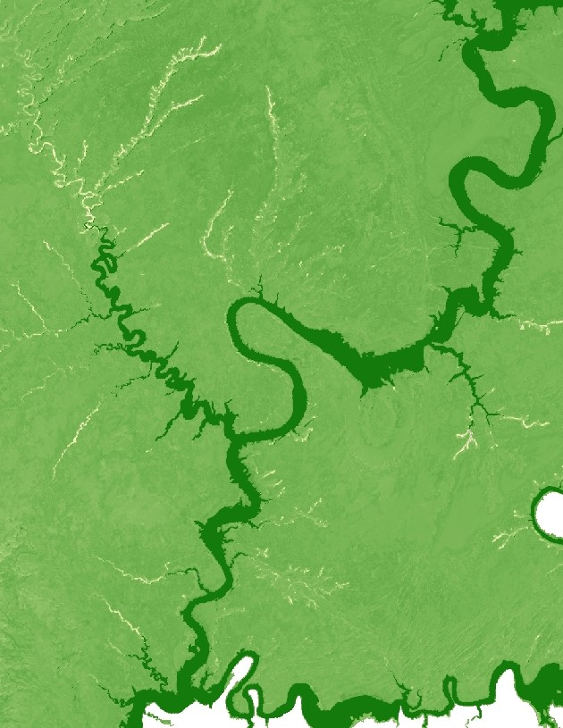
2018 Summer | Virginia – Langley
Glen Canyon Ecological Forecasting
Using NASA Earth Observations to Prioritize Locations for the Further Monitoring and Management of Cultural Resources in Glen Canyon National Recreation Area
Patrick Frier
Cecil Byles
Max Stewart
Notes:
Welcome everyone! We’re excited to share the work we’ve been doing for the past 10 weeks. My name is Patrick Frier and I’m joined by Cecil Byles and Max Stewart. We will be sharing the results of a project in which we…

Slide 2
Partner
National Park Service
Glen Canyon National Recreation Area
Brian Harmon, Archaeologist
John Spence, Park Ecologist
Alahna Moore, Photogrammetry Intern
Notes:
…in which we partnered with the national park service at Glen Canyon National Recreation Area. We partnered with their natural resources division, specifically with their archeologists and ecologists. The folks on this sldie have been great and we cant thank them enough.
Introduce our Project Partner:
Glen Canyon National Recreation Area, Resources Division

Slide 3
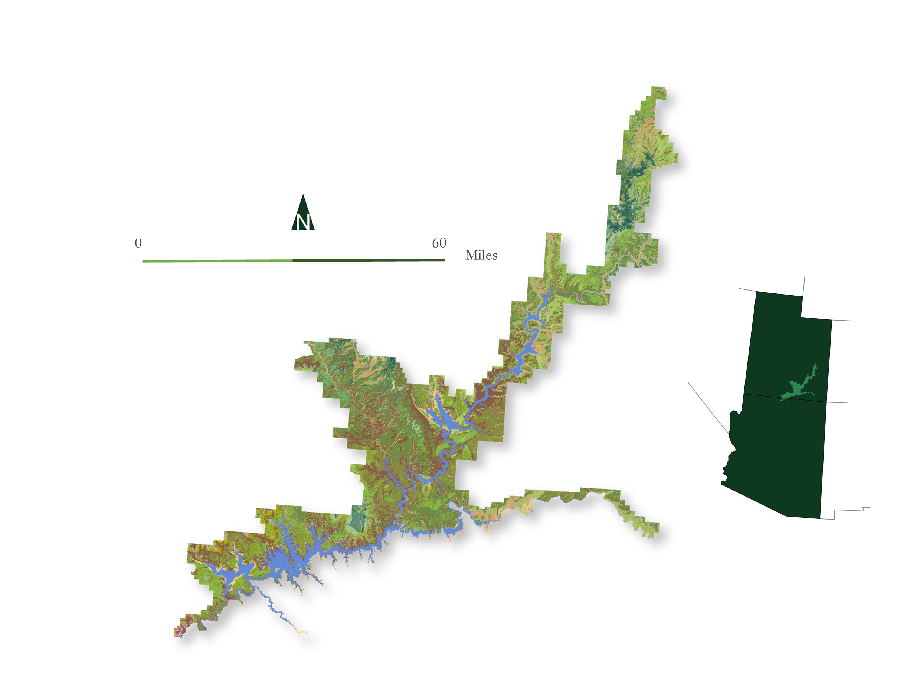
Study Area
Glen Canyon National Recreation Area
Est. October 27, 1972
1,254,117 acres (5,075.23 km²)
Central on the Colorado Plateau
UT
AZ
0
60
Miles
Notes:
Glen Canyon National Recreation Area covers over 1.25 million acres, stretching across a huge expanse of Southern Utah and into Northern Arizona. Nestled in the Colorado Plateau, the canyon is home to hundreds of unique plants an animals species as well as an incredible wealth of cultural and historical sites. Its size makes it the 6th largest park in the lower 48 states, which makes management of park resources extremely difficult by traditional ground-based means.,
Photo credit: Image provided by the National Park Service

Slide 4
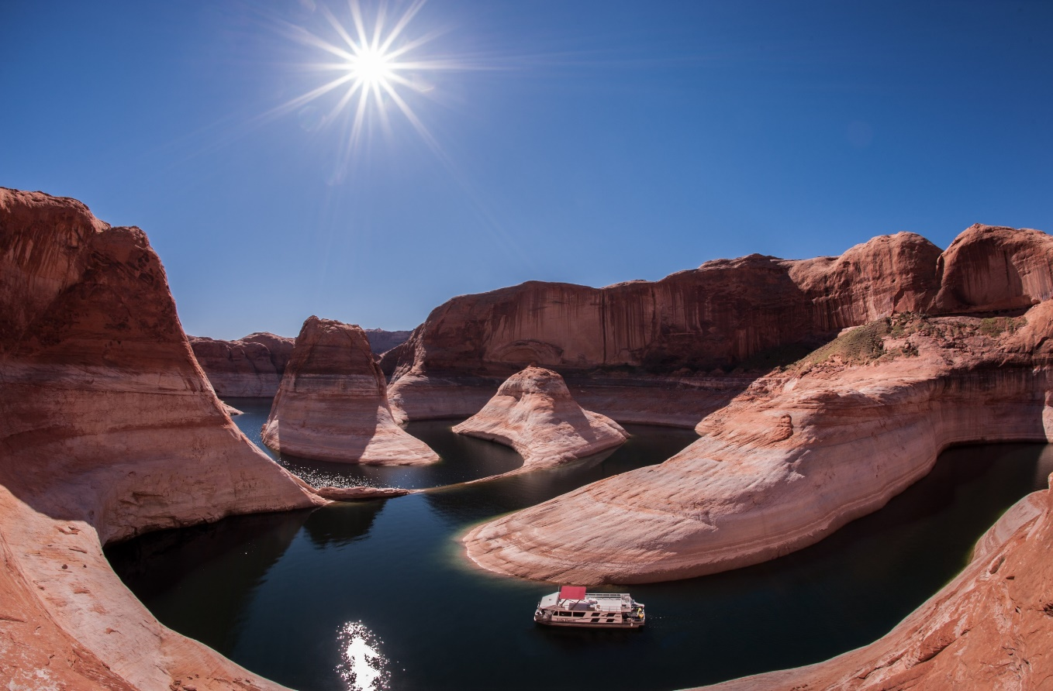
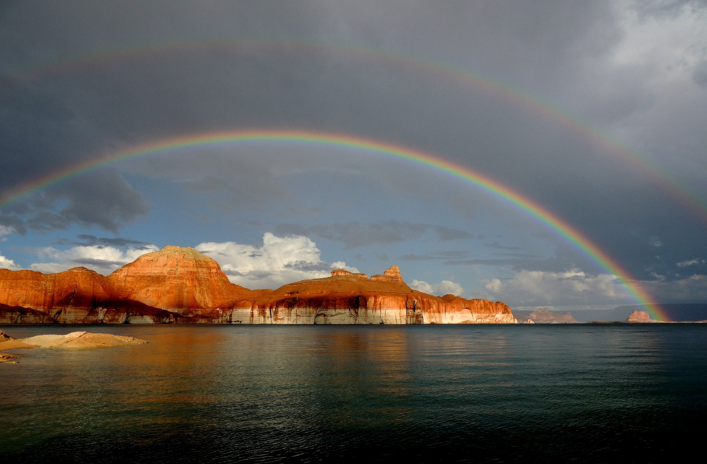
Glen Canyon National Recreation Area
Image Credit: NPS
Image Credit: NPS
NPS
NPS
Reflection Canyon
Lake Powell – Padre Bay
Notes:
The park's position on the Colorado plateau and in the American southwest makes for an extremely arid, hot climate. These images give you a sense for the vast landscapes we’re dealing with. One of the park's most well known features, lake Powell, is shown here.
Photo credit: Image provided by the National Park Service

Slide 5
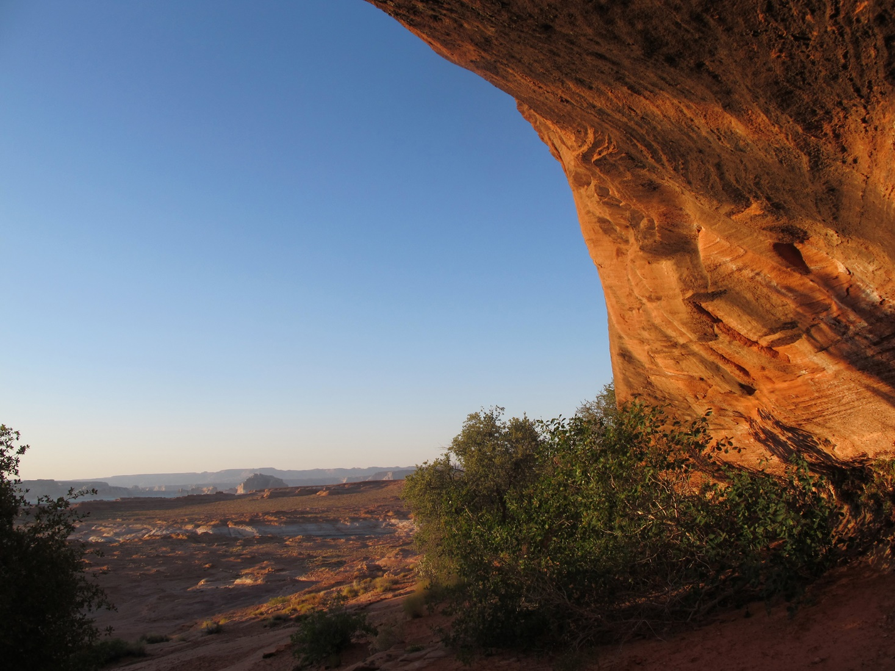
Image Credit: NPS
Hanging Garden
Notes:
This project was focused on helping the NPS manage some of the specific resources at Glen Canyon NRA and help them incorporate NASA Earth observations into the management of their resources.
Photo credit: Image provided by the National Park Service

Slide 6
Archeological and Cultural Sites
Clovis and Folsom projectile points: nomadic big game hunters
ca. 11500 – 8050 BCE
Spanish and Mormon Settlement
ca. 1776 CE - Present
Widespread hunting & gathering
ca. 8050 – 400 BCE
11,500
5000
0
Present
BCE
CE
Early transition from hunting & gathering to cultivation
ca. 400 – 500 CE
Photo: NPS
Notes:
Glen Canyon’s specific resources include some of North America’s most amazing archeological sites, spanning over 12,000 years of human habitation. From early nomadic hunter gatherers of the Clovis and Folsom peoples to more recent evidence of Spanish missionaries and Mormon settlers, these archeological sites preserve evidence of a rich history at Glen Canyon
Photo credit: Image provided by the National Park Service

Slide 7
Community Concerns
The preservation of cultural resources and archeological sites are a top priority in Glen Canyon National Recreation area (GCNRA)
Image Credit: NPS
Notes:
These next two images will give you a sense of the fragility and variability between these sites. This is an image of an almost 2000 year old exposed hearth. Archeological sites like this and….
Photo credit: Image provided by the National Park Service

Slide 8
Community Concerns
The preservation of cultural resources and archeological sites are a top priority in Glen Canyon National Recreation area (GCNRA)
Image Credit: NPS
Notes:
….. And this small township in Glen Canyon’s Lee’s Ferry are exposed and easily threatened by erosion, visitor foot traffic, and grazing. Settlers lived, farmed, and raised families on this harsh landscapes, shaping the culture and history of the American Southwest.
Photo credit: Image provided by the National Park Service

Slide 9
Community Concerns
“The bottom line of all this work is that it’s critical for understanding erosion rates and the loss of vegetation on the landscape”
-John Spence, NPS
Image Credit: NPS
Notes:
Community Concerns → quote from our partner
Our partners at the NPS do not currently incorporate NASA Earth observations into the management and are interested in assessing changes in vegetation distribution through time. Vegetation helps stabilize the top soil and its loss can lead to a higher likelihood of erosion and potential threats to archeological resources managed by the NPS. In an effort to help protect these sites, our team took an in-depth look at the park’s vegetation change over time in order to better understand these trends.
→ Discretely explain the connection between erosion and vegetation cover/soil stabilization. Make this point very obvious. Vegetation loss → destabilizing affect on soils → higher likelihood of erosion → potential threat to archeological sites
Photo credit: Image provided by the National Park Service

Slide 10
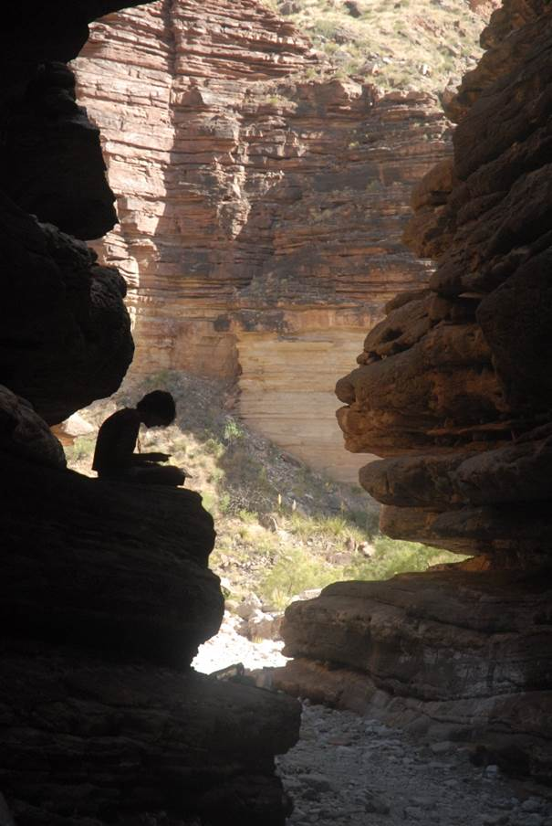
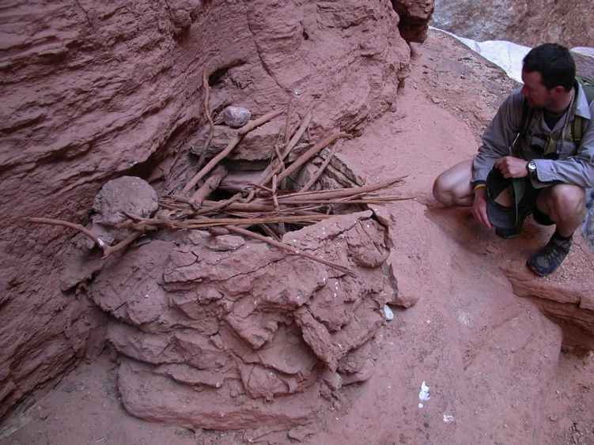
Objectives
Primary
Vegetation distribution maps
Trends and analysis – spatial and temporal
Reproducible methodology
Secondary
Photo: NPS
Rate of change
Python script for automation of future work
Photo: NPS
Notes:
The team took comprehensive satellite observations from 1995 – 2017. We primarily wanted to create a time series of vegetation distribution maps, understand the spatial and temporal trends in vegetation distribution, and give the NPS a reproducible methodology by which they could do this in the future.
We also sought to generate a rate of change raster as a culmination of all the data from this project to give the NPS a single raster for understanding vegetation change quickly and easily. Finally, in keeping with the spirit of DEVELOP as a Capacity Building Program, we learned the basics of coding in order to write a python script that would allow our team to automate much of this process. Our partners wanted a tutorial of the project methodology for the upright GIS, so we ended up pairing the two methods.

Slide 11
Satellites and Sensors
Landsat 5 TM
Landsat 7 ETM+
Landsat 8 OLI
Notes:
We incorporated the following NASA Earth observations into our project: LS5, LS7, and LS8.
We used publicly available, atmospherically corrected, surface reflectance data downloaded from the USGS and capitalized on the temporal range of data available form the Landsat family of satellites.
We downloaded LS data from July, August, and September of each year from 1995-2017 in order to capture the peak vegetation growth each year
Satellites and Sensors → highlight the NASA Earth observations and indicate that we used the Atmospherically corrected product from Earth Explorer.

Slide 12
Methodology
Acquire Landsat imagery
Preprocess imagery: composite, clip, and mosaic images
Produce vegetation indices¹
Compare vegetation indices to mean and 90th percentile
Identify locations experiencing vegetation loss/gain
Analyze spatial and temporal trends
Compute cumulative rate of change raster
¹ Modified Soil Adjusted Vegetation Index (MSAVI) and Normalized Difference Vegetation Index (NDVI)
Notes:
After acquiring data, we performed typical preprocessing steps to fit the data to our study area. After that, we produced vegetation indices which show the vigor and health of vegetation based on photosynthetic activity. We performed several analyses that helped us to identify areas in the park experiencing vegetation loss or gain.
We produced maps showing the max vegetation index values for each year, the mean values over the study period, and a raster showing rate of change of vegetation over the entire study period.

Slide 13
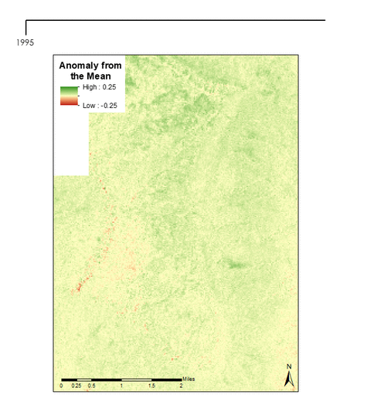
Annual Comparisons
Anomaly from the Mean
Spatial distribution unevenly concentrated based on topographic features (i.e. mesa tops)
Vegetation loss coincides with distribution of different plant/ecological communities
Positive
Negative
Notes:
We found that vegetation vigor tends to fluctuate on a year to year basis. To the right is an example of a small subset of our results. This graphic shows anomaly from the mean over the study period, or in other words, how different each year’s VI values are from the average across the entire study period
We also found that spatial distribution of VI values is unevenly concentrated based on topographic features such as mesa tops. Vegetation change also seems to coincide with the distribution of different ecological communities.

Slide 14
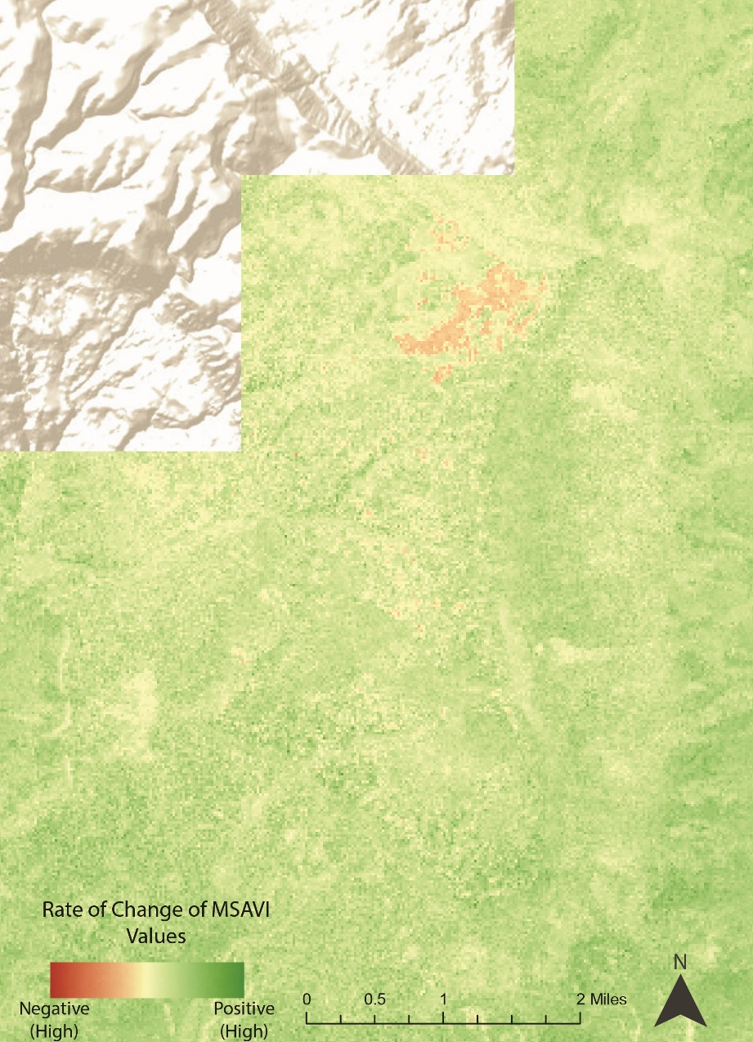
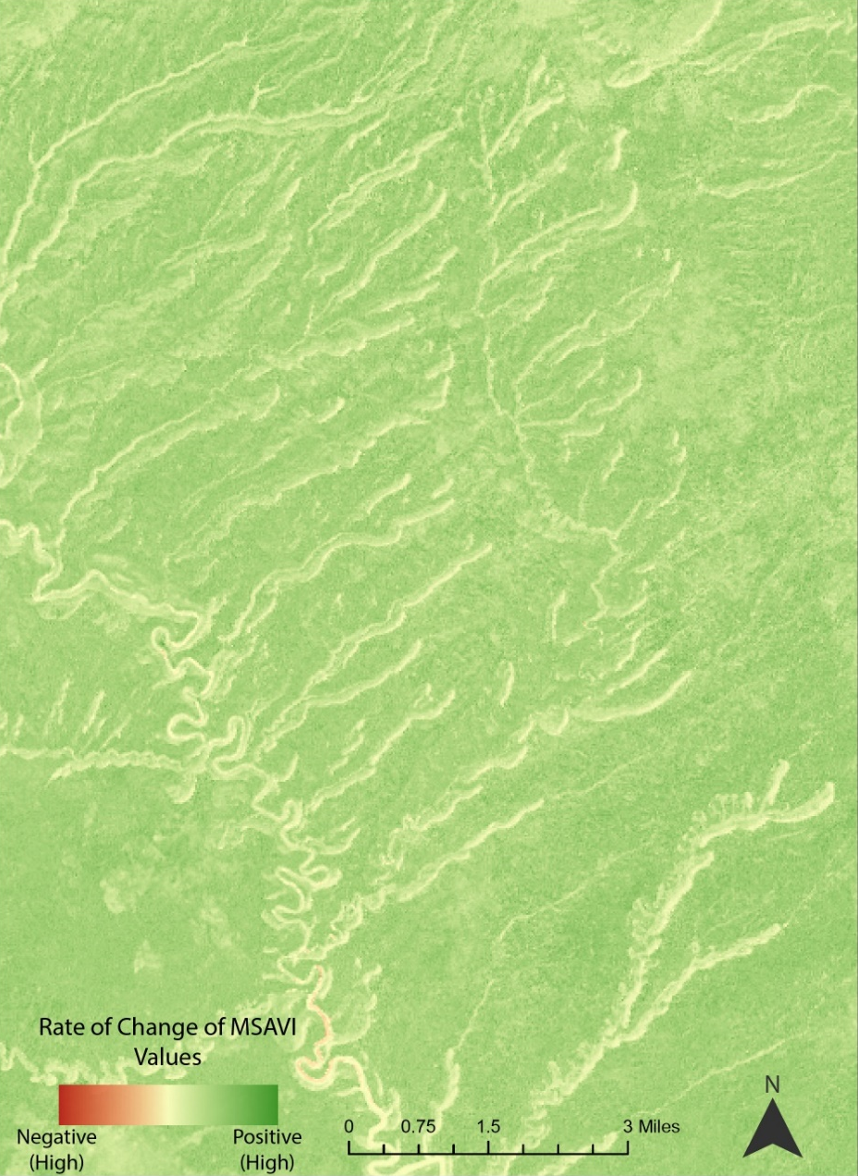
Cumulative Assessment
Overall vegetation abundance has increased marginally over the study period
Vegetation change coincides with the distribution of particular ecological communities
The greatest rate of vegetation loss is found on mesa tops
Notes:
This is the rate of change raster produced by running a linear regression on all of the years in the study period. The figure on the left highlights the mesa top discussed earlier, and the figure on the right focuses on the rate of change in riparian corridors. We found that the cumulative trend is actually a positive increase in vegetation cover.

Slide 15
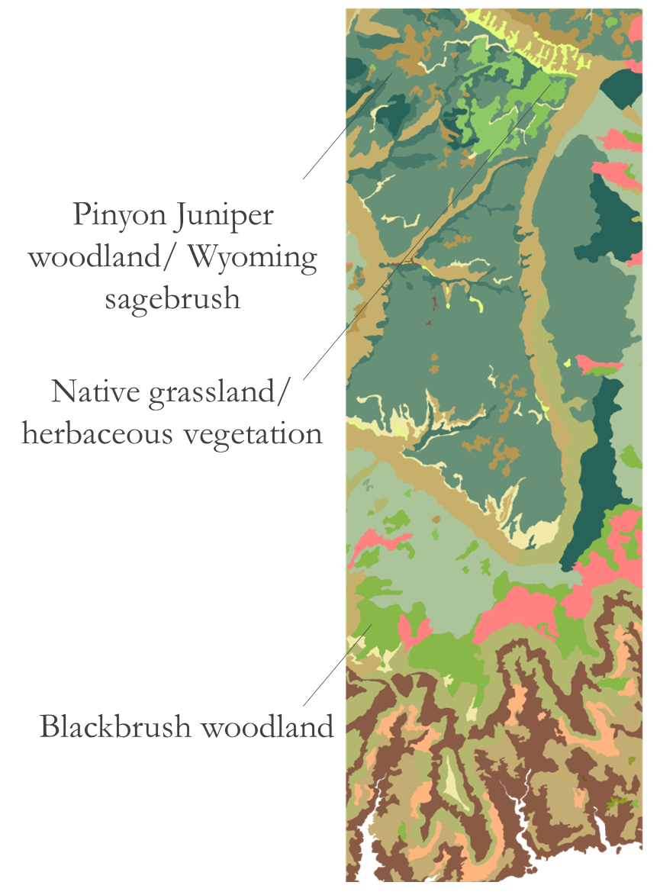
Cumulative Assessment
Overall vegetation abundance has increased marginally over the study period
Vegetation change coincides with the distribution of particular ecological communities
The greatest rate of vegetation loss is found on mesa tops
Pinyon Juniper woodland/Wyoming sagebrush
Native grassland/ herbaceous vegetation
Blackbrush woodland
Notes:
Again, vegetation change coincides with the distribution of particular ecological communities based on ground truth data from the national park service.

Slide 16
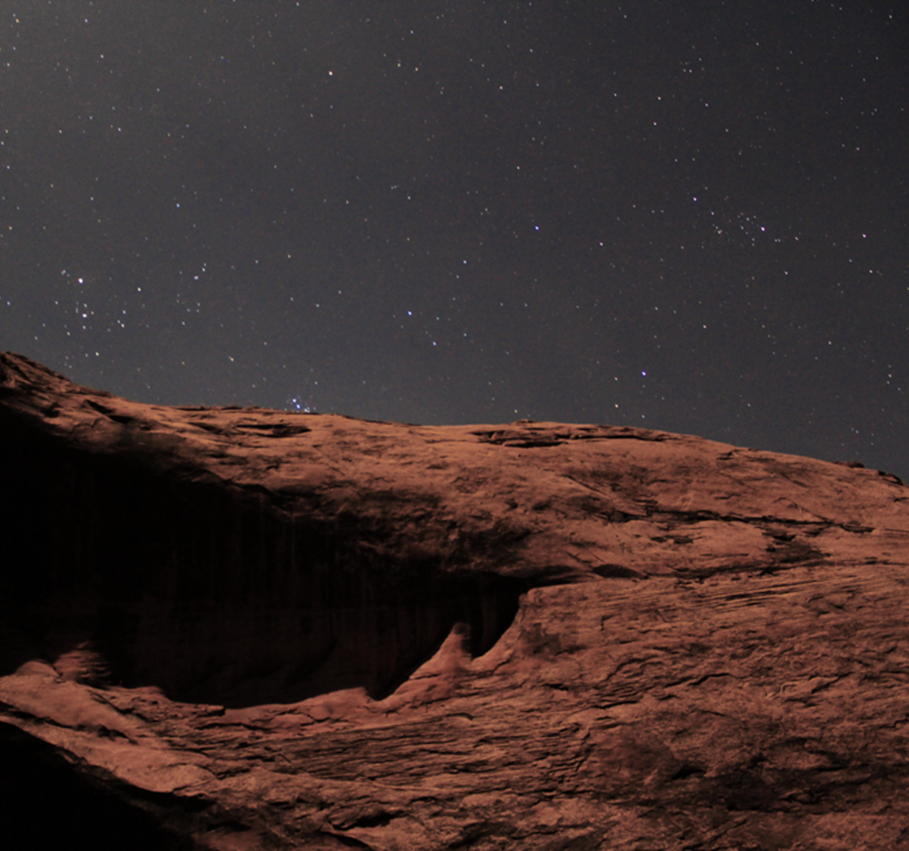
Conclusion/Partner Benefit
Rate of vegetation change nonuniform spatially – topographic differences:
Mesa tops
Steep slopes
Riparian corridors
Partitioning of vegetation loss based on vegetation variety
Photo: Brent Davis Photography
Notes:
In conclusion, we found that vegetation change and the rate of vegetation change is nonuniform, being unevenly distributed based on topographic differences as well as vegetation variety.
Explain NPS benefit → End Strong
The NPS has a preexisting model of archeological sites within the park. They plan to incorporate the work from this project into that model to help identify where archeological sites overlap with areas of vegetation change.
This will help them allocate their scares resources and manpower to better manage these important artifacts.

Slide 17
Conclusion/Partner Benefit
Advantages to NPS land managers:
Park wide
Temporal view
Combined with preexisting archeological site model
Informed allocation of resources
Photo: NPS
Notes:
The datasets we have produced will be highly beneficial to Glen Canyon: They do not currently use any NASA earth observations or park-wide datasets to map vegetation change.
They can overlay their own archeological datasets and models on top of our vegetation trend maps to determine which archeological sites are in greatest danger from erosion. Our products, as well as reproducible methodology, enable them to better allocate their scarce resources to target the sites in need, protecting these culturally and historically significant artifacts for the future.
Explain NPS benefit → End Strong
The NPS has a preexisting model of archeological sites within the park. They plan to incorporate the work from this project into that model to help identify where archeological sites overlap with areas of vegetation change.
This will help them allocate their scares resources and manpower to better manage these important artifacts.

Slide 18
Acknowledgments
Dr. Kenton Ross – NASA DEVELOP, Science Advisor
Team Members
Jonathan O’Brien – NASA DEVELOP, Center Lead
Maximilian Ioffe – NASA DEVELOP, Night Skies Team Lead
Brian Harmon – NPS, Glen Canyon National Recreation Area
William Patrick Frier
Project Lead
Alahna Moore – NPS, Glen Canyon National Recreation Area
John Spence – NPS, Glen Canyon National Recreation Area
Vanessa Glynn-Linaris – NPS, Glen Canyon National Recreation Area
Robert Cecil Byles
Robert Maxwell Stewart
Notes:
We would like to thank these people from NASA DEVELOP and Glen Canyon for their help and contributions with the project.
If you have any questions or comments, please address them at our poster session!
Thank you for your attention!

